Slide 1
MRAM | Monthly Research Administration Meeting
July 13, 2023, 9:00 AM – 10:30 AM Join Webinar: https://washington.zoom.us/j/346891888 Click “CC” to Show Captions in your Zoom Controls
TOPIC | PRESENTER | EMAIL | MIN
Welcome | Kirsten DeFries Research Compliance & Operations | kirsten5@uw.edu | 2
PAFC: Reconciliations | Matt Gardner Post Award Fiscal Compliance | gcafco@uw.edu | 15
Priority Processing & Turnaround Times - GCA & OSP | Juan Lepez & Carol Rhodes Grant & Contract Accounting Office of Sponsored Programs | carhodes@uw.edu kabah12@uw.ed | 15
Award Portal Update July 2023 | Cheryl Haycox Grant & Contract Accounting | chaycox1@uw.edu | 10
New Sponsors & Sponsor Name Changes | Amanda Snyder & Julie Fricks Office of Sponsored Programs & Research Compliance & Operations | acs229@uw.edu julie221@uw.edu | 10
Research Resource Updates | GCA | ORIS | OSP | kabah12@uw.edu carhodes@uw.edu khalstead@uw.edu | 10
Next BONUS MRAM July 21, 2023 9:00 AM - 10:30 AM AUGUST MRAM August 10, 2023, 9:00 AM - 10:00 AM

Slide 2
PAFC HOT TOPIC:
AWARD / BUDGET RECONCILIATIONS
MRAM
July 2023
Matt Gardner
Post Award Fiscal Compliance

Slide 3
TOPICS
What do the terms “internal controls” and “reconciliation” mean?
  What do sufficient internal controls look like?
Pre-Workday vs. Post-Workday World
UW Sponsored Award Policies
Guidance
The Future
MRAM – Matt Gardner – PAFC

Slide 4
Internal Controls for Sponsored Awards
Processes designed to provide reasonable assurance regarding the achievement of the following objectives:
Reliability of financial reporting
Compliance with applicable laws and regulations
Safeguarding of assets
Effectiveness and efficiency of operations
Accomplishment of goal (Award completion)
MRAM – Matt Gardner – PAFC

Slide 5
Basic Internal Control Activities
Award / Budget Reconciliation
Separation of duties
Approvals
  Can be Sponsor, PI, Departmental
Approval of high-risk transactions
  Subaward invoices
  High value purchases
Documentation
  Verification, justifications, retention
Safeguarding of assets
MRAM – Matt Gardner – PAFC

Slide 6
Sponsored Award Reconciliations
A regular and consistent process to review transactions in the UW financial systems to ensure:
  Expenses are posted to the right award
  Expenses are properly approved by the sponsor / PI / PI’s designee
  All necessary supporting documentation is available including:
    Written approvals
    Expense justifications
MRAM – Matt Gardner – PAFC

Slide 7
Sponsored Award Reconciliations
Reconciliation and review should also analyze:
  Balance of expenditures and spend rates
  Available time to complete Award objectives
  Subaward and vendor status
    Invoices, payments, etc.
  Cost Share requirements
    Is cost share being met?
    Are third parties and subrecipients providing their required contributions?
MRAM – Matt Gardner – PAFC

Slide 8
Pre- and Post- Workday Go Live
Pre-Workday
  MyFD Reconciliation tool
  UW Budget Activity Reports
Post-Workday
  “Period Close” or “Month-End Close” process
    Purely financial system-focused
    One part of the overall an internal control
    Is not a sponsored award reconciliation process
  No reconciliation tool or report similar to MyFD
MRAM – Matt Gardner – PAFC

Slide 9
UW Sponsored Award Policies
GIM 2: PI is responsible for adherence to internal controls established by their unit
No specific UW policy on:
  The frequency for sponsored award reconciliations
  The tools and/or reports used for reconciliations
Units may establish specific internal controls based on size and complexity of the sponsored awards
MRAM – Matt Gardner – PAFC

Slide 10
Budget Reconciliation Guidance
Frequency?
  Recommend reconciliations are performed at least quarterly
  May depend on several factors:
    Policies of the unit
    Complexity, size, and risks associated with the Award
Who performs the reconciliation?
  The PI or someone who understands the Award objectives and the fiscal compliance issues
  PI can delegate this responsibility
MRAM – Matt Gardner – PAFC

Slide 11
Budget Reconciliation Guidance –
Audit Perspective
Auditors will review an internal control process to ensure:
  The PI is involved in the process
  The process is consistently performed and documented
  Errors, when discovered, are corrected in a timely manner
“Is there an internal control process?”
“Is the process sufficient?”
“Is the process performed regularly?”
MRAM – Matt Gardner – PAFC

Slide 12
Workday Reports
Standard Budget vs. Actuals
Grant Budget vs. Actual
Income Statement – Month over Month
Find Journal Lines Custom
MRAM – Matt Gardner – PAFC

Slide 13
The Future
Tools and resources to explore for the future:
Customized Workday reports
Development of non-Workday reports
Development of additional systems
MRAM – Matt Gardner – PAFC

Slide 14
Questions
Post Award Fiscal Compliance (PAFC)
  gcafco@uw.edu (Compliance questions)
  effortreporting@uw.edu (Effort questions)
  https://finance.uw.edu/pafc/
Matt Gardner
  mgard4@uw.edu
  206-543-2610
MRAM – Matt Gardner – PAFC

Slide 15
Priority Processing & Turnaround Times
July 13, 2023 MRAM
Juan Lepez, Grant & Contract Accounting
Carol Rhodes, Office of Sponsored Programs

Slide 16
Prioritization of Requests after Go-Live
High Priority Items
Advance Award Requests: New, Renewal, Extensions
Award Setup Requests: New, start date of 7/15 & earlier
Modifications:
  Supplement - awards ending between 5/1-6/30
  Renewal - start date of 7/15 & earlier
  Extension
  Temporary Budget Extension
  Restriction Release - awards ending between 5/1-6/30
  Start Date Change
  Addition of Equipment or Gov't Property
  Change in Cost Center
Other Actions: New award lines (formerly sub budgets) with start date of 7/15 & earlier
Notes:
Speaker: Juan
Our two offices have created this priority list to ensure the most time sensitive and impactful items receive attention they deserve:

Slide 17
Prioritization of Requests
Medium Priority Items
Cost Share Change
Cost Share Change - requires sponsor approval
Non-competing Continuation Funding - start date of 7/16 or later
Notes:
Speaker: Juan

Slide 18
Prioritization of Requests
Low Priority Items
Schedule Changes:
Early Termination
Relinquishment
Funding & Budgeting Changes:
Subaward Addition
Supplement
Carry-over
Rebudgeting
De-obligation
F&A Rate Change
Programmatic Changes to:
Award Line type or other award line changes
Personnel
Key Personnel or effort
  including change in PI
Work Scope
Non-Fiscal Compliance
Other Changes to:
Location
Payment schedule
Notes:
Speaker: Juan

Slide 19
GCA - Award Setup Priority (Effective Immediately)
Catch up activities
Items as discussed in prior slides
Finalizing business processes and documentation
Ad hoc requests
Notes:
Speaker: Juan. Catch up activities = Changes that have happened in legacy systems post June 16th need to be caught up prior to the Life to Date balance loads so that there aren’t any reconciliation issues in late July when that data is converted.

Slide 20
GCA - Invoicing Priorities
July Invoice Freeze Dates
7/19-7/31 - Cost reimbursable sponsor invoices
7/1-7/31 - Schedule payment and milestone invoices
Invoicing Priority Starting (Effective 8/1/23)
> Urgent requests that came through during freeze
> Cost reimbursable backlog final invoices
> Cost reimbursable backlog interim invoices
> Schedule payment and milestone invoice catch up (most of these are automated)
Notes:
Speaker: Juan. Catch up activities = Changes that have happened in legacy systems post June 16th need to be caught up prior to the Life to Date balance loads so that there aren’t any reconciliation issues in late July when that data is converted.

Slide 21
GCA - Closing Priorities (Effective 8/1/23)
> Sponsor refunds
> Residual balance transfers (formerly known as Fixed Price Surplus Transfers)
Notes:
Speaker: Juan. Catch up activities = Changes that have happened in legacy systems post June 16th need to be caught up prior to the Life to Date balance loads so that there aren’t any reconciliation issues in late July when that data is converted.

Slide 22
GCA - Turnaround Times
Internal Deadlines
No turnaround times for July-Aug
Focus is on training and data quality
Award Setup, Closing, Customer Service
External Deadlines
Will continue to meet sponsor deadlines
Sponsor Invoicing, Sponsor Financial Reporting
Notes:
Speaker: Juan. Gathering data on how long the various business process take and will follow up when we have them better defined and have more experience transacting in Workday.

Slide 23
OSP Conversion (excluding subawards)
Converting priority items
823 Funding Actions - ASRs & MODs
722 PACs - MODs
Expect to see ASRs and MODs from OSP coming your way to complete and return to OSP.
Expect to see returned eGC1s for anything that should now be a MOD.
Notes:
Speaker: Carol

Slide 24
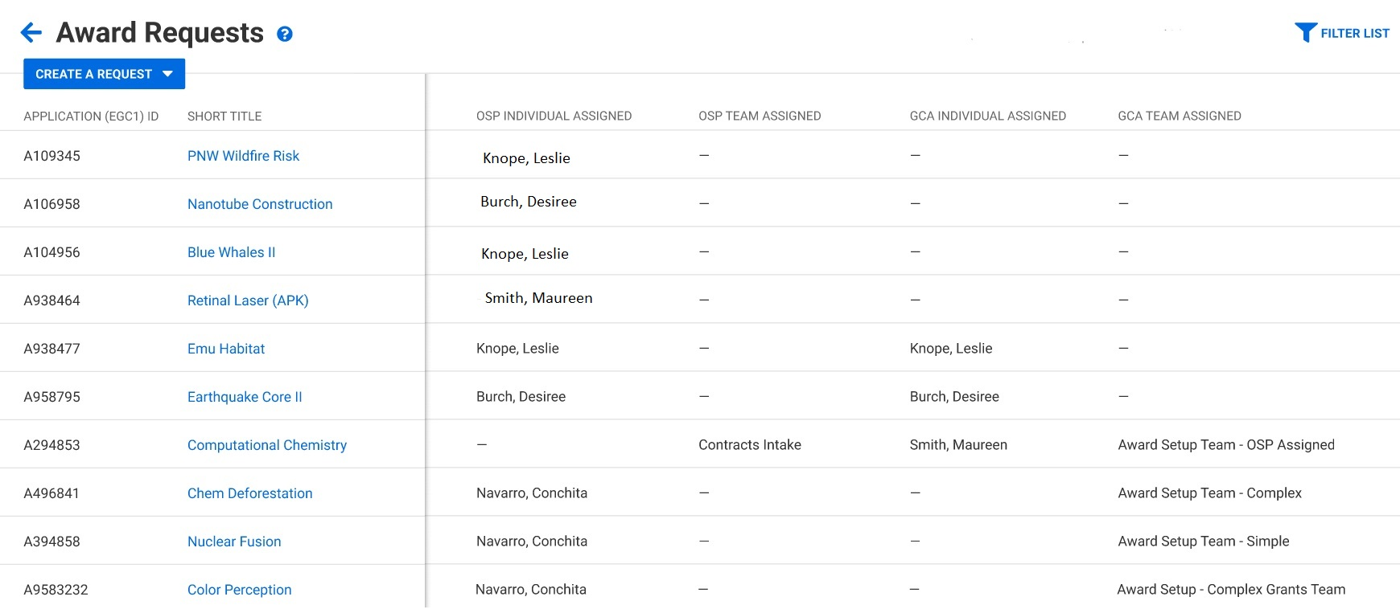
OSP: Assignments
Items OSP sends to you will route back to OSP
All other work is being manually assigned in OSP including eGC1s
  assignment logic similar / based off campus unit & signature authority
  you might hear from some OSP staff you have not worked with on some items
  OSP running reports to monitor our work
Your awards list will show the Assigned OSP Reviewer
Notes:
Speaker: Carol

Slide 25
OSP: Assignments
How do I know who is assigned to my item?
Your awards list will show the Assigned OSP Reviewer
Notes:
Speaker: Carol

Slide 26
No need to hang onto things!!
Use SAGE to send your items in!
Pay attention to sponsor deadlines.
If institutional review, approval, signature, or submission (such as supplemental materials) is required, send it to OSP with ample time for OSP to handle.
Notes:
Speaker: Carol

Slide 27
Questions
Notes:
Speaker: Carol

Slide 28
AWARD PORTAL UPDATE: JULY 2023
Cheryl Haycox
Grant Analyst Manager, Grant & Contract Accounting
July 13, 2023 MRAM

Slide 29
AWARD PORTAL IS LIVE!
Grant Tracker is now read-only
Award Portal launched on July 11

Slide 30
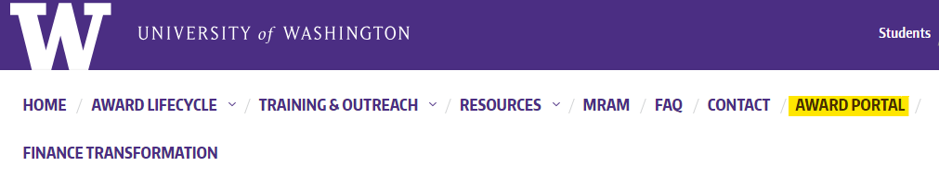
GETTING TO AWARD PORTAL
GCA Homepage
Direct link: https://fin-s-web22.finance.uw.edu/fin/AwardPortal/
Notes:
Tab at the top of the GCA homepage

Slide 31
WHAT TO EXPECT
View:
  Awards and award lines
  Sponsor invoice/financial report info
Submit tickets and attachments
Track outstanding requests
Manage campus contacts
Run reports by cost center
Notes:
Early August = LTD loads

Slide 32
THINGS TO KNOW
Only Workday expenses are visible
FAS expenses coming early August
Sponsor invoices coming early August
Sponsor payments are not available
Issues with Grants deep link to WD
GT will continue to update with FAS transactions
Notes:
Early August = LTD loads

Slide 33
WHEN TO USE GT v. AP
Use Grant Tracker to view info for awards that did not convert to Workday
Awards closed before 6/16/22 did not convert to WD
Award Portal for converted awards and new awards

Slide 34
RESOURCES
Visit Award Portal landing page for:
Job aids
  Create a new Award Portal Ticket
  Respond/Update an Award Portal Ticket
  View reports by cost center
“What’s Changing?” video
Send questions to us at gcahelp@uw.edu

Slide 35
New Sponsors & Sponsor Name Changes
July 2023 MRAM
Amanda Snyder, Office of Sponsored Programs
Julie Fricks, Research Compliance and Operations

Slide 36
New SAGE Data
SAGE now leverages a shared core data resource for sponsor data
Enhanced search functionality for sponsors covers:
  Main sponsor name
  Acronyms
  Related names
  Previous names
Notes:
Amanda

Slide 37
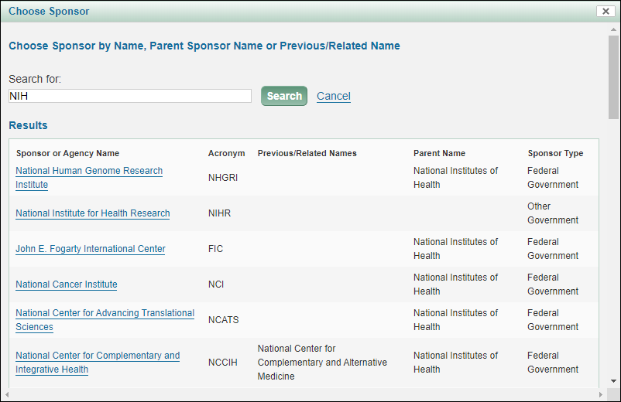
Sponsor Search - eGC1
Notes:
Amanda

Slide 38
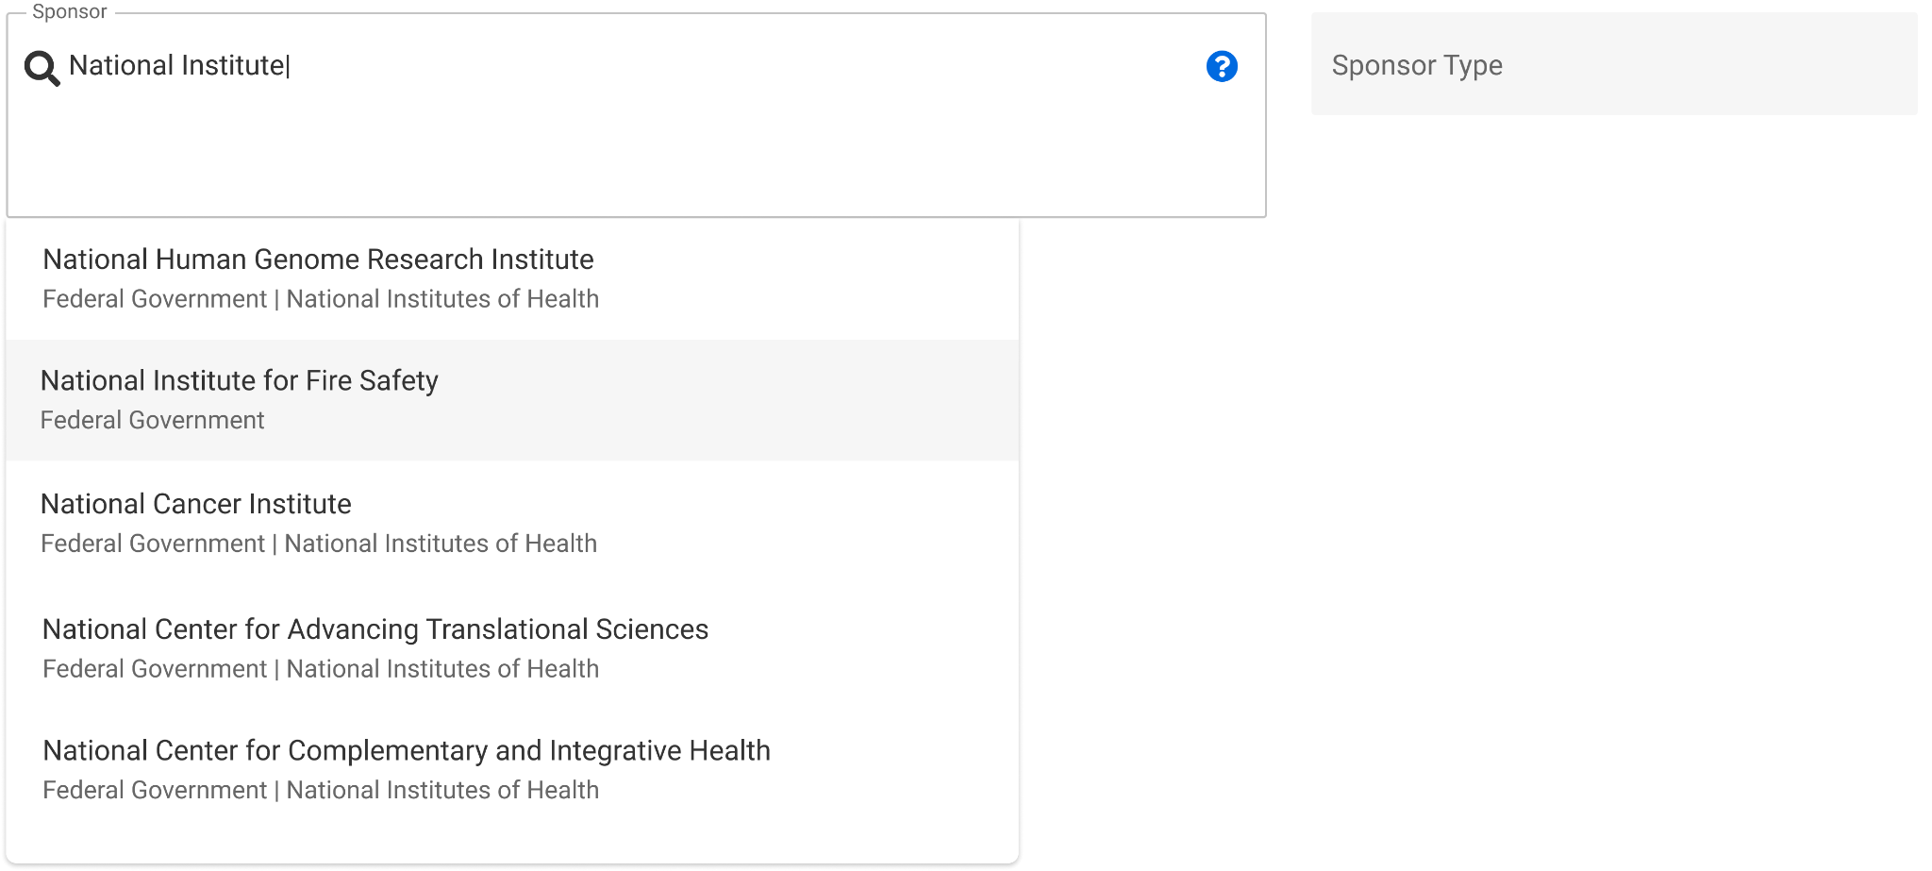
Sponsor Search -
Award Setup Request (ASR)
Notes:
Amanda - Different look for search, but is searching parent names, previous/related names, acronyms, too.

Slide 39
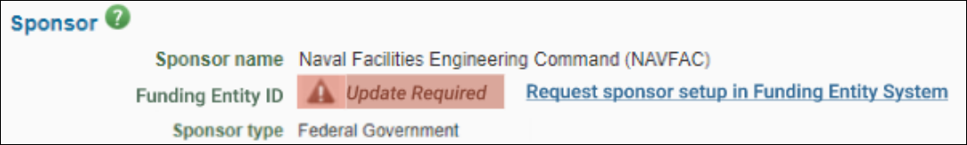
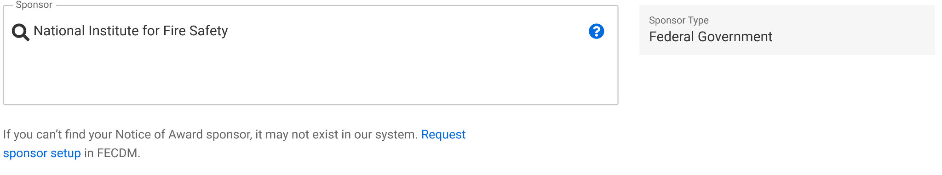
Request Process
When your sponsor does not appear in the search results, follow the link to request new sponsor.
eGC1
ASR
Notes:
Amanda

Slide 40
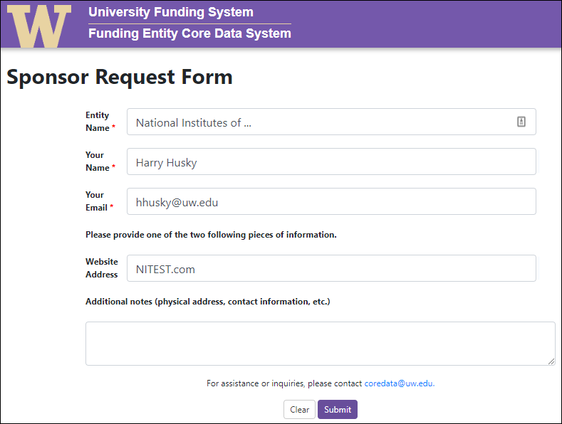
Request Process

Slide 41
Request Process
24-hour turnaround time
You will receive an email notification that your sponsor has been created
~15 minutes from the time the notification is sent until the sponsor is available for use in SAGE

Slide 42
Funding Entity Core Data Management
Emphasis on the need for sponsor clean-up from peer institutions who had converted to Workday
Sponsor is cornerstone data element of a grant
Launched an effort to unify pre-award, post-award sponsor data, as well as donor data

Slide 43
Core Data
Funding Entity Core Data System (FECDS) houses the core data associated with sponsors, donors, and customers
Data which can change depending on the funding instrument and units involved is considered “local” and is not housed in FECDS:
  Compliance designation related to FCOI
  Addresses
  Email contacts

Slide 44
Data Availability
Access the full dataset at any time:
https://fin-s-web22.finance.uw.edu/fin/fecdm
> Data is also available via EDW:
[CoreData].[sec].[FE_MainEntity]
> Data is connected in WDAY via FECID in the
SponsorReferenceID field - visible in EDW:
[UWODS].[sec].[Sponsor]

Slide 45
Modifications
New Requests within FECDS
FECDS also includes options to request modifications to or add additional entities within the application.

Slide 46
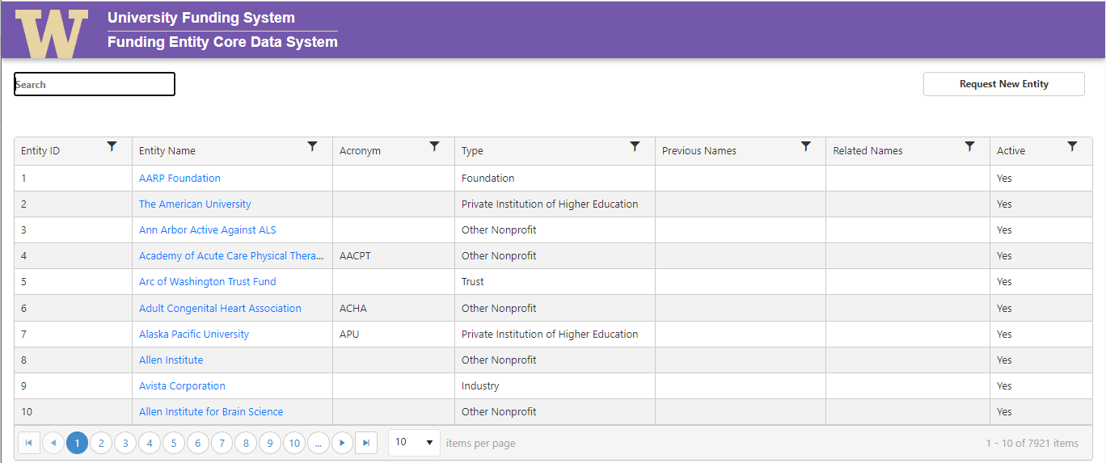
Request Process

Slide 47
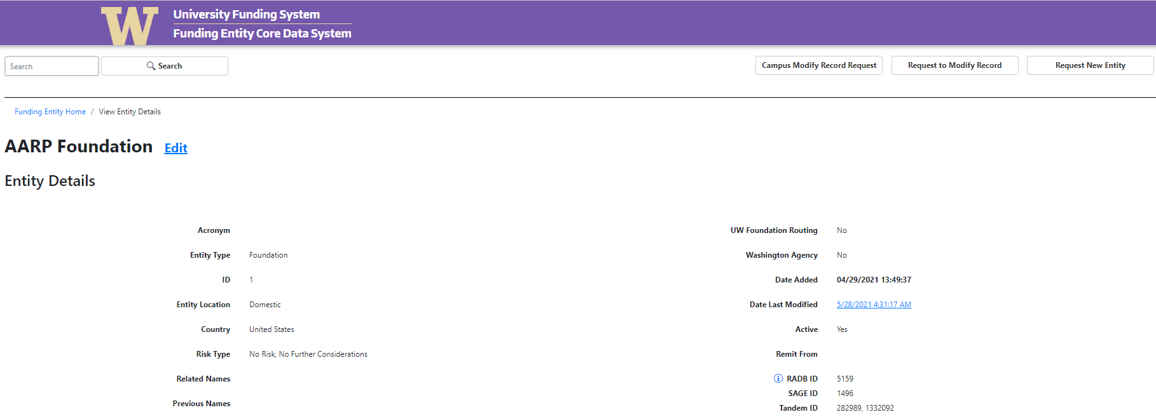
Modification Request
> Navigate to entity from main screen, then:

Slide 48
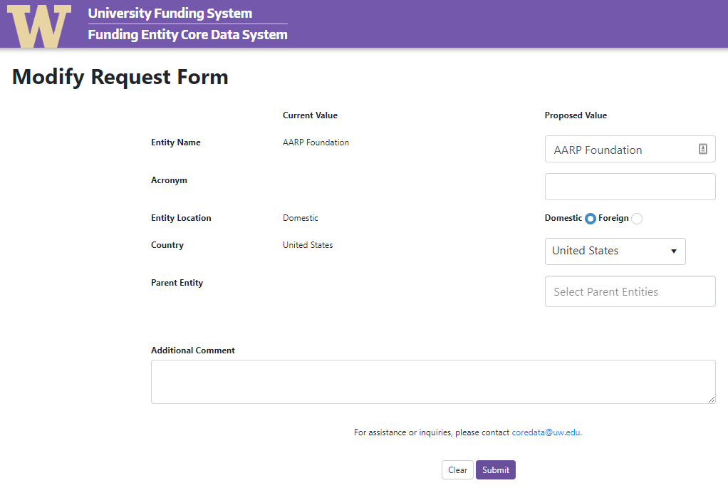
Modification Form

Slide 49
Questions
For questions related to sponsor names, sponsor types, or the FECDS request form: coredata@uw.edu
For issues within SAGE: sagehelp@uw.edu
To update billing contact details in Workday: gcahelp@uw.edu

Slide 50
RESEARCH RESOURCES UPDATES
GCA | ORIS | OSP
July 13, 2023 MRAM

Slide 51
Award Setup
Web Updates
Setup Financials: Guidance on Award Setup Requests
  When do I need an eGC1?
  When will I need an eGC1 vs. a Modification Request in SAGE?
Training & Help
SAGE Award User Guides
Award Setup & Tracking in SAGE eLearning
Additional resources on UWFT for the Research Community webpage

Slide 52
Modifications in SAGE
Web Updates
Award Changes: Guidance for Modification Types & Requests
  When will I need an eGC1 vs. a Modification Request in SAGE?
  Coming soon: How do I know which Modification Request to choose?
Training & Help
Award Modifications Job Aid
Coming soon: Award Modification User Guides

Slide 53
And more…
Web Updates
UWFT for the Research Community
  UWFT for Principal Investigators
GIMs: 2, 9, 15, 21, 23, 39, and a few more to come…
The same OSP Forms/templates are still required for some SAGE Modification request: Change of PI, F&A Waiver, Concurrence Letter, Extension Request
FAQs: Expect to see new FAQs on current topics
Research lifecycle pages will continue to be updated
Job Aids
Organization Code (Org Code) to Cost Center Job Aid
Clinical Trials SAGE Budget Job Aid
Notes:
- These GIMs have been updated and need to be attached to a Modification Request to OSP/GCA
- The Change of PI, F&A Waiver, Concurrence letter, and Extension request form are required for Award Mod requests in SAGE.
- OSP no longer gets an email for Extension Request forms - campus users must attach their responses to a mod request for extensions.
- The Research lifecycle web pages continue to be updated.

Slide 54
SAGE Office Hours &
Instructor-led Classes
Join SAGE Office Hours
July Office Hours
Join our SAGE Office Hours from 11 a.m.-noon today!
Register for SAGE Budget Classes
Thursday, July 20th, 1 - 3 p.m.
Thursday, August 31, 1 - 3 p.m.

Slide 55
GCA
GCA has 112 web pages and over 100 FAQs!
Prioritized web pages that are most frequently used
  Award Setup and Modifications
    Award review points for Campus
    Rebudgeting funds
    Setting up and requesting changes to award lines
  Handling Sponsor Payments (already updated)
  Cost Share
Website updates are in progress and are expected to complete by the end of August
Notes:
Speaker: Juan. Mention that we’ll provide an update when the web updates are complete.

Slide 56
Questions
Notes:
Speaker: Juan

