Slide 1
BONUS SESSION Monthly Research Administration Meeting - MRAM
July 21, 2023, 9:00 AM – 10:30 AM Click “CC” to Show Captions in your Zoom Controls
TOPIC | PRESENTER | EMAIL | MIN
Welcome |  |  | 2
Workday Finance Demo: Grant Security Hierarchies and Security Roles | Jesse Rice UW Finance Transformation | jrice19@uw.edu | 10-15
SAGE Budgets & Award Setup Requests | Kim Halstead Office of Research Information Services | sagehelp@uw.edu | 5
Priority Processing for Extensions | Vince Gonzalez Grant and Contract Accounting | vinceg@uw.edu | 5
Campus to Sponsor Invoicing | Lily Gebrenegus Grant and Contract Accounting | lgebren@uw.edu | 10
Award Change & Modifications in SAGE | Carol Rhodes & Vince Gonzalez Office of Sponsored Programs Grant and Contract Accounting | carhodes@uw.edu vinceg@uw.edu | 10-15
OSP & GCA - Update | Carol Rhodes & Vince Gonzalez Office of Sponsored Programs Grant and Contract Accounting | carhodes@uw.edu vinceg@uw.edu | 10
Subaward Update | Amanda Snyder & Josy Combs Office of Sponsored Programs | acs229@uw.edu | 10
ECC: Effort Statements and Project Statements | Matt Gardner Post Award Fiscal Compliance | gcafco@uw.edu | 10
NEXT MRAM August 10, 2023, 9:00 AM - 10:00 AM
Notes:
Current length: 107 minutes!

Slide 2
Workday Finance Demo: Grant Security Hierarchies and Security Roles
MRAM
July 2023
Jesse Rice
UW Finance Transformation

Slide 3
SAGE BUDGETS & AWARD SETUP REQUESTS
Kim Halstead, Office of Research Information Services
July 21, 2023 MRAM

Slide 4
SAGE BUDGET: LINKING BUDGETS TO AWARD SETUP REQUESTS
Context
The best practice for award budgeting is to create or copy a distinct budget for time of award, separate from the proposal budget.
Why? For easy recognition of which is which when the two budgets vary.
Currently, the SAGE system is allowing users to link proposal budgets to Award Setup Requests and is not requiring a new budget. This will change in the future.
Best Practice
Users should create an award budget by either creating a new SAGE budget or making a copy of an existing budget.
Be sure to select the award budget (new or copied budget) and not the proposal budget on Award Setup Requests.

Slide 5
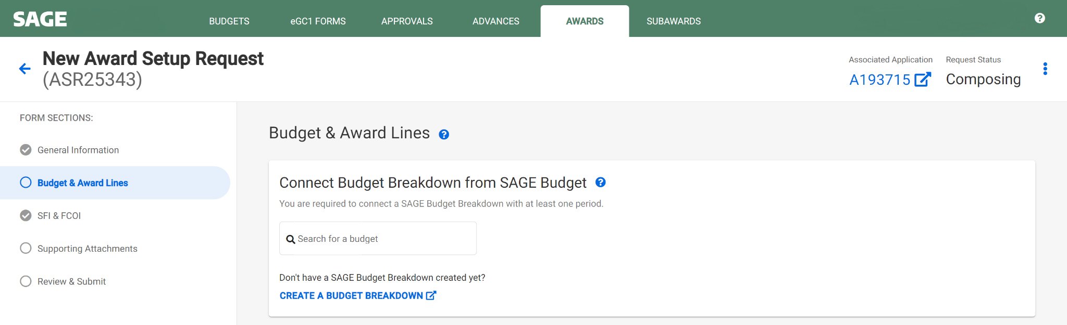
HOW TO CONNECT A SAGE BUDGET
Search for a budget to connect
Search by PI, Title, or Budget ID
Be sure the budget you connect is a new budget or a copy of an existing budget rather than the original proposal budget
Search for an existing budget
Create a new SAGE Budget

Slide 6
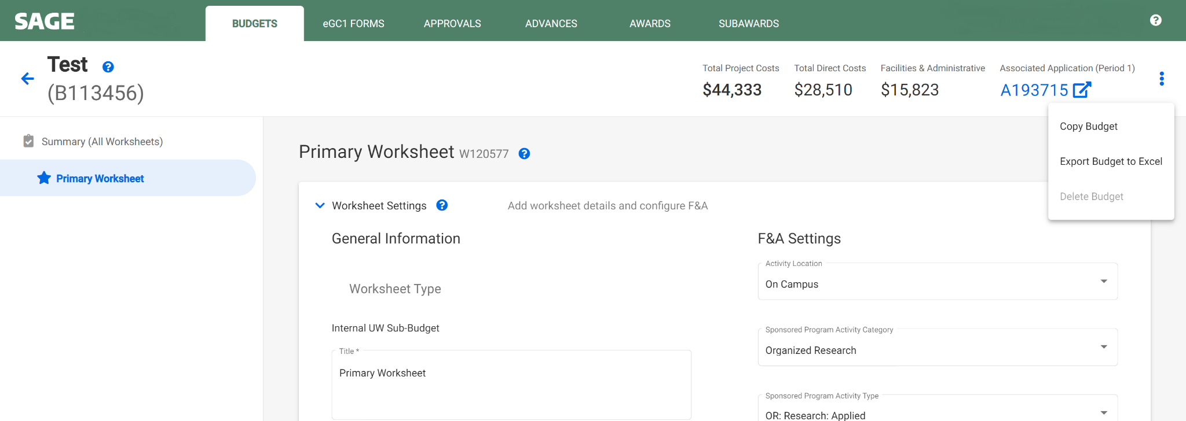
HOW TO COPY A SAGE BUDGET
Copy a SAGE Budget

Slide 7
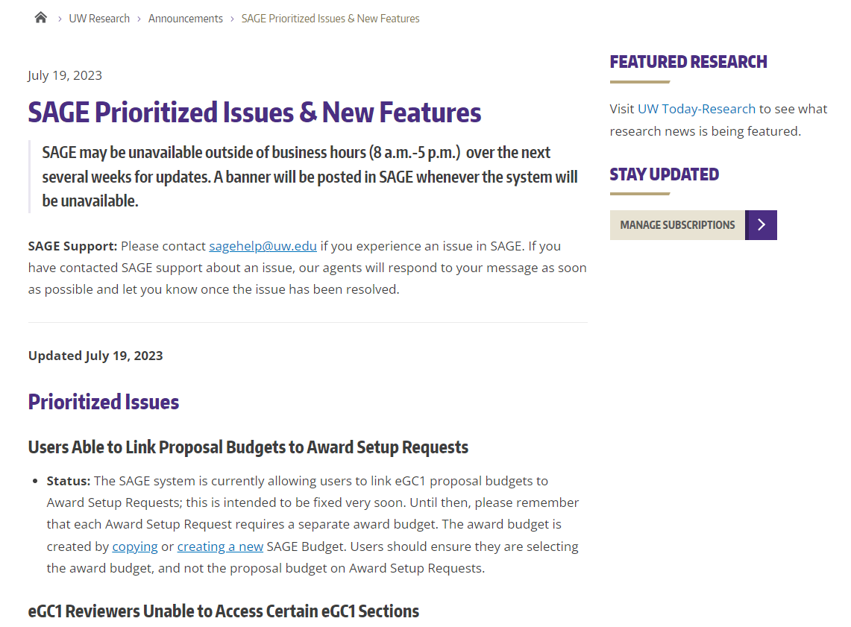
SAGE UPDATES
SAGE Prioritized Issues & New Features
Bookmark this new page to stay current on SAGE fixes and planned updates.
SAGE may be unavailable outside of normal business hours (weekdays from 8 a.m. - 5 p.m.) over the next several weeks. Banners will alert users of planned SAGE unavailability.

Slide 8
QUESTIONS?
Notes:
Speaker: Juan

Slide 9
PRIORITY PROCESSING FOR EXTENSIONS
Vince Gonzalez
Associate Director, Grant & Contract Accounting
July 21, 2023 MRAM

Slide 10
TEMPORARY PROCESS FOR EXTENSIONS
GCA is prioritizing extensions for awards ending in June and July
Processing the following outside of SAGE: Extensions, Temporary Internal Extensions, and the Extension portion of Supplement/Extensions that have been in the SAGE status of “In OSP” since 6/15/23
GCA notifies campus contacts via Award Portal ticket
Goal is to update awards by COB the day before payroll cutoff
Notes:
The “why”: delayed release of SAGE Modifications and to support campus meeting payroll deadlines. Bullet 3: Mention that the normal process would result in an automated SAGE notification not an Award Portal ticket.

Slide 11
TEMPORARY PROCESS FOR EXTENSIONS
New expiration date will be immediately visible in Workday and one day later in other systems (e.g. Award Portal)
Please check that the updates in Workday are accurate

Slide 12
NORMAL PROCESS FOR EXTENSIONS
Release notification will be sent to SAGE users when Award Modifications are available
Once available, OSP will forward the Modifications to GCA to complete the processing in SAGE and make other updates to Workday
Campus will receive another notification when the modification is officially processed in SAGE

Slide 13
WRAP UP
For reference: 2023 Payroll Cutoff Calendar
Please use Award Portal to let GCA know if corrections or further updates are required in Workday

Slide 14
Campus→Sponsor Invoicing for Sponsored Program Awards
Lily Gebrenegus
Grant & Contract Accounting
July 21, 2023 MRAM

Slide 15
BEFORE WORKDAY FINANCE
Campus could bill the sponsor directly when an award required information that GCA does not have access to (e.g. clinical studies)
No GCA involvement needed

Slide 16
AFTER WORKDAY FINANCE
All invoices for sponsored program awards will need a Workday invoice number
Starting in early August, campus will need to contact GCA to get a Workday invoice number before sending it to the sponsor
Notes:
UW Finance Transformation goal: “consolidated visibility into receivables” (source)

Slide 17
GETTING A WORKDAY INVOICE #
Send an Award Portal ticket to GCA under “Sponsor Billing” topic
Provide dollar amount and brief description of what is being billed

Slide 18
EXCEPTION
Invoices generated using OnCore will generate a Workday invoice automatically via integration

Slide 19
QUESTIONS
Please contact GCA at gcahelp@uw.edu

Slide 20
Award Change & Modifications in SAGE
July 21, 2023 MRAM
Carol Rhodes, Office of Sponsored Programs
Vince Gonzalez, Grant & Contract Accounting

Slide 21
SAGE Modifications
Two choices for creating a Modification (MOD) in SAGE
  Modification Request (OSP/GCA)
  Modification Request (GCA)
Select the Associated Award
Select appropriate MOD categories that apply
  Funding & Budgeting Change
  Other Changes
  Programmatic Changes
  Schedule Changes
  End of Award Changes
Review: Award Changes for additional instructions including any required attachments

Slide 22
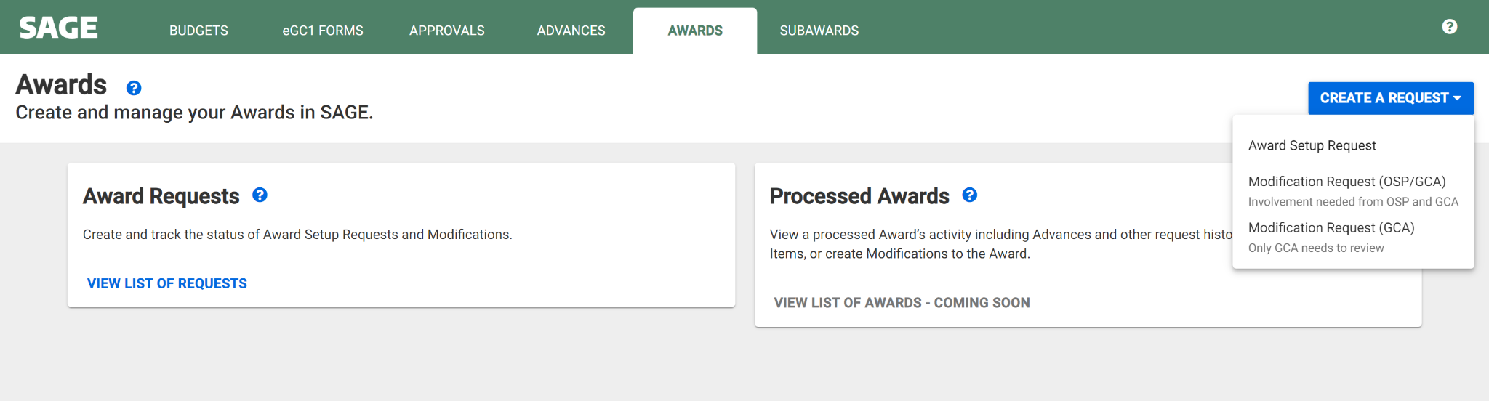
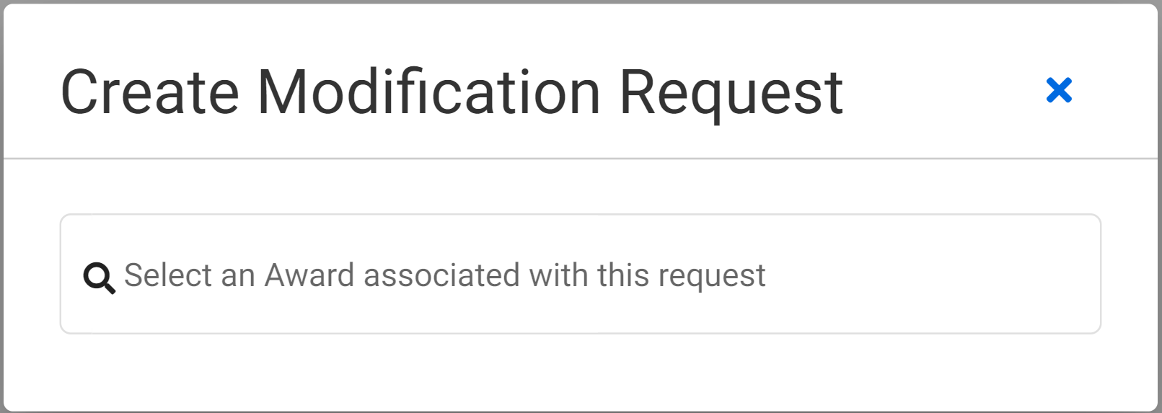
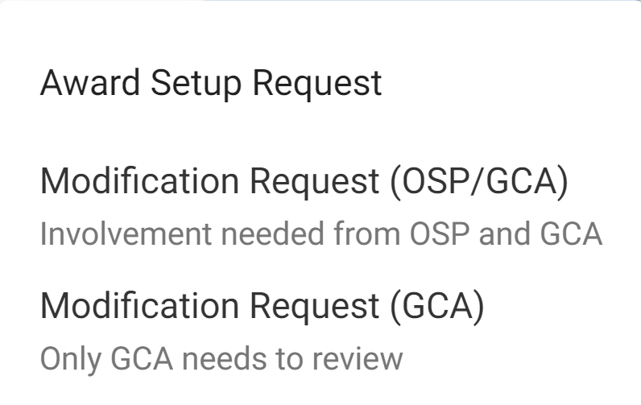
SAGE Modifications
Create the Modification - Navigate from Awards
Review: Award Modifications Job Aid
Notes:
Carol
Submitting Modification Requests in SAGE require you to select either a Modification Request to OSP/GCA or a Modification Request to GCA only. So how do you know which request to select?
All changes that require sponsor approval, an authorized official signature, or review from the Office of Sponsored Programs (OSP), must be requested via a Modification Request (OSP/GCA) in SAGE Awards. Modification requests that do not need OSP handling and can be submitted via a Modification Request (GCA only).

Slide 23
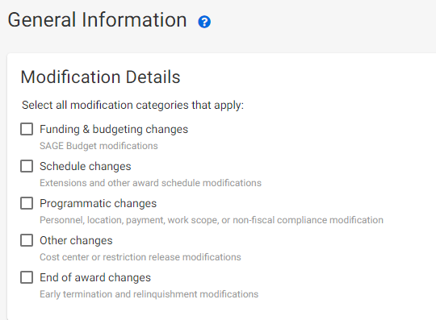
Modification Request - SAGE

Slide 24
Modification Request (OSP/GCA)
Funding & Budgeting Changes
Carryover
Addition of Equipment - Sponsor Approval Required
Deobligations
Other Funding and Budgeting Changes
Payment Schedule Change
Rebudgeting - Sponsor Approval Required
Subaward Addition
Supplement
Review: Award Changes for additional instructions including any required attachments
Notes:
Carol
Use SAGE Modifications to route award changes to OSP & GCA

Slide 25
Modification Request (OSP/GCA)
Other Changes
Progress Report - RPPR - Submission
Restriction Release
Review: Award Changes for additional instructions including any required attachments
Notes:
Carol

Slide 26
Modification Request (OSP/GCA)
Programmatic Changes
Key Personnel Changes - Includes PI
  Change of PI requests require Change of PI form attached to SAGE MOD.
Key Personnel Effort Changes - Includes PI
Addition of Sponsor Property
Work Scope Change
Review: Award Changes for additional instructions including any required attachments
Notes:
Carol

Slide 27
Modification Request (OSP/GCA)
Schedule Change
Award Schedule Change - Start Date Change - requiring sponsor approval
Extension
Temporary Internal Extension
Complete an Extension form & attach to MOD in SAGE.
Review: Award Changes for additional instructions including any required attachments
Notes:
Carol
Extension form similar to other forms has other fields and reminders not yet included in SAGE and can help make sure you provide all of the required information needed to process your request.

Slide 28
Modification Request (OSP/GCA)
End of Award Changes
Early Terminations
Relinquishments
Award Transfers
Relinquishments & Early Terminations also need an End of Award form attached.
Review: Award Changes for additional instructions including any required attachments
Notes:
Carol

Slide 29
Modification Request (GCA only)
In addition to MODs that are routed first to OSP and then GCA, there will also be MODs that are routed from Campus to GCA Only
These MODs will transform adjustments to Workday that do not require sponsor approval by:
  Minimizing the need to send tickets and related attachments to GCA via Award Portal
  Ensuring MOD requests are made in SAGE
Notes:
Vince

Slide 30
Modification Request (GCA only) - SAGE
Modification Details

Slide 31
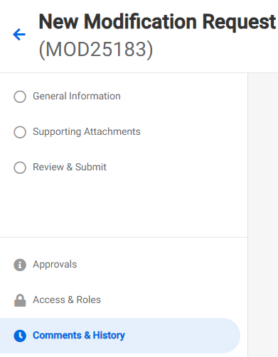
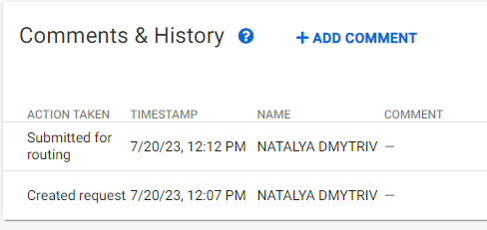
Modification Request (GCA only) - SAGE

Slide 32
Modification Request (GCA only) Examples
Funding & Budgeting Changes
Cost Share Change (no sponsor approval required)
Rebudgeting (no sponsor approval required)
  To be used in place of Transpasus (TPUs)
  Department should update their SAGE Budget worksheets to outline requested changes and ensure alignment between SAGE Budget and Workday
Schedule Changes
Other Award Schedule Changes - Start Date Change (no sponsor approval required)
Programmatic Changes
Location Change
Other Changes
Cost Center Change
Notes:
Vince

Slide 33
Resources
Award Modifications in SAGE Job Aid
Award Modifications User Guide
Award Changes: Guidance and instructions for completing Modification requests
GCA Award Setup guidance
GCA Modification guidance
FAQs:
When will I need an eGC1 vs. create a Modification request?
coming soon: How do I know which modification request to select (OSP/GCA) or (GCA)?
Notes:
Vince

Slide 34
OSP & GCA - Update
July 21, 2023 MRAM
Carol Rhodes, Office of Sponsored Programs
Vince Gonzalez, Grant & Contract Accounting

Slide 35
Prioritizing & Catching Up - OSP
Conversion of over ~700 PACs to SAGE Modifications (MOD)
Setup & processing of your requests may result in:
  Denying Award Setup Requests
  Returning eGC1s that should be a MOD
  Denying MODs sent to incorrect office
Review: When will I need an eGC1 vs. a Modification Request?
Notes:
Carol
Note: Amanda & Josy will be presenting on Subawards after this presentation

Slide 36
Attach Agreement & Related Documents/Correspondence
Attach the award agreement or modification
Include attachments, exhibits, letters, award emails and/or correspondence
Sometimes related emails contain issue date, award #s, POs, additional terms, due dates, sponsor contacts, or conditions needed to process your request
Notes:
Carol-

Slide 37
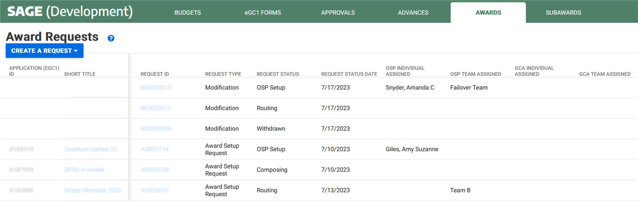
How can I see what’s going on - ASRs & MODs? Request List Status & Assignments
Status
Assigned
Assignments & Status on request list
Notes:
Carol-

Slide 38
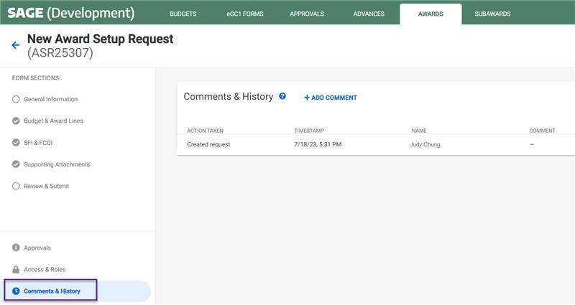
How can I see what’s going on - ASRs & MODs? Comments & History
Detailed history and comments within ASR and MOD
Status viewable on Requests List
Notes:
Carol-

Slide 39
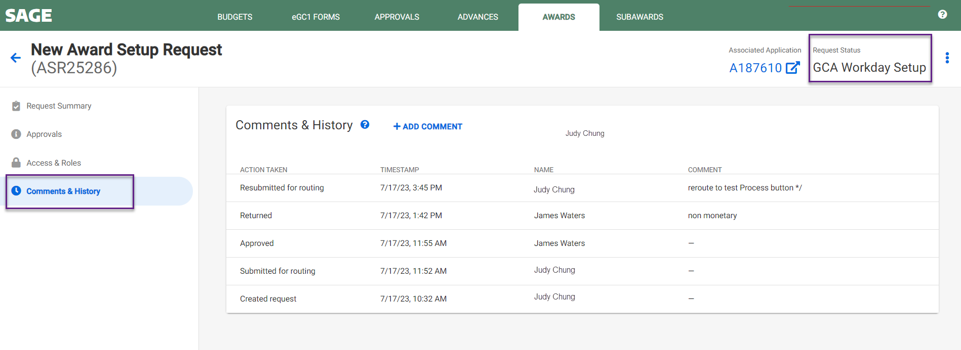
How can I see what’s going on - ASRs & MODs?
Award Request Status List
Detailed history and comments within ASR and MOD
Notes:
Carol-

Slide 40
Workarounds & Requests - GCA
Advances (ADVs) do not include the security hierarchy reference, please add to Comments & History
MODs - If the Grant Worktag (GR) reference is known, please add to the Comments & History
MODs - Please update SAGE Budget worksheet and add the SAGE Budget number to the Comments & History
GCA will return an item if unsure about any of the above to ensure proper setup
Notes:
Vince - Clarify that the SAGE Budget number in the 3rd bullet is not the FAS budget number.

Slide 41
Questions

Slide 42
Subaward Update
July 21, 2023 MRAM
Amanda Snyder & Josy Combs
Office of Sponsored Programs

Slide 43
Transition Update
Active suppliers in Ariba were pulled into WD
Most subaward BPOs converted to WD, but not all
You can search by your BPO # in the PO field in WD
Subrecipients can invoice based on existing BPO # They should include “BPO” as part of the PO number, e.g. “BPO50668”
Supplier instructions for WD: Follow For Suppliers instructions
  Subrecipient does not go into Workday to upload invoices
  Email instructions for suppliers is available in the link

Slide 44
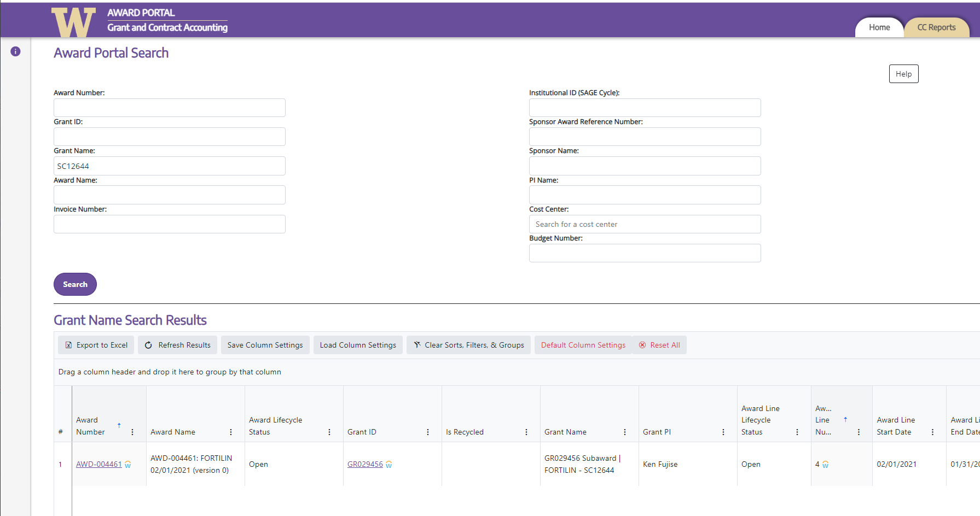
Subaward Award Lines
Each Subward must have its own award line in Workday.
Search using SAGE Subaward (SC) Number in “Grant Name”
Grant Name includes “Subaward” and “SC#”

Slide 45
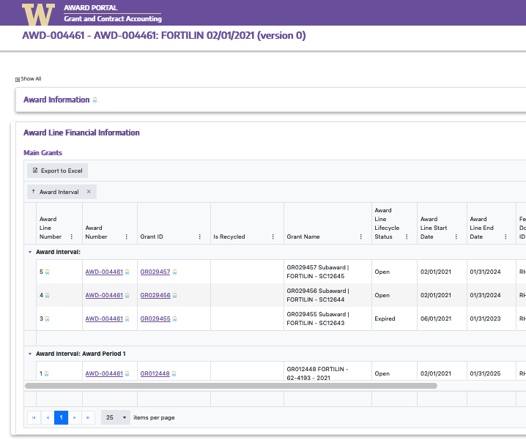
Subaward Award Lines
View Additional Award Lines for this Award

Slide 46
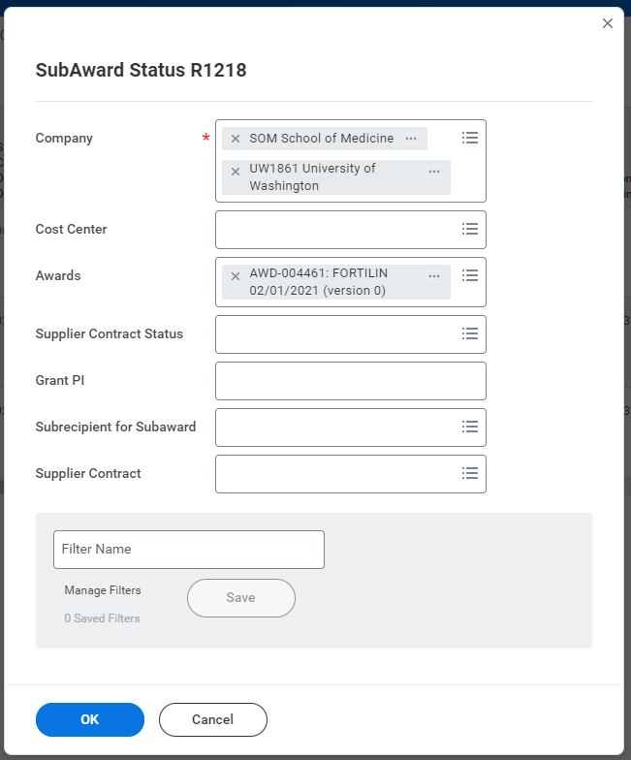
Walk through:
Finding Subaward POs in Workday
Enter Company
Enter Award Number
Click to search
Notes:
Amanda to walk through where POs are listed if they’ve been converted. NOTE: You can find this report on your Grant Manager Dashboard.

Slide 47
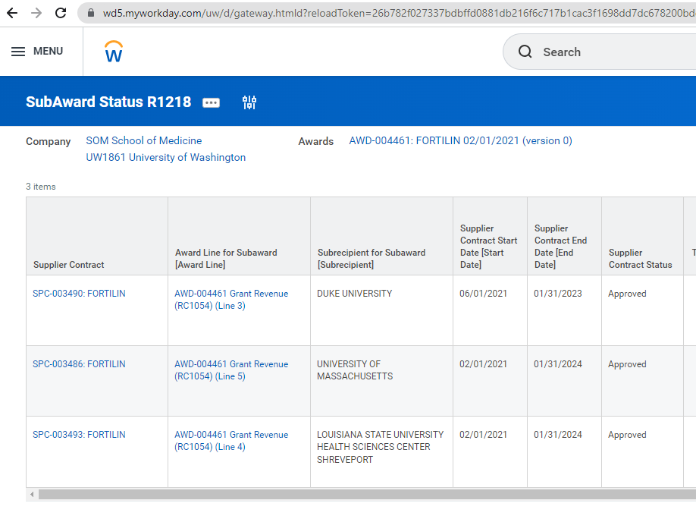
Walk through:
Finding Subaward POs in Workday
Scroll Right
Notes:
Amanda to walk through where POs are listed if they’ve been converted

Slide 48
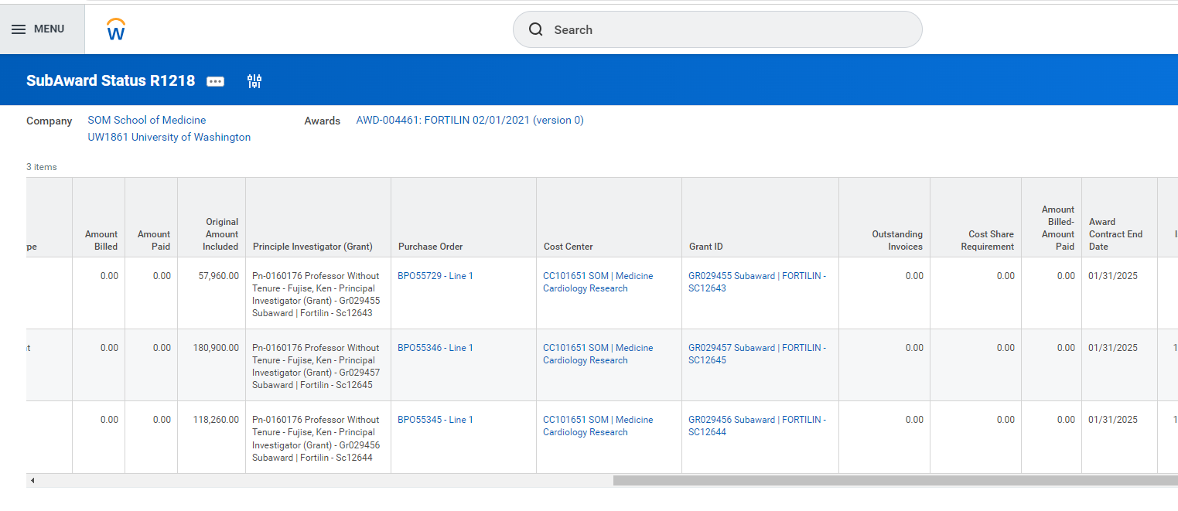
Walk through:
Finding Subaward POs in Workday
Notes:
Amanda to walk through where POs are listed if they’ve been converted

Slide 49
Questions
Other questions we are investigating:
What do you do if you have existing subawards but award lines are not setup in WD? Partial Answer: This will be handled via MOD request. Details to come.
What do I do if our subrecipient isn’t listed as a Supplier Contract listed in the Workday Subaward Status Report (R1218)?
What do I do if my subrecipient’s Supplier Contract in Workday does not have a PO listed?
What should I be reviewing on the Supplier Contract and Purchase Orders to ensure the information is accurate? And, what do I do if they need corrections?
What is the process for the “in flight” subawards and modifications?
How to view a supplier invoice that’s been attached to a (B)PO, and related payment information (e.g., Check/EFT info, payment date or date scheduled for payment, etc.).

Slide 50
ALL THINGS
EFFORT REPORTING
MRAM
July 21, 2023
Matt Gardner
Post Award Fiscal Compliance

Slide 51
FECs for Period Ending 6/30/2023
FEC Release Date: 7/29/2023 (Expected)
FEC Due Dates:
Calendar Cycle – 9/26/2023
Academic Cycle – 10/11/2023
eFECS will be frozen and unavailable for use after 10/11/2023
MRAM – Matt Gardner – PAFC

Slide 52
Necessity for Manual FECs
Two instances where completion of the FEC must occur outside of the eFECS system via a manual process:
Any payroll adjustments which impact pay periods prior to 7/1/2023 for faculty on sponsored awards
Outstanding FECs as of 10/12/2023
Departments must work with the Effort Team to complete the manual certification process
MRAM – Matt Gardner – PAFC

Slide 53
Outstanding and Overdue FECs
Outstanding/Overdue FECs from prior reporting periods still require certification
Units are encouraged to complete as many outstanding FECs as possible by 10/11/2023 before eFECS is frozen
The Effort Team has a list of all outstanding FECs and will be reaching out to units with reminders
MRAM – Matt Gardner – PAFC

Slide 54
ECC Go Live
Employee Compensation Compliance (“ECC”) is the new effort reporting system
The system is scheduled to be available across campus in mid-to-late August
Training for users is also scheduled to begin in mid-to-late August
  Training courses and videos are expected to be approximately 90 minutes in total duration
The Effort Team will reach out with communications in the future regarding the beginning of training and system availability
MRAM – Matt Gardner – PAFC

Slide 55
ECC Go Live and Certification Periods
Project Statements (previously called “GCCRs”)
  Reporting period: 7/1/2023 – 9/30/2023
  Due Dates: Early-to-mid December 2023
Effort Statements (“FECs”)
  Reporting period: 7/1/2023 – 12/31/2023
  Due Dates: Early-to-mid January 2024
MRAM – Matt Gardner – PAFC

Slide 56
Salary Cap and Effort Calculations
Effort team is working on new salary cap and effort calculators for determining allocations in Workday
Look for an email with updated links to the calculators and resources within the next couple of weeks
Reminder:
  Salary cap is not calculated on Payroll Accounting Adjustments
MRAM – Matt Gardner – PAFC

Slide 57
Questions
Post Award Fiscal Compliance (PAFC)
  effortreporting@uw.edu (ECC questions)
  efecs@uw.edu (Legacy effort questions)
  gcafco@uw.edu (All other compliance questions)
  https://finance.uw.edu/pafc/
Matt Gardner
  mgard4@uw.edu
  206-543-2610
MRAM – Matt Gardner – PAFC

