Slide 1
SAGE BUDGETS & AWARD SETUP REQUESTS
Kim Halstead, Office of Research Information Services
July 21, 2023 MRAM

Slide 2
SAGE BUDGET: LINKING BUDGETS TO AWARD SETUP REQUESTS
Context
The best practice for award budgeting is to create or copy a distinct budget for time of award, separate from the proposal budget.
Why? For easy recognition of which is which when the two budgets vary.
Currently, the SAGE system is allowing users to link proposal budgets to Award Setup Requests and is not requiring a new budget. This will change in the future.
Best Practice
Users should create an award budget by either creating a new SAGE budget or making a copy of an existing budget.
Be sure to select the award budget (new or copied budget) and not the proposal budget on Award Setup Requests.

Slide 3
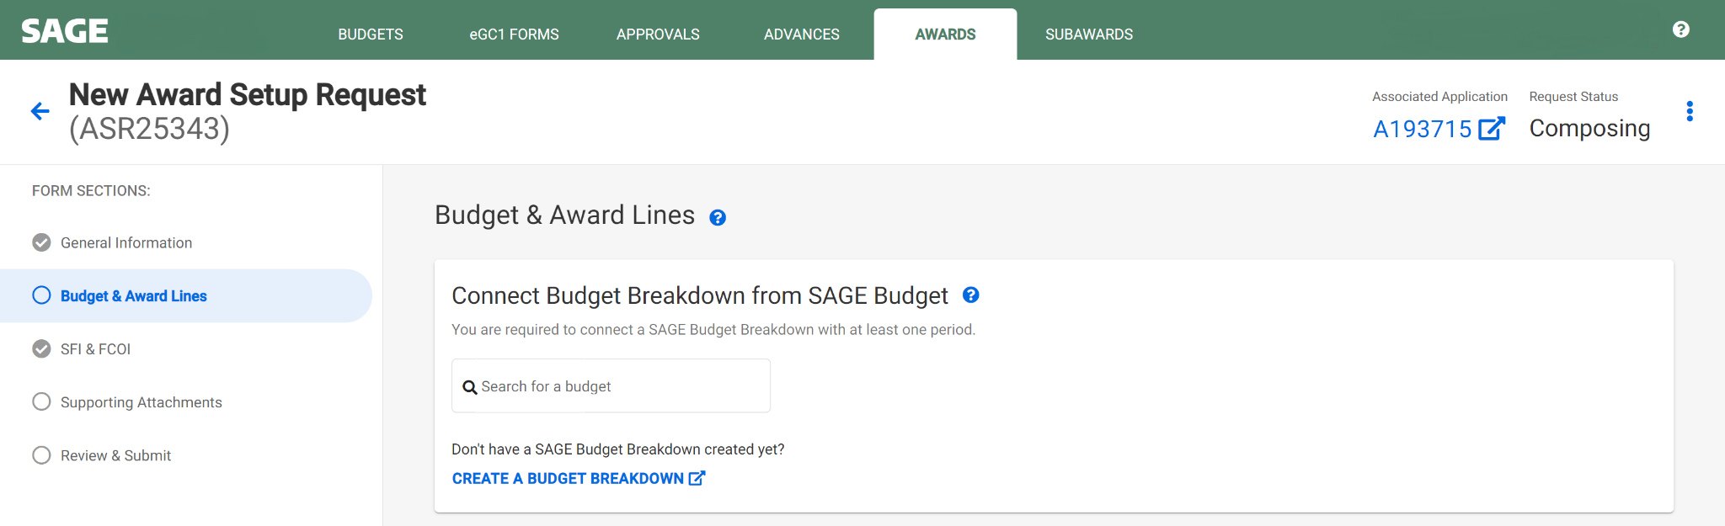
HOW TO CONNECT A SAGE BUDGET
Search for a budget to connect
Search by PI, Title, or Budget ID
Be sure the budget you connect is a new budget or a copy of an existing budget rather than the original proposal budget
Search for an existing budget
Create a new SAGE Budget

Slide 4
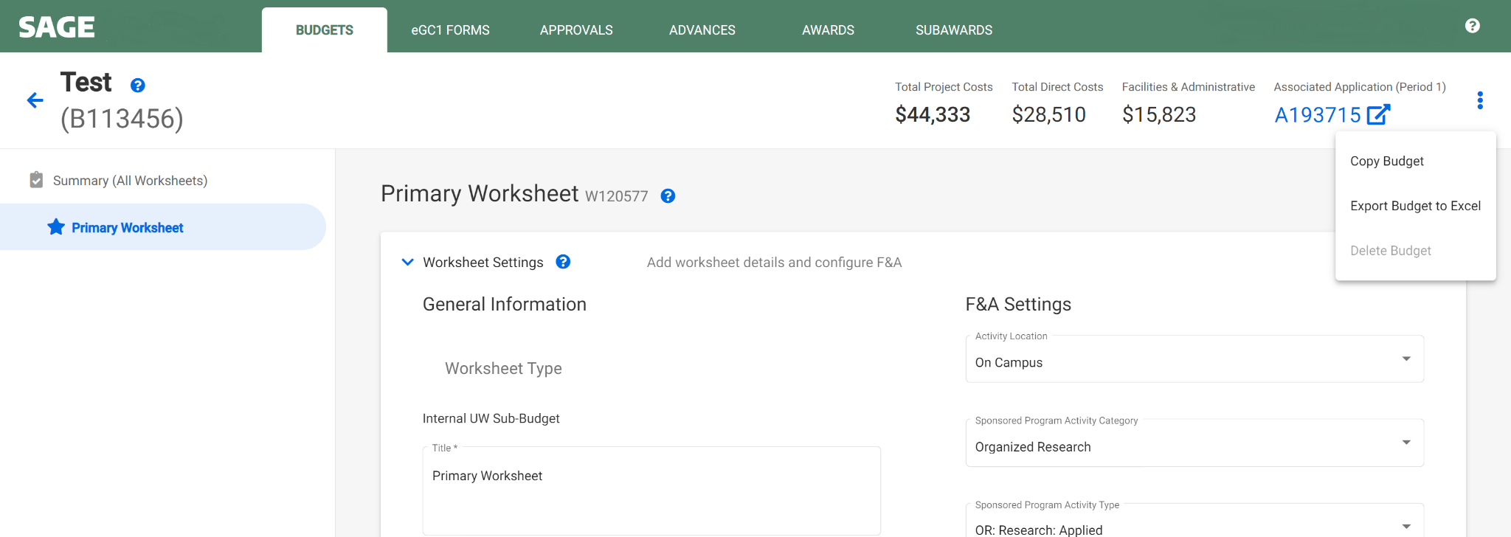
HOW TO COPY A SAGE BUDGET
Copy a SAGE Budget

Slide 5
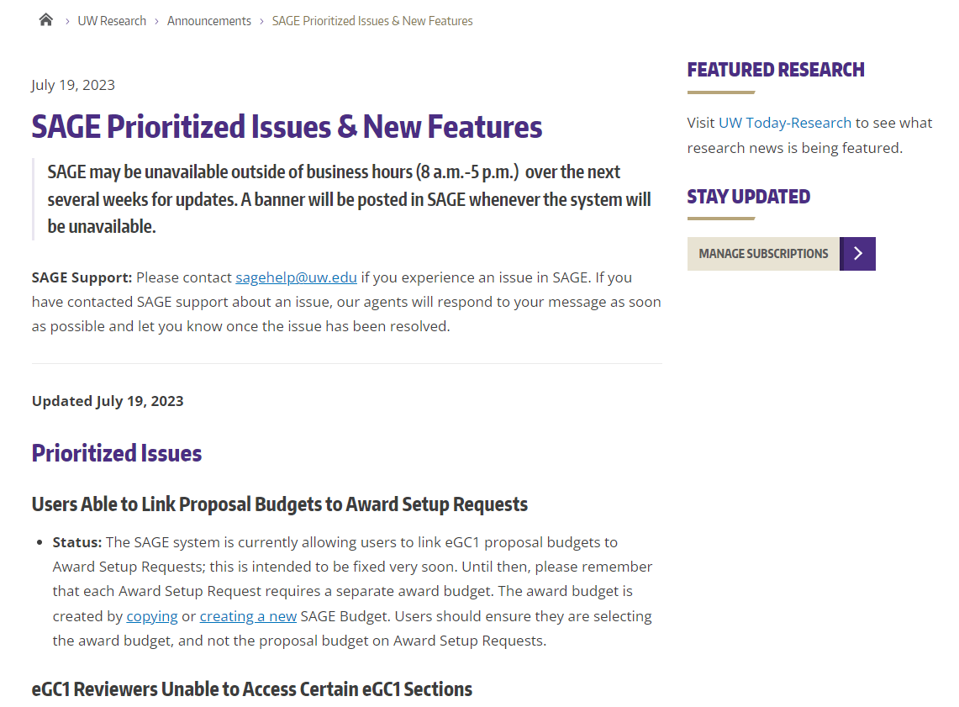
SAGE UPDATES
SAGE Prioritized Issues & New Features
Bookmark this new page to stay current on SAGE fixes and planned updates.
SAGE may be unavailable outside of normal business hours (weekdays from 8 a.m. - 5 p.m.) over the next several weeks. Banners will alert users of planned SAGE unavailability.

Slide 6
QUESTIONS?
Notes:
Speaker: Juan

