Slide 1
New Sponsors & Sponsor Name Changes
July 2023 MRAM
Amanda Snyder, Office of Sponsored Programs
Julie Fricks, Research Compliance and Operations

Slide 2
New SAGE Data
SAGE now leverages a shared core data resource for sponsor data
Enhanced search functionality for sponsors covers:
Main sponsor name
Acronyms
Related names
Previous names
Notes:
Amanda

Slide 3
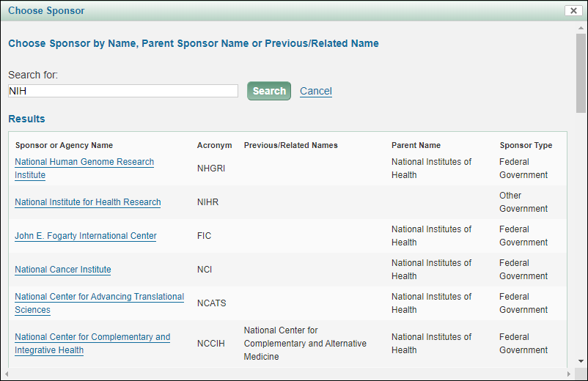
Sponsor Search - eGC1
Notes:
Amanda

Slide 4
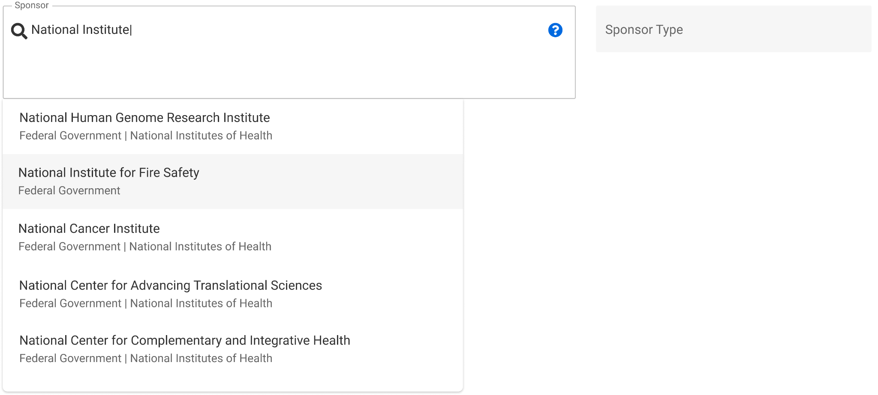
Sponsor Search -
Award Setup Request (ASR)
Notes:
Amanda - Different look for search, but is searching parent names, previous/related names, acronyms, too.

Slide 5
Request Process
When your sponsor does not appear in the search results, follow the link to request new sponsor.
eGC1
ASR
Notes:
Amanda

Slide 6
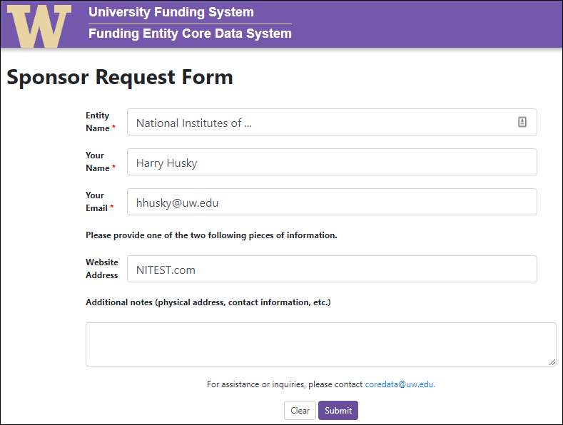
Request Process

Slide 7
Request Process
24-hour turnaround time
You will receive an email notification that your sponsor has been created
~15 minutes from the time the notification is sent until the sponsor is available for use in SAGE

Slide 8
Funding Entity Core Data Management
Emphasis on the need for sponsor clean-up from peer institutions who had converted to Workday
Sponsor is cornerstone data element of a grant
Launched an effort to unify pre-award, post-award sponsor data, as well as donor data

Slide 9
Core Data
Funding Entity Core Data System (FECDS) houses the core data associated with sponsors, donors, and customers
Data which can change depending on the funding instrument and units involved is considered “local” and is not housed in FECDS:
Compliance designation related to FCOI
Addresses
Email contacts

Slide 10
Data Availability
Access the full dataset at any time:
https://fin-s-web22.finance.uw.edu/fin/fecdm
> Data is also available via EDW:
[CoreData].[sec].[FE_MainEntity]
> Data is connected in WDAY via FECID in the
SponsorReferenceID field - visible in EDW:
[UWODS].[sec].[Sponsor]

Slide 11
Modifications
New Requests within FECDS
FECDS also includes options to request modifications to or add additional entities within the application.

Slide 12
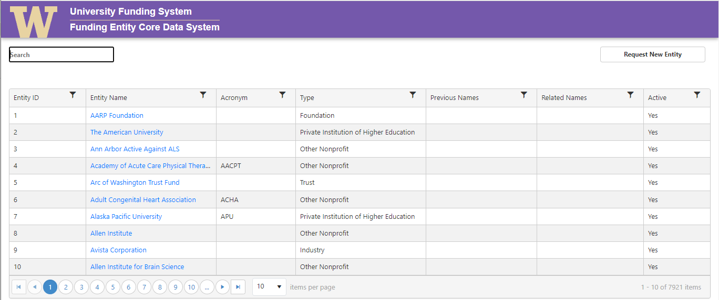
Request Process

Slide 13
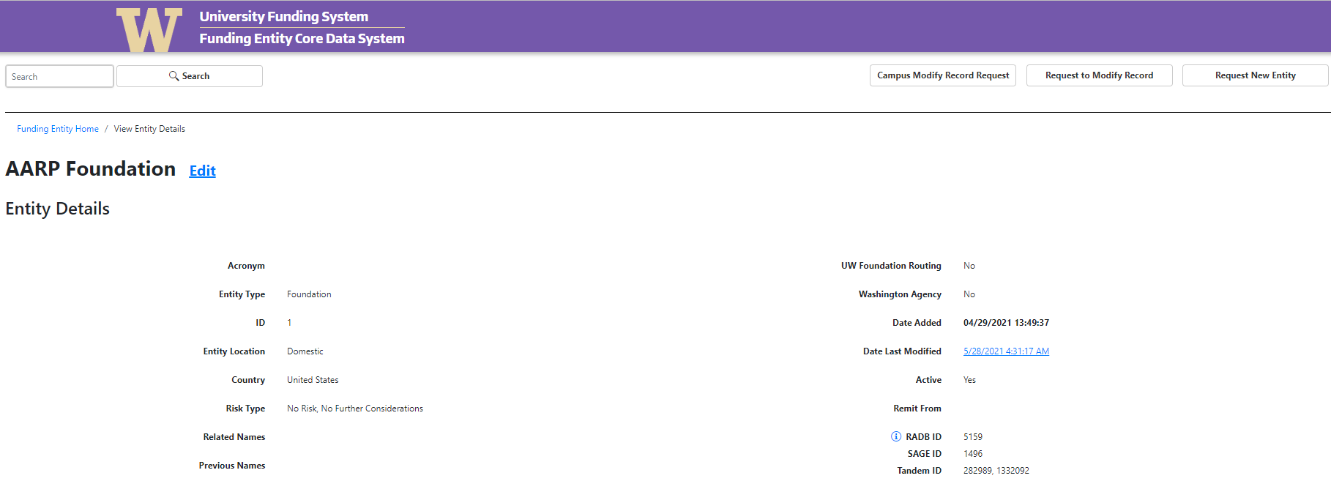
Modification Request
> Navigate to entity from main screen, then:

Slide 14
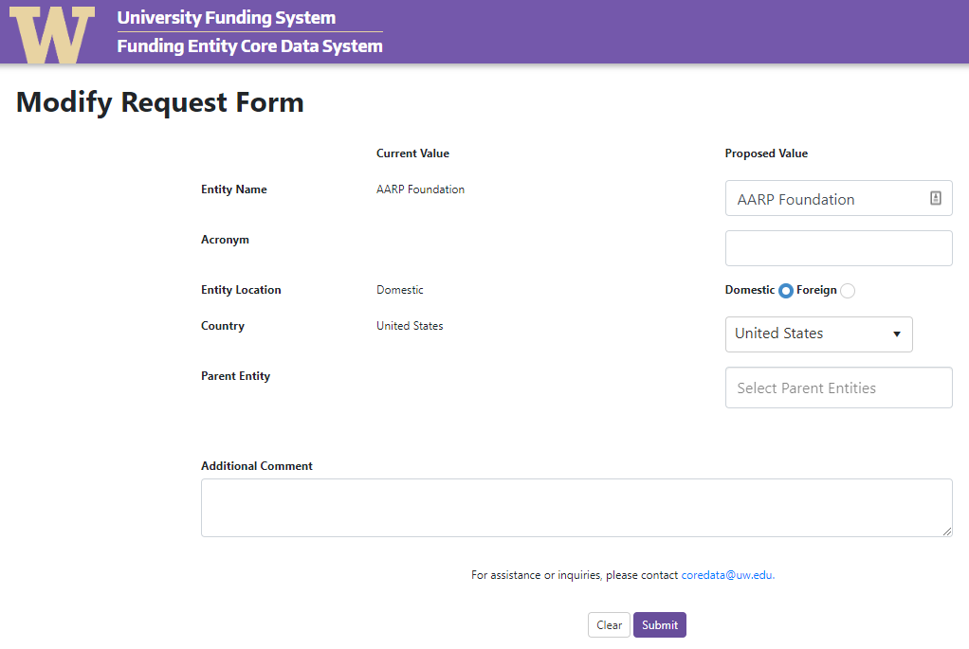
Modification Form

Slide 15
Questions
For questions related to sponsor names, sponsor types, or the FECDS request form: coredata@uw.edu
For issues within SAGE: sagehelp@uw.edu
To update billing contact details in Workday: gcahelp@uw.edu

