Slide 1
Award Change & Modifications in SAGE
July 21, 2023 MRAM
Carol Rhodes, Office of Sponsored Programs
Vince Gonzalez, Grant & Contract Accounting

Slide 2
SAGE Modifications
Two choices for creating a Modification (MOD) in SAGE
Modification Request (OSP/GCA)
Modification Request (GCA)
Select the Associated Award
Select appropriate MOD categories that apply
Funding & Budgeting Change
Other Changes
Programmatic Changes
Schedule Changes
End of Award Changes
Review: Award Changes for additional instructions including any required attachments

Slide 3
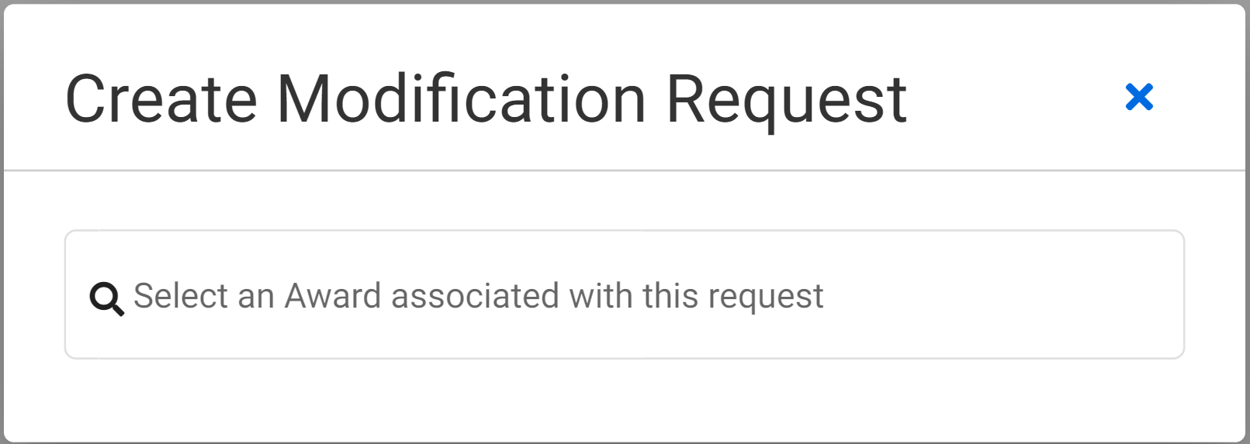
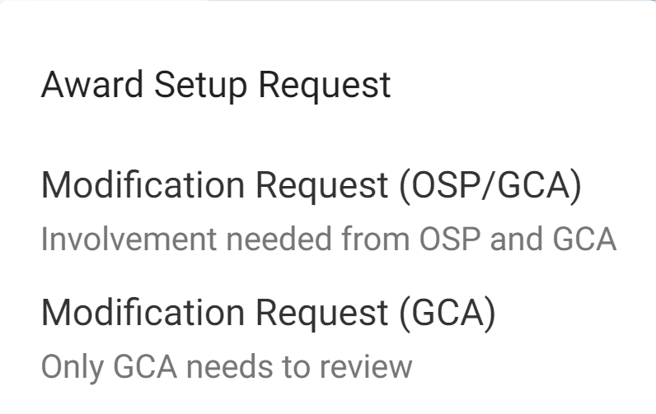
SAGE Modifications
Create the Modification - Navigate from Awards
Review: Award Modifications Job Aid
Notes:
Carol
Submitting Modification Requests in SAGE require you to select either a Modification Request to OSP/GCA or a Modification Request to GCA only. So how do you know which request to select?
All changes that require sponsor approval, an authorized official signature, or review from the Office of Sponsored Programs (OSP), must be requested via a Modification Request (OSP/GCA) in SAGE Awards. Modification requests that do not need OSP handling and can be submitted via a Modification Request (GCA only).

Slide 4
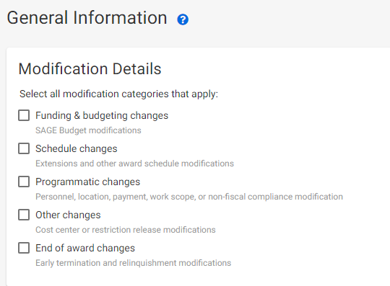
Modification Request - SAGE

Slide 5
Modification Request (OSP/GCA)
Funding & Budgeting Changes
Carryover
Addition of Equipment - Sponsor Approval Required
Deobligations
Other Funding and Budgeting Changes
Payment Schedule Change
Rebudgeting - Sponsor Approval Required
Subaward Addition
Supplement
Review: Award Changes for additional instructions including any required attachments
Notes:
Carol
Use SAGE Modificaitons to route award changes to OSP & GCA

Slide 6
Modification Request (OSP/GCA)
Other Changes
Progress Report - RPPR - Submission
Restriction Release
Review: Award Changes for additional instructions including any required attachments
Notes:
Carol

Slide 7
Modification Request (OSP/GCA)
Programmatic Changes
Key Personnel Changes - Includes PI
Change of PI requests require Change of PI form attached to SAGE MOD.
Key Personnel Effort Changes - Includes PI
Addition of Sponsor Property
Work Scope Change
Review: Award Changes for additional instructions including any required attachments
Notes:
Carol

Slide 8
Modification Request (OSP/GCA)
Schedule Change
Extension
Temporary Internal Extension
Complete an Extension form & attach to MOD in SAGE.
Review: Award Changes for additional instructions including any required attachments
Notes:
Carol
Extension form similar to other forms has other fields and reminders not yet included in SAGE and can help make sure you provide all of the required information needed to process your request.

Slide 9
Modification Request (OSP/GCA)
End of Award Changes
Early Terminations
Relinquishments
Award Transfers
Relinquishments & Early Terminations also need an End of Award form attached.
Review: Award Changes for additional instructions including any required attachments
Notes:
Carol

Slide 10
Modification Request (GCA only)
In addition to MODs that are routed first to OSP and then GCA, there will also be MODs that are routed from Campus to GCA Only
These MODs will transform adjustments to Workday that do not require sponsor approval by:
Minimizing the need to send tickets and related attachments to GCA via Award Portal
Ensuring MOD requests are made in SAGE
Notes:
Vince

Slide 11
Modification Request (GCA only) - SAGE
Modification Details

Slide 12
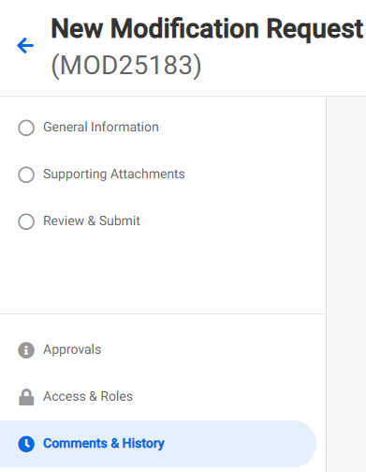
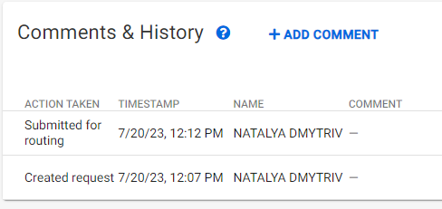
Modification Request (GCA only) - SAGE

Slide 13
Modification Request (GCA only) Examples
Funding & Budgeting Changes
Cost Share Change (no sponsor approval required)
Rebudgeting (no sponsor approval required)
To be used in place of Transpasus (TPUs)
Department should update their SAGE Budget worksheets to outline requested changes and ensure alignment between SAGE Budget and Workday
Schedule Changes
Other Award Schedule Changes - Start Date Change (no sponsor approval required)
Programmatic Changes
Location Change
Other Changes
Cost Center Change
Notes:
Vince

Slide 14
Resources
Award Modifications in SAGE Job Aid
Award Modifications User Guide
Award Changes: Guidance and instructions for completing Modification requests
GCA Award Setup guidance
GCA Modification guidance
FAQs:
When will I need an eGC1 vs. create a Modification request?
coming soon: How do I know which modification request to select (OSP/GCA) or (GCA)?
Notes:
Vince

