Slide 1
Subaward Update
July 21, 2023 MRAM
Amanda Snyder & Josy Combs
Office of Sponsored Programs

Slide 2
Transition Update
Active suppliers in Ariba were pulled into WD
Most subaward BPOs converted to WD, but not all
You can search by your BPO # in the PO field in WD
Subrecipients can invoice based on existing BPO # They should include “BPO” as part of the PO number, e.g. “BPO50668”
Supplier instructions for WD: Follow For Suppliers instructions
  Subrecipient does not go into Workday to upload invoices
  Email instructions for suppliers is available in the link

Slide 3
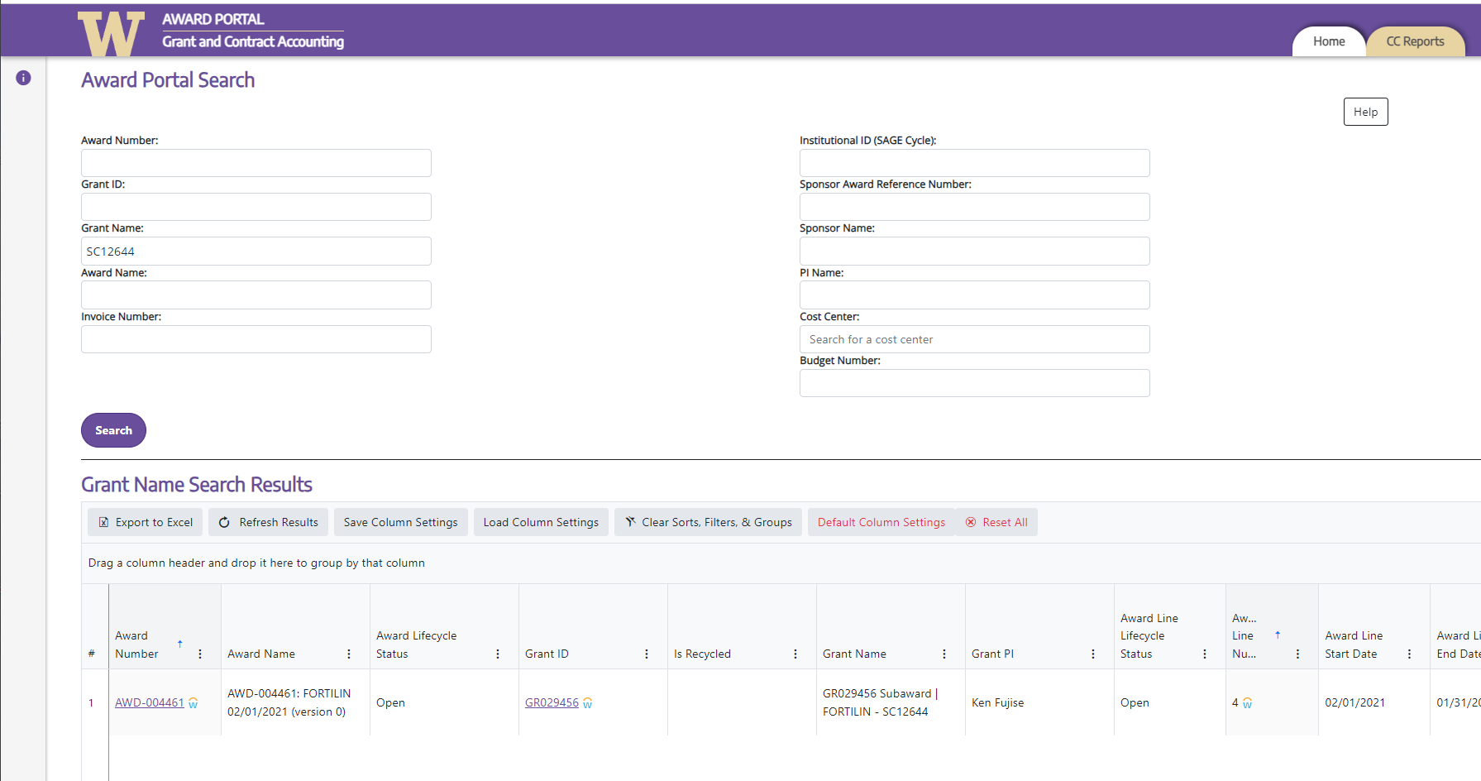
Subaward Award Lines
Each Subward must have its own award line in Workday.
Search using SAGE Subaward (SC) Number in “Grant Name”
Grant Name includes “Subaward” and “SC#”

Slide 4
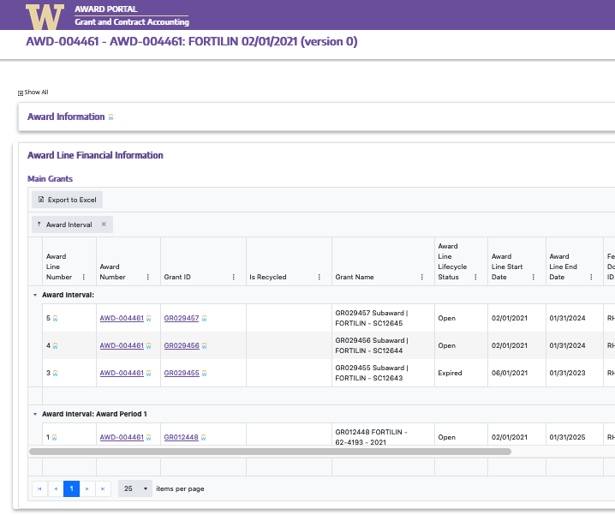
Subaward Award Lines
View Additional Award Lines for this Award

Slide 5
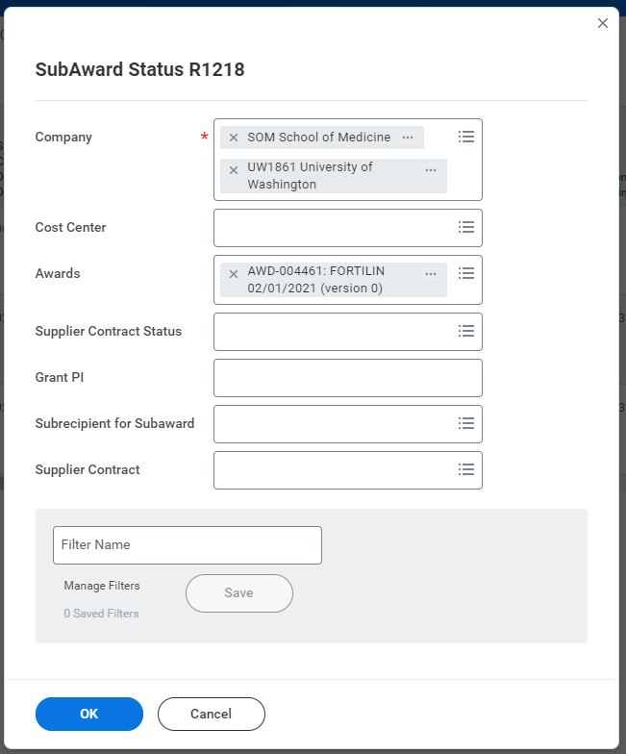
Walk through:
Finding Subaward POs in Workday
Enter Company
Enter Award Number
Click to search
Notes:
Amanda to walk through where POs are listed if they’ve been converted. NOTE: You can find this report on your Grant Manager Dashboard.

Slide 6
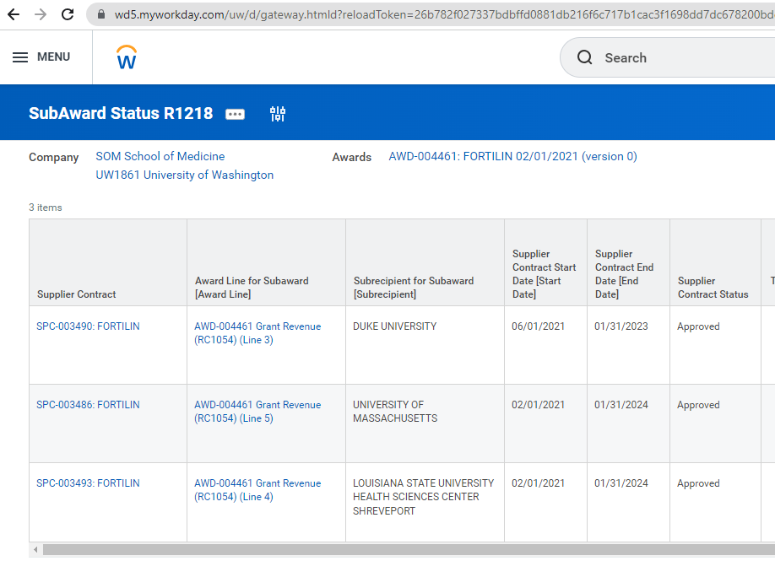
Walk through:
Finding Subaward POs in Workday
Scroll Right
Notes:
Amanda to walk through where POs are listed if they’ve been converted

Slide 7
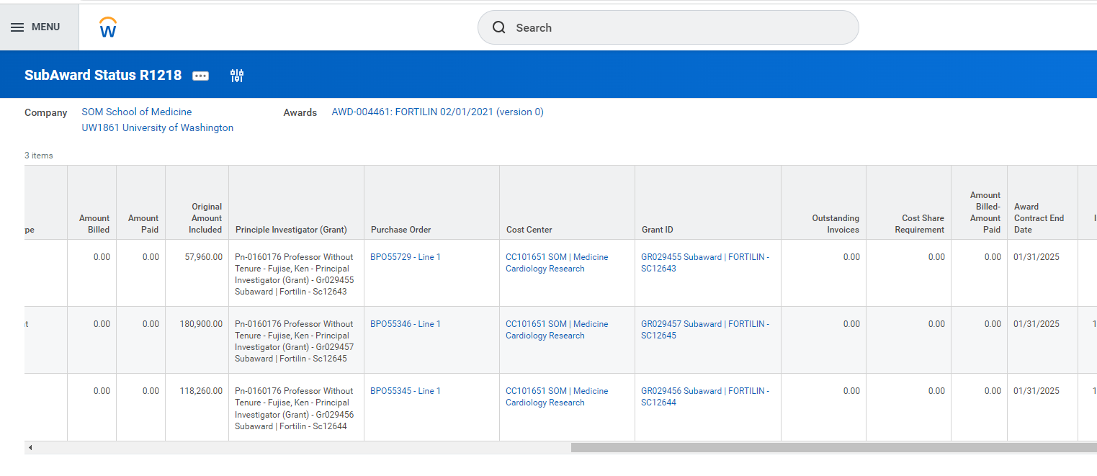
Walk through:
Finding Subaward POs in Workday
Notes:
Amanda to walk through where POs are listed if they’ve been converted

Slide 8
Questions
Other questions we are investigating:
What do you do if you have existing subawards but award lines are not setup in WD? Partial Answer: This will be handled via MOD request. Details to come.
What do I do if our subrecipient isn’t listed as a Supplier Contract listed in the Workday Subaward Status Report (R1218)?
What do I do if my subrecipient’s Supplier Contract in Workday does not have a PO listed?
What should I be reviewing on the Supplier Contract and Purchase Orders to ensure the information is accurate? And, what do I do if they need corrections?
What is the process for the “in flight” subawards and modifications?
How to view a supplier invoice that’s been attached to a (B)PO, and related payment information (e.g., Check/EFT info, payment date or date scheduled for payment, etc.).

