Slide 1
BONUS SESSION Monthly Research Administration Meeting - MRAM
August 18, 2023, 9:00 AM – 10:00 AM Click “CC” to Show Captions in your Zoom Controls
TOPIC | PRESENTER | EMAIL | MIN
Welcome | Amanda Snyder Office of Sponsored Programs | acs229@uw.edu | 2
Standalone Grant vs. Sponsored Grant | Jesse Rice UW Finance Transformation | jrice19@uw.edu | 10
Seeing Worktags & Accounting on Your Transactions | Jesse Rice UW Finance Transformation | jrice19@uw.edu | 10
Grant Budget vs. Actual | Jesse Rice UW Finance Transformation | jrice19@uw.edu | 10
SAGE Updates and Q&A | ORIS/OSP/GCA | sagehelp@uw.edu | 30
NEXT MRAM September 14, 2023, 9:00 AM - 10:30 AM

Slide 2
Workday
MRAM
Stepanka Sirotek, Jesse Rice, Nicole Flagg
Integrated Service Center (ISC)

Slide 3
Agenda
Standalone Grant vs. Sponsored Grant
The accounting of your transactions
Costing Allocations Update
Budget vs. Actual Report

Slide 4
Standalone Grant vs. Sponsored Grant
What’s the difference?
The grant worktag in Workday is meant to represent sponsored grants. Due to the complicated nature of UW’s accounting system, there was a need to also use the grant worktag for another, separate purpose.
The grant worktag is also being used for Startup funds, Retention funds, and a few other edge cases by the Accounting team.

Slide 5
How can I tell them apart?
Ways to differentiate:
  Standalone grant name will often include terms such as “startup” or “retention”
  No award is connected to a standalone grant
  The most reliable way is to look at the Financial Hierarchy. You can navigate up the hierarchy until you see “Standalone Grant” or “Grants with Awards”
Examples:
  GR022403 is a sponsored grant
  GR000953 is a standalone grant

Slide 6
View accounting
SI-0000015256
GR019710

Slide 7
Costing Allocations Issue
Email sent on 8/16 to impacted departments
We are seeing folks override grant worktags on costing allocations. We have set up a validation to not allow this. For validations already created, you will have to go back and redo the costing allocation

Slide 8
Budget vs. Actual
All of the live to date data posted to Workday in lump sums with a June 2023 accounting date. To access transaction level details on your historical data you will need to go into the legacy financial systems.

Slide 9
Useful Excel Formulas (ty Stepanka Sirotek)
The following can be useful when you download a report from Workday to Excel that has all of the worktags in one column:
=IFERROR(MID(O2,SEARCH("Balancing Unit: ",O2,1),21),"")
=IFERROR(MID(O2,SEARCH("Fund: ",O2,1),11),"")
=IFERROR(MID(O2,SEARCH("Function: ",O2,1),15),"")
=IFERROR(MID(O2,SEARCH("Resource: ",O2,1),18),"")
=IFERROR(MID(O2,SEARCH("Grant: ",O2,1),15),"")
=IFERROR(MID(O2,SEARCH("Cost Center: ",O2,1),21),"")

Slide 10
SAGE UPDATES & Q&A
Kim Halstead, Office of Research Information Services
August 18, 2023 MRAM

Slide 11
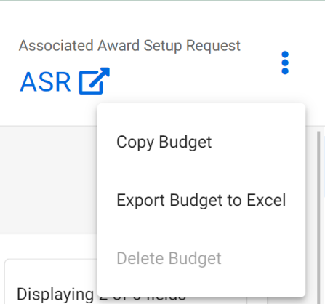
SAGE UPDATES | 8/17/23 RELEASE
SAGE Budget Delete Button: When a SAGE Budget is connected to an Award Setup Request, the ability to delete the budget is inactive.
Award Setup Request Visibility for Ad Hoc Approvers: Ad hoc Award Setup Request approvers who have access to the Award Setup Request but not the connected SAGE Budget can now view and approve the request.
Notes:
Ad hoc approvers will have access to the ASR and connected SAGE Budget. However, award preparers will still need to add the ad hoc approver as a general collaborator to the ASR in order for the ASR to show up on the ad hoc approver's request list

Slide 12
SAGE UPDATES | 8/17/23 RELEASE
SAGE Budget Rounding: SAGE Budget totals, when rounded to whole numbers, were at times showing $1 differences due to rounding errors. This resulted in the Award Setup Request and Workday submitted totals being off from the SAGE Budget summary page total by $1. Now, Award Setup Request and Workday sent totals are adjusted to appropriately sum up the worksheet rounded totals.
Modification Request Form Defaulted Information: By default, the "Modification Application" field will now be blank until the user searches and selects an eGC1.
Notes:
Previously, the MOD request form defaulted the awarded eGC1 short title in the "Modification Application” field.
OSP can delete modification requests when created in SAGE Central in OSP Setup status.

Slide 13
SAGE UPDATES | 8/17/23 RELEASE
eGC1 Contacts & Access Navigation: SAGE users listed as an Award Preparer and Access User with read/write permissions can now navigate away from the eGC1 “Contacts & Access” section.
Award Authorized Start & End Date Visibility: The "Award Authorized Start Date" and “Award Authorized End Date” both display on the Modification Review & Submit page and Request Summary page when the "Funding & Budgeting Changes" modification category is selected.
Notes:
Previously, the MOD request form defaulted the awarded eGC1 short title in the "Modification Application” field.
Previously, the system was showing two copies of the End Date and not the start date.
OSP can delete modification requests when created in SAGE Central in OSP Setup status.

Slide 14
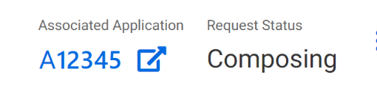
SAGE UPDATES | NEW FEATURES
Change the eGC1 Linked to an Award Setup Request: Users can now change which eGC1 is connected to an active Award Setup Request.
  Coming soon!: Change the SAGE Budget linked to an Award Setup Request.
Delete an Award Modification Request: Users can now delete a Modification Request in “Composing” status.
  SAGE users cannot delete Modification Requests created by OSP in SAGE Central and sent to Campus to complete (even though status is “Composing”).
Notes:
Some of the content of the ASR will be updated upon connection to a new eGC1, where defaulted. SAGE users will need to refresh the "Access & Roles" section after changing the eGC1 to see updated data from the changed eGC1.
OSP can delete modification requests when created in SAGE Central in OSP Setup status.
They can check comments & history to see who created the request.

Slide 15
PRIORITIZED ISSUES
Personnel Lookup Search in Tasklists is not working yet; however, PI Name Search is working.
  Workaround: Please contact sagehelp@uw.edu if you need any urgent data pulls for personnel until this is resolved.
Copy eGC1 – Personnel Issues: Due to the change from Financial Organization Codes (Org Codes) to Cost Centers, the copied over eGC1 personnel will not include the Cost Center data needed to support approval routing.
  Workaround: Users should remove and re-add the personnel to apply the Cost Centers needed for approvals.

Slide 16
PRIORITIZED ISSUES
Subaward Requests Reference Funding Actions (FAs): The subaward request has not yet been updated to select the award instead of the FA.
  Workaround: Temporarily, continue to select an available FA. Users will be blocked when initiating a subaward against a brand new Award Setup Request initiated in SAGE; therefore, a fix is planned soon for this issue.

Slide 17
RESOURCES
Contact SAGE Support at sagehelp@uw.edu or (206) 685-8335.
Bookmark the SAGE Prioritized Issues & New Features page.
Save the date for the next SAGE Office Hours on Thursday, August 24, from 1 - 2 p.m.
Register for the SAGE Budget class on Thursday, August 31, from 1 - 3 p.m.
Review SAGE job aids on UWFT for the Research Community.

Slide 18
Q&A

