Slide 1
MRAM | Monthly Research Administration Meeting
August 10, 2023, 9:00 AM – 10:30 AM Join Webinar: https://washington.zoom.us/j/346891888 Click “CC” to Show Captions in your Zoom Controls
TOPIC | PRESENTER | EMAIL | MIN
Welcome | Matt Gardner Post Award Fiscal Compliance | gcafco@uw.edu | 2
NSF Responsible and Ethical Conduct of Research Training Requirement | Julie Severson Office of Research | severson@uw.edu | 5
PAFC: Reduction in PI Effort | Matt Gardner Post Award Fiscal Compliance | gcafco@uw.edu | 10
How eGC1s are related to Awards and their Modifications | Tim Mhyre Office of Sponsored Programs | osp@uw.edu | 10
GCA Update | Juan Lepez Grant & Contract Accounting | kabah12@uw.edu | 10
Award Setup Requests and GCA Only Modifications | Vince Gonzalez Grant & Contract Accounting | vinceg@uw.edu | 10
Subaward Update | Amanda Snyder & Josy Combs Office of Sponsored Programs | acs229@uw.edu combsj@uw.edu | 10
SAGE Issue Reporting and Help Resources | Kim Halstead Office of Research Information Services | sagehelp@uw.edu | 5-10
Workday Salary Cap | Jesse Rice, Nicole Flagg, Stepanka Sirotek UW Finance Transformation | jrice19@uw.edu nicole@uw.edu sr8@uw.edu | 20-30
NEXT MEETING September 14, 2023 9:00 AM - 10:00 AM Questions about MRAM? email mramques@uw.edu

Slide 2
New National Science Foundation (NSF) Policy & Requirement for RCR
MRAM
August 10, 2023
Julie R. Severson, PhD, JD
Director, Office of Research Misconduct Proceedings

Slide 3
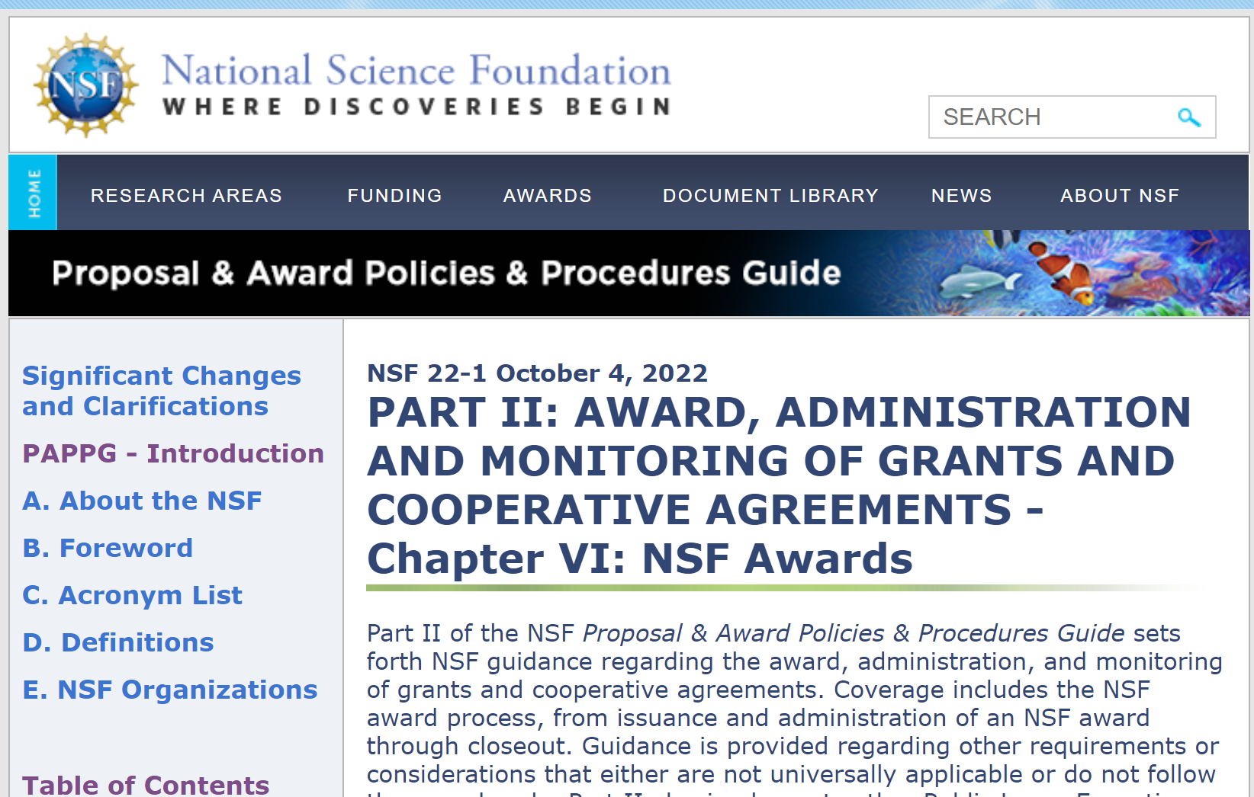
NSF’s old policy & RCR requirement
Undergraduate students, graduate students and postdoctoral researchers who are supported by NSF to conduct research are required to take responsible and ethical conduct of research (i.e., RCR) training.
Source: NSF’s Proposal and Award Policies and Procedures Guide (PAPPG 2022)

Slide 4
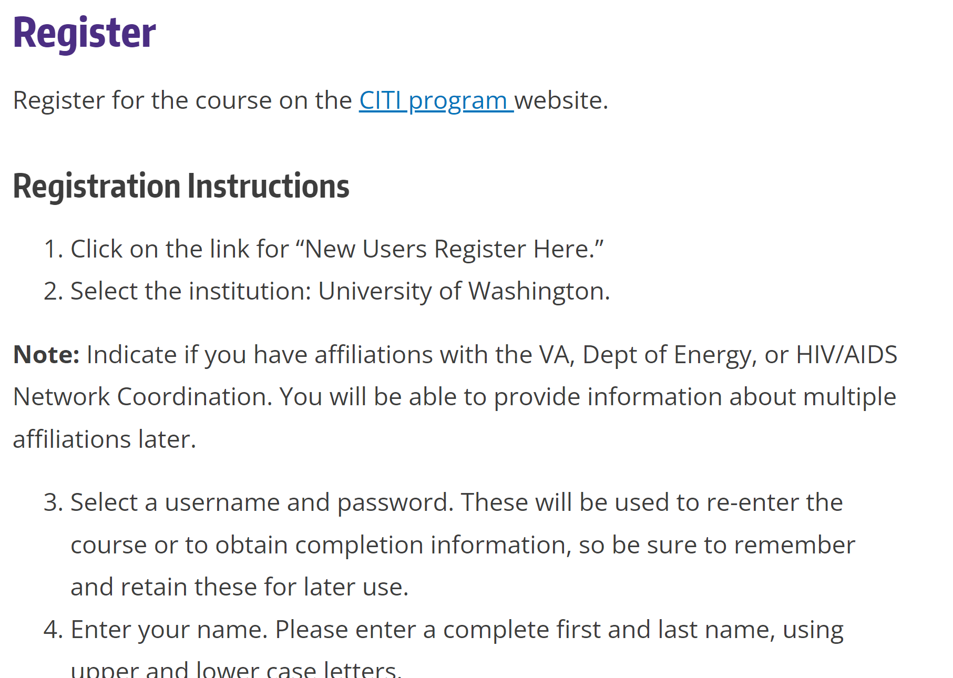
NSF’s old policy & RCR requirement
Compliance at UW
Collaborative Institutional Training Initiative (CITI Program) RCR Basic Course
Link & directions provided on Office of Research webpage:
https://www.washington.edu/research/compliance/responsible-conduct-of-research-rcrtraining/

Slide 5
NSF’s new policy & RCR requirement
For new proposals submitted or due on/after July 31, 2023…
Undergraduate students, graduate students, postdoctoral researchers, faculty and other senior personnel who will be supported by NSF to conduct research are required to take responsible and ethical conduct of research (RCR) training, and
That training must include mentor training and mentorship.
Source: CHIPS and Science Act (2022) amendments to America Competes Act (2022); as announced in the NSF’s Proposal and Award Policies and Procedures Guide (PAPPG 2023)

Slide 6
What changes at UW?
How: no change
UW will continue to meet our obligations via the CITI Program via the same OR link and registration process.
Upload training completion certificate via MyResearch.
Who: + faculty & other senior personnel
If a researcher (undergraduate student, graduate student, postdoc, faculty or other senior personnel) will be supported by NSF to conduct research (when the proposal was submitted or due on/after July 31, 2023) they will need to register for, and take, the CITI Basic RCR Course.
This course includes the module: Mentoring and Healthy Research Environments

Slide 7
COMPLIANCE HOT TOPIC:
PI & KEY PERSONNEL EFFORT REDUCTION
MRAM
August 2023
Matt Gardner
Post Award Fiscal Compliance

Slide 8
PI / Key Personnel Effort on Federal Awards
2 CFR 200.308(c)(3)
“… Recipients must request prior approvals from Federal awarding agencies for … a 25% reduction in time devoted to the project by the approved project director or principal investigator.”
Regulation applies to individuals named as the PI or Key Personnel on the Notice of Award
MRAM – Matt Gardner – PAFC

Slide 9
PI / Key Personnel Effort on Federal Awards
All Federal sponsors require prior approval for an effort reduction of 25% or more unless waived, in writing, via the:
Notice of Award, or
Applicable agency terms & conditions
Prior approval requirement flows down to ALL subrecipients of Federal awards
Flow-down requirements may be more restrictive but cannot be less restrictive
MRAM – Matt Gardner – PAFC

Slide 10
PI / Key Personnel Effort on Federal Awards
Approval must come from the applicable sponsor official
Typically, the Grants Management Specialist or Grants Officer, not the Program Officer
Review the NoA for guidance on the appropriate official
If the UW is a subrecipient, approval must come from the flow-thru sponsor, not the prime
MRAM – Matt Gardner – PAFC

Slide 11
PI / Key Personnel Reduction in Effort - Audit
Auditors will review the following to determine compliance with effort commitment requirements:
Proposal budget and justification
Certified effort reports
Applicable progress and technical reports
Supplemental documentation
UW is audited from many different entities: Federal government, individual sponsors, state of Washington, etc.
Failure to correctly document effort can result in disallowance of costs, fines, or other actions
MRAM – Matt Gardner – PAFC

Slide 12
PI / Key Personnel Reduction in Effort: Examples
PI commits to 10% effort
Award period: Jan. 1, 2022 – Dec. 31, 2022
Example A:
Effort Statement #1 (1/1/22 – 6/30/22): 10%
Effort Statement #2 (7/1/22 – 12/31/22): 10%
Example B:
Effort Statement #1 (1/1/22 – 6/30/22): 7%
Effort Statement #2 (7/1/22 – 12/31/22): 7%
Example A is in compliance
Example B is not in compliance unless prior written approval is obtained from the sponsor
MRAM – Matt Gardner – PAFC

Slide 13
PI / Key Personnel Reduction in Effort: Examples
PI commits to 2% effort
Award period: Jan. 1, 2022 – Dec. 31, 2022
Example A:
Effort Statement #1 (1/1/22 – 6/30/22): 2%
Effort Statement #2 (7/1/22 – 12/31/22): 2%
Example B:
Effort Statement #1 (1/1/22 – 6/30/22): 1%
Effort Statement #2 (7/1/22 – 12/31/22): 1%
Example A is in compliance
Example B is not in compliance unless prior written approval is obtained from the sponsor
Reduction in effort from 2% to 1% is greater than a 25% reduction
MRAM – Matt Gardner – PAFC

Slide 14
PI / Key Personnel Reduction in Effort: Examples
PI commits to 10% effort
Award period: Jan. 1, 2022 – Dec. 31, 2022
Example:
Effort Statement #1 (1/1/22 – 6/30/22): 5%
Effort Statement #2 (7/1/22 – 12/31/22): 15%
Example is in compliance
The overall effort for all certified periods covering the Award must meet the commitment
MRAM – Matt Gardner – PAFC

Slide 15
PI / Key Personnel Reduction in Effort: Examples – Multiple Budget Years
Award period: Jan. 1, 2022 – Dec. 31, 2024
PI commits:
5% in Year 1
10% in Year 2
15% in Year 3
Auditors will expect to see certified effort at the committed effort level for each budget year or written approval of a different effort level, if the deviation is at least 25%
MRAM – Matt Gardner – PAFC

Slide 16
PI / Key Personnel Reduction in Effort: Examples – Shift in Funding Source
Scenario: PI commits 10% effort in the proposal but during the award decides to only charge 5% to the award (but still devote 10%) in order to save costs.
The effort statement will show 5% effort charged to the award – how do we show 10% effort overall?
Utilize the “Shift” function to identify effort from non-sponsored funding as devoted to the sponsored award.
MRAM – Matt Gardner – PAFC

Slide 17
Effort Statements in ECC
Similar to eFECS, users will be able to “shift” effort in ECC in order to certify all the effort related to the Award, even if paid from non-sponsored sources.
ECC training courses and materials will provide instructions on how to use the “shift” feature for effort reporting.
MRAM – Matt Gardner – PAFC

Slide 18
Reduction in Effort - Resources
Federal Regulations
2 CFR 200.308(c)(3)
GIM 35 – Effort Reporting
https://www.washington.edu/research/policies/gim-35/
MRAM – Matt Gardner – PAFC

Slide 19
Questions
Post Award Fiscal Compliance (PAFC)
gcafco@uw.edu (Non-effort compliance questions)
effortreporting@uw.edu (Effort questions)
https://finance.uw.edu/pafc/
https://finance.uw.edu/maa/effort-reporting
Matt Gardner
mgard4@uw.edu
206-543-2610
David Parks
parksd2@uw.edu
MRAM – Matt Gardner – PAFC

Slide 20
How eGC1s are related to Awards and their Modifications
August 10, 2023 MRAM
Tim Mhyre, Office of Sponsored Programs

Slide 21
Understanding eGC1s' relation to converted Awards & their Modifications
Awards migrated into SAGE Central/Workday are based on the earliest awarded eGC1.
Modifications are created off of those Awards, not the eGC1s.
For example when an Award Setup Request is created on an earlier eGC1 and a supplement is awarded on a later eGC1.
Modifications are then setup under the Award that is related to that originally awarded earlier eGC1.
Make sure to update personnel on those original eGC1s for an award so the right personnel are listed.
Notes:
confusion around why the earliest eGC1 being attached to an Award & relating it to the MOD
confusion about outdated personnel on an older eGC1

Slide 22
Example converted eGC1s related to Award & Modifications in SAGE
eGC1s approved prior to go-Live
A123456
New
not awarded
A124567
Resubmission
received 9/01/2022
Year 1 NOA
Earliest Awarded eGC1, automatically converted from an FA
AWD-001234
MOD-001347
Year 2 NOA Supplement
A125678
RPPR
RPPR submitted before cutover
Modifications not created under an eGC1
Update PI/Personnel on A124567 eGC1 connected to the Award & related to those Modifications.
Notes:
A124567 is the earliest Awarded Application (eGC1)
AWD-001234 Created during conversion to Workday relates to this eGC1, MODS created from this award
eGC1s related to a Sponsored Award
RPPRs used to be submitted as eGC1s
MODs are not created from an EGC1

Slide 23
Example - Use of eGC1s going forward
eGC1s - Used for Proposals (New/Competing & Supplemental)
A123456
New
Not Awarded
MOD-001635 Year 2 Supplement
MOD-001598
Year 2 NOA
A124567
Resubmission
Awarded
Year 1 NOA
Earliest Awarded eGC1
AWD-001234
Year 1 NOA
MOD-001564
Rebudget
A126789
Supplemental Proposal
MOD-001347
RPPR
Notes:
eGC1s related to a Sponsored Award
RPPRs routed on MODs
Rebudget request routed on MOD
Year 2 processed on MOD
Year 2 Supplement Proposal routed on eGC1
Year 2 Supplemental Funding processed on MOD
MODs are not created from an EGC1

Slide 24
Tips & Reminders for ASRs & MODs
Attach agreements & correspondence with sponsor
Copy or create a new SAGE budget & attach to Award Setup Requests & Modifications
Add Comments - indicate what you are requesting & for MODs include any Grant ID#s impacted
Review:
Setup Financials - guidance on Award Setup Requests
Award Changes - guidance on Modifications

Slide 25
Questions

Slide 26
GCA UPDATE
Juan Lepez
Director, Grant & Contract Accounting
August 10, 2023 MRAM

Slide 27
GCA WORKING IN WORKDAY
GCA teams have a staggered introduction to Workday
Backlogs in Award Setup Requests and Modifications
Delay in creating WD sponsor invoices
We appreciate your patience while we work through this!

Slide 28
AWARD TASKS
GCA can enter, update and complete award tasks for GCA tasks and campus tasks
Decision was made to postpone entering award tasks for campus tasks until after Hypercare ends in September 2023
Reviewed with GA2C PTT in June 2023
Allows GCA to focus on core processes like sponsor invoicing
Will revisit this in October 2023

Slide 29
COMMUNICATING WITH GCA
How to contact GCA:
Award Portal (preferred)
Email to gcahelp@uw.edu
Phone call to (206) 616-9995
UW Connect Finance (new with Workday Finance)

Slide 30
AWARD PORTAL/GCA HELP/UW CONNECT
Award Portal (preferred)
Internal UW customers
Workday award must be present
GCA Help
Sponsor or Internal UW customers
Best for when the award is not in Workday Finance
UW Connect
Internal UW customers
For general or technical/access issues
For lists of changes to converted grant budgets

Slide 31
SHARED ENVIRONMENT ROLE IN CLOSEOUT
Update from July Bonus MRAM Q&A
Confusion with SE role in sponsored program closeout
SE role is to support compliance with GIM 39
Details are available in SE Operations Manual

Slide 32
NEW RESOURCES
New webpages
Advance awards
New awards
Modifications
Award line setup
How to review a new award
New job aid
Manage Campus Contacts in Award Portal
New!

Slide 33
QUESTIONS
Please send questions to kabah12@uw.edu

Slide 34
AWARD SETUP REQUESTS AND GCA ONLY MODIFICATIONS
Vince Gonzalez
Associate Director, Grant & Contract Accounting
August 10, 2023 MRAM

Slide 35
INTRODUCTION
GCA has been processing Award Setup Requests (ASRs) and Modifications (MODs) over the last month
We have compiled trends and recommendations to share with campus partners to improve overall process for both ASRs and MODs

Slide 36
TRENDS AND ISSUES FOR ASRs
SAGE Budget worksheets don’t match award
Problem: GCA cannot enter Workday award plan
Solution: Make sure difference between award and worksheet total is zero
Principal Investigator is not entered on SAGE Budget worksheet
Problem: Wrong PI or no PI will appear in Workday grant
Solution: Check PI on each worksheet especially if award has multiple PIs
Cost Center or Security Hierarchy is blank
Problems: GCA does not know how to determine and populate these mandatory fields into Workday
Solution: Make sure that both fields are populated on each worksheet

Slide 37
TIPS AND REMINDERS FOR ASRs
Enter Fiscally Responsible Cost Center and Workday Security Grant Hierarchy for each worksheet
Make sure a PI is identified with appropriate role in each worksheet
Pay attention to alerts like:
Update SAGE Budget before routing to OSP

Slide 38
LIST OF GCA ONLY MODIFICATIONS
GCA Only Modifications are actions that must not require sponsor approval.
Modifications not otherwise requiring sponsor approval:
Cost Share Change
Rebudgeting
Restriction Release
Start Date Change
UW Internal Changes:
New award line
Add funding to existing award line
Cost Center Change
Award Line Type Change
Location Change
Note: If any of these changes do require sponsor approval, route Modification request to “OSP/GCA”.
Notes:
Speaker note: The first 4 bullet points are actions that can sometimes require sponsor approval. Route to “GCA Only” if they do not require sponsor approval. Route to “OSP/GCA” if they do require approval.
Speaker note: UW Internal Changes do not require sponsor approval and do not require OSP involvement.

Slide 39
TRENDS AND ISSUES FOR MODIFICATIONS
Missing detail about requested change
Problem: GCA does not know what change is needed
Solution: Include brief statement about the change
Missing grant worktag ID
Problem: GCA does not know which award line to update
Solution: Include Grant Worktag ID
SAGE Budget worksheet is not updated
Problems: Systems are out of sync and GCA does not have enough information to process request
Solution: Make sure that requested change is reflected in appropriate SAGE Budget worksheet before routing to GCA
Notes:
Speaker note: Mention that GCA relies heavily on the Comments & History section of MODs to know more about the requested change.

Slide 40
TIPS AND REMINDERS FOR MODS
Update SAGE Budget worksheet
Add statement to Comments & History about what change is needed
Add grant worktag ID (GR12345) to Comments & History
Example: requesting a new award
General Information category: Funding & Budgeting changes
Create new SAGE Budget worksheet
Add “Please set up a new award line for AWD-012345 using SAGE Budget number B678901” to Comments & History

Slide 41
NEXT STEPS
Working with OSP and ORIS on campus resources to help

Slide 42
RESOURCES
GCA Award Setup
GCA Modifications
OSP Setup Financials
OSP Award Changes
SAGE Awards User Guides
Award Modifications in SAGE Job Aid

Slide 43
QUESTIONS
Please send questions to vinceg@uw.edu

Slide 44
Subaward Update
August 10, 2023 MRAM
Amanda Snyder & Josy Combs
Office of Sponsored Programs

Slide 45
What needs to be in place to pay a subrecipient:
Prime Award available in Workday
Sponsor approval in place for each subaward
Subaward end dates need to fall within prime award dates
Subrecipient as supplier in Workday
Subrecipient as subrecipient in SAGE & Workday
Award line for each subaward
Supplier Contract
Purchase Order
Fully executed subaward

Slide 46
Setting the Stage for a Subaward
There must be an Award Line in Workday
Prime Award must be available in Workday
Each Subaward must have an award line (Grant ID)
Don’t have an award line in WD for each subaward?
Submit a SAGE Award Modifications Request, for a Subaward Addition, include a SAGE Budget for each Subaward being requested
Notes:
Ideally, award lines for each subrecipient should be available in WD before a subaward is requested in SAGE

Slide 47
1 of 2
Prime Award from sponsor available in Workday?
Sponsor approval in place for each subaward
Subaward dates need to fall within prime award dates
Award Line (GR#) for Subaward in Workday?
No? Submit Award Modification Request (GCA) provide a budget worksheet for each subaward.
Is the Subrecipient a Supplier in Workday?
No? Have subrecipient follow Procurement steps for UW Supplier registration
Are they also a Subrecipient in Workday?
No? Send Award Portal ticket asking for the subrecipient to be added.
OSP Issues Subaward to Subrecipient
OSP admin issues subaward to subrecipient, CC’s dept
OSP Administrator Assigned
OSP Manager/designee does preliminary review then OSP Admin drafts subaward
Submit Subaward Request in SAGE
Begin Subaward Request in SAGE
Subrecipients not in SAGE require additional steps review guidance
SAGE Status = “Issued”
SAGE Status = “OSP Assigned”
SAGE Status = “IN OSP”
SAGE Status = “Composing”
Review & Negotiation
Subrecipient reviews & returns Partially Executed Agreement
OSP admin negotiates terms, if necessary
OSP requests Supplier Contract & Purchase Order
OSP submits request to Procurement for Supplier Contract & PO
Procurement Creates Supplier Contract & Purchase Order in Workday
Procurement routes PO to Campus Grant Manager in Workday
Campus Reviews & Approves PO
1. Grant Manager reviews & approves PO
2. Grant Manager provides PO # to OSP
Campus
Central Offices: OSP, Procurement, GCA
Notes:
https://www.washington.edu/research/myresearch-lifecycle/setup/subawards/

Slide 48
2 of 2
OSP Signs & Activates Subaward
OSP adds PO # to agreement, signs, and returns to Subrecipient, CC’s department
GCA Activates Award Line in Workday
GCA receives notice of the PO & activates Award Line in Workday
Invoice Submission
Subrecipients should email invoices to uwashington@ghxinvoicing.com with PO# on their invoice
Invoice Approval
Grant Manager reviews & approves or requests updates from subrecipient
PI reviews & Approves Invoice for payment
SAGE Status = “Active”
WORKDAY Status changes from ”Pending Subaward" to "Open"
Review:
Setting up a subaward
UW Procurement - For Suppliers
Campus
Central Offices: OSP, Procurement, GCA
Subrecipient

Slide 49
Q&A Updates
What do you do if you have existing subawards but award lines are not setup in WD?
Submit an Award Modification (MOD) to GCA only
Include SAGE Budget worksheet & comments
What should I review on the Supplier Contract & Purchase Orders to ensure accuracy?
Review the dates and the dollar amounts
For converted subawards, amount on award line and amount on PO should equal available funding, not full subaward amount
What do I do if an award line for a subaward needs corrections?
Submit an Award Modification (MOD) to GCA only
Include SAGE Budget worksheet & comments
Review more Q&A from 7/21 MRAM

Slide 50
Open Questions
We are still investigating responses to these questions:
What do I do if my subrecipient’s Supplier Contract in Workday does not have a PO listed?
What do I do if there is no Supplier Contract for an existing subaward in Workday?
I have a subaward with two BPOs. These did not get converted correctly. How do I correct?
Review more Q&A from 7/21 MRAM

Slide 51
Questions?

Slide 52
SAGE ISSUE REPORTING & HELP RESOURCES
Kim Halstead
Office of Research Information Services

Slide 53
SAGE | PRIORITIZED ISSUES
Prioritized Issues (8/10/23 Release)
When searching eGC1s in advanced search, duplicate eGC1 search results will be removed.
An issue with Advance Budget Extension requests’ allowed end dates not calculating correctly will be fixed.
When searching for budgets to connect to an Award Setup Request, SAGE will display only budgets that are not already connected to an eGC1or Award Setup Request.
Update Coming Soon
Change the eGC1 and budget connected to an Award Setup Request in composing, returned, or withdrawn status.

Slide 54
SAGE | COMMUNICATIONS
Communications from ORIS
When updates are made, we’ll send out a weekly overview of recently released SAGE fixes and resources.
For a reference list of SAGE updates and fixes since UWFT go-live, visit SAGE Prioritized Issues & New Features.
Notes:
This communication cadence of roughly weekly email notifications will continue at least through the next month of hypercare.

Slide 55
SAGE | WHAT TO REPORT
System Issues: You are experiencing unusual loading times, repeated error messages, an inability to log in, content that fails to load, or similar issues.
Permissions Issues: You are unable to view items (eGC1s, Award Setup Requests, Advances, Modifications) you expect to have access to.
Approvals Issues: You are unable to review an item assigned for your approval or an approval graph is not generating as expected.
Miscellaneous Issues: You have a question, concern,
or suggestion related to SAGE not covered by the above.

Slide 56
SAGE | HOW TO REPORT
Email sagehelp@uw.edu with a description of the issue.
Include screenshots if applicable.
Call (206) 685-8335, leave a voicemail, and request a call back.
Attend SAGE Office Hours from 11 a.m. - noon today!
Notes:
Users do not need to go through Shared Environments for SAGE questions - contact SAGE support directly, as you always have.
SAGE, OSP, and GCA representatives will be at SAGE Office Hours

Slide 57
SAGE | NEW RESOURCES
Job Aids: Creating an Award Modification Request
How to Find an Award ID Number in Award Portal (AWD-123456)
Use Award Portal to find this required information for requesting Modifications.
What Workday Grant Worktag ID Information Do I Need for a SAGE Modification Request?
View a roadmap of what information is needed to process a Modification.
How to Find a Workday Grant Worktag ID in Award Portal (GR123456)
Grant Worktag IDs are required when requesting most Modifications.
How to Make a Comment on a SAGE Modification Request
Comment to provide additional information to OSP
and GCA on requested Modifications.
Notes:
Campus users will need to consistently add a comment to the GCA-only mods until the request categories become more specific with later SAGE releases.

Slide 58
SAGE | NEW RESOURCES
Job Aids: Budget Modifications
How to Make a SAGE Budget Snapshot & How to Include Your SAGE Budget Snapshot on a SAGE Modification Request: Reference these job aids to provide appropriate budget information on Modifications that require a SAGE Budget.
User Guides
Award Modification User Guides
Notes:
How to Include Your SAGE Budget Snapshot on a SAGE Mod Request is a temporary process until we’re able to update SAGE to collect all the appropriate information in the system fields.

Slide 59
WHEN TO CONTACT OSP & GCA
OSP: For questions on award terms and conditions, no-cost extensions, award changes, subawards, and other sponsor-related questions, reach out to the Office of Sponsored Programs (OSP) at osp@uw.edu.
GCA: For questions on award information in Workday, Award Portal, or financial terms and conditions, contact Grant & Contract Accounting (GCA) via Award Portal or at gcahelp@uw.edu.

Slide 60
QUESTIONS?
Notes:
Speaker: Juan

Slide 61
Workday Salary Cap
MRAM
Stepanka Sirotek, Jesse Rice, Nicole Flagg
Integrated Service Center (ISC)

Slide 62
What are the issues?
Cannot use a Standalone Grant to pay for Salary Over the Cap
Cannot pay for Salary Over the Cap with a different company than the regular salary
Workday working on enhancing Salary over the Cap features but there are no guarantees and earliest release would be second half of 2024

Slide 63
Standalone Grant Solution
The recommended resolution for this issue is for departments to use another worktag and process a funding transfer to reflect the cost on the Standalone grant desired.
It is important not to use PAAs to try to solution for this
Specific solutions will be department specific. Communication has been sent to URLs/Department leaders to pass on guidance within their School/College

Slide 64
Intercompany Solution
We have worked with School/College leaders to stand up a series of Program Worktags to account for these cases
The leaders/Shared Environments of the Schools/Colleges will transfer the funds between each other on a regular cadence

Slide 65
Intercompany Salary Cap Worktags
Program | Name
PG121320 | SPH | Salary Over the Cap SOM
PG121321 | CAS | Salary Over the Cap SOM
PG121322 | Engineering | Salary Over the Cap SOM
PG121323 | Dentistry | Salary Over the Cap SOM
PG121324 | Nursing | Salary Over the Cap SOM (still being worked on)
PG121325 | SOP | Salary Over the Cap SOM
PG121326 | Social Work | Salary Over the Cap SOM
PG121327 | SOM | Salary Over the Cap UW1861

Slide 66
Intercompany Example #1
Jane PI is in SOM
She works on a grant in UW1861. Her home department in SOM wants to pay her salary over the cap
You can use the newly created Program worktags for this scenario

Slide 67
Regular Salary Component SOM Employee working on UW1861 grant
Jane PI

Slide 68
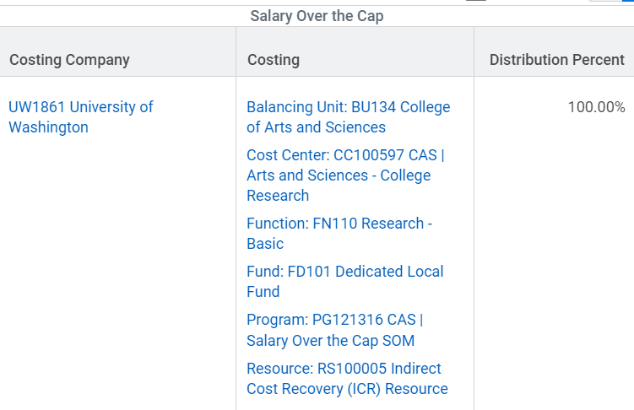
Over the Cap Salary Component SOM Employee working on UW1861 grant

Slide 69
Intercompany Example #2
Joe PI is in UW1861
He works on a grant in SOM. His home department in UW1861 wants to pay his salary over the cap
You can use the newly created Program worktags for this scenario

Slide 70
Regular Salary Component UW1861 Employee working on SOM grant
Joe PI

Slide 71
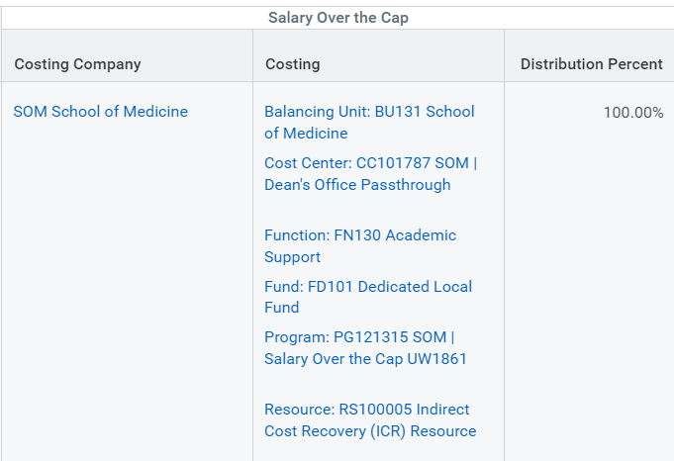
Over the Cap Salary Component UW1861 Employee working on SOM grant

