Slide 1
New National Science Foundation (NSF) Policy & Requirement for RCR
MRAM
August 10, 2023
Julie R. Severson, PhD, JD
Director, Office of Research Misconduct Proceedings

Slide 2
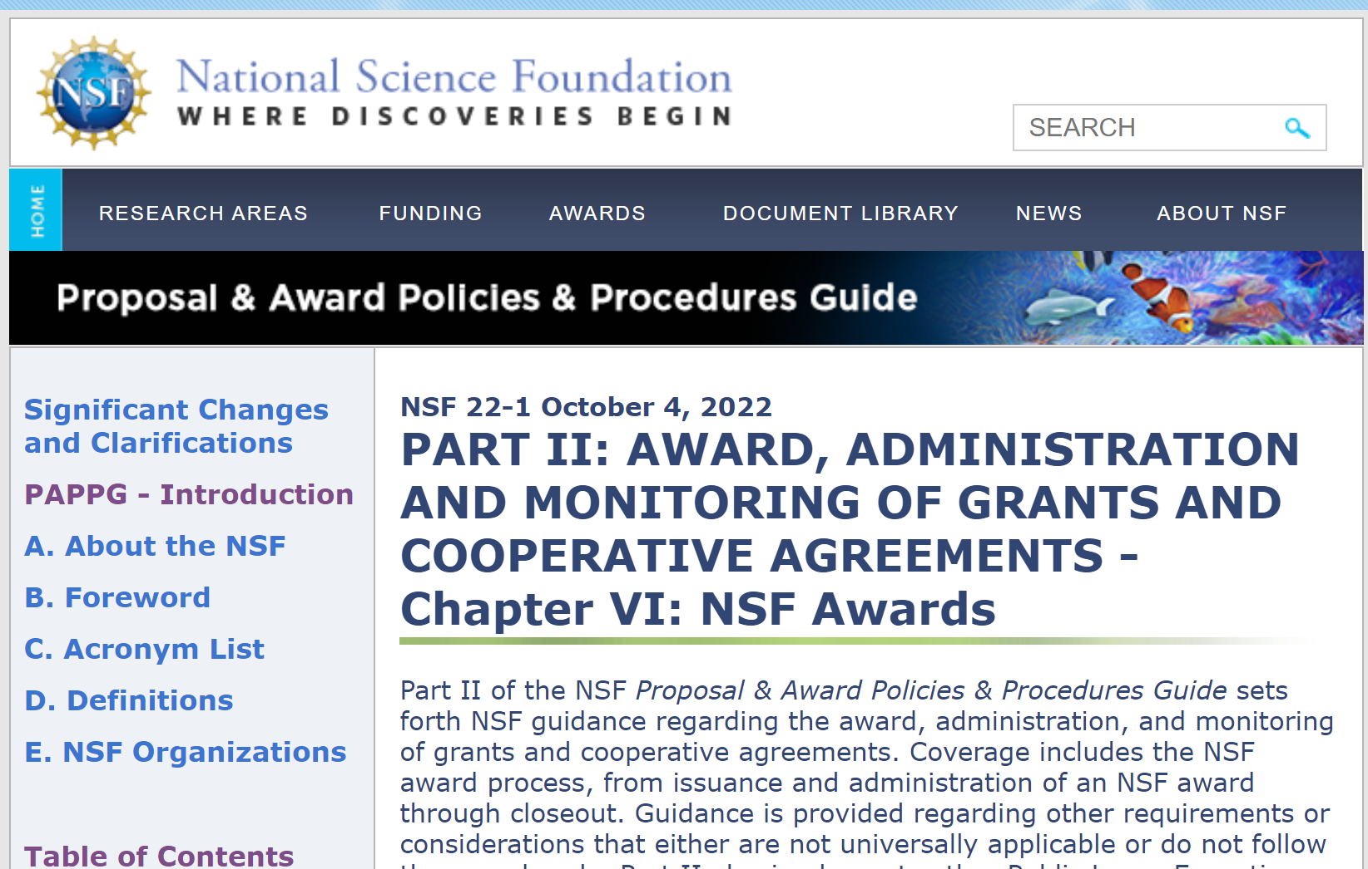
NSF’s old policy & RCR requirement
Undergraduate students, graduate students and postdoctoral researchers who are supported by NSF to conduct research are required to take responsible and ethical conduct of research (i.e., RCR) training.
Source: NSF’s Proposal and Award Policies and Procedures Guide (PAPPG 2022)

Slide 3
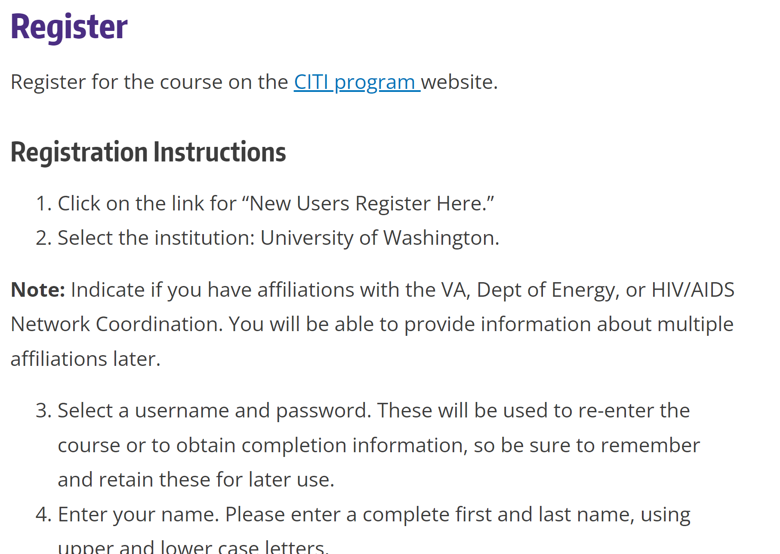
NSF’s old policy & RCR requirement
Compliance at UW
Collaborative Institutional Training Initiative (CITI Program) RCR Basic Course
Link & directions provided on Office of Research webpage:
https://www.washington.edu/research/compliance/responsible-conduct-of-research-rcrtraining/

Slide 4
NSF’s new policy & RCR requirement
For new proposals submitted or due on/after July 31, 2023…
Undergraduate students, graduate students, postdoctoral researchers, faculty and other senior personnel who will be supported by NSF to conduct research are required to take responsible and ethical conduct of research (RCR) training, and
That training must include mentor training and mentorship.
Source: CHIPS and Science Act (2022) amendments to America Competes Act (2022); as announced in the NSF’s Proposal and Award Policies and Procedures Guide (PAPPG 2023)

Slide 5
What changes at UW?
How: no change
UW will continue to meet our obligations via the CITI Program via the same OR link and registration process.
Upload training completion certificate via MyResearch.
Who: + faculty & other senior personnel
If a researcher (undergraduate student, graduate student, postdoc, faculty or other senior personnel) will be supported by NSF to conduct research (when the proposal was submitted or due on/after July 31, 2023) they will need to register for, and take, the CITI Basic RCR Course.
This course includes the module: Mentoring and Healthy Research Environments

