Slide 1
MRAM | Monthly Research Administration Meeting
September 14, 2023, 9:00 AM – 10:00 AM Join Webinar: https://washington.zoom.us/j/346891888 Click “CC” to Show Captions in your Zoom Controls
TOPIC | PRESENTER | EMAIL | MIN
Welcome | Kirsten DeFries Research Compliance & Operations | kirsten5@uw.edu | 2
Proposal Reminders | Mike Snow & Ari Santander Office of Sponsored Programs | osp@uw.edu | 10
Tips for Success - Award Setup & Modification Requests in SAGE | Ari Santander & Juan Lepez Office of Sponsored Programs & Grant & Contract Accounting | osp@uw.edu kabah12@uw.edu | 10
GCA - Award Setup Update | Juan Lepez Grant & Contract Accounting | kabah12@uw.edu | 10
GCA - Milestone Award Tasks | Juan Lepez Grant & Contract Accounting | kabah12@uw.edu | 5
PAFC: Effort Reduction | Matt Gardner Post Award Fiscal Compliance | gcafco@uw.edu | 15
ECC Update | Matt Gardner Post Award Fiscal Compliance | gcafco@uw.edu | 5
Federal Data Repository Requests & Certifications | Mike Snow Office of Sponsored Programs | osp@uw.edu | 5
CORE Update | Laurie Stephan Collaborative On Research Education (CORE) | corehelp@uw.edu | 2
NEXT Regular MRAM October 12, 2023 9:00 AM - 10:00 AM Questions about MRAM? email mramques@uw.edu

Slide 2
Proposal Preparation
Tips & Reminders
September 14, 2023 MRAM
Mike Snow & Ari Santander, Proposal & Awards Team Managers
Office of Sponsored Programs

Slide 3
Draft Proposal Review
7 Business days before sponsor deadline
Route an eGC1 to OSP for initial review 7 business days before sponsor deadline.
Business and administrative components should be complete
Scientific/programmatic portions can be draft versions
Include link to sponsor Request for Proposal (RFP) or attach it to the eGC1
OSP will review and provide reviewer comments, as applicable.

Slide 4
Ready to Submit per GIM 19
GIM 19 deadline - Before 5:00 pm, 3 business days before sponsor due date, proposal must be “Ready to Submit” (RTS).
Applications in sponsor electronic systems:
PI must have given OSP access to proposal in system
OSP must have submission access
Application is in “Ready for Submission” status
RTS eGC1 means a complete proposal in final format, ready for submission to the sponsor. This includes:
Documents attached in the order required by sponsor
Significant Financial Interest disclosures completed for all investigators
Ready to Submit question on eGC1 marked “Yes”
eGC1 is “In OSP” status

Slide 5
Formatting
Incorrect formatting can prevent proposal submission to Grants.gov and other sponsor systems. Thankfully, these errors are relatively easy to fix if you know what to look for.
More from Grants.gov: Submitting Special Characters
More from NIH:
Font & Margin Guidelines
Format Attachments
NOT-OD-18-126: Appendix Policy
NIH Policy on Hypertext in NIH Applications

Slide 6
Additional Tips for Success
Use project management tools & timeline to help ensure:
Investigators are available and have access in UW systems, such as the Financial Interest Disclosure System (FIDS)
Sponsor system accesses/permissions are obtained
Limited Submission approval is sought and documented, if applicable
Permission from NIH to exceed $500,000 direct cost limit, if applicable
Subrecipient materials are received timely to incorporate into UW’s overall proposal

Slide 7
Other Key Details
Understand who is reviewing what on the eGC1, as it routes. OSP uses GIM 1 criteria for review once it arrives in OSP.
Run sponsor system validations or error checking for draft proposal. This helps “clean up” formatting & other requirements that sponsor systems are designed to catch.
Do not route a brand new proposal to OSP on the GIM 19 deadline. Plan to get OSP review on the draft proposal well ahead of the GIM 19 deadline.

Slide 8
Grant Runner & FORMS-H
Release Timing: September 14, 5:30 - 7:00 p.m.
Today’s Update: The updated PHS 398 Research Plan form will be available for National Institutes of Health (NIH) applications sent via Grant Runner.
  This update will support the high-volume opportunities due early October, including R01, R03, and R21 types.
Future Update: The PHS 398 Career Development Award Supplemental form and PHS Fellowship Supplemental form are targeted for release in Grant Runner later this fall.

Slide 9
UW Resources
Fall Proposal Reminders
Submit Proposal
Is my eGC1 Ready?
What is Ready to Submit?
GIM 1: Review & Submission Requirements for Proposals
GIM 19: Internal Deadlines for Proposals to External Entities
Limited Submission Information

Slide 10
Questions

Slide 11
Tips for Success
Award Setup and Modification Requests in SAGE
September 14, 2023 MRAM
Ari Santander & Juan Lepez
Office of Sponsored Programs and Grant & Contract Accounting

Slide 12
Award Setup Requests
Attach:
  Award documentation and any sponsor correspondence that accompany award document
  Documentation when there is a sponsor deadline for accepting an award
  Compliance documentation (IRB/IACUC)
Include sponsor contact information
Use the comments to provide more information or to provide an explanation
Setup Financials - Research web guidance on Award Setup Requests
Grant & Contract Accounting Award Setup Request process
Notes:
Speaker: Ari
include explanations in comments that may help reviewers understand what you are trying to do

Slide 13
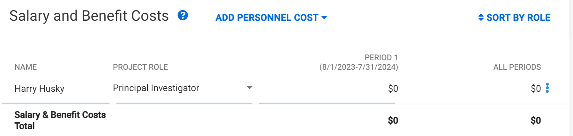
SAGE Budget Worksheets
Enter a named Principal Investigator for each SAGE Budget worksheet, even if they are not supported by the award.
  This populates the Workday Principal Investigator (Grant) field.
SAGE Budget Job Aid & Updated SAGE Budget eLearning
Notes:
Speaker: Juan

Slide 14
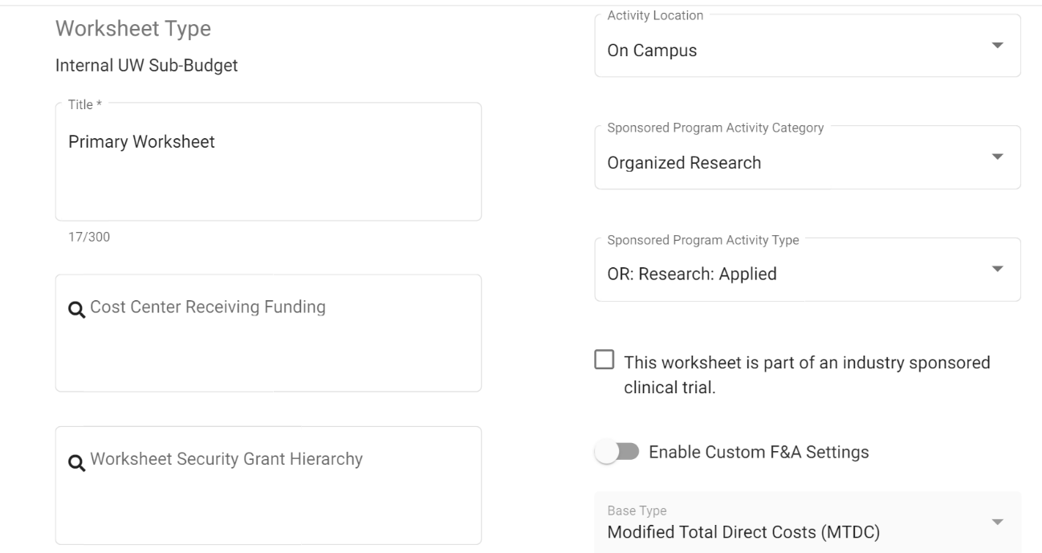
SAGE Budget Worksheets
Cost Center Receiving Funding: Enter the Cost Center Receiving Funding on the Award Setup Request and all worksheets.
Worksheet Security Grant Hierarchy: Enter the security hierarchy into the Worksheet Security Grant Hierarchy field for all budget worksheets.
Sponsored Program Activity (SPA) Type: Ensure the SPA type on budget worksheets matches the Award Setup Request SPA type, unless there’s a legitimate reason for them to be different (e.g. sponsored program award includes multiple SPA types).
3
1
CC103048
2
SPH | Epi Grants B (GRH 04)
Notes:
Speaker: Juan

Slide 15
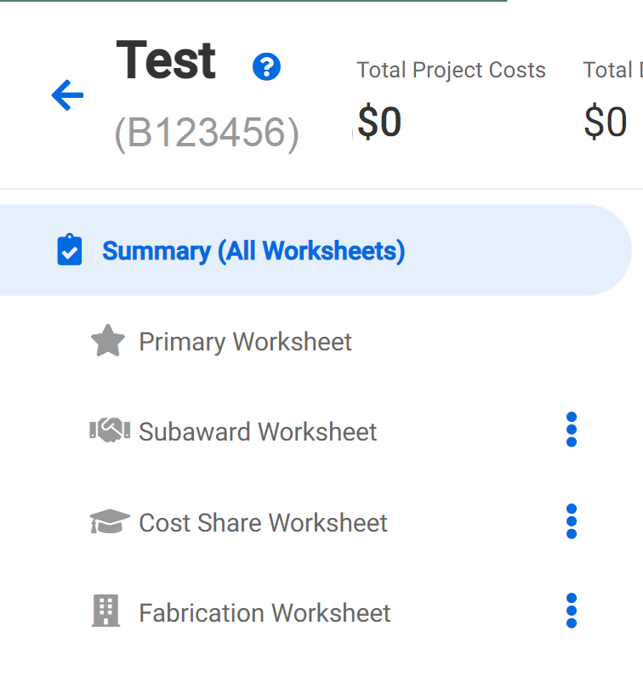
SAGE Budget Worksheets
SAGE Budget worksheet periods should match, or be within, the Award Setup Request Current Period Start Date and the Current Period End Date.
Create and include separate worksheets for anything that needs to be on a separate award line in Workday, including subawards, equipment fabrication, multiple F&A rates.
GCA Award Line Types, SAGE Budget Job Aid , Updated SAGE Budget eLearning
Notes:
Speaker: Juan

Slide 16
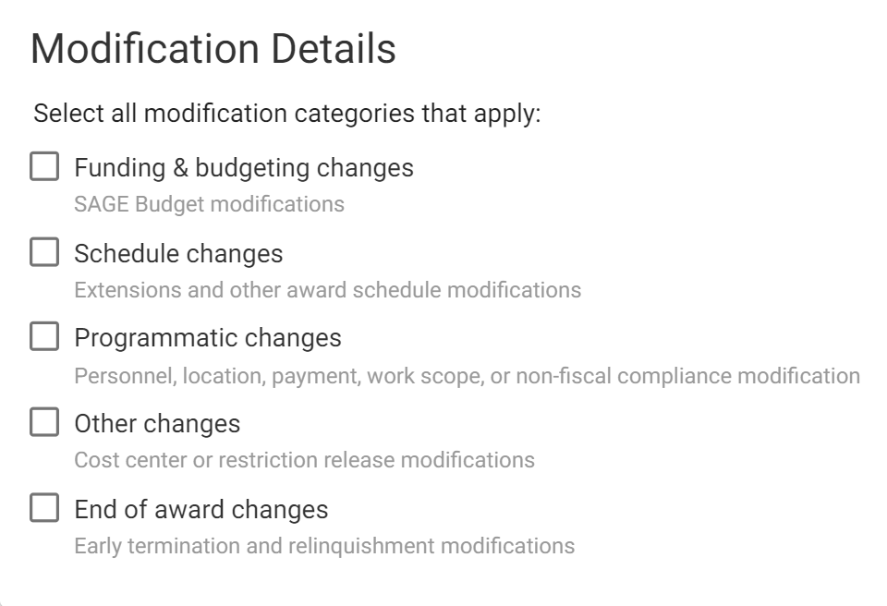
Award Modification Requests
Select at least one MOD category, and all that apply
  e.g. Funding & Budgeting Changes, Schedule Changes, Other Changes, etc.
Manage Award Changes - Research web guidance
Grant & Contract Accounting - Modifications
Notes:
Speaker: Ari

Slide 17
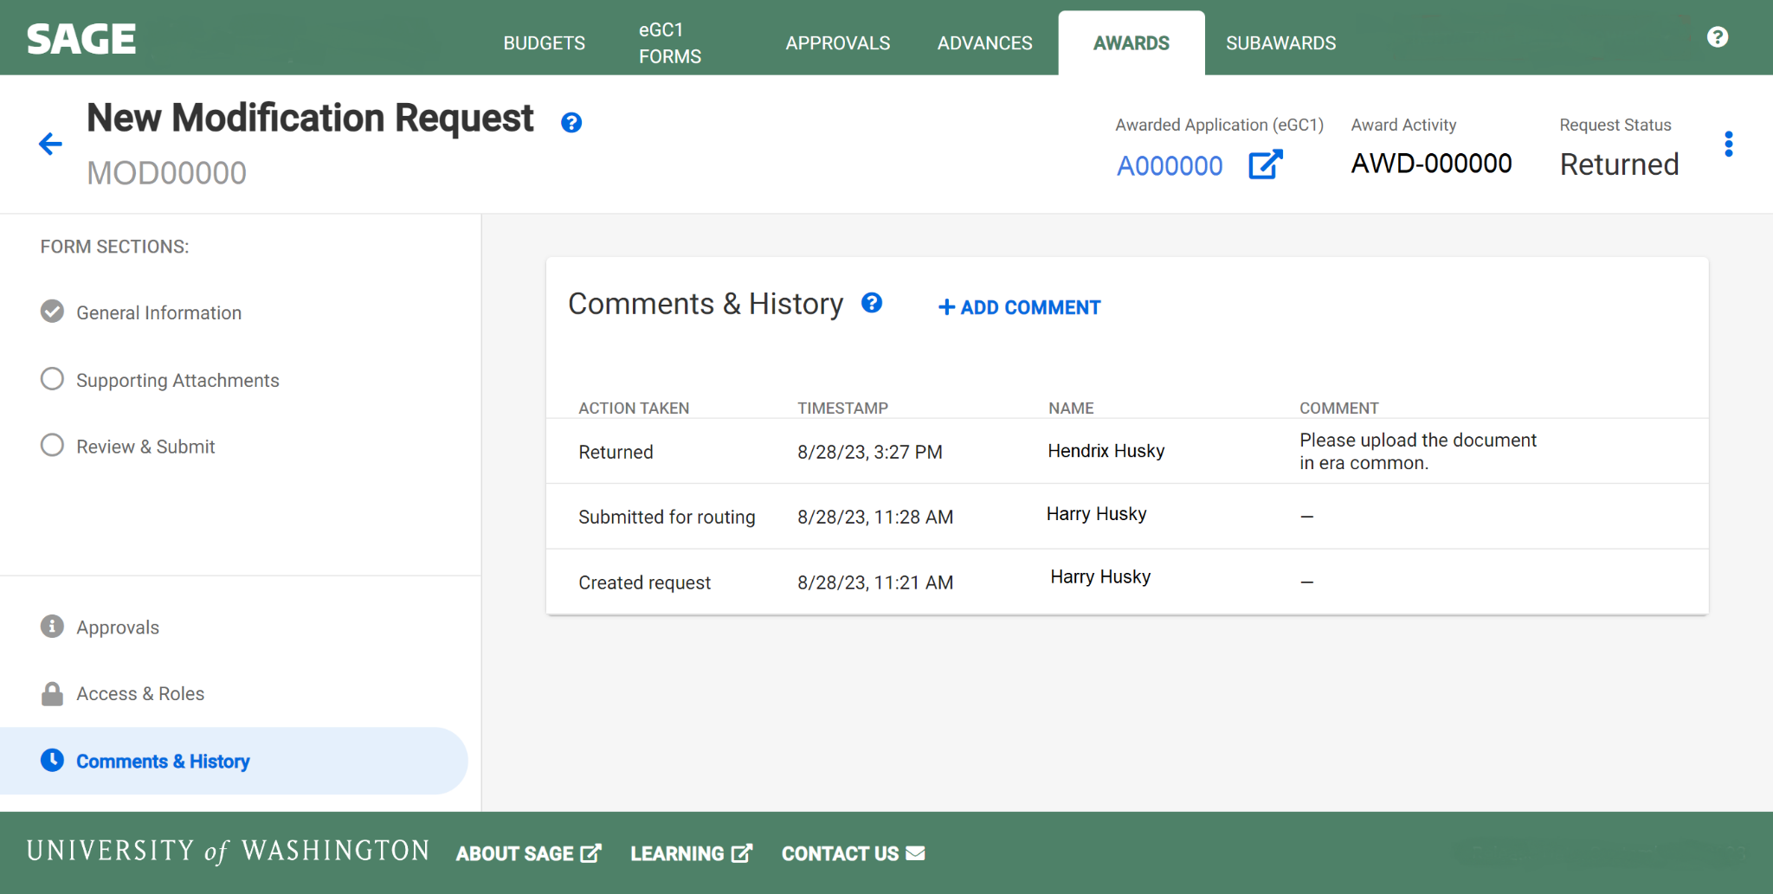
Returned Items
Review the Comments & History section for information about why the request was returned.
Address reasons an item was returned before sending it back to OSP or GCA.
Notes:
Speaker: Ari

Slide 18
Questions
Notes:
Speaker: Ari

Slide 19
GCA AWARD SETUP UPDATE
Juan Lepez
Director, Grant & Contract Accounting
September 14, 2023 MRAM

Slide 20
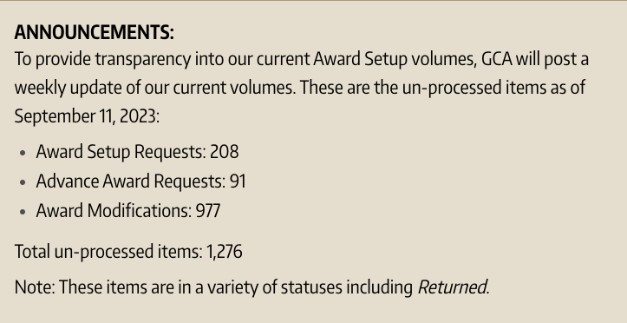
GCA BACKLOG UPDATE
GCA is posting a weekly update of un-processed items on our homepage:
https://finance.uw.edu/gca/
GCA is reviewing between 40-50 items each day and processed over 900 items in August
Notes:
Speaker notes:
GCA realizes that backlog is creating issues for campus partners.
Mention that we are posting volumes in response to campus feedback. Transparency is the goal.
“GCA is reviewing…” means processing or returning to OSP or returning to campus.

Slide 21
DEDICATED RESOURCES
Assembled new team to focus on Modifications
Team is focused on critical requests such as Extensions and Temporary Internal Extensions

Slide 22
NEW GCA FORMS
Request an non-primary Advance Award Line
  Attach completed form as attachment to Award Portal ticket with topic “Award Setup”
  Will be posted next week
SAGE Modification Request Form Checklist
  Attach when there is no existing form
  Demo
  Will be posted next week
Forms are intended to provide all necessary information to process request timely
Notes:
Speaker note: email to MRAM list when forms are available

Slide 23
BACKLOG PLAN
Eliminating the backlog will require your help
GCA will strongly encourage MOD Checklist and continue to require existing forms
GCA will attempt to process existing MODs but if detail is missing, GCA will return MOD and suggest Checklist to be included
Notes:
GCA needs more detail in order to process requests more efficiently

Slide 24
USE OF EXISTING FORMS
MODs routing through OSP will continue to require the same forms (e.g. Extension, PI Changes, End of Award Changes, Cost Share, F&A Waiver)

Slide 25
QUESTIONS
Contact GCA for assistance by creating a ticket in
Award Portal or email gcahelp@uw.edu

Slide 26
COMPLETE A MILESTONE AWARD TASK IN WORKDAY
Juan Lepez
Director, Grant & Contract Accounting
September 14, 2023 MRAM

Slide 27
MILESTONE AWARD TASKS
GCA creates an award task for each milestone and requires confirmation that it’s met before creating a sponsor invoice
Campus can use Workday to tell GCA that a milestone has been met

Slide 28
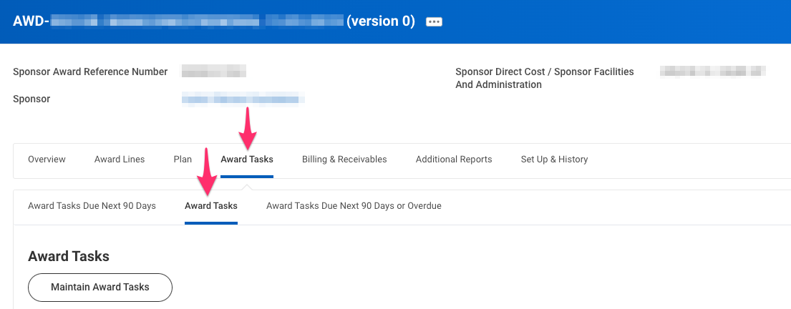
NAVIGATE TO AWARD TASKS
Search for your award in Workday
Go to Award Tasks tab>Award Tasks sub-tab

Slide 29
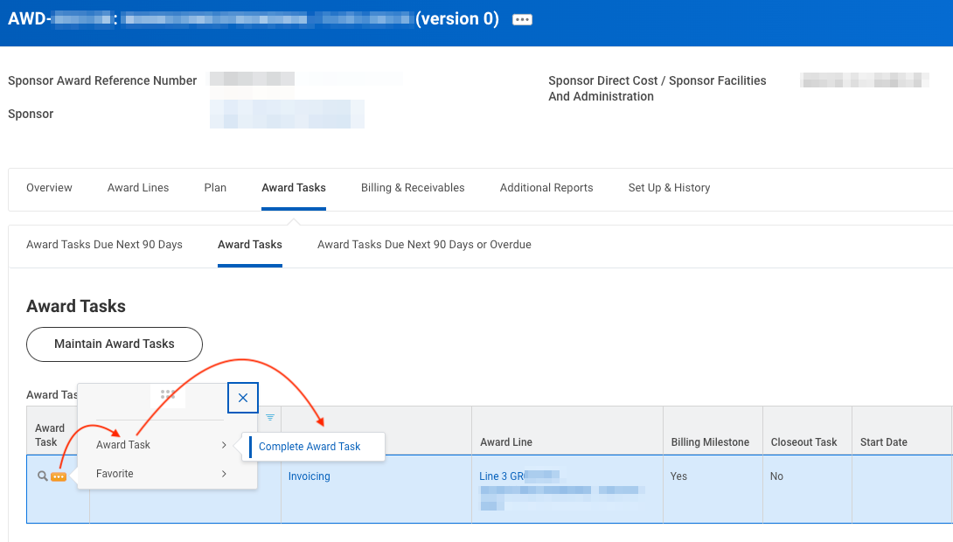
COMPLETE AWARD TASK
Find the milestone
Magnifying glass icon>“Award Task”> “Complete Award Task”
Notes:
Speaker note: Complete award task adds a Completed On date and changes status to Completed.

Slide 30
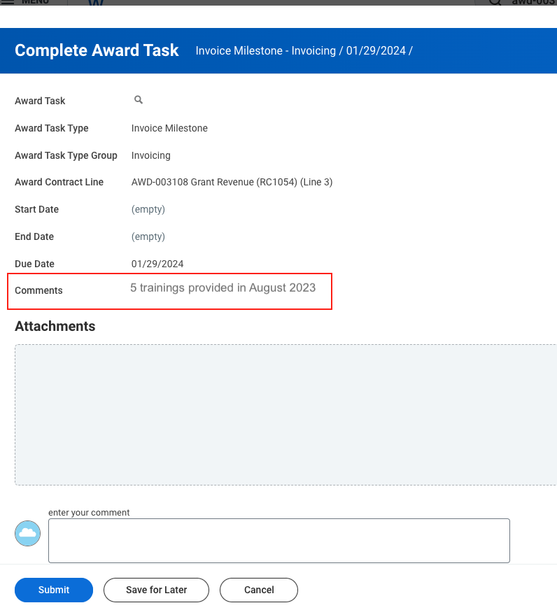
DEMO
Review “Comments”
Attach a document or enter comments
Click "Submit"

Slide 31
RESOURCES
Complete a Milestone Award Task
Workday Grant Award Closeout Part 2
  Timestamp 20:00-21:14
Award Line Types and Reimbursement Methods

Slide 32
QUESTIONS
Contact GCA for assistance by creating a ticket in
Award Portal or email gcahelp@uw.edu

Slide 33
COMPLIANCE HOT TOPIC: EFFORT REDUCTION – PART II
MRAM
September 2023
Matt Gardner
Post Award Fiscal Compliance

Slide 34
PI and Key Personnel Effort Reductions
Definitions of “Key Personnel”
Other reduction scenarios
Shift in Funding Source
MRAM – Matt Gardner – PAFC

Slide 35
Definition of Key Personnel
Sponsors can have different definitions of what constitutes “key personnel”
Examples:
  NIH: Individual named on the Notice of Award
  NSF: Individuals named as PI or Co-PI on the proposal
  Department of Defense: The “approved” PI or Project Director
Know your sponsor’s applicable terms and conditions
MRAM – Matt Gardner – PAFC

Slide 36
Other Reduction Scenarios
“My budget was cut from what was in the proposal… do I need approval to reduce effort?”
Reduction in the number of months in the budget period
Cut in the amount of overall funding
Cut in the amount of funding for salaries
MRAM – Matt Gardner – PAFC

Slide 37
Other Reduction Scenarios - Guidance
If the Award is modified, reduced, changed from what was originally proposed –
  Re-budget based on the Awarded funds, budget periods, etc.
  Give notice to the sponsor that you are re-budgeting based on the changes to the Award from what was proposed
Key point: If something significantly changes on the Award, keep the sponsor notified of the impact on the budget and proposed workplan
MRAM – Matt Gardner – PAFC

Slide 38
Shift in Funding Source
Both eFECS and ECC can accommodate scenarios where the faculty devotes effort to the Award but charges the salary to a non-sponsored resource to save money on the Award.
This typically is done after the Award begins and isn’t considered big “C” Cost Share
  This isn’t tracked as cost share in the system, nor reported to the sponsor as cost share
  https://finance.uw.edu/maa/fec/managing-effort/shift-funding-source
MRAM – Matt Gardner – PAFC

Slide 39
EFFORT REPORTING & ECC UPDATES
MRAM
September 2023
Matt Gardner
Post Award Fiscal Compliance

Slide 40
New Effort Reporting System is Live
ECC (“Effort Compensation Compliance”) went live on August 31st
ECC will be used for certifications for the first time for:
  Project Statements with a period end of 9/30/2023
  Effort Statements with a period end of 12/31/2023
If you are an effort coordinator that wasn’t on the initial access list, or you believe you need to be added to the coordinator list, please email the Effort Team
If you access ECC and have issues with your assigned role, please email the Effort Team
effortreporting@uw.edu
MRAM – Matt Gardner – PAFC

Slide 41
ECC Training Schedule
Now: Initial System Walk-through
  Delivery method: Video; Duration: 7 minutes
9/25/2023: Effort Coordinator Training
  Virtual instructor led; 1.5 hours
10/16/2023: Certifier Training
  On-Demand video; 1.5 hours
10/23/2023: Optional Certifier Training
  Virtual instructor led; 1.5 hours
MRAM – Matt Gardner – PAFC

Slide 42
ECC Launch Office Hours
The Effort Team will also provide weekly office hours for any user to provide hands-on support or to answer questions.
State Date: 9/25/2023
Frequency: Weekly; for as long as needed
Duration: 1 hour
Delivery method: Zoom
MRAM – Matt Gardner – PAFC

Slide 43
ECC Resources
Training timeline
  https://finance.uw.edu/maa/ecc_training_timeline
ECC Overview
  https://finance.uw.edu/maa/ecc
Known Issues
  https://finance.uw.edu/maa/ecc_known_issues
ECC FAQs
  https://finance.uw.edu/maa/faq/202
MRAM – Matt Gardner – PAFC

Slide 44
Current Faculty Effort Certifications – Period Ending June 30, 2023
The eFECS Effort Reporting System will be frozen after October 11, 2023
Two scenarios to consider:
FECs which do not require any salary transfers/adjustments
FECs which do require salary transfers/adjustments
MRAM – Matt Gardner – PAFC

Slide 45
Current Faculty Effort Certifications – Period Ending June 30, 2023
For FECs which do not require any salary transfers/adjustments:
October 11, 2023, is the last day to certify these FECs electronically in eFECS
Any outstanding FEC after 10/11/23 will require a manual “paper” certification
MRAM – Matt Gardner – PAFC

Slide 46
Current Faculty Effort Certifications – Period Ending June 30, 2023
For FECs which do require a salary transfer:
Because the adjustment must occur in Workday, the FEC will not update in eFECS
The FEC cannot be certified in eFECS and will require a manual “paper” process
If you know that an FEC will require a salary transfer, please email the effort team at efecs@uw.edu with the name of the faculty and the impacted FEC period
MRAM – Matt Gardner – PAFC

Slide 47
Current Faculty Effort Certifications – Period Ending June 30, 2023
The Effort Team is aware that FECs that require salary adjustments are not going to be completed by the certification due date
Manual certifications will likely take several weeks to process, depending on the volume
Our goal is to have adjustments processed and the manual certifications complete by the end of October
If you have questions on the process, timeline, or anything else, please reach out to us and we’re happy to talk through it
  efecs@uw.edu
MRAM – Matt Gardner – PAFC

Slide 48
Open Position at PAFC
Compliance Analyst
Req # 225649
https://uwhires.admin.washington.edu/ENG/Candidates/default.cfm?szCategory=jobprofile&szOrderID=225649
MRAM – Matt Gardner – PAFC

Slide 49
Questions
Post Award Fiscal Compliance (PAFC)
  gcafco@uw.edu
  efecs@uw.edu (FEC/eFECS related questions
  effortreporting@uw.edu (ECC-related questions)
  https://finance.uw.edu/pafc/
Matt Gardner
  mgard4@uw.edu
  206-543-2610
MRAM – Matt Gardner – PAFC

Slide 50
Federal Data Repository Requests & Certifications
September 14, 2023 MRAM
Mike Snow
Office of Sponsored Programs

Slide 51
Repository Data Access/Submission
Research data in repositories that are maintained or funded by federal agencies
Repository facilitates data sharing consistent with agency policy (e.g., NIH DMSP)
Data may be directed toward a particular repository by funding opportunity
Policy breadth has led to increased activity regarding:
  Requests to access data in a repository
  Certifications when submitting data to a repository

Slide 52
Identifying Features
Requests to access data or submissions of data to federal repositories can require institutional certification
Documents may have various names (Data Use Certification, Data Submission Agreement)
Format is most often unilateral, PI and OSP sign but agency does not sign
Non-negotiable, terms to ensure compliance with repository conditions
Examples: dbGaP, NIMH Data Archive

Slide 53
Change in Process
Routing in SAGE to OSP for institutional certification:
Instead of Non-award Agreement (NAA) eGC1, use Award Modification Request (MOD)
Award Modification maintains the link between the request or certification and the underlying project
Use the MOD category “Other changes”
Process is even more streamlined than NAA
Updated web content for this process coming soon.
Notes:
Not specifically a data use agreement

Slide 54
Questions

Slide 55



Updates
FT and the CORE certificate
    Most Instructor-led Zoom courses offered this fall. Schedule published.
    A few on-demand courses have been republished.
    Learners must restart on-demand coursework not completed prior to July 6, 2023.
    A few required on-demand classes on hold for a few months until updates clarified.
    Some required and elective classes may be retired.
    Go to the Curriculum Guide to get most up-to-date information about course status.
CORE Registration
https://uwresearch.gosignmeup.com/public/course/browse
CORE Home https://www.washington.edu/research/training/core/
Notes:
The fall schedule is published. Almost all our instructor-led courses are available.
Where we have information available, we have made updates to the eLearning and live courses. Some updates are taking longer to make due to evolving systems.
Check the Curriculum Guide for updates to course statuses. Updates will also be sent to the MRAM email list.

