Slide 1
COMPLETE A MILESTONE AWARD TASK IN WORKDAY
Juan Lepez
Director, Grant & Contract Accounting
September 14, 2023 MRAM

Slide 2
MILESTONE AWARD TASKS
GCA creates an award task for each milestone and requires confirmation that it’s met before creating a sponsor invoice
Campus can use Workday to tell GCA that a milestone has been met

Slide 3
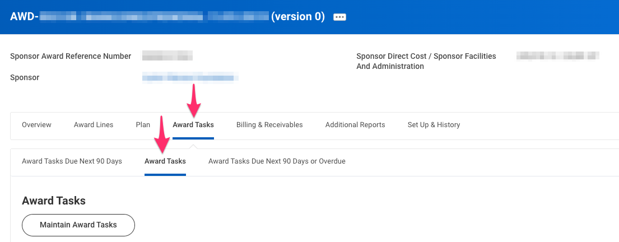
NAVIGATE TO AWARD TASKS
Search for your award in Workday
Go to Award Tasks tab>Award Tasks sub-tab

Slide 4
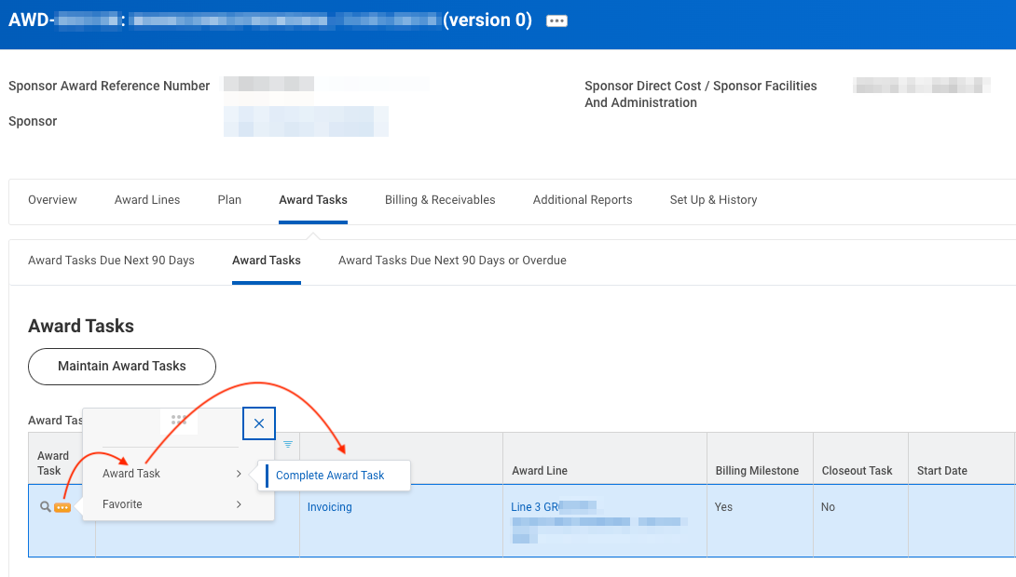
COMPLETE AWARD TASK
Find the milestone
Magnifying glass icon>“Award Task”> “Complete Award Task”
Notes:
Speaker note: Complete award task adds a Completed On date and changes status to Completed.

Slide 5
RESOURCES
Complete a Milestone Award Task
Workday Grant Award Closeout Part 2
  Timestamp 20:00-21:14
Award Line Types and Reimbursement Methods

Slide 6
QUESTIONS
Contact GCA for assistance by creating a ticket in
Award Portal or email gcahelp@uw.edu

