Slide 1
DISCLAIMER
The GCA Forum will be recorded and retained for the legally approved retention period under Washington State Policy
It is subject to release under the Washington State Public Records Act or Federal Freedom of Information Act (FOIA)
It will be posted publicly on our GCA YouTube channel
  Slide decks and recordings for this and past Forums are linked on our GCA Forum web page
  https://finance.uw.edu/gca/resources/gca-forum

Slide 2
GCA SUMMER FORUM
August 26, 2020

Slide 3
Welcome!
We have prepared material for the entire hour.
Please ask us questions using the Chat feature in Zoom. We will pause after each segment to answer them.
We want you to be engaged. This meeting is for you!

Slide 4
Agenda
Post Award Fiscal Compliance Training Update
September is NIH Training Grant Season
SAGE FT Changes: Award Intake
UWFT Subaward Business Process Design
UWFT Operating Model

Slide 5
Post Award Fiscal
Compliance (PAFC)
Training Updates
Andra Sawyer

Slide 6
PAFC Training Update
Converting some of our CORE in-person classes to on-demand (Zoom recordings).
Some of the modules (8-10 min. lessons) will be available for stand-alone viewing on either the GCA or PAFC webpage.
More information coming – in the meantime let PAFC know if you have any ideas/input: gcafco@uw.edu

Slide 7
September is NIH Training Grant Season
Michelle Davis

Slide 8

Stipend Reconciliation
As part of our reconciliation process, we review stipend payments to ensure that trainees were paid correctly
We look at how much each trainee was paid on the budget against their Statement of Appointment (SoA) or Termination Notice (TN)
  Trainees must be paid according to stipend levels established by NIH
If the budget ended 6/30/20 and the trainee’s appointment started 6/16/20, we would expect to see a payment of $1,034 (1 pay period) on the budget

Slide 9
Possible Stipend Issues
Underpayments
  Sometimes we see trainees paid according to their prior year appointment, resulting in an underpayment.
Overpayments
Incorrect earn type
  Pre-docs should be paid out of 01-90 and post-docs out of 01-50
  Trainees cannot be paid out of other object codes (such as 01-10) as they are not considered UW employees. This will also cause unallowable benefits to be charged to the award.

Slide 10
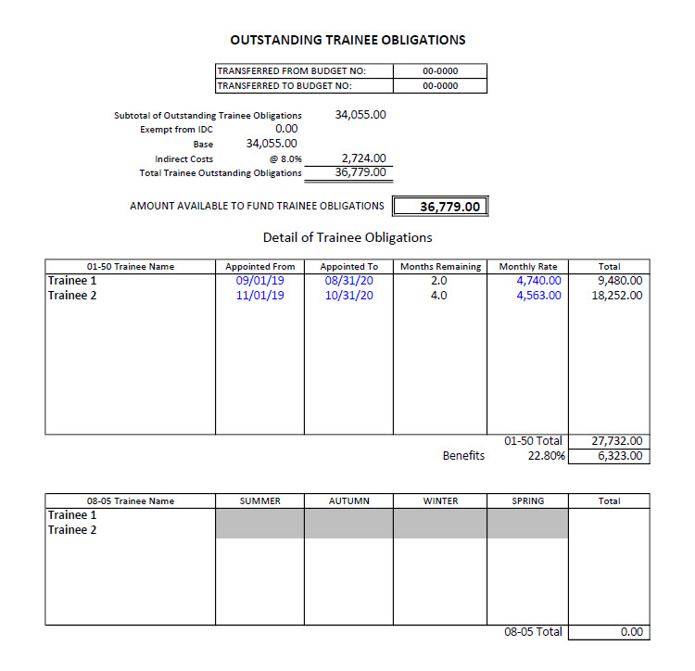
Outstanding Trainee Obligations Report
We will also create an Outstanding Trainee Obligations (OTO) report, which outlines the trainee costs that weren’t expended by the budget end date.
  The stipend amount is based on the months remaining in the trainee’s appointment
  We will also indicate if there are funds available for tuition obligation and which quarters are eligible.
    To obligate tuition, the trainee needs to be paid 5 out of the 6 pay periods of the academic quarter.

Slide 11
What We’ll Send You
Upon completing our reconciliation, we will send you a GrantTracker communication that outlines the following:
  Stipend issues
  Unallowable charges
  Draft of the Outstanding Trainee Obligations (OTO) report + balance available for tuition obligation
  Unmet cost share (if applicable)
  Deficit amount and options for deficit transfer
    We can transfer to continuation budget (if available) or to non-federal budget(s).

Slide 12
Department Next Steps
Please review the OTO form, add the tuition you’d like to obligate, and return the updated form to GCA via GrantTracker.
If any stipend issues were identified, please make the necessary corrections.
If a deficit was identified, please provide us with a non-federal budget to transfer it to (if applicable). If the deficit should be split over multiple budgets, we will need the amounts for each budget as well.

Slide 13
Additional Resources
Guidance for NIH Institutional Training Grants:
  https://www.washington.edu/research/collaboration/guidance-for-nih-institutional-training-grants/
Overview of T32 Awards (Post-Award Fiscal Compliance):
  https://finance.uw.edu/pafc/nrsa-nih-training-grants
Managing NRSA Training Grant Budgets at the UW (CORE):
  https://www.washington.edu/research/research-administration-learning/managing-nrsa-training-grants-and-fellowships-at-the-uw/
  (Class handout and slides available)

Slide 14
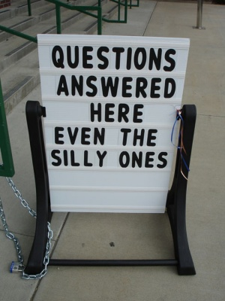
Questions?

Slide 15
SAGE FT Changes:
Award Intake
Judy Chung

Slide 16
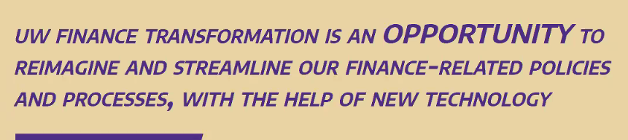
Finance Transformation

Slide 17
Process Streamlining: SAGE Side
Moving From…. To….
Email intake, comms
System intake, messaging
Paper approvals
Online approvals
Unclear Status
Status transparency
Duplicate entry SAGE:FIN
Integrations SAGE:Workday

Slide 18
Pre-FT Release: Laying Foundation
> Advance Budget Setup - Streamlining
  Establishes a new template for intake
  Leverages data submitted prior to reduce duplicate entry
  Introduces much-needed streamlining without waiting 2 yrs for FT release

Slide 19
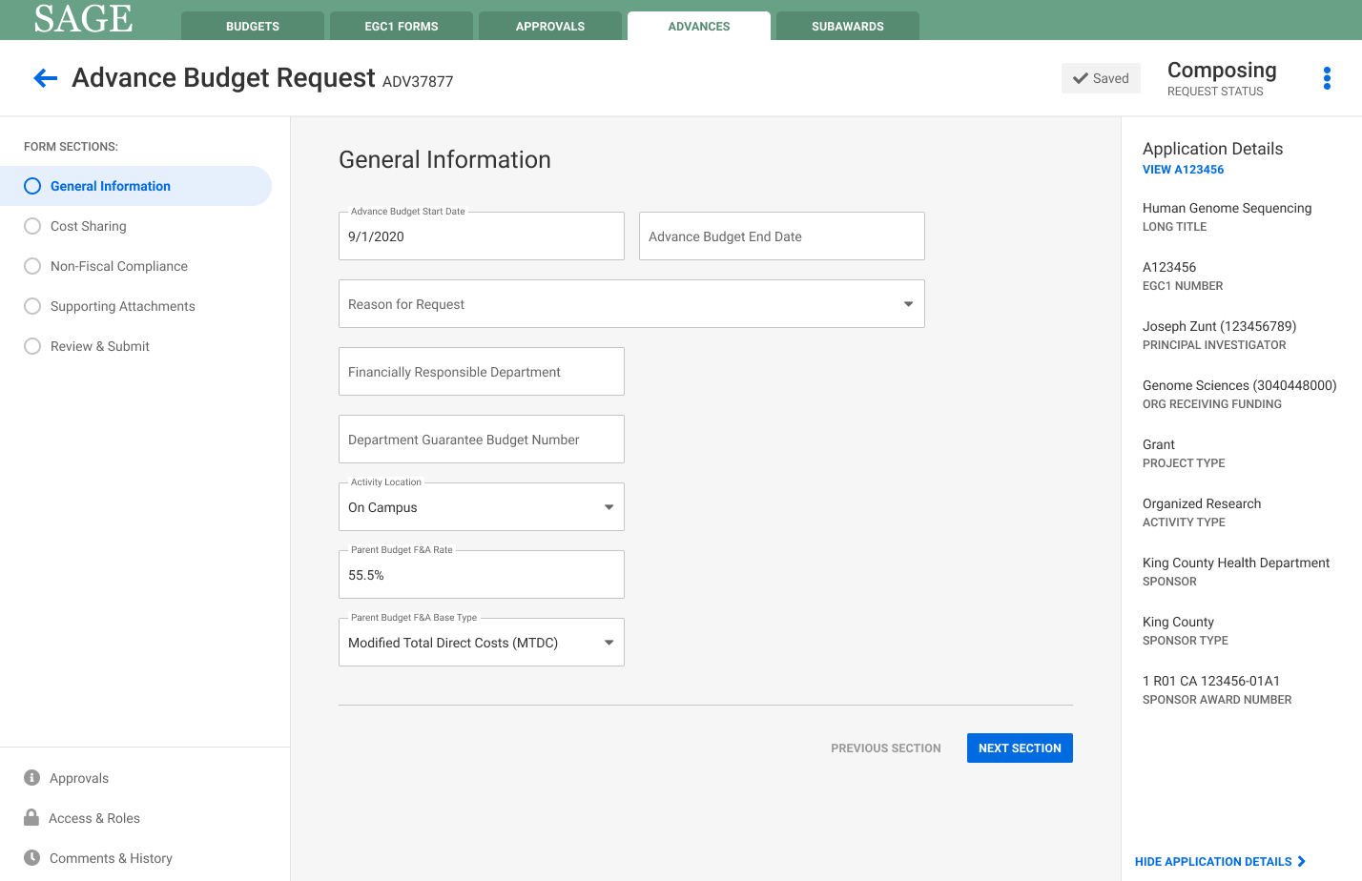
Design Concepts: Advance Intake Form
View proposal details
Section Navigation

Slide 20
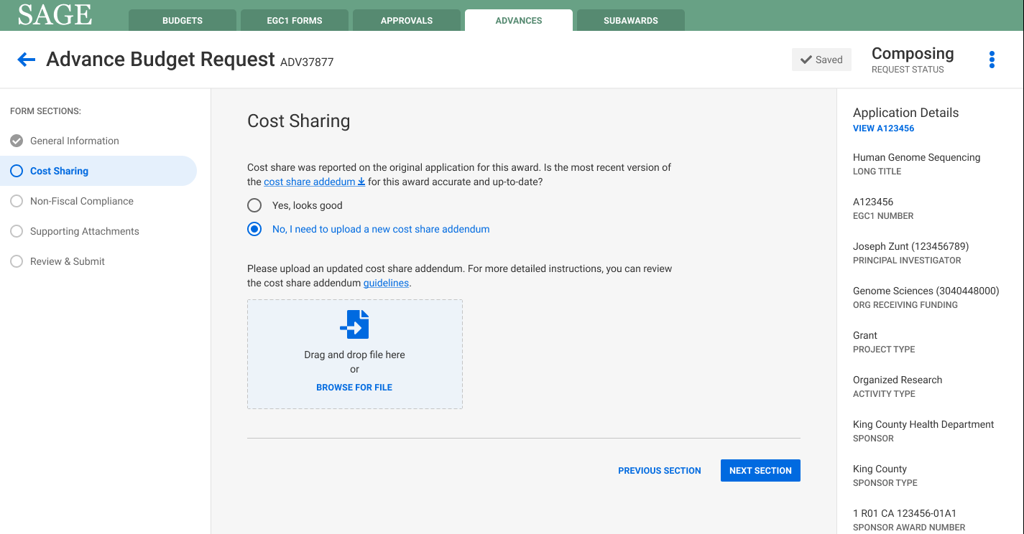
Advance Intake Form: Cost Share
For future Award Intake, this section would become “Budget & Cost Share”, with ability to connect a SAGE Budget
Evaluating use of SAGE Budget for online entry of cost share

Slide 21
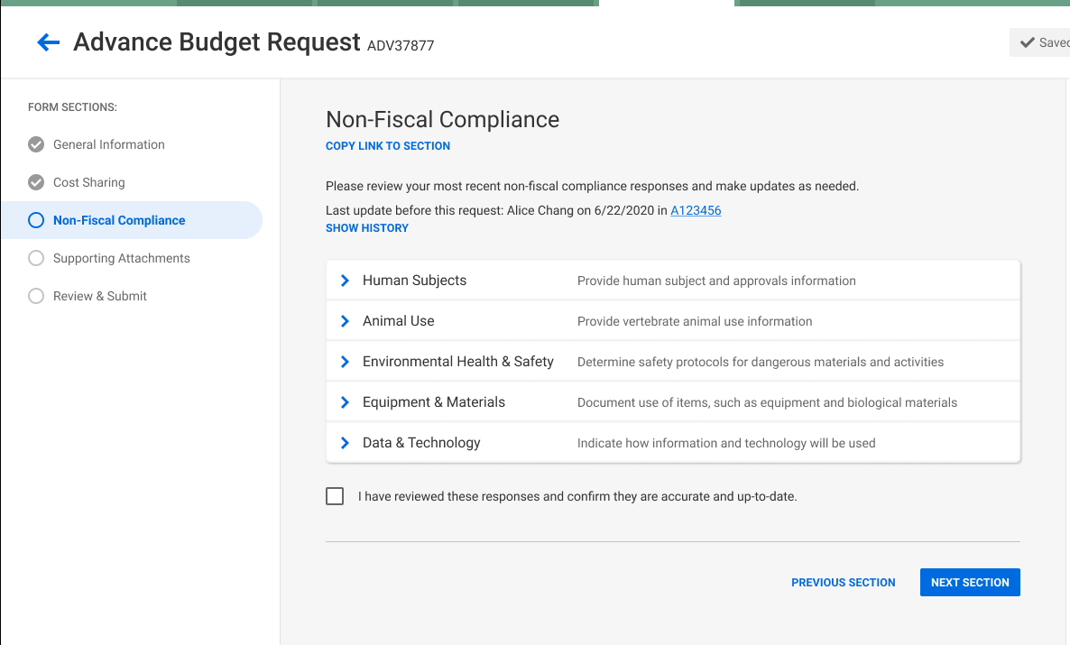
Advance Intake: Non-Fiscal Compliance
Displays most recent data submitted and allows for updates
Send a link to PI for their review
Quick “no change” confirmation

Slide 22
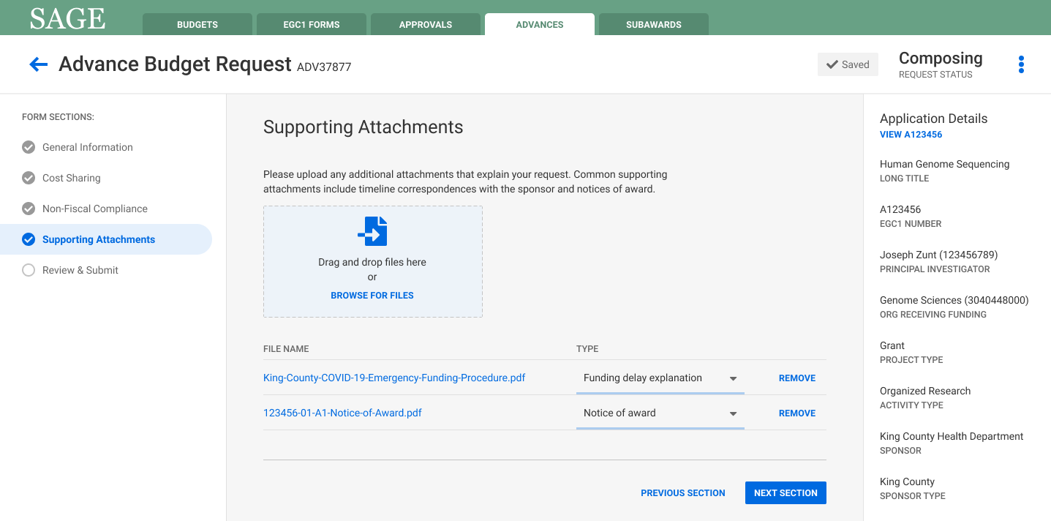
Advance Intake: Attachments

Slide 23
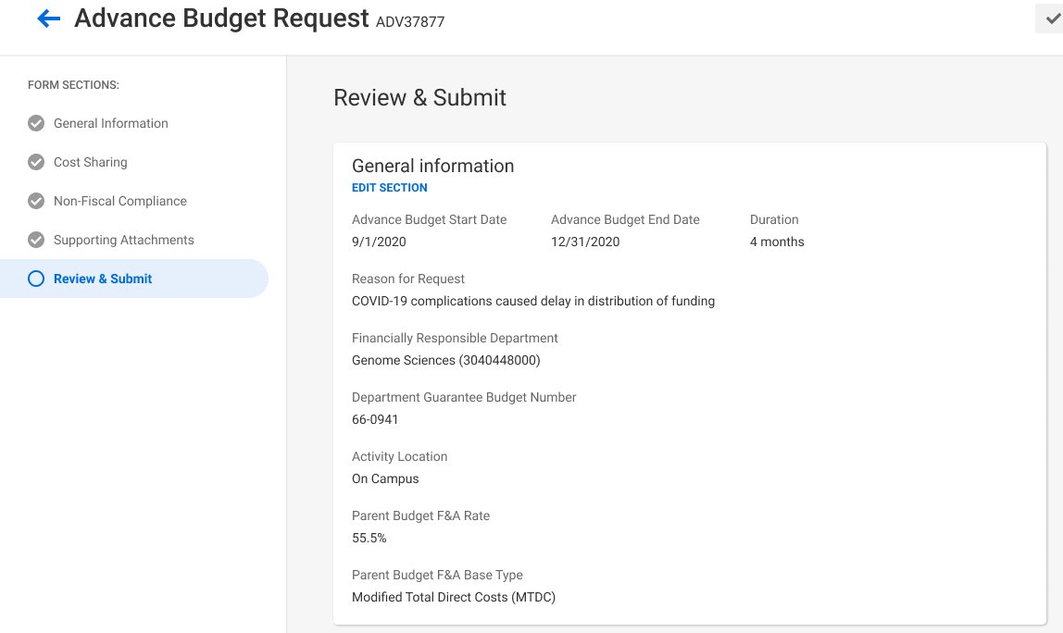
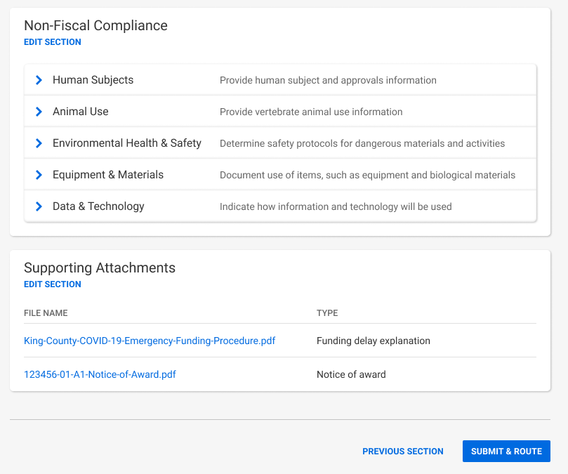
Advance Intake: Review & Submit
Scroll down page for full view of all responses

Slide 24
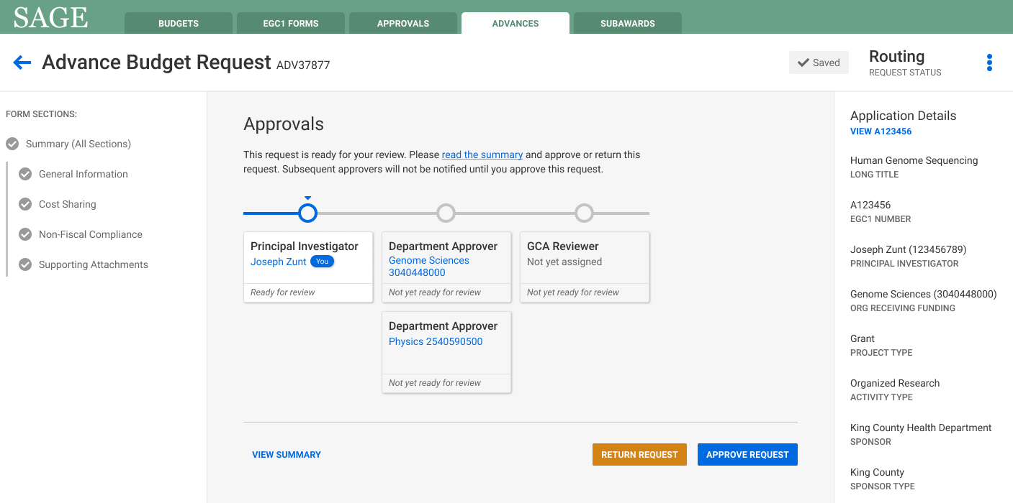
Approvals

Slide 25
Pre-FT Releases: Awards in SAGE
Award Section Buildout
  Provides a view into existing award data, actions and status
  The place to launch future intake/actions from

Slide 26
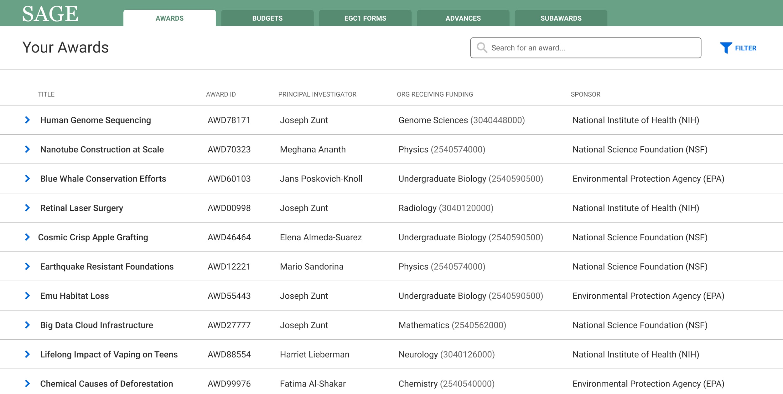
Design Concepts: Awards View

Slide 27
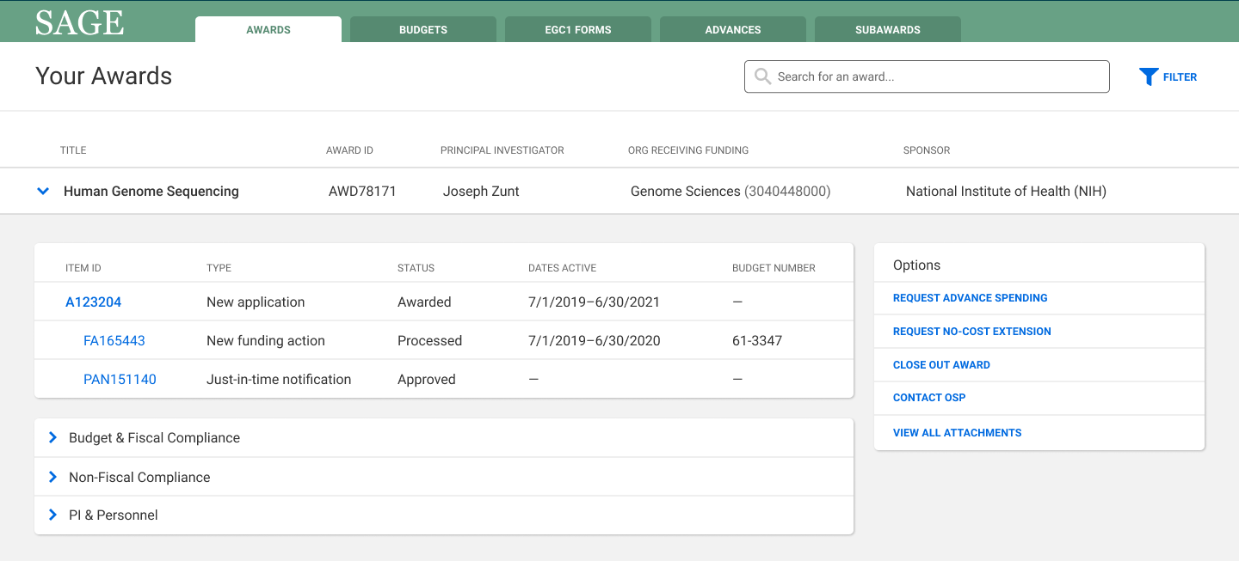
Design Concepts: Awards Actions/Intake
Establish the “Award View” in SAGE, and allow actions to initiate from the award
List of available actions
(not a complete list)
Existing award activity
Items that live at Award Level (latest)

Slide 28
Pre-Workday Release Targets
Advance Intake - late Fall 2020
Award View - Winter 2020

Slide 29
FT SAGE Workday Release Targets (2022)
Award Intake
Award Modifications Intake
Connect SAGE Budgets to above intake for
  Award & Renewal Budgets & sub-budgets
  Subaward budgets
  Budget Reallocations/Changes
  Cost share budgets (tbd)

Slide 30
Award & Mod Intake: Similar Experience
Award Intake AWD1234
Budget & Cost Share
Questions specific to type of intake: Award Intake or Modification

Slide 31

Questions? Comments?
Thank You!
Judy Chung, ORIS
jachung@uw.edu
Ready for the ride?

Slide 32
UWFT Subaward Business Process Design
Nicole Flagg

Slide 33
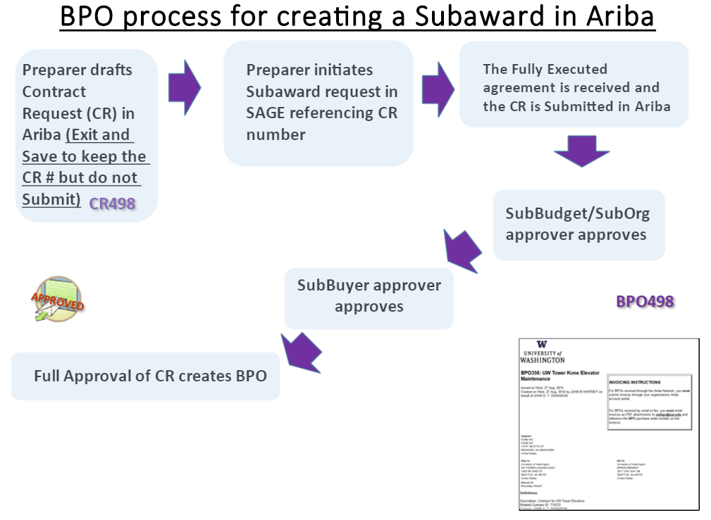
Current State

Slide 34
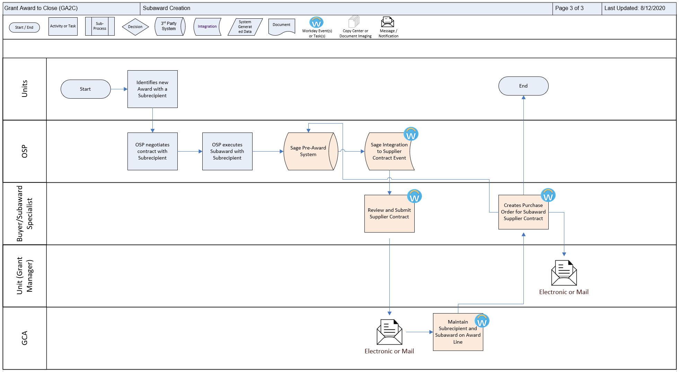
Epic Scenario – Subaward Creation
Notes:
1. Why we need it ?
2. Level of shared
3. Cross-function/cross-platform with HRP
Award set up will involve creating worktags (R2R & FDM) Budget and Cost Sharing (PMTB), Sub awards created (Procurement) capturing special conditions that will support equip purchase (assets & depreciation) How we will collect to bill (CR2P & Cross platform with HRP & MCFA)
4. System integration points

Slide 35
Drafted Future State Design – What’s Changing?
Units submit Subaward request in a single system, SAGE
  No additional approvals needed to establish Subaward in Workday
Placeholder Award Lines will be established when a Subaward is anticipated under a new award
  A Unique Award Line is established for each Subaward
Unique Award Lines enable real-time F&A expenses, calculated and posted when a subaward invoice posts, up to the specified basis limit (typically the first $25,000)

Slide 36
Drafted Future State Design – What’s Staying Close to Current State?
Units continue to confirm whether Subrecipient exists in our system
Units continue to direct new Subrecipients to register through a Supplier Portal
  OSP does not need to wait, but Subrecipient must be in Workday before OSP can trigger the system integration
Subrecipients continue to submit invoices via a Supplier Portal

Slide 37

Sponsored Award Components
The sponsor’s Notice of Award (NOA) can be broken down into these main objects.
1
Award
Defines the business rules to correctly bill, collect, and report activities related to the award.
4
Award Budget
Workday automatically builds the periods based on the award schedule.
2
Sponsor, Flow Through Sponsor
Award Line
Manages award details and ties Grant to Award.
Award Date
Award Schedule
Reimbursement Method
Award Line Attributes
Award Schedule
F&A Rule
Budget Breakdown
3
Grant
Collects costs
Award Amounts
Start and End Dates
Grant
(Worktag)
Award Attributes
Sub-recipient
Grant
(Worktag)

Slide 38

Questions?

Slide 39
UWFT Operating Model
Libby Hartman

Slide 40
Goals of the Shared Service
Achieve greater efficiency and productivity through creation of consistent and standardized policies and processes while ensuring critical business requirements are met
Free up administrators, faculty and staff from manual entry and reconciliation of data in order to support higher value activities aligned with the mission
Enable savings and other productivity gains that accrue to 15% cost reduction over 3-5 years
Increase compliance with Federal, State and University wide policies and procedures
Provide high quality, consistent customer service across units

Slide 41
Definitions
Shared Services: The entire structure of finance, procurement, and supply chain business processes that reside at all levels of shared at the UW
Hub – shared service centers within the Finance/Procurement Shared Services Organization
Op Model: Defines where shared work will happen (i.e. levels of shared)
Strategic Org Design: The high-level structure and organization of the shared services (i.e. conceptual op model): how many hubs, how organized, reporting to whom. What role of central offices delivering org-wide and enterprise-wide activity will be.
Tactical Org Design: Specific roles and responsibilities at the various levels of shared: job descriptions, capacity planning, etc.
Resource Transition Planning: Plan and execution for filling new shared service positions
Shared Services Governance Model: Decision-making, meeting cadence, metrics, oversight, escalation management, etc.
40

Slide 42
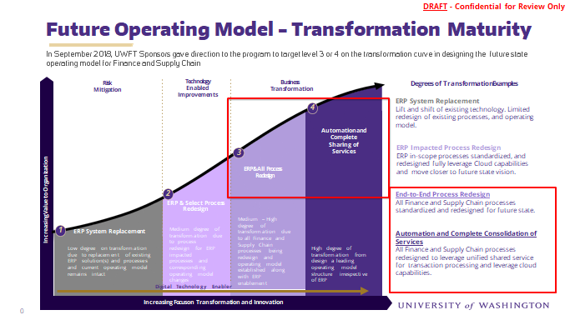
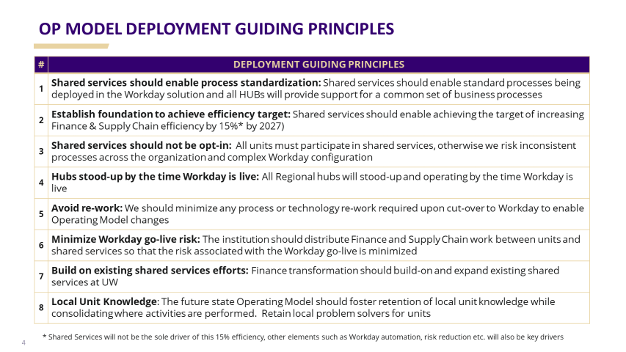
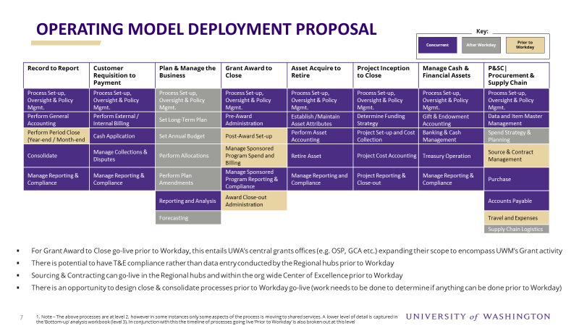
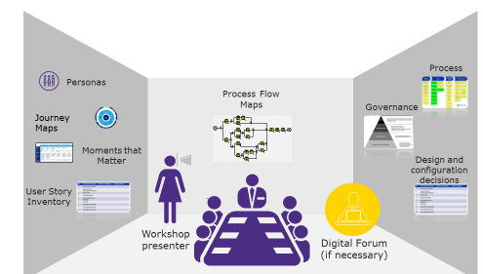
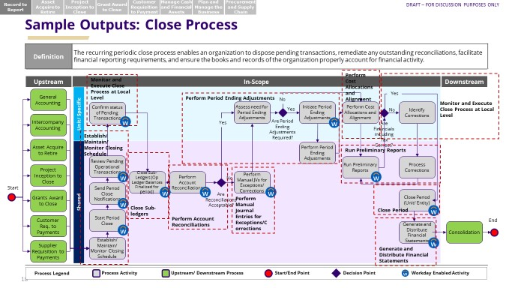
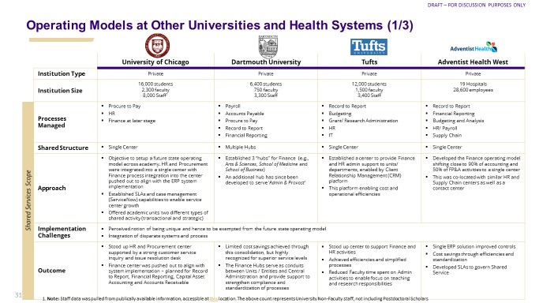
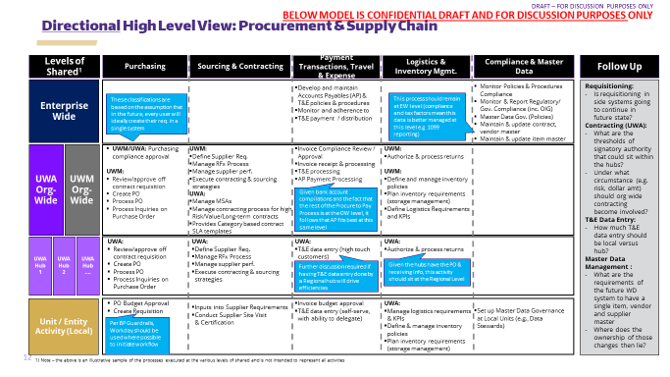
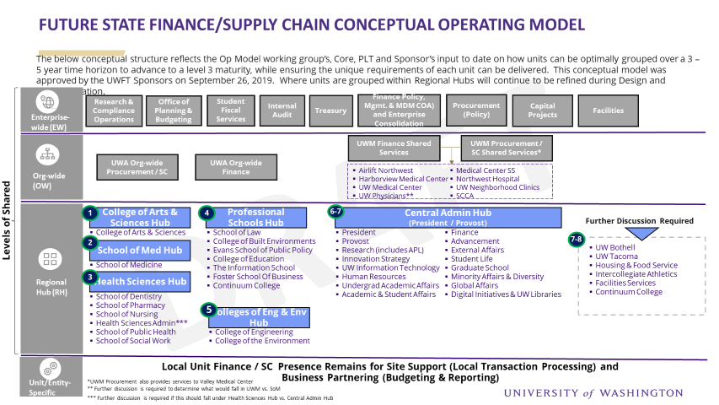
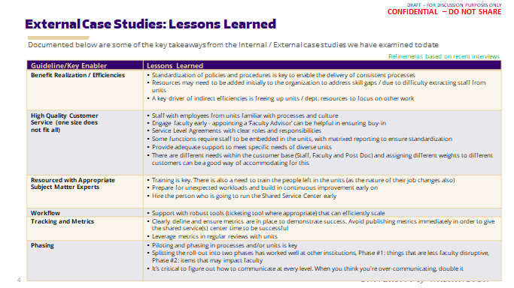
Top Down Guidance Meets Bottom-up Analysis – Process Design Workshops
Target
Transformation Maturity
Deployment
Guiding Principles
Op Model
Deployment Approach
Top Down Guidance & Support
Process Design Workshops
A combination of top-down guidance and bottom-up analysis has been used to inform the operating model direction to date and provide key inputs into the Process Design Workshops. This will continue to be the approach going forward.
Bottom Up
Detailed Analysis
Op Model
Process Workshops
‘Level of Shared’
Conceptual Op
Model Structure
Peer Case Studies

Slide 43
Where Should Finance Work Be Performed?
Levels of Shared
Location | Definition | Example of Activities
Enterprise Wide (EW) | Process can be shared by all of UW | Enterprise consolidation Enterprise policy and procedures Travel and Expense Compliance Maintenance of Master Data (e.g. vendor master, customer master, foundation data model)
Org-wide (OW) | Process can be shared by all of UWA or UWM, but not across both organizations | Cash Application and Collections (Misc. AR) Org-level close and financial statements
Regional Hub (RH) | Process can be shared at a Regional Level via a hub (serving more than one major organization/major unit) (e.g. across multiple schools/colleges, administrative units, auxiliary units and/or campuses. For larger schools and colleges this could be across multiple depts/divisions) | Initial point of contact for units for finance and supply chain questions Transaction processing (e.g. purchase orders, travel & expenses entry, invoice generation) Post award grants management analysis and reporting
Unit Level Finance Work
Processes that are unique or specific to an individual unit

Slide 44
DRAFT Level Of Shared Summary View - Finance
KEY
Gold = Process moving
to new level of shared
Process
Sub-Process
Process Area (FTE) | Record to Report | Customer Requisition to Payment | Plan & Manage Business | Grant Award to Close | Project Inception to Close | Asset Acquire to Retire | Manage Cash & Financial Assets
Ent Wide | Core Config & Gov* Year / Month End Close General Accounting - Allocate Costs & Revenue (impacting both Orgs) Consolidate Manage Reporting & Compliance Process Set-up, Oversight & Policy Mgmt. | Core Config & Gov Manage Reporting & Compliance | Core Config & Gov. Set Annual Budget Perform Allocations (e.g., state funding) Set Long-Term Plan Forecasting Perform Plan Amendments Reporting & Analysis (i.e. WD Report QA)* | Core Config & Gov Post Award Set-up Manage Sponsored Program Spend & Billing Manage Sponsored Program Reporting & Compliance | Core Config & Gov. Project Set-up and Cost Collection – Est / Maint. Project Structure & Funding Rules, Est / Maint. Project Budget/Plan | Process Set-up, Oversight & Policy Mgmt. - Establish / Maintain Asset Mgmt. Policies Manage Reporting & Compliance - Monitor Adherence to Policies & Procedures | Process Set-up, Oversight & Policy Mgmt. Cash Forecasting & Monitoring Cash Reporting Gift & Endowment Accounting
Org Wide | Year / Month End Close Consolidate General Accounting - Allocate Costs & Revenue | Cash Application Execute Collection Activities Manage Dispute Resolution | Set Annual Budget Perform Allocations Set Long-Term Plan (except for Finalize Long-Term Plan) Forecasting Reporting & Analysis (i.e. WD Report dev. by “superusers”)* | Pre-Award Administration (from unit) | Project Cost Accounting Project Reporting & Close-out Project Set-up & Cost Collection - Project Capitalization | Process Set-up, Oversight & Policy Mgmt. Policies – Est / Maint. Asset Config* Est/Maint. Asset Attributes Perform Asset Accounting Retire Asset Manage Reporting & Compliance - Perform Misc. Asset Reporting | Bank Reconciliation Processes Cash Collections & Disbursement* Ad-Hoc / Misc. Payments
Reginal Hub | Process Journals Month/Year End Close | Create External Invoice Create Invoice Adjustments |  | Perform Cost Transfers / JEs Award Closeout Reconciliation Effort Reporting Review Clinical Trial Invoicing
Local | Identify need for Journal Entries Audit Support Ext. Reporting Support | Create Internal Invoice Initiate request for customer billing Dispute Mgmt. & Support Issue Resolution | Perform Allocations Run Standard Reports (self-serve) Develop departmental (bottom-up) budgets Gather Financial Plan inputs Unit level Forecasting | Effort Certification Analysis / Review of Grant Reports / Forecast Analysis & Reporting | Project Cost Accounting (ITS)* Track/Record Input Efforts and Costs Generate Status Reports | Identify Need for Asset Maintenance Identify need for Asset Retirement Identify need for Manual Asset Registration | Bank Reconciliation Processes – provide support for exceptions that requires local input
*Further Discussion Ongoing with PTTs
Notes:
Op Model
This is UWFT taxonomy language, aligned to the level of shared approved by sponsors.

Slide 45
DRAFT Level Of Shared Summary
View – Procurement & SC
KEY
Gold = Process moving
to new level of shared
Process
Sub-Process
Process Area (FTE) | Accounts Payable | Purchase | Source & Contract Mgmt. | Spend Strategy & Planning | Supply Chain Logistics | Travel & Expenses
Ent Wide | Establish/Maintain Accounts Payable Policies Establish/Maintain Supplier Configuration | Establish/Maintain Procurement Policies Establish/Maintain Procure to Pay Configuration | Process Set-up, Oversight & Policy Mgmt. | Process Set-up, Oversight & Policy Mgmt. | Establish/Maintain Supply Chain Policies Establish/Maintain Supply Chain Configuration | Establish/Maintain Travel & Expense Policies Establish/Maintain Travel & Expense Configuration Travel & Expense Compliance check (high risk transactions)
Org Wide | Invoice Processing Payments / Disbursements* | Process Receipt of Materials and Services (UWM) Manage Procurement Financial Reporting Monitor Adherence to Policies and Procedures | Manage Supplier Contracts (High Risk, High Dollar) Monitor and Manage Contracts Sourcing Event (High Risk, High Dollar, category based input) | Perform Strategic Sourcing | Supply Chain Logistics (UWM) Receive Material (UWM) Manage Logistics and Distribution (UWM) Manage, Track, and Control Inventory (UWM) Replenish Inventory Manage Supply Chain Financial Reporting
Regional Hub |  | Manage Requisitions Manage Purchase Orders | Manage Supplier Contracts (Low Risk, Low Dollar) Manage Sourcing Event (Low Risk, Low dollar) |  |  | Travel & Expense Compliance Travel and Expense Data Entry (high touch customers)
Local | Submit Supplier Invoice Requests | Process Receipt of Materials and Services (UWA / UWM Desktop) Requisitioning | Raise Supplier / Contract Request | Clinical Utilization and Cost Analysis Perform Demand Planning Perform Inventory Planning |  | Travel and Expense Data Entry
*Further Discussion Ongoing with PTTs
Notes:
Op Model
This is UWFT taxonomy language, aligned to the level of shared approved by sponsors.

Slide 46



BELOW IS CONFIDENTIAL DRAFT AND FOR DISCUSSION PURPOSES ONLY
DRAFT Future State Finance/Supply Chain Conceptual Operating Model
KEY
UWA
UWM
Record to Report
Asset Acquire to Retire
Customer Requisition to Payment
Grant Award to Close
Manage Cash and Financial Assets
Procurement & Supply Chain
Project Inception to Close
Plan & Manage the Business
DRAFT
UWA Financial Accounting
UWM
Controllership
Group
Management Accounting & Analysis
Grant & Contract Accounting
UW Advancement
Travel Services
UW Facilities Capital Projects
Integrated Service Center
Tax Office
Post-Award Fiscal Compliance
Enterprise Procurement Governance
Office of Planning and Budgeting
Enterprise-wide (EW)*
FDM Governance Spans Both Organizations with both parties are at the table
DRAFT
UWA Financial Accounting
Equipment & Inventory Office
UWA Financial Accounting
Research & Cash Accounting
UWA Financial Accounting
UWA Procurement Services
UW Facilities Capital Projects
Office of Planning and Budgeting
UWM Controllers Office
UWM Controllership Group
UWM Controllers Office
Office of Sponsored Programs
UWM Controllers Office
UWM Supply Chain
UWM Controllers Office
UWM Financial Planning and Analysis
Org-wide (OW)
UWA Procurement Services
UWM Controllers Office
Levels of Shared
1
4
6
College of Arts & Sciences Hub
Professional Schools Hub
Central Admin Hub (President / Provost)
Further Discussion Required
College of Arts & Sciences
School of Law
College of Built Environments
Evans School of Public Policy
College of Education
The Information School
Foster School of Business
Continuum College
President
Provost
Research (includes APL)
CoMotion
UW Information Technology
Human Resources
Undergrad Academic Affairs
Academic & Student Affairs
Finance
Advancement
External Affairs
Student Life
Graduate School
Minority Affairs & Diversity
Global Affairs
Digital Initiatives & UW Libraries
?
2
School of Med Hub
UW Bothell
UW Tacoma
Housing & Food Services
Intercollegiate Athletics
Facilities Services
Continuum College
School of Medicine
3
Regional Hub (RH)
Health Sciences Hub
School of Dentistry
School of Pharmacy
School of Nursing
Health Sciences Admin***
School of Public Health
School of Social Work
5
Colleges of Eng & Env Hub
College of Engineering
College of the Environment
Local Unit Finance / Supply Chain Presence Remains for Site Support (Local Transaction Processing) and
Business Partnering (Budgeting & Reporting)
Unit/Entity-Specific
*FDM Governance TBD & not reflected in EW LoS
Notes:
Revised version after Op Model / App Support Workshop

Slide 47
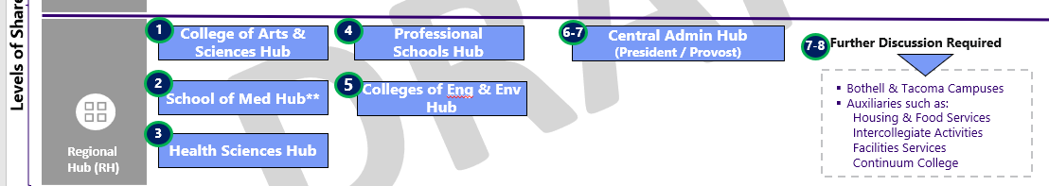
For Discussion Purposes Only
Operationalizing the Directionally Approved Regional Hub Model
Unit Aligned Model
Finance/Procurement Shared Services
College of Arts & Sciences Hub
Professional Schools Hub
Central Admin Hub
School of Medicine Hub
Hub Manager
Hub Manager
Hub Manager
Hub Manager
Procurement Team
Grants Team
Procurement Team
Grants Team
Procurement Team
Grants Team
Procurement Team
Grants Team
Misc. A/R Team
R2R Team
Misc. A/R Team
R2R Team
Misc. A/R Team
R2R Team
Misc. A/R Team
R2R Team
Shared Service Operations
College of Engineering and Env. Hub
Health Sciences Hub
TBD Hub(s)
Operations Manager
Hub Manager
Hub Manager
Hub Manager
Project Management
Campus Engagement
Procurement Team
Grants Team
Procurement Team
Grants Team
Procurement Team
Grants Team
Training
BI/Analytics
Misc. A/R Team
R2R Team
Misc. A/R Team
R2R Team
Misc. A/R Team
R2R Team
App Management
ISC
WD Reporting
ISC
DW Reporting
Fin IT
Work sitting elsewhere
Notes:
Case study interviews from other higher ed institutions.

Slide 48
Anticipated Hub Organization
XYZ Hub
Hub Manager
Purchasing Team
PO Processing
Manage Requisitions
Manage Supplier Contracts
Manage Sourcing Event
T&E Compliance
(X)
Grant Award to Close
Perform Cost Transfers/JEs
Award Closeout Reconciliation
Effort Reporting Review
Clinical Trial Invoicing
(X)
Misc. A/R
Create External Invoices
Perform Invoice Adjustments
(X)
Record to Report
Process Journals
Month/Year End Close
(X)
Notes:
Case study interviews from other higher ed institutions.

Slide 49


Get Messy – High Level Approach
Objective: In order to begin ‘stress testing’ the perspective on ‘level of shared’ emerging from the PTTs, we want to engage with key representatives from the unit in order to simulate sizing and staffing of these hubs*.
Preparation: to do this exercise we will use the detailed data from the Hackett study and expect this session to be 4-6 hours
1
Review Hackett Data for
Unit
2
3
Mock Move People
Discuss Latest Level of Shared
& Approximate FTE Shift
Aggregate Data & Estimate #
of FTEs Moving to Shared
4
Unit
Hub
Review Hackett data for organizations and identify how work is split across the various processes in the current state
Discuss latest levels of shared and approximate* how many FTEs will need to move to shared to execute activities
Aggregate estimates across all end-to-end process areas and develop consolidated view of overall movement from Unit → Shared
Review all staff who do finance, procurement, grant, reporting, etc. work and talk through the movement process.
* Based on currently available Hackett & volumetric data
Notes:
Taking the sponsor approved level of shared and aligning it to the UW taxonomy Processes in Bold are level 2 under UW taxonomy, processes in bullets are level 3
Two areas of focus here are related to travel and expense, and are aligned to the Unit and Regional levels of shared.
T&E Compliance at the regional level for greater level of control
Consistent with Leading Practice, T&E Data Entry is at the unit level as a self-service process
For certain high touch individuals (faculty) there is opportunity for them to delegate their T&E data entry to an admin assistant
Rich will discuss detail on the process flow
If Asked: The only key differences from what was approved by sponsors are:​
-T&E Data Entry - from what is known now this can be more efficiently done via self service at the local level​
-T&E Compliance - which has been identified as a good candidate for sequencing at the regional hub​
-Non-PO Invoicing - not previously called out by the Sponsor Approved level of shared, but represents a good opportunity for regional hub to conduct instead of Org Wide level

Slide 50


Timeline for Sharing Shared Service Answers With Stakeholders
What work will be done in each “level of shared”?
How will the strategic shared
services org be designed?
How many hubs will there be, and what work will each do? Where will they report?
What’s the approach for hiring, job placement, and retention?
What is the confirmed work to be done in each “level of shared”?
What will future-state job descriptions be?
What will the org structure for each shared services hub look like?
How is my job changing?
ARCHITECT
CONFIGURE & PROTOTYPE
TEST
DEPLOY
Spring 20
Summer 20
Fall 20
Winter 20
Spring 21
Summer 21
Fall 21
Winter 21
JUN 2022
Spring 22
Where will the shared services hubs be physically (or virtually) located?
What departments / units will perform enterprise- and org-wide tasks?
When will training on Workday happen?
How can we continue to optimize shared services at the UW?
Notes:
Talking Points:
We’re glad to show the slide, but it comes with important context; understand that we can’t (yet) share widely
This timeline will change when we learn more; don’t take it as gospel
But, UW HR has approved this timeline, and is fully involved in these decisions
Remember that there is no call to reduce headcount as part of UWFT. Reporting may shift, and some roles may move; individuals may choose not to continue on at the UW.
Decision/approval process runs:
OM team (w/input from OMWG),
vetting with units (iterative),
UWFT leadership (incl. input from UW-HR)
PAT → Sponsors → Provost
Specific Terms
“Work at which ‘level of shared’”: What part of what business process will be in a hub vs. local vs. org wide?
“Where will hubs report”: Org structure question. Do hubs report to UW Finance, to local leadership, to the Provost? Will there be a hybrid/dotted line?
“Approach to hiring, placement, and retention.”: the process by which the hubs will be staffed. For roles/effort that shifts from in-unit to in-hub, how does the UW staff each role? Applications? A lift-and-shift? How will we ensure contracts are honored?
“Confirmed work”: part of the ‘iterative’ process. What we think is the case now may change through config; this will be the “final”.
“Future-state JDs”: written in cooperation with UW HR and unions
“Org structure for each hub”: includes expertise needed (not all hubs will need same) and # of FTEs; managerial chain, etc.

Slide 51



Questions?

Slide 52
Contact us
Email
gcahelp@uw.edu
Phone (Message Only)
206-616-9995
GrantTracker
https://www.washington.edu/research/gca/budget/granttracker.html

