Slide 1
GCA WINTER FORUM
January 22, 2020

Slide 2
WELCOME
Bathrooms are located around the corner to the right
We want you to be engaged. This Forum is for you!
Please ask us questions (but nothing budget specific!)

Slide 3
INTRODUCTION
Please introduce yourself!
Name
Department

Slide 4
AGENDA
Subcontract F&A (BSC)
Billing on Awards with Cost Share Commitments
Final Action Date
Final Fabrication Journal Voucher
Q&A Time!

Slide 5
Subcontract F&A (BSC)
Susan Wilbanks

Slide 6
What’s so special about subcontract F&A?
Quick reminder: Subcontracts (aka subawards) are when the UW contracts with another institution to complete some of the work on an award budget.
UW only charges Facilities & Administrative costs (F&A) on the first $25,000 of each subcontract for the total award period, even if we issue a new budget number for each year within the award.
The $25K limit is specific to awards using the Modified Total Direct Costs (MTDC) F&A base—i.e. most awards with federal or federal flow-through funding. Always read your award to be sure of its F&A base!

Slide 7
Subcontract F&A Challenges
This is currently a manual process – subcontract F&A does NOT post automatically as expenditures post, unlike the vast majority of F&A.
You WILL see a lag between subcontract invoice payments posting to 03-62 and the associated F&A posting to 25-99.
Our goal is to reconcile and post subcontract F&A quarterly.

Slide 8
Encumbering subcontract F&A
Upon setting up a award that has subcontracts, GCA encumbers subcontract F&A in 37-99-00 RESTR.FDS with the reference BSC9999-99. The encumbrance is reduced as subcontract F&A posts.

Slide 9
When to contact gca
More than 3 months since last subcontract F&A adjustment
When you need an immediate adjustment (e.g. if you need an up-to-date balance for an extension request)
If you find an error
Use GrantTracker, Indirect Costs topic

Slide 10
Reconciliation spreadsheet
Issued via GrantTracker when GCA processes a Journal Voucher (JV) to post subcontract F&A
Gives so much information it can be tough to follow!

Slide 11
JV tab – the bottom line

Slide 12
BSC tab – so much information!

Slide 13
Breakdown
Starts with overall setup
Identifying details for each subcontract
IDC rate (F&A)
Total amount budgeted
Amount subject to IDC
Exempt amount

Slide 14
Breakdown
03-62 expenditures as of JV date
If budget is standalone or in its first year, total column should equal 03-62 total in MyFD on JV date
Second section shows remaining unspent balances

Slide 15
Breakdown
Here we move from the 03-62 direct costs to the associated F&A
Past: Posted on previous JVs
Present: The current JV amount (matches JV tab)
Totals to date

Slide 16
Breakdown
Future: Subcontract F&A remaining to be charged
Once IDC Balance to Be Charged is $0.00, no further JVs needed (unless you add additional subcontracts)

Slide 17
Other Tabs
Transaction Detail and List: Both list 03-62 charges broken down by subcontract – could be useful for cross-check with your records
Input and Collating Order: For GCA use

Slide 18
Questions?

Slide 19
BILLING ON AWARDS WITH COST SHARE COMMITMENTS
Austin Campbell

Slide 20
If an award has cost share, is GCA checking if the minimum commitment has been met before invoicing or drawing funds?
It depends:
Are there award – or sponsor-specific requirements?
What is the billing method?
Letter of Credit (LOC) or invoicing?
If invoicing – is it an interim or final invoice?

Slide 21
Letter of Credit (LOC) Awards
No hard stop for an unmet cost share requirement
“If you charge it, we draw it”
Unmet cost share could appear to sponsor on the financial reports
This does not affect draw process for our LOC specialists
(interim report)
Notes:
Interim or final report, but cost share should be met prior to FAD/final reporting.
Here is an example from an interim report—overall cost share is unmet (we report on what has been reported to GCA/entered) but this may or may not matter to the sponsor

Slide 22
Awards with Invoicing
UW standard invoicing format does show cost share to-date
GCA invoices regardless of cost share actuals with the exception of…
Awards with specific interim cost share requirements (i.e. must maintain a match)
GCA will send a reminder to campus to report non-FEC cost share or submit an interim cost share report for FEC cost share
Final invoices for all awards with a cost share requirement
Communication is sent ~1 week prior if cost share is unmet

Slide 23
Awards with Invoicing
United States Forest Service (USFS)
Special process for this sponsor
Matching cost share is required throughout the duration of the project
We will NOT invoice on these awards unless the interim requirement is met
Invoicing is postponed until required match is met
Each quarter GCA checks these awards to determine if we can invoice

Slide 24
FINAL ACTION DATE
Austin Campbell

Slide 25
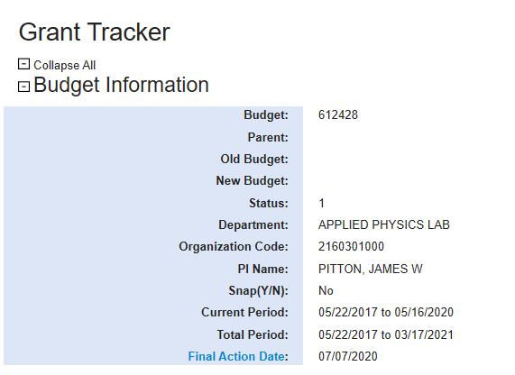
Final action date
Last day the budget is open to expenditures and revenue (status 1)
All expenditures must be posted to the sponsored budget no later than the Final Action Date
All cost share obligations must be reported to GCA
Notes:
Here is where you can find the Final Action Date on the Budget Summary Page

Slide 26
To access the Department View feature, open GrantTracker and click on
“Org Code Reports (Dept View)” at the top of the left-side menu bar

Slide 27
To create a report of expiring budgets, enter the Org Code as instructed and review the data under
“Budgets with Final Action or End Dates in Next 90 Days”
This report features an “Export to Excel” option to increase usability

Slide 28
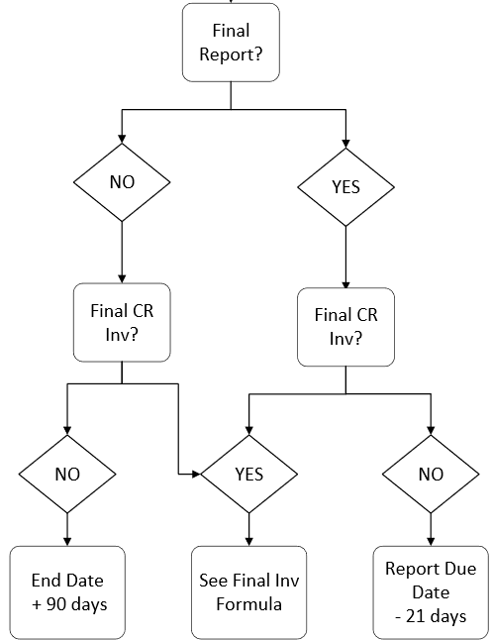
How is the Final Action Date determined?
Calculated based on final report and/or final invoice due dates
This allows a period of time for GCA to prepare required financial statements prior to the due date

Slide 29
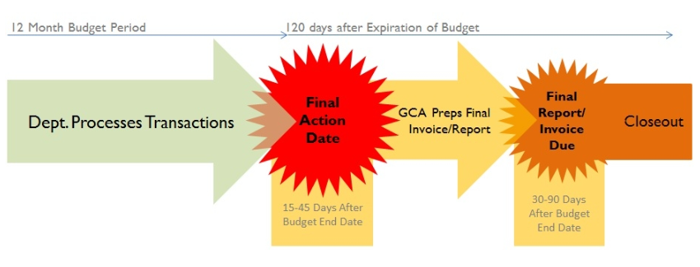
How is the Final Action Date determined?
Also allows time for department to reconcile and finalize transactions after the end of the budget period
& finalizes transactions

Slide 30
Can the Final Action Date be changed?
The Final Action Date you see in GrantTracker is automatically populated by the data entered in our systems at budget setup
Final invoice and/or report due dates (if applicable)
This isn’t something GCA can simply adjust, but a change in due date could result in a change to the Final Action Date
Notes:
A commonly asked question!

Slide 31
What if my report isn’t due for a long time?
The maximum due date GCA enters in the system is 90 days
This allows time to ensure an accurate report of expenditures
Helps maintain compliance with GIM 39 (closeout to status 4 within 120 days of award end date)
If additional transactions are expected beyond 90-day window but prior to actual due date, the standard process for late charges should be followed (more info later)
Notes:
A commonly asked question!

Slide 32
Why is my Final Action Date prior to my budget end date?
The final report or invoice is due prior to the end date or immediately after the period ends
Always refer to your award agreement for specific terms and conditions
In this case, a comment is typically included on the Funding Action, however GCA still needs time to prepare final financial statements
We recognize that this short turn-around time produces challenges for departments, so we ask that you notify us of any transactions that still need to post (in case we need to delay the preparation of invoice/report) but…
We should not be billing for/reporting on transactions that have not posted to the financial system

Slide 33
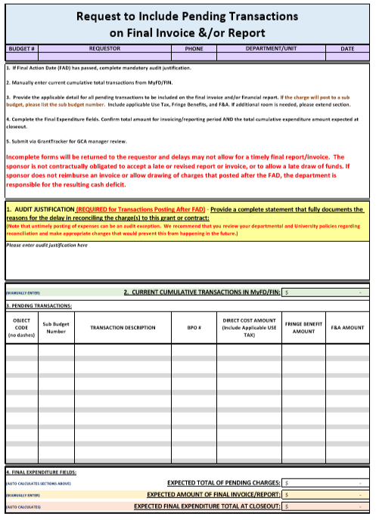
Late Transactions
If your Final Action Date is approaching and you think you might have pending transactions, please reach out to GCA BEFORE the Final Action Date
Include a completed Pending Transaction Detail Form
We need to know what is expected to post and why it is posting late

Slide 34
Late Transactions
Without notification, we will proceed with reporting/invoicing per our standard process post-FAD
Re-opening a budget for charges after FAD requires GCA manager approval
Charges under $200 are the responsibility of the department
Pending credits in any amount are allowable
Sponsor not contractually obligated to accept late/revised report or invoice
The department is responsible for any resulting cash deficit
Written sponsor confirmation is required for a revised final report or invoice
Notes:
After FAD
GCA manager review and approval is required
Outstanding transactions less than $200 will be the responsibility of the department
You must provide an audit justification for the late reconciliation
Sponsor approval may be required
Funds may no longer be available
If approved, GCA will submit a supplemental final invoice and/or a revised final report

Slide 35
Late Transactions
Late posting transactions pose an audit risk
May indicate mismanagement of award funds
Federal sponsors have been cracking down
Recent NSF audit
~70% of “questioned costs” were at or after award end
UW policies/procedures can be even more stringent than federal regulations
Unsure how late posting transactions will be handled in the future
Best practice to assume financial systems will not be as accommodating

Slide 36
Final fabrication Journal voucher
Azalea Vasquez

Slide 37
Equipment fabrication
In order to conduct a research project, sometimes there is a need to create a piece of equipment for a functionality that doesn’t exist. This is called equipment fabrication.
It is defined by the UW as “the transformation of salaries, benefits, supplies and materials, services, equipment, maintenance, and/or travel into one or more items of customized capital equipment for University of Washington use.”

Slide 38
Department responsibilities
Departments determine if they need to fabricate equipment for their sponsored award.
A TRANSPASU is sent to Grant and Contract Accounting (GCA) to set up a fabrication sub budget (budget type and class of 05-49).

Slide 39
Department responsibilities
Once the sub budget is set up and fabrication work begins the department needs to contact the Equipment Inventory Office (EIO) to obtain an equipment tag and to have their asset information entered into OASIS.

Slide 40
Fabrication journal vouchers
Another very important step during the life of the fabrication sub budget is the submission of a fabrication journal voucher (JV) to EIO.
Having a sub budget does not eliminate the need to submit this JV on a regular basis.
These JVs are used to reclassify the other costs (salaries, services, materials) to the equipment category.

Slide 41
Fabrication journal vouchers
Please allow 10 working days for the JV to post on the sub-budget, as EIO needs time to review and process. (The time is increased if errors are found on the request form.)

Slide 42
Final fabrication journal vouchers
The final fabrication JV should be posted to the sub budget before the project Final Action Date.
If the sub budget ends before the parent budget it is ok to do a final reconciliation and JV (we prefer it).
Expenditures that are not fabricated at the end of the award are subject to indirect costs.

Slide 43
Gca notifications
If we notice that your final fabrication JV has not been processed we will send you a friendly reminder in GrantTracker:
“GCA is in the process of preparing the Final Report on this budget which is due to the sponsor no later than 01/31/20. There is currently a sub budget ,which was created for the fabrication of equipment. All expenditures on this sub budget should be posted under the object code 06-00. If the expenditures are not moved to the 06 object code, they will be subject to Indirect Costs.
If we do not hear from you by 01/19/20, we will assume that the expenditures should be subject to IDC and will charge the budget at the rate of the parent budget, and report the total expense to the sponsor.”

Slide 44
Resources
To find out more information about equipment fabrication please visit the Equipment Inventory Office’s website:
https://finance.uw.edu/eio/equipment/acquisitions/equipment-fabrication
You can also contact them via phone (206) 543-4663 or email eio@uw.edu

Slide 45
Q&A Time!
What would you like to know more about?

Slide 46
COMING SOON!
Starting with the Spring Forum, we will be streaming our Forums via Zoom. More details to follow!

