Slide 1
New MyFD JV Feature Demo Webcast August 1, 2018

Slide 2
Agenda
Features & Benefits
Preparing/Submitting JV Transactions
Approver Submits JV
Approver Returns JV
Saved & Submitted JVs
Viewing Posted JVs

Slide 3
Features & Benefits
The new JV functionality in MyFD will allow users to:
Submit JV transactions within MyFD, including those for general ledger accounts
Increase visibility and compliance
Strengthen financial controls to eliminate compliance risks. Some examples are:
Adding Preparer and Approver roles, which provides an audit trail allowing proper review of accounting entries
Moving away from an Excel template that creates a lot of re-work and errors
Adding business rules to mitigate compliance risks

Slide 4
Preparing/Submitting JV Transactions
Login to MyFD
On the MyFD Home page, click on the TRANSACTIONS drop-down menu and choose Journal Voucher

Slide 5
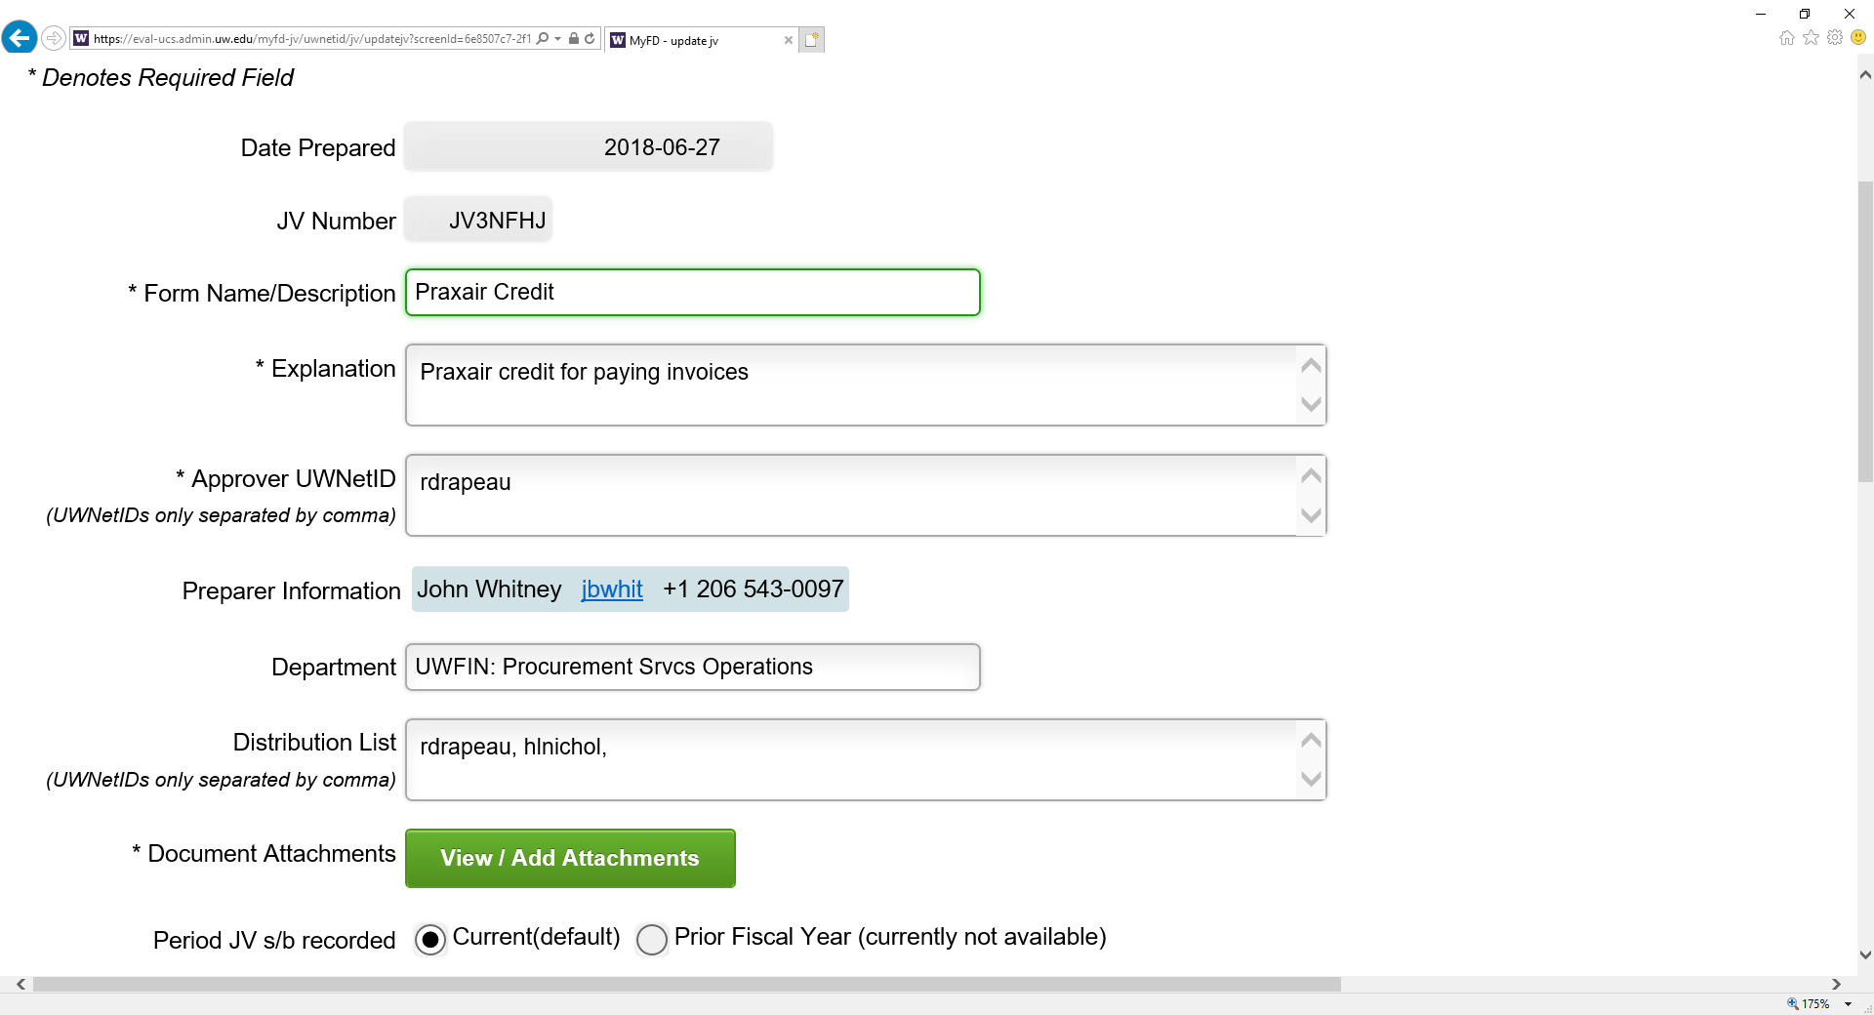
The Preparer (Initiator) enters the information into the JV form fields, as shown in the example below. Some fields are system generated, and will auto-populate with information.
Important: The Preparer or Departmental Approver (at least one person) must have current Expense Transfer authorization in ASTRA to complete the JV Process in MyFD
Asterisk = Required Field
System generated field
System generated field, JV number is created once the form is Saved
22 character limit
500 character limit
Approver(s) notified via email when JV form is Submitted.
System generated field that displays name, UWNetID and work phone #
System generated field
Notification email sent to everyone on list. Enter UWNetID’s only, shared NetID’s cannot be used
Click to View/Add Attachments

Slide 6
After clicking the View/Add Attachments button, the Save JV screen appears. In order to attach documents, the JV form must be saved.
Note: Clicking the Yes, Save button also generates the JV number
The Attachments screen appears after clicking Save. To add Attachments:
Click Browse to search for File(s) on your computer
Click Add File(s)
Attached File(s) will appear in blue text under File Name. Most file types are accepted.
Max single file size limit is 50MB

Slide 7
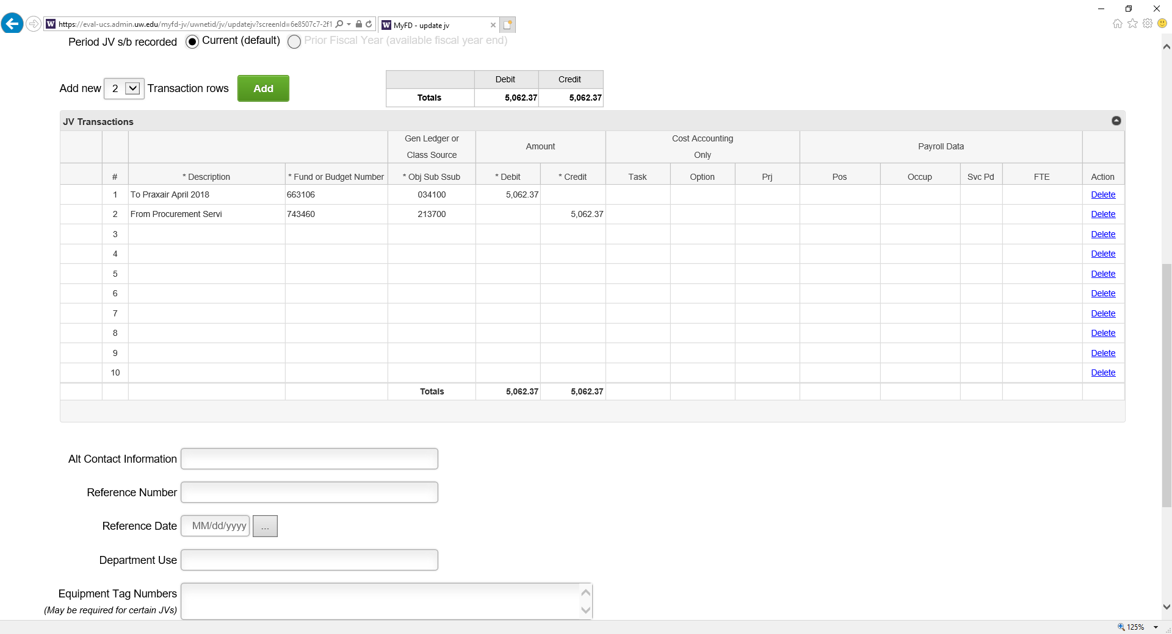
The JV Transactions form in MyFD is very similar to the manual JV form layout. Information is entered into the Transaction rows, and rows can be added or deleted. Located below the JV Transactions form is the Optional fields section.
The Preparer has the option to Check for Errors, Save or Submit Now for approval. Once Submitted, the Approver will receive an email notification stating that the JV form is awaiting approval.
The screen shot below is an example of a completed JV Transaction ready for Submittal:
Defaults to Current.
Only available during fiscal year end & Biennium close
Click to delete rows
Enter JV information into the rows
Optional fields section. Information entered into these fields will not post to FAS
Click to view calendar
Equipment Tag Numbers may be required for certain JVs
Preparer can choose Check for Errors, Save or Submit Now

Slide 8
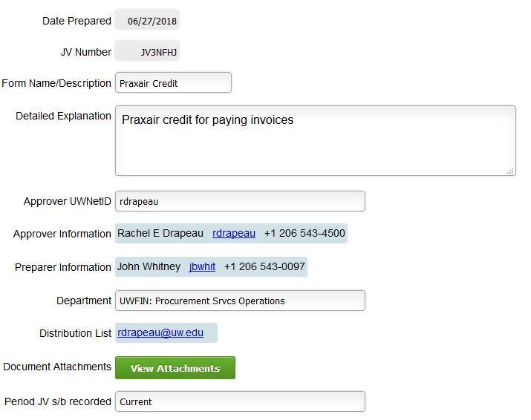
Approver Submits JV
Once the JV is Submitted, the Approver receives an email notification prompting them to review and approve the JV. The Approver can either Submit the JV, or Return to Sender (Back to the Preparer).
The Approver reviews all the JV form information and Attachments:
The Approver reviews the JV information
The Approver downloads the document(s) for review

Slide 9
Once the Approver has reviewed the full JV and Attachments, and has determined that it’s ready to be Submitted, they will click the green Submit Now button located in the bottom left corner of the screen.
The Approver reviews the JV Transaction information
The Approver checks for any optional information entered

Slide 10
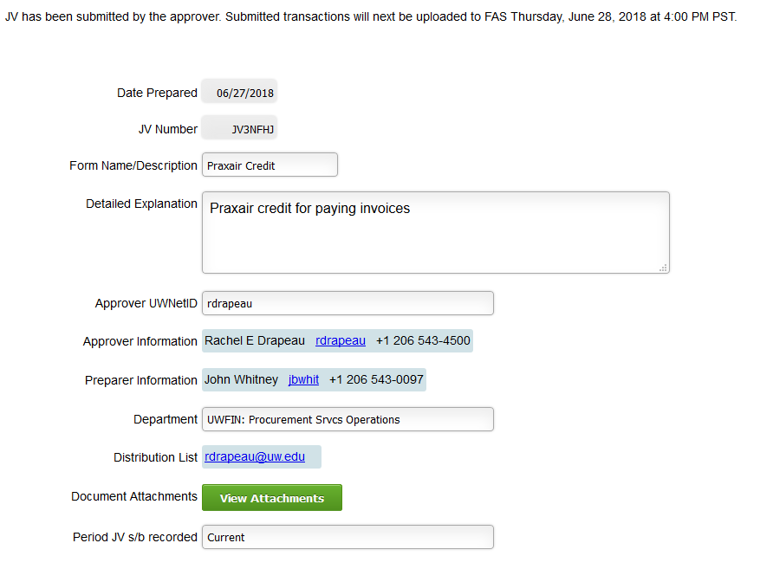
After clicking Submit Now, the Approver will see the “Submitted” confirmation message at the top of the screen indicating the date and time the JV will be uploaded to FAS, as shown below.
Note: “Will next be uploaded to FAS” in the confirmation message means that FAS has received the upload, but the transactions won’t appear in FAS until the next day
“Submitted” confirmation message

Slide 11
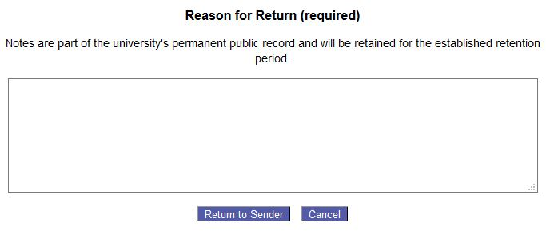
Approver Returns JV
If the Approver has reviewed the JV, and decides that it needs to be returned to the Preparer, they will click the green Return to Sender button located in the bottom left corner of the screen.
After clicking Return to Sender, a screen appears where Notes must be entered to explain the reason for the return (Required). The Approver enters their Notes into the box, then clicks the blue Return to Sender button:
The Preparer will receive an email notification stating that the JV has been Returned
The Approver also has the option to Cancel the Return
This JV is being returned because the wrong invoice was attached
Enter Notes here. Max number of characters is 8,000

Slide 12
After clicking the blue Return to Sender button in the Reason for Return screen, the screen disappears.
The Approver can access the Notes again at any time by clicking the green Expand Notes button located in the bottom left corner of the screen.
The Notes will appear showing the Approver’s UWNetID, date and time the Notes were entered.
The View Full Audit Trail link, highlighted in blue below the Notes field, is available for both the Approver and Preparer. Click the link to view the Audit Trail screen.
The Audit Trail screen displays Status, UWNetID and Date/Time information
This JV is being returned because the wrong invoice was attached. Use invoice# 123456
Click the link to access the Audit Trail screen

Slide 13
When the Preparer is notified via email that the Approver has returned the JV, they can enter back into the JV and click the Expand Notes button to view the Notes from the Approver, make any necessary corrections and Submit the JV back to the Approver.
The Preparer also has the option to click the Delete button to start the process over and create a new JV
Click to read Notes from Approver
This JV is being returned because the wrong invoice was attached. Use invoice# 123456

Slide 14
Saved & Submitted JVs
To access saved & submitted JV’s, navigate to the MyFD Home page and choose Saved & Submitted from the TRANSACTIONS drop-down menu.

Slide 15
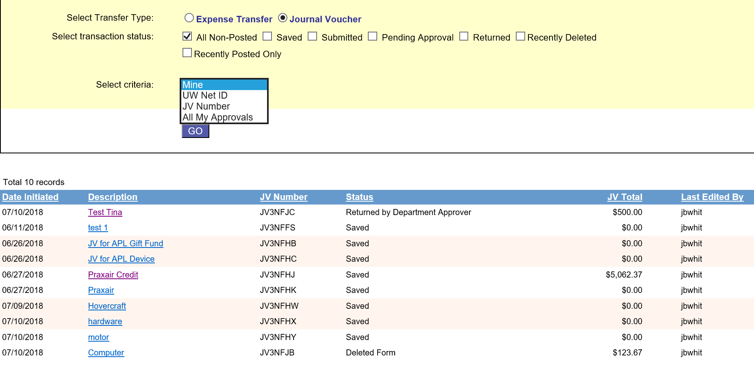
On the Saved & Submitted page, you can select the Transfer Type, transaction status and criteria to customize and refine the JV results.
Click GO to initiate the JV results
Note: Transaction entries through the MyFD JV tool impacting the general ledger and fund entries can be found on the Saved & Submitted page.
Select Journal Voucher
Select a transaction status to refine your search
Select criteria from the drop-down menu
Click GO
The JV results appear in this section
The Description column contains links to the JVs. Click the link to go to the JV form

Slide 16
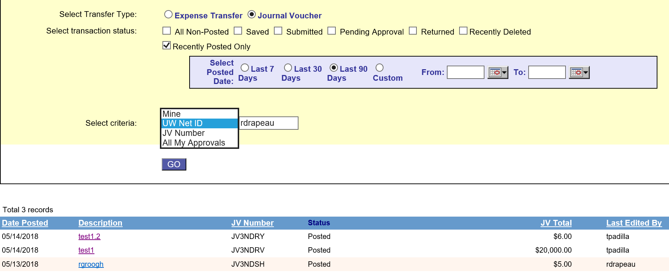
Viewing Posted JVs
To view Posted JVs, go to the Saved & Submitted page and:
Select Journal Voucher
Select Recently Posted Only
Select criteria
Click GO
The Select Posted Date section appears with several date options, including a custom fields/calendar option that allows the user to enter a specific date range. The JV results will appear at the bottom of the screen.
Select Journal Voucher
Select Recently Posted Only
After clicking GO, the Select Posted Date section appears containing several date range options
Select criteria
Click GO

Slide 17
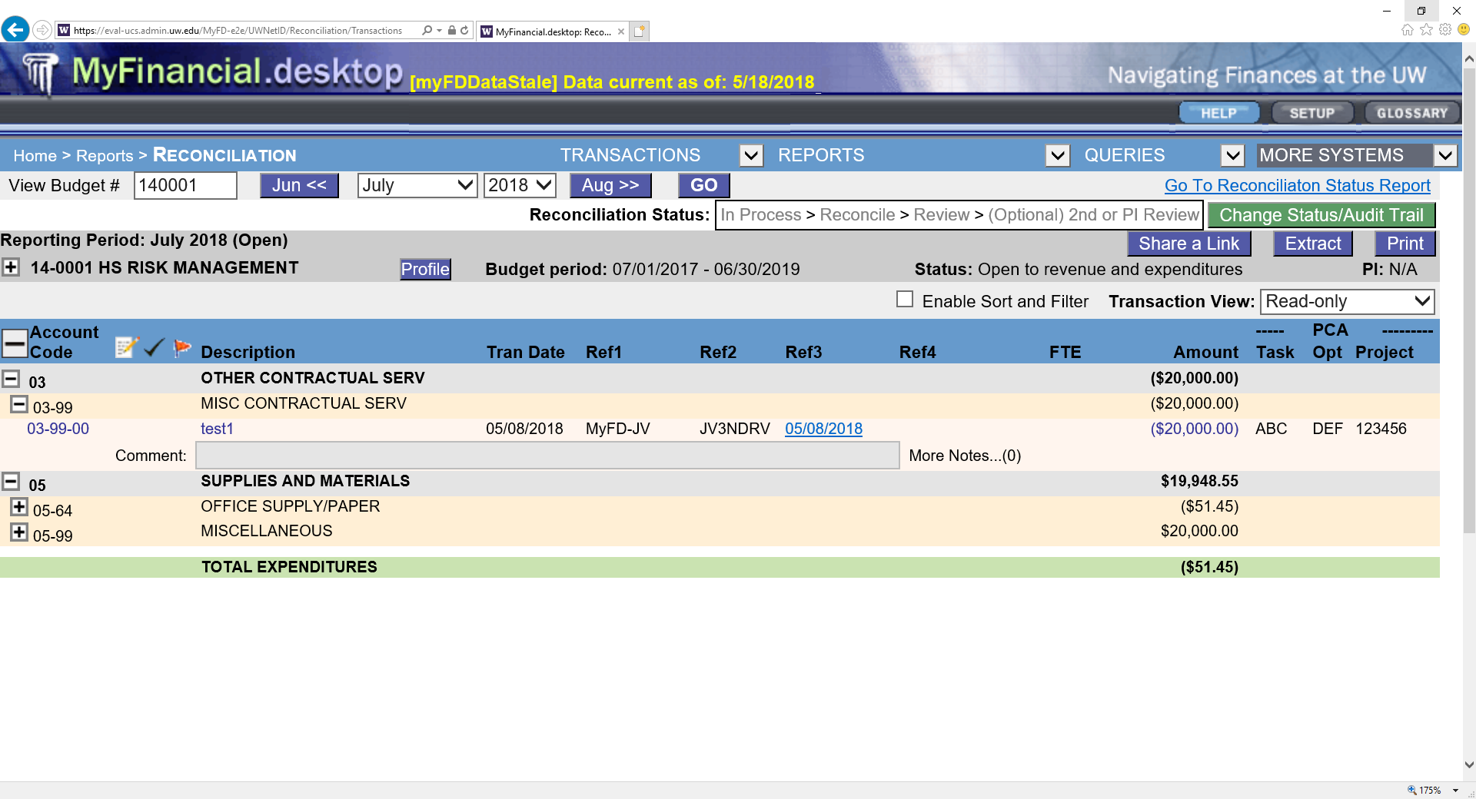
To view Posted JVs in the MyFD Reconciliation Report:
Choose Reconciliation from the REPORTS drop-down menu
Enter the JV Budget # and date information
Click the Account Code button to expand and locate Account Code used
In the Ref3 column, a link will appear highlighted in blue referencing the date the JV was prepared. Click the link to go to the JV form
The JV transactions amount link will appear in the Amount column highlighted in blue. Click the link to view the JV attachments
Enter JV Budget & date info
Choose Reconciliation
Click to expand Account Codes
JV form link appears in Ref3 column
JV transactions amount link appears in Amount column

