Slide 1
FOCUSED TOPIC
OFFICE HOURS
October 22, 2026
Matt Gardner & David Parks
Post Award Fiscal Compliance

Slide 2
Status Reports in ECC
Department Dashboard
Certification Status Report (Effort Statements)
Project Status Report (Project Statements)
Need to be assigned to the applicable cost center to view/run the Dept. Dashboard and status reports
The tools are helpful to review the status of all statements within a cost center
Matt Gardner - PAFC
Notes:
Good way to catch statements that are from past periods due to retro or PAAs which are processed months later.

Slide 3
Department Dashboard
Allows the user to view all statements within a cost center
The view will show statements in every status (Certified, Pre Reviewed, Auto Approved, etc.)
The view is filtered by reporting period; one reporting period can be viewed at one time
Benefit: Allows the user easily view the current period and the status of all statements.
  Includes information on the assigned effort coordinator or grant manager in ECC
Matt Gardner - PAFC

Slide 4
Status Reports
ECC Status Reports allow the user to view statements over multiple reporting periods and for user-defined statuses.
Benefit: Allows the user to more easily identify any overdue or newly created statements from past reporting periods.
Matt Gardner - PAFC

Slide 5
Search Function
Once you have the GR number or the faculty name, you can use search to look up the individual account
You will be able to see all the statements for that GR or Faculty (current and past periods) and the statements status
Matt Gardner - PAFC

Slide 6
Resources
Department Dashboard Overview
  https://finance.uw.edu/pafc/files/Effort-Reporting/10-department-dashboard-user-guide_v1.0.docx
Managing ECC Assignments
  https://finance.uw.edu/pafc/files/Effort-Reporting/05-manage-ecc-certifier-and-grant-manager-assignments_v1.0.docx
Matt Gardner - PAFC

Slide 7
Workday Reports
R1269.1 – Find Salary Journal Lines with Worker Details
R1234 – Grant Budget Vs. Actuals
Recent changes to these reports have made them easier and more reliable to use for comparing with ECC and identifying retro pay

Slide 8
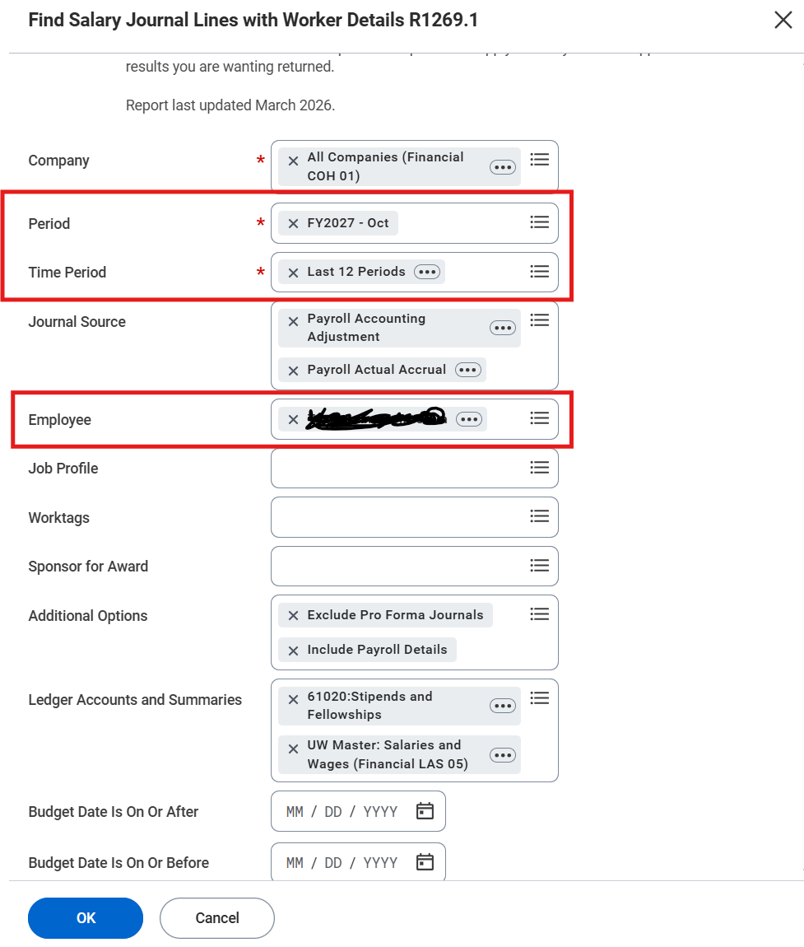
R1269.1 Parameters - Effort
“Period” should be the current month, with “Time Period” looking back far enough to cover first period involved in the statement you’re reviewing. This ensures any PAAs/retro pay lines are included in the results
“Employee” as the faculty whose effort statement you’re reconciling

Slide 9
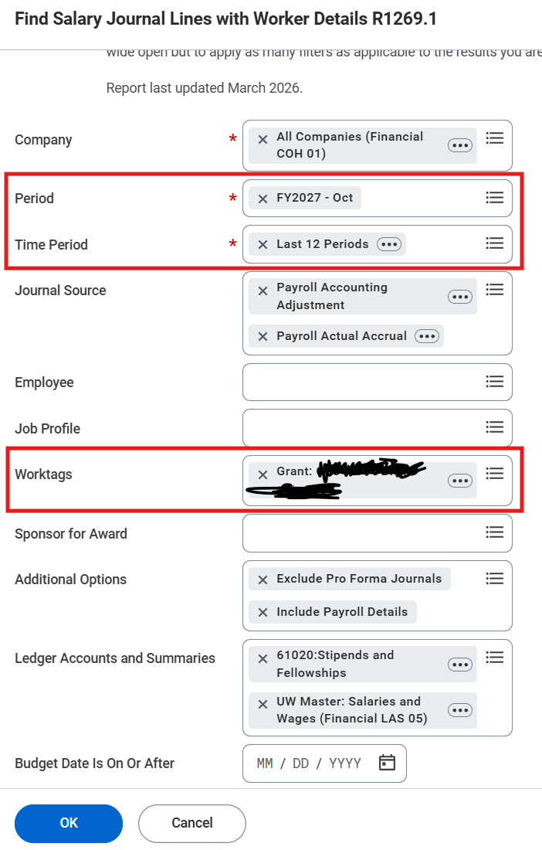
R1269.1 Parameters - Project
“Period” should be the current month, with “Time Period” looking back far enough to cover first period involved in the statement you’re reviewing. This ensures any PAAs/retro pay lines are included in the results
“Worktags” as the grant number of the project statement

Slide 10
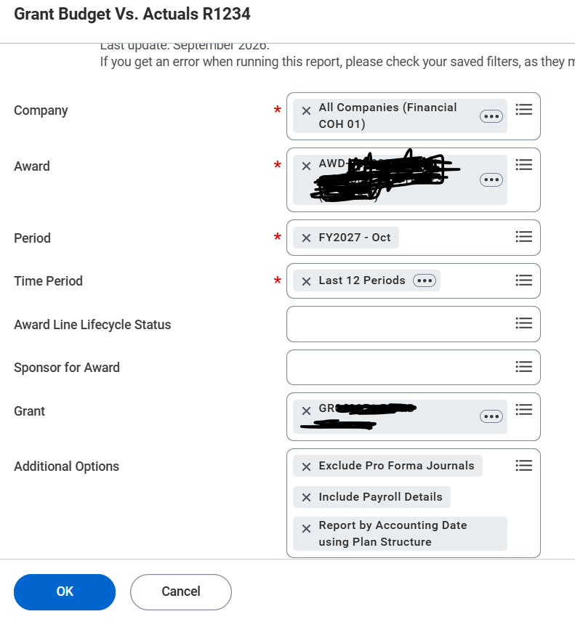
R1234 Parameters
“Period” should be the current month, with “Time Period” looking back far enough to cover first period involved in the statement you’re reviewing. This ensures any PAAs/retro pay lines are included in the results

Slide 11
Demos
Pivot tables for R1269.1
  Effort Statements
  Project Statements
R1234

Slide 12
Additional Considerations for Filters
Retro pay
Pay component
  Effort Statements only shows Institutional Base Salary (IBS)
  ECC does not receive stipend pay results.
Job category/family
  project statements only show non-faculty employees

Slide 13
Questions
Post Award Fiscal Compliance (PAFC)
  effortreporting@uw.edu (Effort questions)
  gcafco@uw.edu (All other compliance questions)
  https://finance.uw.edu/pafc/
Matt Gardner
  mgard4@uw.edu
David Parks
  parksd2@uw.edu
MRAM – Matt Gardner – PAFC

