Slide 1
Focused Topic Office Hours: Known Issues Updates, ECC Tips, PAAs w/ Salary Cap, and Award Closeout
Jan 23rd, 2025
David Parks & Matt Gardner
Post Award Fiscal Compliance

Slide 2
Known Issues Updates
Implemented Changes - Non-faculty PIs and Stipends
Periods beginning 01/01/2025, only faculty will have effort statements
Stipends are no longer sent to ECC (those previously sent are still within the system)
7/1/2024 – 12/31/2024 periods are still impacted by these issues
Difference between “Computed Effort” and “Certified Effort” columns
Result of intended functionality in ECC – demo on how to fix
Retro pay
Date fields on Workday reports (R1269.1)
Salary cap WD bug
IPAs/JPAs/Staff assignments
Working on reclassifying as not required for certifying
In the meantime are manually ‘auto approving’

Slide 3
ECC Tips
ECC reports
Statement Logs
Accessing Building/Certified/Pre Reviewed Statements
Reviewing completed statements
Job Aids: https://finance.uw.edu/pafc/effort-reporting/job-aids-and-tools/ecc-job-aids-and-user-guides

Slide 4
PAAs with Salary over the Cap (1 of 2)
There is no automatic salary cap split on PAAs
When transferring salary of someone over the salary cap to a grant that applies cap, you must include a journal line for the portion that is for Salary over the Cap (SoC)
SoC journal line requires the following worktags to be identified as SoC to the grant in ECC:
Grant
Salary Over the Cap Type
Salary Over The Cap Basis*
Must have non-grant fund/resource worktags

Slide 5
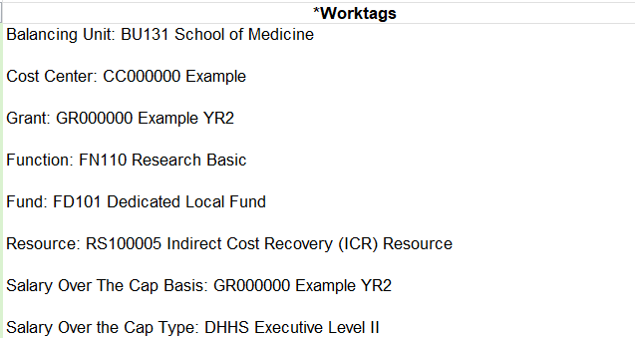
PAAs with Salary over the Cap (2 of 2)
New ‘Salary Over The Cap Basis’ worktag is not intended to be used as a replacement for the ‘Grant’ Worktag when doing PAAs for SoC
ECC will be unable to associate the SoC journal line with each individual grant, unless the ‘Grant’ worktag is present
Example:

Slide 6
Question Break

Slide 7
Award Closeout in Workday (1 of 2)
Key Terms
Final Action Date:
The last day the award line is open for the department to post expenditures and adjustments
Typically, one to three weeks prior to the due date of the final invoice or final financial report
Award Lifecycle Status will change from “Expired” to “Closeout in Progress” after the FAD
The FAD can always be found in Award Portal under “Grant Information” for the specific Grant Worktag
The FAD can’t be changed; the Lifecycle Status can be changed in Workday by GCA, but the FAD is a system-calculated date which is driven by the due date of the final invoice or financial report

Slide 8
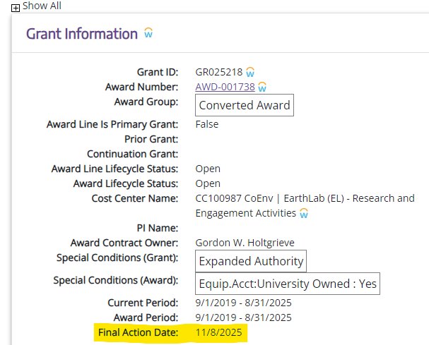
Final Action Date in Workday - Example

Slide 9
Award Closeout in Workday (2 of 2)
Key Terms
Invoice Due Date / Financial Report Due Date:
The date specific by the sponsor to request final payment or to report final expenditures for the entire award
Federal sponsors are becoming increasingly strict on final invoicing/reporting and closeout deadlines
Under UW policy, charges must post by the Final Action Date for inclusion on the final invoice or financial report (GIM 39)

Slide 10
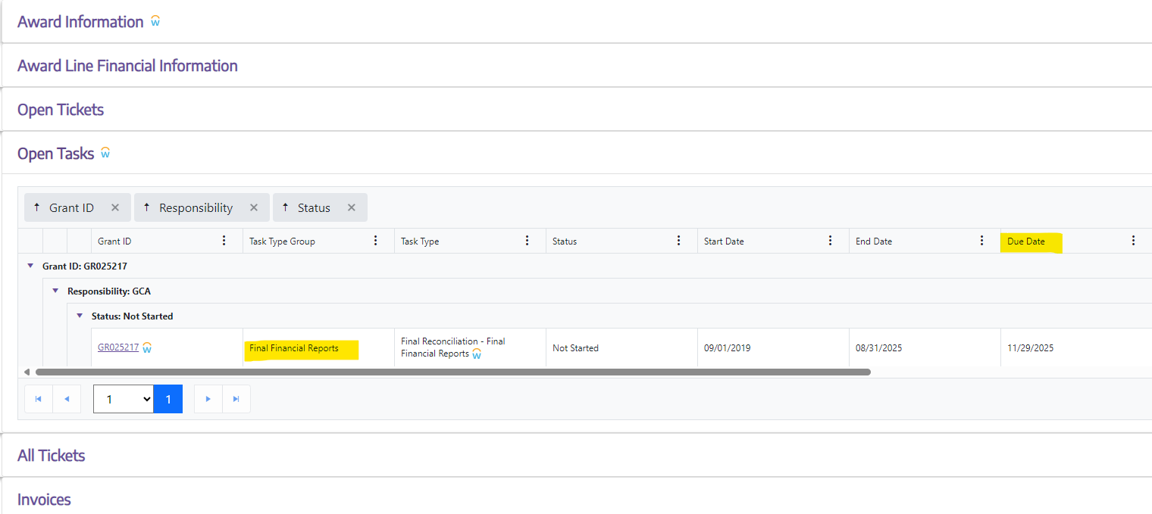
Final Invoice or Financial Report Due Dates in Workday - Example
Due dates can be found in Award Portal under the “Open Tasks” section of the Award

Slide 11
Effort Reporting and Award Closeout
Effort Reporting is not an Award Closeout task or closeout function
The Final Action Date and invoice/financial reporting due dates will typically not align with Effort Reporting periods
Do not wait until Effort or Project Statement review to reconcile/review charges on an Award that is ending
To verify charges on a closing Award, utilize the following Workday reports are available:
R1269.1 for salary charges
R1234 for all charges

Slide 12
Example of Effort Reporting and
Closeout Due Dates – Sample Award
Sample Award
Award end date: 11/30/2024
Final Action Date: 12/31/2024
Final Invoice Due Date: 1/31/2025
The Effort Report and Project Statements for the final two months of the Award will not be available to review/certify until after the Final Action Date:
Pre-Review Start: 2/4/2025
Certification Start: 2/26/2025
Certification Due Date: 5/9/2025
Need to review final salary and expenditure posting prior to Effort and Project Statement review

Slide 13
Resources
Award Portal
https://fin-s-web22.finance.uw.edu/fin/AwardPortal/Main
Lifecycle Statuses (GCA website)
https://finance.uw.edu/gca/award-lifecycle/managing-your-award/workday-award-line-lifecycle-statuses
Workday Award Task definitions
https://finance.uw.edu/gca/award-lifecycle/managing-your-award/workday-award-task-statuses

Slide 14
Questions
Post Award Fiscal Compliance (PAFC)
effortreporting@uw.edu (Effort questions)
gcafco@uw.edu (All other compliance questions)
https://finance.uw.edu/pafc/
Matt Gardner
mgard4@uw.edu
David Parks
parksd2@uw.edu

