Slide 1
Salary over the Cap (SoC) Overview
ECC Focused Topic Office Hours
November 2025
Matt Gardner & David Parks
Post Award Fiscal Compliance

Slide 2
Agenda
Salary Cap Definition and Compliance Overview
Workday Salary over the Cap (SoC) Process
Question break
ECC SoC Process
Common Issues
PAFC Resources
Questions

Slide 3
What is a Salary Cap?
A restriction by the sponsor on how much of a worker’s base salary can be charged to a grant
Imposed across all a sponsor’s awards
Different from a “Salary Limitation” or “Funding Limitation” which is award specific – e.g. K awards
Check your award terms and conditions for this type of limitation
Salary over the Cap is NOT Cost Share – not documented on a Cost Share worktag

Slide 4
Examples of Salary Caps
Most common Salary Cap is DHHS Executive Level II (EL II) cap
Currently $225,700 (effective 1/1/2025)
Typically increased annually, effective January
Applied by all DHHS agencies
Non-Federal sponsors can also apply a salary cap. For example:
PCORI: currently $200,000
Susan G. Komen Foundation: $250,000
Multiple Sclerosis Society: DHHS EL II

Slide 5
Compliance Specifics
When determining if a worker’s salary is over the cap, we compare based on Institutional Base Salary (IBS)
Cap is based on rate of pay
Actual FTE impacts cap, as does level of effort an individual grant
Any IBS earned beyond an imposed cap must be charged to non-sponsored sources
Cap compliance must be documented within the effort reporting process

Slide 6
Basic SoC Calculation
EL II cap: $225,700 per year
Worker’s paid IBS: $250,000 per year at 100% FTE
Effort commitment to the grant: 10%
$250,000 * 10% = $25,000 total
$225,700 * 10% = $22,570 charged to the grant
$25,000 - $22,570 = $2,430 SoC

Slide 7
UW SoC Processes – Workday
Workday automates the SoC calculation – splits off cap compliant amount from salary allocation when payroll runs
Award line setup – GCA needs to associate the sponsor’s cap (if they apply one) to each award line
Annual cap updates
Salary allocations
Non-clinical (X only) – allocate committed effort to GR
Clinical (X & Y) – may need allocation adjustment (see allocations calculator)
PAAs – WD doesn’t split cap for PAAs. Need to do this manually by including line for SoC.

Slide 8
Salary Cap flag in Workday
Salary cap indicator can be on either the Award line or the Grant line.
Converted awards will have the cap on both, but awards set up after 7/1/23 will the flag only on the Award line.

Slide 9
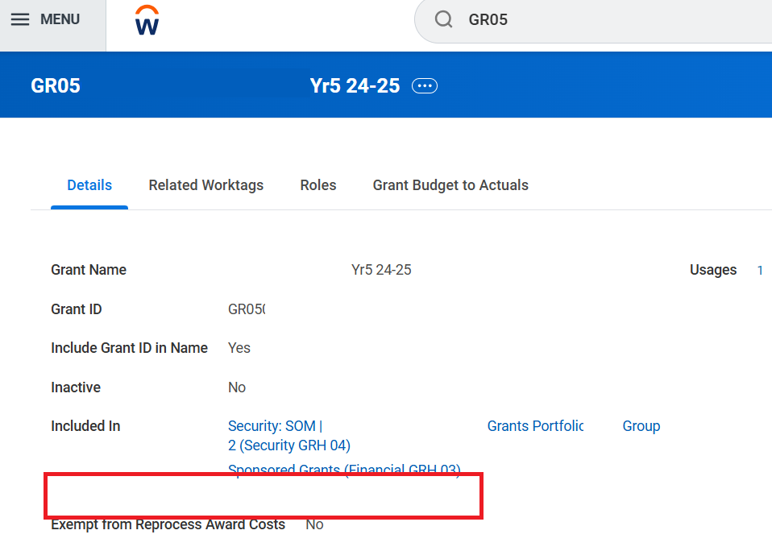
Salary Cap flag in Workday
Grant line may not show SoC flag:

Slide 10
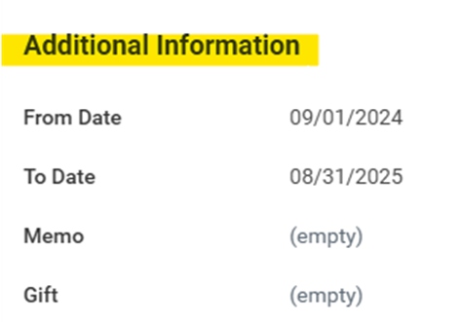
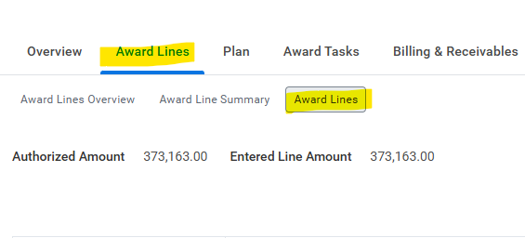
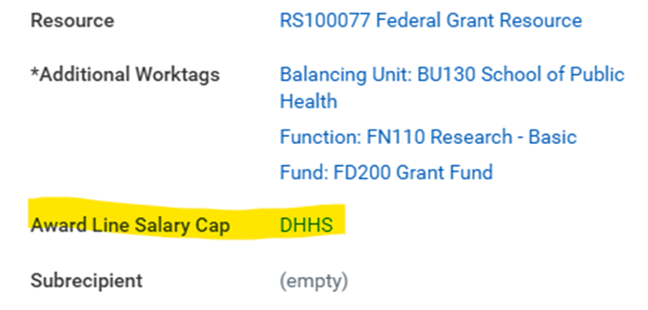
Salary Cap flag in Workday

Slide 11
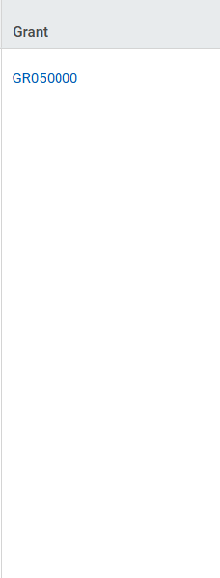
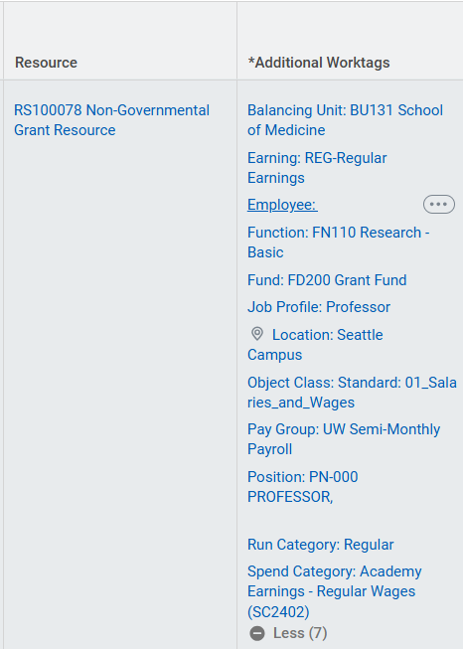
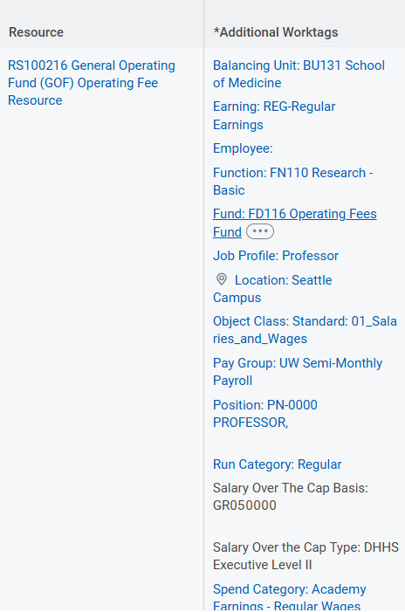
SoC in Workday
Grant
Grant paid result line
SoC result line (still associated w/ GR #)
Different resource (RS)
Different fund (FD)
SoC identifier worktags. ‘Basis’ worktag is not used by ECC yet. ‘Type’ identifies the result line as SoC to ECC.
Automatically populated on the journal line from the allocation
Notes:
SoC source (FD, RS, etc…) is determined within the allocation – specified by the department before payroll runs

Slide 12
Question Break

Slide 13
UW SoC Process - ECC
ECC is where cap compliance is documented, and is the system of record for SoC
Prior to Certification:
Important to review effort statements for cap compliance (SoC Verification tool)
Complete any necessary shifts (most commonly to account for a Y salary component) – shift job aid (#4)
Notes:
Documented in ECC because ECC documents the amount of effort, which is needed to understand whether the salary charged to the grant is cap compliant or not – SoC required is always relative to effort performed

Slide 14
SoC in ECC
Often referred to in the ECC as “Cost Share” (“Add Cost Sharing” = ‘Shift’) – but it is not truly Cost Share
Within a separate column on the statement – “K Award / Funding Shift / Over Cap”

Slide 15
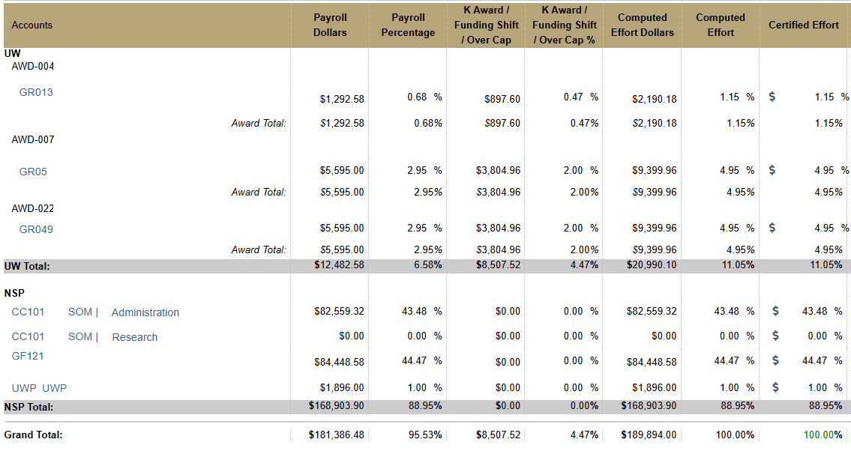
SoC on an ECC Effort Statement
Total (grant paid + SoC) attributing to effort to the grant
SoC results
Grant paid results

Slide 16
Common Issues
SoC not associated with a sponsored award
Mistakes in shifts
Certified without compliant SoC coverage
Retro issues

Slide 17
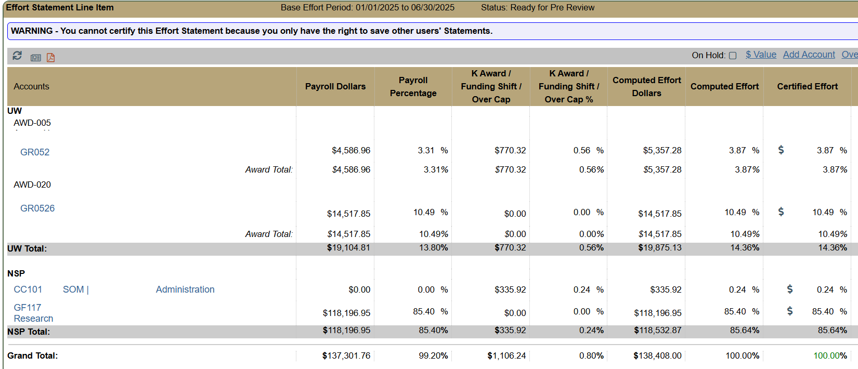
1 - SoC not associated with a sponsored award
Caused by:
PAAs of SoC lines without a Grant worktag
PAAs to stand alone grant worktags
Example (PAA of SoC w/out a GR):
Correctable with a PAA or shift

Slide 18
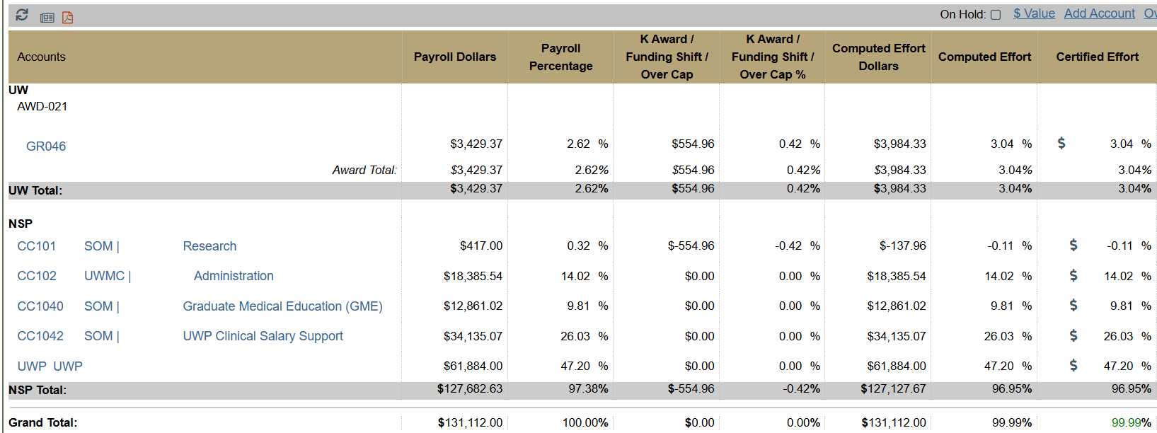
2 - Mistakes in Shifts
Flipping ‘To’ and ‘From’ accounts
Insufficient funds in selected ‘From’ account
Must reach out to PAFC (effortreporting@uw.edu) to delete/edit mistakes
Example (Insufficient funds):
Shifted $554.96 to the grant from the research cost center
Results in negative balance to research cost center – not compliant
Maximum amount that can be shifted from this source

Slide 19
3 - Certified without compliant SoC Coverage
Either because…
Necessary shifts were not completed
Or did PAAs without SoC journal lines added
Statement needs to be reopened to allow for shifts (or maybe PAAs)
Use SoC verification tool for determining shift amounts

Slide 20
4 – Retro pay
Retro pay for individuals:
Workday incorrectly applies the salary cap on some retro pay for individuals that are below the cap threshold.
Current Status:
Workday deployed an update which was supposed to fix the issue of the system incorrectly applying the salary cap on Retro Pay
Based on UW testing, the update did not fix the issue
Workday/UW are continuing to pursue a fix
Current Solution:
If Workday incorrectly applies the salary cap on retro pay, a PAA must be processed to move the over-the-cap portion back to the applicable grant worktag.

Slide 21
Salary Cap: Use of clinical pay for cap coverage
Allowability:
Clinical pay is an allowable source of cap coverage if the applicable clinical time benefits the objectives of the associated sponsored award.
This would also apply to using clinical pay to meet a cost share commitment (or other effort commitments)
Certification of an Effort Statement where clinical pay is used to cover salary cap or to meet a cost share commitment is an affirmation that a portion of the clinical time directly benefits the objectives of the applicable sponsored award

Slide 22
PAFC Resources
Salary Cap webpage
Calculators/Tools – allocations calculator and SoC verification tool
Job aids
Salary cap notice examples:
NIH
AHRQ
GIM 35 – Effort Reporting

Slide 23
Questions?
Post Award Fiscal Compliance (PAFC)
effortreporting@uw.edu (Effort Reporting / ECC questions)
gcafco@uw.edu (All other compliance questions)
https://finance.uw.edu/pafc/
Matt Gardner
mgard4@uw.edu
David Parks
parksd2@uw.edu

