Slide 1
Focused Topic Office Hours: ECC Update
July 18th, 2024
David Parks & Matt Gardner
Post Award Fiscal Compliance

Slide 2
Recap: Effort certifications in ECC
Employee Compensation Compliance (ECC) is the system replacing eFECS for effort certifications at the UW. ECC statements include:
Effort Statements (old “FECs”)
Project Statements (old “GCCRs”)
Issue with payroll data integration discovered which required pausing certifications until fixes could be implemented
Fixes were implemented and tested, and all payroll data is currently re-loading into the system
ECC will be re-started in the next couple of weeks and effort certifications will resume in August

Slide 3
Effort Statements -
Revised Reporting Periods
Effort Statements
Who certifies: All faculty with compensation paid from a sponsored award
Standard period: Six months
January 1 – June 30
July 1 – December 31
Revised period: One year
July 1, 2023 – June 30, 2024

Slide 4
Project Statements -
Revised Reporting Periods
Project Statements
Covers: Staff salaries for specific sponsored awards
Who certifies: Principal Investigators
Standard: Every three months/quarter
January 1 – March 31
April 1 – June 30
July 1 – September 30
October 1 – December 31
Revised: Six months
July 1, 2023 – December 31, 2023
January 1, 2024 – June 30, 2024

Slide 5
Target Re-start and Certification Dates
Re-open ECC and kick off Pre-Review period
Week of July 22nd 29th
No hard due date on end of Pre-Review period
Completing the pre-review enables certification to occur
Certification period
Tentatively August 14th 22nd - October 25th
Applies to all three of FY2024 reporting periods:
Effort Statement – July 1, 2023 – June 30, 2024
Project Statement – July 1, 2023 – December 31, 2023
Project Statement – January 1, 2024 – June 30, 2024
Back to the standard reporting periods for FY2025

Slide 6
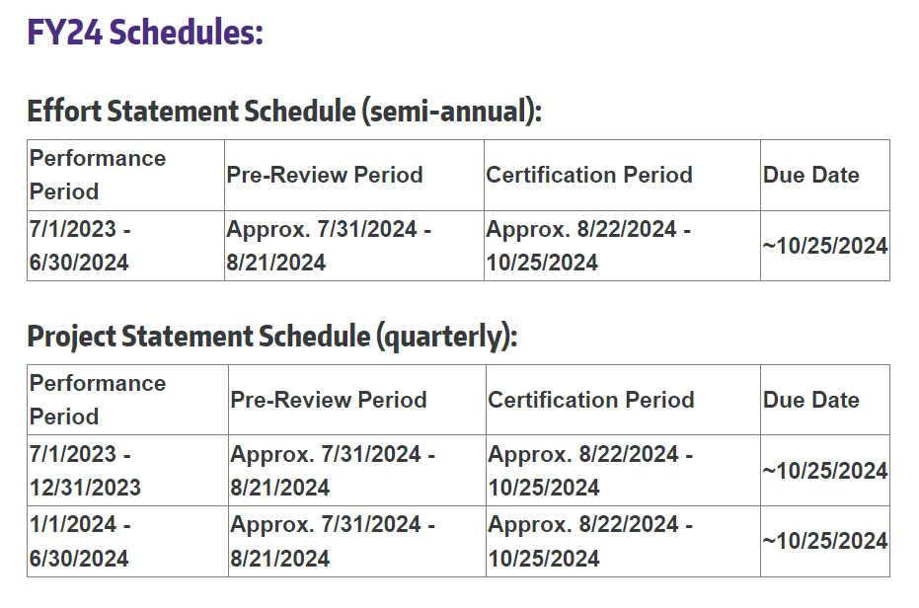
Approximated FY24 Schedule
https://finance.uw.edu/pafc/effort-reporting/effort-reporting-schedule

Slide 7
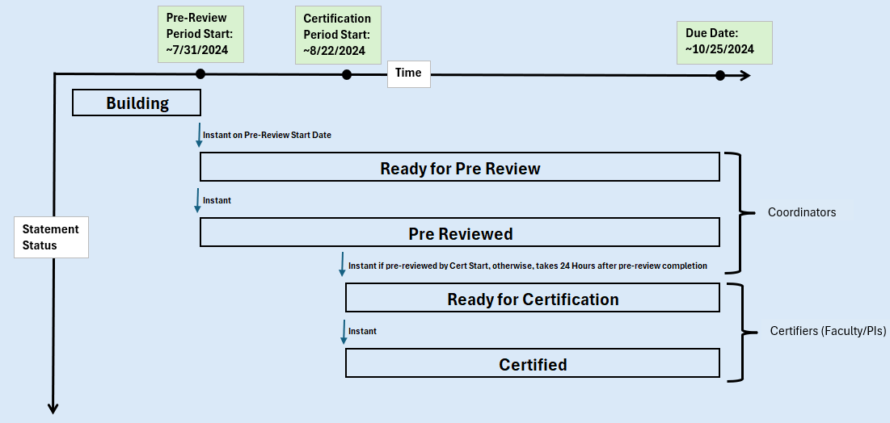
Statement Status Flow Timeline

Slide 8
Lingering Issues in ECC / Impacts of Fixes
Linger Issues:
Stipends
Non-faculty PIs on Effort Statements
Impacts:
“NF-Pay” - Pay components outside of REG Equivalent Pay Component Group and not ADS/ENS
Summarized values per pay period
Reports certified prior to the operational pause are not longer valid

Slide 9
Resources and Links
ECC
https://washington.huronecc.com/ecc/multipleInstitutionSelect.action
Job Aids & User Guides
https://finance.uw.edu/pafc/effort-reporting/job-aids-and-tools/ecc-job-aids-and-user-guides
Salary Cap Calculator (recent update impacting < 100% FTE)
https://finance.uw.edu/pafc/effort-reporting/job-aids-and-tools/calculatorstools
Training Videos
https://finance.uw.edu/pafc/effort-reporting/training
Recordings of prior Focused Office Hours
https://finance.uw.edu/pafc/session_recordings

Slide 10
Future Office Hours
Future “Focused” Office Hours
August 1st
August 15th
Open Office Hours Every Friday at 10am
https://finance.uw.edu/pafc/effort-reporting/ecc-office-hours

Slide 11
Questions
Post Award Fiscal Compliance (PAFC)
effortreporting@uw.edu (Effort questions)
gcafco@uw.edu (All other compliance questions)
https://finance.uw.edu/pafc/
Matt Gardner
mgard4@uw.edu
206-543-2610
David Parks
parksd2@uw.edu

