Slide 1
Focused Topic Office Hours: Allocations Tool & Pre-Review Tips
August 15th, 2024
David Parks & Matt Gardner
Post Award Fiscal Compliance

Slide 2
ECC Status

Slide 3
Salary Allocations Tool
Designed for…
Calculating necessary REG allocation to achieve an effort amount the user enters in the tool
Allocations to sponsored awards (grants)
Showing what Workday will calculate given the suggested allocation
Showing how the payroll will appear in ECC and the effort it will show up as
Most helpful when…
Faculty’s Institutional Base Salary (IBS) is over the salary cap & they have commitments to grants that apply cap
Faculty has salary components outside of REG pay (ADS/ENS and Clinical)

Slide 4
Salary Allocations Tool
Not designed…
As a budgeting tool
For determining non-sponsored allocations
For when ADS is charged to grants

Slide 5
Recent Update to the Tool
Changes relating to situations less than 100% FTE
Removed the forced FTE adjustment column (column D)
Added optional tab with the formula to adjust for less than 1 FTE
Instructions on the new sheet
Reach out to us (effortreporting@uw.edu) if you have any questions regarding the new tab

Slide 6
Demo…
Tool locate here:
https://finance.uw.edu/pafc/effort-reporting/job-aids-and-tools/calculatorstools

Slide 7
Institutional Base Salary (“IBS”)
Under the Uniform Guidance…
“IBS is defined as the annual compensation paid by a [university] for an individual's appointment, whether that individual's time is spent on research, instruction, administration, or other activities.”
“Charges of a faculty member's salary to a Federal award must not exceed the proportionate share of the IBS for the period during which the faculty member worked on the award.”
2 CFR 200.430(h)(2)

Slide 8
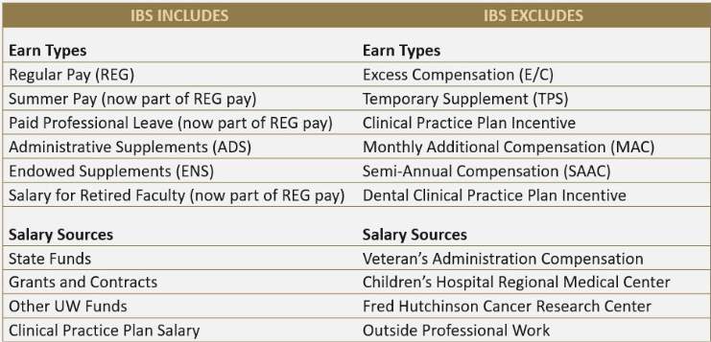
IBS at the UW

Slide 9
Effort Statements and IBS
Effort is reported as a proportion of IBS, not just REG pay, as required under the federal regulations 2 CFR 200.430(i)
When faculty are also paid an ADS or ENS, this will impact how payroll allocations for REG will display on the Effort Statement

Slide 10
Calculator Questions…

Slide 11
Pre-Review Tips for Effort Statements
PAAs – make sure all that have posted are showing in ECC (R1269.1 Report is helpful for comparing to Workday to ECC)
Faculty’s effort shown on the statement vs. what was committed in the proposal
Cost Share Worktags
K-Award effort level
Making notes or attachments for specific circumstances/justifications (reach out to effortreporting@uw.edu with questions on if a situation would require this)

Slide 12
Resources and Links
ECC
https://washington.huronecc.com/ecc/multipleInstitutionSelect.action
Job Aids & User Guides
https://finance.uw.edu/pafc/effort-reporting/job-aids-and-tools/ecc-job-aids-and-user-guides
Salary Cap Calculator
https://finance.uw.edu/pafc/effort-reporting/job-aids-and-tools/calculatorstools
Training Videos
https://finance.uw.edu/pafc/effort-reporting/training
Recordings of prior Focused Office Hours
https://finance.uw.edu/pafc/session_recordings

Slide 13
Future Office Hours
Future “Focused” Office Hours
Open Office Hours Every Friday at 10am
8/29/2024
https://finance.uw.edu/pafc/effort-reporting/ecc-office-hours

Slide 14
Questions
Post Award Fiscal Compliance (PAFC)
effortreporting@uw.edu (Effort questions)
gcafco@uw.edu (All other compliance questions)
https://finance.uw.edu/pafc/
Matt Gardner
mgard4@uw.edu
206-543-2610
David Parks
parksd2@uw.edu

Slide 15
Appendix
Cost Share
Cost Share in Workday
Cost Share in ECC

Slide 16
Cost Share
Cost Share will appear in ECC on Effort and Project Statements only when salary is charged to the cost share award line Worktag in Workday.
If the salary is charged to either a different grant Worktag or to a non-sponsored Worktag (Gift, RCR, Start-up, etc.), the salary will not appear as Cost Share on either Effort or Project Statements.

Slide 17
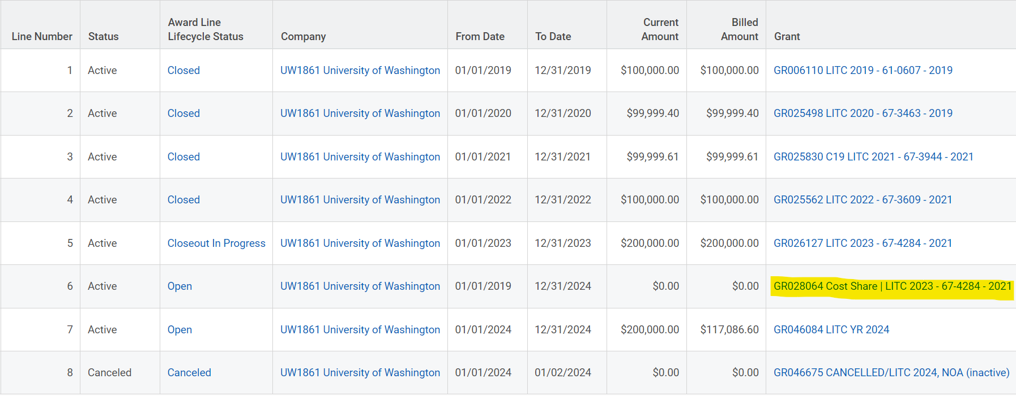
Cost Share in Workday

Slide 18
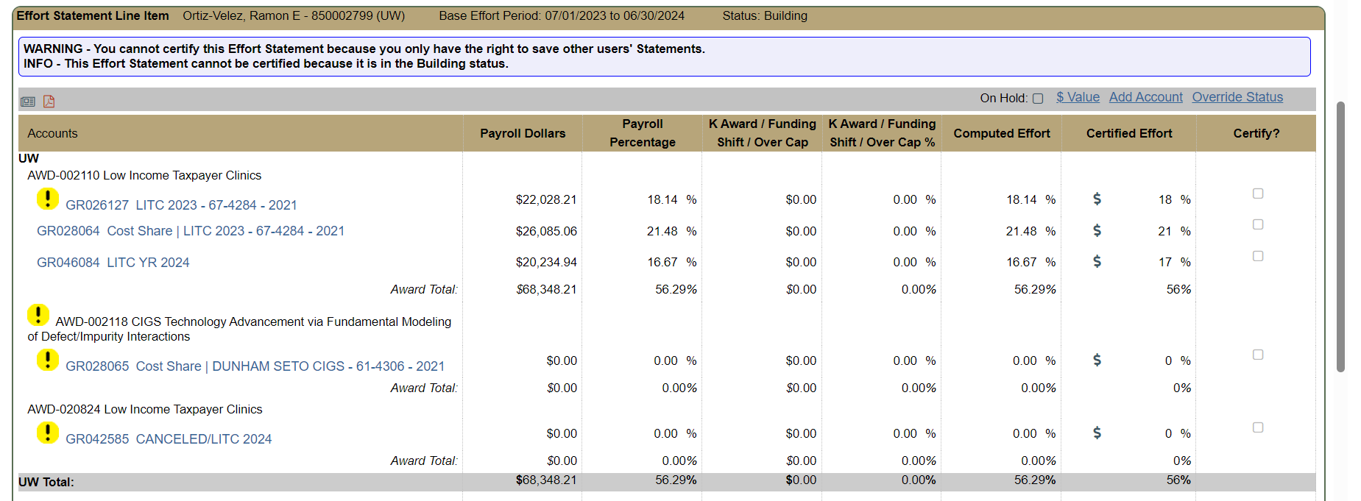
Cost Share in ECC

