Slide 1
Workday Salary Cap
MRAM
Stepanka Sirotek, Jesse Rice, Nicole Flagg
Integrated Service Center (ISC)

Slide 2
What are the issues?
Cannot use a Standalone Grant to pay for Salary Over the Cap
Cannot pay for Salary Over the Cap with a different company than the regular salary
Workday working on enhancing Salary over the Cap features but there are no guarantees and earliest release would be second half of 2024

Slide 3
Standalone Grant Solution
The recommended resolution for this issue is for departments to use another worktag and process a funding transfer to reflect the cost on the Standalone grant desired.
It is important not to use PAAs to try to solution for this
Specific solutions will be department specific. Communication has been sent to URLs/Department leaders to pass on guidance within their School/College

Slide 4
Intercompany Solution
We have worked with School/College leaders to stand up a series of Program Worktags to account for these cases
The leaders/Shared Environments of the Schools/Colleges will transfer the funds between each other on a regular cadence

Slide 5
Intercompany Salary Cap Worktags
Program | Name
PG121320 | SPH | Salary Over the Cap SOM
PG121321 | CAS | Salary Over the Cap SOM
PG121322 | Engineering | Salary Over the Cap SOM
PG121323 | Dentistry | Salary Over the Cap SOM
PG121324 | Nursing | Salary Over the Cap SOM (still being worked on)
PG121325 | SOP | Salary Over the Cap SOM
PG121326 | Social Work | Salary Over the Cap SOM
PG121327 | SOM | Salary Over the Cap UW1861

Slide 6
Intercompany Example #1
Jane PI is in SOM
She works on a grant in UW1861. Her home department in SOM wants to pay her salary over the cap
You can use the newly created Program worktags for this scenario

Slide 7
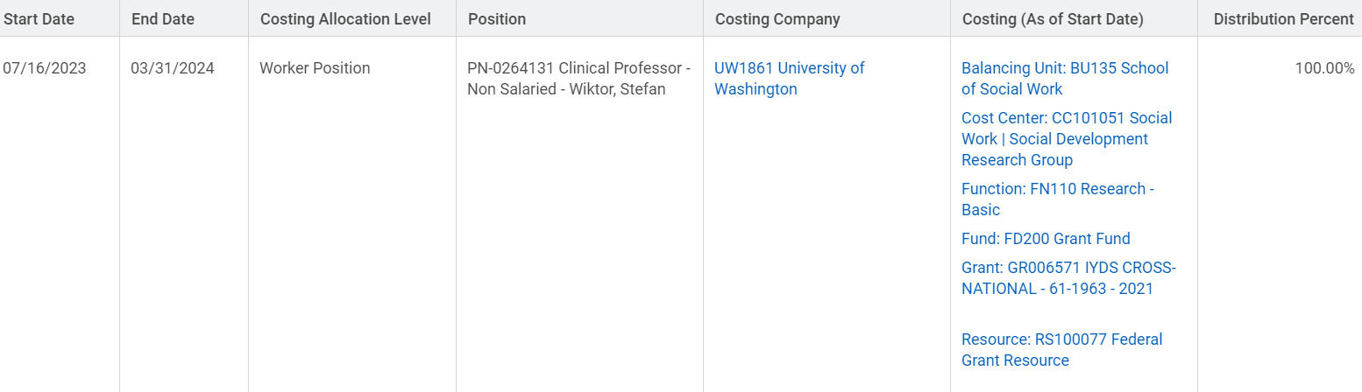
Regular Salary Component SOM Employee working on UW1861 grant
Jane PI

Slide 8
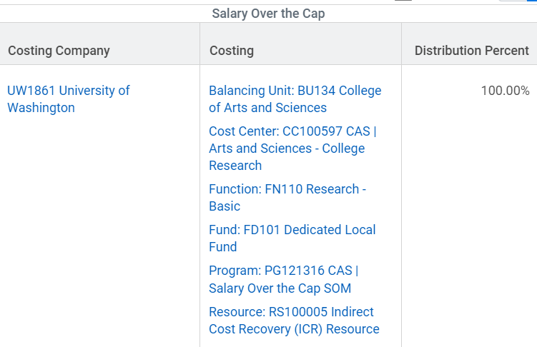
Over the Cap Salary Component SOM Employee working on UW1861 grant

Slide 9
Intercompany Example #2
Joe PI is in UW1861
He works on a grant in SOM. His home department in UW1861 wants to pay his salary over the cap
You can use the newly created Program worktags for this scenario

Slide 10
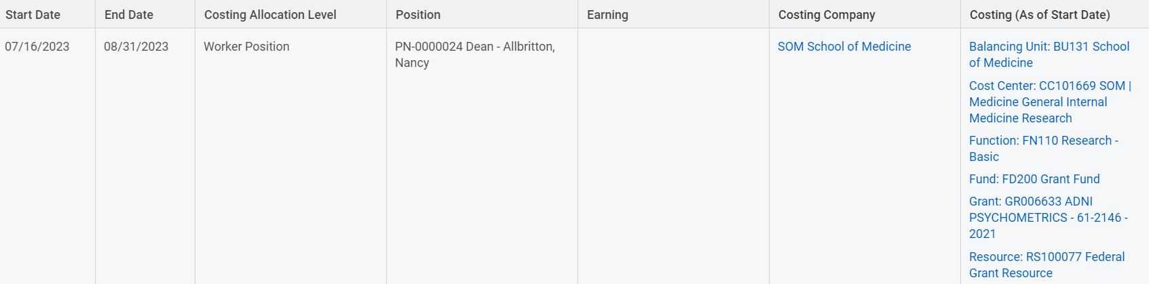
Regular Salary Component UW1861 Employee working on SOM grant
Joe PI

Slide 11
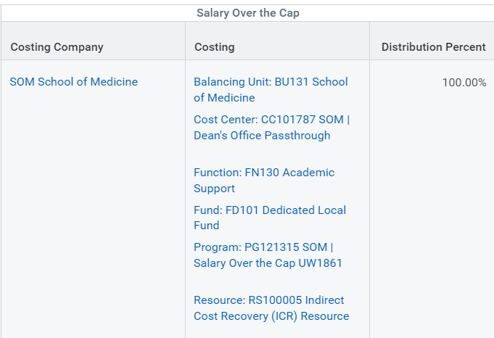
Over the Cap Salary Component UW1861 Employee working on SOM grant

