Slide 1
LEGISLATIVE KICK-OFF 2026
UW Finance, Planning & Budgeting
UW State Relations

Slide 2
FPB POLICY, PLANNING & STATE OPERATIONS (PPSO) TEAM CONTACTS
Jed Bradley
jedbrad@uw.edu
(206) 616.4684
Christine Leibbrand
cleibb@uw.edu
(425) 647.5101
Teja Raichur
tejar@uw.edu
(student intern)
Lauren Hatchett
lehatch@uw.edu
(206) 616.7203
Alexandre Beard
ajbeard2@uw.edu

Slide 3
LEGISLATIVE PROCESS, BILL ANALYSIS, & LOBBYGOV
Lauren Hatchett
Senior Policy Analyst
Finance, Planning & Budgeting

Slide 4
WHY DOES IT MATTER?
Legislative decisions impact:
Higher ed. policy (tuition & financial aid, access, preparedness, curriculum, enrollment).
UW operations (budget, sustainability, transportation, real estate).
Health care policy affecting UW Medicine.
Lots of other things (research, land use, forest lands, etc.)

Slide 5
LEGISLATIVE TERMS
“House of Origin” or “First House”: The chamber in which a piece of legislation originates (can be House or Senate)
“Opposite House” or “Second House”: The second chamber through which a piece of legislation moves
Substitute bill: (SSB or SHB) a new version of a bill that completely replaces the original bill
“Striking amendment” or “striker”: an amendment that removes everything and inserts a new bill
Engrossed: (E2SHB) legislation into which one or more amendments have been incorporated, and has passed a chamber

Slide 6
LEGISLATIVE PROCESS
Bill Intro.
Public Hearing
Executive Session
House of Origin Floor
Opposite House
Governor Action
Need feedback here!

Slide 7
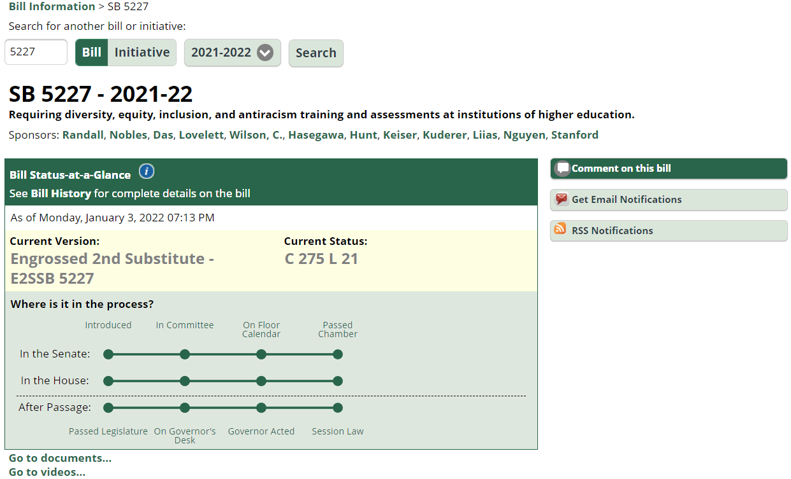
STEP 1: READ THE BILL
Scroll Down

Slide 8
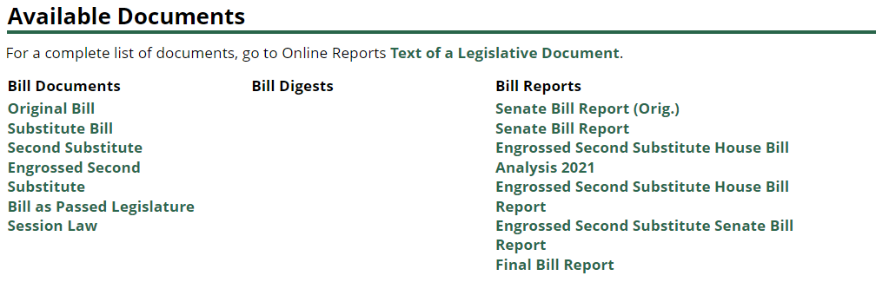
Available Documents
Make sure you’re reading the right version! Most recent will be last.
Bill reports can provide helpful context but are not a replacement for reading the bill!

Slide 9
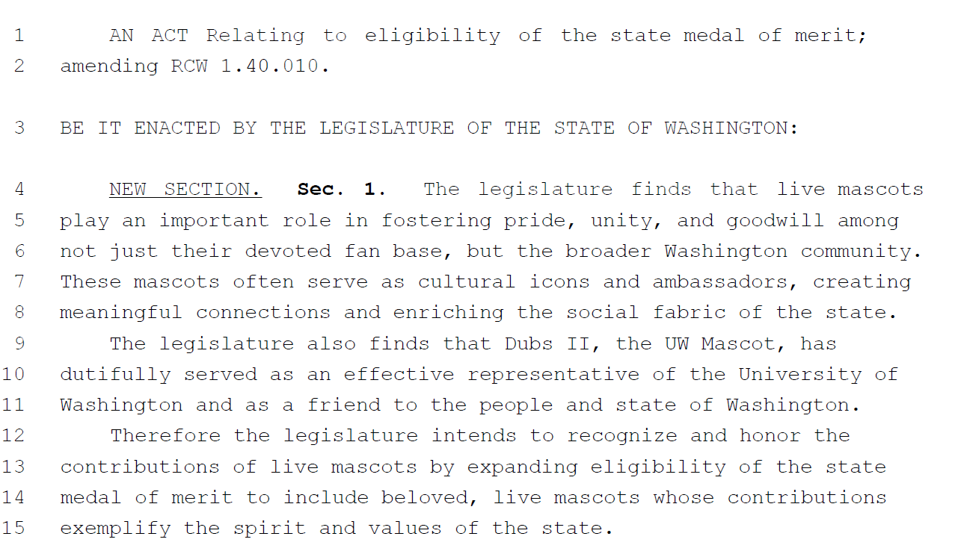
Bill Text Example
“NEW SECTION” language is all new but is not underlined. Please read carefully!

Slide 10
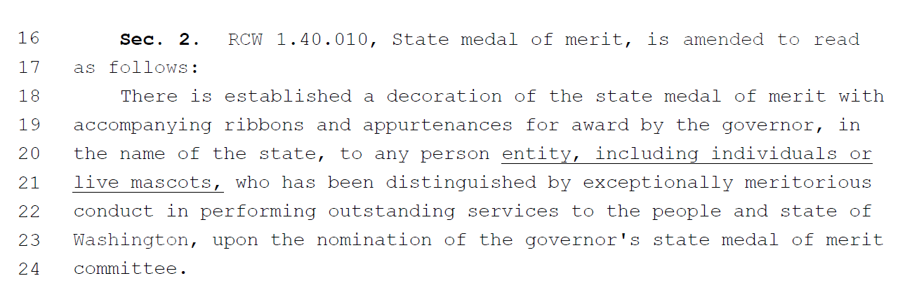
Bill Text Example 2
Struck out text is to be removed from existing statute.
Underlined text is entirely new language

Slide 11


Dubs

Slide 12
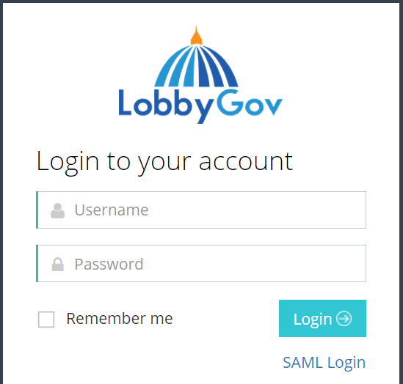
WHAT IS LOBBYGOV?
uw.lobbygov.com

Slide 13
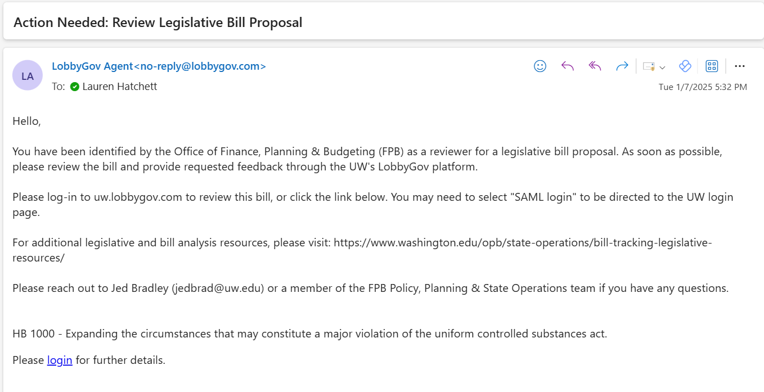
REVIEWER VIEW OF LOBBYGOV

Slide 14
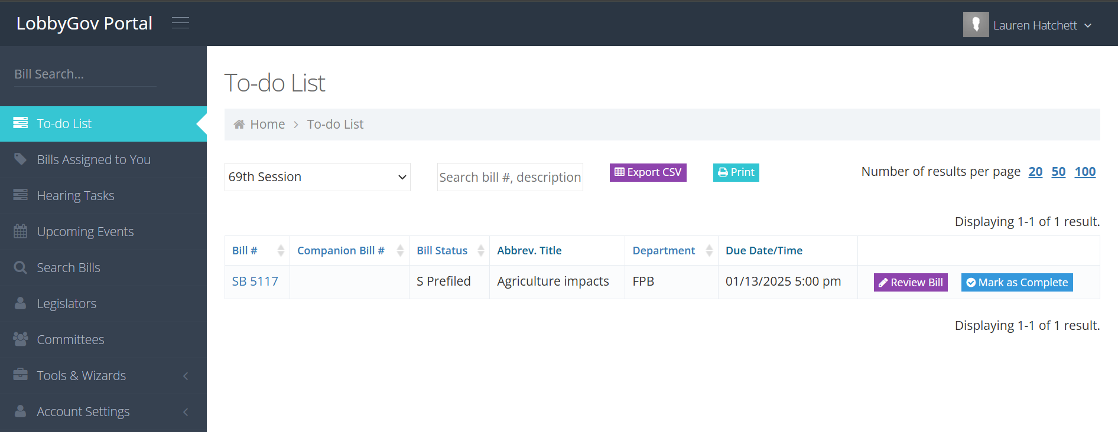
REVIEWER VIEW CONT.

Slide 15
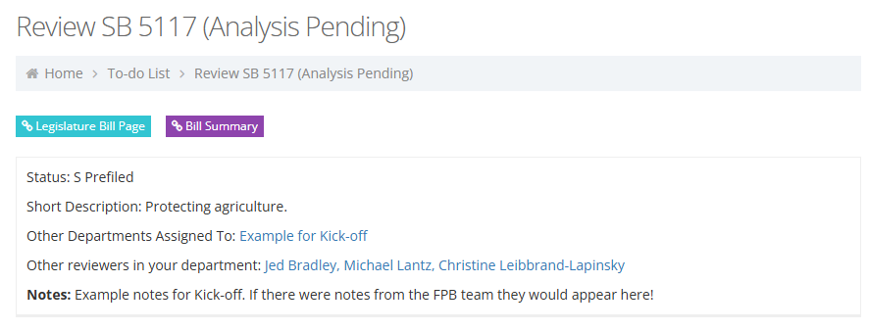
LobbyGov Review

Slide 16
PROVIDING ASSESSMENTS
Helpful:
Provides a detailed summary on what the bill does & how it changes current policy.
Summarizes how the change would affect UW.
Recommends a position and priority.
Less Helpful:
Limited and does not assess the impact of the bill.
Indicates concerns and recommends as a high priority bill but does not detail what the concerns are.
Does not offer amendments to alleviate concerns.
Does not offer any helpful rationale for opposition.
NOT HELPFUL:
No assessment provided

Slide 17
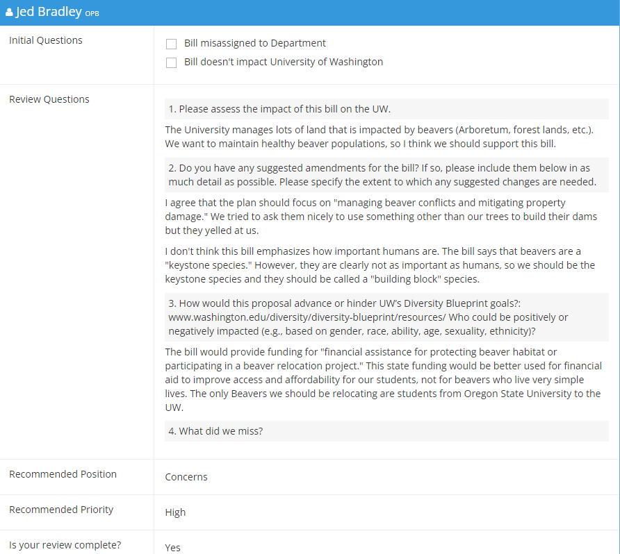
LobbyGov Review Example
UW Diversity Blueprint Goals
Goal 1: Cultivate an Accessible, Inclusive, and Equitable Climate
Goal 2: Attract, Retain, and Graduate a Diverse and Excellent Student Body
Goal 3: Attract and Retain Diverse Academic Personnel
Goal 4: Attract and Retain Diverse Staff
Goal 5: Develop Place-Based Education and Engagement to Advance Access, Equity, and Inclusion
Goal 6: Improve Accountability and Transparency at All Levels
https://www.washington.edu/diversity/diversity-blueprint/resources/

Slide 18
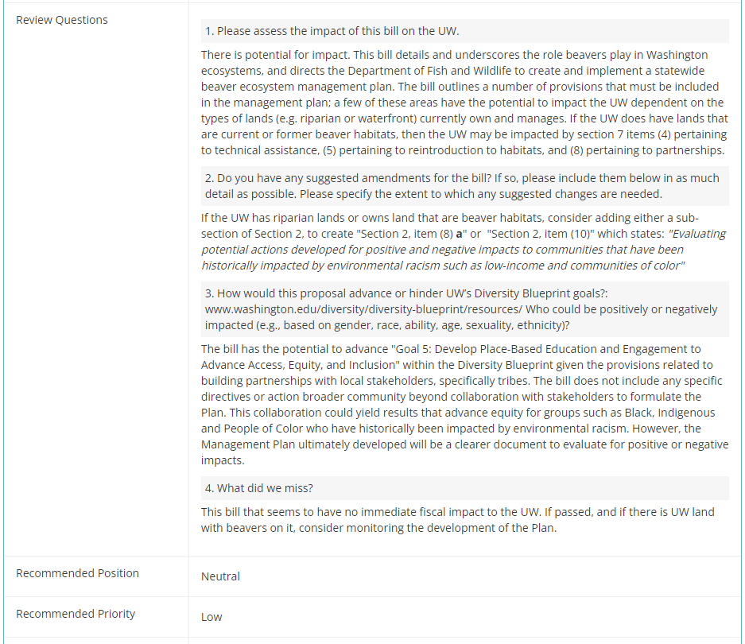
LobbyGov Review Example 2
Specific amendments are extremely helpful!

Slide 19
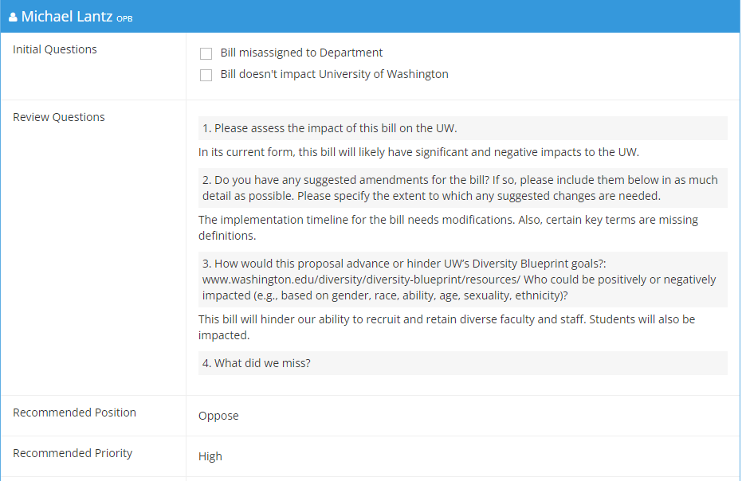
LobbyGov Review Example 3

Slide 20
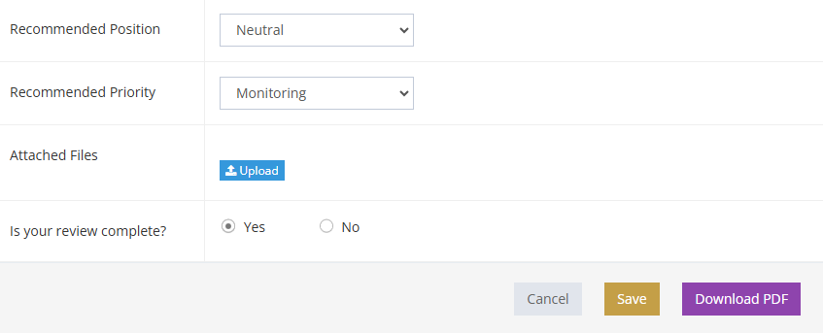
LobbyGov Review Example 4
Guidance for selecting a position/priority can be found in our Bill Tracking Overview
Don’t forget to select “Yes” and “Save” when your review is complete.

Slide 21
QUESTIONS TO CONSIDER:
What does this bill add/remove from existing law?
Would this have a fiscal impact? (e.g., additional staff, materials, travel)
Would it have a programmatic impact? (e.g., time from a PI)
Would it have an operational impact (facilities, sustainability?)
What amendments would you recommend? (i.e., what improvements could be made to the bill in its current form?)

Slide 22
HELPFUL REMINDERS…
Be clear and concise
Note any areas of confusion
Provide some education
Give us a sense of importance & scale
Pay attention to the version of the bill you are responding to
And please….
Respond as soon as possible!

Slide 23
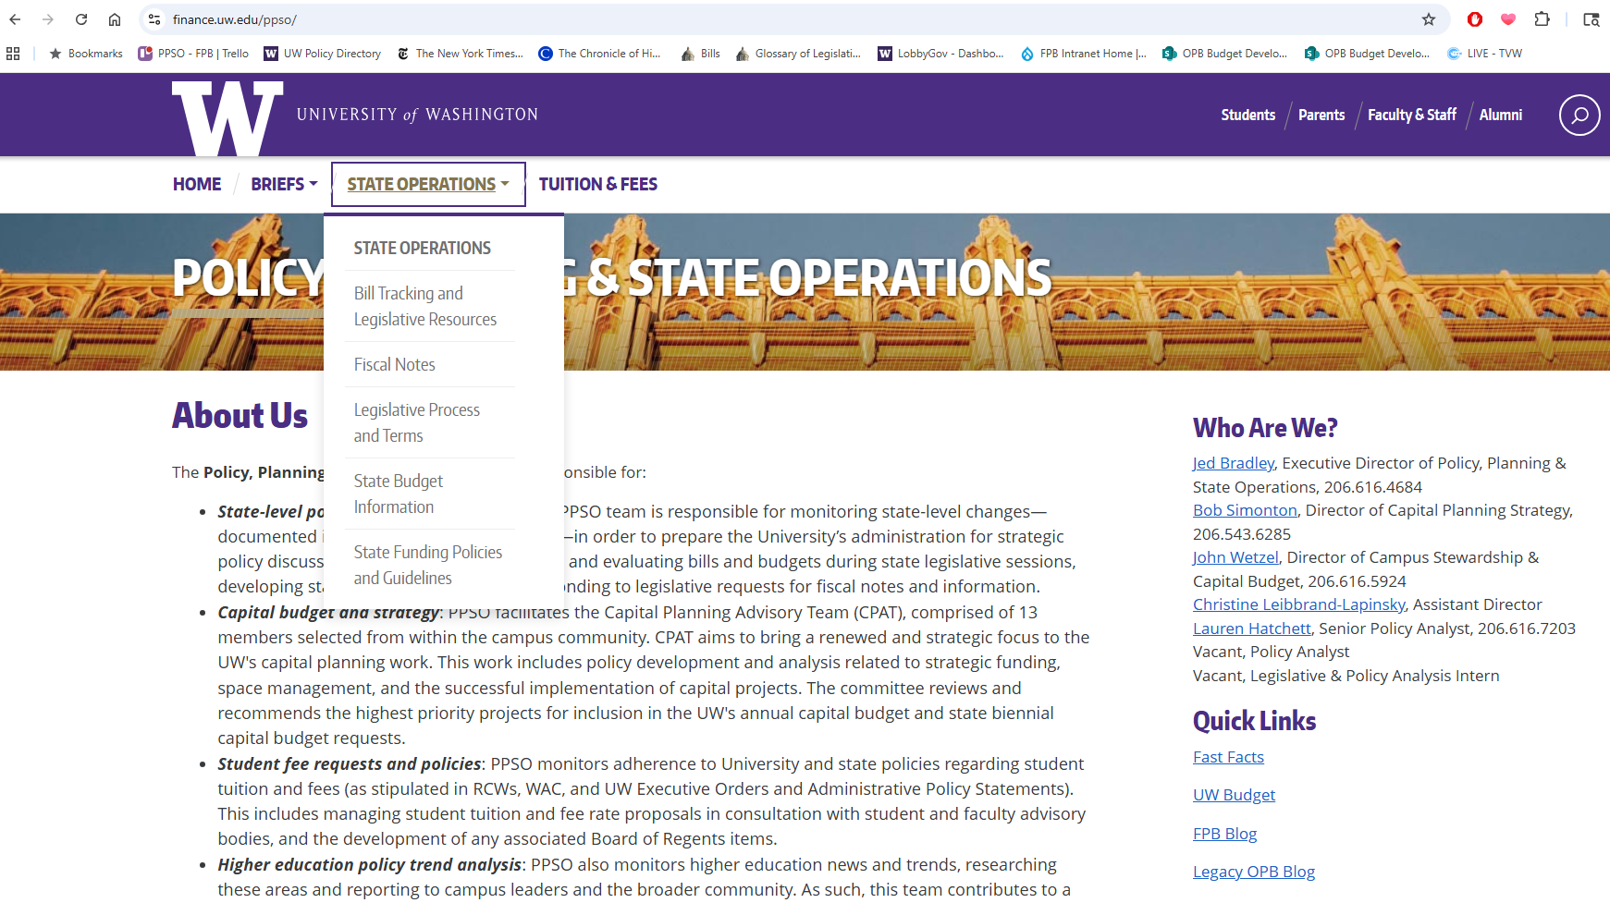
LEGISLATIVE RESOURCES

Slide 24
QUESTIONS?

Slide 25
FISCAL NOTE UPDATES AND REMINDERS
Christine Leibbrand-Lapinsky
Assistant Director
Finance, Planning & Budgeting

Slide 26
WHAT IS A FISCAL NOTE?
An estimate of a bill’s fiscal impact
6-year projection
Least expensive way to reasonably implement the bill
Tied to a specific version of a bill
Helps legislators evaluate a bill’s costs and merits
Informs legislative staff, journalists, lobbyists, etc.

Slide 27
WHY SHOULD YOU CARE ABOUT FISCAL NOTES?
They are important because:
They inform legislative decisions that impact the UW
… so, we need to be responsive and accurate.
They are tricky because:
We have less than 72 hours to respond
They cover a huge variety of topics
… so, we need your help!

Slide 28
THE FISCAL NOTE PROCESS
FPB receives and distributes request
Assessors and FPB analyst draft and finalize FN
FPB analyst reviews and submits FN
< 72 Hours

Slide 29
TO RESPOND TO A FISCAL NOTE REQUEST…
Read the email from your FPB Analyst, note the due date, respond to let us know you’re on it
Read the bill for how it impacts the UW
Coordinate your response with and loop in others as needed (Bothell and Tacoma campuses, other units)
We use SharePoint for drafting FNs
Fill out the calculation and narrative on SharePoint templates
Use the @ function in SharePoint or respond to the e-mail to let us know you are done!

Slide 30
PLEASE FILL OUT
Summary: overview of how the bill would impact the UW (or why it wouldn’t)
One or more of the following areas of impact:
Cash Receipts: estimated tax or fee collections
Expenditures: estimated costs to implement the bill, assumptions made
FTEs: additional staff time needed
Capital: expenditures and FTEs, plus predesign/design, construction, grants/loans, staff, and other costs

Slide 31
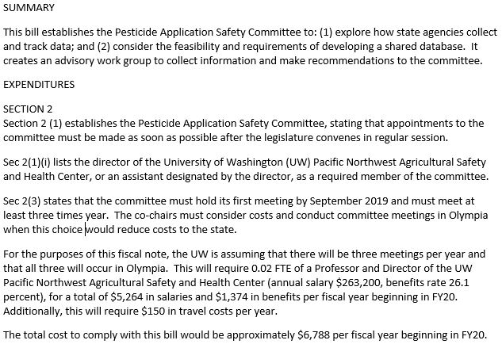
NARRATIVE
← Brief overview
← Cost drivers by section, assumptions, subtotals and total by FY

Slide 32
CALCULATIONS

Slide 33
WHAT IF THERE ARE TOO MANY UNKNOWNS?
Talk to your assigned analyst (sooner than later) to discuss unknowns, options for scalability, options for identifying some determinate impacts.
Give us your best estimate.
“Indeterminate” fiscal notes rarely get funding!

Slide 34
TIPS & REMINDERS
Fiscal notes take priority over general bill analysis
Respond as soon as possible!
Loop others in as needed (e.g. other staff and units, Bothell and Tacoma campuses)
Avoid “indeterminate” responses; explain why if “no impact”
Write for a general audience: avoid jargon, spell out acronyms
Identify and explain all assumptions. Calculations - repeatable, logic - clear
Report the bill’s incremental impact over current law (new costs/impacts)
Identify costs/receipts as one-time or on-going (current dollars, no inflation)
Consider implementation dates—what fiscal years are affected?
For additional staff/time, we need title, full-time annual salary, benefits rate/classification, and percent FTE
Remember, we just need estimates and your best guesses!

Slide 35
RESOURCES

Slide 36
QUESTIONS?

Slide 37
2026 LEGISLATIVE SESSION & BUDGETS
Christine Leibbrand-Lapinsky
Assistant Director
Finance, Planning & Budgeting

Slide 38
SUPPLEMENTAL SESSIONS & BUDGETS
“Short” sessions last 60 days, with the possibility of one or more 30-day special sessions (January 12 – March 12)
Supplemental budgets are usually our opportunity to course-correct based on changing revenue forecasts, cashflows, and caseloads.
Bill introductions recommence starting with a numerical progression from the end of the 2025 session.
‘Zombie Bills’ from last year are still alive

Slide 39
2026 SESSION – REVENUE FORECAST & BUDGET OUTLOOK
​The Economic and Revenue Forecast Council (ERFC) November revenue forecast:
Total state revenue projections were increased by $105.4 million in the current biennium (2025-27) and decreased by $184.9 million in the next biennium (2027-29). These are minor changes from past forecasts, but even minor changes are tough given last year’s budget deficit
Between changing caseloads and the shift in the revenue forecast, the current budget deficit is now estimated at $2.3 billion

Slide 40
GOVERNOR FERGUSON’S PROPOSED 2026 SUPPLEMENTAL BUDGETS
Governor Ferguson used the November forecast as a basis for his proposed 2026 supplemental operating and capital budgets. At a high level, these proposals would:
Cut base state funding to the UW by 3% or $15.8 million per year starting in FY27
Cut administrative spending by $3.5 million beginning in FY27
Include ongoing funding for the Center for Behavioral Health and Learning, though provide no other policy-level funding
Capital budget: no funding for the Power Plant Electrification and Hot Water Loop – Phase 1 project
Would not change authorized salary increases of 2% in FY27 in the underlying biennial budget

Slide 41
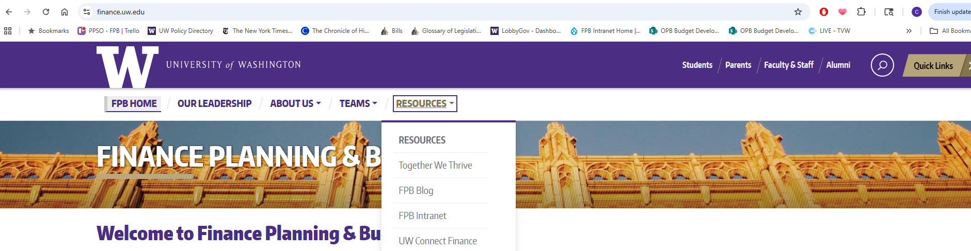
AS A REMINDER…
Leadership in the House and Senate will release their own budget proposals over the course of session.
FPB will review budgets as they are released and will produce budget briefs for all major budget proposals
Stay tuned to session related emails and the FPBlog (https://finance.uw.edu/blog) for updates regarding:
Budget proposals
Revenue forecasts

Slide 42
TIPS FOR EFFECTIVE LEGISLATIVE ADVOCACY
Morgan Hickel
Director
Office of State Relations

Slide 43
WHAT IS LOBBYING – WA STATE?
Involves making an ask.
Request for action or inaction on policy and/or funding.
Advocacy with state elected officials and their staff.
Various modalities: In-person, virtual, testimony.
Regulated and enforced by the Washington State Public Disclosure Commission (PDC).
UW Administrative Policy Statement 1.3 governs UW employee engagement with elected officials.

Slide 44
YES, YOU CAN:
Engage in the political process as a private individual on personal time using personal resources.
You may use your UW affiliation if it’s clear you’re not speaking on behalf of the UW.
Educate state officials on University work/programs or serve as an expert on policy.
Respond to direct requests for information.
Lobby on behalf of the UW using University resources in coordination with the UW Office of State Relations.
Notify the UW Office of State Relations if you’re engaging or want to engage with state officials.

Slide 45
LOBBYING ON BEHALF OF THE UW:
UW is a public agency.
Advocacy with public funds is strictly governed and must be reported.
Advocate only on official UW business.
Legislative agenda and official policy positions.
Report lobbying activity and expenditures quarterly to the PDC via the UW Office of State Relations.
UW employees are individually responsible for reporting. Failure to report may result in personal penalties.
Coordinate with the UW Office of State Relations.
Helps ensure compliance with state laws, advocacy is aligned, and impactful engagement.

Slide 46
CONNECTING WITH LEGISLATORS:
Be early – things move quickly during session.
Be flexible – schedules change often.
Be gracious – thank them for their time and do not disparage other advocacy groups, legislators, or political parties.
Be prepared and concise – time is precious and cognitive bandwidth is limited.
Use concrete examples that connects policy and funding to the needs of the state and its residents.
If you don’t know the answer, that’s ok, we’ll find it together and follow up.

Slide 47
NO, YOU CAN’T:
Use UW resources for:
Grassroots lobbying
Indirect lobbying that aims to influence government or public decisions. Typically includes a coordinated call to action to support or oppose specific policy or budget issues.
Political campaigns
Ballot measures (e.g., initiative)
Unofficial UW business
Includes direct and indirect UW resources, such as: facilities, technology, UW emails and contact lists, UW branding and letterhead, time on the clock.

Slide 48
2026 SESSION & LEGISLATIVE AGENDA
Morgan Hickel
Director
Office of State Relations

Slide 49
2026 SESSION AT A GLANCE:
A “Democratic Trifecta” exists in Olympia.
Governor Bob Ferguson.
60% majorities in the House and Senate.
60-day (short) session starting Jan. 12.
The focus will be on the 2026 supplemental budgets (operating, capital, and transportation).
Supplemental budgets adjust or apply fixes to the biennial budgets.
Once again, the state faces a 4-year operating budget shortfall.
Gov. Ferguson released his supplemental budget proposals in mid-December
The House and Senate budget proposals will be unveiled after the state’s next revenue forecast in mid-February.

Slide 50
UW 2026 LEGISLATIVE AGENDA
Operating Budget:
Recognizing the state is entering a difficult budget year, the UW is not advancing new requests.
Instead, the UW seeks to stabilize funding for core operations and mitigate new cuts.
Not new: Center for Behavioral Health & Learning operating costs ($18.34M ongoing) for the state’s 75 long-term civil commitment beds.
Continues one-time funding provided in FY25 and FY26.

Slide 51
UW 2026 LEGISLATIVE AGENDA CONT.
Capital Budget:
$47.5M (CCA) for UW Seattle Power Plant Electrification & Campus Hot Water Loop – Phase 1
Immediately reduces greenhouse gas emissions and supports compliance with the Climate Commitment Act and Clean Building Performance Standard.

Slide 52
PLEASE AND THANK YOU:
Complete legislative analysis when asked.
Get your fiscal notes in on time.
Be a problem solver – remember we’re all on one team.
Be responsive – session doesn’t stop after 5pm, on the weekends, or for holidays.
Coordinate with us if you plan to visit Olympia or engage with an elected official.
Call or text if you need us ASAP. If you can’t get in touch with me, don’t panic – call Kevin or Jordan.

Slide 53
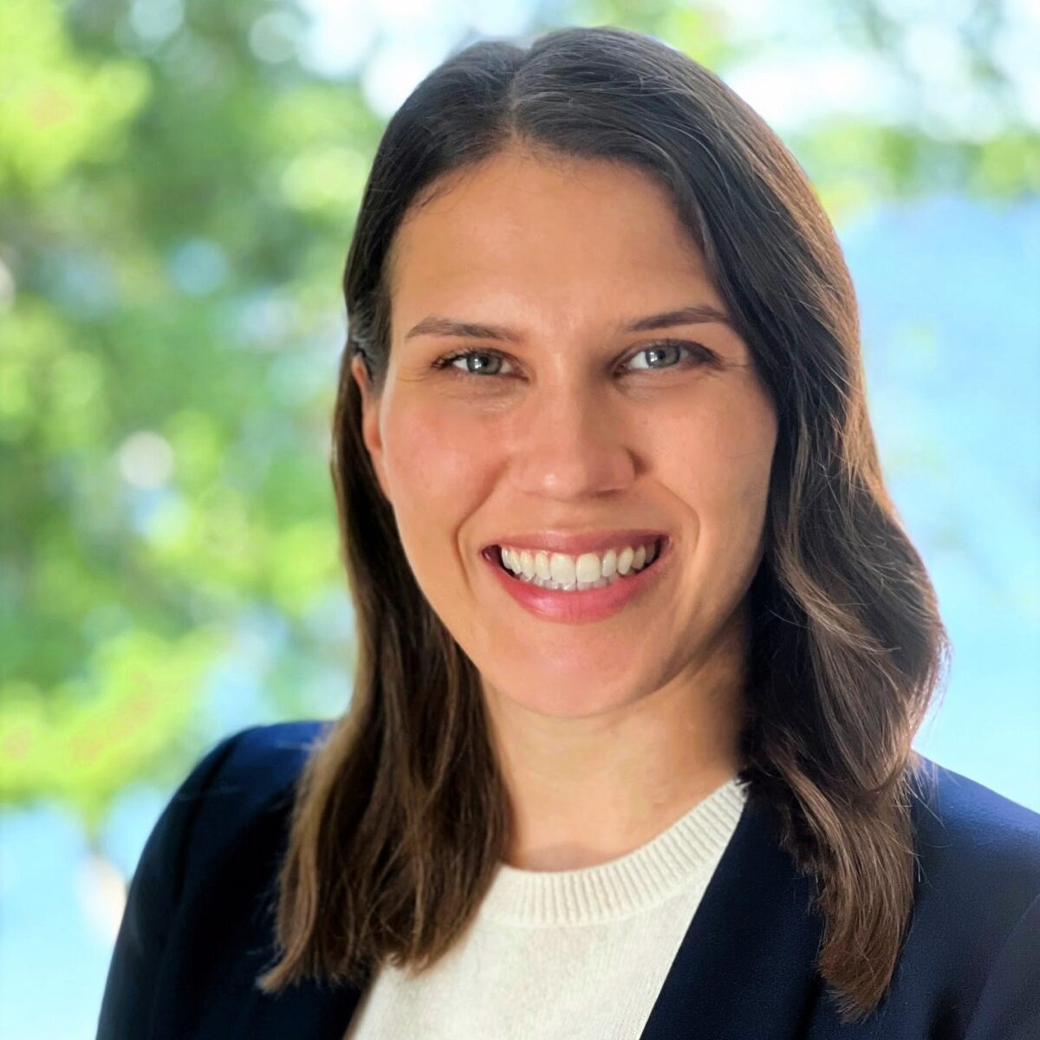

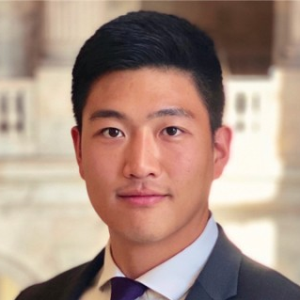

STATE RELATIONS TEAM CONTACT INFO
Morgan Hickel
mhickel@uw.edu I 206-303-8864
Kevin Chang
kchang28@uw.edu I 206-681-7313
Jordan Caron
jvcaron@uw.edu I 253-304-2277

Slide 54
QUESTIONS?

