Slide 1

AMAZON BUSINESS PRIME @ the UW Academy – An Overview

Slide 2

Agenda
Background and Account Overview
Best Practices
Tools overview
Last Mile Delivery – Brought to you by Creative Communications
Notes:
Demonstration will be screenshots, not on Workday
Please note that there are a lot of different avenues and scenarios regarding MPs, but this demonstration will be a general overview/high level. This meant to be more of a supplement to the other tools available, such as our website and the job aid

Slide 3
Amazon Business Prime – A brief history
UW started using Amazon in 2015 in an effort to manage our ProCard "tail spend"
When we started, there were 12 groups across the UW
Today, we have 353 Groups – and over 500 sub-groups
Annual Spend with Amazon Business has reached $5.4M in a calendar year

Slide 4
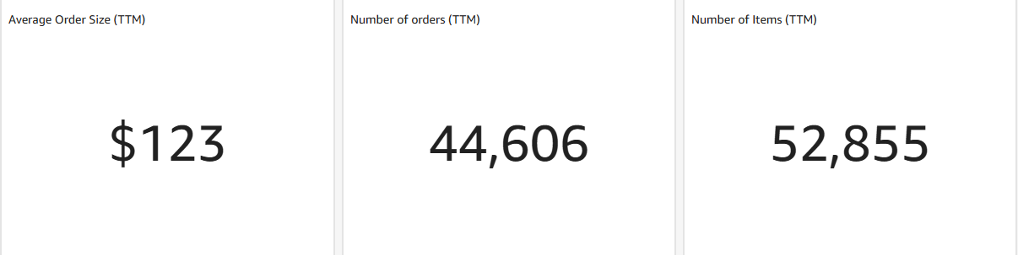
Amazon Business Prime Account Overview – in the Trailing Twelve Months period

Slide 5
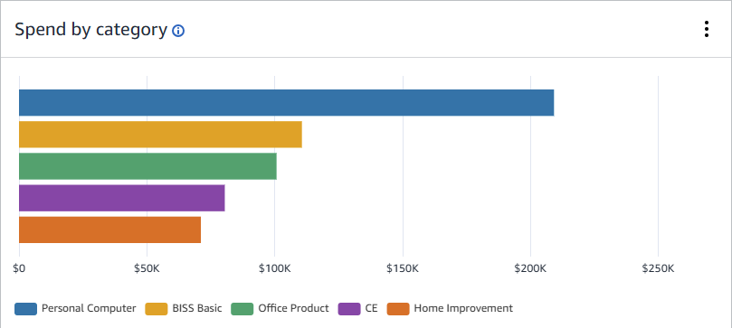
Leading Spend Categories – Oh, and gift cards are popular too
Notes:
Business Industrial Scientific Supplies – BISS
CE = Consumer Electronics

Slide 6
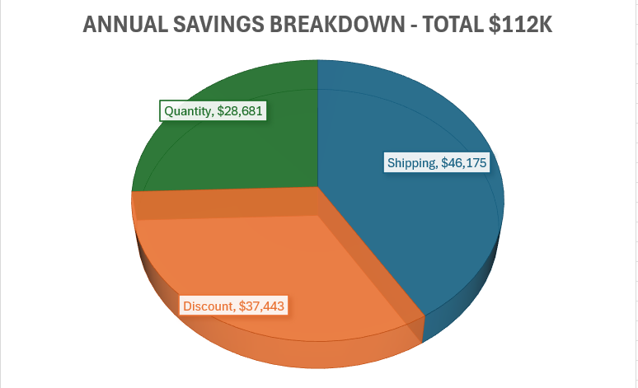
Savings Captured for the TTM

Slide 7
Best Practices & Recommendations
Amazon Business Prime is meant to be a self-managed buying solution for the campus. At the unit level – establish a strong governance structure so the right stake holders can approve orders if needed – more on how to do this in the Buying Policies
Be aware of what to purchase on Amazon Business Prime, and what not to buy. e.g. consumer grade computing devices is not a good idea for business use and should be purchased from CDWG
Shopping on Amazon Business Prime is fun – be aware of the PCard and Procurement policies and procedures
Its design for business purpose only and never for personal shopping – UW Pcard is a requirement
Be sure to join the UW Central Business Prime account – avoid losing out on the Business Prime Benefits – amazonbusiness@uw.edu

Slide 8

Available Tools within Amazon Business Prime

Slide 9
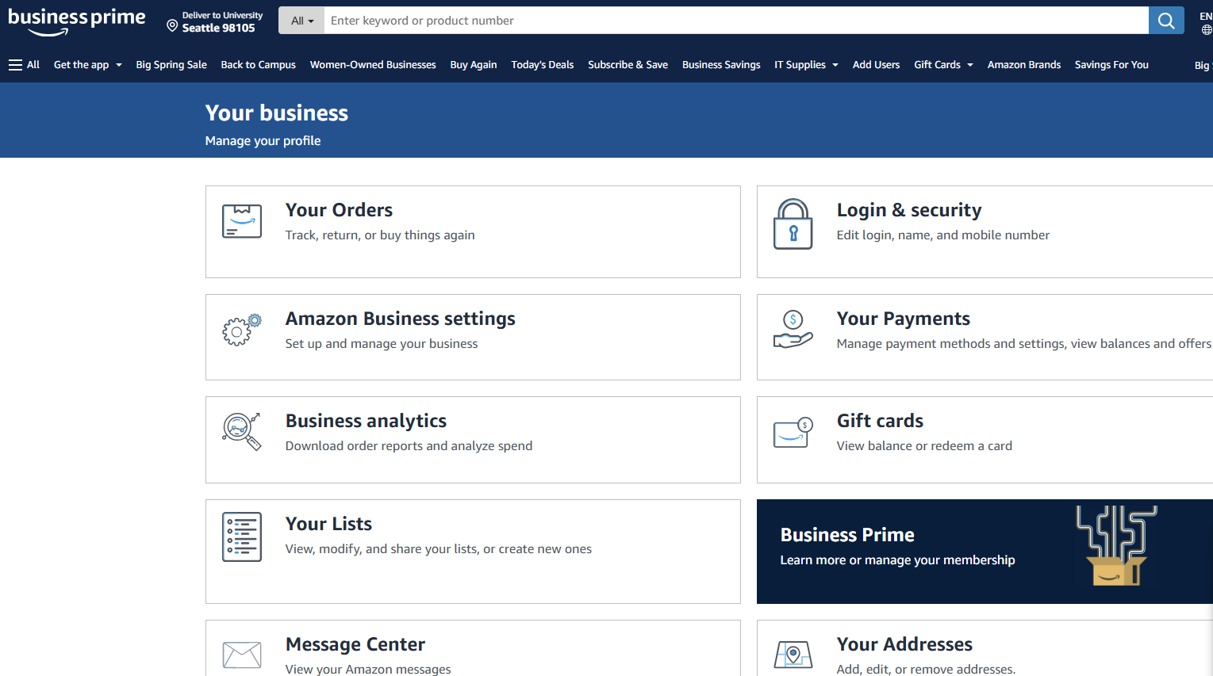
Business Prime

Slide 10
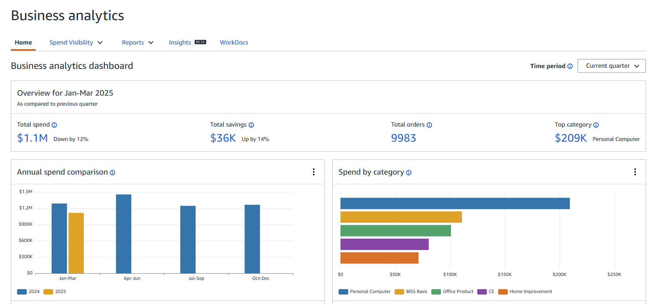
Business Analytics
Notes:
Alternate path

Slide 11
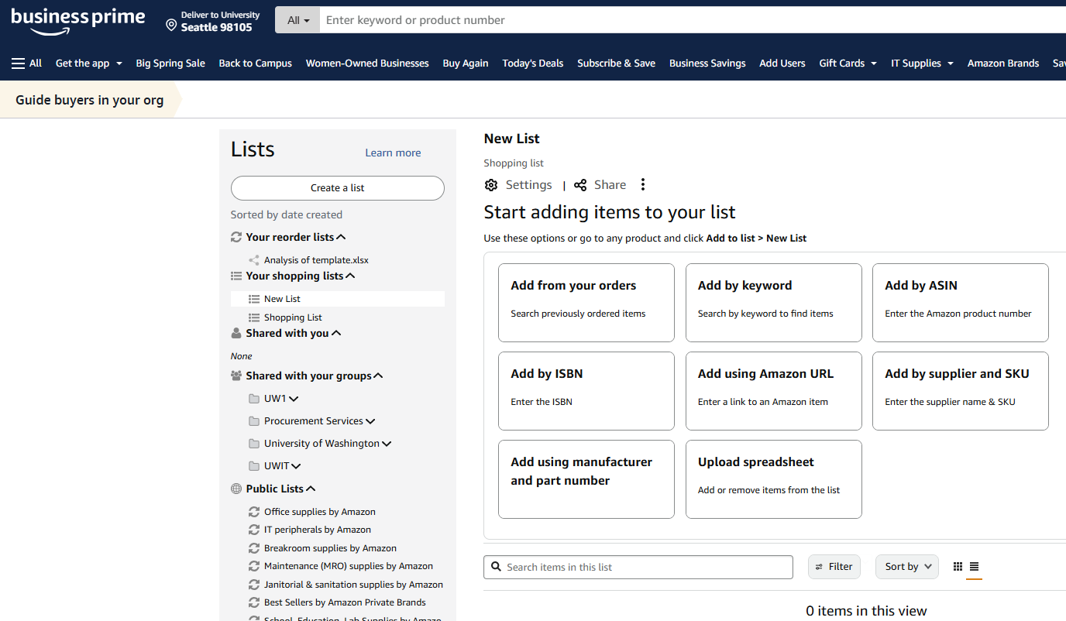
Managing Shopping Lists

Slide 12
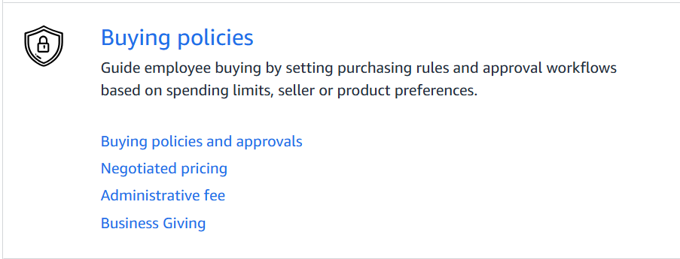
Buying Policies and Approvals – Can be set at any organizational Levels

Slide 13
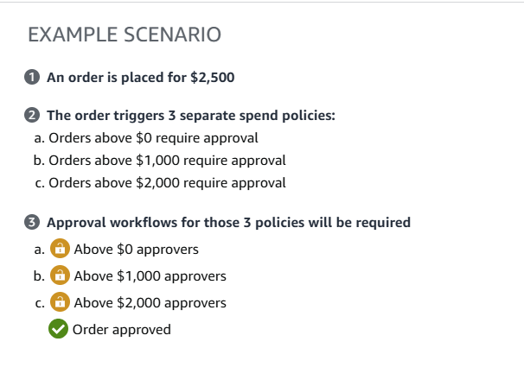
Spending Limits

Slide 14
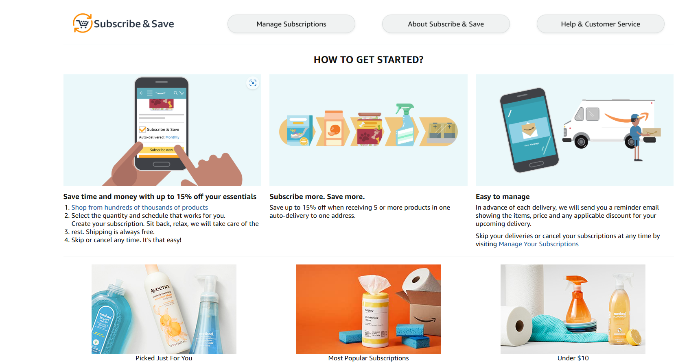
Subscribe and Save Option

Slide 15
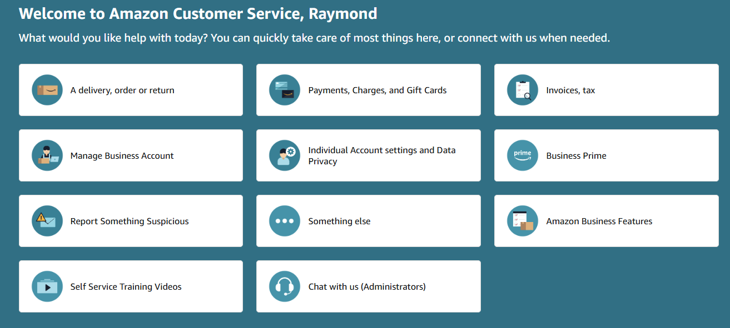
Amazon Business Customer Service

Slide 16
Amazon Business Prime Last Mile Delivery
UW Creative Communications (C2) Delivers
Mailing Services has delivered USPS shipped Amazon packages for years
Deliveries expanded a year ago for official Last Mile Program
Last Mile Program is for Amazon Business Prime orders
  Orders filled from Amazon warehouses
  Multiple pallets a day
  Deliveries occur same day
  Handles priority/rush deliveries by request
  Hundreds of packages delivered every day
  Mailing Services delivers using UW mailbox number and/or room number
  Last Mile Program partially funded by Amazon
Deliveries provided primarily by eBike but also by hybrid electric
truck, when needed
Notes:
zelle (research subject payments only – will go into later)

Slide 17
Next Steps with Last Mile Program
Address issues with courier deliveries
  Deliveries prone to mis-delivery or off-hours delivery
  Currently working with Amazon to have all deliveries on campus routed to Mailing Services
  Exceptions include Housing and Food Services locations and UPS and FedEx deliveries
Work with Procurement to communicate value of Amazon Business Prime
  Identify departments still using personal accounts
  Move departments ordering with personal accounts to business accounts
Partner with UW Administrators
  Mailing Services to provide Central Delivery service for all shipments
  Holiday hold and delivery service

Slide 18
Why the Last Mile Program is Important
Reduces traffic on-campus
Good for the environment – eBike delivery
Mailing Services knows campus
Mailing Services staff has access to secured buildings
Mailing Services would never leave a package in an unsecured location
Trusted chain of custody, with campus custody held by Mailing Services (a UW department). Tracked by QTrak system.
Mailing Services is already going to all the locations every day
Centralized service – you can always call Mailing Services to help locate your package

Slide 19
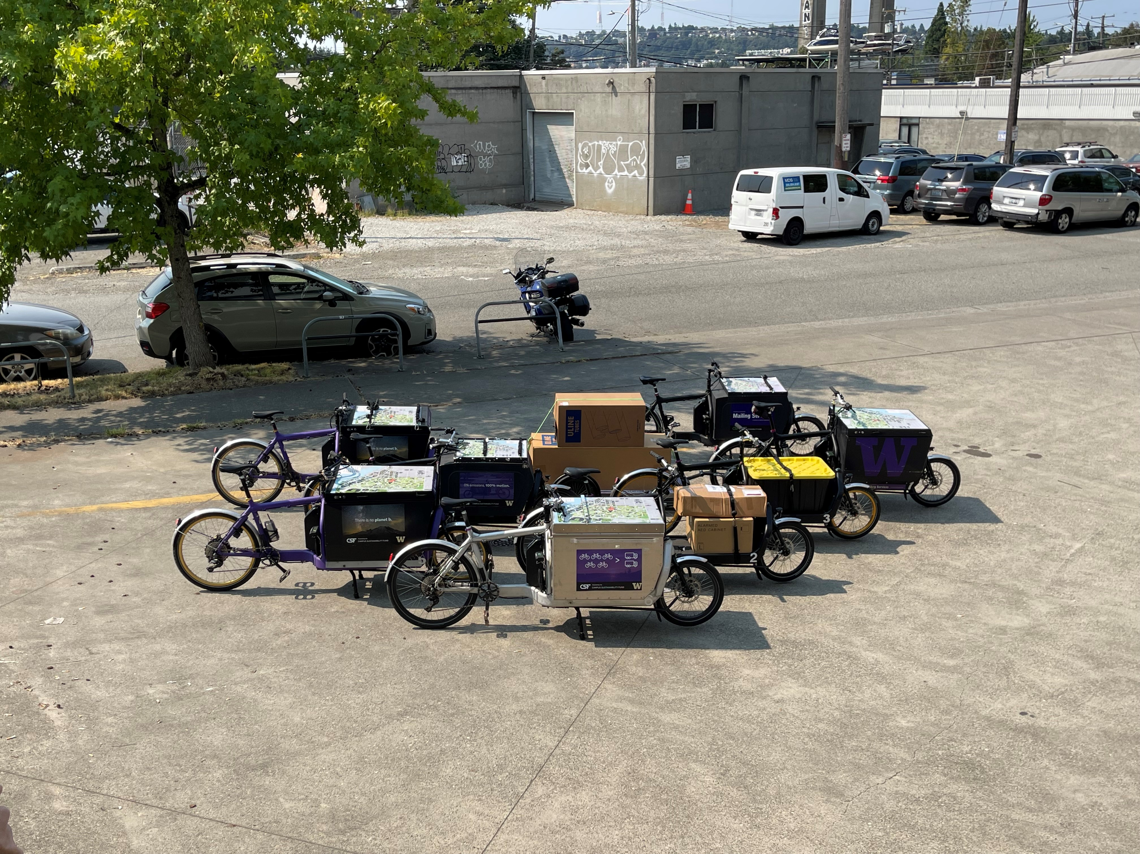
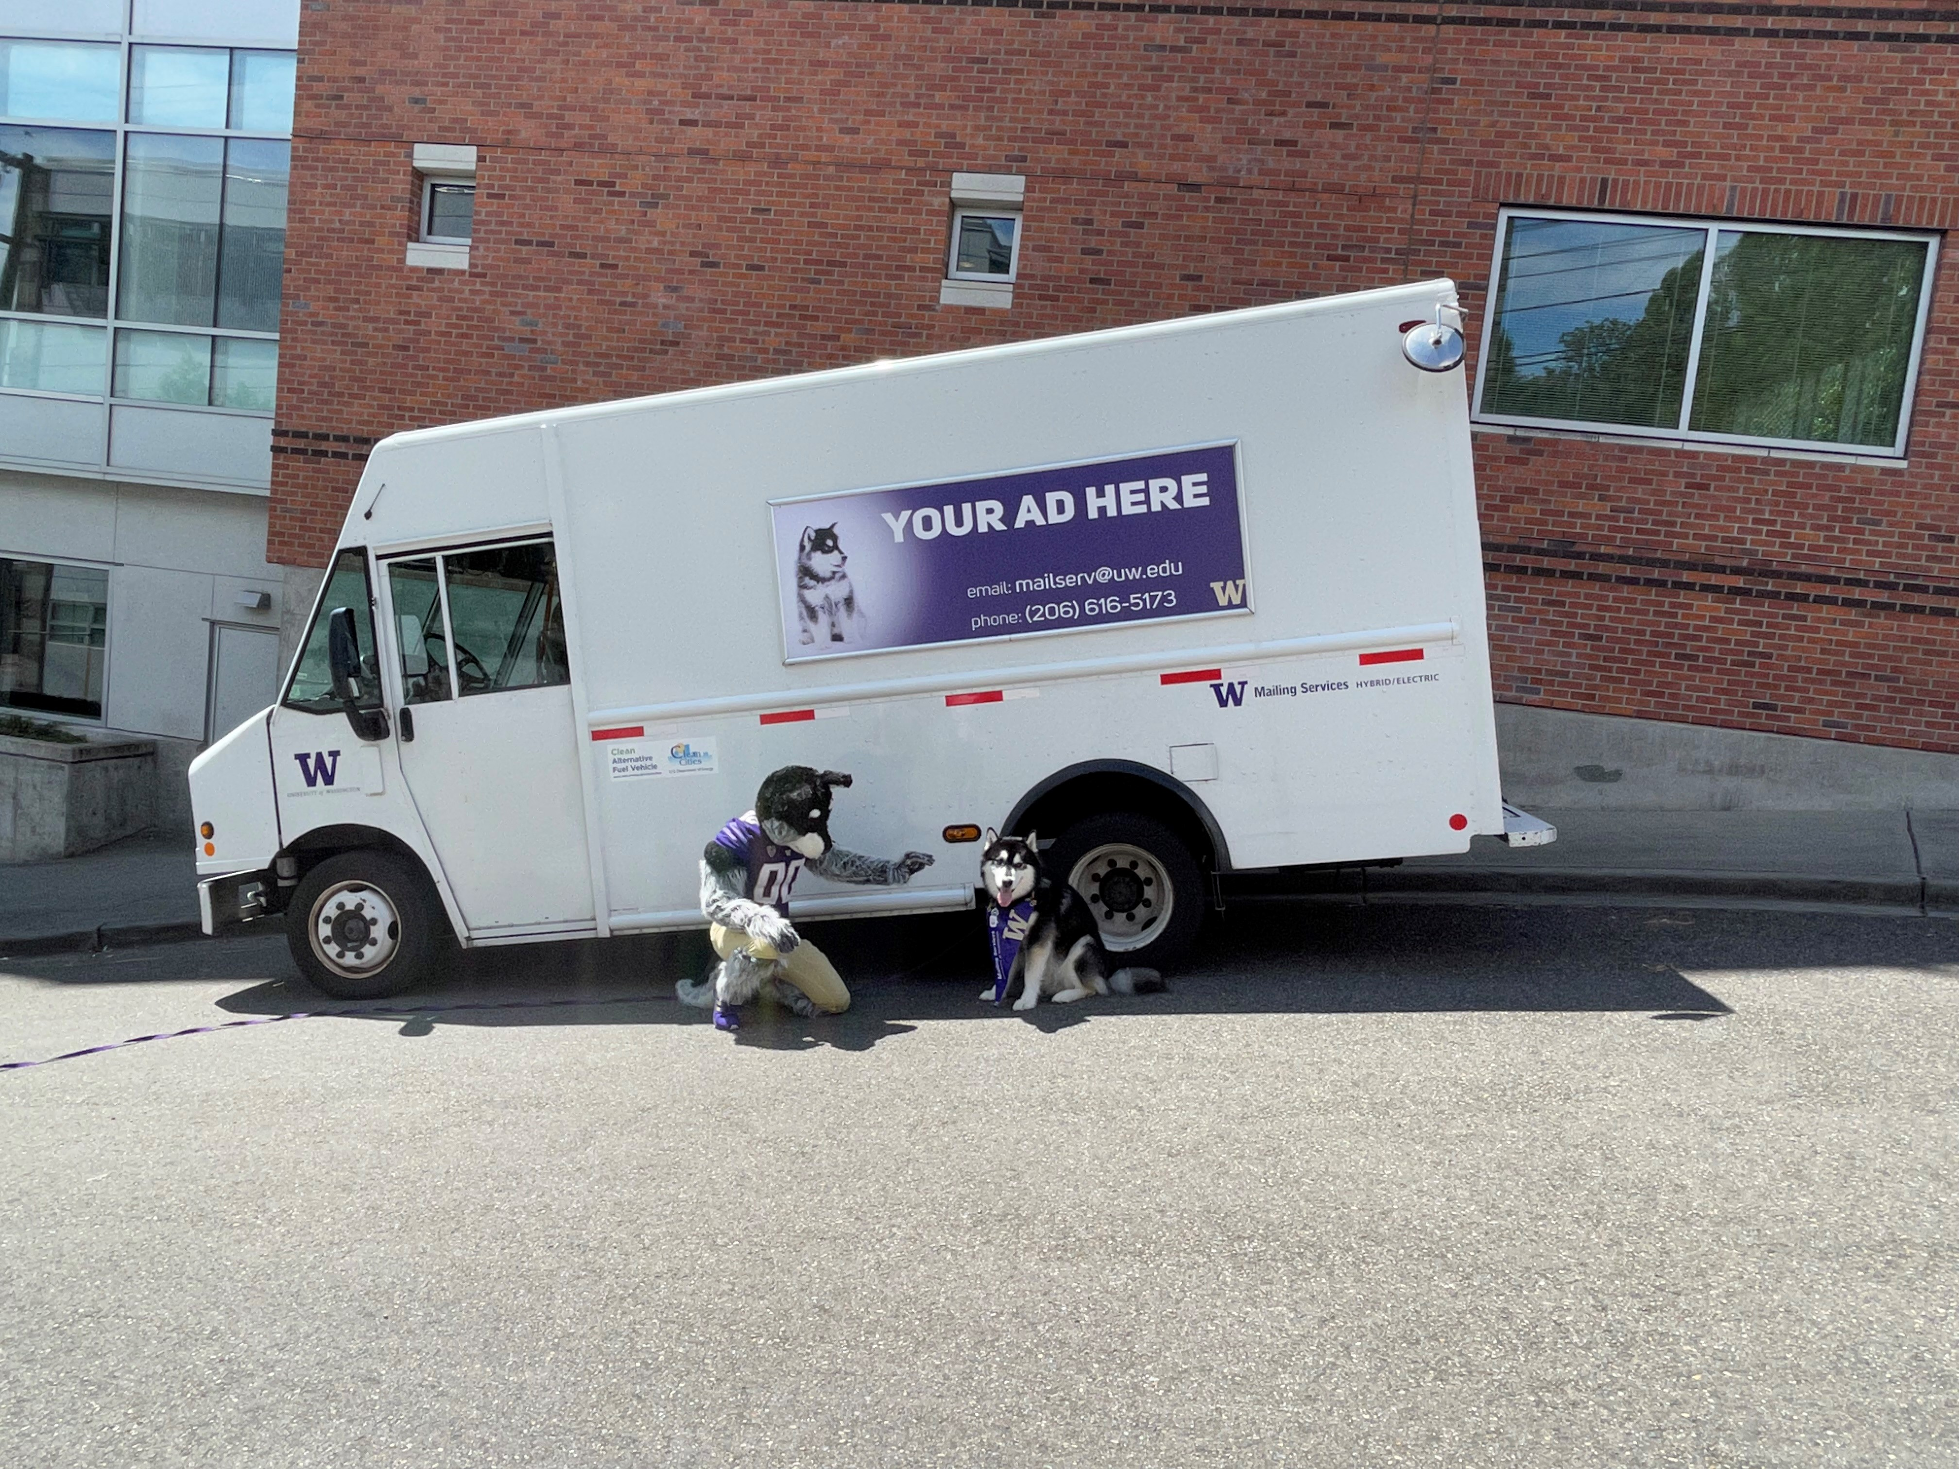
How Mailing Services Does It!

Slide 20

Questions?
Notes:
Facilitator Notes:
Say: Thank you for being such a wonderful cohort, I hope this training was helpful.

Slide 21
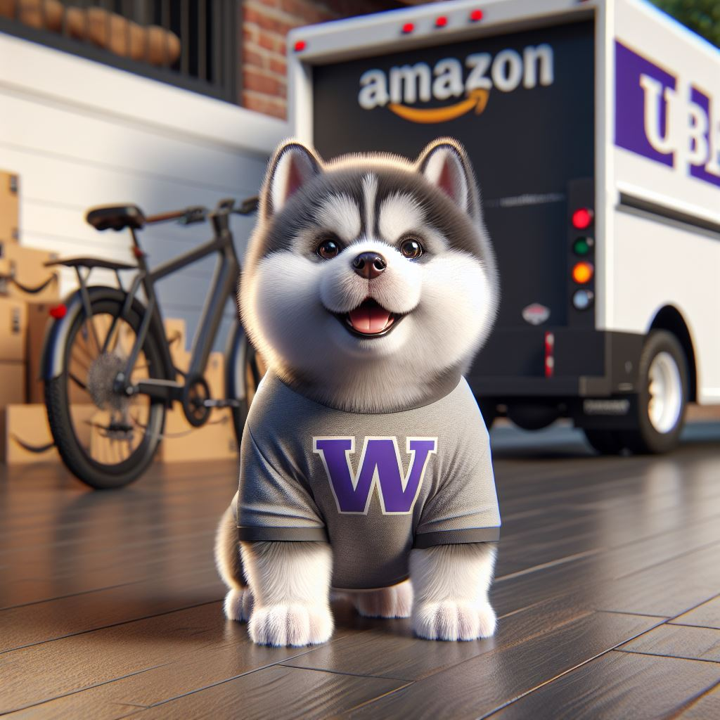
Thank You!
Notes:
Facilitator Notes:
Say: Thank you for being such a wonderful cohort, I hope this training was helpful.

