Slide 1
Supplier Invoices, Adjustments and Credits

Slide 2
Agenda
Who is Accounts Payable and what do they do?
PO Invoices
Department Responsibilities
Credits
Report Options
Note: We won’t be able to research individual ticket issues today.

Slide 3
Accounts Payable

Slide 4
Who is Accounts Payable and What Do They Do?
Accounts Payable (AP) is part of Procurement Services and they:
Approve/Adjust invoices
Process supplier invoices and credits against purchase orders
Approve Supplier Invoice Requests (SIR)

Slide 5
What AP Can Do with Supplier Invoices in Workday
Attach a corrected invoice
Move invoice to a different PO
Update pricing discrepancy with a new invoice (must match PO).
Update quantity and dollars (must match PO).
Rematch invoice with PO
Correct the SI if it is routing to the incorrect person (once it is updated in Workday)

Slide 6
What AP Cannot Do with Invoices in Workday
Update the supplier name (unless the PO number is incorrect)
Change worktags (unless the PO was updated)
Process an SI on a closed PO that cannot be reopened
Update purchase orders
Change address for supplier
Change Payment type on the supplier record

Slide 7
Invoices

Slide 8
What is an Invoice?
Invoice: A bill for goods and/or services provided
In Workday:
An invoice is known as a Supplier Invoice (SI)
Invoices will receive a document number (beginning with SI) assigned by Workday, known as the “Invoice Number”
A supplier’s invoice number is known as the “Supplier’s Invoice Number” (number without the SI in front)
SI could also be a “supplier invoice adjustment” and notated in description in Workday
More about Invoices:
Header charges = charges not typically billed on the line-item like tax, shipping, other charges etc.
Workday will only catch invoice duplicates for the same supplier if invoice numbers are identical. i.e.: no extra spaces etc.

Slide 9
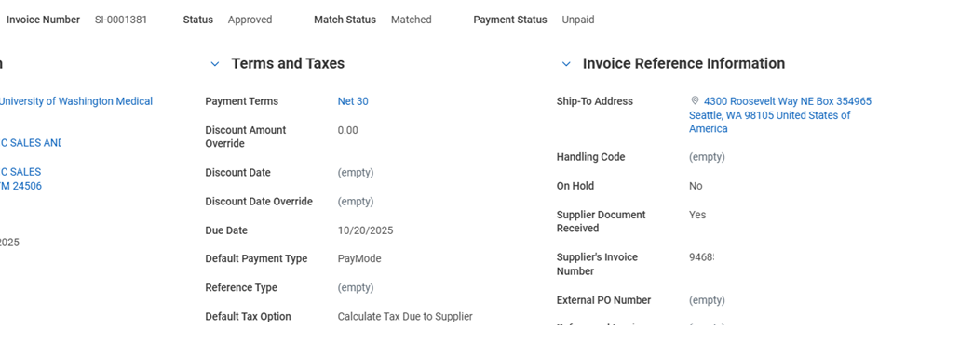
Invoice in Workday
Invoice number from Workday
Supplier’s invoice number

Slide 10
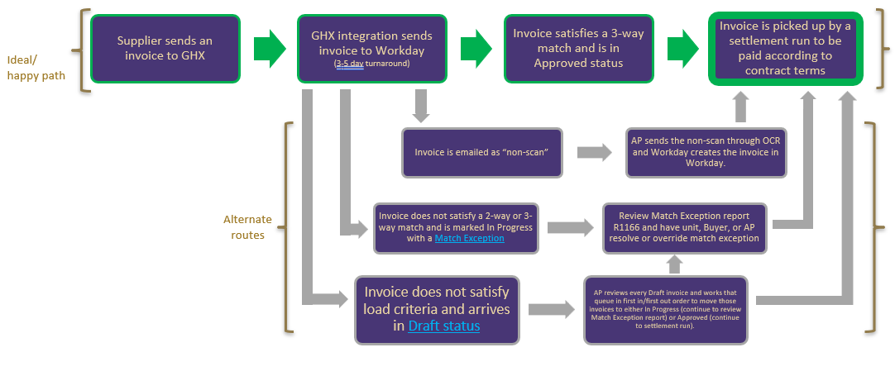
Supplier Invoice Lifecyle

Slide 11
Invoice Matching Process
Once an invoice is uploaded to Workday, it applies to the purchase order number assigned as it was set up.
The system puts it through a matching process. If it matches, it will move forward to the payment process. If it doesn’t match it will create a match exception.
Setting | Matching
PO: No Receiving Required | 2-way matching Compares the invoice to the PO (service line items)
PO: Receiving Required | 3-way matching Compares invoice to PO to Receipt

Slide 12
Information For Suppliers
Share the “For Suppliers” page. It has all the information they need to know about registering as a supplier with UW and invoice requirements.
Invoices must have:
“University of Washington” being featured prominently in the invoice header
Full PO number with letters, dashes and number
UW Ship-To Address
UW Customer Contact (who placed the order)
Invoice number and date
Line-item charges and description for each item, matching the PO line items and referencing same line-item number from the PO
Sales tax when applicable identified as tax
Clearly marked invoice dollar amount in USD

Slide 13
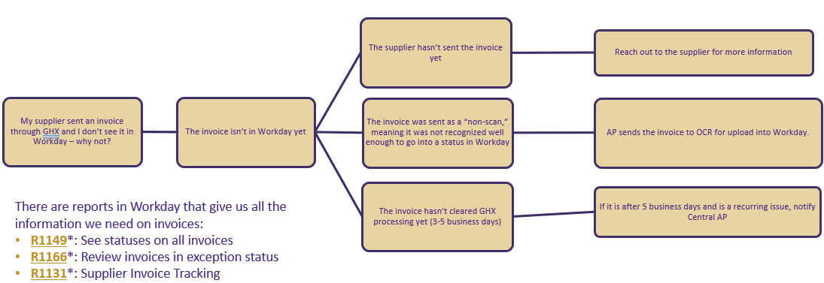
Where is my Invoice?

Slide 14
Exceptions that Accounts Payable Can Resolve
When the matching processes doesn’t generate a match, the invoice is assigned a match exception.
The following exceptions will be resolved by AP with request from campus through “Match Discrepancy Request From.”
Supplier Invoice Freight Amount Exceeds $2,000 Threshold
Other Charges Exceeds $500 Threshold
*Other exceptions can occur. To resolve other match exceptions, utilize the “How to Resolve Match Exceptions Job Aid.”

Slide 15
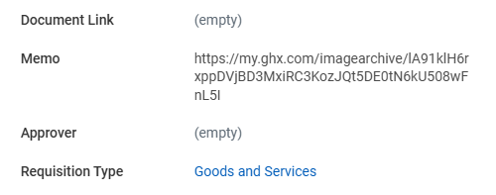
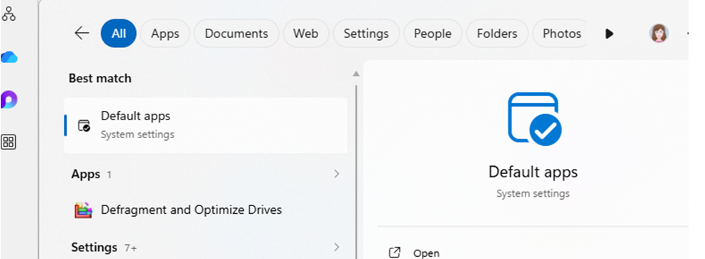
Troubleshooting Invoice Files
For some users, the invoice link in the memo field will not display all invoice pages. It may only show one.
To view all you will need to set the default application for tiff files to Windows Photo Viewer. Search for default apps.

Slide 16
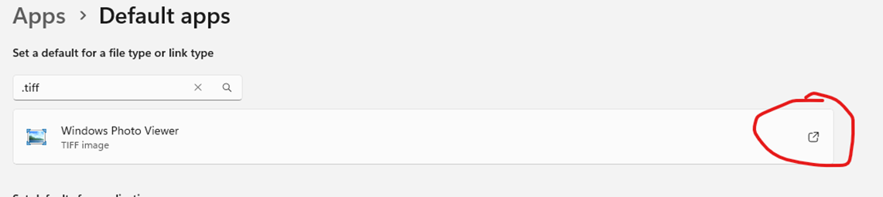
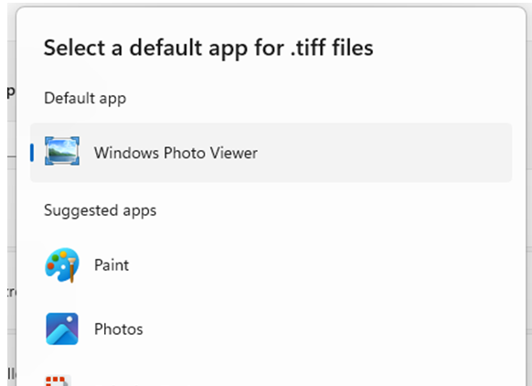
Troubleshooting Invoice Files Continued
Search for “tiff” in the field type field. Click the icon to the right for a dropdown list of options. Then select “Windows Photo Viewer.”

Slide 17
Department Responsibilities

Slide 18
What You Can Do
Review the invoices in Workday
Contact the supplier to resolve issues
Submit UW Connect Forms for corrections and resolutions
  Cancel Supplier Invoice Form – only for specific reasons
  Match Exception Form – corrections and adjustments and, certain exception approvals
Complete Receiving if required

Slide 19
Cancel Invoice Form Best Practices
Before filling this form out, ask yourself:
Does it need to be corrected?
Does it need to be on a different PO?
Do I have a credit memo coming?
Have I talked to the supplier about this invoice?
Considerations:
Don’t cancel an invoice before working with the supplier
Request corrected invoice/credit from supplier
Only cancel for the reasons in the next slide

Slide 20
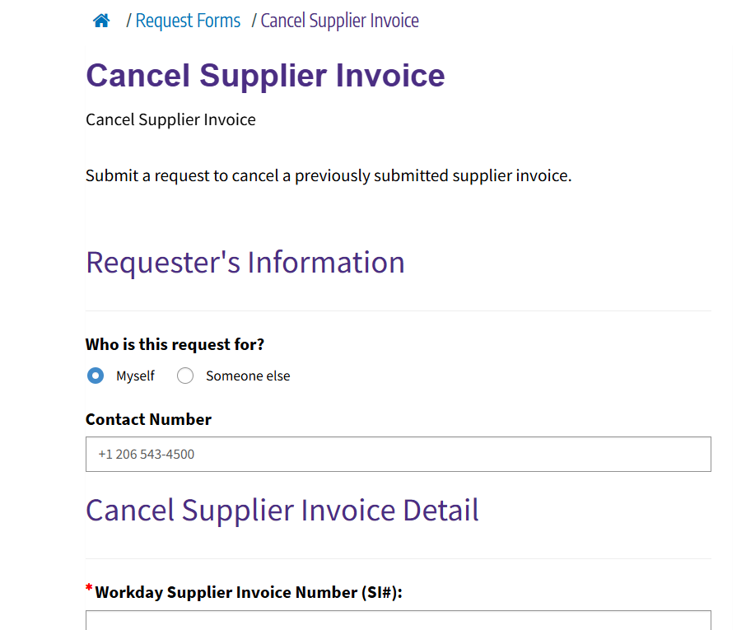
Cancel Supplier Invoice Form
Use For Canceling Invoices that:
Have a PO that is closed and cannot be reopened
Has the wrong supplier
Has an item billed erroneously and not part of the original order
Has been paid through alternative method (ProCard)

Slide 21
Department Match Exception Form Best Practices
If there are discrepancies with:
Quantity
Pricing
Number of items, etc.
1. Resolve the issue with the supplier and obtain a corrected invoice and/or credit memo.
2. Then use the "Department Match Exception" form in Connect to submit the corrected invoice/credit memo/s to Accounts Payable.
3. AP will use the corrected invoice and make adjustments in Workday without the need of canceling the original invoice and resubmitting to GHX.

Slide 22
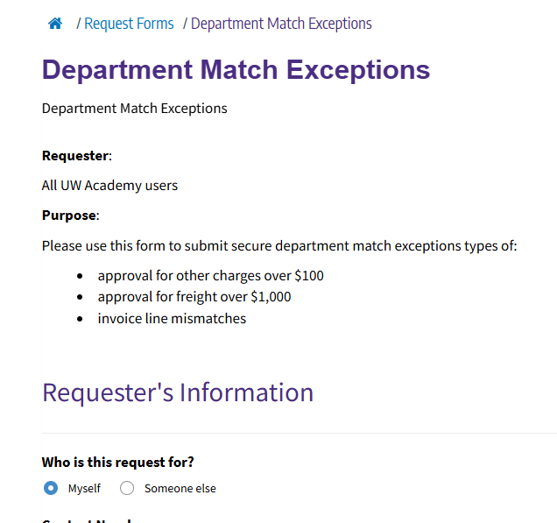
Department Match Exception Form
Use For:
Moving invoices to other line items
Moving invoices to other purchase orders
Approving Freight exception
Approving “Other Charges” exception
Current thresholds will be updated soon.

Slide 23
Other Exceptions
Other invoice match exceptions occur on invoices. Review:
For information on how to handle all exceptions, review:
  The “Match Exceptions” deep dive presentation
  The “How to Resolve Match Exceptions” job aid for information on how to handle all exceptions
The Purchase Order – Change or Close Connect Form
  Other match exceptions may need adjustments made on purchase orders to allow invoices to pay
  Form allows campus to update or close purchase orders
Most common exception is “Supplier Invoice Processed Without Receipt Created”
  If invoice is appropriate, complete receiving in Workday. See “How to Receive in Workday” job aid.

Slide 24
Credits

Slide 25
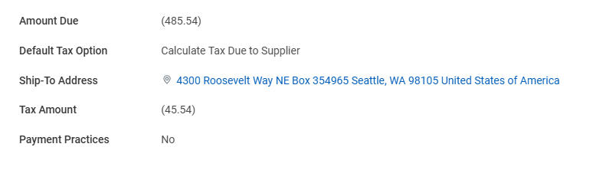
Credit Memos in Workday
GHX cannot process credits
Any credits sent to GHX by the supplier will be sent to AP “non-scan” folder to be entered manually by AP
If a unit receives a credit for a purchase order, use the Match Exception Form to submit the document for AP to process
  If the credit does not reference a PO, contact the supplier for more information
No receiving required
Adjustment on a goods line does not show on PO, only shows on the invoice (SI) on the PO
  i.e.: if tax was not originally paid on the invoice
Credit Amounts will display like this:

Slide 26
Sample Scenario
June: PO receives invoice A123 for $152.36 for PO990011
July: PO received invoice B456 for $152.36 for PO990011
Unit believes this is a duplicate and requests to cancel invoice
Q: Why is the purchase being billed again with a new invoice number?
Best Practice:
Contact the supplier to find out why an unexpected invoice has been received.
Check if credit has been issued to your account
It is best to find out what the supplier is doing before asking AP to take any action.
Our records should match what the supplier has

Slide 27
Reports

Slide 28
Important Reports
R1149: Find Supplier Invoices
  View the invoice or adjustment number, company, status, supplier, invoice date, memo, discount date, due date, invoice amount, amount due and adjustment for entered supplier invoices.
R1166: Invoice Match Exceptions
  View all invoices with an "In Progress" status and have a match exception that needs resolution to be paid, including receiving.
R1131: Supplier Invoice Tracking
  View the invoice or adjustment number, company, status, supplier, invoice date, memo, discount date, due date, invoice amount, amount due, adjustment, initiator, and exceptions for entered supplier invoices.

Slide 29
Other Resources

Slide 30
Resources
PCS Help: When it doubt, send a ticket to PCS Help through Connect or call 206-543-4500
Match Exception Job Aid
Receiving Job Aid
Invoicing Web Page
Procurement Center of Excellence Event Training Calendar
Procurement Services Website
In Workday:
R1525 Service Line Invoice in Match Exception in Workday
R1149 Find Supplier Invoice in Workday
R1131 Supplier Invoice Tracking in Workday
R1166 Invoice Match Exception

