Slide 1
Ariba Transition Informational Session

Slide 2
AGENDA
Background Information
How to Connect to the UW Spend Cube
Common searches in the UW Spend Cube
What if it isn’t in UW Spend Cube?
Resources

Slide 3
BACKGROUND INFORMATION
Ariba will be retired on June 30, 2025, to reduce costs and security risks.
A project is planned to migrate long-term records to EDMS for grant/audit needs.
Procurement will support Ariba data requests from campus, as needed.
Full retirement will occur after data migration is complete and no sooner than July 1, 2029 (7 years post-Workday Finance cutover).

Slide 4
CONNECTING TO THE UW SPEND CUBE
What is a Cube?
How to Connect to the UW Spend Cube
Troubleshooting Connection Issues
Getting Help

Slide 5
COMMON SEARCHES IN THE UW SPEND CUBE
Search for Legacy Invoice Payments
Search for Legacy Object Codes
Search for Paid Expenses, including Budget
Search for Check Numbers/Clear Dates for Purchase Order

Slide 6
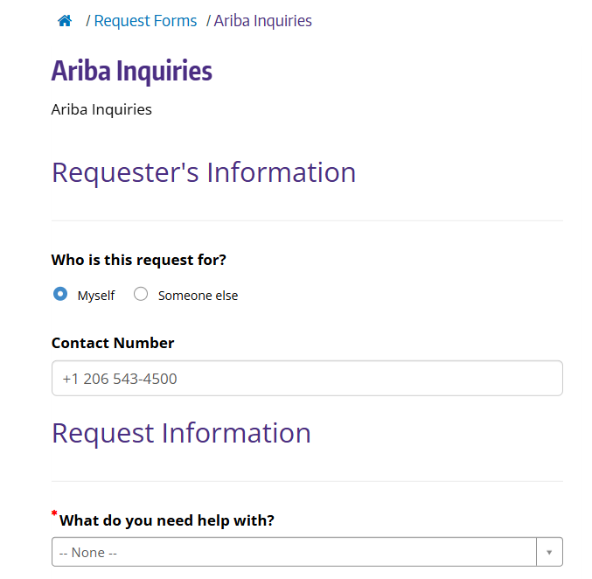
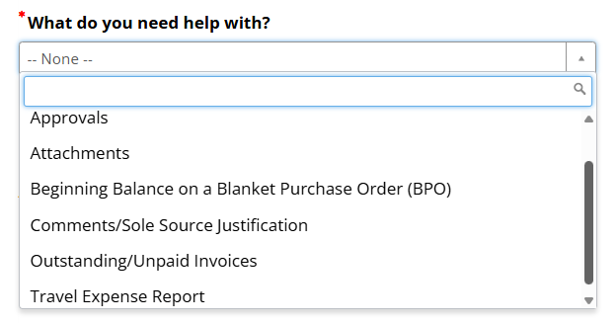
WHAT IF I CANNOT FIND WHAT I WANT IN THE SPEND CUBE?
Fill out the "Ariba Inquires" webform in the UW Connect Finance Portal

Slide 7
RECOMMENDED RESOURCES
Cube Wiki
How to connect to data cube
Spend Cube Wiki & Templates
Husky On-Net VPN
Webinar Resources (includes several cube-related webinars)
Troubleshoot connection issues
Getting Help
Reporting Office Hours - Sign up page for our weekly office hours.
Help@uw.edu, type “BI Portal” in the subject line.
Ariba Inquires webform in the UW Connect Finance Portal
Deep Dive Recordings (including Ariba Transitional Informational Session)

Slide 8
QUESTIONS

