Slide 1
Buying from Contracts

Slide 2
Agenda
Benefits of using Contracts
When to use a Contract
Contract Types
Diverse and Small Supplier Contracts
Workday Catalog Contracts
UW Public Contract and Bidding Portal
Searching for Contracts within Workday
Delegated Signature Authority
Q&A

Slide 3
Contracts Save You Time and Money
Contracts are also the easiest way to buy. Here are some of the benefits of using Contracts:
No competitive bid requirements
Established pricing and discounts
No sole source requirements
They can be used at any dollar amount
Terms and conditions are pre-negotiated
Contract Sales Representatives can provide assistance with:
Product selection
Installation
Training
Returns
Buying from a Contract provides the best overall value to the University and results in lower overall cost.

Slide 4




Contract Types
Contracts are managed by the Buying staff at UW Procurement Services.
There are four types of Contracts available for the UW campus to use:
UW Contract
State Contract
GPO
Interlocal
Established by Procurement Services staff.
Established by State of WA Enterprise Services staff
Established by a group purchasing organization
Established by other public agencies

Slide 5
When to use a Contract
Contracts are there for your convenience and are available to use at any time.
Consider using a Contract if you are presented with any of these following purchasing scenarios:
The purchase exceeds the current direct buy limit ($10,000)
A sole source justification does not apply
A competitive solicitation would take too long
The preferred buying method when purchasing goods and services at the UW is from Contracts available in the Workday Catalog.
Notes:
Update right before Deep Dive

Slide 6
Diverse and Small Supplier Contracts
Many of the Contracts available to campus are established with diverse, minority-owned, women-owned, veteran-owned, small and local businesses who seek the visibility and opportunity to do business with the UW community.
Ensuring these businesses have Contracting opportunities gives the UW access to a wider array of business solutions, helps drive innovation and strengthens our local economic growth.
The UW encourages campus to purchase from Contracts that feature these suppliers, which directly supports the University’s initiative and commitment to supporting diversity, equity and inclusion.

Slide 7
Workday Catalog Contracts
Did you know that the UW Workday catalog suppliers are Contract suppliers? These Contracts are a mixture of the four Contract types presented earlier.
Ordering through the Catalog is the recommended first choice for purchasing goods at the UW. Here are some reasons why:
Fastest order method
No dollar amount threshold
A competitive solicitation or sole source justification is not required
Purchases through Catalog contracts offer established pricing, terms and discounts designed to offer the best overall value to campus.

Slide 8
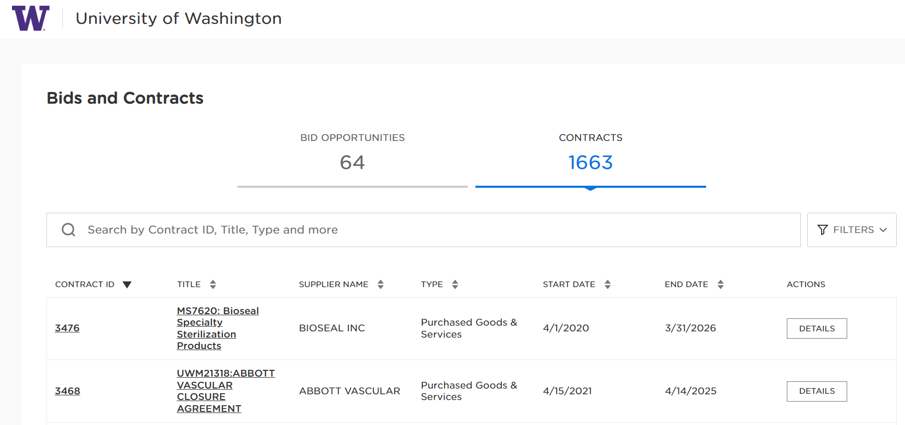
UW Public Contract and Bidding Portal
If you can’t find what you’re looking for in the Workday Catalogs, try using the UW Public Contract and Bidding Portal. The Portal is located on the Procurement Services website and provides visibility into Contracts that UW staff are able to leverage within their departments. The Contracts displayed in the Portal are a mixture of the four Contract types.
There are four fields available in the Report (as shown below), that allow users to search for Contracts in a variety of ways. You can search by:
Supplier Name/Number
Contract Number/Contract Title
Keyword Search
After entering your search criteria, click the View Report button to see the Contract information results. Leaving the fields blank will display all available Contracts.
Notes:
Facilitator Notes:
Say:

Slide 9

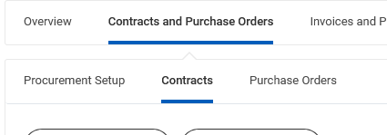
Searching for Contracts within Workday
There are multiple ways to identify if a supplier in Workday has a contract you can use to make a purchase. The easiest is to use the search bar in Workday and either search
Searching by Supplier:
In the main Workday Search Bar - type “Supplier:” (without quotes): then type the Supplier name (as shown in the example below)
A list of suppliers will populate. Click on the name of the one you are interested in.
When the Supplier page loads, click on the “Contracts and Purchase Orders” tab, and the sub-heading “Contracts”:
Review the list of SPCs (supplier contracts) that are associated with the supplier.

Slide 10
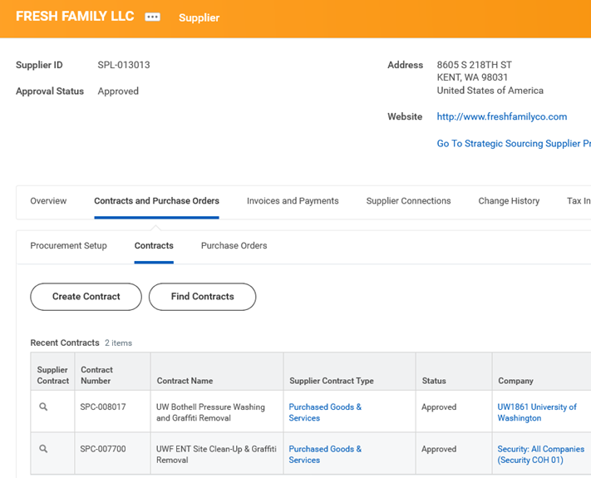
Searching for Contracts
Hover over the magnifying glass to the left of the SPC number and right click for a menu to pop up. Select “See in new Tab” to open the contract in a new browser window and read more about its description and Overview.
Choose the contract with the best fit (description) and read the Overview to confirm. Be sure to review the scope and usage of the agreement before selecting the contract. You will need to return to your original browser tab to select the Contract.
Subaward Contracts are OSP agreements only and may not be used/selected by campus.

Slide 11
Delegated Signature Authority
Delegated signature authority is granted to the University of Washington by the State Legislature and is further delegated internally to the Executive Director for the Procurement Services department, who has further delegated signature authority to Procurement Services buying staff.
Procurement Services Contract Managers are considered agents of the University and are authorized to sign contracts on behalf of the university.
Campus departments do not have the authority to execute or sign contracts, including maintenance and service agreements.
It is recommended that Contracts, or other documents requiring a signature, be reviewed by a Procurement Services Contract Manager regardless of the method of payment or dollar amount.
To submit a Contract or other documents requiring signature to be reviewed by a Procurement Services Contract Manager, you can submit through UW Connect Finance form “General Finance Help Request” https://uwconnect.uw.edu/finance
If you can’t find what you’re looking for in both the Workday Catalogs and the UW Public Contracts and Bidding Portal, contact a Procurement Services Contract Manager for assistance in finding other Contract possibilities.

Slide 12
Resources
Procurement Subject Matter Experts: https://finance.uw.edu/ps/contact-us/subject-matter-experts
Finding UW Contracted Suppliers Job Aid: https://uwconnect.uw.edu/finance?id=kb_article_view&sys_kb_id=447c56d293061e5086a27b847aba1001&spa=1
Buying from Contracts webpage: https://finance.uw.edu/ps/how-to-buy/buying-from-uw-contracts
UW Public Contract and Bidding Portal: https://university-of-washington.public-portal.us.workdayspend.com/contracts

Slide 13
Questions?
Notes:
Facilitator Notes:
Say: Thank you for being such a wonderful cohort, I hope this training was helpful.

