Slide 1
Field Advance and Research Subjects

Slide 2
AGENDA
Research Subjects
Field Advance

Slide 3
RESEARCH SUBJECT OVERVIEW
Research projects involving human subjects and often offer a small payment to the research subject for purposes of recruitment or encouragement for participation of a project. Payments to research subjects can be made using one of the following methods:
US Bank VISA Rewards Card
Tango Email Gift Card
UW Revolving Fund Account (discontinued for new accounts)

Slide 4
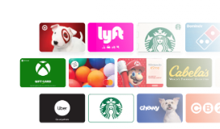
TANGO CARD
Tango Card is an email gift card that can be used to pay research subjects. Internet access will be needed by the recipient to redeem the card. The recipient can choose to purchase cards from a variety of vendors online.
Fees:
No fee to order
$25.00 - $250.00 fee to cancel reward/card number/s

Slide 5

TANGO CARD
How the process works:
Order cards by creating a requisition in Workday. You will indicate the number of cards needed in the requisition.
Tango will email the requester the email gift card numbers
The requestor will distribute to the recipient(s) with instructions on how they can use the card
How to get help:
Dedicated contacts for Tango cards are shown on the Tango Card web page.

Slide 6
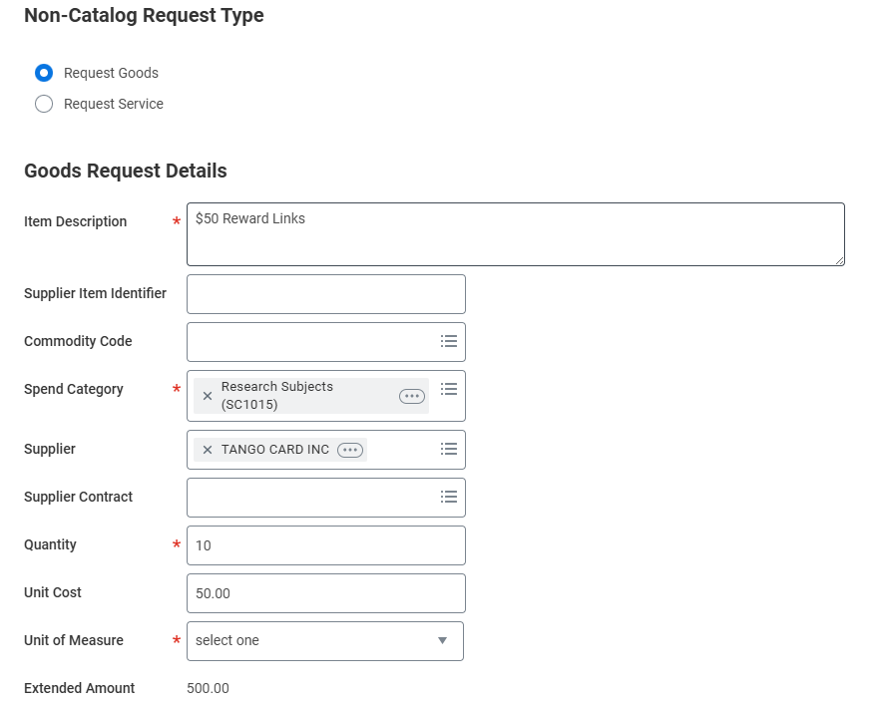
TANGO CARD
Refer to the job aid in UW Connect Finance Portal.
Workday Role Needed: Requisition Requester

Slide 7
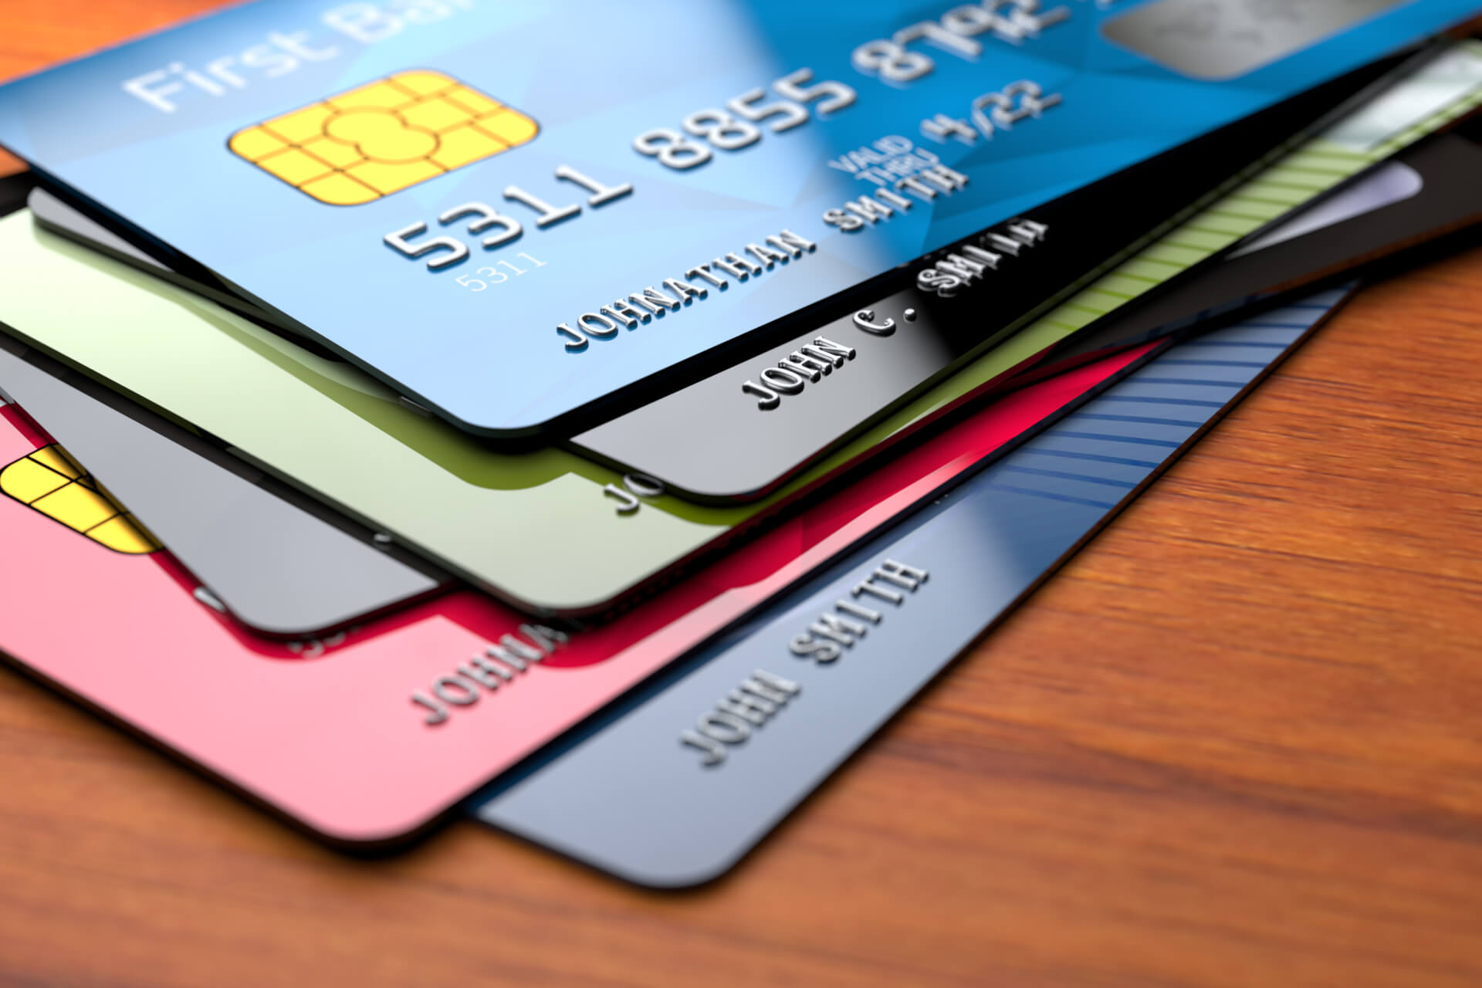
US BANK CARD
US Bank VISA Rewards card.
Anonymous
Onetime load
Used anywhere VISA is accepted
For participation incentive
$10.00 - $1,500.00
No cost for card
Fees are described when card is received
Allow time for ordering and receiving new cards for a project
Only load when ready to distribute

Slide 8

US BANK CARD
How to order cards:
Fill out and submit the “Order and Load US Bank VISA Rewards Card” form in the UW Connect Finance Portal.
After departmental approval, card orders are filled within 7-10 days.
How to load cards:
Fill out and submit the “Order and Load US Bank VISA Rewards Card” form in the UW Connect Finance Portal.
After departmental approval, cards are loaded within 7-10 days.
Note: Cardholders are encouraged to register their card online so they can check the balance and view their transactions. Registering is free.

Slide 9
UNIT RESPONSIBILITIES
Read the web pages thoroughly
Read the “Department Responsibility” document available on the top of the:
  Tango web page
  US Bank Card web page

Slide 10

RESEARCH SUBJECT QUESTIONS

Slide 11
FIELD ADVANCES OVERVIEW
What is a Field Advance?
A field advance is a loan from the University of Washington (UW) general funds made to a UW department, under the supervision of a UW employee (custodian) to provide a temporary source of funds for conducting official UW business.
All field advances issued are subject to federal, state, and university purchasing rules and guidelines.
Field advance requests are under $10,000 and can last no more than six months.

Slide 12
FIELD ADVANCES
What can you use the Field Advance for?
Conducting research or training in remote areas
Per diem advances for UW students and other individuals not on the UW payroll
Research subject payments when subjects need to be paid in cash
What you cannot use the Field Advance for:
Travel expenses for UW employees and personal travel insurance
Domestic purchases for goods and services
Reimbursements or payment for services to UW employees
Alcohol
Payments to nonresident aliens (NRA) for services rendered in the US
Items not for a project’s purpose

Slide 13
FIELD ADVANCES PROCESS
Create “Spend Authorization” in Workday to request funds
Receive funds via UW debit card
Spend Field Advance
Save receipts and documentation
Create spend down in Workday with “Expense Report”
Return unused funds and close
*Expense Data Entry Specialist role required in Workday

Slide 14
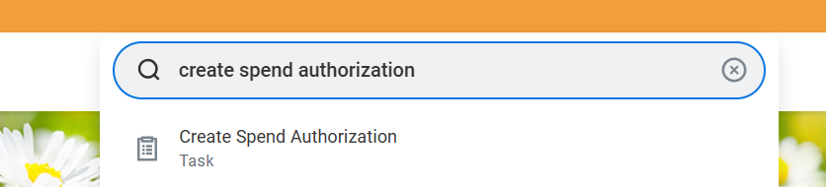
FIELD ADVANCES
How the Field Advance is issued:
Issued via UW debit card up to $10,000. Additional review needed for funds being wired or sent via ACH deposit
Request is approved in between 7-10 business days. Add an additional 10 days if receiving the UW debit card for the first time.
Custodian requirements:
Must be a UW employee for the entire duration of the field advance
Does not have any past due field advances

Slide 15
CREATING THE SPEND AUTHORIZATION
(Make sure to review the job aid “How to Manage Field Advance.pdf)
To ensure there are no delays in the approval and funding for your advance:
Fill out the request form fully and completely.
Check the end date is no more than 6 months from the start date.
Complete the justification section thoroughly to document the purpose of the Field Advance
Select the “Payment Reimbursement Type: Check, Direct Deposit, Reloadable Bank Card”
If selecting Reloadable Bank Card, please provide the last 4 digits of the card to be loaded
Make sure the “Cash Advance Requested” box is checked

Slide 16
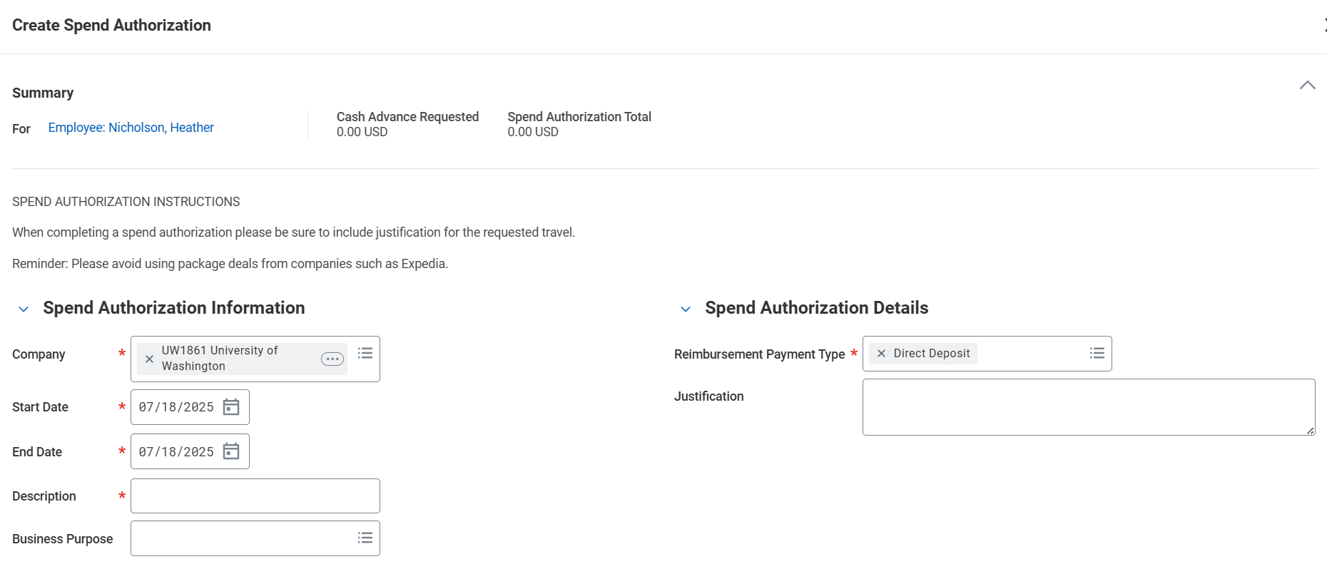
Spend Authorization

Slide 17
FIELD ADVANCES
How do you pay back the loan?
Keep all receipts and documentation
Within Workday, request a spend down for the Field Advance by using the “Create Expense Report” task.
Select “Create New Expense Report from Spend Authorization”
Attach the documentation and receipts within the “Expense Report.”
Spend down the Field Advance until all funds are accounted for
If there are unused funds, arrangements will need to be made to return the monies to UW

Slide 18
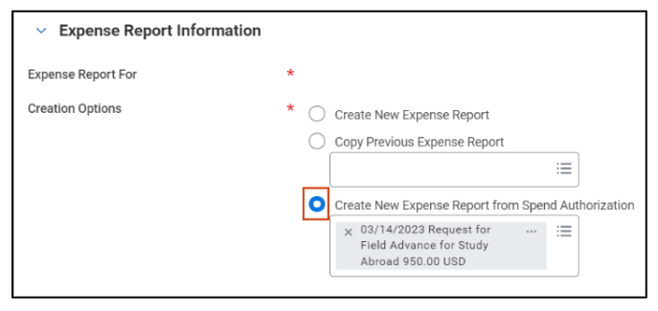
Spend Down Expense Report

Slide 19
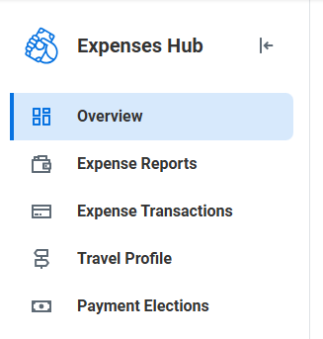
FIELD ADVANCES
How can you track Expense Reports?

Slide 20
FIELD ADVANCE QUESTIONS

Slide 21
Resources
Research Subjects:
Tango Card Web Page
How to Order Tango Cards Job Aid
US Bank Card Web Page
How to Order US Bank Cards Job Aid
How to Load US Bank Cards Job Aid
Order and Load US Bank Visa Rewards Cards Request Form
Field Advances
Field Advances Web Page
How to Manage Field Advances Job Aid

