Slide 1
MISCELLANEOUS PAYMENTS

Slide 2
AGENDA
Covered Today:
Miscellaneous Payments Overview
The Miscellaneous Payees
Miscellaneous Payment Workday Walkthrough (screenshots)
Recent Updates
Questions
Not Covered Today:
Non-Employee Travel Reimbursement MPs
  Refer to Travel Services website
Employee Reimbursements (Expense Reports)

Slide 3
MISCELLANEOUS PAYMENTS OVERVIEW
One-time payments to individuals that are not currently registered as a supplier in Workday and does not meet the criteria for supplier registration.
Eligible payees are individuals that are U.S. citizens, lawful permanent residents or foreign nationals (non-residents)
Payees may NOT be UW employees

Slide 4
MISCELLANEOUS PAYMENTS OVERVIEW - CATEGORIES
What kind of payments can I make?
Request Category | Definition | Example
Honorarium | Thank-you payment in recognition of a professional individual’s special service | Guest lecturer Sitting on a panel
Service | One-time payment for personal services | Consulting Editing/reviewing Graphic Design
Reimbursement | Payment for out-of-pocket expenses paid by non-UW employees for expenses paid with personal funds | Individuals purchases food for an office party
Refund | Transactions that are pre-approved by the unit and AP | “manual check request” pre-Workday
Stipend | Payments made to non-UW affiliated individuals to support participation in a training or learning experience | $2,000 to support a UW summer program participant's living expenses.

Slide 5
MISCELLANEOUS PAYMENTS OVERVIEW – CATEGORIES CONTINUED
What kind of payments can I make? (Cont.)
Request Category | Definition | Example
Award | Awards or prizes in recognition of a special achievement. | Winning 1st place in a competition
Non-UW Scholarship | Amount given to a non-UW affiliated individual for study, training or research | $1,000 scholarship to an individual to help pay for tuition and books
Research Subject | Payments to individuals participating in research projects, for purposes of recruitment or encouragement of participation | $20 thank-you payment made to an individual who participated in a study
Royalties | Payments for the right to use intellectual or tangible property legally owned by another individual | Payment to an author for use of published work

Slide 6
MISCELLANEOUS PAYMENTS OVERVIEW – WHAT IS NOT ALLOWED
What can NOT be paid as a Miscellaneous Payment request?
Payment | Instead Use
Payments to individuals performing recurring services | Purchase Order/Supplier Invoice Request
Payments to individuals currently registered as a supplier | Purchase Order/Supplier Invoice Request
Payments to a company or organization using an Employer Identification Number (EIN) | Purchase Order/Supplier Invoice Request
Service payments over the Direct Buy Limit | Purchase Order/Supplier Invoice Request
Payments to UW employees | Payroll or Expense Report
Payment for goods | Purchase Order/Supplier Invoice Request

Slide 7
MISCELLANEOUS PAYMENTS OVERVIEW – PAYMENT OPTIONS
What payment options are available?
Payment Option | Considerations
Check | Option to mail directly to payee or through campus mail
ACH | Payees with domestic banks only ACH Transactions over $5K require additional verification
Wire | Primarily used for payees with banks outside of the U.S. Payee address is required (ISO 20022)
Zelle | Research Subject payments only Payee phone number or address that is registered with Zelle

Slide 8
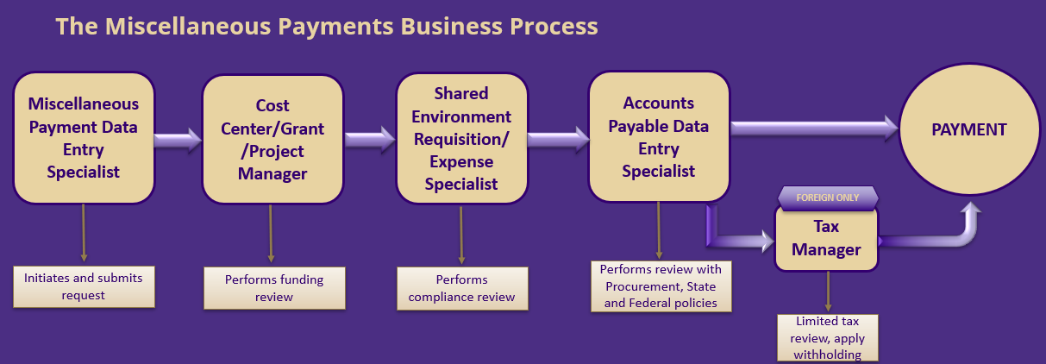
MISCELLANEOUS PAYMENTS OVERVIEW - PROCESS

Slide 9
Step 1: The Miscellaneous Payee

Slide 10
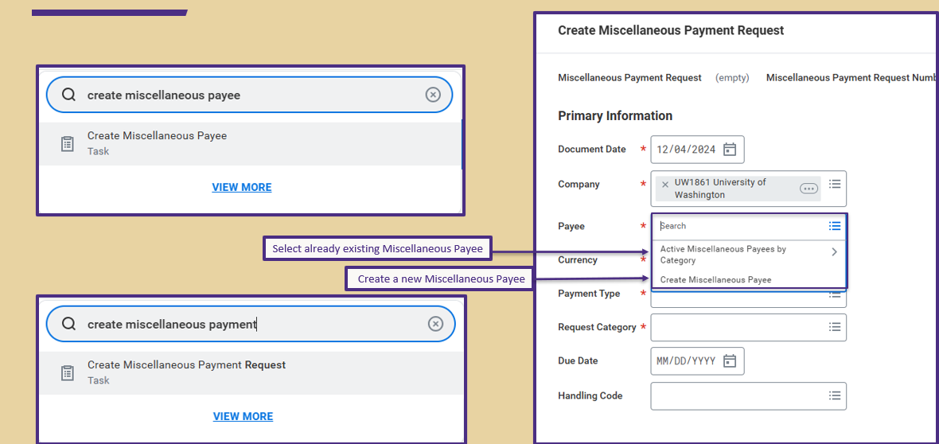
CREATING THE PAYEE PROFILE

Slide 11
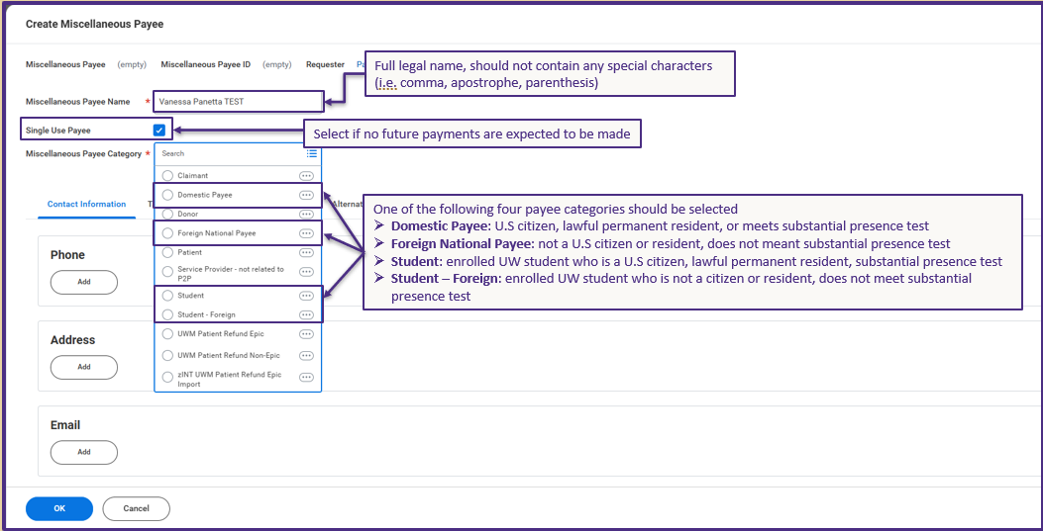
CREATING THE PAYEE PROFILE – PAYMENT CATEGORY

Slide 12
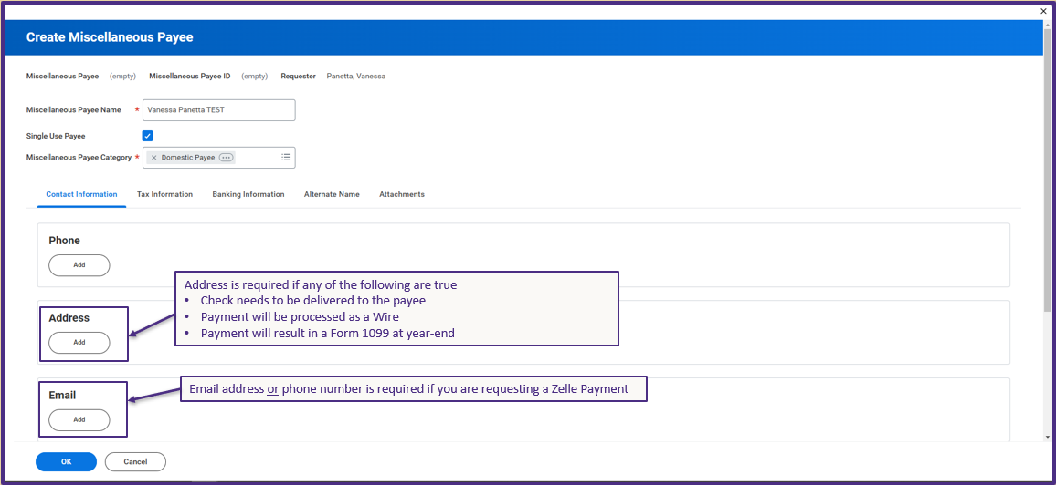
CREATING THE PAYEE PROFILE – ADDRESS AND EMAIL

Slide 13
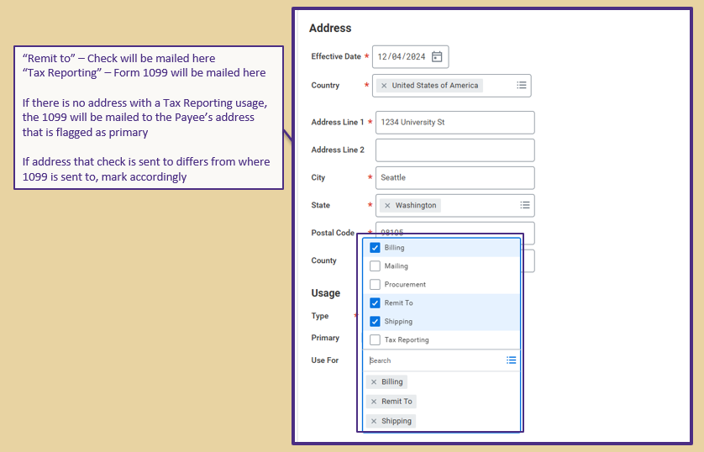
CREATING THE PAYEE PROFILE – ADDRESS USAGE

Slide 14
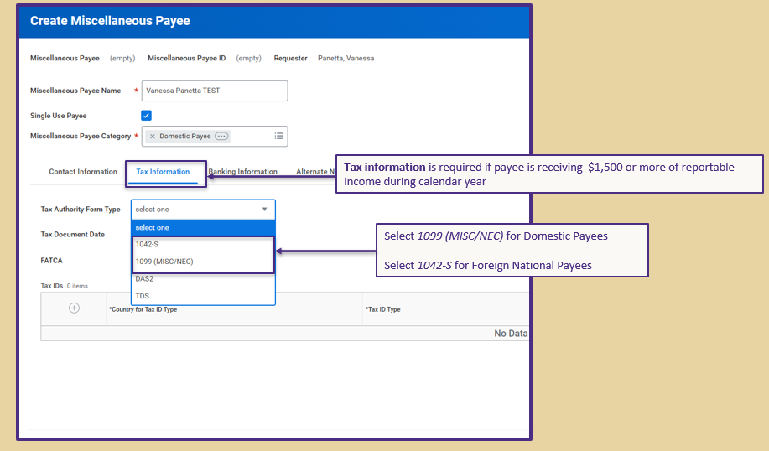
CREATING THE PAYEE PROFILE – TAX INFORMATION

Slide 15
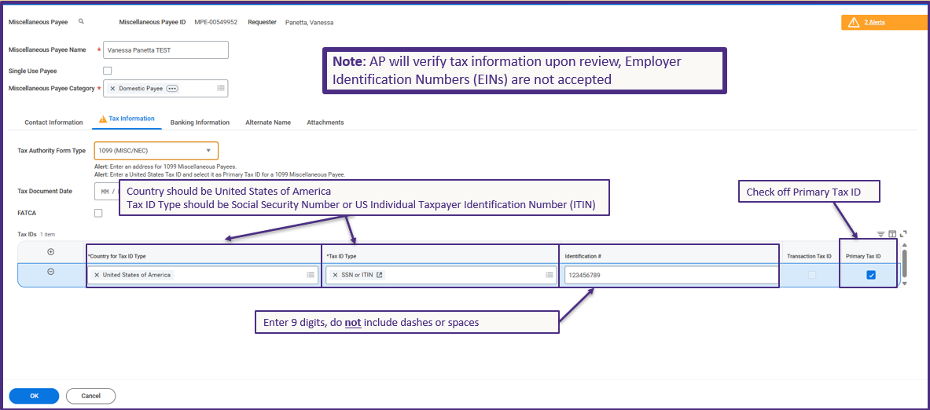
CREATING THE PAYEE PROFILE – TAX ID INFORMATION
Notes:
Alert won’t go away, but ignore it
Don’t have to select Tax Document Date
When AP reviews the MP, we verify the tax information provided with IRS records so please make sure information entered is accurate and matches the payee’s social security card. If there are any discrepancies, we will have to send the MP back
9 digits, no spaces or dashes
If you are unsure if payee requires tax information best practice is to include it so the tax office doesn’t have to go chasing after them at year end

Slide 16
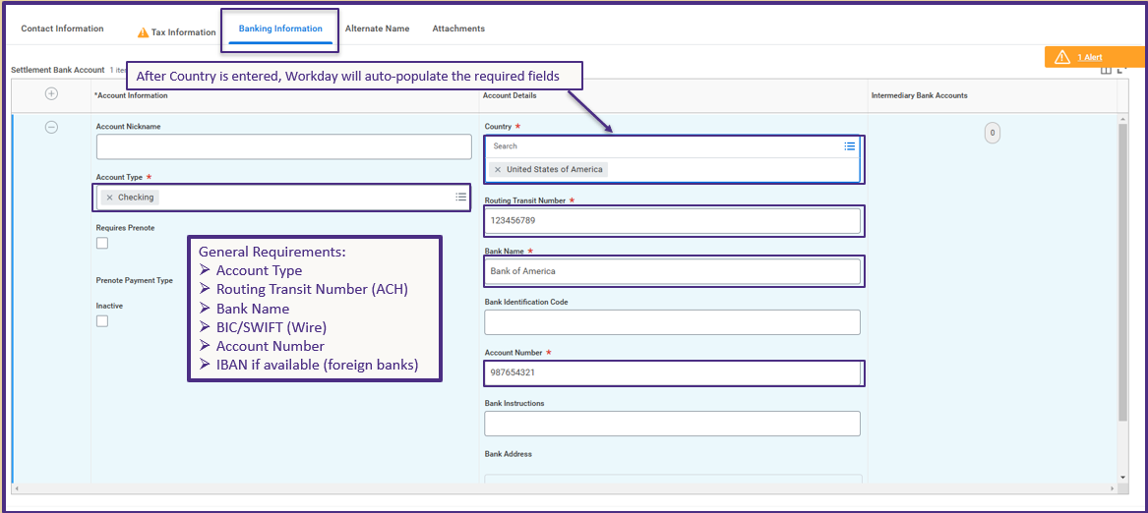
CREATING THE PAYEE PROFILE – BANKING INFORMATION

Slide 17
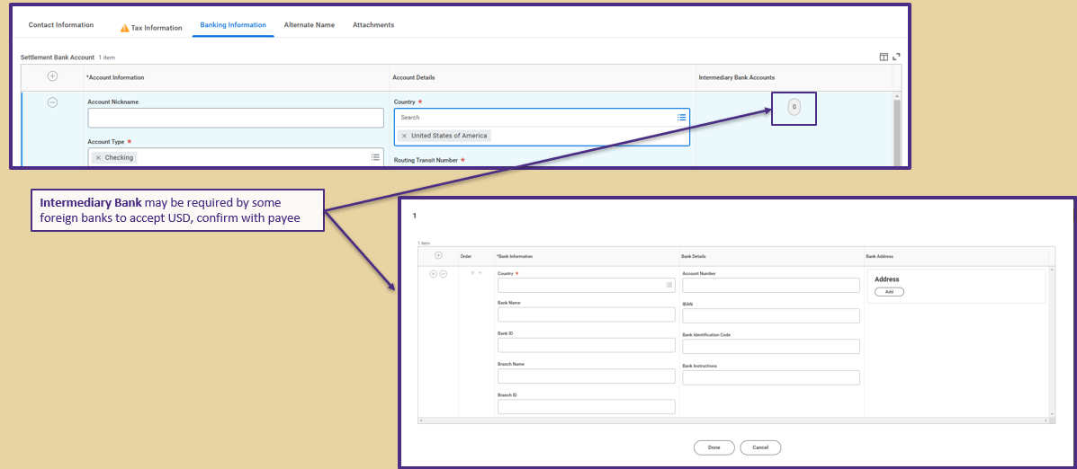
CREATING THE PAYEE PROFILE – INTERMEDIARY BANK

Slide 18
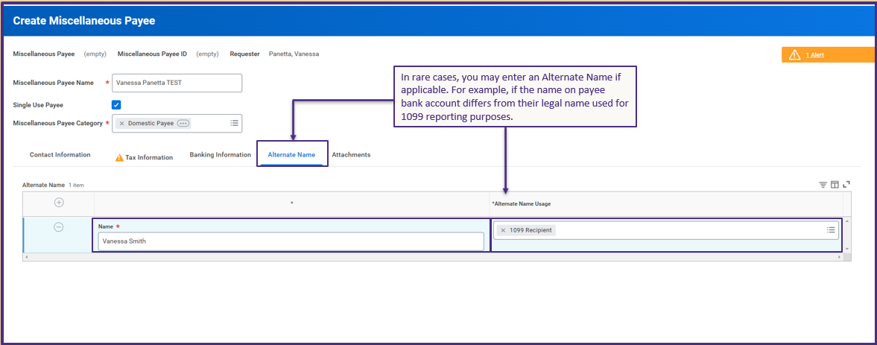
CREATING THE PAYEE PROFILE – ALTERNATE NAME

Slide 19
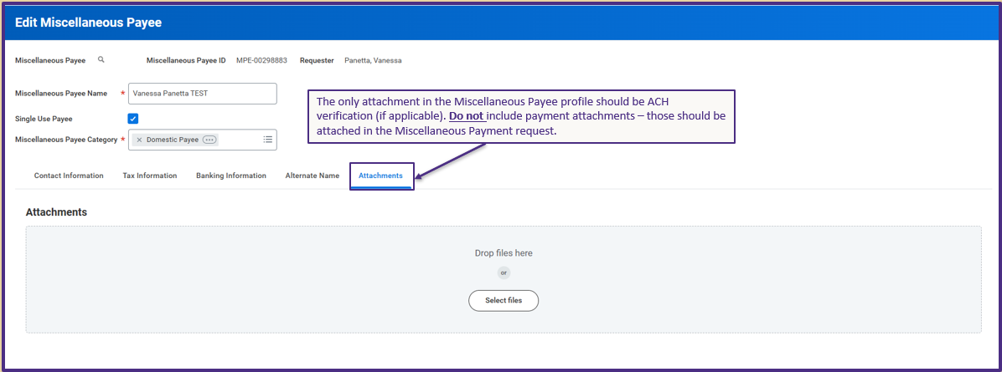
CREATING THE PAYEE PROFILE - ATTACHMENTS

Slide 20
Step 2: The Miscellaneous Payment

Slide 21
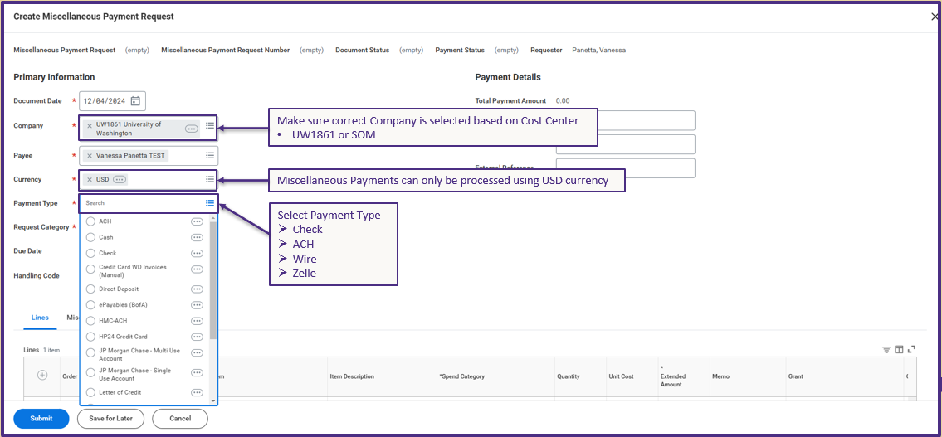
CREATING THE MISCELLANEOUS PAYMENT

Slide 22
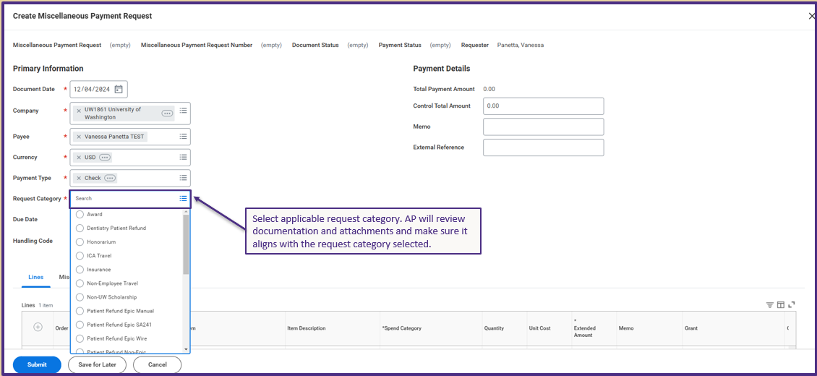
CREATING THE MISCELLANEOUS PAYMENT – REQUEST CATEGORY

Slide 23
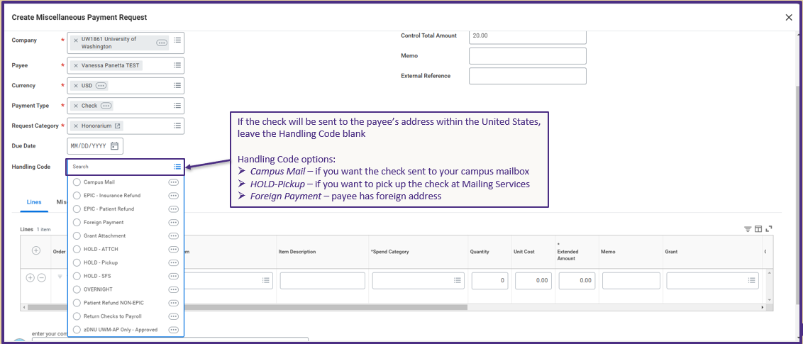
CREATING THE MISCELLANEOUS PAYMENT – HANDLING CODE

Slide 24
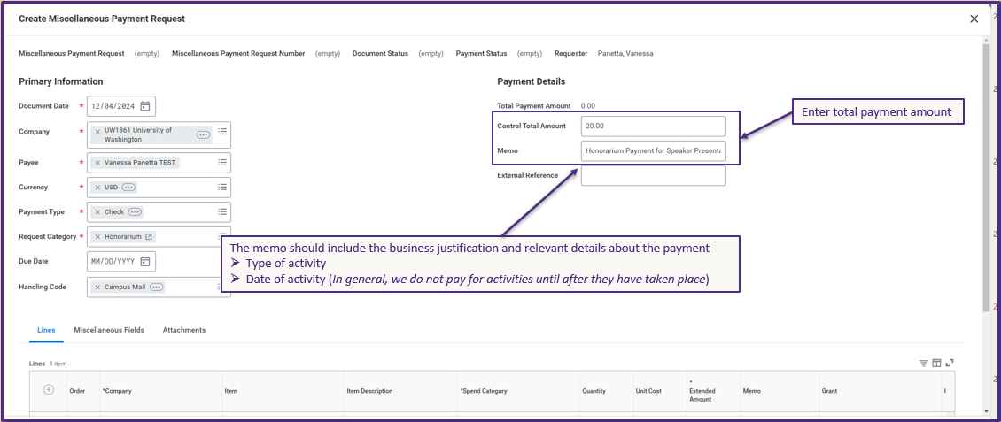
CREATING THE MISCELLANEOUS PAYMENT – TOTAL AND AMOUNT

Slide 25
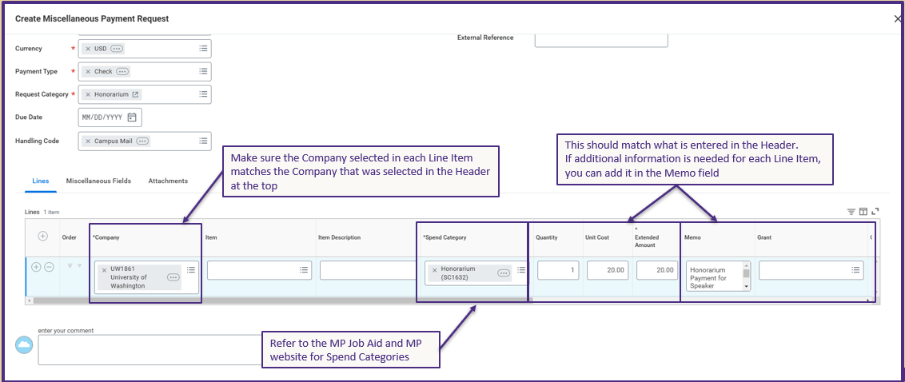
CREATING THE MISCELLANEOUS PAYMENT – LINE ITEM

Slide 26
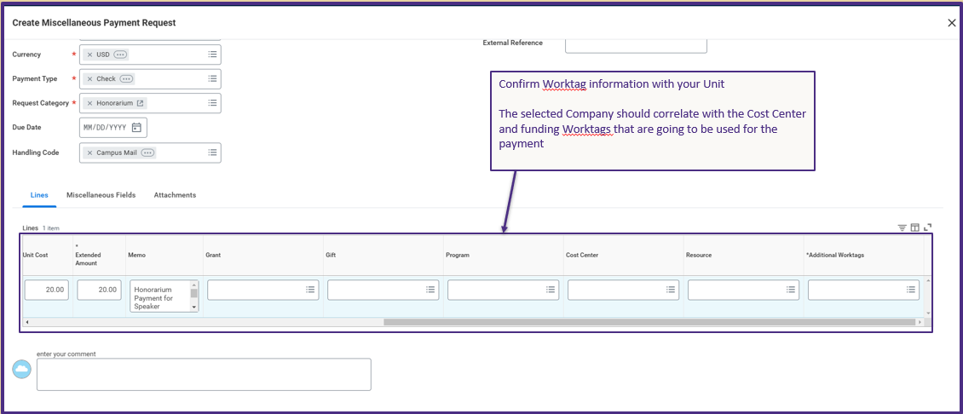
CREATING THE MISCELLANEOUS PAYMENT - WORKTAGS

Slide 27
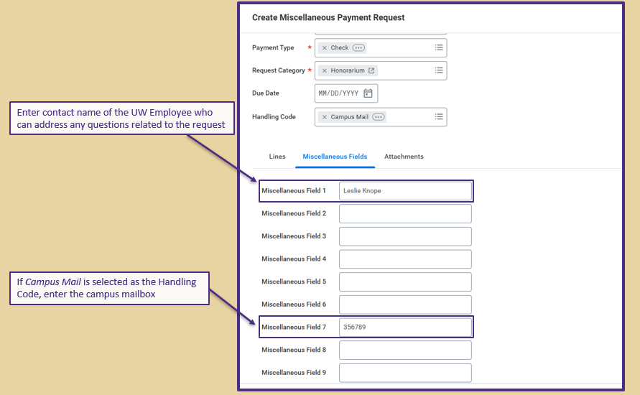
CREATING THE MISCELLANEOUS PAYMENT – MISCELLANEOUS FIELDS

Slide 28
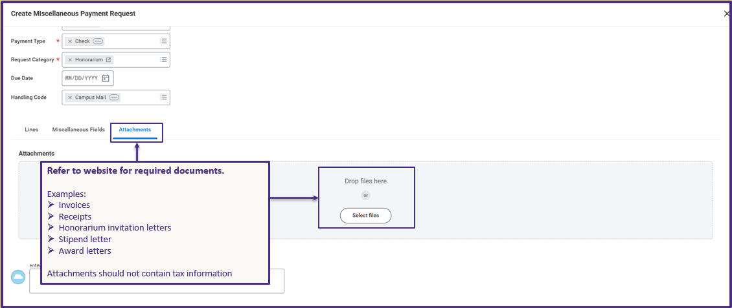
CREATING THE MISCELLANEOUS PAYMENT - ATTACHMENTS

Slide 29
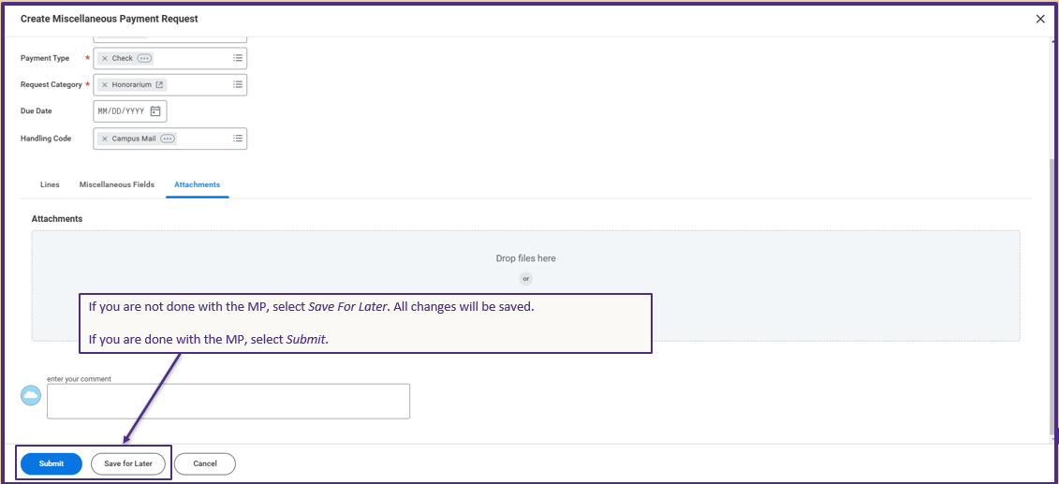
CREATING THE MISCELLANEOUS PAYMENT – NEXT STEP

Slide 30
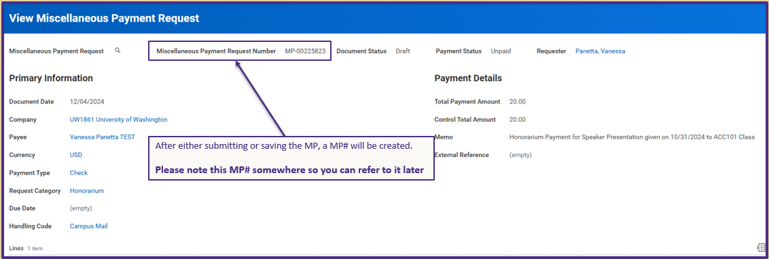
CREATING THE MISCELLANEOUS PAYMENT – PAYMENT REQUEST NUMBER

Slide 31
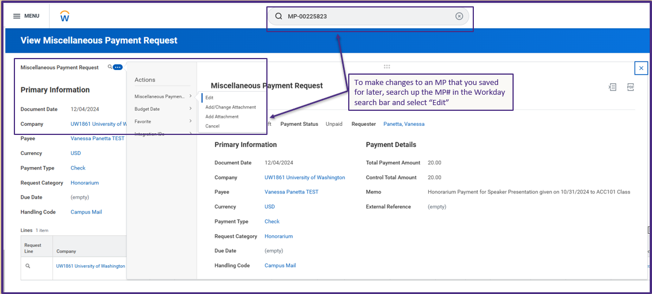
CREATING THE MISCELLANEOUS PAYMENT – EDIT FUNCTION

Slide 32
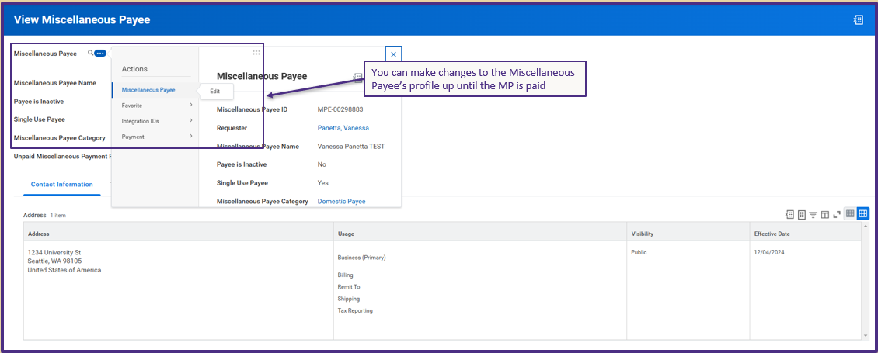
CREATING THE MISCELLANEOUS PAYMENT – PROFILE EDIT

Slide 33
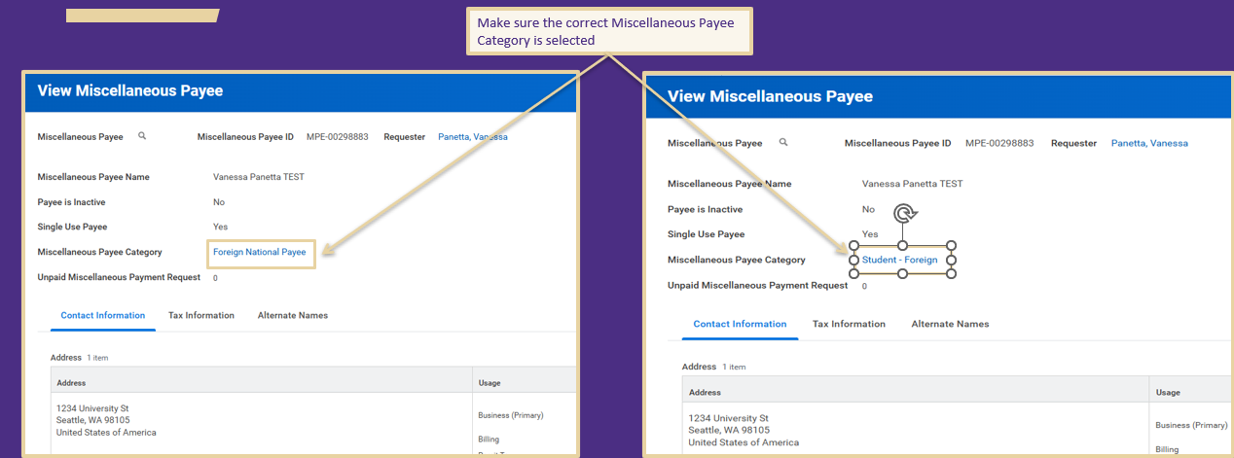
FOREIGN PAYMENTS

Slide 34
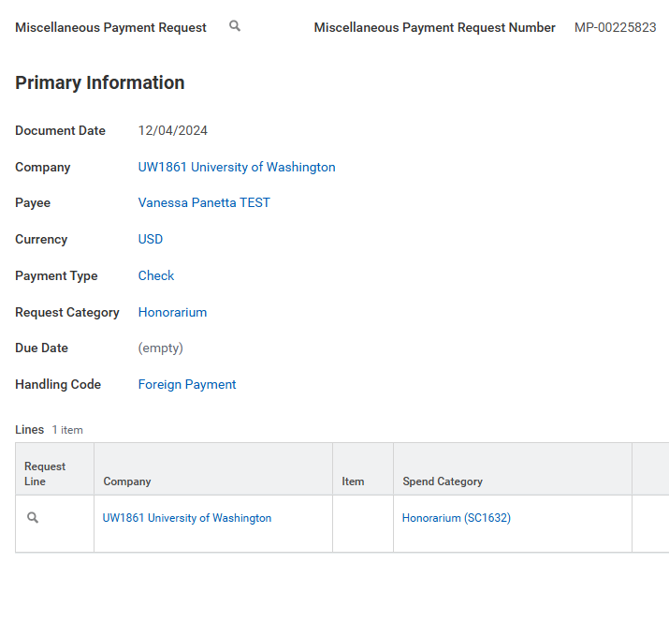
FOREIGN PAYMENTS – HANDLING CODE
Select the “Foreign Payment” Handling Code if the check is being sent to the payee’s address and they live outside of the United States.

Slide 35
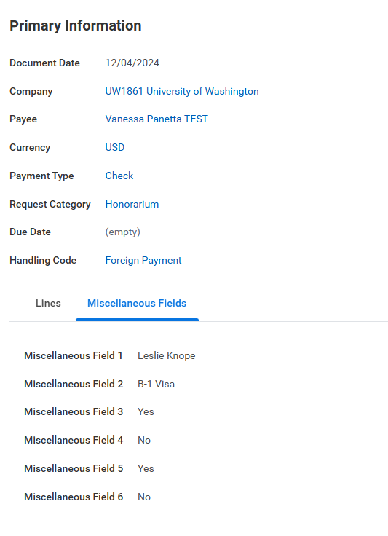
FOREIGN PAYMENTS – MISCELLANEOUS FIELDS
Miscellaneous Fields 2-6 required if the payee is Foreign National Payee
Misc Field 2: visa type
Misc Field 3: Did the foreign payee perform the activity within the U.S.?
Misc Field 4: Has Form 8233 been collected?
Misc Field 5: Has Form W-8BEN been collected?
Misc Field 6: Has Form W-8BENE been collected?

Slide 36
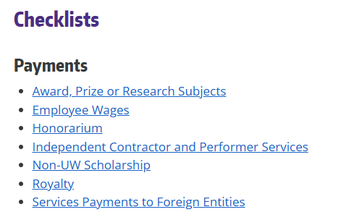
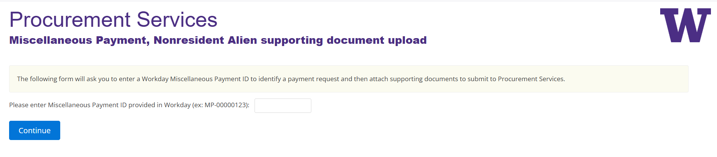
FOREIGN PAYMENTS -CHECKLISTS
Use our checklists to determine what documents are required
For security reasons, all required documents should be uploaded to our Docusign portal . Do NOT attach on Workday.
After you submit the MP, Workday will give you a to-do step requesting confirmation that the attachments have been uploaded to Docusign.

Slide 37
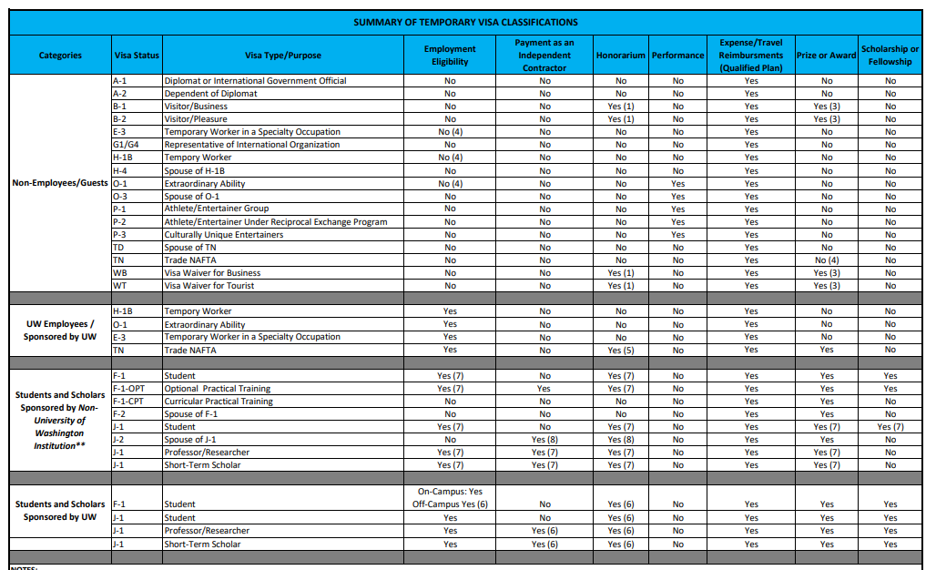
TEMPORARY VISA CLASSIFICATIONS

Slide 38
Recent Updates

Slide 39
REQUIREMENTS FOR ACH PAYMENTS
ACH transactions of $5,000 USD or grater involving new payees or changes to existing payee
In accordance with updated NACHA guidelines, additional verification will need to be provided
Attach to the Miscellaneous Payee profile
Document | Details
Phone call (between payee and department) using a previously established/independently sourced phone number | Upload a call log document that includes that date, time, phone number, and the name of the person they contacted
Official bank document - voided check | Check must state "VOID" and contain account details including name, address, and bank account
Official bank document - signed bank letter | Letter must contain the bank's letterhead confirming account details including name, address, and bank account number
Redacted bank statement or online bank screen print | Screen print must contain account details including name, address, and bank account number

Slide 40
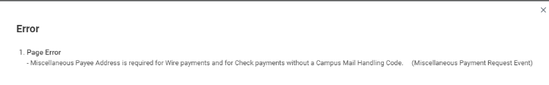
ADDRESS REQUIREMENT (WIRES)
Pursuant to updated ISO 20022 Standards, payee addresses are now required for wires
If Wire payment type is selected, payee address must be entered in payee profile
Workday will result in an error if address is not provided

Slide 41
RESTRICTED PARTY SCREENING
University requires Restricted Party Screening prior to activities that involve a foreign party
  Identifies legal and reputational risk in a relationship, screens for any sanctions or other legal restrictions
  The University prohibits working with individuals/entities that are included on a Restricted Party list
Should be performed by the Unit prior to payment agreement
UW has purchased Visual Compliance™ software to screen against the major US government lists
  Anyone with a UW NetID can create an account
If the payee is a foreign national or the payment relates to an international engagement, perform the following:
  Carry out Restricted Party Screening
  Follow the International Activity Assessment Process (IAAP) when applicable
  Recommended to keep internal record and attach to MP

Slide 42
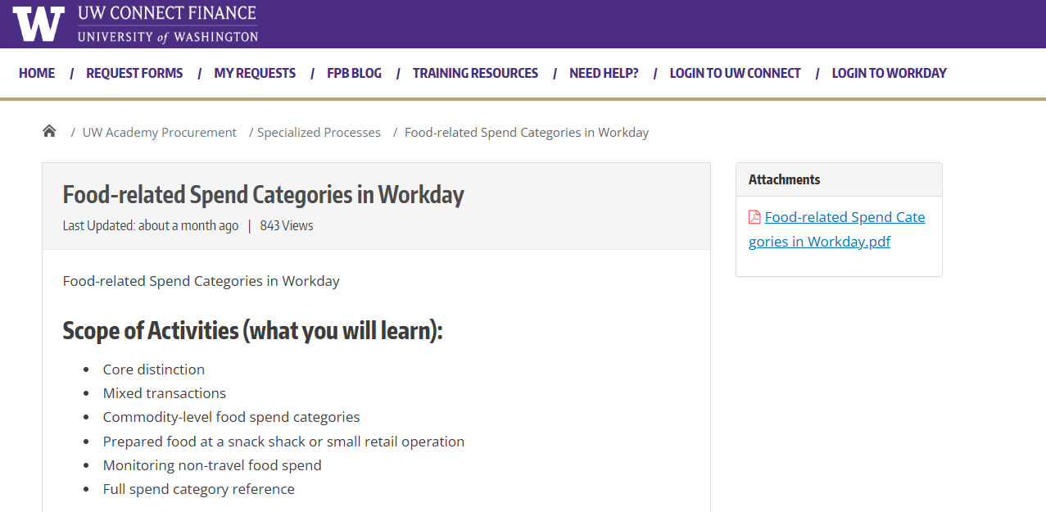
FOOD-RELATED SPEND CATEGORIES GUIDANCE

Slide 43

RESOURCES
Procurement Website - Miscellaneous Payments
How to Perform Miscellaneous Payments in Workday job aid

Slide 44
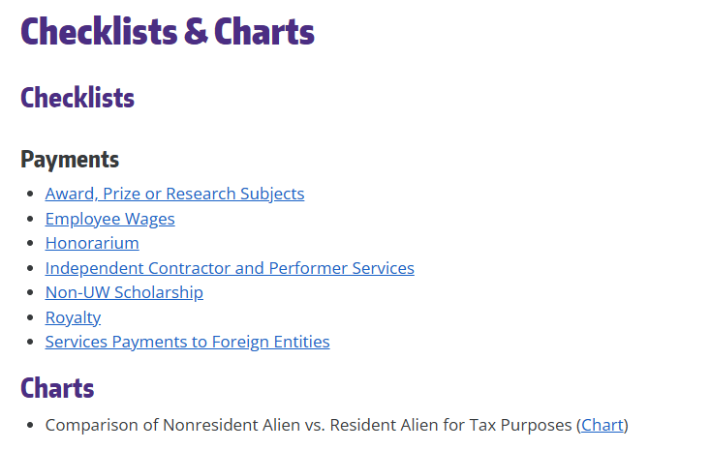
RESOURCES (CONT.)
Resources for Foreign Payments
Foreign Nationals Working in the U.S.
Foreign Payees Checklists and Charts
U.S. Citizenship and Immigration Services - Temporary Workers
Restricted Party Screening
International Activity Assessment Process (IAAP)
Docusign Portal

Slide 45
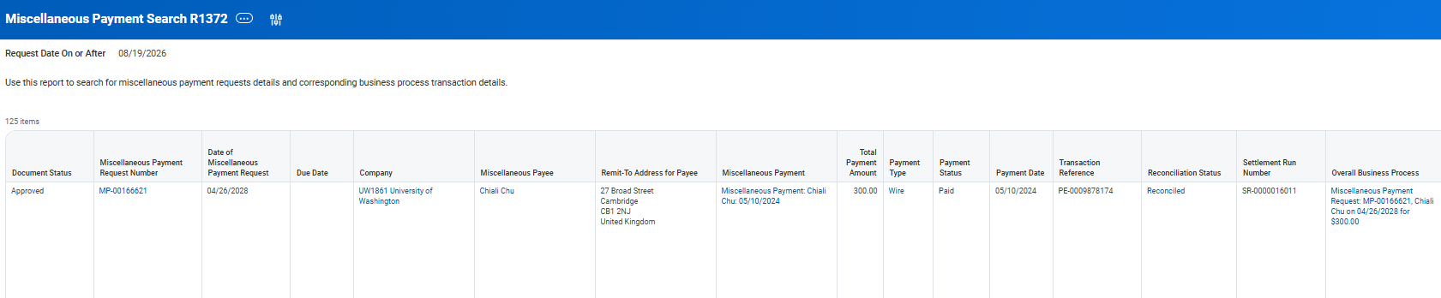
REPORT RESOURCES
Reports in Workday
View Miscellaneous Payee
Miscellaneous Payments Search R1372

Slide 46
Questions?

Slide 47
Thank You!

