Slide 1
MISCELLANEOUS PAYMENTS

Slide 2
Agenda
Miscellaneous Payments Overview
Miscellaneous Payees
Demonstration - Screenshots
Final questions
What we won’t cover today:
Miscellaneous Payments for Non-Employee Travel Reimbursement
see Travel Office for Travel training

Slide 3
Miscellaneous Payments
Miscellaneous Payments (MPs) are a way of making a one-time payment to Non-UW employees that are US Citizens and Foreign Nationals.
Not used for the purchase of goods
See the Procurement Services website for the full list of Request Categories
Most common: Honorarium and Service payments, Reimbursements
Workday security role: Miscellaneous Payment Data Entry Specialist

Slide 4
Miscellaneous Payments – Service Payments
Service Payments
How do you know if the service payment should be an MP vs Supplier Invoice?
These are all scenarios that would go down the supplier invoice route:
individual with recurring or multiple payments
payee is a company or organization (using an EIN)
payment amount exceeds the $10K Direct Buy Limit
Workday security role: Miscellaneous Payment Data Entry Specialist

Slide 5
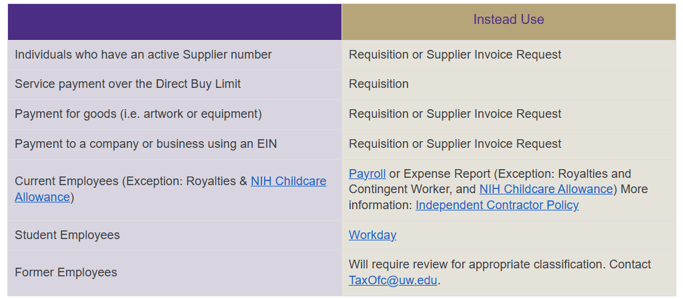
What is not allowed

Slide 6
Step 1: The Miscellaneous Payee

Slide 7
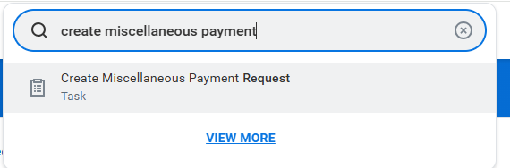
Creating Miscellaneous Payee Profile - Search

Slide 8
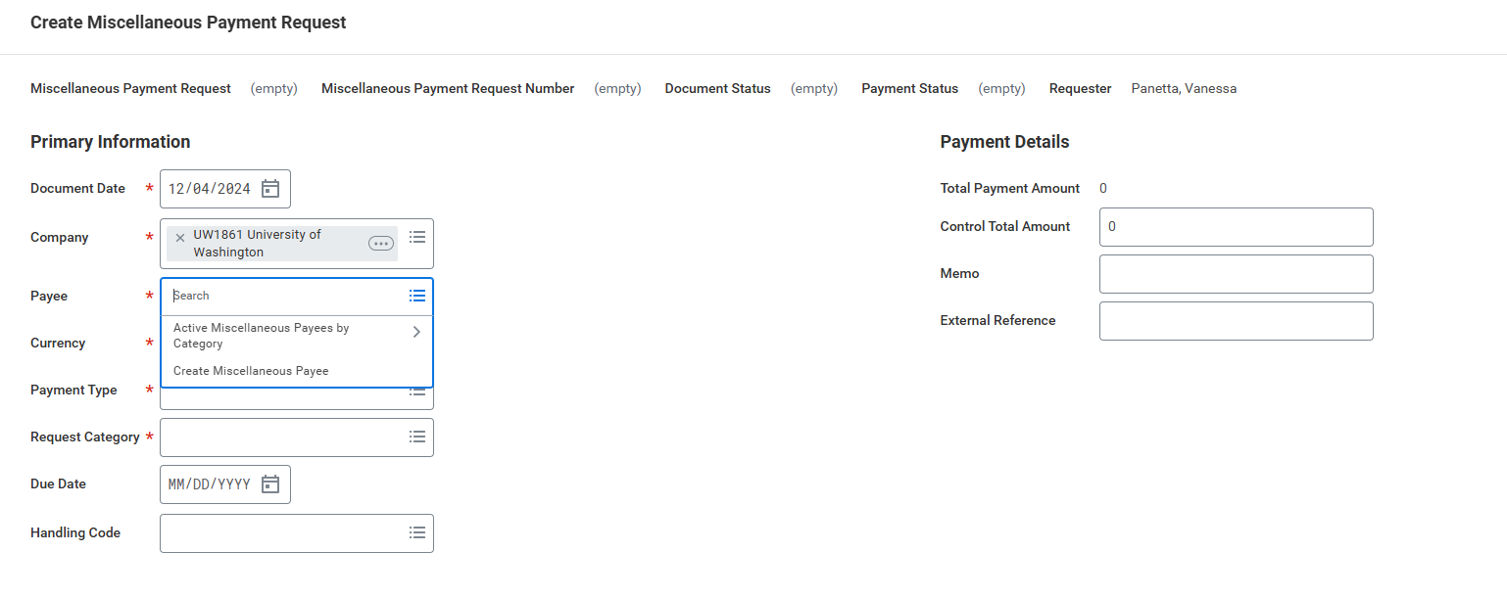
Creating Miscellaneous Payee Profile - Payee
Select already existing Miscellaneous Payee
Create a new Miscellaneous Payee

Slide 9
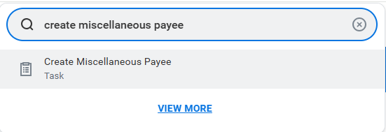
Creating Miscellaneous Payee Profile – Payee Search

Slide 10
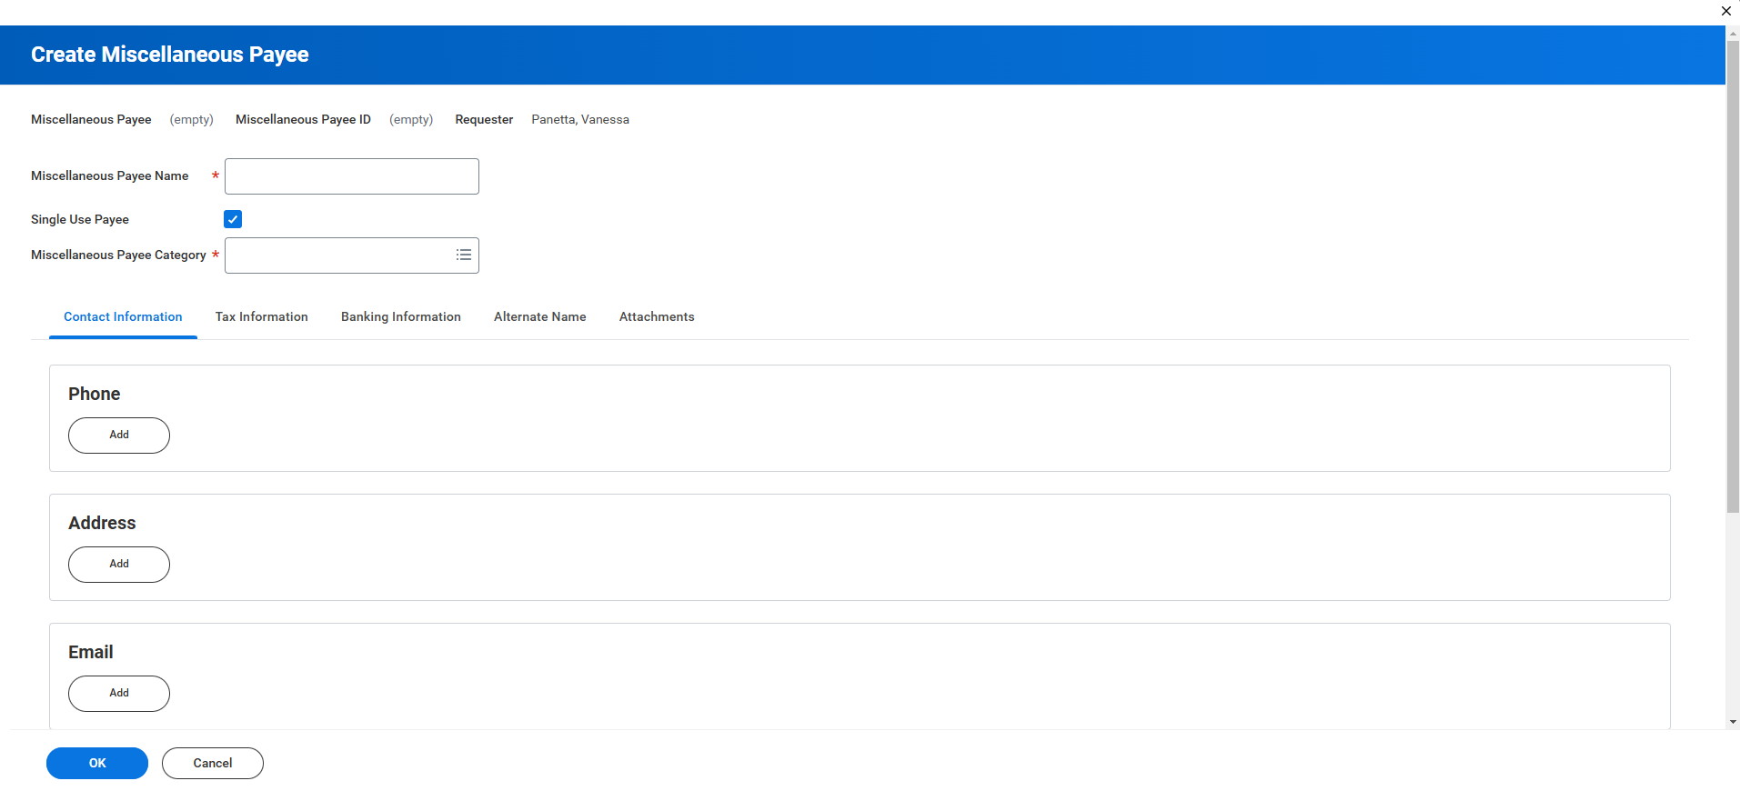
Creating Miscellaneous Payee Profile – New Payee

Slide 11
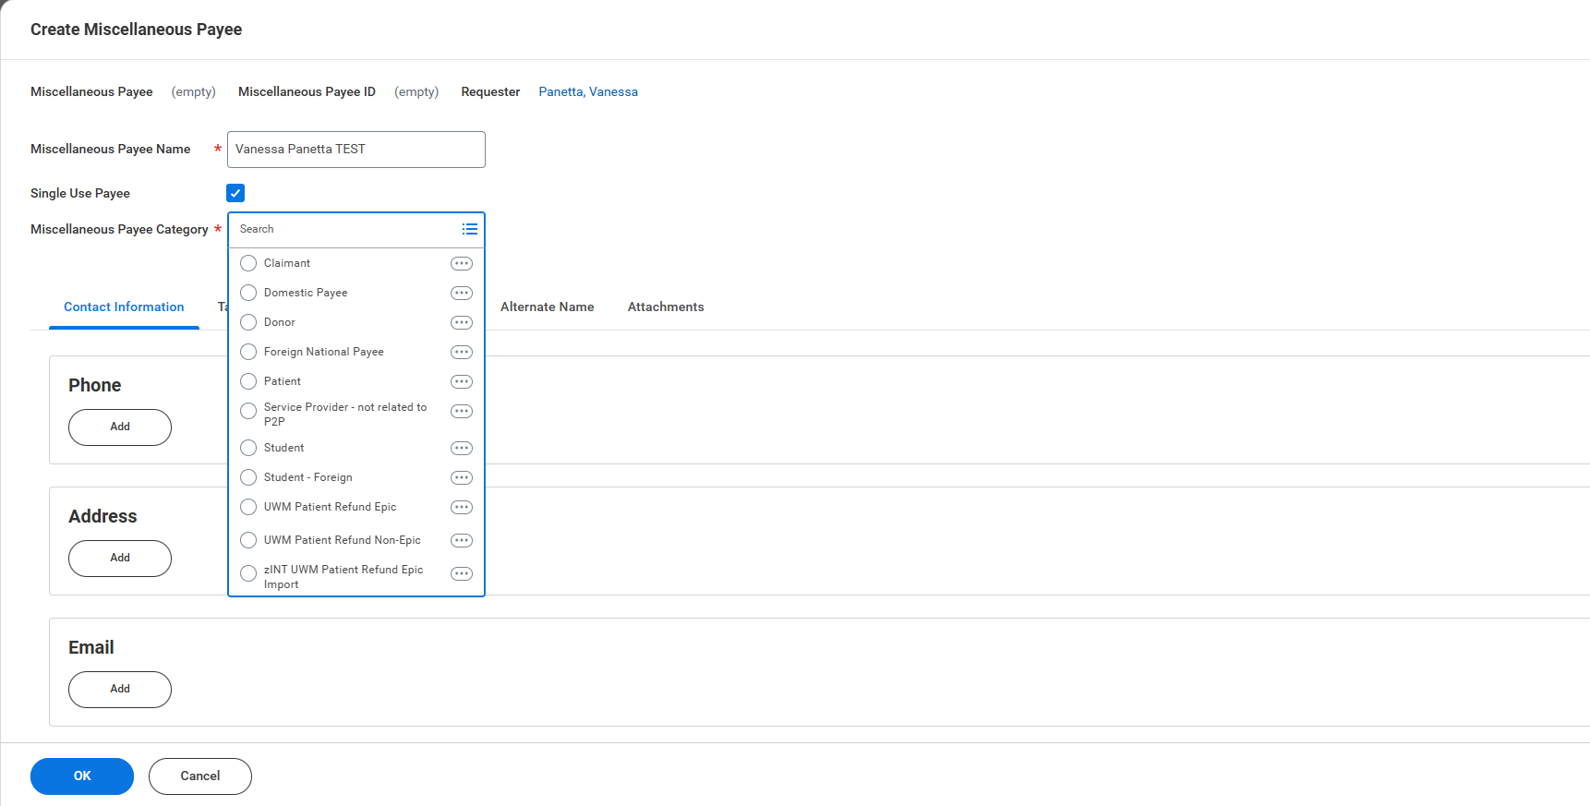
Creating Miscellaneous Payee Profile – Name and Category
Names should not contain any special characters (i.e. comma, apostrophe, parenthesis)
Select if no future payments are expected to be made
One of the following four payee categories should be selected
Domestic: U.S. Citizens or Resident Aliens
Foreign National Payees: Non-Resident Alien
Student: Non-UW students who are U.S. Citizens or Resident Aliens
Student – Foreign: Non-UW students who are Non-Resident Aliens

Slide 12
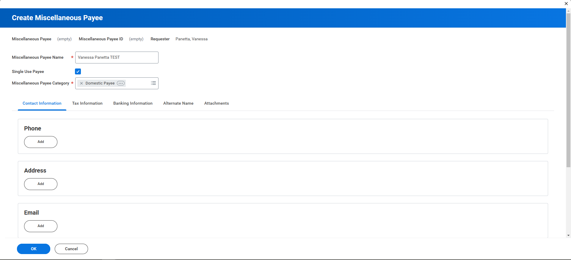
Creating Miscellaneous Payee Profile – Address and Email
Address is required if you would like a check sent to the payee
Email address or phone number is required if you are issues a Zelle Payment

Slide 13
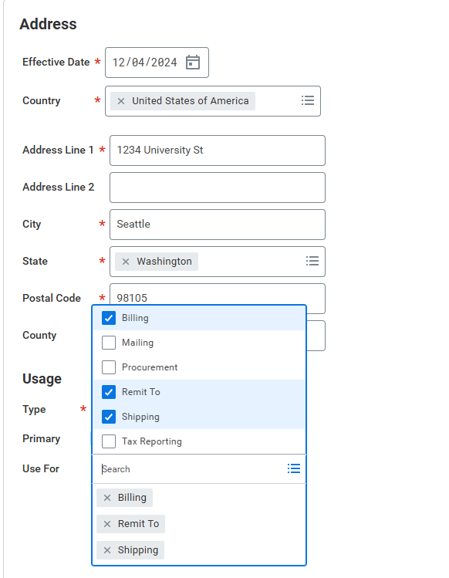
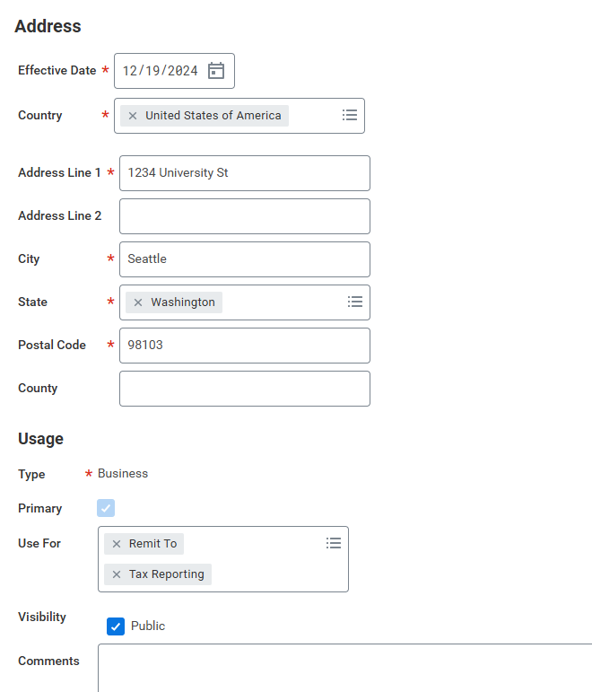
Creating Miscellaneous Payee Profile – Remit To
“Remit to” – Check will be mailed here
“Tax Reporting” – Form 1099 will be mailed here
If there is no address with a Tax Reporting usage, the 1099 will be mailed to the Payee’s address that is flagged as primary
If address that check is sent to differs from where 1099 is sent to, mark accordingly

Slide 14
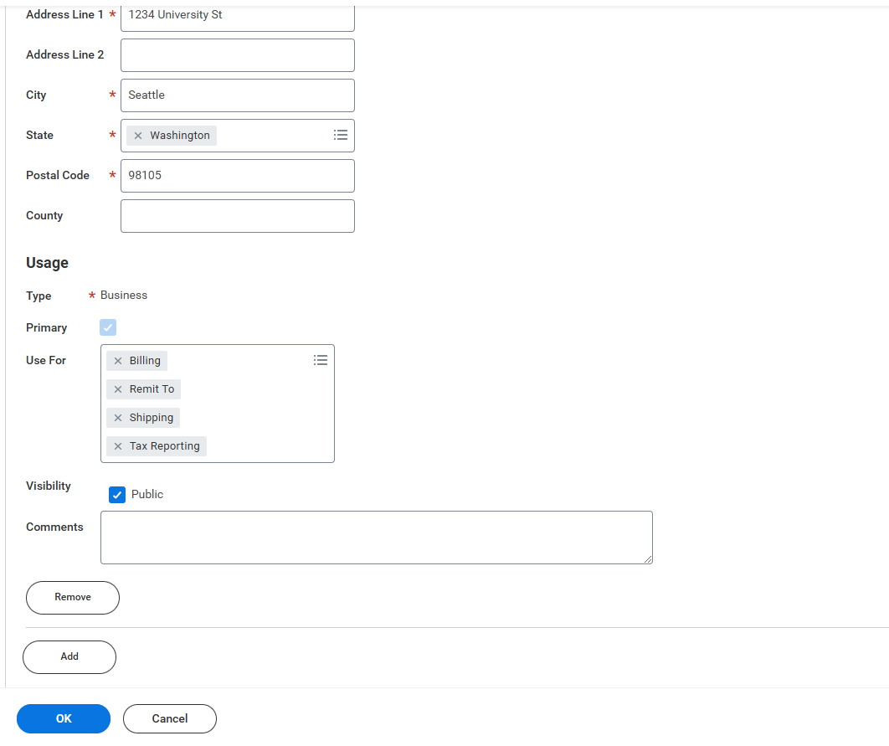
Creating Miscellaneous Payee Profile – Complete Payee
Click “Add” to add another address
Click “OK” if you are done with the payee’s profile

Slide 15
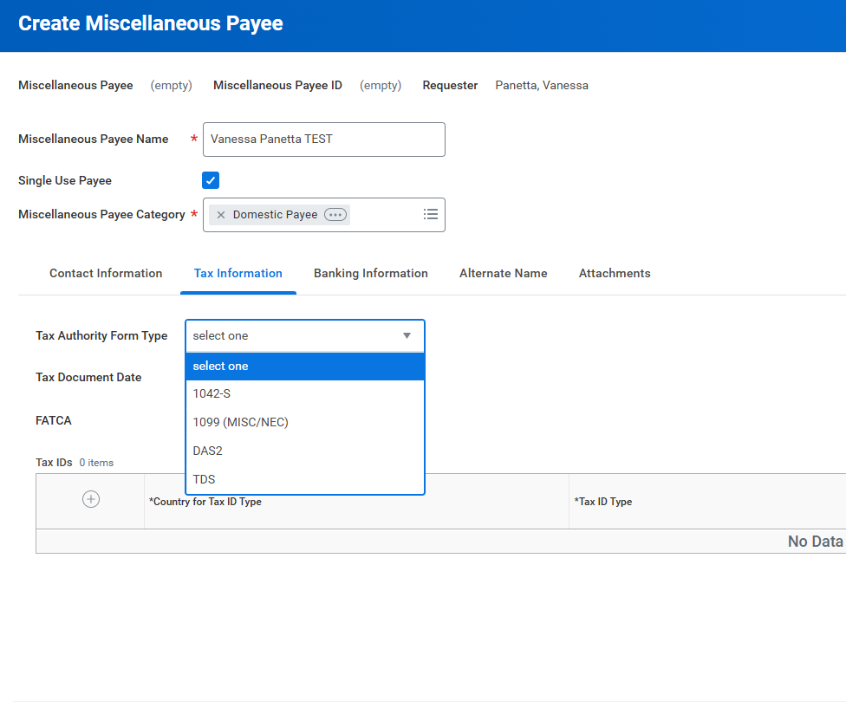
Creating Miscellaneous Payee Profile – Tax Information Tab
Tax information is required if payee is receiving $600 or more of reportable income during calendar year
Select “1099 (MISC/NEC)” for Domestic Payees
Select “1042-S” for Foreign National Payees

Slide 16
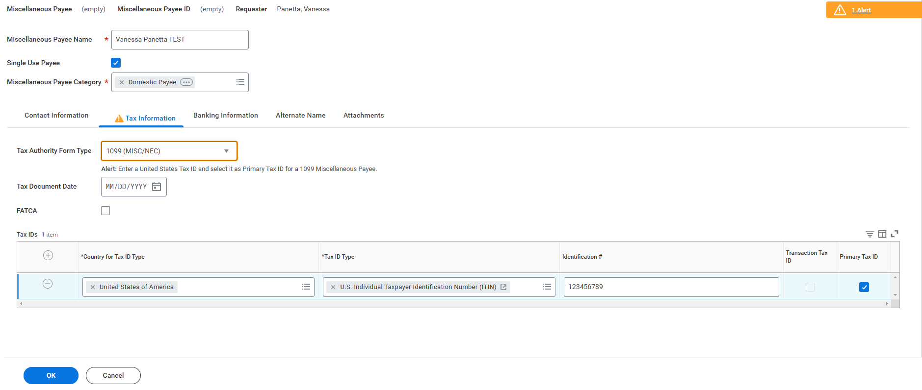
Creating Miscellaneous Payee Profile – Tax Information
Note: AP will verify tax information upon review
Country should be United States of America
Tax ID Type should be US Individual Taxpayer Identification Number (ITIN)
Check off Primary Tax ID
The Identification # should be a Social Security Number, not an Employer Identification Number
Enter 9 digits, do not include dashes or spaces

Slide 17
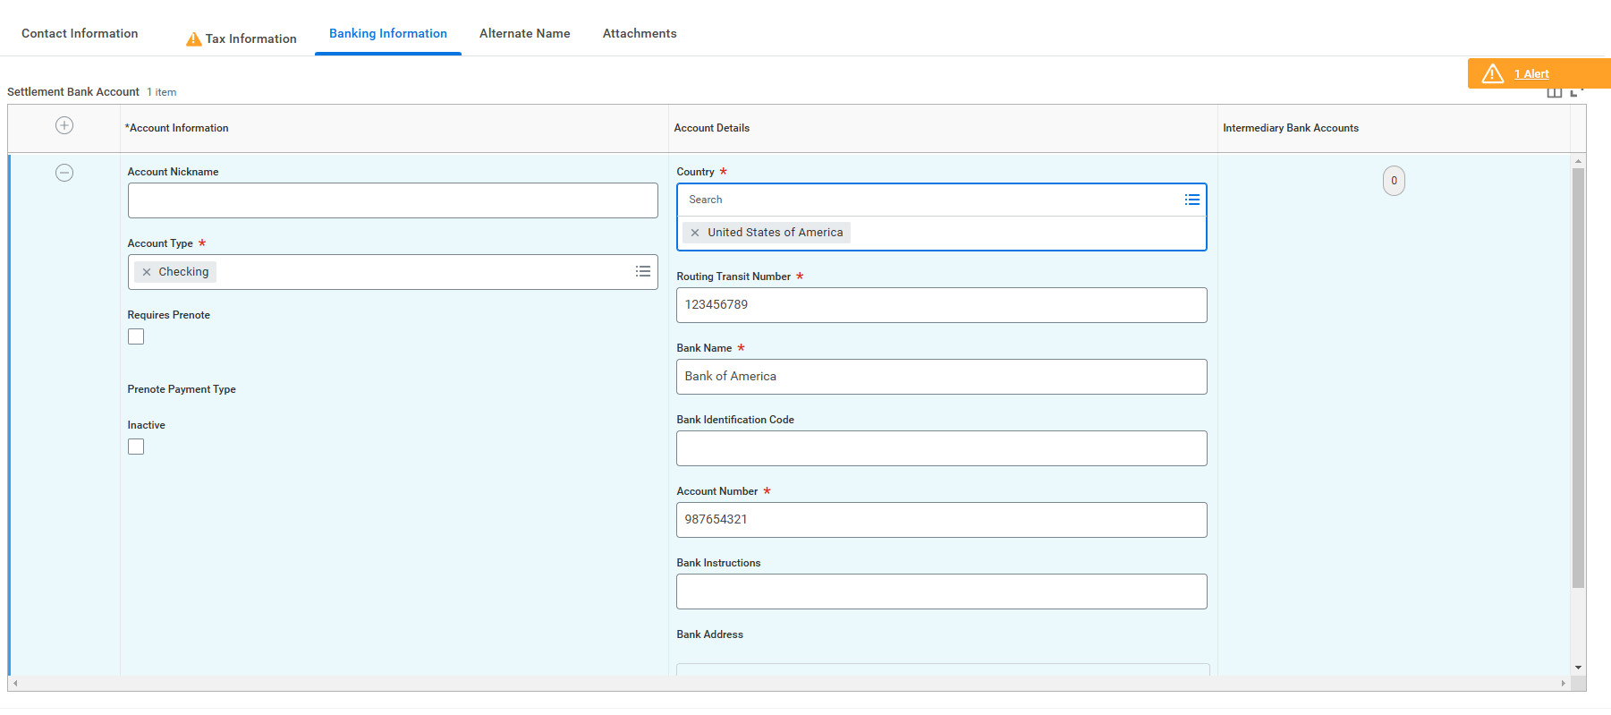
Creating Miscellaneous Payee Profile - Banking Information
After you type in the country, Workday will show the required fields
General rule of thumb: bank name, account name, account number, SWIFT/BIC (if wire), routing number (if ACH), The IBAN helpful if payee has an EU bank)
Make sure the payee’s bank can take USD. Some banks will require intermediary bank

Slide 18
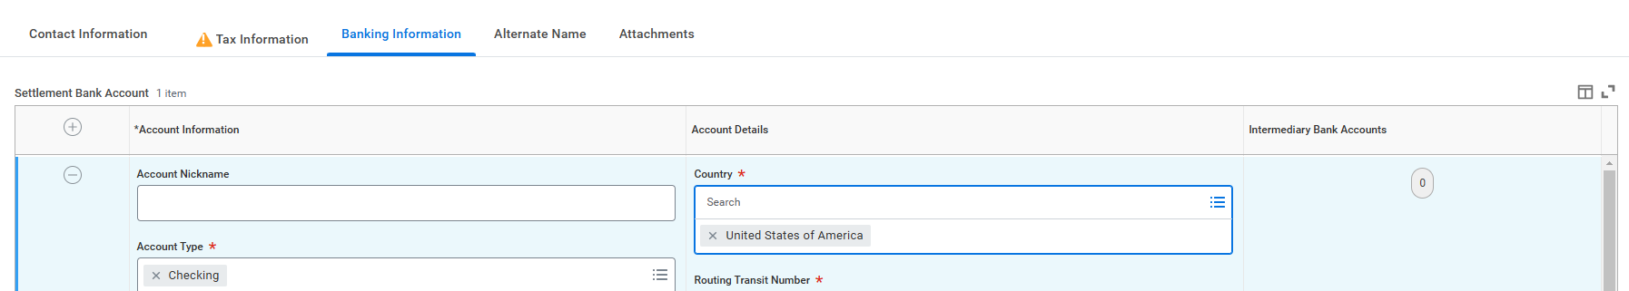
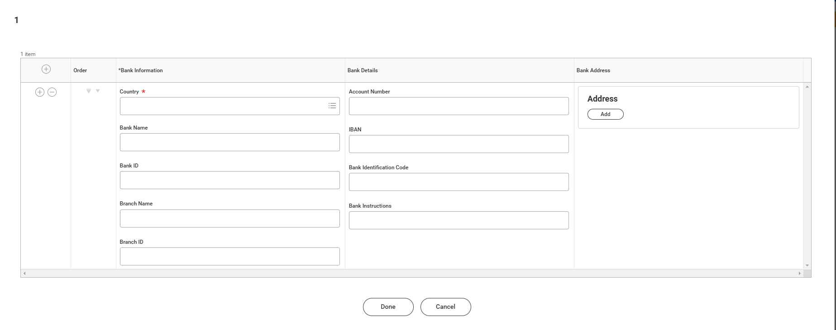
Creating Miscellaneous Payee Profile – Intermediary Bank
Enter Intermediary Bank information

Slide 19
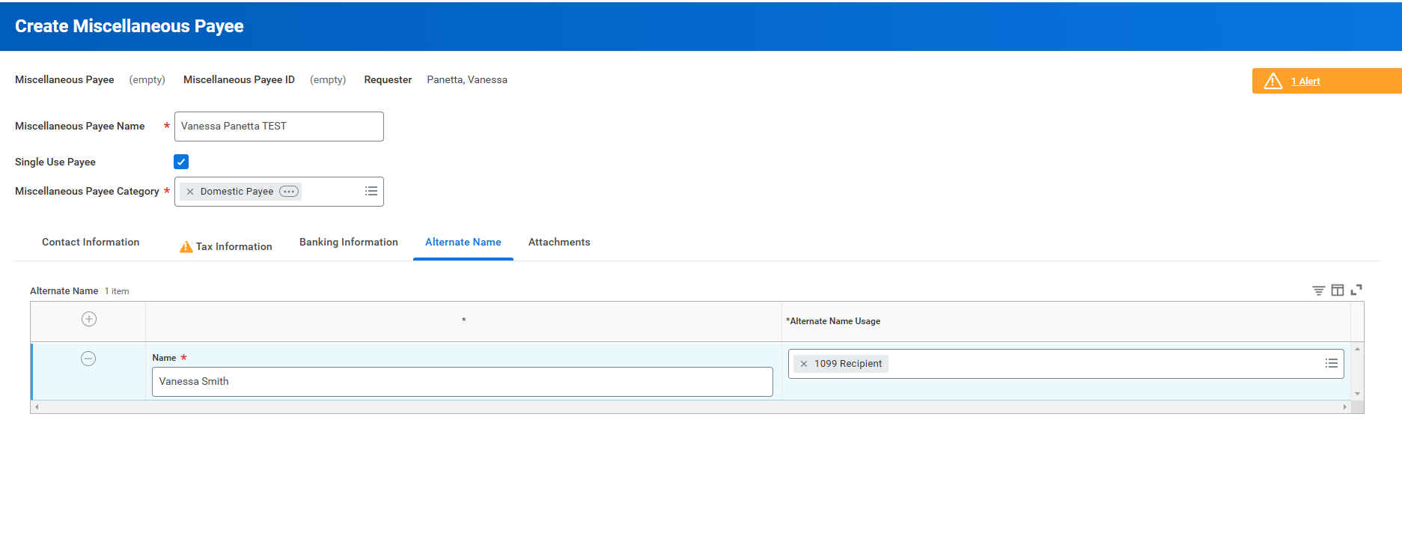
Creating Miscellaneous Payee Profile - Alternate Name
You have the option to enter an Alternate Name if applicable. For example, if the name on payee bank account differs from their legal name used for 1099 reporting purposes.

Slide 20
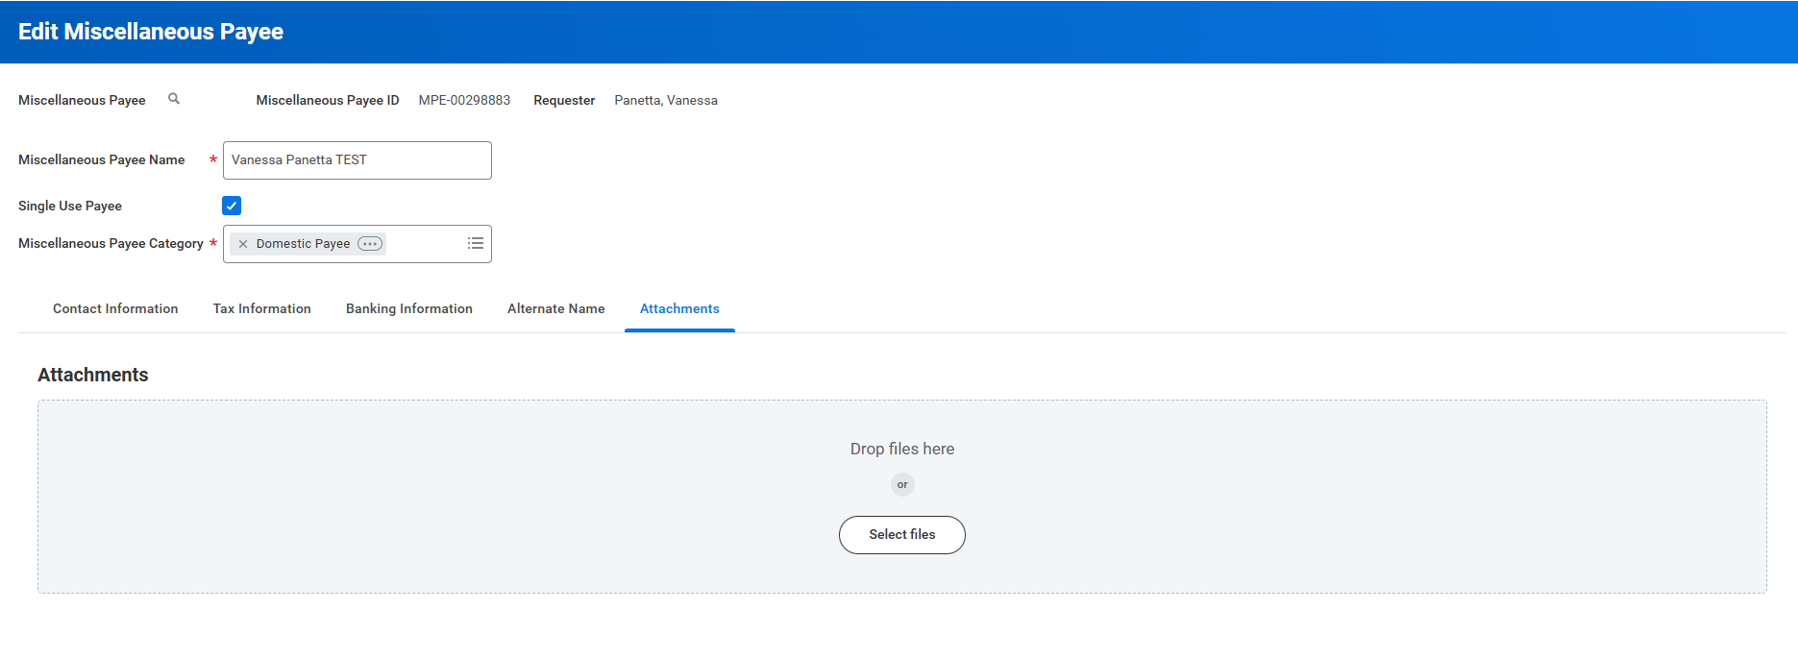
Creating The Miscellaneous Payment - Attachments
Please do not attach documents to the payee’s Workday profile

Slide 21
Step 2: The Miscellaneous Payment

Slide 22
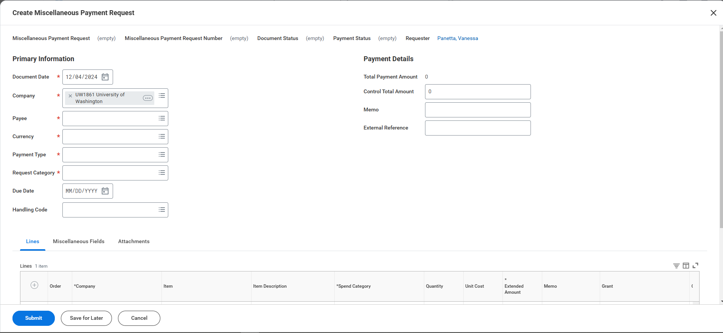
Creating The Miscellaneous Payment

Slide 23
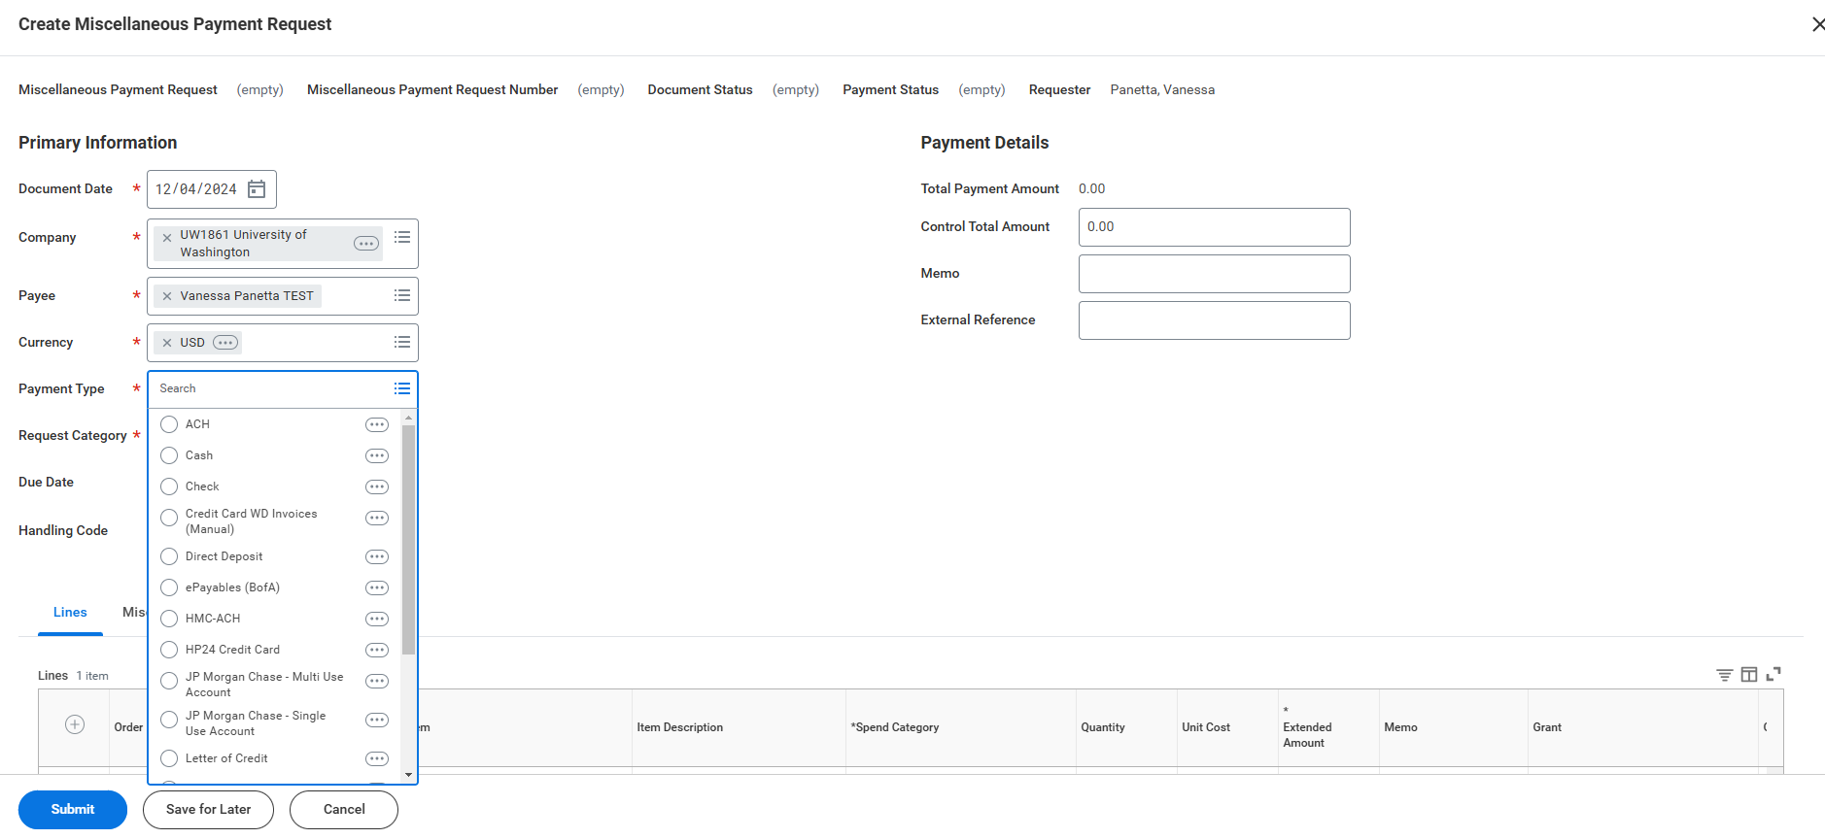
Creating The Miscellaneous Payment – Company and Payment Type
Make sure correct Company is selected
UW1861 (if UW Academy) or School of Medicine
Miscellaneous Payments can only be processed using USD currency
Possible Payment Type: Check, ACH, or Wire
ACH is for domestic banks only
Check can be sent directly to payee or through campus mail
Zelle Payment Type can also be used for Research Subject payments

Slide 24
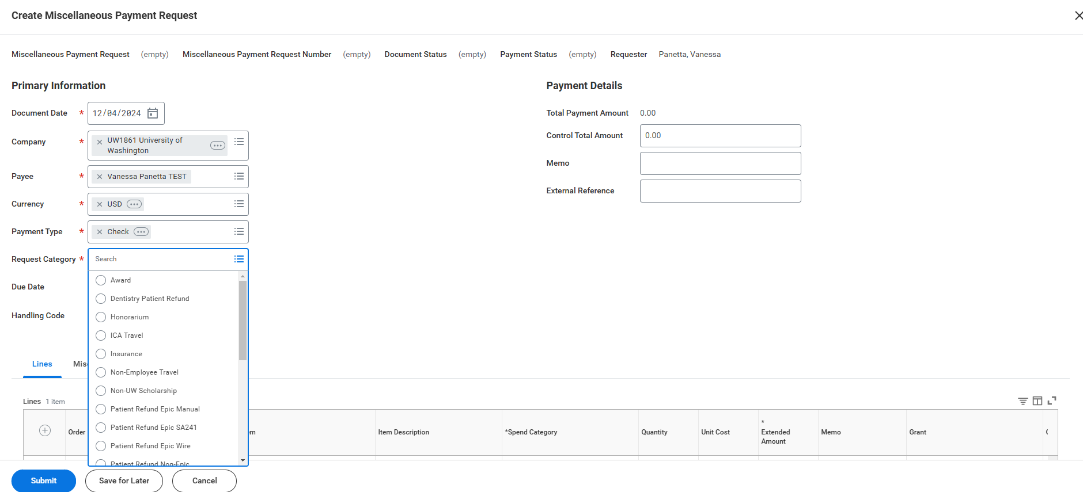
Creating The Miscellaneous Payment – Request Category
Select applicable request category. AP will review documentation and attachments and make sure it lines up with the request category selected.

Slide 25
Request Categories
Request Category | Definition | Example
Honorarium | Small thank you payment for a lecture/talk, address, or colloquium | Guest lecturer Sitting on a panel
Service | Personal service performed that requires payment | Consulting Editing/reviewing Teaching non-UW course
Reimbursement | payment to non-UW employees for payment of expenses made on behalf of UW | Individuals pays for food for an office party
Refund | Pre-approved transfers of owed money to non-UW payees These are not true payments, the payee will not recognize these as income | Refund of deposits Anything completed as a manual check request pre-Workday
Stipend | Payments made to individuals to support a training/learning experience and defray living expenses | Amount paid to an individual participating in a UW summer program during the duration of the program

Slide 26
Request Categories Continued
Request Category | Definition | Example
Award/Prize | Payment in recognition for a special achievement. Typically, there is no stipulation on how to use these funds. | Winning 1st place in a competition
Non-UW Scholarship | Scholarships to non-UW students, such as a department awarding a scholarship to a student from another school. Scholarships should be intended to be used towards educational expenses (i.e tuition, fees, books, and supplies required for enrollment) | Amount paid to a non-UW student for attending a UW Summer Program to be applied towards enrollment fees and supplies
Research Subjects | Small payments to individuals who participated in a research project for purposes of recruitment or encouragement for participation | $20 thank-you payment made to an individual who participated in a study
Royalties | Payment to the legal owner of a property, patents or copyrighted work for the right to use intellectual property | Payment to an author for use of published work

Slide 27
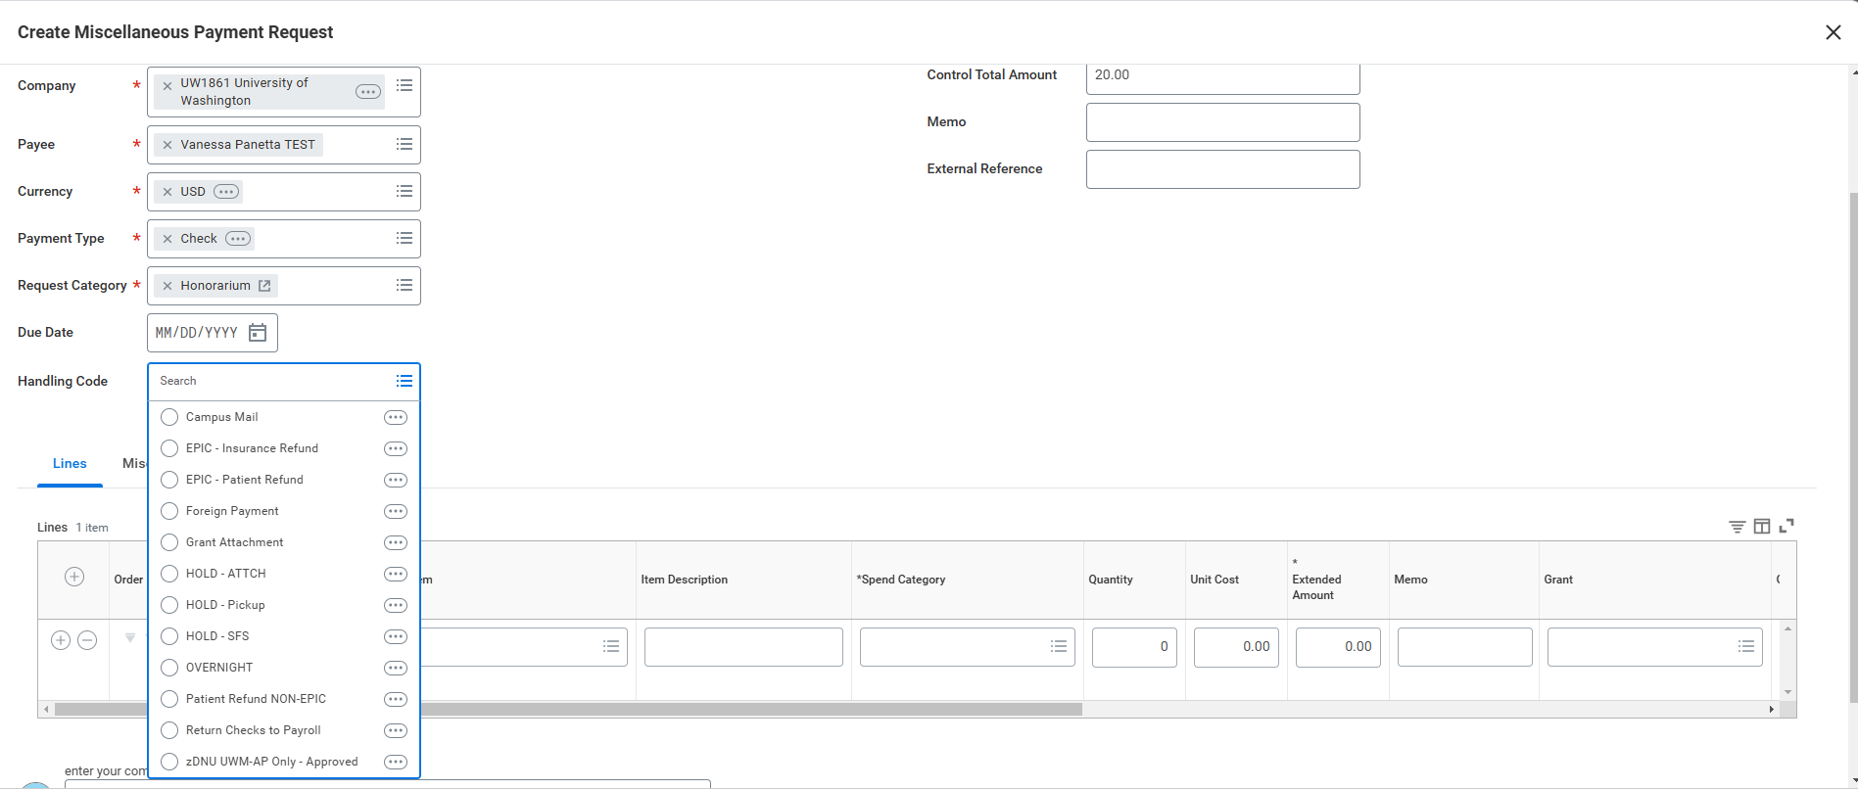
Creating The Miscellaneous Payment – Handling Code
If the check will be sent to the payee’s address within the United States, leave the Handling Code blank
Handing Code options:
Campus Mail – if you want the check sent to your campus mailbox
HOLD-Pickup – if you want to pick up the check
Foreign Payment - payee has foreign address

Slide 28
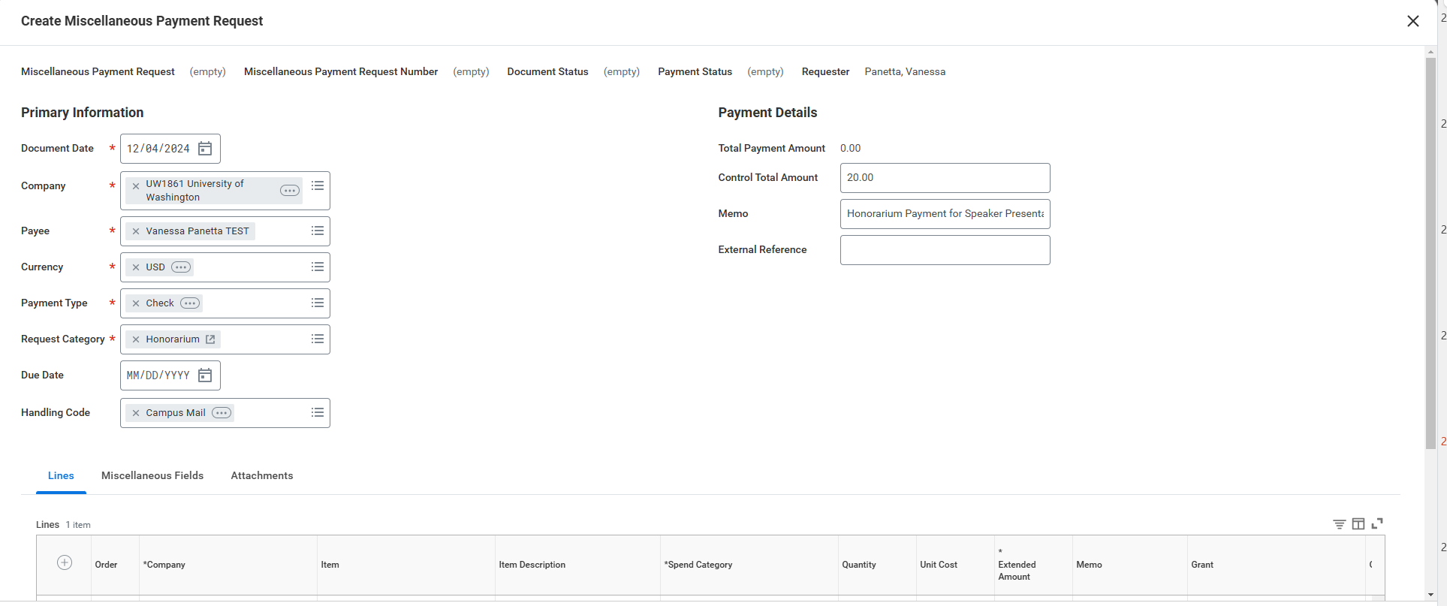
Creating The Miscellaneous Payment – Control Total Amount and Memo
Enter total payment amount
The memo should include the business justification and relevant details about the payment
Type of activity
Date of activity
In general, we do not pay for activities until after they have taken place

Slide 29
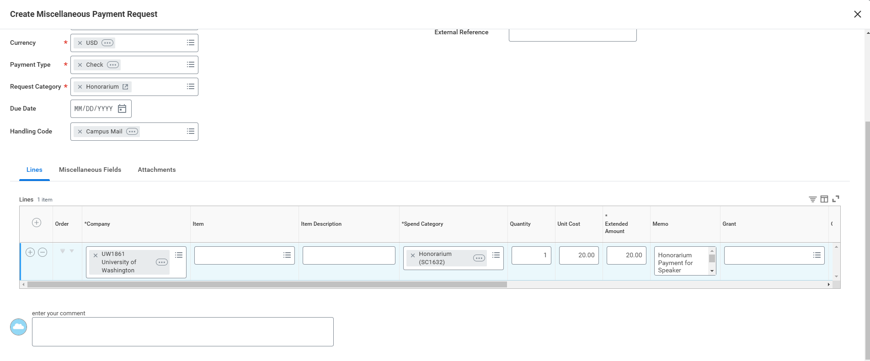
Creating The Miscellaneous Payment – Line Fields
This should match what is entered in the Header.
If additional information is needed for each Line Item, you can add it in the Memo field
Make sure the Company selected in each Line Item matches the Company that was selected in the Header (under the Primary Information at the top)
Refer to the MP Job Aid for a list of Spend Categories allowable for Miscellaneous Payments

Slide 30
Spend Category
It is generally up to the department to determine what Spend Category is the most fitting
For Service payments, the Spend Category should be 1099 reportable
Refer to the list in the job aid for a list of spend categories that are allowable with MPs
The list outlines which Spend Categories are 1099 reportable
Spend Categories that are 1099 reportable will require the payee’s tax information, even if the amount of payment is less than $600
If the payee’s tax information is not required, enter 9 zeros in the SSN field to bypass the error from Workday

Slide 31
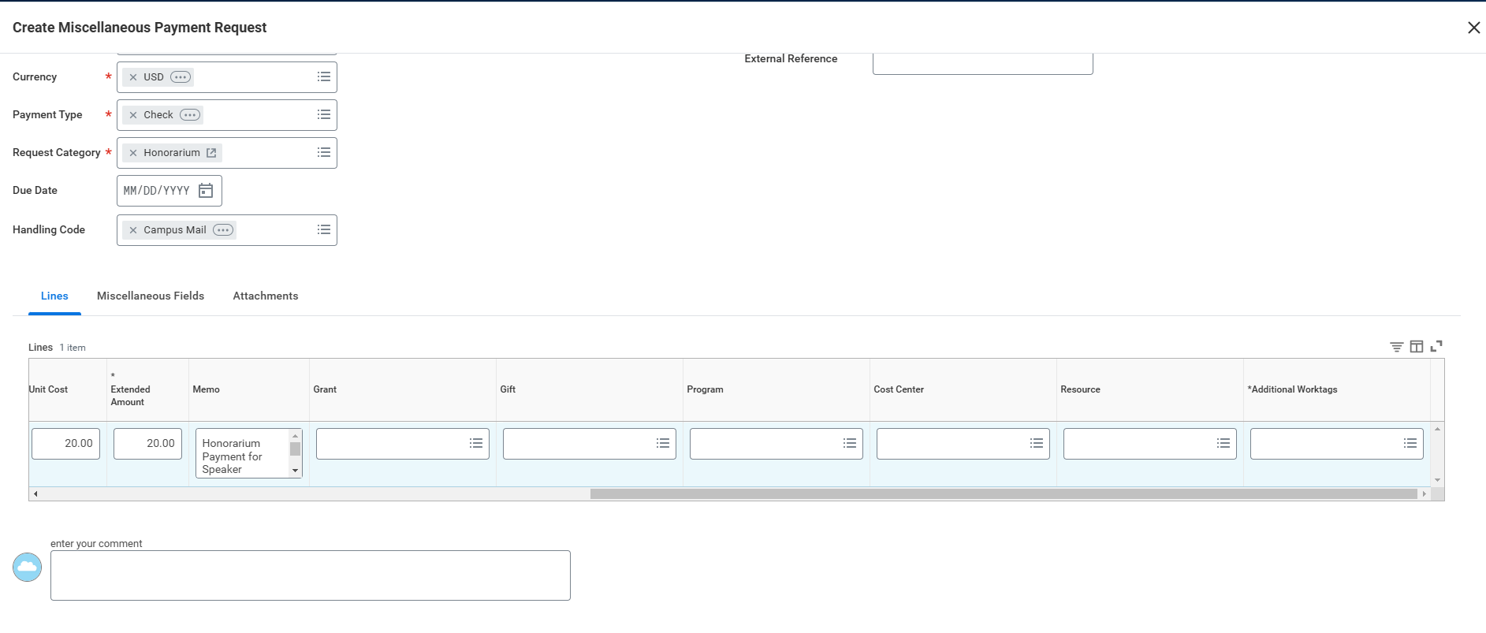
Creating The Miscellaneous Payment – Line Fields Continued
Refer to your department for Worktag information
The company should correlate with the Cost Center and funding Worktags that are going to be used for the payment

Slide 32
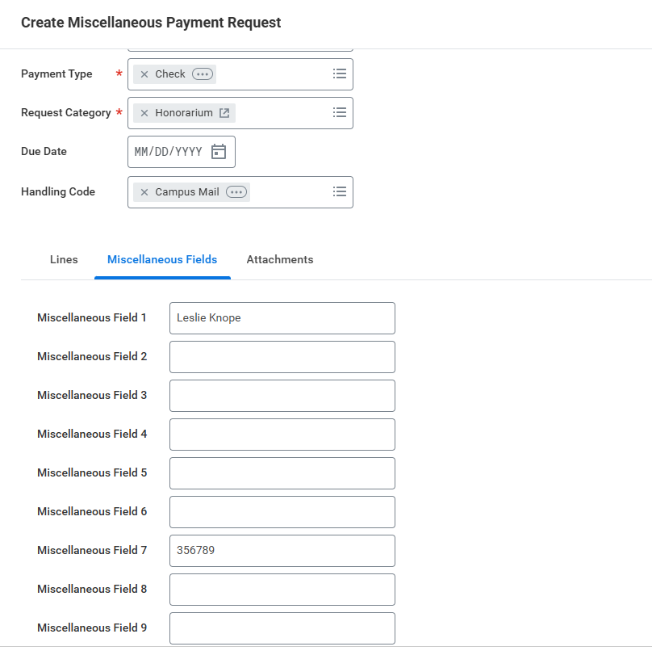
Creating The Miscellaneous Payment – Miscellaneous Fields
Enter contact name of the UW Employee who can address any questions related to the request
If “Campus Mail” is selected as the Handling Code, enter the campus mailbox

Slide 33
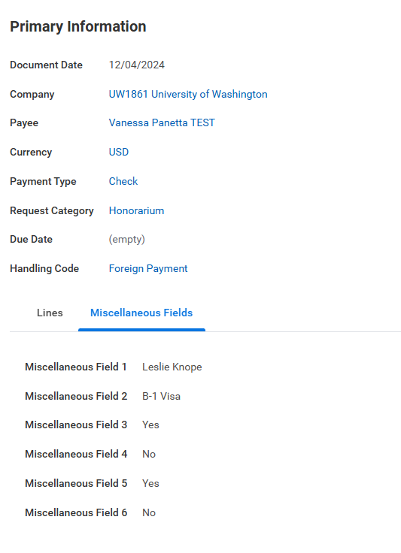
Creating The Miscellaneous Payment – Miscellaneous Fields Continued
Miscellaneous Fields 2-6 are only required if the payee is Foreign National Payee
Misc Field 2: visa type
Misc Field 3: Did the foreign payee perform the activity within the U.S.?
Misc Field 4: Has Form 8233 been collected?
Misc Field 5: Has Form W-8BEN been collected?
Misc Field 6: Has Form W-8BENE been collected?

Slide 34
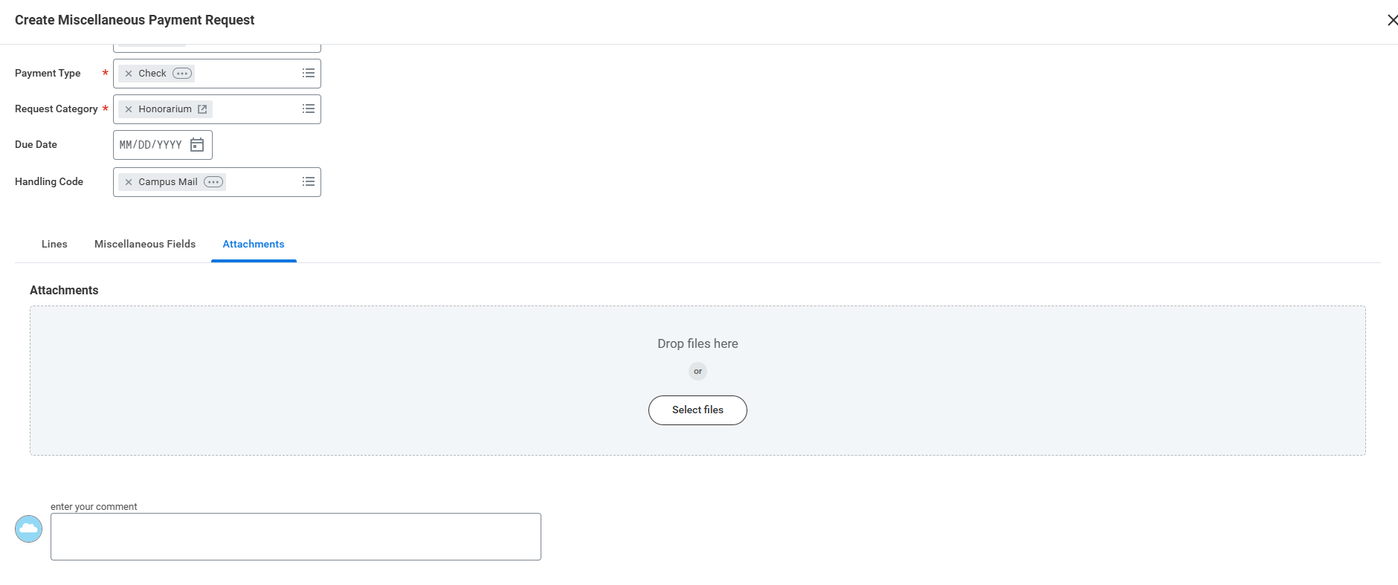
Creating The Miscellaneous Payment - Attachments
Attach any relevant documents.
Note: Invoices are required for Service payments, receipts are required for Reimbursement payments
For all other Payment Types (i.e. Honorarium, Stipend, Awards), attachments are highly recommended to assist AP’s review
Examples of acceptable attachments:
Invoices
Receipts
Honorarium invitation letters
Stipend letter
Award letters
Attachments should not contain personal information, such as tax information or banking information

Slide 35
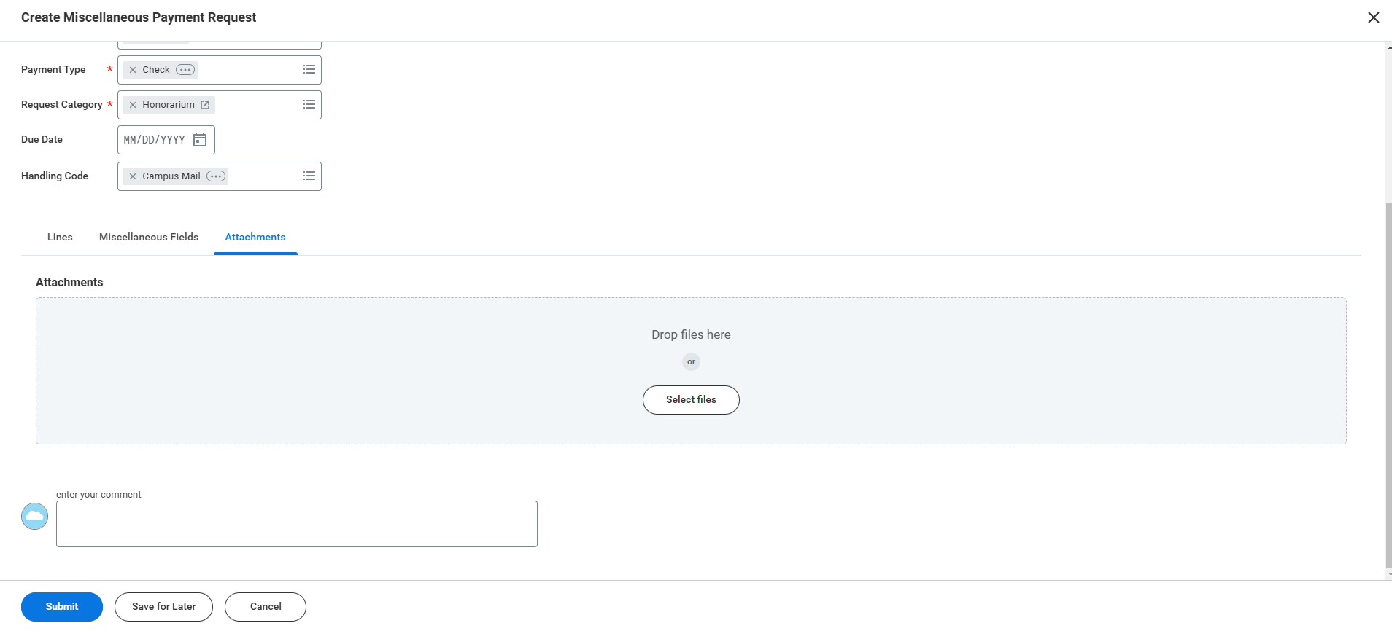
Creating The Miscellaneous Payment - Submit
If you are not done with the MP, click Save For Later. All changes will be saved.
If you are done with the MP, click Submit. The MP will be routed through approvals. The typical approve flow is as follows:
Initiator → Cost Center Manager → Shared Environment Requisition Specialist → Accounts Payable
If the MP is charged to a grant worktag, it will route to a Grant Manager for approval

Slide 36
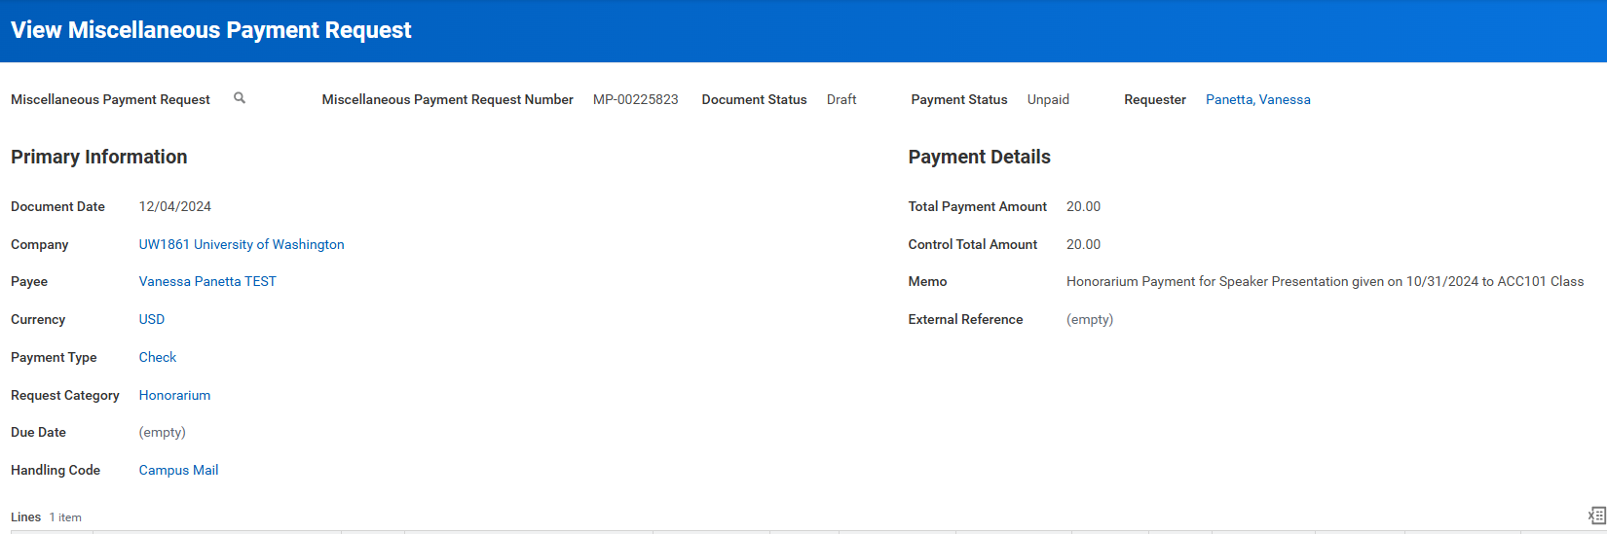
Creating The Miscellaneous Payment – View Payment Request
After either submitting or saving the MP, a MP# will be created.
IMPORTANT: Make sure to note this MP# somewhere so you can refer to it later

Slide 37
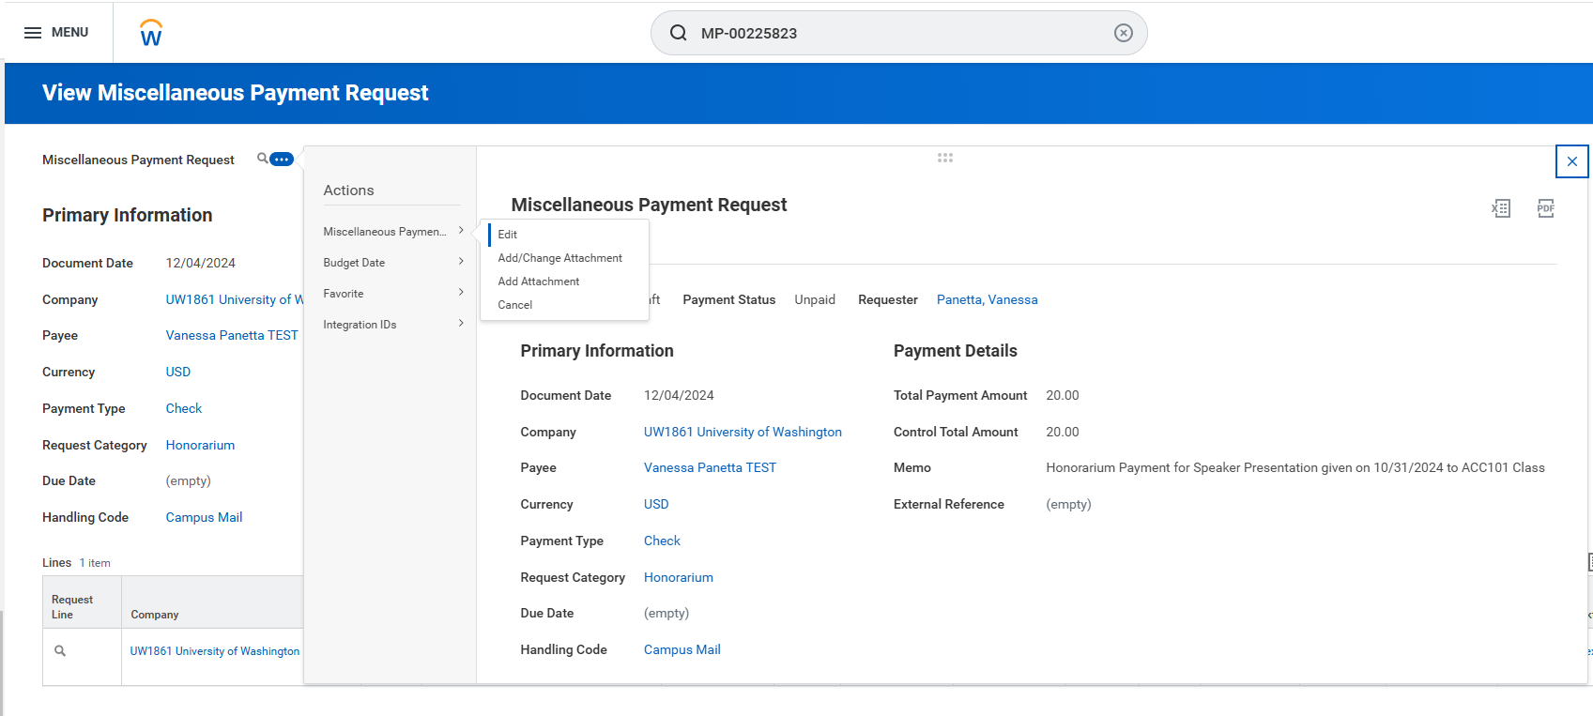
Creating The Miscellaneous Payment – View Payment Request Action Menu
To make changes to an MP that you saved for later, search up the MP# in the Workday search bar and select “Edit”

Slide 38
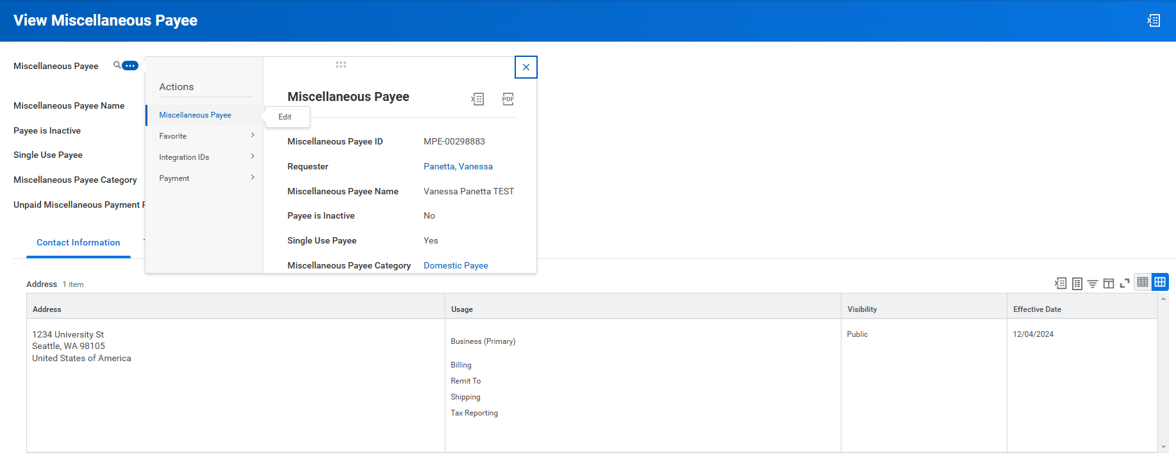
Creating The Miscellaneous Payment – View Payee Edit
You can make changes to the Miscellaneous Payee’s profile up until the MP is paid

Slide 39
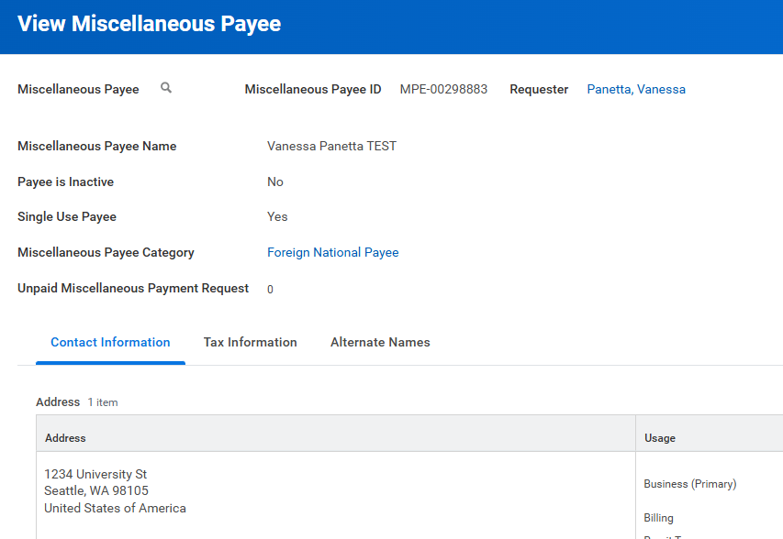
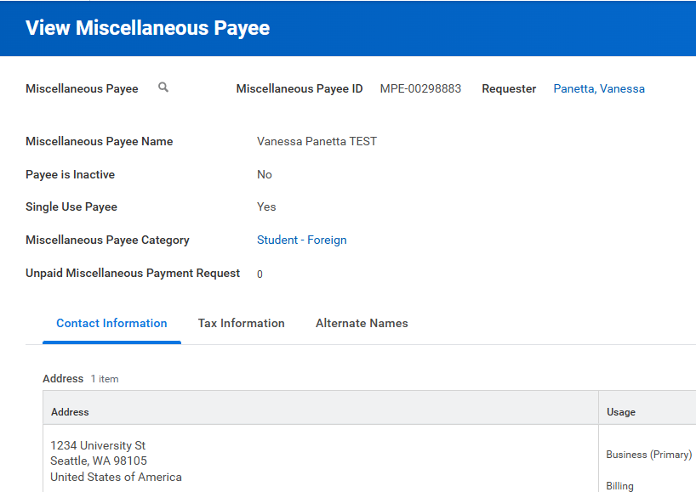
Foreign Payments
Make sure the correct Miscellaneous Payee Category is selected

Slide 40
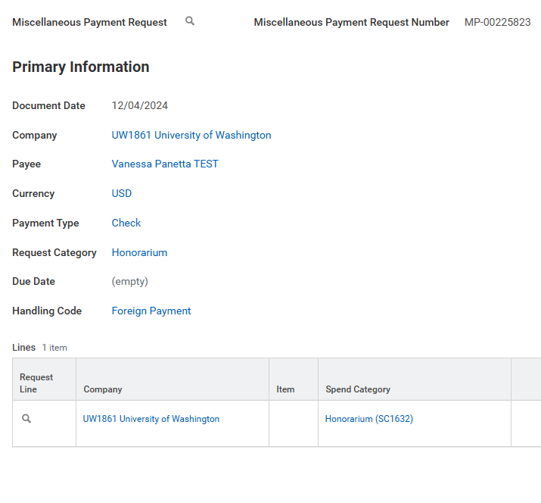
Foreign Payments – Handling Code
Select the “Foreign Payment” Handling Code if the check is being sent to the payee’s address and they live outside of the United States.

Slide 41
Foreign Payments – Visa Information
Make sure Miscellaneous Fields 2-6 are completed

Slide 42
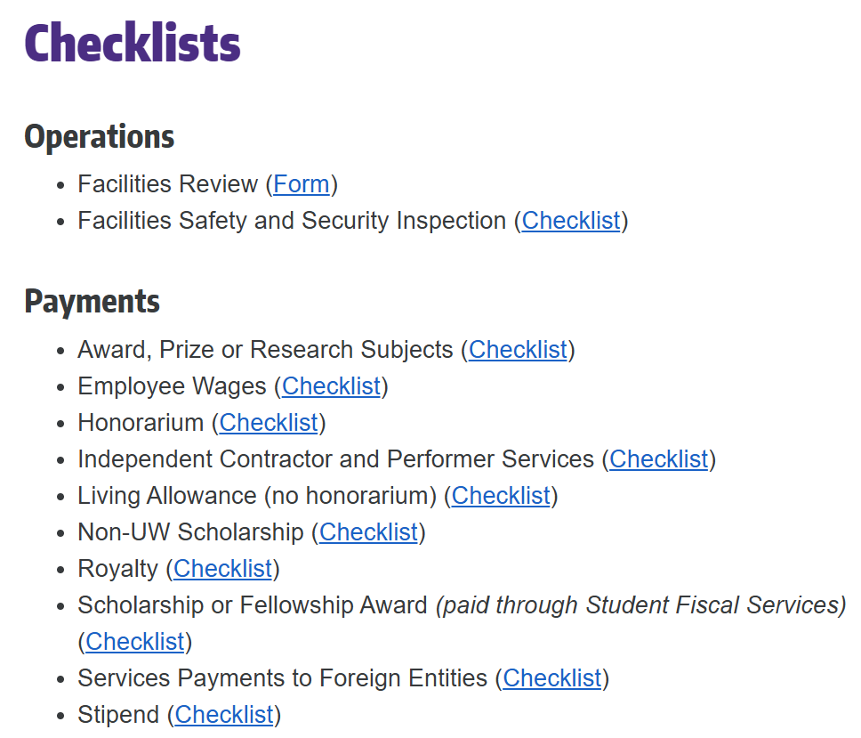
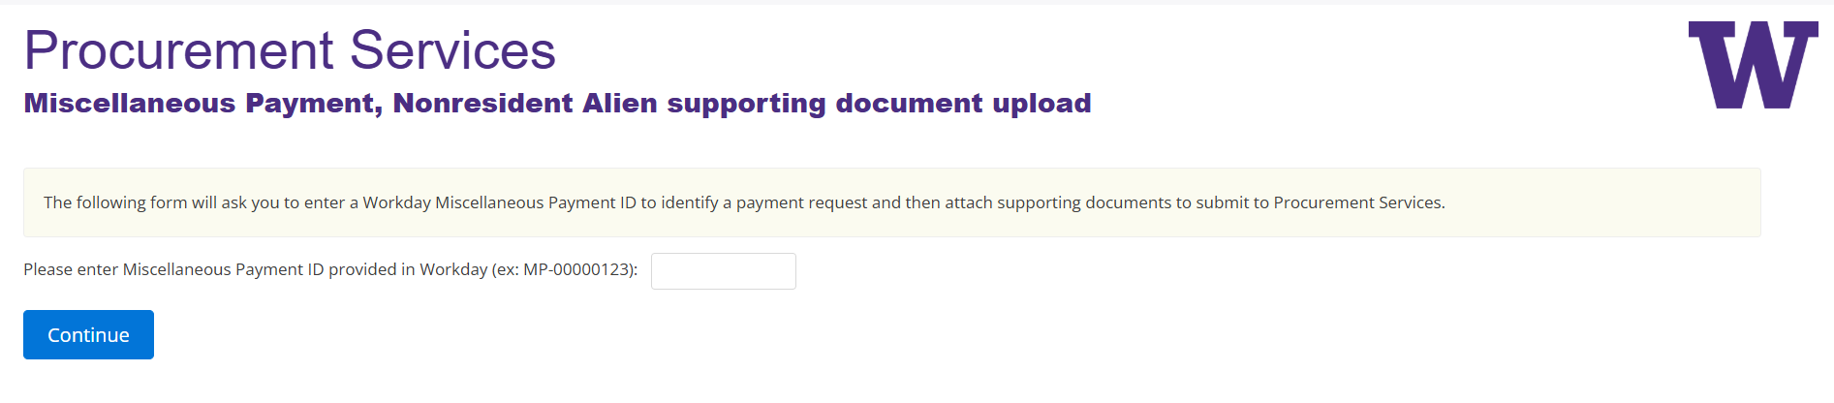
Foreign Payments - Checklists
Use our checklists to determine what documents are required
For security reasons, all required documents should be uploaded to our DocuSign portal . Do NOT attach on Workday.
After you submit the MP, Workday will give you a to-do with the link to the DocuSign Portal. The link can also be found on our website.

Slide 43
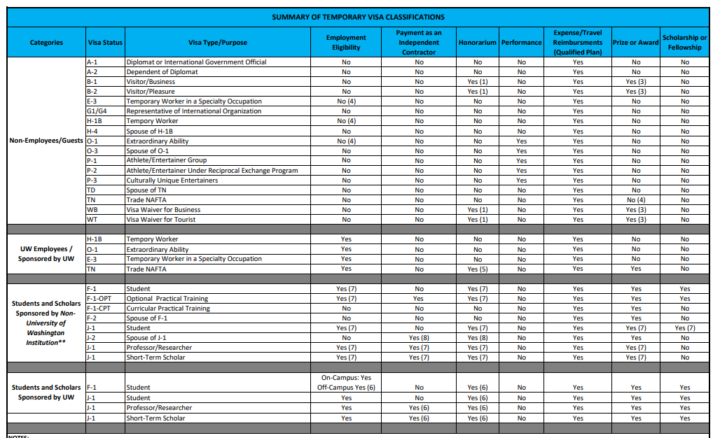
Foreign Payments – Temporary Visa Classifications

Slide 44
Special Considerations – Research Subjects
Tax info not required if payments are less than <$600
These will bypass central office review
Please keep track of payments made to the same recipient
If payments exceed $600, department is responsible for obtaining tax information
Please communicate with research subject and be aware if they are receiving payments from other departments
If they have had payments made to them already, please make sure you are using the same Miscellaneous Payee profile. Do not create a new one
If using Zelle, include the payee’s phone number OR email address
Entering both will cause an issue with the payment

Slide 45
Special Considerations – Other
Reimbursements
Travel (reimbursable vs non-reimbursable)
Non-Employee Travel (SC2566) reimbursable
Non-Employee Travel 1099 (SC2567) non-reimbursable

Slide 46
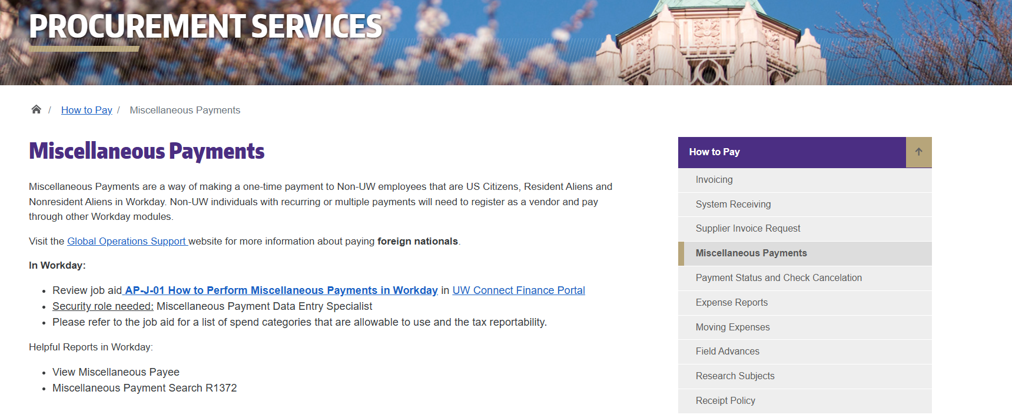
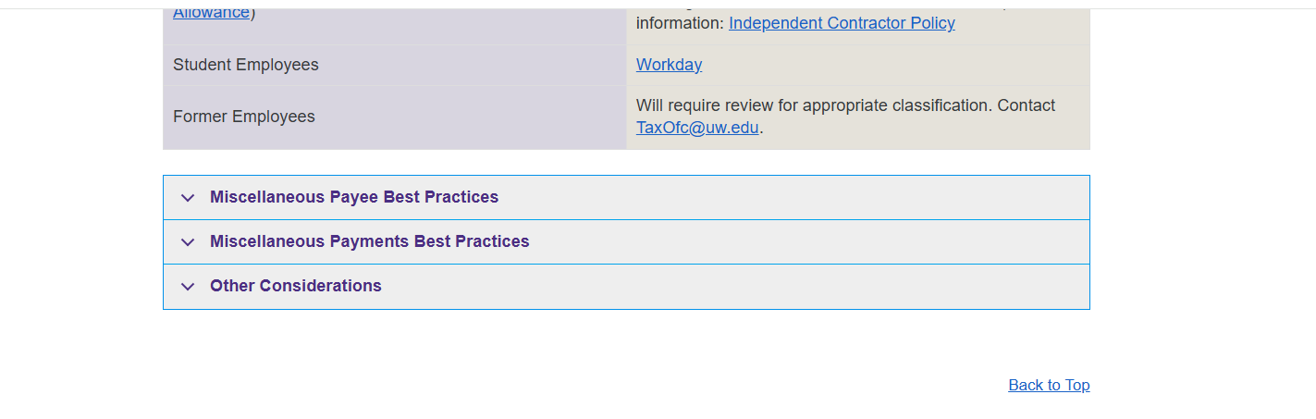
Resources
Procurement Services Miscellaneous Payment webpage

Slide 47
Questions?

Slide 48
Thank You!

