Slide 1
Individual Travel Card and Central Travel Account

Slide 2
AGENDA
What to Know Before You Begin
Central Travel Account
Individual Travel Account
Resources

Slide 3
What to Know Before You Begin

Slide 4
Travel Purchasing Options
UW faculty and staff have options for having UW pay for business travel. A popular option is for an employee to pay for the travel and then be reimbursed through Expense Report.
Two other options are:
    Central Travel Account
    Individual Travel Card

Slide 5
Policies
Travel policies can be found the on the Travel Website.
Suspension policy can be found on the ProCard home page and the CTA Rules and Responsibilities page.

Slide 6
Central Travel Account (CTA)

Slide 7
What is Central Travel Account?
The CTA allows departments to charge for travel expenses that take place 50 miles away from their designated work location to a centrally billed account.
Funds are charged directly to the CTA card account. This is NOT an individual liability card requiring reimbursement.

Slide 8
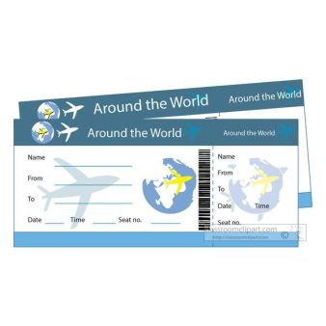
What You Can Pay For
Airfare
Specified Lodging
Bus Tickets
Rail Tickets

Slide 9
Requirements
Review Central Travel Account Training – new assessment required
Review the "How to Create an Expense Report for CTA Verification" Job Aid.
Learn department specific guidelines from your department
Receive approval via UW Connect Card Services Form
Abide by all Washington State & UW Purchasing regulations

Slide 10
Important Restrictions
Limits are $20,000 monthly and $10,000 single.
Transactions are restricted to travel merchants.
Personal travel expenditures are prohibited on a CTA. This includes incidentals and personal time added before or after UW business travel. Flight dates need to be in line with UW business need for the travel when using the CTA.
Lodging charged on a CTA of 4 or less UW faculty/staff is not allowed.
If 5 or more UW faculty/staff are lodging at the same hotel for the same time period, the CTA may be used with prior written approval from The ProCard Office. Email procard@uw.edu.

Slide 11
Important Restrictions Continued
Student lodging (1 or more) allowed
UW employees and students are subject to per diem.
For lodging, only room and tax is allowed on the CTA.
The department must obtain an itemized statement from the hotel showing the breakdown of the total charges by room, by night, and by guest name.
Upgrades to airfare and hotels are not allowed.

Slide 12
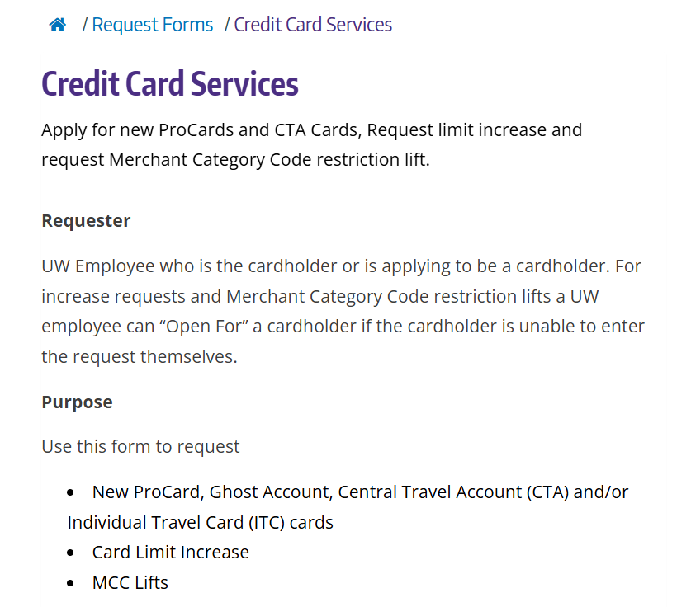
How to Get a CTA
Step 1: Review CTA Training video.
Step 2: Complete and submit a CTA application in the UW Connect Card Services Form.
New! Assessment now required!

Slide 13
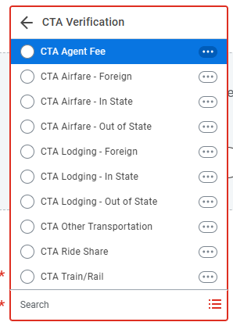
Verification
CTA charges are verified in Workday through Expense Report.
Verification Process:
Create Expense Report
Select Business Purpose as CTA Card Verification
Select open charges to verify
Use only Expense Items starting with CTA

Slide 14
CTA Verification Approval
Verification
Cardholder
Expense Data Entry Specialist
Approval
Expense Data Entry Specialist
Grant Manager, Cost Center Manager etc.
Approval
Grant Manager, Cost Center Manager etc.

Slide 15

Attachments
Required for every verification
Best practice to attach an itemized receipt
Some examples of what is not acceptable:
  Handwritten document
  Excel spreadsheet listing charges
  Email description of the purchase
Types of documents for CTA:
  Folio
  Plane fare documents
  Bus/rail fare documents

Slide 16
Individual Travel Account (ITC)

Slide 17
What is an Individual Travel Card?
The Individual Travel Card is an individual liability card for faculty and staff while in travel status. It is a card travelers can take with them and use to pay for travel costs while on UW business in travel status.
Benefits:
Ideal for frequent travelers
Flexibility for frequent travelers
No Annual fee or personal credit report processed
The card is accepted at more than 16 million merchants worldwide
Lost Baggage coverage up to $1250
Collision damage insurance up to the full value of the rental car
The default single transaction limit is $5000

Slide 18
What Can you pay for?
You may use your ITC for the following expenses related to travel for UW Business while in travel status:
Airfare (CTA preferred)
Lodging
Meals
Meals associated with hosting and entertaining
Car Rental
Ground Transportation
Miscellaneous travel expense

Slide 19
Requirements
Expected to take at least 2 business trips per year
UW Faculty and staff are eligible to apply for an individual travel card with department/unit approval.
Watch the Individual Travel Card eLearning with a passing score of 11/12 on the assessment.
Must abide by all Washington State & UW Purchasing regulations when purchasing with the ITC.

Slide 20
Requirements Continued
Full payment of the balance is required by next billing statement
Individual cardholders are required to pay JPMC the full balance of the card
Using the ITC for personal use is a violation of the Washington State Ethics Act and may result in the immediate cancellation of the card.

Slide 21
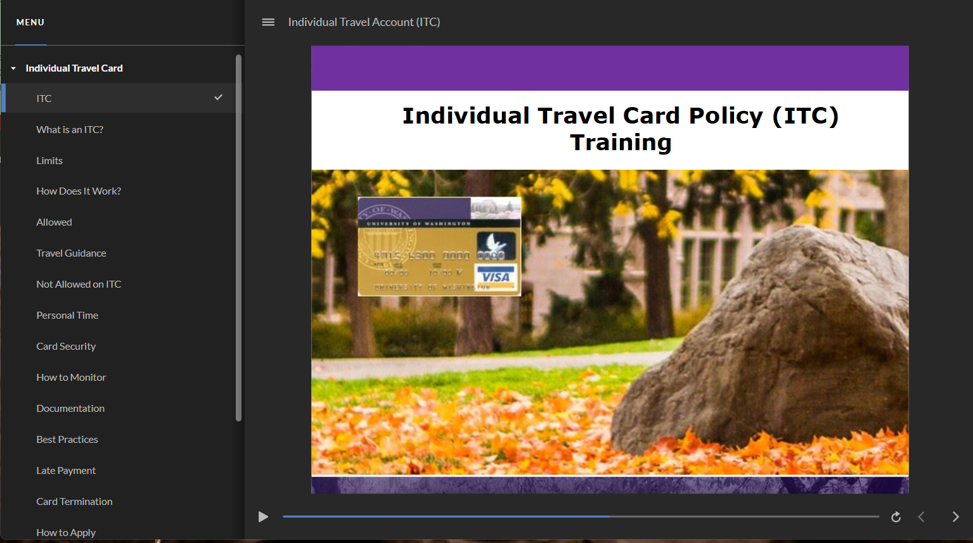
How to Get an ITC
Step 1: Watch the Individual Travel Card eLearning
Step 2: Pass the assessment (with a minimum score of 11/12).
Step 3: Complete the UW Connect Card Services Form to apply.

Slide 22
Card Security
The Travel Card should be treated with the same security as a personal credit card
Keep it with you or lock it in a secure place
Do not write any portion of the card number down or share the number with others.

Slide 23
ITC Spend Process
Pay for travel charges with ITC during business travel
Receive statement with charges
Pay JPMC directly for charges
Request reimbursement for charges with ER in Workday

Slide 24
ITC Reimbursement
Travel cardholders must seek reimbursement for authorized travel expenses through Expense Report (ER) module in Workday which is processed by Travel Services.
As a condition of accepting reimbursement, cardholders agree to use all of the reimbursement money to pay the charges in full on the ITC
If the reimbursement money has been sent to the cardholder and there is still a balance on the ITC, the cardholder will be subject to corrective actions for violating the terms of this policy and will be subject to proceedings under the State Ethics Act.

Slide 25
Attachments
Required for every Expense Report
Best practice to attach an itemized receipt
Some examples of what is not acceptable:
  Handwritten document
  Excel spreadsheet listing charges
  Email description of the purchase
Types of ITC documents:
  Receipts
  Hotel

Slide 26
Expense Report (ER) Approval Process
Initiator submits Expense Report
Compliance Approver (SE Expense Specialist)
Funding Approver (CC/Grant/Project Manager)
Expense Partner (Travel Services)

Slide 27
Resources

Slide 28
Resource List
How to Create an Expense Report for CTA Job Aid
How to Create Travel and Non-Travel Spend Authorizations and Expense Reports Job Aid
CTA Policy eLearning
ITC Policy eLearning
Travel Purchasing page (ITC and CTA)
Travel Website
Verification Classes for ProCard and CTA

