Slide 1
Match Exceptions

Slide 2
Agenda
Tools
Reviewing Invoices
Exception Types
Resources

Slide 3
Tools

Slide 4
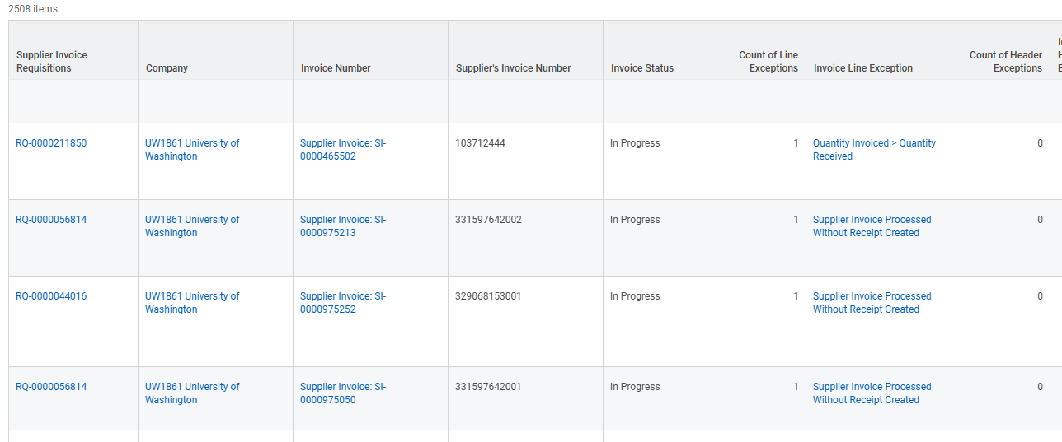
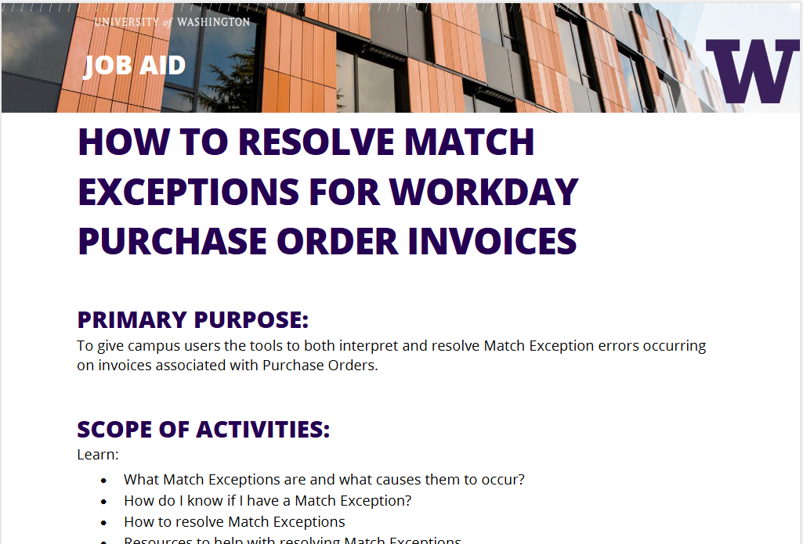
Important Tools
Invoice Match Exceptions R1166 Report in Workday
Recommended to run weekly so you can catch invoice issues as soon as possible and avoid payments from being delayed.
Shows all invoices with exceptions
Match Exception Job Aid
Review the job aid to learn what to do when you see an invoice exception

Slide 5
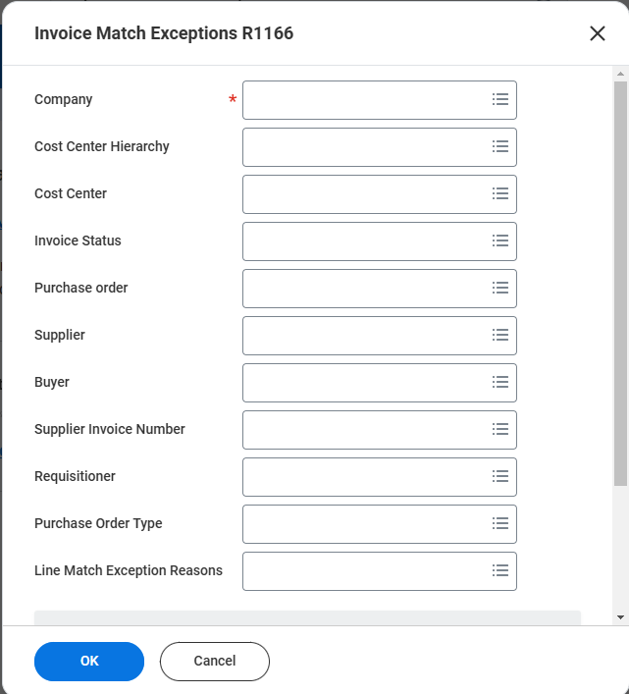
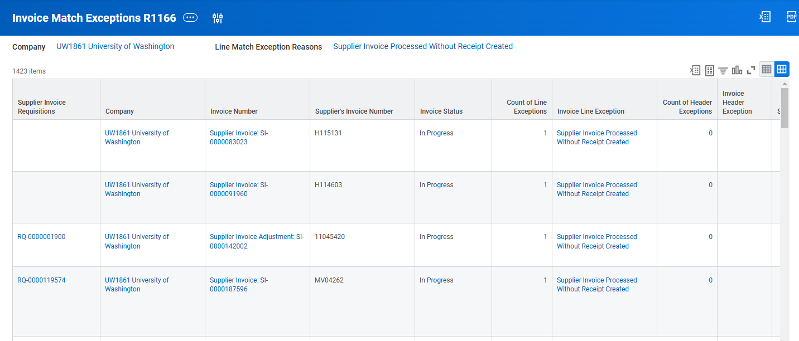
Invoice Match Exceptions R1166
To pull a report of the list

Slide 6
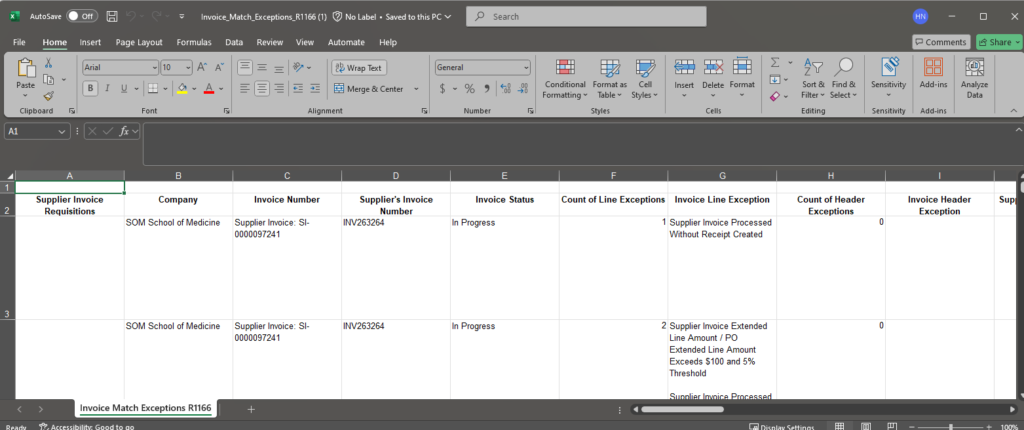
Report Export

Slide 7
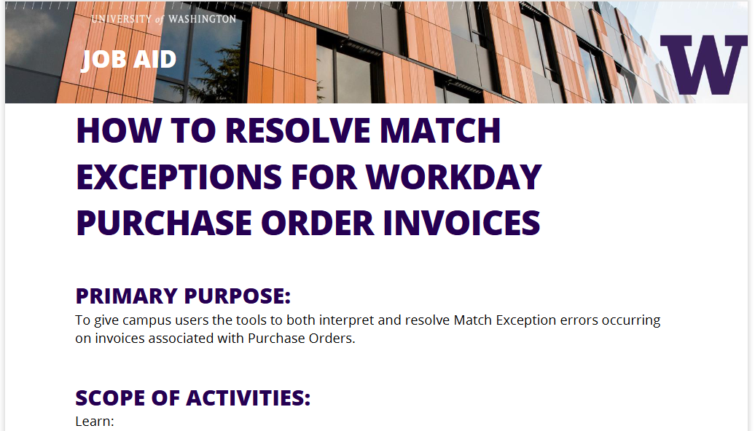
How to Manage Match Exceptions Job Aid
The job aid will have each exception type and the possible ways to resolve. A lot of variable apply to finding a resolution to an exception.

Slide 8
First Questions When Reviewing the Report
Does the invoice belong to this order?
If “No”
Fill out the “Cancel Supplier Invoice” form in the Finance Portal to cancel.
If “Yes”
Move on to next question
Is the invoice applied to the correct line item?
If “No”
Fill out the webform “Department Match Exception” in the Finance Portal
If “Yes”
What does the exception mean? Let’s find out.

Slide 9
Reviewing Invoices

Slide 10
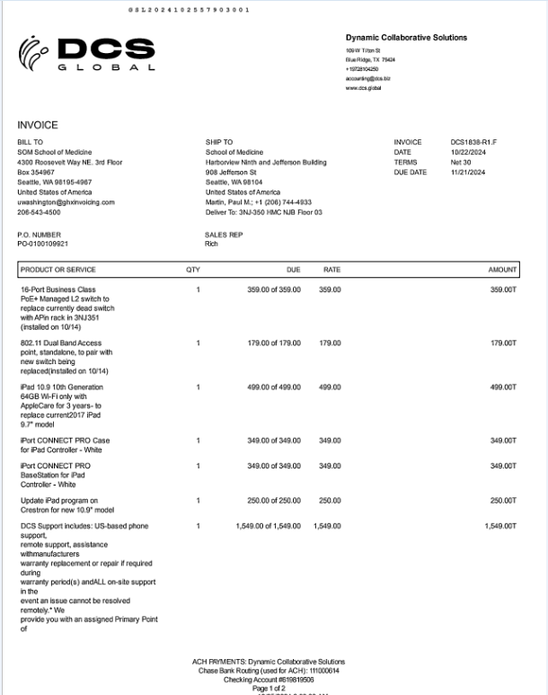
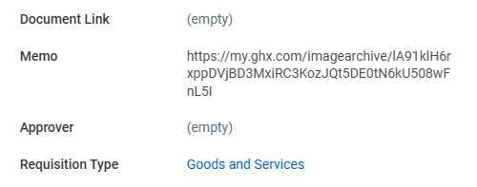
Reviewing Invoices
Reviewing invoices is critical to resolving match exception. The URL of the supplier invoice will be in the memo field of the invoice.
When reviewing the invoice, you will want to look at:
How the requisition was set up
How much/how many you are being billed (Does it match the PO? Does it match the quote? If it matches the quote, was the PO set up correctly?)
The line item being billed
*There are a couple of ways to see this in Workday.

Slide 11
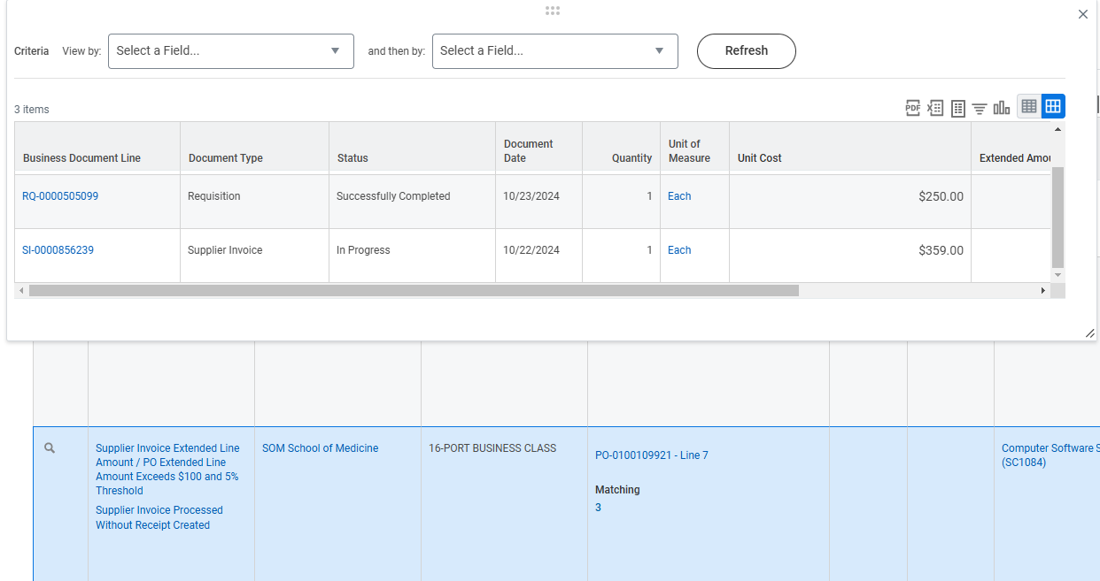
Workday Invoice/Line Item
Example Possibilities:
Wrong line billed
Correct line but overbilled

Slide 12
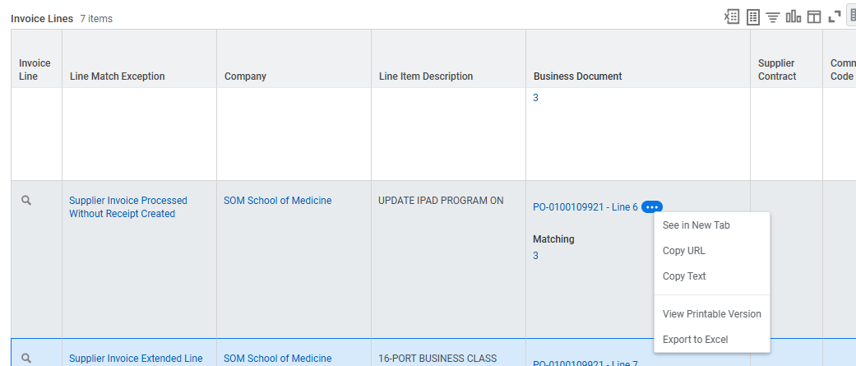
Review PO and Compare to Invoice
Have the invoice open in one tab and the PO open in another.
Review the information on the requisition compared to the billing on the invoice.

Slide 13
Receiving Exception
The most common match exception is “Supplier Invoice Processed Without Receipt Created.”
What does this mean?
Receiving needs to be performed in Workday.
Invoices do not pay until Receiving is completed.
Individuals with the “Requisition Requester” role perform this task.
Review the invoice to see if is billed correctly.
If it is, perform receiving for the invoice. See Receiving job aid for assistance: https://uwconnect.uw.edu/finance?id=kb_article_view&sysparm_article=KB0032902
If not billed correctly, have the invoice cancelled through the “Cancel Invoice Form” in the Finance Portal.

Slide 14
When Reviewing the Report
But wait, why do I have a Receiving exception on my PO that has a service line?
Are there any Goods lines on the order as well?
Orders can have both types of lines
Most likely, the Receiving is for the Goods lines being billed on the same invoice. But Receiving must happen for those, before the invoice can release for payment.

Slide 15
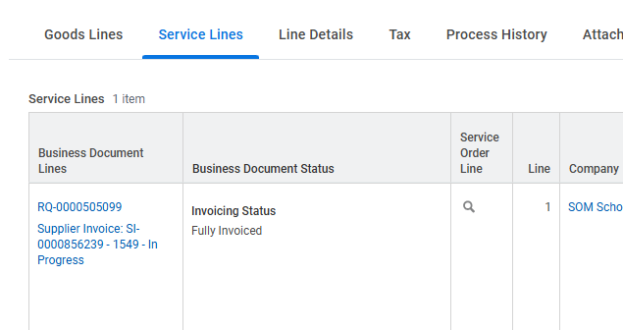
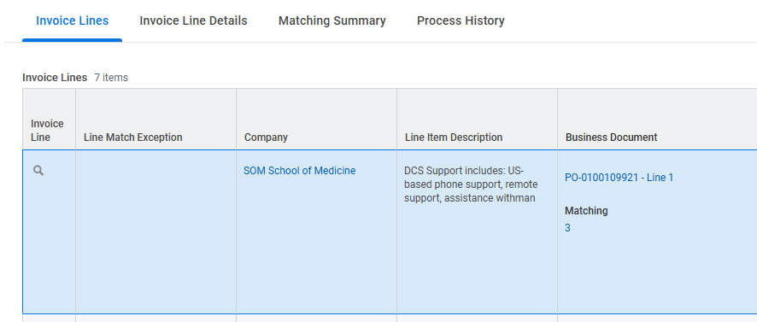
Some orders have Goods lines and Services lines
Orders with service lines ONLY probably won’t require receiving.
No exception on Service line of the invoice.
Invoice is billing both Goods and Service lines, so invoice needs to be received for the Goods lines.

Slide 16
Exception Types

Slide 17
Exception Types – Change Orders
The following exceptions may indicate more money/quantity is needed on the order:
Supplier Invoice Extended Line Amount / PO Extended Line Amount Exceeds $100 and 5% Threshold
Quantity Invoiced > Quantity Received
Service Line Total Amount Invoiced > PO Line Amount
Supplier Invoice Total Amount / PO Total Amount Exceeds $100 and 5% Threshold

Slide 18
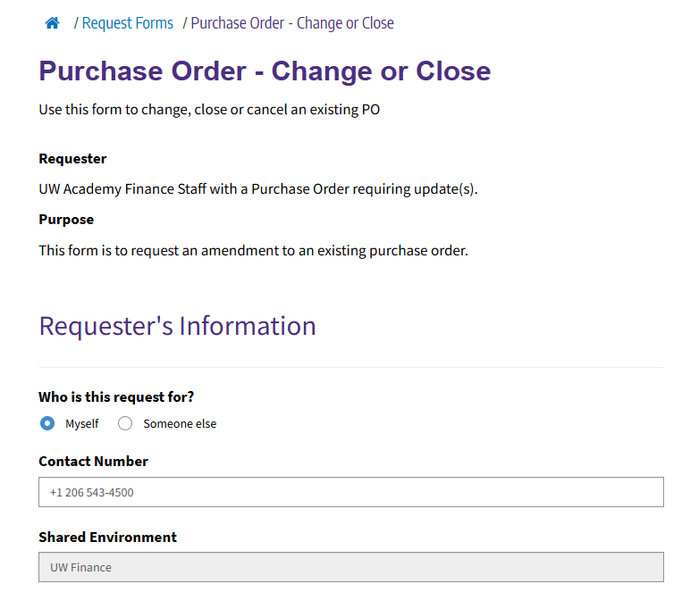
Change Orders
Possibilities for these exceptions:
Wrong line billed
Correct line billed but overbilled (not enough money)
Correct line billed but line not set up to accommodate more than one invoice. i.e.: purchase order only set up for quantity 1, but supplier is invoicing the line in two separate invoices.
If you determine the invoice posted is:
On the correct order
On the correct line
Including the correct charge
Then the order will potentially need to be changed to pay the invoice. Only our Purchasing department can do the change in Workday.
To request the change, fill out the “Purchase Order – Change or Close Form” in the Finance Portal to add money or a new line item.

Slide 19
Change Orders
Tips:
Have your order open in Workday to be able to copy over the correct information.
Some things cannot be changed on a line item.
Also, change orders go to the supplier.

Slide 20
Other Exceptions
The following exceptions indicate charges that exceed Workday system thresholds.
Supplier Invoice Freight Amount Exceeds $1,000 Threshold
Other Charges Exceeds $100 Threshold
What to do – Review the invoice
If the amount charged is acceptable:
-Fill out the form “Department Match Exceptions Form:”
-Central office will review and approve.
If the charge is NOT acceptable:
-Fill out the “Cancel Supplier Invoice Form:”
-Request a revised version of the invoice from the supplier or dispute the charge.

Slide 21
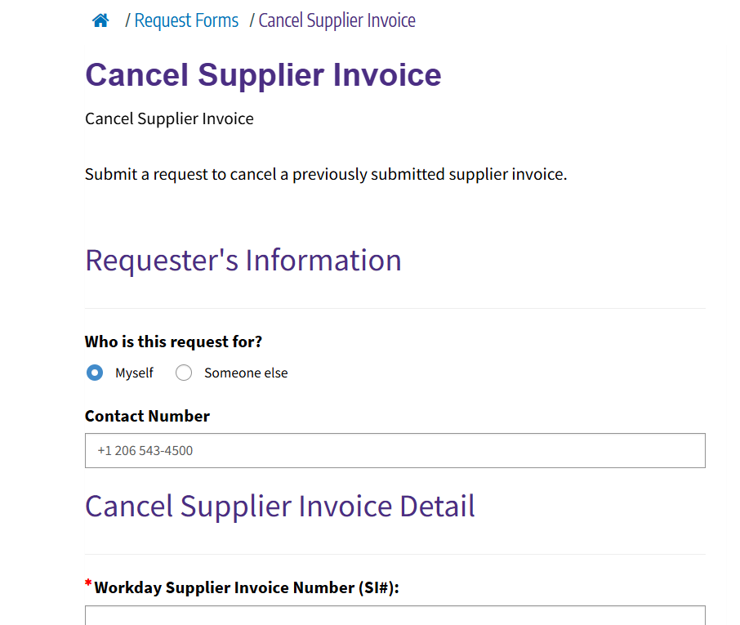
Cancel Supplier Invoice Form
Cancel the incorrect invoice in Workday before a new corrected invoice is received in Workday.
Preferably:
Obtain corrected invoice and attach to the “Cancel Supplier Invoice” Form when having the original invoice cancelled. AP will make the necessary adjustments with the new corrected invoice.
Note: If the supplier sends a corrected invoice before the original incorrect invoice has been cancelled in Workday, the new corrected invoice could encounter problems.

Slide 22
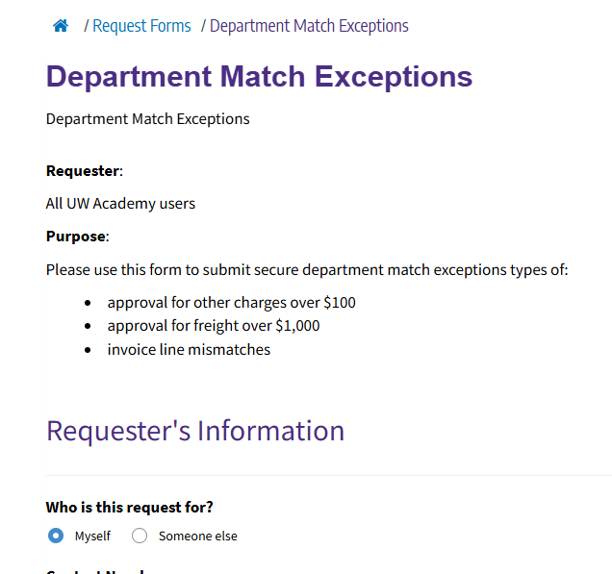
Department Match Exception Form
For:
Moving invoices to other line items
Approving Freight exceptions
Approving “Other Charges” exception

Slide 23
Other Resources

Slide 24
Other Resources
PCS Help: When it doubt, send a ticket to PCS Help through Connect or call 206-543-4500
Match Exception Job Aid
Receiving Job Aid
Change/Close Web page
Invoicing Web Page
Procurement Center of Excellence Event Training Calendar
In Workday:
R1525 Service Line Invoice in Match Exception in Workday
R1149 Find Supplier Invoice in Workday
Supplier Invoice Tracking R1131 in Workday

