Slide 1
Procurement Deep-Dive – Procurement 101

Slide 2
Compliance as a Service
Procurement Customer Service (PCS) Help
Contracts & Sourcing
Travel
Accounts Payable
ProCard Team
Global
Business Systems/Vendor Control
Training Team
Procurement
What we do
Why we do it
Benefits

Slide 3
Rules & Policies

Slide 4
Washington State Resource: DES
DES: Washington State Department of Enterprise
Provides many different services and training for all levels of government
  City
  County
  State
  Tribal
Establishes master contracts for use by all State agencies
Training is a requirement for all employees at UW whose jobs involve “…developing, executing or managing procurement or contracts for goods and services”
  See the DES Procurement Training page to determine your level of requirements needed: https://des.wa.gov/services/contracting-purchasing/policies-training/contracts-procurement-training-development
For more information, visit our Procurement DES page:
  https://finance.uw.edu/ps/DES-training

Slide 5
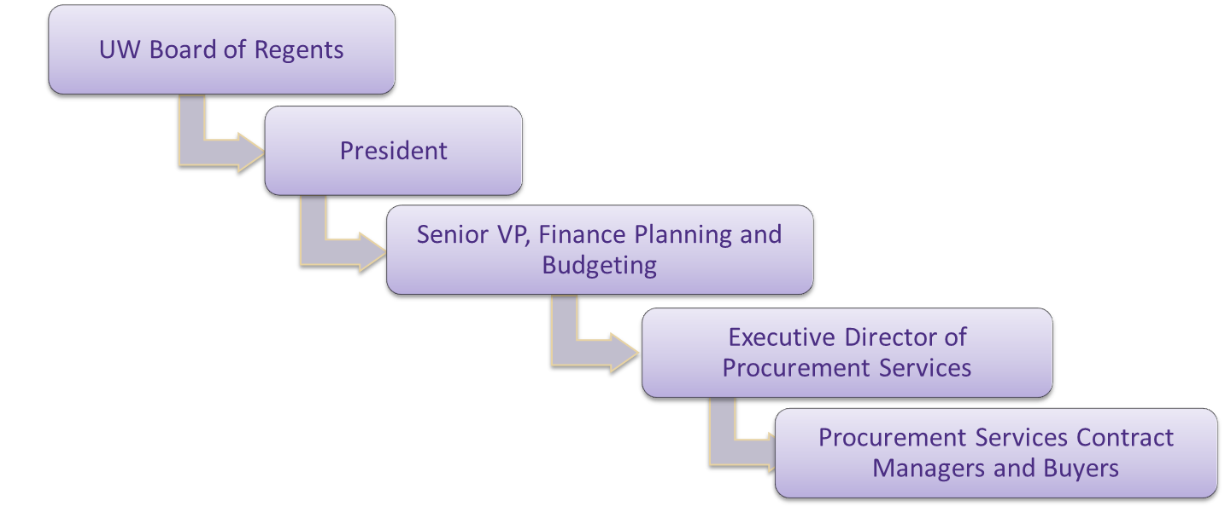
Delegated Signature Authority
Delegated signature authority is the authority to sign a binding document on UW’s behalf, up to specified dollar thresholds
Signature authority is passed down from the state to UW Procurement
Campus departments do not have the authority to execute or sign contracts, including maintenance and service agreements.
Documents signed without this state authority put the onus and fiscal responsibility of the agreement onto the individual who signed
Notes:
Facilities and Capital Planning have their own delegated signature authority. The structure determined by RCW’s. Give examples.

Slide 6
Direct Buy Limit
Current Direct Buy Limit: $10,000 aggregate spend
Includes shipping and handling
Does not include tax
The Direct Buy Limit is the dollar amount departments may use to make purchases without securing competitive pricing per state regulation
Procurement Services reviews all purchases over the Direct Buy Limit for compliance before the purchase occurs.
Some special items require compliance review regardless of dollar amount
  Blood/serums, charters, radioactive materials, resale items, UW logo usage
  Full list: https://finance.uw.edu/ps/how-to-buy/exception-items

Slide 7
Direct Buy Limit – Aggregate Spend
When a department has purchased more than $10,000 total for a service or good from one supplier, regardless of the period of time, the direct buy limit has been reached
Do not split an order to make it appear under the direct buy limit
  Splitting orders would be an audit finding
An example:
If a department intends to purchase 20 of the same item valued at $2,000 each from the same supplier, the total will exceed the direct buy limit.
In this case, unless the department is utilizing a University approved contract, Procurement Services should be consulted regarding the appropriate buying method.

Slide 8
Above the Direct Buy Limit
Options to select suppliers:
Contracted Supplier
Sole Source
Solicitation
  (Always performed by Procurement)
  Important: Each option above must be approved and verified by Procurement Contract Manager (usually via Requisition) prior to the purchase or payment occurring.

Slide 9


Buying From Contracts
Why should I use Contracts?
Contracts are the easiest way to buy. Here are some of the benefits of using Contracts:
  No competitive bid requirements
  Established pricing and discounts
  Do not require a sole source/exempt from Direct Buy Limit
  They can be used at any dollar amount
  Terms and conditions are pre-negotiated
  Contracted Supplier Sales Representatives can assist with:
    Product selection
    Installation
    Training
    Returns
Buying from a Contract provides the best overall value to the University and results in lower overall cost.
Contact the Procurement Services Purchasing Team for assistance with Contract availability.
https://finance.uw.edu/ps/contact-us/subject-matter-experts

Slide 10
Sole Source Justification
Definition: A “Sole Source” purchase means that only one supplier (source), to the best of the requester’s knowledge and belief, based upon research, is capable of delivering the required product or service
The State requires written justification for all Sole Source purchases
For more information on UW sole source purchasing: https://finance.uw.edu/ps/how-buy/sole-source-purchasing
Examples of valid Sole Source justifications:
Buying from other governmental agencies
The supplier is named in a grant
Equipment maintenance and parts if provided by the Original Equipment Manufacturer (OEM)
Software maintenance and support if provided by licensor
Utilities- power, water, heat, etc.

Slide 11
Sole Source Justification Visual
Insignificant Justifications
The Supplier offers a competitive price
Friendly Sales Staff
Concrete Justifications
Supplier Named by Funding Source
Need for Identical Equipment/ Continuity
Unique Expertise, Background or Education
Personal Recommendations
One Manufacturer, OEM Repair or Maintenance

Slide 12
Competitive Solicitation
A Competitive Solicitation is defined as the process of seeking proposals, quotations or information from suppliers that bid competitively.
Informal
$10,000 - $99,999.99
Formal
$100,000+
Procurement Services Contract Managers work with departments to obtain bids, quotes, or proposals from a minimum of three (3) suppliers including one minority-owned and one women-owned business.
Advertising the solicitation process is not required.
Risk associated with purchase is low to moderate
Procurement Services Contract Managers will issue a written solicitation and advertise via the Washington State Electronic business Solutions (WEBS) website.
Long-term, campus-wide contract possible
Risk associated with purchase is high
Complex supplier negotiations
Review the Competitive Solicitation Process web page on the Procurement Service website: https://finance.uw.edu/ps/suppliers/solicitation-process

Slide 13
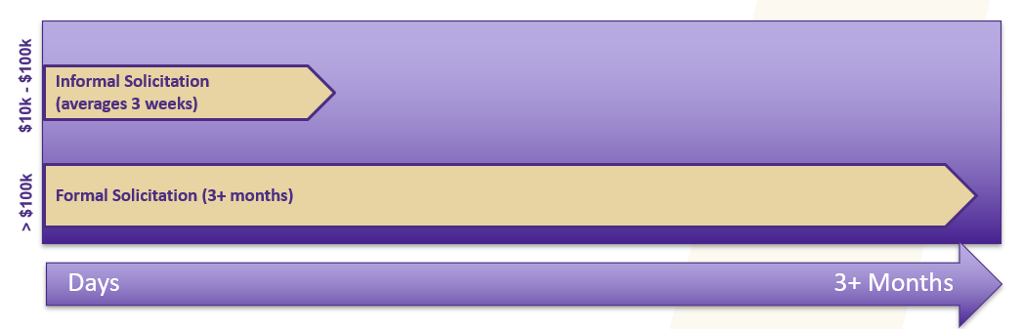
Competitive Solicitation Timeline
* Note, timelines are general and meant to serve as a guideline for advanced planning
Notes:
Informal solicitations are typically based on price alone
RFP/formal solicitations are awarded, and not based on price alone. They include explicit criteria developed by the department who is purchasing the good or service, and contracts are awarded based on overall value to UW. Any multi-year, master contract is created through this process.

Slide 14
Procurement Process Overview

Slide 15
Procurement Process
Beginning to End
Confirm Funding Source and Availability
Define Requirements
Know Relevant Rules and Regulations
Advance planning and communication with Procurement Services is encouraged
Understand Options
(See Procurement Services Website for guidance)
Purchase via Appropriate Method
(Catalogs, Procard)
Receive Goods and Services
Reconciliation and Payment Process
Notes:
Point out that a lot of time departments skip these process and end up at the “Receive Goods and Services” step, and this can be a problem.

Slide 16

Planning Checklist
> By asking yourself these important questions before starting the procurement process, you can save time and money:
What exactly do I need?
When do I need it?
What are the specific requirements?
Will the goods/services exceed the direct buy limit?
Does the purchase qualify as a sole source?
Is what I want available in the Workday Catalogs? If it isn’t, is there a Contract available?
Will I need to do a competitive solicitation?
> Reach out to Procurement Services if you have any questions!

Slide 17
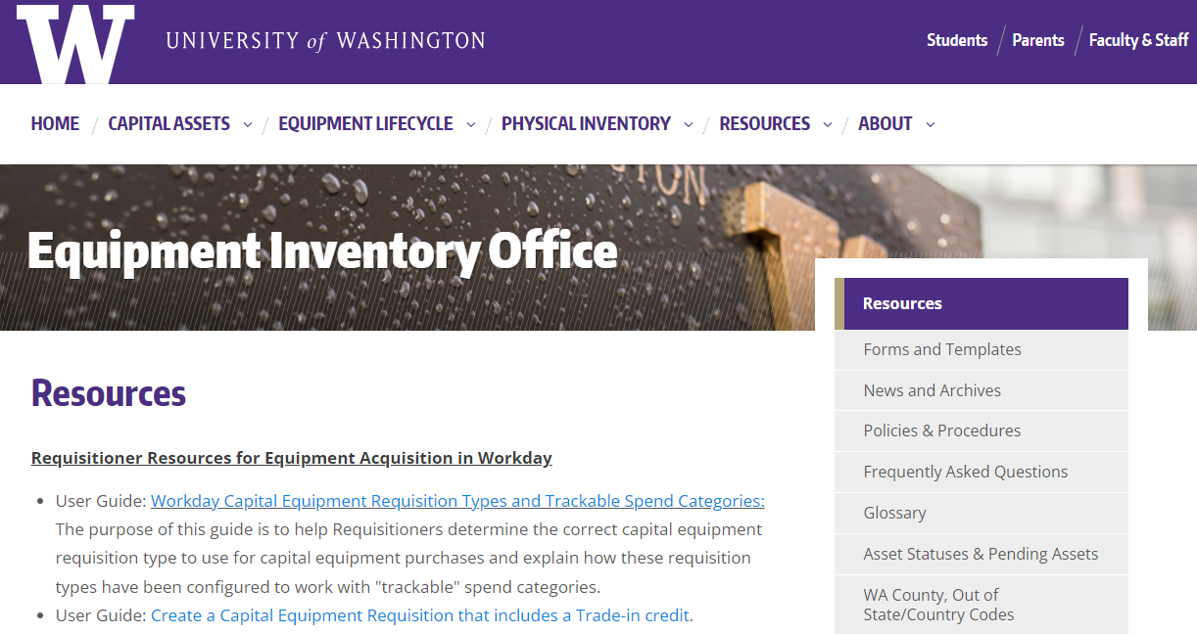
Equipment Inventory Office (EIO)
Visit the Equipment Inventory Office website to learn more about what is required when processing Capital Asset and Multi-Component Capital Asset requisitions and the application of the Machinery and Equipment Tax Exemption (M&E).
https://finance.uw.edu/eio/home

Slide 18
Workday Catalog & Non-Catalog Requisitions
What is a Workday Round-Trip Catalog purchase?
  Catalog requisition purchases use UW Contracts for established pricing, terms and discounts designed to offer the best overall value to customers. Ordering through catalogs in Workday is the fastest order method and the recommended first choice for purchasing goods at the UW.
What is a Workday Non-Catalog purchase?
  A Non-Catalog purchase Order is the process of placing an order in Workday with a supplier when the goods and/or services are not available in a catalog. UW employees with the Requisition Requester role in Workday can start Requisitions to become purchase orders.

Slide 19
Workday Requisition Types
Requisition Type | Description
Goods and Services | Primary requisition type to order general goods and services. Commonly used for catalog orders and non-catalog orders for goods.
Blanket Request | An agreement between a supplier and an organization that outlines pricing and terms that can be used over time for orders to be placed against. Will involve multiple billings and start and end services dates.
Capital Asset Request | This Requisition Type is used to purchase Capital Assets (items with a useful life > 1 year and a total cost >= $5,000 including ancillary costs) and all weapons and accessories, regardless of cost. Per UW Policy these must be tracked in Workday. Visit the Equipment Inventory Office web page for more information on this requisition type and to learn about the “Trackable Spend Categories” which must be used with this requisition type to identify capital equipment.
Construction - Capital Projects | Request to purchase materials needed for a specific capital construction project
Multi-Component Capital Asset Request | This is the Requisition Type used when purchasing multiple components/parts that need to be combined to create one functioning piece of equipment. When the components are combined, they must have a total cost >= $5,000 including ancillary costs and a useful life > 1 year. Visit the Equipment Inventory Office web page for more information on this requisition type and to learn about the “Trackable Spend Categories” which must be used with this requisition type to identify capital equipment.

Slide 20
What About Procard?
M&E Tax Exempt equipment purchases are prohibited on ProCard
Other Limitations
  Anything over the Direct Buy Limit should be reviewed by Purchasing in advance of the ProCard increase request
  Purchase Orders contain UW Terms and Conditions
  Purchase Orders can facilitate important documentation and attachments like Sole Source Justifications, M&E Tax Exempt Certificates etc. that are crucial to the order approval process
  Audits and Public Records Requests
  Some Exemption items cannot be purchased via Procard

Slide 21
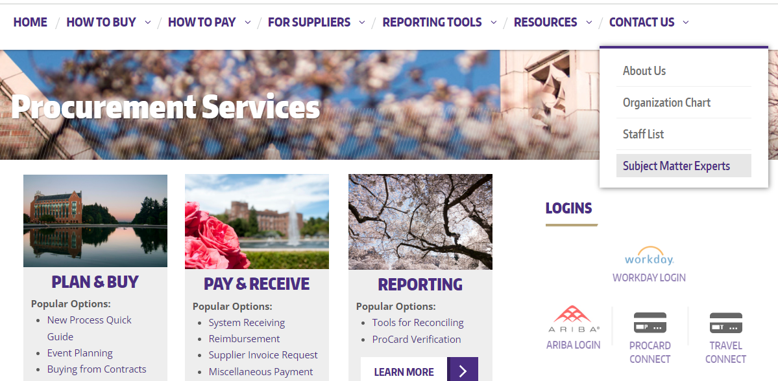
Procurement Subject Matter Experts
To locate the Procurement Subject Matter Experts webpage, navigate to the Procurement Services website.
  Click on the Contact Us tab
  Click on Subject Matter Experts in the drop-down menu
https://finance.uw.edu/ps/contact-us/subject-matter-experts

Slide 22
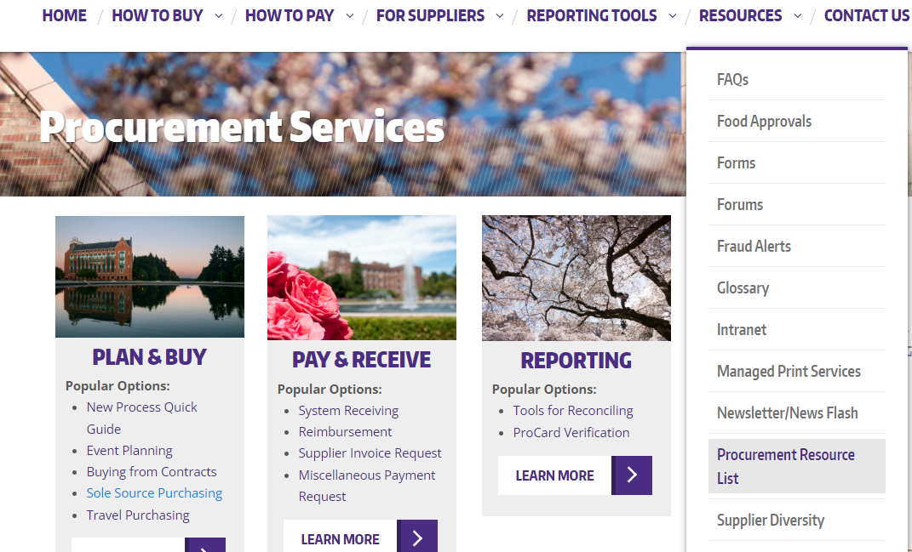
Procurement Resource List
To locate the Procurement Resource List, navigate to the Procurement Services website.
  Click on the Resources tab
  Click on Procurement Resource List in the drop-down menu
https://finance.uw.edu/ps/resourcelist

Slide 23
Q & A

Slide 24
Suggestion for Future Deep Dive Topics

Slide 25
Thank you!

