Slide 1
Procurement Customer Service

Slide 2
AGENDA
What is PCS Help?
Campus Inquiries
Supplier Inquiries
Other Considerations and Resources
Forms Demonstration
Note for today: We cannot research individual tickets already submitted in today’s session.

Slide 3
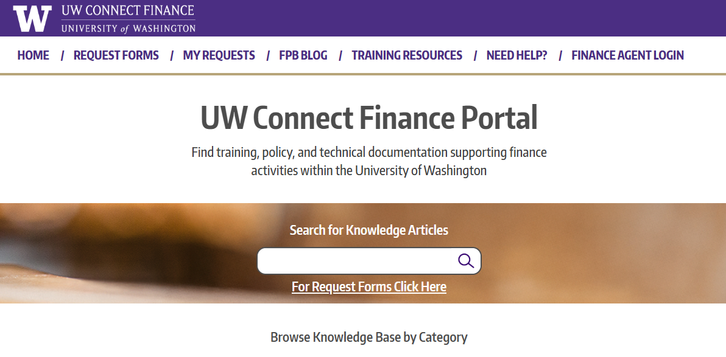
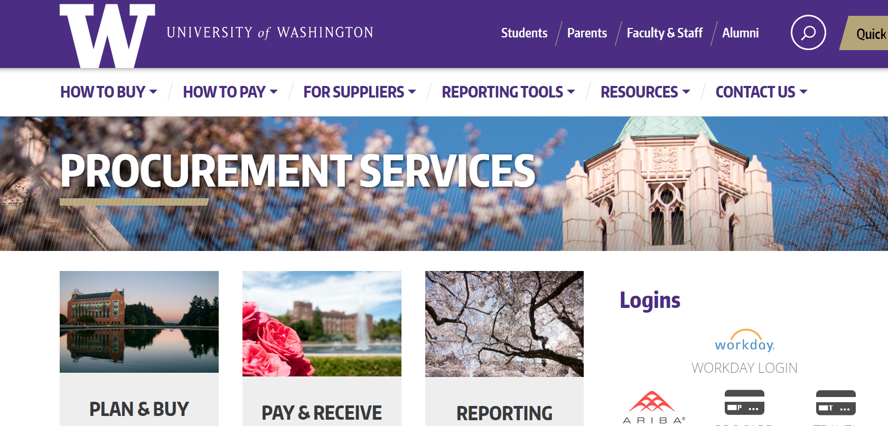
PRIMARY RESOURCES
UW Connect Finance Portal:
Procurement Services Website:

Slide 4
WHAT IS PCSHELP?

Slide 5
What is PCS Help?
Procurement Customer Service Help or “PCSHelp” is customer service unit for Procurement Services inquires that are not related to Travel or Procard/CTA.
Who is Procurement Services?
Accounts Payable/Global Services
Contracting/ Sourcing
Procurement Customer Service/Travel Services
Business Systems
Center of Excellence (Training)

Slide 6
What does PCSHelp Do?
Front line support for inquiries for all units under Procurement Services.
Front line for supplier inquires
When the team receives a ticket, they:
Assign the ticket to a team member
Work the que oldest to newest
Evaluate the ticket and research
Reassign the ticket if the inquiry belongs to a process partner (i.e.: If the inquiry is for ProCard, reassign to the Card Services team)
Inquire with other individuals/sources if the query is more complex
Respond as soon as possible

Slide 7
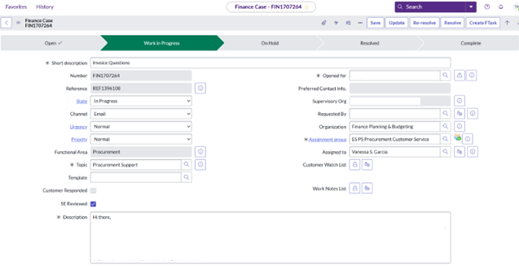
HOW CAMPUS UNITS CAN SUBMIT INQUIRIES
Connect Ticket
Email to pcshelp@uw.edu also creates a Connect ticket
Phone call (206-543-4500 for rush requests, leave a voicemail for return call)
Connect Ticket: generates an REF and FIN number, both can be searched in Connect. They can be seen in “My Requests”.

Slide 8
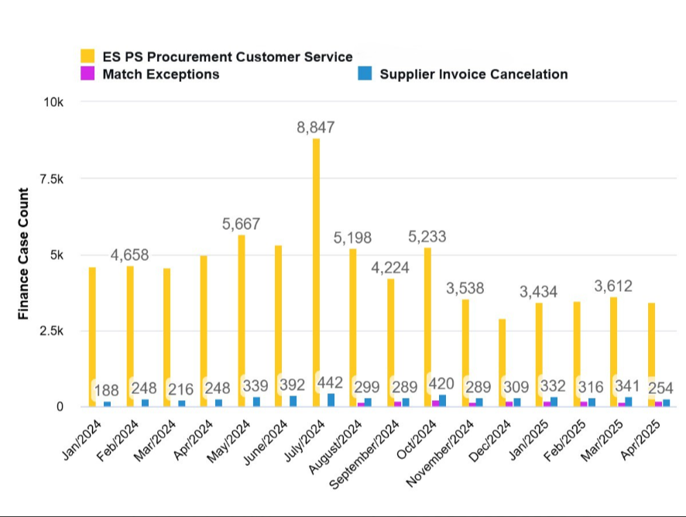
CAMPUS TICKETS

Slide 9
MOST COMMON INQUIRES FROM CAMPUS
Policy and procedure clarifications:
Resource: Procurement Services website
Invoice payment status:
Resource: Workday and Invoicing web page
Why an invoice submitted to GHX is not showing in Workday
Payments not received by the supplier
Forms guidance (PO Change/Close and Department Match Exceptions)
Note: Do not use the forms for putting invoices “on hold”

Slide 10
MOST COMMON INQUIRIES FROM CAMPUS
Encumbrances and receipt accruals
Receipt Issues
Resource: How to Receive in Workday Job Aid
Status on suppliers be added to Workday
Resource: Check with supplier on their progress
Request to expedite payment or approvals
How to resolve match exception showing on an invoice
Resource: How to Resolve Match Exceptions Job Aid

Slide 11
WHAT HELPS ANSWER THESE CAMPUS INQUIRIES?
In the ticket include:
Relevant PO#, SI#, MP# etc.
Screen shots of any error messages received
If forwarding communications from suppliers, make sure to include relevant information from your unit as well
Do not add comments to check back on your inquiry. It will change the “Last Modified Date” and move your ticket the end of the que. If no response, call phone line and leave a voicemail with REF#

Slide 12
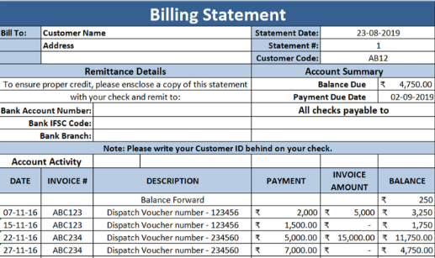
SUPPLIER INQUIRIES
Common inquiries:
Overdue Invoice Statements
Invoice Status
Documentation
Payment inquiries

Slide 13
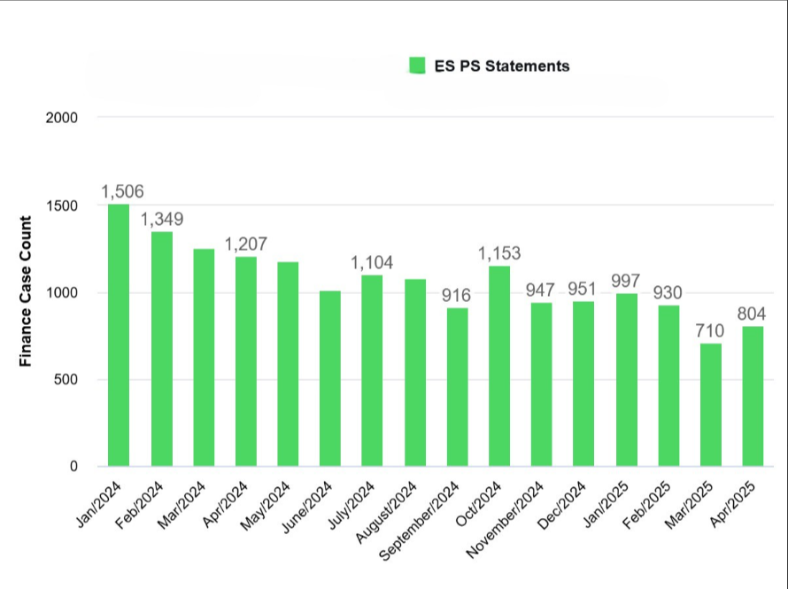
SUPPLIER TICKETS

Slide 14
WHAT HELPS ANSWER THESE SUPPLIER INQUIRIES?
Have thoughtful internal comments on Workday transactions. This helps PCS Help pass information onto the supplier.
Have appropriate documentation attached
Have line-item descriptions that make sense to suppliers
If forwarding communications from suppliers, make sure to include relevant information from your unit as well

Slide 15
Other Considerations
If you need a contract or quote that needs review and signature, use the new Procurement Contract Manager Support Request form in the UW Connect Finance portal.
If you have requested a new supplier through the webform, and don’t see your supplier in Workday, contact the supplier first to see if they have completed their process steps.
Regularly check for invoices that need receiving.
Payment information can be found in Workday. The Payment Status and Check Cancellation page can provide guidance for statuses and payment format.

Slide 16
OTHER RECOMMENDED RESOURCES
For Suppliers web page
Live Event calendar to see upcoming training opportunities
Invoicing Information web page
Utilize the Procurement Services Resources List web page
Links to Forms for getting help on the Procurement Services website

Slide 17
FORMS DEMONSTRATION

Slide 18
Questions
Note for today: We cannot research individual tickets already submitted in today’s session.

