Slide 1
Planning an Event

Slide 2
Agenda
Components of Events:
    Catering
    Hotels
    Conferences
    Charters and Transportation
    Event Requisition Best Practices in Workday
    Resources

Slide 3
What to know before planning an Event
UW Procurement Services has negotiated contracts and maintains a list of approved caterers and hotels as well as many suppliers providing event planning services, equipment rentals, and charters to assist campus with their special event needs.
If the dollar amount of your request is greater than the Direct Buy limit ($10,000 including shipping and handling and excluding tax), and you are not using a UW Contract supplier a sole source justification must be provided or quotes obtained In consultation with a Procurement Service buyer to ensure compliance with the competitive solicitation requirements.
Check to see if there is a supplier that can meet your needs that has a Contract with the UW by searching within Workday or the UW Public Contract Portal. Some of the benefits of using a Contracted Supplier are:
  Discounted pricing
  Terms and conditions are already negotiated
  No need to provide a sole source justification for purchase over $10K
Make sure not to sign any supplier Agreement or Contract and have a Contract Manager at Procurement Services review it prior to the Event.
  Deposits
  Legal language (Force Majeure, indemnification etc.)
  Contact a Procurement Services Contract Manager by visiting the Subject Mateer Experts webpage.

Slide 4

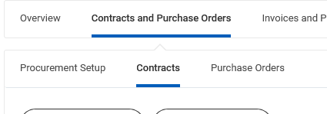
Searching for Contracts within Workday
There are multiple ways to identify if a supplier in Workday has a contract you can use to make a purchase. The easiest is to use the search bar in Workday:
Searching by Supplier:
In the main Workday Search Bar - type Supplier: then type the Supplier name (as shown in the example below)
A list of suppliers will populate. Click on the name of the one you are interested in.
When the Supplier page loads, click on the “Contracts and Purchase Orders” tab, and then the sub-heading “Contracts”
Review the list of supplier contracts that are associated with the supplier.

Slide 5
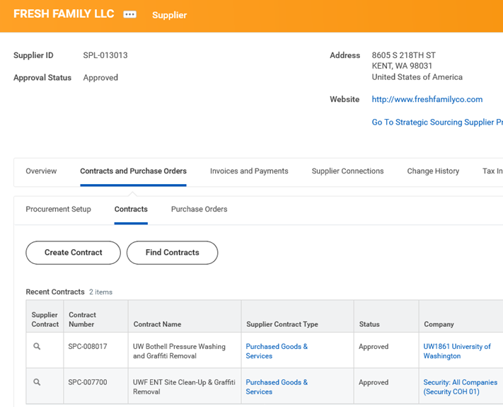
Searching for Contracts
Hover over the magnifying glass to the left of the SPC number and right click for a menu to pop up. Select “See in new Tab” to open the contract in a new browser window and read more about its description and Overview.
Choose the contract with the best fit (description) and read the Overview to confirm. Be sure to review the scope and usage of the agreement before selecting the contract. You will need to return to your original browser tab to select the Contract.

Slide 6
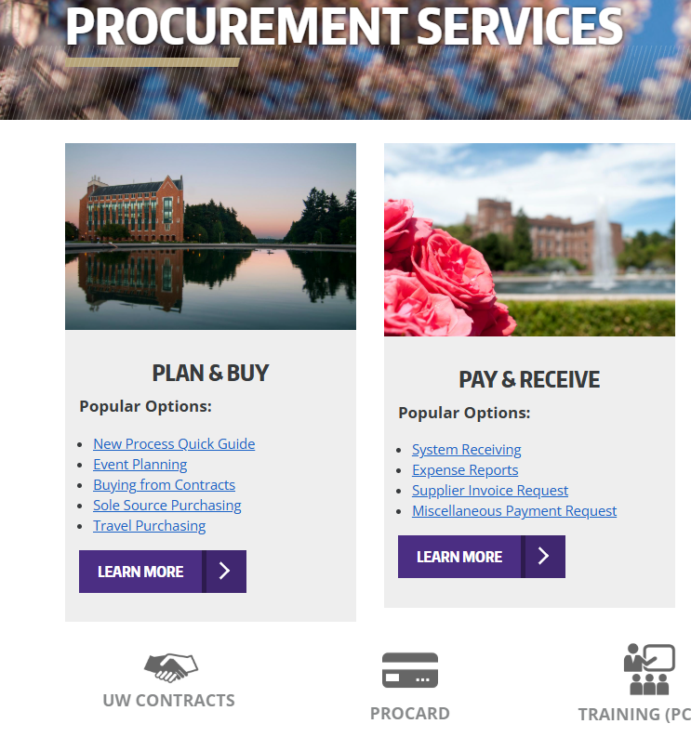
UW Public Contract and Bidding Portal

Slide 7
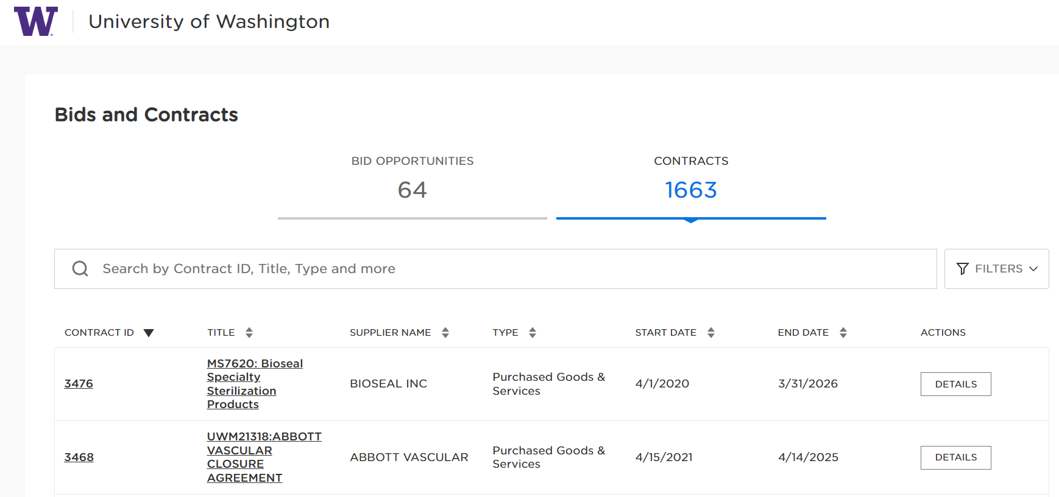
UW Public Contracts and Bidding Portal
The Portal is located on the Procurement Services home webpage and provides visibility into Contracts that UW staff are able to leverage within their departments.
Users can search for Contracts in a variety of ways. You can search by:
  Supplier Name/Number
  Contract Number/Contract Title
  Keyword Search
After entering your search criteria, click the View Report button to see the Contract information results. Leaving the fields blank will display all available Contracts.

Slide 8
Delegated Signature Authority
Delegated signature authority is granted to the University of Washington by the State Legislature and is further delegated internally to the Executive Director for the Procurement Services department, who has further delegated signature authority to Procurement Services buying staff.
Procurement Services Contract Managers are considered agents of the University and are authorized to sign contracts on behalf of the university.
Campus departments do not have the authority to execute or sign contracts, including maintenance and service agreements.
It is recommended that Contracts, or other documents requiring a signature, be reviewed by a Procurement Services Contract Manager regardless of the method of payment or dollar amount.
To submit a Contract or other documents requiring signature to be reviewed by a Procurement Services Contract Manager, you can submit through the UW Connect Finance form “General Finance Help Request” https://uwconnect.uw.edu/finance
  Note: Starting May 1st there will be a new Procurement Contract Review form available
To submit a Contract or other documents requiring signature to be reviewed by a Procurement Services Contract Manager, you can submit through UW Connect Finance form “General Finance Help Request” https://uwconnect.uw.edu/finance

Slide 9
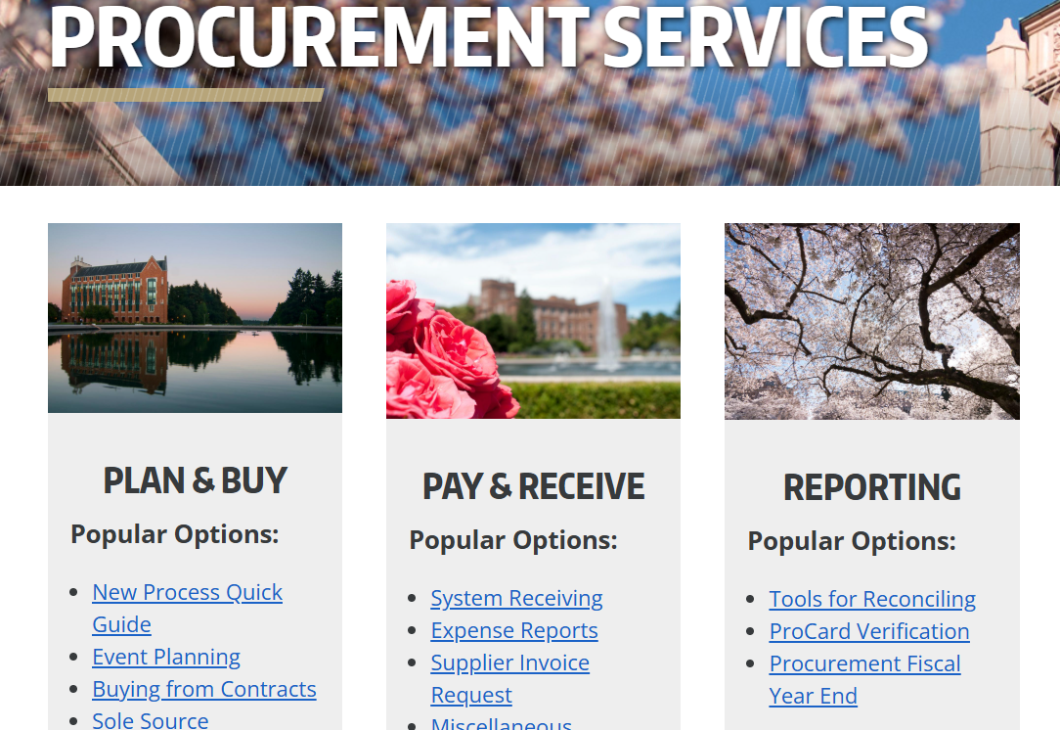
Procurement Services – Event Planning Webpage

Slide 10
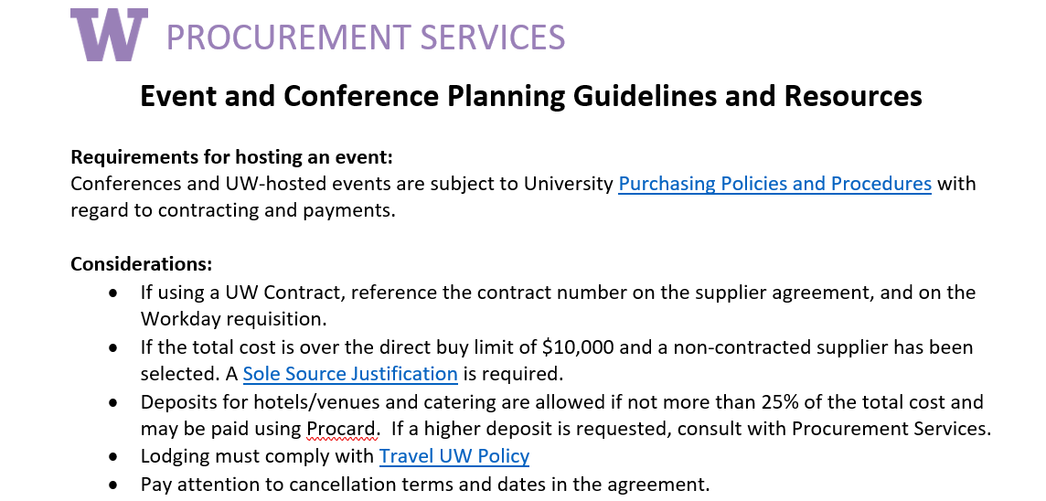
New! Event Planning Quick Guide

Slide 11
Catering - UW Campus Resources
Consider using Bay Laurel Catering for your event (Housing & Food Services):
  Have been catering events at UW since 2007
  For UW departments, Workday coding is used to charge via ISD (Internal Sales Document)/Workday
  Purchases made using a UW Cost Center of Grant are exempt from Washington State sales tax.
  Do not accept gratuities for any services.
  As the only UW Environmental Health and Safety-approved caterer you won’t need to navigate the food permit process.
  Does not accept ProCard from UW departments

Slide 12
Catering – UW Contract Supplier Pool
Check out the list of over 40 Caterers that are under contract with the UW by accessing the spreadsheet on the Event Planning webpage on the Procurement Services home page.
  All Suppliers on the list have completed the registration and submitted the required insurance and health permits, unless noted on the list. Please reference UW Contract #UW-19-0038 when using any of the companies.
Suppliers on the list are subject to EH&S approval for individual events, and UW personnel hosting or sponsoring an event at a UW location where food will be served, sold, or given away should review EH&S guidance regarding when to apply for a Temporary Food Service Permit. The permit application allows EH&S to assess the safety of the food source, evaluate food preparation steps, handling, and storage to protect health and prevent food borne illness.
Please remember to review University Food Policy Guidance and to complete the Food Approval Form 1798.
Reasons a permit may be denied by EH&S.

Slide 13
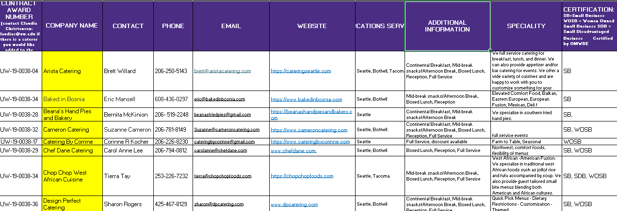
Catering Supplier Pool Spreadsheet

Slide 14
Hotels
Using a Hotel that is under Contract/Agreement with the UW is highly recommended for your convenience because of greater cost savings, ease of booking reservations and lower risk.
The list of UW Hotels with Contracts/Agreements can be found by visiting the Travel Services website and searching under the Lodging drop down menu, or by doing a search in the UW Public Contract Portal.
Pre-negotiated terms and conditions allows for lower risk and protection for campus
Hotels on the list can be used for conferences, visiting families, sports team members etc.
UW has negotiated rates and special deals (meeting rooms at no charge with minimum number of hotel rooms for conferences.
  Note: Updated Hotel Contract pool coming soon.

Slide 15
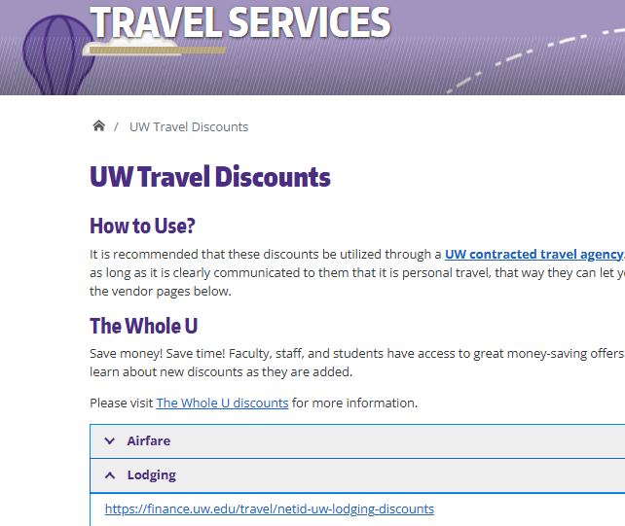
Hotels – Travel Services Website

Slide 16
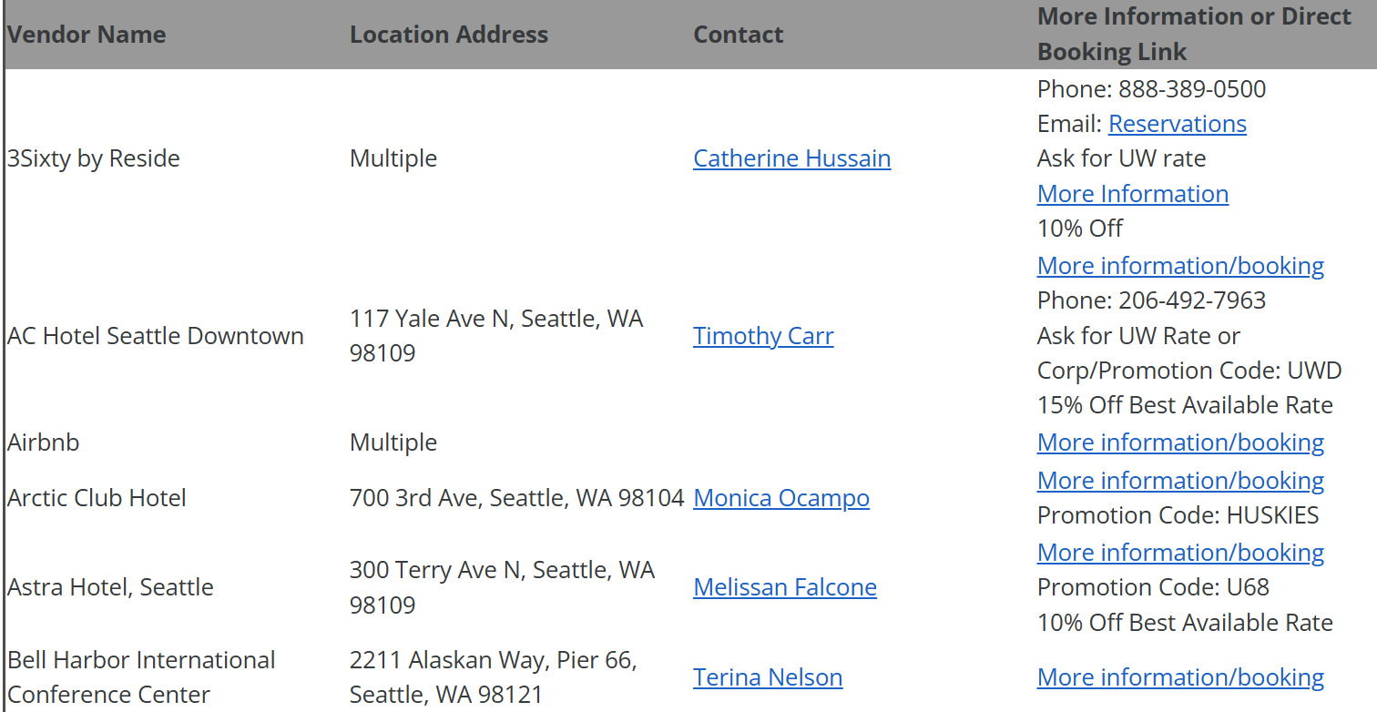
Travel Services – Hotel Contract/Agreement List

Slide 17
Charters/Transportation
Departments and organizations on campus occasionally need to utilize shuttle and/or charter services for air, land, or sea transportation. Charters range from local, one-day trips to extended multi-day trips spanning many states, or even multiple countries. A list of contracted charter suppliers is below.
For all charters, using a contracted supplier will minimize risk, save money, and reduce the time necessary to schedule a charter.
Charters (air/land/sea) require proof of insurance from the service provider. If using a non-Contracted supplier, the Charter company must include the UW Board of Regents as additional insured.
Below are some best practices for Charters/Transportation:
  Vessel charters: Place orders in Workday, not with a Procard. Orders must include the name of vessel and location of cruise.
  Air charters: Place orders in Workday, not with a Procard. Order must include the aircraft make and model in the description or memo section of Workday.
  Make sure to read through the important Charter information on the Event Planning webpage.

Slide 18
Conferences
Requirements for hosting an Event:
Conferences and UW-hosted events are subject to UW Purchasing Policies and Procedures with regard to contracting and payment.
When selecting a conference venue, please first consider using University facilities/catering or other state facilities or a supplier with a UW Contract before selecting an outside, non-contracted supplier.
If the department did not select a UW Contracted supplier or UW/State facility, the department is responsible for providing the reason for selecting the supplier (Sole Source Justification).
The University faculty, staff and students are covered for general liabilities arising from negligent acts and omissions committed in the course and scope of their University duties.
  Keep a list of the attendees at the conference and indicate their UW affiliation (i.e., UW employees/faculty, UW students or non-UW
  A copy of the certificate of insurance is available through Risk Management.

Slide 19
Workday Requisition Best Practices - Events
Deposit best practices:
  Procurement Services must sign the Contract before the deposit is paid
  The payment method must stay consistent for the entire event
  Workday will not allow multiple payment types on a PO (if you pay a deposit with a Procard, Workday prohibits any other payment methods on that PO)
All attachments with the Requisition must include a contract/agreement signed by buyer, food approval form, and sole source if necessary).
Make sure to have a Discretionary Cost Center ready to cover alcohol and other expenses that are not allowable on the regular budget if necessary (flowers, decorations items, etc.).
If you’re sending a Hotel rooming list and are doing a group or conference event at a Hotel, be sure to have the Hotel complete and sign a UW Data Processing Agreement along with the Contract.

Slide 20
Resources
Procurement Event Planning webpage: https://finance.uw.edu/ps/how-to-buy/planning-event
Procurement Buying from Contracts webpage: https://finance.uw.edu/ps/how-to-buy/buying-from-uw-contracts
Procurement Subject Matter Experts webpage: https://finance.uw.edu/ps/contact-us/subject-matter-experts
Finding UW Contracted Suppliers Job Aid: https://uwconnect.uw.edu/finance?id=kb_article_view&sysparm_article=KB0033394
UW Housing & Food Services website: https://hfs.uw.edu/Home
Environment Health & Safety website: https://www.ehs.washington.edu/
Travel Services website: https://finance.uw.edu/travel/netid-uw-lodging-discounts

Slide 21
Questions?

Slide 22
Thank You!

