Slide 1
ProCard Best Practices

Slide 2
AGENDA
What to Know Before You Begin
Verification
Tools

Slide 3
What to Know Before You Begin

Slide 4
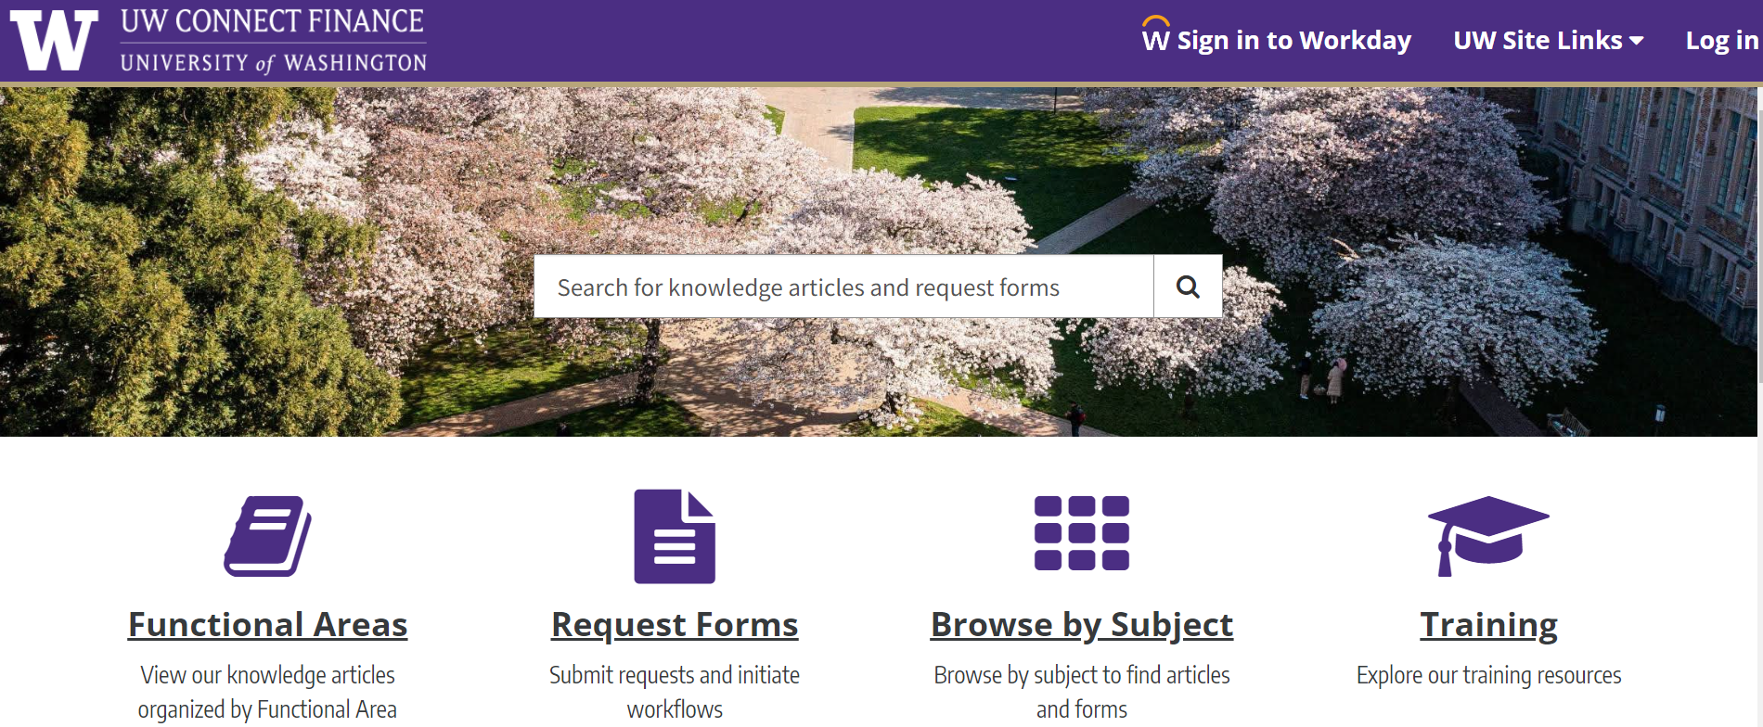
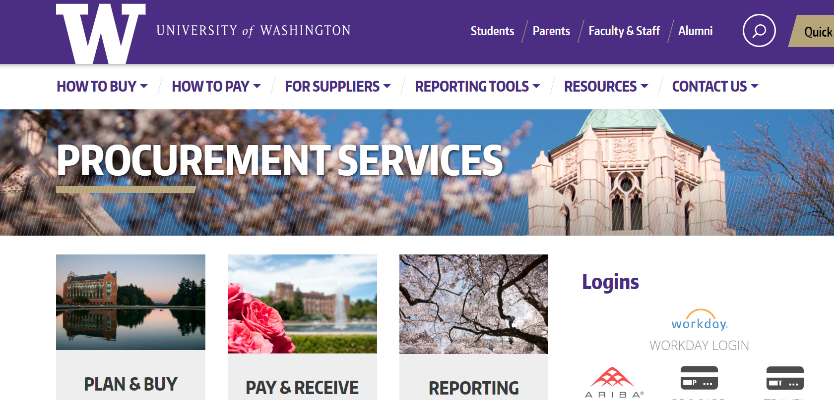
RESOURCES
UW Connect Finance Portal:
How to Manage ProCard in Workday: https://uwconnect.uw.edu/finance?id=kb_article_view&sysparm_article=KB0033590
Procurement Services Website:
Card Services: https://finance.uw.edu/ps/how-to-buy/procurement-card
Updated frequently!

Slide 5
Regular Verification
ProCard Cycle: 1st day of the month to the last banking business day of the month (i.e.: 11/1-11/29 and 11/30-12/31)
Verify Transactions weekly in Workday to meet monthly deadline
Backups: Have more than one backup for each security role.
Suspension Policy: Began November, policy on the ProCard home page for reference.

Slide 6
Responsibilities for Verification
Obtain documentation to attach in Workday to support the transactions
Cardholders/PDES make sure that the charges are fully verified through the process and get final approval before month end deadline
Approvers do approval in a timely manner

Slide 7
Verification

Slide 8
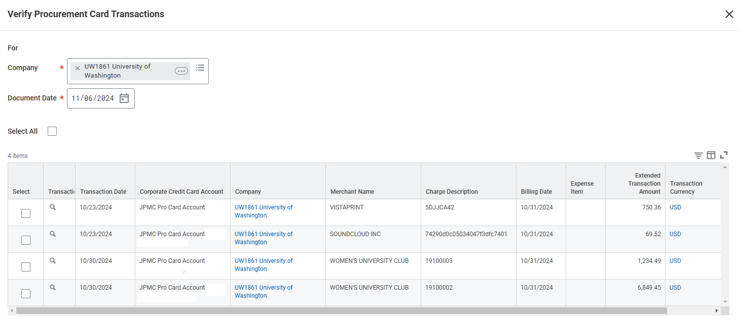
Verification – Selecting Transactions
Verifying multiple transaction at one time is ok if they all will be under the same Cost Center/Grant. Avoid lumping verifications together if they will have different accounting.

Slide 9
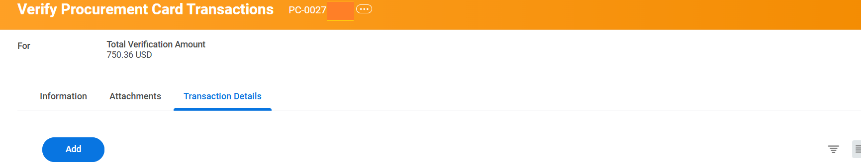
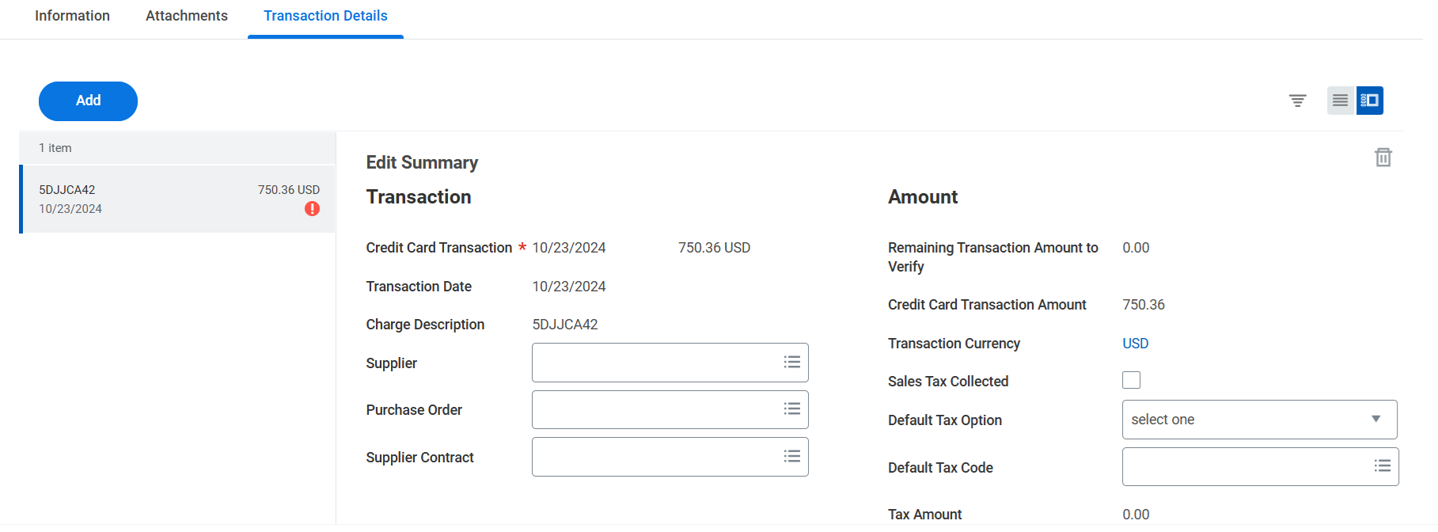
Verification – PC Number
Once you pick a transaction to verify, it is assigned a PC#.
Every PC# has a creation date. Workday uses that date to compare to dates that security roles were assigned.
If an individual is assigned a security role after the PC creation date, they will not see or be able to approve those past verifications.
PC00204410

Slide 10
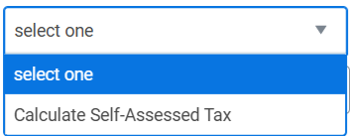
Verification – Tax and Supplier
Tax assessment: Was tax paid?
Yes, check the box
No, is it taxable?
Optional “Supplier” field: if the supplier’s name is listed exactly the same as shown on your receipt.

Slide 11
Taxes
It is the responsibility of University of Washington employees to ensure tax is charged to all UW purchases if the item being purchased is used in the state of Washington. Each receipt/invoice for ProCard transactions with an out of state merchant should be reviewed to determine if the merchant charged Washington State sales tax.
Sales tax was charged: check the “Sales Tax Collected” box.
Sales tax was not charged, use tax needed: use “Default Tax Option” to assess use tax.
Purchase not taxable: do not check the sales tax box or use the “Default Tax Option” and ignore the warnings that come up.

Slide 12
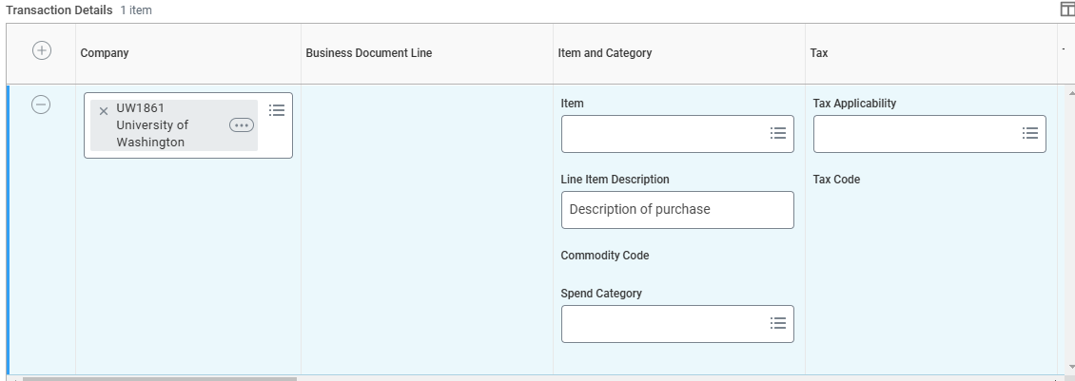
Verification – Line Fields
Line Item Description: Description of the purchase.
Company: You cannot split a transaction between funds in two different companies. All funds need to be the same company.
Spend Category: Pick an appropriate spend category that has the correct taxability.

Slide 13
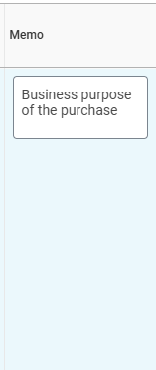
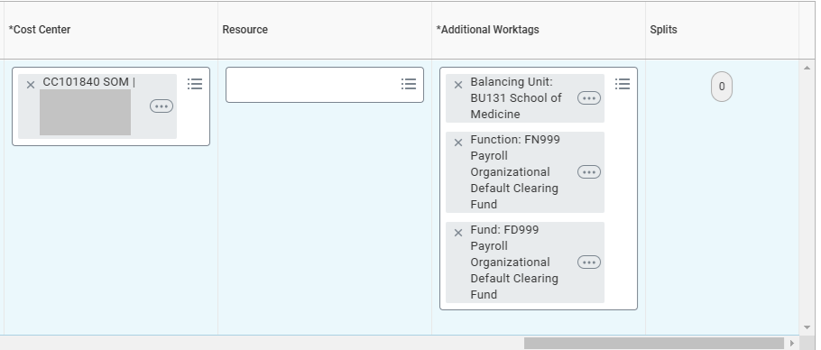
Verification – Additional Line Fields
Splits: A way to split the line item between funds in the same Company.
Cost Center and Additional Worktags: X out all worktags before adding appropriate worktags.
Memo: the business purpose of the purchase.

Slide 14
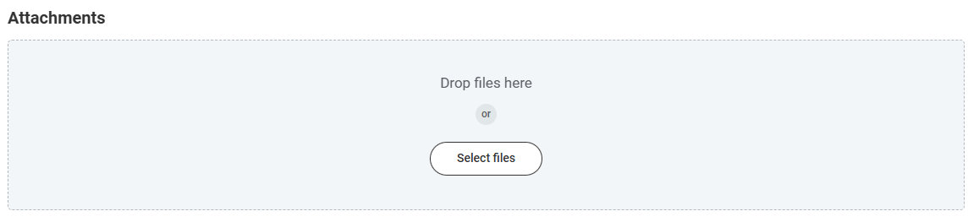
Attachments
Required for every verification
Best practice to attach an itemized receipt
Some examples of what is not acceptable:
Handwritten document
Excel spreadsheet listing charges
Email description of the purchase

Slide 15
ProCard Verification Approval
Report Option
Verification
Cardholder
Procurement Data Entry Specialist
R1439
My Procurement Card Verifications
Approval
Procurement Data Entry Specialist
Grant Manager, Cost Center Manager etc.
Filter in My Tasks
R1438
Filter in My Tasks
R1438
Approval
Grant Manager, Cost Center Manager etc.

Slide 16
Cancelling a Verification
Note: Does not cancel the charge, it just cancels the PC# assigned and returns the transaction to the cardholder’s que.
When you might need to cancel a ProCard verification (PC#):
When multiple transactions were verified (but unapproved) together and should not have been
When a verification has a creation date earlier than the date an individual’s security role was set up and that person needs to be able to approve it.

Slide 17
Tools

Slide 18
ProCard Activity Reports
R1439 – Find Credit Card Transactions
Will show ProCard Transactions in draft and new status. Audience: Individuals who verify charges and administrators who are keeping track of staff work progress.
R1438 – Find Procurement Card Transaction Verifications
Finding ProCard verifications for any worker that have been started (In Progress). Audience: Individuals who verify charges and administrators who are keeping track of staff work progress.
R0552 – Business Processes in Flight Initiated by Me
Finding transactions on business processes that have been submitted by the individual running the report, shows the next step in the approval process (In Progress). Audience: cardholder keeping track of what status their charges are in.
R1523 – In-Progress Business Process Event Tracking
Run for any worker. Audience: Administrators and Approvers with auditing department ProCard activity (In Progress)

Slide 19
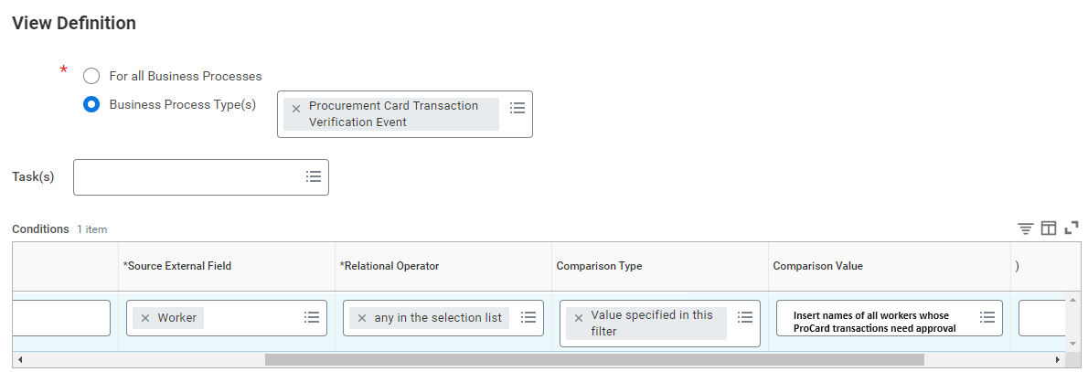
Filter for ProCard - PDES
Note: Use the same filter set up as other individuals in your same role.
Approving ProCard transactions as the Procurement Data Entry Specialist (PDES)

Slide 20
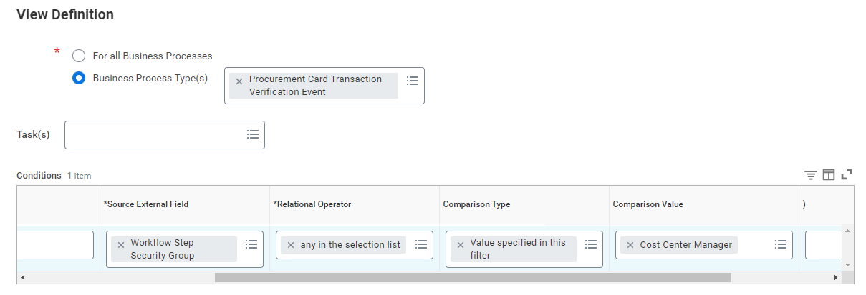
Filter for ProCard – Funding Manager
Note: Use the same filter set up as other individuals in your same role.
Approving ProCard transactions as the Funding Manager (Cost Center Manager or Grant Manager

Slide 21
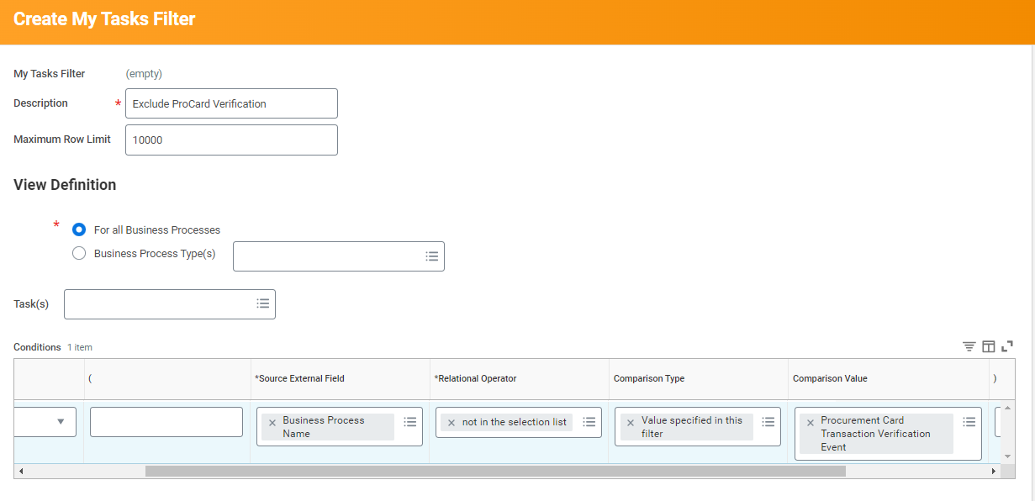
Filter for ProCard - Removal
Note: Use the same filter set up as other individuals in your same role.
Removing card transactions from inbox

Slide 22
More Resources
How to Manage ProCard in Workday Job Aid: https://uwconnect.uw.edu/finance?id=kb_article_view&sysparm_article=KB0033590
ProCard Website: https://finance.uw.edu/ps/how-to-buy/procurement-card
Spend Categories Guidance in the UW Connect Finance Portal: https://uwconnect.uw.edu/finance?id=kb_article_view&sysparm_article=KB0032449
ProCard Verification eLearning: https://finance.uw.edu/ps/node/5567
In Workday:
Find Spend Categories Report
Extract FDM – Spend Categories R1324 Report

