Slide 1
ProCard Process and Responsibilities

Slide 2
AGENDA
Responsibilities
Card Security
Verification
Tools: Reports, Dashboard, Links

Slide 3
Responsibilities for Cardholders
Perform regular verification of card transactions.
  Remember: Card transactions cannot post to funding sources until they are verified and fully approved.
Run Reports Often:
  Verify Procurement Card Transactions (which will show transactions not yet part of a Verification Document)
AND
  My Procurement Card Transaction Verifications (which will show transactions that are “Pending” but have not been approved)
Report any fraudulent activity immediately (JPMC may not reimburse for fraud reported after 60 days from the transaction date)

Slide 4
Responsibilities for Approvers
Run Reports Often:
  R1439 – Find Credit Card Transaction
  Displays ProCard Transactions in draft and new status.
  R1438 – Find Procurement Card Transaction Verification
  Displays ProCard Verification for any worker that have been started (In Progress).
Assign Backups to cover your approval tasks
  When using filters, make sure any backup individuals use the exact same filter as the person they are backing up or they may not see the same data.

Slide 5
Responsibilities for Verification Process
Obtain Purchase receipts and supporting documentation
  i.e., proof of receipt of goods, business purpose, itemized list of what was purchased and pricing information) to attach in Workday
Mind The Deadlines:
  Transactions are aged when they are three fiscal months old
  3 or more suspensions in a Calendar year can lead to card closure.
Keep ProCard Office informed of any relevant exceptions
  The item has not delivered.
  Credit has not posted for reported Fraud/Dispute.
  The verification is stuck in process.

Slide 6
Card Security

Slide 7
Card Security- Protect Yourself from Fraud
Do not respond or reply to an email, phone call or text message that:
Reminders:
Pay special attention to links and attachments – JPMC will not send emails asking you to reply by sending personal or business information
Requires you to supply personal or account information (such as a user ID, password, or account numbers) directly in the email, non-secure webpage, survey, or text message
Regularly check your account activity for any suspicious transactions and contact us immediately about anything suspicious
Claims there is fraud on your account & then asks you to provide or confirm your personal or account information
Asks you to confirm, verify or refresh your account, password or billing information

Slide 8
Card Security- Protect Yourself from Fraud:
Reminders:
JPMC does not have the cardholders DOB or SSN on file for ProCard and Central Travel Accounts.
Cards should only be used by the person to whom the card is issued and should not be shared or lent to other staff.
Do not write any portion of the ProCard number down or share the number with others.
All third-party payment systems should be avoided.
  This includes (but is not limited to) PayPal, Google pay, Amazon pay, etc.
Report any fraudulent activity immediately (JPMC may not reimburse for fraud reported after 60 days from the posting date)

Slide 9
Update to Post- Audit:
The ProCard office conducts audits on ProCard transactions monthly.
ProCard office no longer uses Oversight, but instead uses a Discovery Board (CARDiscovery) in Workday and pulls current data
It is important to respond to emails you receive from ProCard@uw.edu on flagged transactions.

Slide 10
Verification

Slide 11
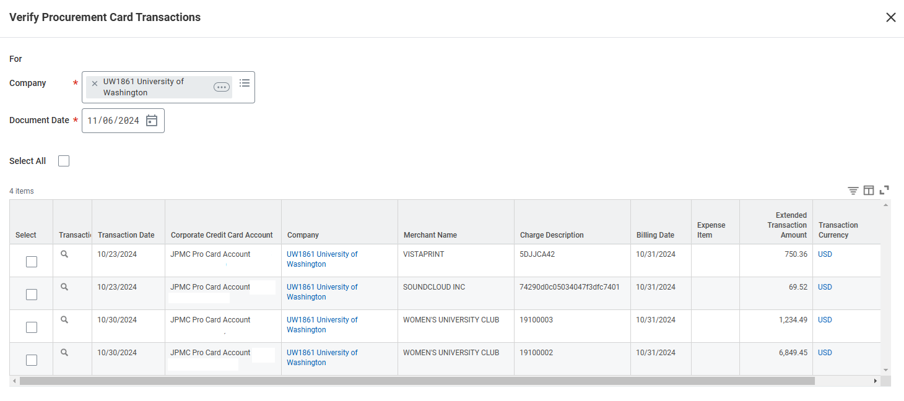
Verification – Selecting Transactions
Verifying multiple transaction at one time is ok if they all will be under the same Cost Center/Grant. Avoid lumping verifications together if they will have different accounting.

Slide 12
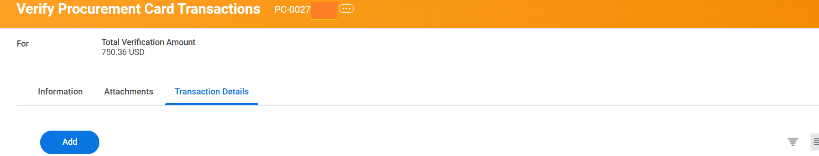
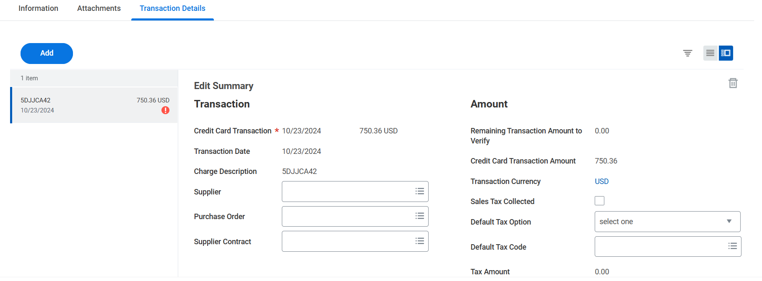
Verification – PC Number
Once you pick a transaction to verify, it is assigned a PC#.
Every PC# has a creation date. Workday uses that date to compare to dates that security roles were assigned.
If an individual is assigned a security role after the PC creation date, they will not see or be able to approve those past verifications.
PC00204410

Slide 13
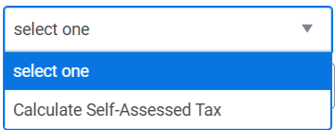
Verification – Tax and Supplier
Tax assessment: Was tax paid?
Yes, check the box
No, is it taxable?
Optional “Supplier” field: if the supplier’s name is listed exactly the same as shown on your receipt.

Slide 14
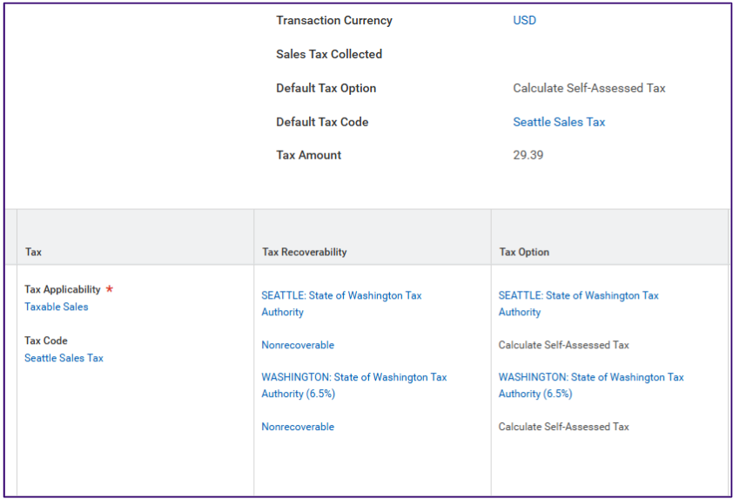
Use Tax
Should not be blank:
Tax Code
Tax Recoverability
Tax Option
If it is taxable, use tax can be applied:
Default Tax Option: Calculate Self-Assessed Tax
Default Tax Code: Selected for delivery location

Slide 15
Taxes
It is the responsibility of University of Washington employees to ensure tax is charged to all UW purchases if the item being purchased is used in the state of Washington. Each receipt/invoice for ProCard transactions with an out of state merchant should be reviewed to determine if the merchant charged Washington State sales tax.
Sales tax was charged: check the “Sales Tax Collected” box.
Sales tax was not charged, use tax needed: use “Calculated Self-Assessed ” and fill in Default Tax Code.
Purchase not taxable: do not check the sales tax box or use the “Default Tax Option” and ignore the warnings that come up.

Slide 16
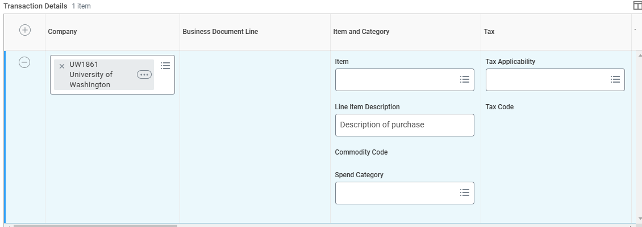
Verification – Line Fields
Line Item Description: Description of the purchase.
Company: You cannot split a transaction between funds in two different companies. All funds need to be the same company.
Spend Category: Pick an appropriate spend category that has the correct taxability.

Slide 17
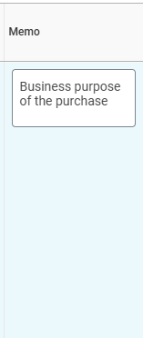
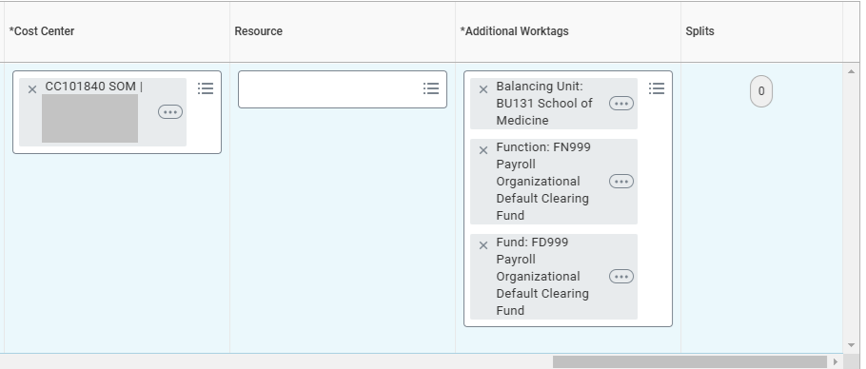
Verification – Additional Line Fields
Memo: the business purpose of the purchase.
Cost Center and Additional Worktags: X out all worktags before adding appropriate worktags.
Splits: A way to split the line item between funds in the same Company.

Slide 18
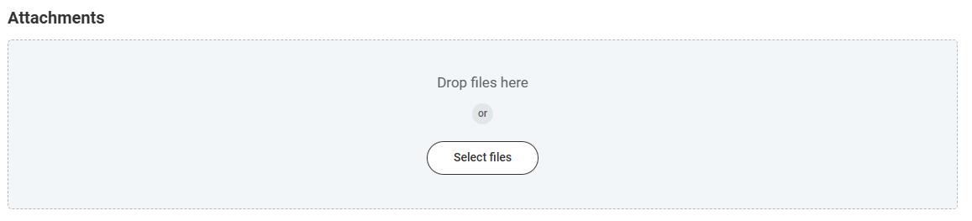
Attachments
Required for every verification
Best practice to attach an itemized receipt
Some examples of what is not acceptable:
  Handwritten document
  Excel spreadsheet listing charges
  Email description of the purchase

Slide 19
Cancelling a Verification
Note: Does not cancel the charge, it just cancels the PC# assigned and returns the transaction to the cardholder’s que.
When you might need to cancel a ProCard verification (PC#):
  When multiple transactions were verified (but unapproved) together and should not have been
  When a verification has a creation date earlier than the date an individual’s security role was set up and that person needs to be able to approve it.

Slide 20
Tools

Slide 21
Procurement Card Dashboard
New tool in development in Workday!
The Procurement Card Dashboard provides:
Centralized View of Unverified Transactions (those in prepaid, pending, and new transaction status)
Divided by Balancing Unit for easy identification
Reducing the need to run multiple reports
Viewable by more security roles
The “Aging ProCard Transactions by Unverified Cardholders” tab is the best tab to use for now, other tabs are still in progress but will be rolled out soon.

Slide 22
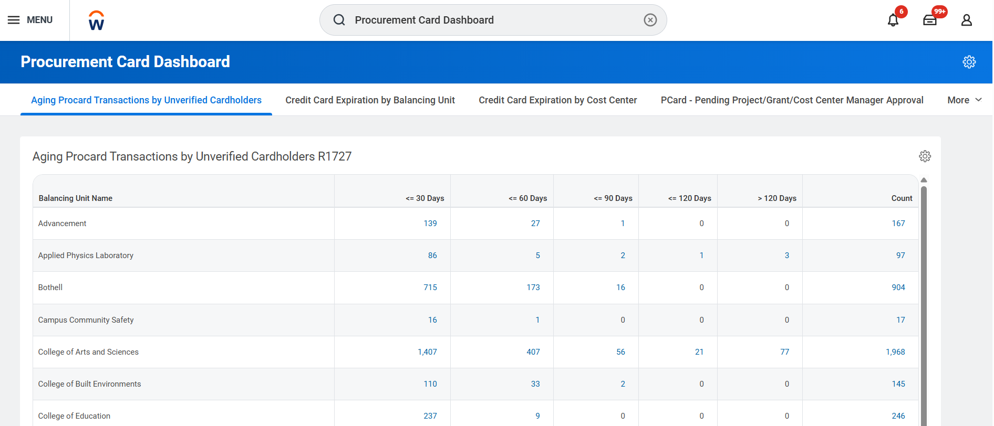
Procurement Card Dashboard Workday
On the main page, scroll down to find the “View More” button to open all balancing units.

Slide 23
Other ProCard Activity Reports
R1439 – Find Credit Card Transactions
  Will show ProCard Transactions in draft and new status. Audience: Individuals who verify charges and administrators who are keeping track of staff work progress.
R1438 – Find Procurement Card Transaction Verifications
  Finding ProCard verifications for any worker that have been started (In Progress). Audience: Individuals who verify charges and administrators who are keeping track of staff work progress.
R0552 – Business Processes in Flight Initiated by Me
  Finding transactions on business processes that have been submitted by the individual running the report, shows the next step in the approval process (In Progress). Audience: cardholder keeping track of what status their charges are in.
R1523 – In-Progress Business Process Event Tracking
  Run for any worker. Audience: Administrators and Approvers with auditing department ProCard activity (In Progress)

Slide 24
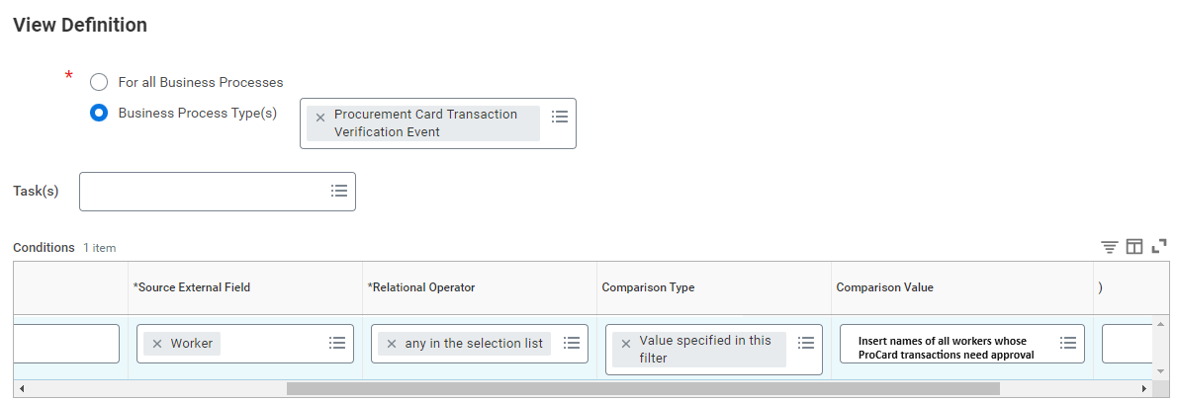
Inbox Filters for Approving Verifications
Use inbox filters to find transactions for approval
For work coverage, use the same filter set up as other individuals in your same role

Slide 25
More Resources
How to Manage ProCard in Workday Job Aid
ProCard Website
Spend Categories Guidance in the UW Connect Finance Portal
ProCard Verification eLearning
In Workday:
  Find Spend Categories Report
  Extract FDM – Spend Categories R1324 Report

