Slide 1
Sole Source Justifications & Competitive Solicitations

Slide 2
DIRECT BUY LIMIT
The Direct Buy Limit, currently set at $10K, is the dollar limitation set by State law under which purchases may be made without securing competitive pricing.
Departments may place orders with suppliers of choice within the Direct Buy Limit ($10K or less, including shipping and handling and excluding tax), without prior approval of Procurement Services.
Visit: http://finance.uw.edu/ps/resources/glossary#d

Slide 3
ABOVE THE DIRECT BUY LIMIT
Options to select suppliers:
Contracted Supplier (Workday Catalog, Enterprise Contract, etc.)
Sole Source Justification
Competitive Solicitation (Informal or Formal)
(Always performed by Procurement Services Contract Managers)
Important: Each option above must be approved and verified by a Procurement Contract Manager (usually via Requisition) prior to the purchase or payment occurring.
If you are unsure about any of the options above, make sure to contact Procurement Services for guidance.

Slide 4
SOLE SOURCE JUSTIFICATION
A sole source exists when goods or services, because of unique characteristics or other reasons, are only available from a single source. Sole source justifications are reviewed and approved by Procurement Services prior to an order being placed.
Definition: A “Sole Source” purchase means that only one supplier (source), to the best of the requester’s knowledge and belief, based upon thorough research, (i.e. conducting a market survey), is capable of delivering the required product or service.
The sole source justification should document the steps taken to determine the sole source, include a list of the required specifications required of the product or service, and the companies that were contacted in the search for alternate source

Slide 5
SOLE SOURCE GUIDELINES
A sole source justification is required for every purchase over the Direct Buy Limit ($10,000 including shipping and handling but excluding tax) unless the purchase is being made from an existing contract, the supplier is specifically named in the funding source award documents, or the purchase is being competitively solicited.
A sole source cannot be based on preference
A sole source statement cannot be provided/written by the Supplier
A sole source cannot be based on price comparisons as it indicates the existence of a competitive marketplace, please reach out to Procurement and they will work with you on issuing a competitive solicitation.

Slide 6
SOLE SOURCE JUSTIFICATION CRITERIA
The following list of criteria may be used in determining if a sole source situation exists:
Item must be identical to equipment already in use to ensure compatibility with existing equipment or systems, and that item is only available from one source.
Named in award/Grant: Supplier is specifically named by the funding source award documents, inter-agency agreement, or clinical trials agreement. Proposal and/or budget documents are not considered an "award document" and might not be accepted by the Contract Manager reviewing the sole source.
Maintenance or repair by the original equipment manufacturer (OEM).

Slide 7
SOLE SOURCE JUSTIFICATIONS CRITERIA
The following list of criteria may be used in determining if a sole source situation exists:
Replacement or spare parts from the OEM, and the OEM does not have distributors for those parts.
A medical/surgical decision by a medical/dental professional, where a specific brand is required for patient care, and the manufacturer has no distributors for the product.
Professional Services: Describe how it was determined that the chosen Supplier has unique expertise, background in recognized field of endeavor, the result of which may depend primarily on the individual's invention, imagination, or talent. Supplier has advanced or specialized knowledge, or expertise gained over an extensive period of time in a specialized field of experience.

Slide 8
SOLE SOURCE: VALID VS. INVALID
Nice Logo or Website
Friendly Sales Staff
Supplier Named by Funding Source
Need for Identical Equipment
Unique Expertise, Background or Education
Personal Recommendations
One Manufacturer, OEM Repair or Maintenance
Understand the criteria that carry weight in a sole source justification

Slide 9
STATE-FUNDED SOLE SOURCE PURCHASES
Sole source purchases over the direct buy limit and made with more than 50% state-appropriated funds (GOF, worktag RS100000) require advance approval by the State of Washington Department of Enterprise Services (DES).
This approval process is in addition to the UW's approval process.
DES requires a minimum of 10 days to review and approve a sole source purchase.
Procurement Services staff cannot expedite the DES review process.
Be prepared to allow a minimum two additional weeks for the process if state-appropriated funds are used.
State funded sole source purchases must also be publicly advertised on the UW website for 15 days, and on the State's WEBS website for 10 days, before the purchase may be made.

Slide 10
SOLE SOURCE JUSTIFICATION WEB FORM
Effective March 10, 2025, the Procurement Sole Source Justification web form is mandatory, any requisitions without the form may be returned. Campus is requested to do the following:
Before completing the sole source form, please review the Exceptions and Special Items Page and follow instructions regarding your purchase.
Download the PDF generated on the confirmation screen
Attach the PDF and any other supporting documentation to the request in Workday not visible to suppliers.
Do not put the sole source in the Memo to Suppliers field or in the line item memo field as those fields are visible to suppliers.

Slide 11
COMPETITIVE SOLICTATIONS

Slide 12
COMPETITIVE SOLICITATION RULES
State of Washington and Federal purchasing rules require that purchases over the Direct Buy Limit be competitively solicited in the absence of a contract, funding source mandate, or a sole source justification.
Procurement Services contracting professionals are responsible for issuing competitive solicitations. Departments do not have the authority to issue solicitations, and if the proposed purchase is expected to exceed $10,000 (direct buy limit) and not available from a UW Contract supplier, funding source mandate, or sole source, Procurement Services should be consulted and will manage the solicitation process.

Slide 13
REQUIREMENTS FOR COMPETITIVE SOLICITATIONS
The required solicitation process is determined by the dollar amount of the purchase, including shipping & handling, and excluding tax.
The matrix below identifies the buying limits at the UW, and describes the competitive processes that are required depending on the dollar amount:
Direct Buy Limit
$9,999 and under
Informal Competition
Between $10,000 and $99,999
Formal Competition
Over $100,000
Departments may place orders with third-party suppliers without prior approval of the Procurement Services Contracting Team.
The Procurement Services Contracting Team will issue an informal solicitation to qualified suppliers. Responses may be provided by telephone or in writing (email, fax or U.S. mail), depending on instructions from Procurement Services.
The Procurement Services Contracting Team will issue an advertised Formal solicitation to qualified suppliers.

Slide 14
COMPETITIVE SOLICITATION PROCESS
A Competitive Solicitation is defined as the process of seeking proposals, quotations or information from suppliers that bid competitively.
Informal
Formal
Procurement Services Contract Managers obtain bids, quotes, or proposals from a minimum of three (3) suppliers, including small and veteran owned businesses.
Advertising the solicitation process is not required.
Risk associated with purchase is low to moderate
Procurement Services Contract Managers will issue a written solicitation and advertise via the Washington State Electronic business Solutions (WEBS) website.
Long-term, campus-wide Contract possible
Complex supplier negotiations
Risk associated with purchase is moderate to high
Review the Competitive Solicitation Process web page on the Procurement Service website: https://finance.uw.edu/ps/suppliers/solicitation-process

Slide 15
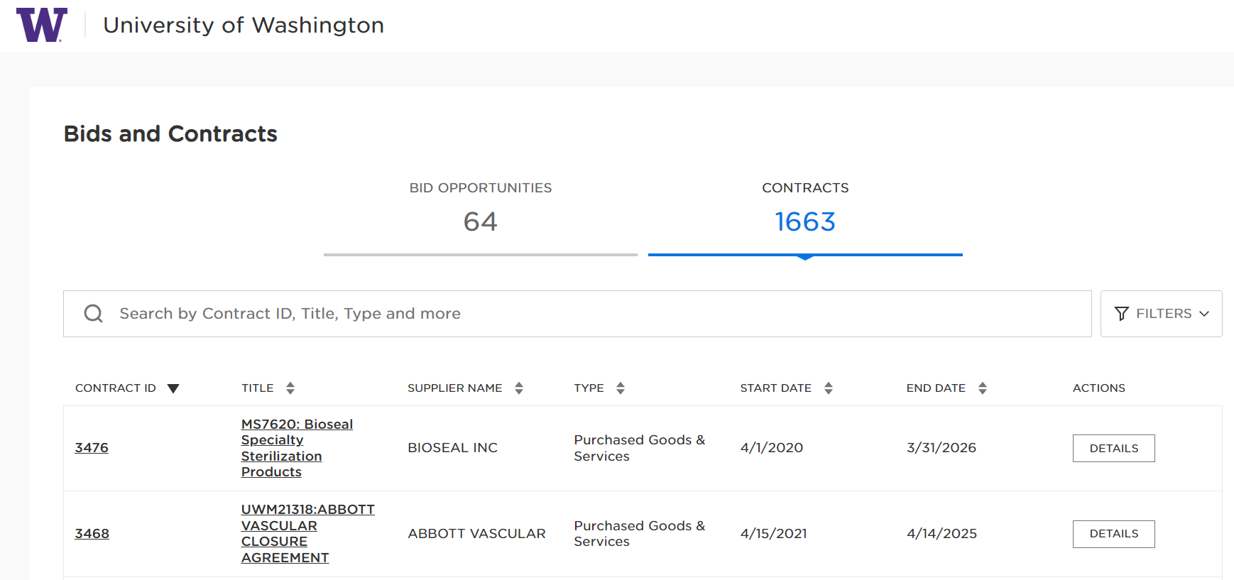
UW PUBLIC CONTRACT SEARCH PORTAL
The UW Public Contract Portal is the University’s open search website for both active posted public solicitations (bids) and Contracts.

Slide 16
COMPETITIVE SOLICITATION TYPES & TIMELINE
The most common types of competitive solicitations issued by Procurement Services Contract Managers are:
Request for Quotation (RFQ) – Solicitation is based mainly on price alone.
Request for Proposal (RFP) – Award(s) is not based on price alone and includes other important criteria that are evaluated to determine the best overall value to the UW. Multiple year, Master Contracts are usually created through the RFP process.
Below is a competitive solicitation timeline that displays the average amount of time it takes to conduct both solicitation types. For formal RFP’s in particular, planning in advance and involving a Procurement Services Contract Manager early in the process is crucial.
Informal Solicitation - Request for Quotation (RFQ)
$10k - $100K
Formal Solicitation - Request for Proposal (RFP)
> $100K
Immediate
7-10 Days
3-6 Weeks
> 3 Months

Slide 17
BUYING FROM CONTRACTS
Contracts are the easiest way to buy at the UW. Here are some of the benefits of using Contracts:
No competitive bid requirements
Established pricing and discounts
No sole source requirements
They can be used at any dollar amount
Terms and conditions are pre-negotiated
Contract Sales Representatives can provide assistance with:
Product selection
Installation
Training
Returns
Buying from a Contract provides the best overall value to the University and results in lower overall cost.

Slide 18

PLANNING BEFORE BUYING
By asking yourself these important questions before starting the procurement process, you can save time and money:
What exactly do I need?
Will the goods/services exceed the direct buy limit?
When do I need it?
What are the specific requirements?
Is what I want available in the Workday Catalog? If it isn’t, is there a Contract available?
Does the purchase qualify as a sole source?
Will I need to do a competitive solicitation?
Always make sure to communicate early with Procurement Services if you are not sure about any of the questions above.

Slide 19
RESOURCES
Subject Matter Experts: https://finance.uw.edu/ps/contact-us/subject-matter-experts
How to Buy: https://finance.uw.edu/ps/how-to-buy
Sole Source Justifications:: https://finance.uw.edu/ps/how-to-buy/sole-source-purchasing
Procurement Sole Source Justification web form::https://finance.uw.edu/ps/form/sole-source-justification
Sole Source Guidance and Example Job Aid: https://finance.uw.edu/ps/files/guidance-for-writing-sole-source-justifications.pdf
Competitive Solicitations: https://finance.uw.edu/ps/competition-guidelines-purchasing
Buying from Contracts: https://finance.uw.edu/ps/how-to-buy/buying-from-uw-contracts

Slide 20
QUESTIONS?

Slide 21
THANK YOU!

