Slide 1
Purchase Orders in Workday

Slide 2
PURCHASE ORDER PROCESS
Requisition requested through Workday
Requisition Approved
Purchase order sent to supplier
Supplier ships items/performs services
Supplier submits invoices
Invoices paid/viewable through Workday
You are here

Slide 3
Creating the Requisition - REMINDER
Selecting the Supplier
Selecting the correct supplier:
PO will be submitted to the incorrect supplier
Payment goes to incorrect supplier
Getting the funds back
Cancelling and creating RQ with correct supplier; you lose time

Slide 4
AGENDA
What is a Purchase Order?
Overview of Purchase Order Elements
Purchase Order Header Elements
Purchase Order Line Detail Elements
Managing your Purchase Orders
Troubleshooting

Slide 5
2 KEY TAKE AWAYS
Where to locate Elements of the PO
Recognize the Element and if management actions are needed

Slide 6
What is a Purchase Order?
Did you know?
A Purchase Order is not: an invoice payment request
A Purchase Order performs the following functions:
Internal documentation of budget, and compliance approvals
A commitment of funds to a supplier or entity to purchase goods/services
A legally binding contract that outlines the terms and conditions between the parties (UW and the Supplier)
An internal mechanism to manage your purchase.

Slide 7
Purchase Order Header Elements

Slide 8
Purchase Order Header Elements
LIVE PURCHASE ORDER: PO-0100094318
Purchase Order #
used for tracking, invoicing and identification of the order to the supplier
Purchase Order Version
Displays when there has been a purchase order change to the original PO.
Change Order Reason
Reason: short header of WHAT type of Change Order was processed
Comments: short description of WHY the change order was needed

Slide 9
Purchase Order Header Elements Continued
LIVE PURCHASE ORDER: PO-0100094318 & PO-0100083652
Purchase Order Status:
In Progress
Approved
Issued
Change Order in Progress
Closed
Cancelled
Invoice Status | Receiving Status:
indicates if invoicing or receiving have been performed

Slide 10
More Purchase Order Header Elements
LIVE PURCHASE ORDER: PO-0100083652
Issue Option: How the PO is issued to the supplier
Email
EDI/Auto
Print
Supplier PO Issue Email: Displays the email used to issue the PO to
Memo: Anything in this box will print on the face of the PO to the Supplier
Internal Memo: For internal use only, will not print on the face of the PO

Slide 11
Purchase Order Line Detail Elements

Slide 12
Purchase Order Line Detail Elements Information
LIVE PURCHASE ORDER: PO-0100094318 and PO-0100083652
Goods lines and Service lines
Spend Category - Determines routing, approvals, and taxability.
Tax options
Amount (Service Lines) / Quantity (Goods Lines)
Ordered ($ ordered or # ordered), Received (by unit) and Invoiced (by Supplier)
Business Documents Lines
RC # : Receipt Status (in process, draft, approved, cancelled)
RQ # : Requestion
SI # : Invoice (in process, draft, approved, cancelled)

Slide 13
Purchase Order Line Detail Elements Continued
LIVE PURCHASE ORDER: PO-0100094318 and PO-0100079624
Version History (PO-0100094318)
Prior Versions
Pending Versions
Process History - example (PO-0100079624)
Shows approval flow and awaiting Actions

Slide 14
More Purchase Order Line Detail Elements
LIVE PURCHASE ORDER: PO-0100079624
Attachments
Agreements
Approvals
Sole source
Printing Runs
PDF version of the PO sent to the supplier
Balances
Show the obligated amounts of the PO

Slide 15
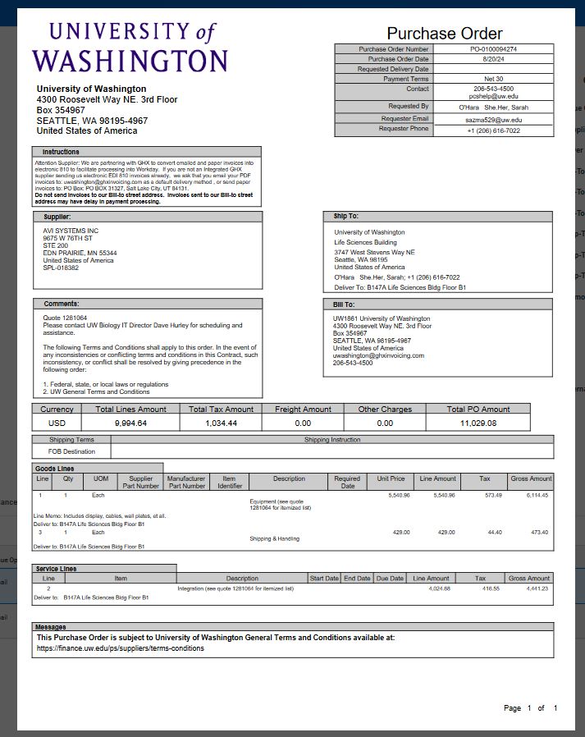
The PO Our Suppliers See
Boilerplate
Language how
to invoice via GHX
Memo Displays here
UW Terms &
Conditions on the PO
Line Memo: for supplier only

Slide 16
Live Demo – View PO in Workday

Slide 17
Manage Purchase Orders in Workday

Slide 18
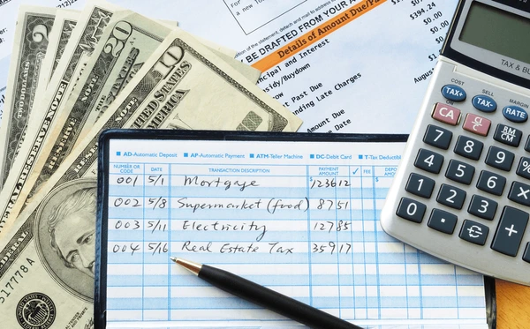
Purchase Order Management
Analogy: your Purchase Order is not only a contract – it is also similar to an account you write “checks” or debits (invoices/purchases) against.
When the PO is out of money, invoices cannot be paid (just like your own personal bank account)

Slide 19
Managing your Purchase Orders
The PO issued is your one stop shop for the procure-to-pay process.
Managing your PO is crucial to ensure everything goes smoothly in this process.

Slide 20

Managing your Purchase Order – Order and Invoices
Track the Order
Manage Supplier Invoices
Receive Goods/Services
Manage budget/funds
Click into your PO elements – blue text are links – Live example: PO-0100083652

Slide 21
Managing your Purchase Order – Wrap Up
Handle Discrepancies
Update Records
PO Closure
Analyze and Report

Slide 22
Managing your Purchase Orders – Why Important
Why is it important?
What is the impact?
Suppliers may stop work or operations; not just at your department, but across the University as a whole.
Operational shutdowns can impact research, classes, employment, and deadlines.
By actively managing your POs, you can ensure timeliness of deliveries/project completion, accurate/timely payments, and better overall procurement efficiency.

Slide 23
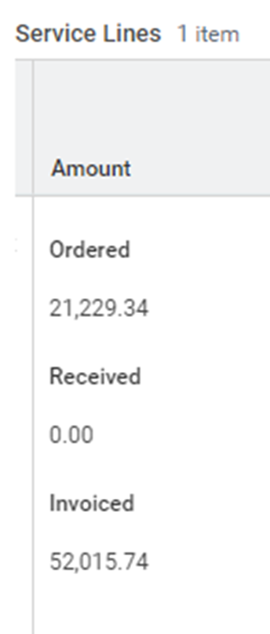
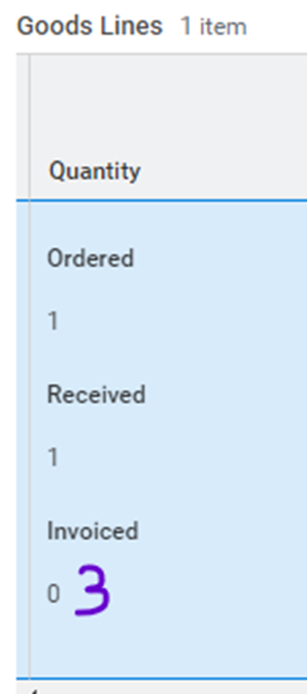


Example

Slide 24
Common Purchase Order Issues
Issue | Solution
Purchase Order is out of funds: Quantity/Amount Invoiced greater than Quantity/Amount Ordered | Submit Change PO
Quantity Received is zero (no receipt) | System Receiving by local Department/Unit
Purchase Order budget (Worktags) expired | Submit Change PO
Purchase Order with Goods Line instead of Service Line Unit of measure used: “Lump Sum” or “Lot” | Submit Change PO
Obligation Amount Remaining is not zero | Submit Close PO request

Slide 25
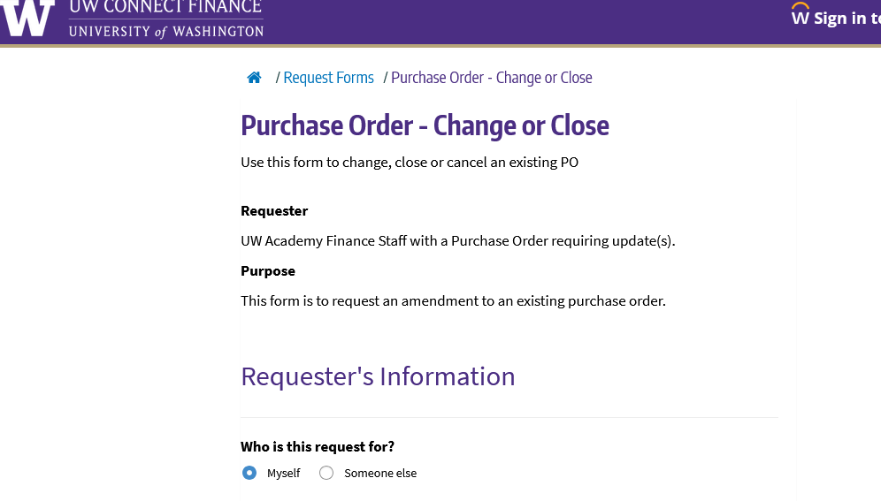
How do I update my Purchase Orders?
Purchase Order Change/Close form:
https://uwconnect.uw.edu/finance?id=sc_cat_item&sys_id=df0175731ba1b5d0cc990dc0604bcbed

Slide 26
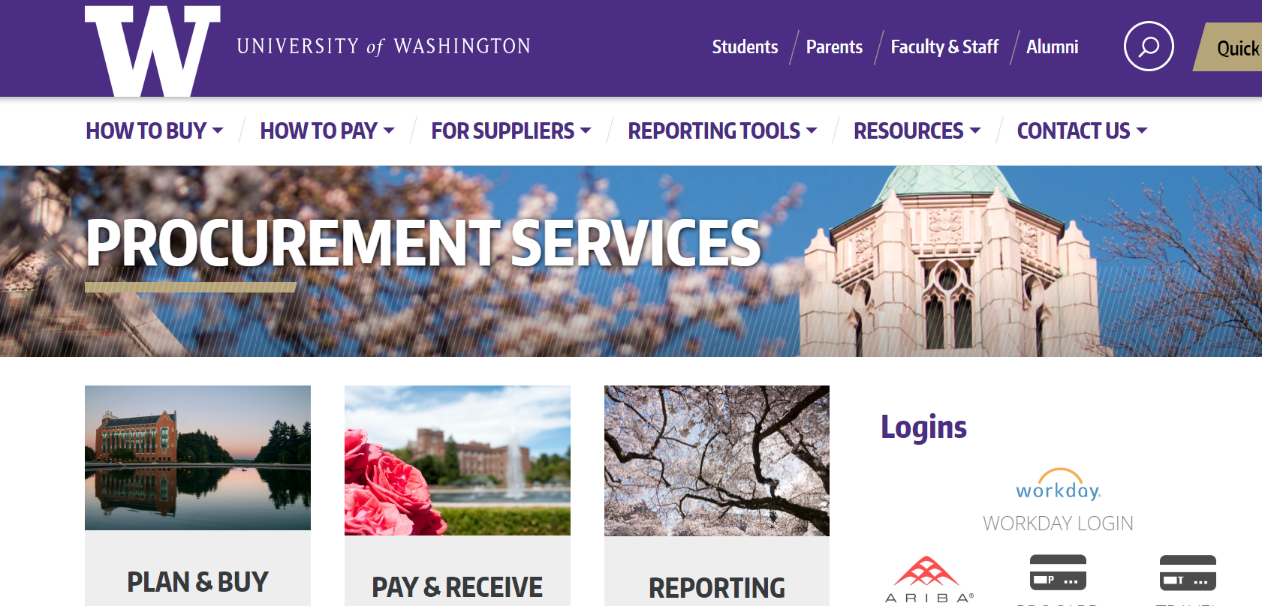
RESOURCES
Procurement Services Website:
How to Buy:
https://finance.uw.edu/ps/how-to-buy
How to Pay:
https://finance.uw.edu/ps/how-pay/invoicing
Workday Invoicing:
https://finance.uw.edu/ps/how-pay/invoicing
System Receiving:
https://finance.uw.edu/ps/how-to-pay/receiving
Procurement Resource List:
https://finance.uw.edu/ps/resources/resourcelist
Subject Matter Experts:
https://finance.uw.edu/ps/contact-us/subject-matter-experts
Reporting Tools:
https://finance.uw.edu/ps/reporting-tools

Slide 27
THANK YOU

