Slide 1
PROCUREMENT DEEP DIVE – UW Facilities Procurement

Slide 2
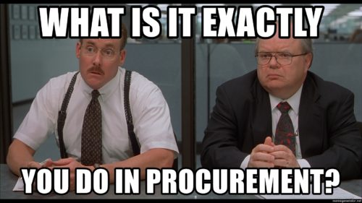
AGENDA
Who we are
Areas of expertise and support services
Campus Support
How Facilities Procurement helps campus
Helpful Hints

Slide 3
UW Facilities (UWF) Procurement
We are now part of the Procurement Services team within Financial Planning & Budgeting (FPB)
We provide specialized support to Facilities units, which in turn, support projects and operations across campus.

Slide 4
Team Members
Tricia Olsen Demarest
Associate Director
Brianna Divine
Senior Contracts Manager
Shirley Yang
Senior Contracts Manager
Michael Grumm Albert
Procurement Specialist
Bryan Kapski
Procurement Specialist

Slide 5
Areas of Expertise & Who We Support in Facilities
Real Estate
Asset Management
Operations
Campus Energy
Business IT
Finance

Slide 6
How Facilities Assists Campus
Day-to-Day Operations
Maintenance
Public Works: Renovations, Upgrades, New Buildings

Slide 7
Can my department …?
Hire an architect to redesign a space?
No.
Hire a contractor to remodel an office?
No.
Why?
Only UWF has the authority to contract for Public Works (construction) under Revised Code of Washington (RCW) 39.04 and Architect/Engineer (A/E) services under RCW 39.80.
Departments should never procure these services on their own.

Slide 8

Can the department …?
Hang a shelf by drilling into the wall?
No.
Paint a door?
No.
Reprogram the building AC?
No
Why?
Safety, Fire, Regulated Materials, Permits
Facilities Trade Shops must be given the first opportunity to perform the work.
Administrative Policy Statement (APS) 56.6 – Alterations to UW Seattle Campus Buildings and Grounds

Slide 9
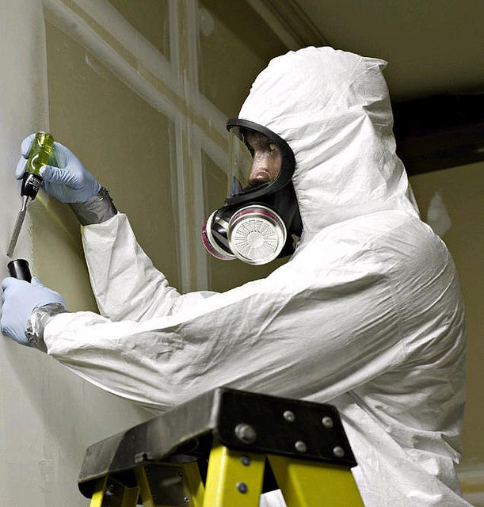
Did you know?
Many older UW buildings are
made of hazardous materials!
Departments that violate APS 56.6 and proceed to do their own work will be responsible for all costs associated with having work brought into compliance with UW standards.

Slide 10



How can my department …?
Request Maintenance
Life Threatening Emergencies Dial
9-1-1
Report a Problem
Start a Project

Slide 11
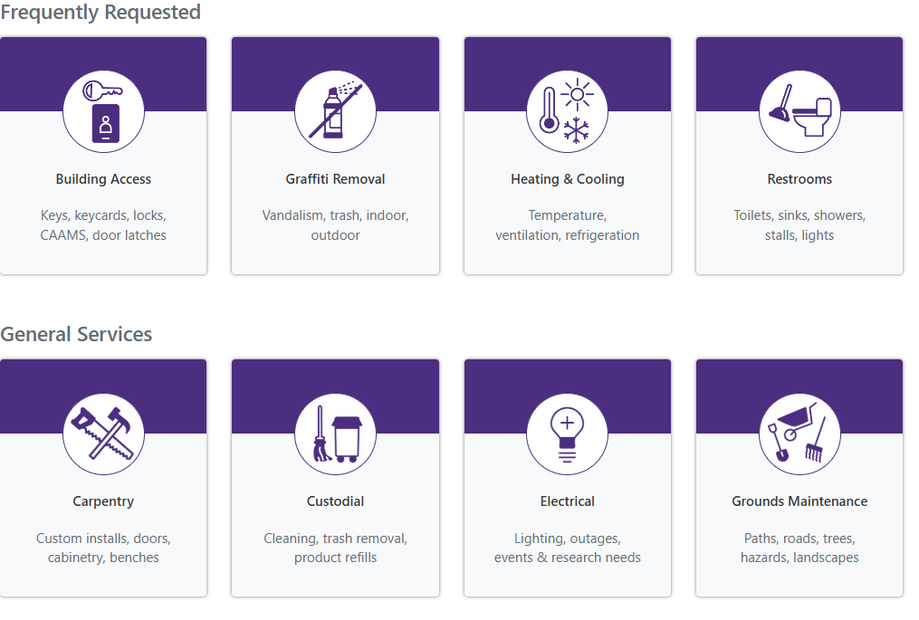
Always contact Customer Care First
Facilities.uw.edu
https://washington.assetworks.cloud/ready/

Slide 12
How we support Facilities
Supplier Relationships
Support Services for Customer Care Tickets
Sourcing Suppliers & Contracts
Compliance
Minimizing Risk
Managing Contracts
Negotiating Terms and Conditions
Resolve Billing Issues

Slide 13
Campus Support
Workday
Facilities Specialist Approval
Facilities Requisition Approval
Connect Tickets
Change & Close POs

Slide 14

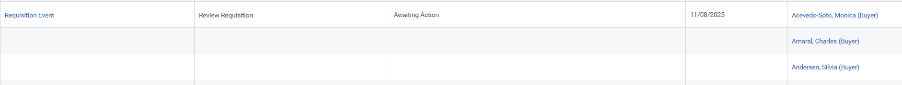
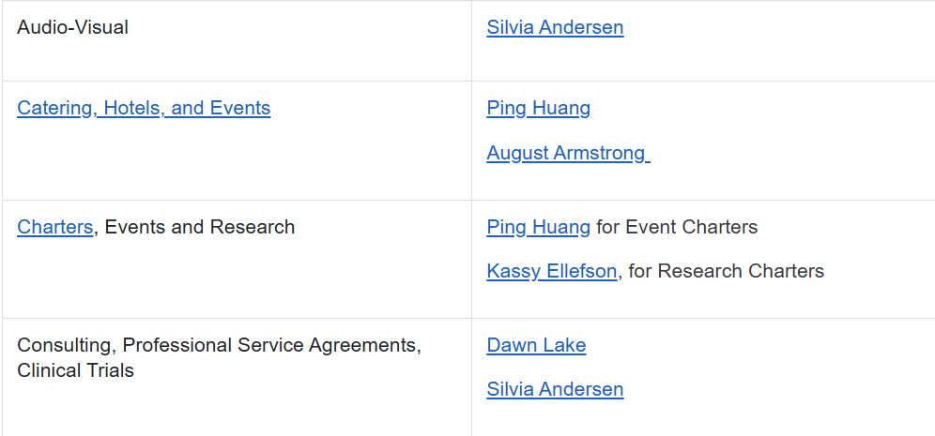
A Note about Workday RQ Approvals
The approver list is in alphabetical order; however not all approvers can approve all orders. Go to the Subject Matter Experts page on the Procurement Services webpage to find the correct approver for your commodity.
https://finance.uw.edu/ps/contact-us/subject-matter-experts

Slide 15

Find Contracts in UW’s Public Portal
https://finance.uw.edu/ps/
Contract Abbreviations
UWF = Facilities use only
ENT = Enterprise (everyone can use)
UWA = Academy use only
UWM (UW Medicine), UWMC (UW Medical Center), HMC (Harborview Medical Center), or starting with a number = Medical Center(s) use only

Slide 16
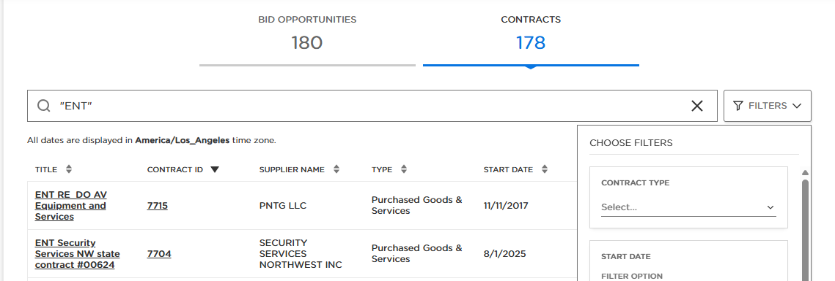
Finding Contracts in UW’s Public Portal
Click Contracts
Search by “ENT” for contracts campus can use or other search terms
Search for the full word (e.g., catering vs. cater)
Use the Filter to narrow results by Contract Type, Dates, or Supplier Name

Slide 17

Q & A

Slide 18

Thank you!

