Slide 1
WELCOME
University of Washington Supplier Orientation
Presentation will start at 10:30 am

Slide 2








Participants

Slide 3
Doing Business with the University of Washington
Goods and Services Contracting
Main Campus, Bothell and Tacoma
UW Medical Center Supply Chain

Slide 4
Agenda May 7, 2026
Welcome and Introductions
Please add your email in chat
Overview - Doing Business with:
University of Washington
UW Foster Business School
Academy
Medicine Supply Chain
State of Washington
Introduction to Other Resources:
Office of Minority and Women’s Business Enterprises
APEX Accelerator (formerly Washington PTAC)
Small Business Development Center

Slide 5
UW Statistics
The UW received more federal research dollars in FY25 than any other U.S. Public University.
One of the few universities in the U.S. with total research funding over one billion. $1.7 Billion
Since 1972, the UW has continued to receive more externally sponsored research funding than any other U.S. public university.
The University has locations in Seattle, Bothell, Tacoma and throughout the world.
Across all campuses and facilities: 60,400+ students and 4,300+ faculty
Notes:
Many of the federally funded contracts have small business spending goals. Federal contracts vs grants valued at $750,000 require a Small Business Subcontracting Plan and our office is responsible for developing these plans and identifying businesses to help achieve the goals.

Slide 6


Consulting & Business Development Center
Accelerating student careers and growing businesses in communities where they’re needed the most
Notes:
In this presentation we will cover how to use the Playbook and its content.

Slide 7
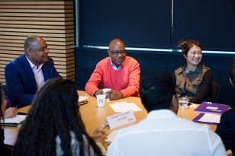
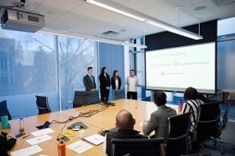
Mission and Goals
Center’s Mission:
Link students, faculty, and staff from the UW Foster
School with a racially and ethnically diverse business and nonprofit community to:
Expand students’ knowledge and skills
Help small businesses grow, create, and retain jobs
Open educational opportunities for URM students
Stimulate innovative economic development research
Goals:
Provide field-based learning experiences to Foster students while growing small businesses
Teach business owners cutting-edge techniques and business disciplines to improve firm competitiveness
Notes:
In this presentation we will cover how to use the Playbook and its content.

Slide 8
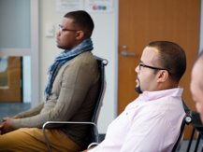
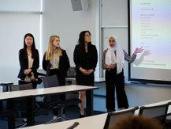

Student Consulting Programs
Business Management Consulting Program
Long-term strategic consulting, 6 to 7 month core program
Ideal for companies with $800K+ revenues, 3+ employees
Business Technology Consulting Program
5-month program providing technical assistance with technology integration
Sample projects include researching marketing platforms, new technologies, and cybersecurity
Summer Consulting Program
135 student consulting service hours
Quarter-long project
Outcomes and Highlights:
Field experience for students solving real-world problems
Positions students for successful consulting careers
1,000 companies served, $300M in revenue created
200K jobs retained
Notes:
In this presentation we will cover how to use the Playbook and its content.

Slide 9
Faculty-led Executive Education
Minority Business Executive Program
1-week residential executive education program
Supplier for Fortune 500 companies
Ascend Seattle (National Network)
5-month cohort-based business growth program
M3: Management Education, Market Access, Financing
Construction/A&E Industry
Notes:
In this presentation we will cover how to use the Playbook and its content.

Slide 10
Certificate Programs & Other Offerings
Yakima Business Certificate Program
6-week business certificate
Focus on leadership and strategy
Tribal Gaming & Hospitality Management Certificate Program
Management leadership development
Coursework: Marketing, Accounting, Finance, Management/Leadership
Lending to Underserved Communities
UW MBA students work with small businesses to gain access to business loans
Ethical Leadership
UW MBA students work with small businesses on consulting projects
Board Fellows (MBA/MPA Students)
Board leadership development
Notes:
In this presentation we will cover how to use the Playbook and its content.

Slide 11



Contact Us
Student Consulting Programs
Gabriela Michan, Associate Director, gmichan@uw.edu
Business Certificate Programs
Wil Tutol, Director of Programs, wtutol@uw.edu
Gabriela Michan, Associate Director, gmichan@uw.edu
Minority Business Executive Program
Wil Tutol, Director of Programs, wtutol@uw.edu
Ascend Seattle
Jonathan Orrala, Assistant Director, jorrala@uw.edu
Ascend National Programs
Mayte Manzo, Director of National Programs, mkmanzo@uw.edu
Lending to Underserved Communities
Amadou Loum, Director of WA Programs, amuloum@uw.edu
Board Fellows
Amina Bouayad, Assistant Director, abouayad@uw.edu
Follow Us Online!
Visit our website!
Notes:
In this presentation we will cover how to use the Playbook and its content.

Slide 12

Thank you

Slide 13
Introduction – UW Procurement Services
The University strives to create relationships with the supplier community which results in:
maximizing pricing & efficiency benefits to our campus departments,
meeting the University’s goals of environmental stewardship,
the creation of opportunities for small, diverse and local suppliers.
The University is committed to conducting a fair and open purchasing process for all suppliers while:
encouraging use of existing contracts.
following federal, state, and University rules and regulations.
Purchasing processes are based on state purchasing statutes, which require competition where possible.

Slide 14
What and How UW Purchases
What UW Buys
The University purchases many different types of goods and services, ranging from “one-off” equipment purchases, to consulting services, to purchases available from established University-wide (master) contracts.
Centralized Teams of Buyers & Contract Managers
With dedicated buyers for:
Housing & Food Services
UW IT
UW Medical Center IT
Tacoma Campus
UWMC Supply Chain
UW Facilities
Notes:
Note the variety of purchases and services – If you can imagine it, the University probably has purchased it. With locations around the world and locally, the diversity of products is staggering.

Slide 15
How Purchasing is Managed
Goods and Services Procurement at the University is managed by centralized procurement teams within the UW Academy and UW Medical Center, while:
Allowing departments the discretion to make purchases up to the direct buy threshold with prior approval of Procurement Services (with some exceptions).
Working directly with departments for purchases of $10,000 or more, not available through an existing contract that may require a formal solicitation, managed by the procurement team.
Utilizing State Contracts and contracts established by Group Purchasing Organizations (GPOs), or other public agencies, if desired.
Notes:
Unlike other state agencies, the University has some independent authorities that allow for flexibility due to the nature of the University. We are not required to use DES contracts, however we do use many of them. A distinction should be noted between UW Academy and UW Medical Center. Procurement for the Medical Center (includes, UWMC, NW Hospital, Airlift NW, UW Physicians, Neighborhood Clinics and alliances with Childrens and Fred Hutchinson)

Slide 16
The Solicitation Process
Please note that registration with WEBS is distinct and separate from the
UW Supplier Registration requirement.
Solicitation Process | Description of Process | Goods and Services
Direct Buy | Competition or justification for vendor selection is not required. Departments may place orders with supplier of choice within the direct buy limit without prior approval of Purchasing Services. Some exceptions may apply. | less than $10,000 including shipping and handling, and excluding tax)
Informal Competition | Procurement Services Buyer will issue an informal solicitation to qualified suppliers. Responses may be provided by telephone or in writing (email, fax, or U.S.. mail), depending on instructions from UW Buyer. If the solicitation is not advertised via Washington Electronic Business Solutions (WEBS) UW Procurement Service Buyer must include at least one minority and one woman owned business certified by the State Office of Minority and Woman Business Enterprise (OMWBE) in the solicitation process. (RCW 28B.10.029(c)(iii) | $10,000 to less than $100,000
Formal Competition | Procurement Services Buyer will issue a written solicitation and advertise via Washington Electronic Business Solutions (WEBS). Formal receipt process required. | $100,000 and greater
Notes:
This process applies across campus, including UWMC Supply Chain

Slide 17
Things to Keep in Mind
Departments may request quotations for purchases over the direct buy threshold for budgetary purposes only.
A formal solicitation may be required and will be coordinated by Procurement Services Contracting staff.
Don’t accept an order from a department if it is over the direct buy threshold (currently $10,000)
Departments are not authorized to sign contracts and are required to submit them to the procurement team for review.

Slide 18
Existing and New University Suppliers
New suppliers receiving first payment from UW
Maintaining Your Profile
Suppliers are expected to communicate with our central office to keep their company data current.
Changes to addresses and some information is easily communicated to Suppliers@uw.edu
Registered UW suppliers who are regularly paid by UW and have an address change or addition do NOT need to submit the Supplier Registration Form; suppliers should contact suppliers@uw.edu directly with a copy of their W-9 and explanation for the adjustment to addresses currently on file with UW.
Other company changes, such as business name or Taxpayer ID Number, require a new Supplier Registration Form (online Substitute W-9) to be submitted; see our UW Supplier Registration website for more information.
Suppliers were previously registered with UW but have had their information deleted due to lack of use for two years or more will be require a new registration to ensure companies details are current.
Suppliers that have a change in business name (including changes to DBA or Remit To names), ownership or taxpayer ID number
https://finance.uw.edu/ps/suppliers
Notes:
Critical information – Ask questions during the process – debriefs are an opportunity to learn

Slide 19
Workday Financial System Replaces Ariba
Transitioned from Ariba to Workday for ordering and sourcing on July 6, 2023
Multi-year process to implement a new financial system for the University including the Medical Center
Please view our Supplier Page for current updates about the System

Slide 20
Construction – Public Works
UW Facilities Project Delivery Group manages public works construction contracts with the support of UW Facilities Procurement and Sourcing.
All construction projects over $1M estimated cost require an Inclusion Plan or a Business Equity Contribution form detailing bidder’s approach to including diverse subcontractors and suppliers on projects.
All projects are posted on the UW Facilities home page and in the Seattle Daily Journal of Commerce and Workday Sourcing.
https://www.djc.com
https://facilities.uw.edu/projects/business-opportunities

Slide 21
UW Medicine and Component Units
UW Medicine is a Comprehensive Healthcare Organization that includes
Harborview Medical Center and its associated clinics (“HMC”);
Valley Medical Center (dba) Public Hospital District No. 1 and its associated clinics (“VMC”); - leaving UW Medicine in 2026
University of Washington Medical Center, operating at two separate campuses, Montlake and Northwest, and its associated clinics (“UWMC”)
UW Physicians Network dba UW Neighborhood Clinics (“UWNC”)
The Association of University Physicians dba UW Physicians (“UWP”)
University of Washington School of Medicine (“UW SoM”)
Airlift Northwest (“ALNW”)

Slide 22
UW Medicine
UW Medicine Supply Chain Role
Vizient is a Group Purchasing Organization (GPO) and the nation's leading health care performance improvement company utilized by UW Medicine. Serve more than half of the health care organizations across the United States – from large integrated delivery networks and academic medical centers to community hospitals, pediatric facilities, and non-acute care providers.
Liaison into UW Medicine Supply Chain and Vizient Contract opportunities.
Eddie Y. Smith
Contract Specialist
UW Medicine Supply Chain Management
cell 253-3592417 vm 206-598-0448
e-mail eys2@uw.edu

Slide 23
Sustainable Supplier Commitments
In support of the University of Washington Policy on Environmental Stewardship
Procurement Services encourages the purchase of environmentally friendly products that are made with post‐consumer recycled content, recyclable, energy efficient, and/or bio‐based products. In our commitment to support the purchase and use of such products, sustainability requirements shall be included in all University‐wide contract solicitations. Suppliers will be required, upon request, to provide within a reasonable timeframe, information to enable a life cycle assessment, including material sources, extraction, fabrication and transportation to assess their impact on the environment.
Suppliers are expected to adhere to the University’s Supplier Code of Conduct
Notes:
Sustainability is something on the top of mind for UW. When offering products, or promoting your business, focusing on how you support sustainability resonates on campus.

Slide 24
UW Policies
Gifts/Gratuities
UNIVERSITY EMPLOYEES MAY NOT ACCEPT ITEMS FOR PERSONAL USE (free lunch, coffee cards, gift certificates, T-shirts, etc.)
Giveaways for office use, pens, portfolios, lab products are acceptable when used in the office (UW Medicine restricts these items).
The University would prefer that suppliers offer special product promotions.
Trademarks/UW Logo Use
The Trademarks and Licensing Office administers the University's licensing program to control the commercial use of the University's name and registered trademarks.
Manufacturers of emblematic merchandise must obtain a licensing agreement to secure the rights to print the University's name or identifying marks on their products.
The licensing agreement requires products are manufactured in compliance to the University's Code of Conduct.
Notes:
Please keep this in mind - Currently there are 10 companies approved by Trademarks (based on an RFP process) that are authorized to sell promotional and branded products to University departments and organizations.
UW has a pool of pre-qualified/approved companies that can sell logo/branded products to UW departments.

Slide 25
UW Business Engagement
The University is committed to Diversity Equity & Inclusion in all aspects, particularly business and supplier diversity and has established an enterprise-wide team.
The passage of the Statement of Business Equity by the Board of Regents codifies these values in university policy, making it clear that business practices will be guided by a belief in inclusiveness and equity.
The UW Business Diversity & Equity team is made up of a multi-disciplinary group of procurement and business specialists that:
Facilitates connections between diverse businesses and opportunities on all 3 campuses across all procurement types.
Engages local diverse businesses regardless of state-certified and regardless of their gross revenues to maintain inclusive contracting and procurement practices.
Provides leadership in business equity and inclusion in a way that promotes opportunity, reflects transparency, and supports the economy of the state of Washington.
Seeks opportunities to be a catalyst for business development and growth
The University Campus Sustainability Action Plan includes goals related to diversity and inclusion in our contracting practices.

Slide 26
Doing business with the State of Washington
Shana Barehand, Business Diversity Marketing Manager Joe Norwood, Customer Service Representative (WEBS)
Contracts and Procurement Division

Slide 27
DES Contracting
Good and services contracting: DES oversees around 200 statewide contracts with more than 1,500 private vendors who provide more than $1.9 billion worth of goods and services each year. DES purchases over $100 million a year in goods and services for DES operations.
Public works contracting: Across the state, DES manages nearly 400 design and construction projects worth more than $290 million each year.
Notes:
Good and services contracting: DES oversees state master contracts with more than 1,200 private vendors who provide more than $1 billion worth of goods and services each year. DES purchases over $100 million a year in goods and services for DES operations.
Public works contracting: Across the state, DES manages nearly 400 design and construction projects worth more than $290 million each year.

Slide 28
What is WEBS you may ask?
“WEBS” is the acronym used for the “Washington’s Electronic Business Solution”. It is simply an electronic “bid system” where goods and services are procured by State agencies, non-profits, municipalities, educational institutions, tribal organizations, etc. On the other side of WEBS, you have the WEBS vendors or “suppliers” who provide the goods and services that are procured by the “Government Customers”. A match is made by the use of commodity codes that are used in WEBS.
Notes:
“WEBS” is the acronym used for the “Washington’s Electronic Business Solution”. It is simply an electronic “bid system” where goods and services are procured by State agencies, non-profits, municipalities, tribal organizations, etc. On the other side of WEBS, you have the WEBS vendor accounts or “suppliers” who provide the goods and services that are procured by the “Government Customers”. A match is made by the use of commodity codes that are used in WEBS.

Slide 29
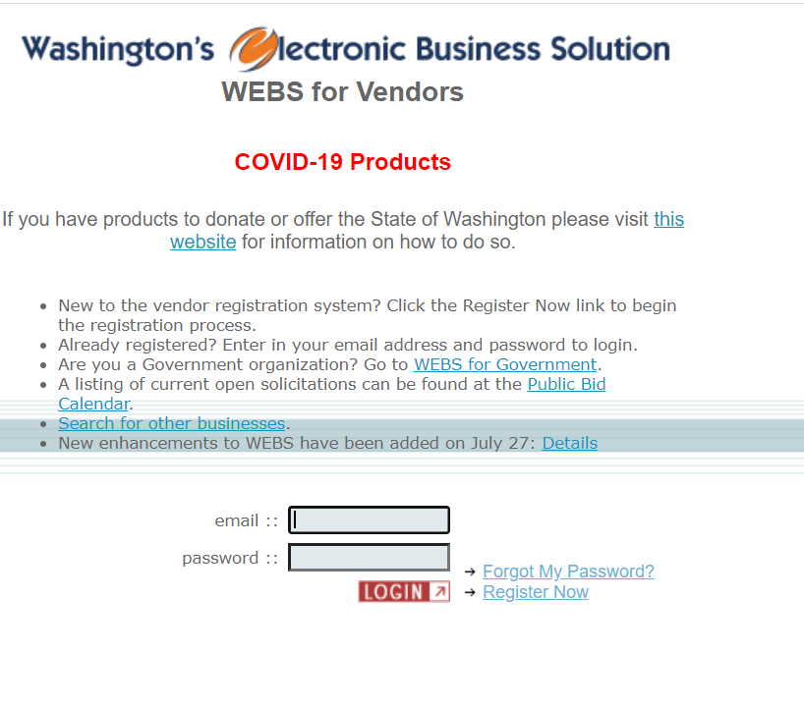
We are here to help
WEBS Customer Service
(360) 902-7400
WebsCustomerService@des.wa.gov
joe.norwood@des.wa.gov
Shana.barehand@des.wa.gov
WEBS Registration Link
Notes:
Contact our customer service team with all things WEBS
Our team is also a great resource for our division, central contact, and quick responses

Slide 30
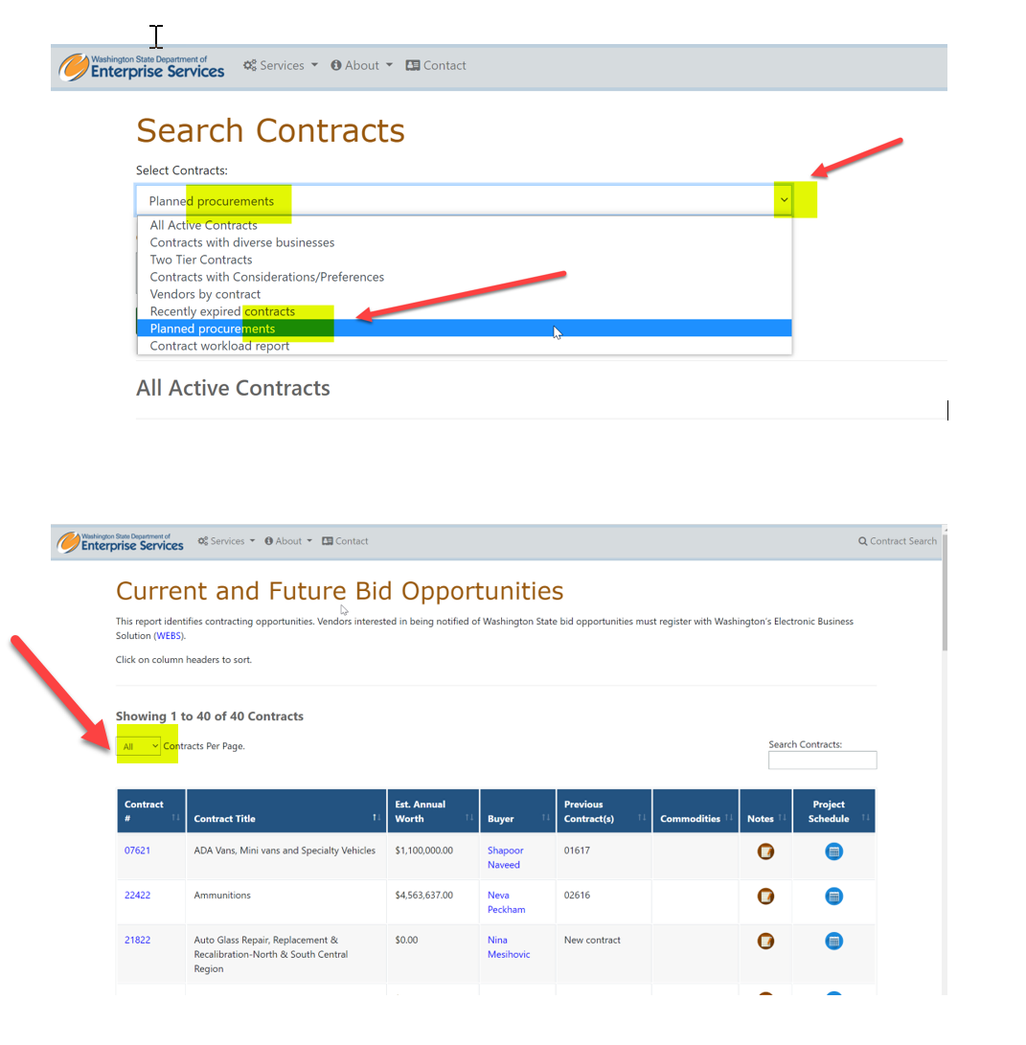
Planned Procurements
We post this process publicly
We list anticipated dates and duration of each phase
Transparency
Statewide Contracts: Planned Procurements
https://apps.des.wa.gov/DESContracts/Home/PlannedProcurement
Agency Contracts: Forecasts
Public Works: Forecasts
Notes:
I’ve included the links to our planned procurement page that shows where we are in the process and our agency forecasts.
This is listed for master contracts, those centralized contracts. Our DES goods and services contracts. Our public works division also posts forecasts. This happens with the state capital budget, versus continuous like master contracts.

Slide 31
Contact US
Public Works, Facilities, Leasing
(360) 407-2220
FacilitiesandLeasing@des.wa.gov
Contracting & Purchasing
(360) 407-2210
ContractingandPurchasing@des.wa.gov
WEBS Customer Service
(360) 902-7400
webscustomerservice@des.wa.gov
Enterprise Policy
(360) 407-2210
DESmiEnterpriseProcurementPolicy@des.wa.gov

Slide 32

INTRODUCTION TO CERTIFICATION

Slide 33


ABOUT US
Will Pina, Certification Supervisor
Sherif Azab, Outreach Specialist

Slide 34

OMWBE Purpose
To be a vital and trusted resource for businesses owned by minorities, women and other under-represented communities to gain access to state contracting and procurement opportunities.
We work to promote equity in how Washington State spends its resources in the private sector by eliminating barriers to equitable participation in public spending and contracting.

Slide 35
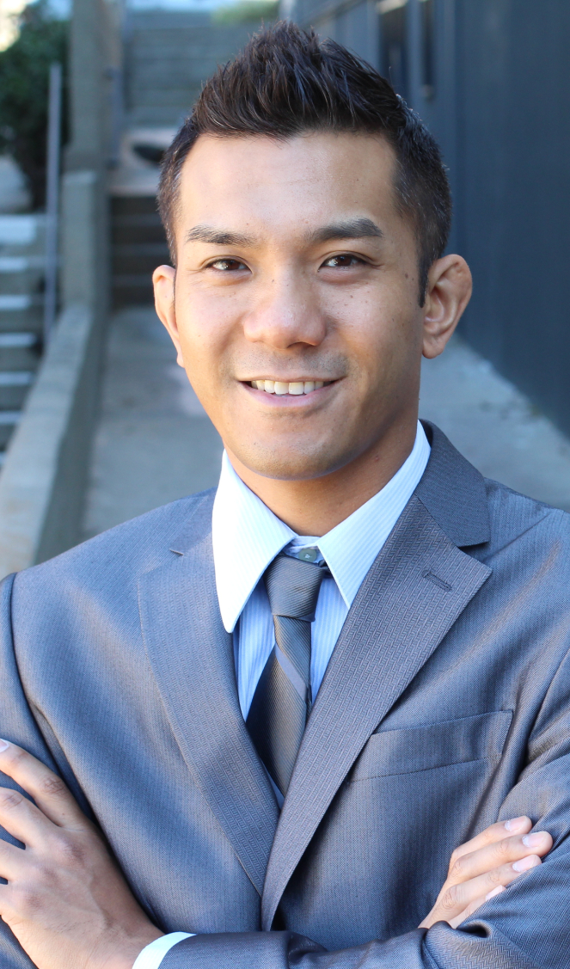
WHAT IS
Certification?
State certification is a program of Washington state
Federal certification is a program of US Department of Transportation
OMWBE certifies businesses to increase contracting opportunities with state and local government
We are the sole certifying agency in Washington state

Slide 36


WHY Certification Matters
Opportunity
State agencies, educational institutions, and local governments may have diverse spend goals
Be seen
Increase your visibility for those seeking diverse businesses
Promote participation
Your work contributes to diverse spend goals

Slide 37

CERTIFICATION
Eligibility
BUSINESS
Business is for-profit
Licensed to do business in Washington State
Gross receipts under $30.72 million (3-year average)
BUSINESS OWNER
Woman or minority owned
At least 51% ownership
Show financial investment of capital or expertise
Need to have knowledge/experience in the field seeking certification in
Final decision-making authority
Personal Net Worth of owner is under $2.047 million

Slide 38
CERTIFICATION Types
FEDERAL CERTIFICATION
STATE CERTIFICATION
Minority Business Enterprise (MBE)
Minority Woman Business
Enterprise (MWBE)
Woman Business Enterprise (WBE)
Combination Business
Enterprise (CBE)
Socially and Economically Disadvantaged Business Enterprise (SEDBE)
Public Works Small Business Enterprise (PWSBE)
Disadvantaged Business
Enterprise (DBE)
Airport Concession Disadvantaged
Business Enterprise (ACDBE)
Small Business Enterprise (SBE)

Slide 39

TYPES OF
Documents
Affidavit of Certification
Personal and Business Taxes (3 Years, 5 Years)
Personal Net Worth Statement
Business Formation and Operating Documents
Resume(s)
Proof of Initial Investment
List of Equipment

Slide 40

Application Process Time
Application Process Time
UP TO
90 DAYS FOR
FEDERAL
CERTIFICATION
*Federal Certification Requires an Onsite Visit
UP TO
60 DAYS FOR
STATE
CERTIFICATION

Slide 41


OMWBE is Waiving
Certification Fees

Slide 42

CERTIFICATION
Application
Where do I start my certification application?
CREATE AN ACCOUNT ON THE CERTIFICATION PORTAL
Visit omwbe.diversitycompliance.com
“Apply For / Renew Certification” | “Create Account”
If you want both State and Federal certifications → Start with Federal and select State when it prompts you
You can start and application and save it to finish it later. It does not need to be completed in one sitting.

Slide 43


LINKED
Deposit
The Linked Deposit Program helps to make borrowing capital more affordable for state certified businesses
State-certified businesses who borrow with a participating lender
Business-related loans up to $1 million dollars are eligible to apply to enroll
Receive an interest rate reduction of up to 2%
Notes:
Department of Commerce is a partner in this program.

Slide 44

Q & A
Thank You!
Certification Application Questions
Email: TechnicalAssistance@omwbe.wa.gov
Phone: (360) 664-9750
Office of Minority & Women’s Business Enterprises
1110 Capitol Way S #150, Olympia, WA 98501
Phone: (360) 664-9750 | omwbe.wa.gov

Slide 45


APEX Accelerator Outreach & Training
What are APEX Accelerators…….
……and how can APEX Accelerators help?
APEX Accelerator
Green River College
Serving King and Pierce Counties
Darrell Sundell
Melinda Martirosian
APEX Business Advisors

Slide 46
APEX Accelerator
The mission of the APEX Accelerator is to maximize the number of capable companies successfully participating in the government marketplace.
We provide technical assistance and training to help clients prepare for, find, respond to, and perform on government contracting opportunities.
Delivered through:
One-on-one Counseling
Classes and Workshops
Networking events
Web-based Bid-Match Service

Slide 47
APEX Accelerator Assistance Includes
Providing education on government contracting
Assisting with registrations and certifications
Providing guidance on preparing for contracting opportunities
Reviewing marketing materials and strategies
Assisting with locating bid opportunities
Helping to understand the rules and regulations
Helping to interpret solicitations and determine bid readiness
Reviewing client responses to IFBs, RFQs, RFQQs and RFPs
Hosting matchmaking sessions for small businesses with agencies and prime contractors
Providing post-award assistance

Slide 48
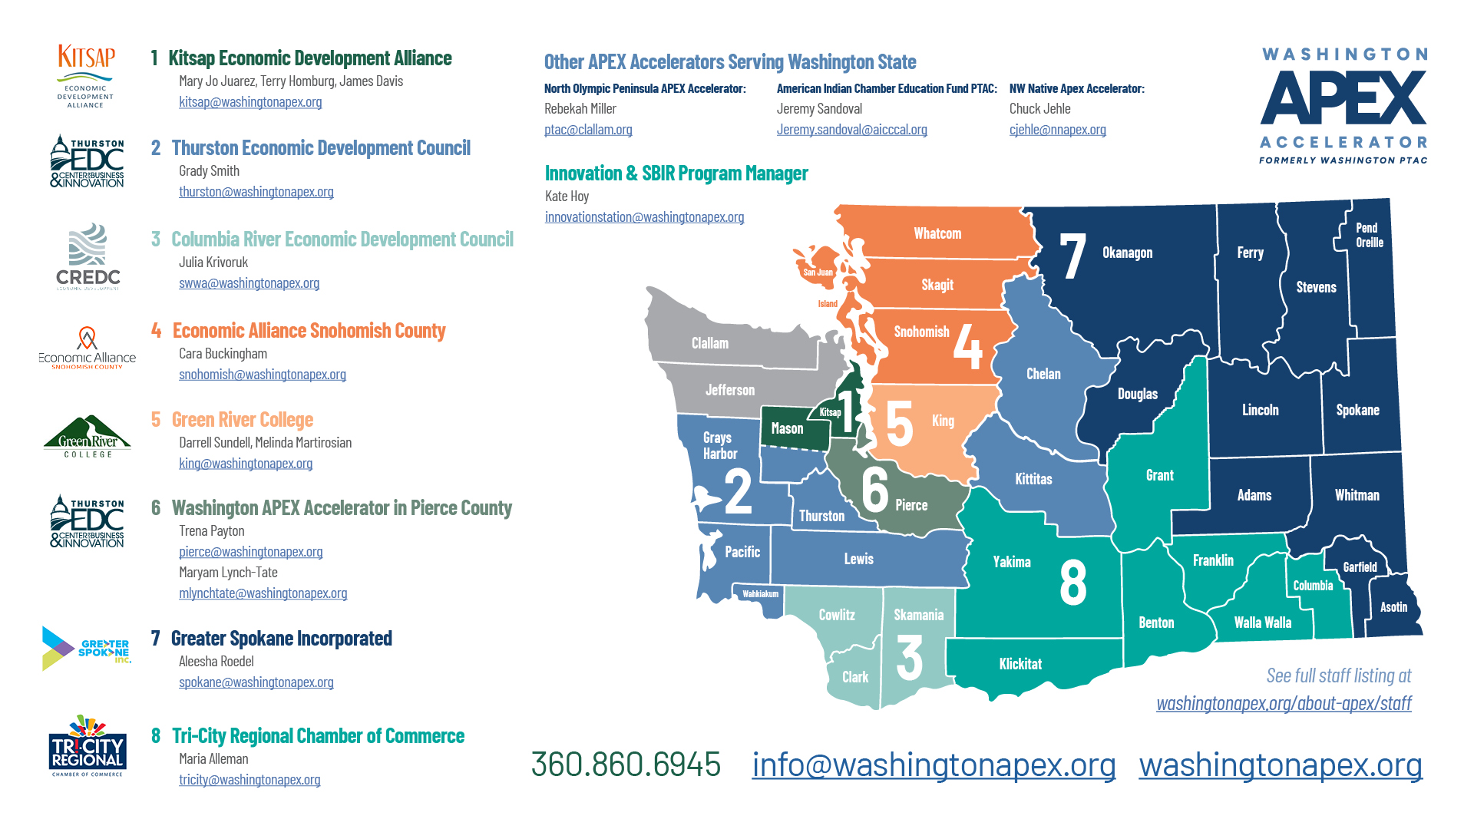
APEX ACCELERATOR LOCATIONS
www.washingtonapex.org

Slide 49
APEX Accelerator is Here to Help!
One-on-one Counseling
Classes and Workshops
Web-based Bid-Match Service
Matchmaking with government agencies and primes
Questions? dsundell@greenriver.edu
mmartirosian@greenriver.edu
www.washingtonapex.org 253-520-6284

Slide 50
About the Washington Small Business Development Center
2026

Slide 51
Washington SBDC
No-cost services:
One-on-one business advising that is tailored, objective, and confidential
Market research
Referrals to resources and experts
Guidance on every stage of business development for any industry. Topics include:
Business/Marketing Plan
Buy/Sell a Business
Cash Flow
Exporting
Financing
Financial Analysis
HR Issues
Operations Efficiency
Pricing & Profitability
Sales & CRM
Tech Commercialization
Turnaround
Notes:
We provide no cost 1:1, confidential, objective, expert advising to help you make informed decisions on your business across a spectrum of specialty areas. We also provide no or low-cost management training, market intelligence, and access to resources.

Slide 52
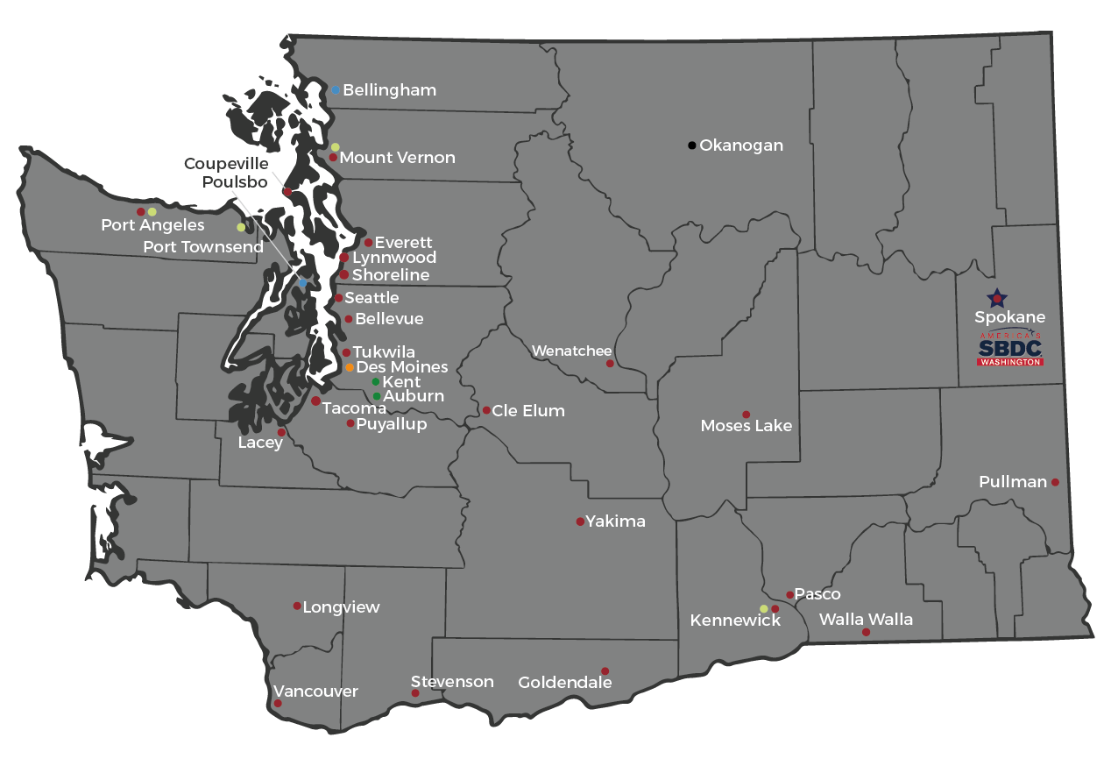

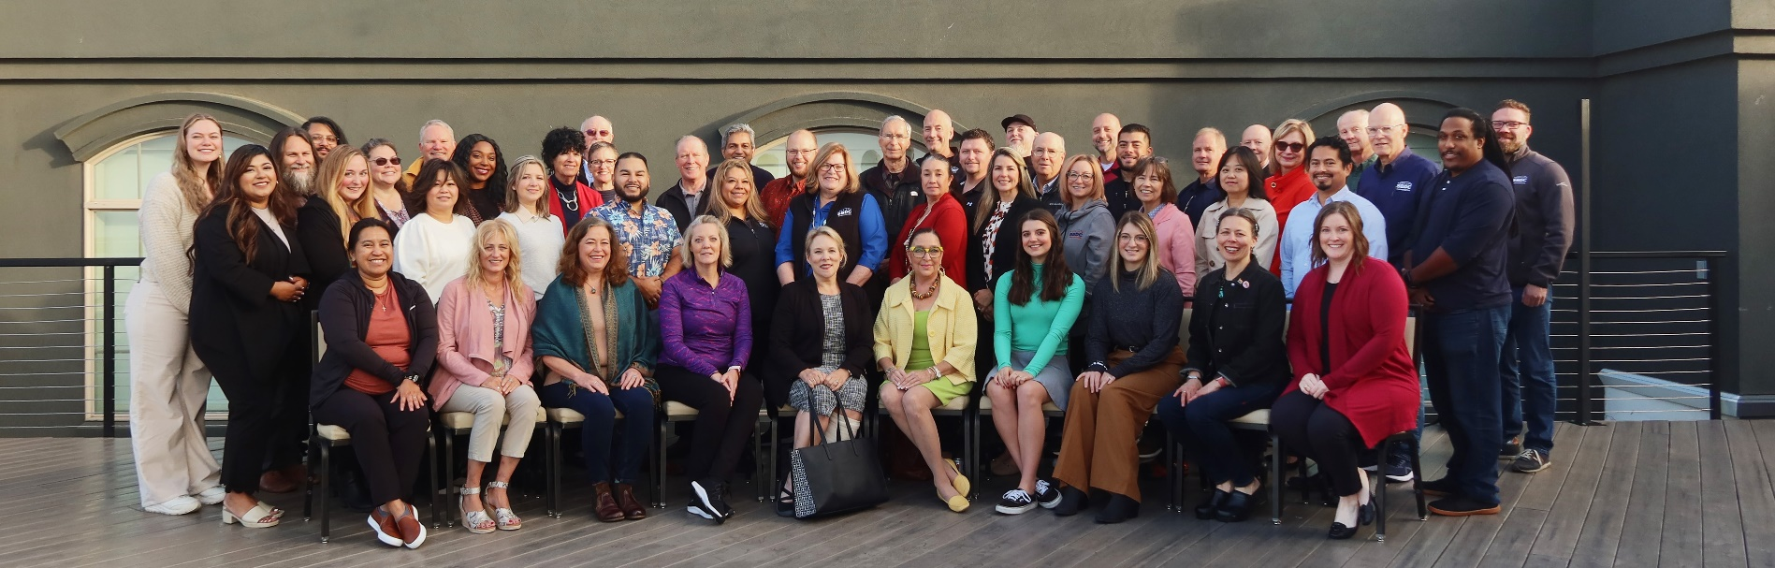
Statewide Network
Together…we help Washington businesses grow & succeed
Notes:
We are a highly collaborative statewide network supported by the Lead Center in Spokane with various services, licensing tools, training and resources.
Every client that we serve has access to over 40+ advisors with years of experience and knowledge that spans every industry and phase of business operation.
If I don’t have the expertise you need, we can bring in someone from the Network that has that specialty or knowledge.

Slide 53
SBDC vs Other Services
Network of 40+ full-time advisors from diverse industries
Extensive small business ownership or management experience qualifications
In-house market research team
International trade advising
Aligned success metrics
Notes:
Full-time network of advisors
Certified Business Advisor process (6-month process)
Previous small business ownership or management experience
MBA or equivalent & continuing education requirements (32 hours/year)
Outcome orientation – client/stakeholder focus
America’s SBDC Accreditation review
External financial and programmatic audits

Slide 54
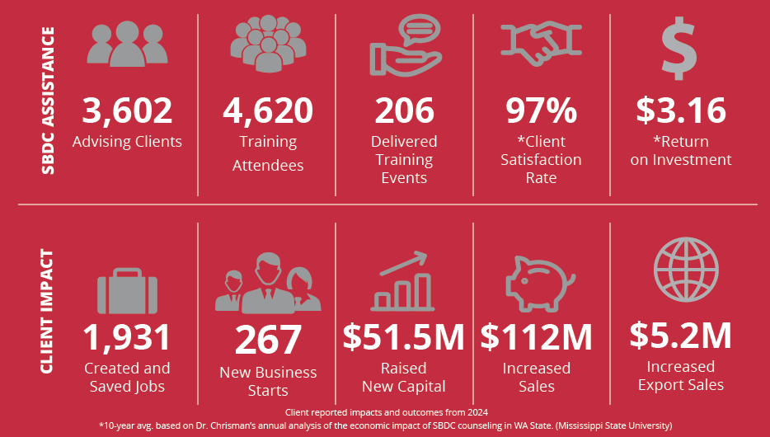
Economic Impact (How We are Measured & Funded) 2024 by the Numbers
Notes:
We are measured on specific measured on specific metrics such as business starts, jobs created, increased revenue, raised capital at an aggregate level.
These metrics cannot be self-reported, in order to count it needs to be reported by clients directly via emails or surveys that you respond to with specific data.
All your details are confidential, but we aggregate the numbers.
It’s key that this happens as without it, our funding and services get cut.
Do you agree to do this for us when you get the surveys?

Slide 55

Seattle SBDC: Supo Techagumthorn
15+ years in the restaurant industry at his family’s Thai restaurant, Chili Basil in Lynnwood, WA
7+ years of small business advising as the founder of a tech consulting firm, called Sidekick, and as the small business technology coach at Ventures Nonprofit
10 years in residential and commercial real estate, representing clients in the Greater Seattle Area
Conversationally fluent in Thai
Graduated from UW’s Foster School of Business
Current community involvements include the Good Business Network of Washington (formerly, the Seattle Good Business Network) and the Seattle Hub of the Global Shapers Program at the World Economic Forum

Slide 56
www.WSBDC.org
Supo Techagumthorn
Seattle SBDC
supo@wsu.edu
Notes:
Next steps: Interested attendees can send me an email to register as a client for our services

Slide 57
Upcoming Events
Association of Women and Minority Businesses
Monthly Meeting - 2nd Wednesday of every month
4:00pm-5:30pm via Zoom - visit: https://awmbwa.org/
UW Supplier Orientation
Monthly- 10:30am-12:00pm
Please register though Eventbrite
Central Washington Regional Contracting Forum – Yakima Convention Center – September 3, 2026 – Registration link #https://omwbe.wa.gov/about/events/central-regional-contracting-forumRCFregister2026 #YakimaWA #ContractingOpportunities

Slide 58
University Contacts
Academy Procurement Services - Goods and Services
Kassy Ellefson ellefson@uw.edu / Scientific
Claudia Christensen claudiac@uw.edu /Furniture - Small Business Administrator
Robert Hardie / bhardie@uw.edu/ – Tacoma Campus
Chao Huang / choung21@uw.edu/ - Bothell Campus
Ping Huang /pinghuang@uw.edu – Catering and Conferences
Dawn Lake dawnlake@uw.edu / Consulting – Professional Services
Silvia Andersen/ silvif@uw.edu- Audio Visual – IT Consulting
Ben Cory bcory@uw.edu/ - IT and Software
Kassy Ellefson/Claudia Christensen- Office, Janitorial, Laundry and Maintenance
Graham Sherwood grams@uw.edu / Housing & Food Services
uwfbuy@uw.edu - work that affect UW buildings or infrastructure, including maintenance, repairs, alterations, or installations involving trade labor.
UW Medicine Procurement – IT Purchases
Lisa Walton lw225@uw.edu
UW Medicine Procurement – Supply Chain
Eddie Smith eys2@uw.edu
UW Facilities - Construction
Monica Acevedo-Soto / monica25@uw.edu/ Trica Olsen Demarest / triciaod@uw.edu
Angela Jones / ajones77@uw.edu – BDE Coordinator
UW Foster School Consulting and Business Development Center
Wil Tutol wtutol@uw.edu / Gabriela Michan gmichan@uw.edu

Slide 59
UW Internal Supplier Business Directory
Register to join the university’s internal supplier business directory (powered by Supplier.io). Supplier.io is an advanced business directory data platform designed to help organizations identify and monitor diverse suppliers.
University of Washington buyers and internal partners leverage this system to enhance spend initiatives and use the internal database when seeking businesses for work. The UW supplier business directory is open to all businesses interested in opportunities with the university. Small, veteran-owned, disadvantaged businesses, may register in the database, and provide evidence of their certification status (if applicable).
Register at: https://universityofwashington.supplierone.co/

Slide 60
University Workday Strategic Sourcing
Some University solicitations are managed electronically through Workday and information about how to respond to solicitations in Workday will be included in the publication posted in WEBS. There is no fee for using Workday to respond to solicitations.
To view open solicitations posted in Workday visit: https://university-of-washington.public-portal.us.workdayspend.com
Workday Strategic Sourcing Supplier Account Set-up Guidance
https://doc.workday.com/user-guide/en-us/strategic-sourcing/supplier-account-setup/gnj1594911610346.html

Slide 61
City of Seattle – The Liberty Project
Achieving equitable growth of Black and African-American-owned businesses
The Liberty Project Seattle collaborates with The City of Seattle, Tabor 100, the Consulting and Business Development Center at the University of Washington Foster School of Business, and the Business Foundry at Seattle University’s Albers School of Business and Economics to support the growth of Black and African-American-owned businesses in Seattle, aiming for equitable representation. Their services encompass technical assistance and business development, with applications directed to anchor partners for tailored support. Please sign here up if this could be beneficial to you.
PORT OF SEATTLE CONTRACTING
Yared Belete, Diversity Contracting Coordinator
Belete.Y@portseattle.org
(206) 512-5548

Slide 62
Additional Resources
Washington’s Electronic Business Solution (WEBS ): The University and other agencies post solicitations on this site.
System for Award Management (SAM): Register to do business with the Federal Government – the University uses this site to identify potential suppliers.
State of Washington Office of Minority and Women Business Enterprises (OMWBE). Certifies small businesses owned and controlled by minority, women, and socially economically disadvantaged persons.
Small Business Administration: Register to receive news, information and tools to help your business.
Washington Apex Accelerator (formerly Washington PTAC): Mission is to maximize the number of capable U.S. companies participating in the government marketplace by offering technical assistance.
FedBiz Ops: Central website where federal agencies post procurement opportunities with a value of at least $25,000. FBO.gov has been moved to beta.SAM.gov and is now known as Contract Opportunities.
Governor’s Office for Regulatory Innovation and Assistance: Provides tools to help plan start or grow your business in Washington State.
GSA Schedules: Under the Schedules Program, businesses sell their commercial goods and services directly to government agencies. GSA works with businesses to ensure they are compliant with basic federal regulations and policies and offer goods and services at fair and reasonable prices. State and local governments including the University can buy technology, security, fire and law enforcement goods and services via GSA Multiple Award Schedules (MAS) formerly Schedules 70 and 84.
Vizient: Establishes and manages contracts on behalf of members.
Register for opportunities at https://www.vizientinc.com/suppliers

Slide 63
THANK YOU FOR ATTENDING
UW Foster School | UW Procurement | UW Medical Center | State Department of Enterprise Services DES and OMWBE | Washington APEX Accelerator | Small Business Development Center - SBDC
Wil Tutol wilturol@uw.edu | Dawn Lake dawnlake@uw.edu | Eddie Smith sys2@uw.edu | Joe Norwood -joe.Norwood@des.wa.gov | Melinda Martirosian mmartirosian@greenriver.edu | Supo Techagumthorn supo@wsu.edu
Gabriela Michan gmichan@uw.edu | Linda Moran imherelm@uw.edu |  | Shana Barehand shana.barehand@ des.wa.gov | Darrell Sundell dsundell@greenriver.edu | Giselle Saquid giselle.saquid@wsu.edu
 | Claudia Christensen claudiac@uw.edu |  | DES Procurement contractingandpurchasing@des.gov
 |  |  | DES Diversity and Inclusion: Kim Sauer / C&P Business Diversity Program Manager kim.sauer@des.wa.gov

