Slide 1
Requisitions

Slide 2
AGENDA
WHAT TO KNOW BEFORE YOU BEGIN
CATALOG REQUISITION
NON-CATALOG REQUISITIONS
OTHER REQUISITION CONSIDERATIONS

Slide 3
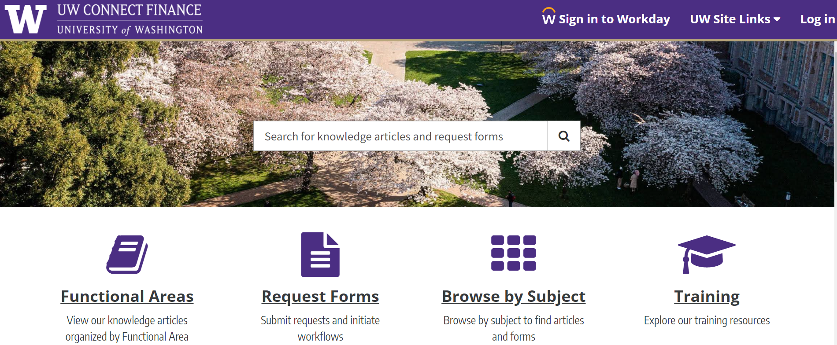
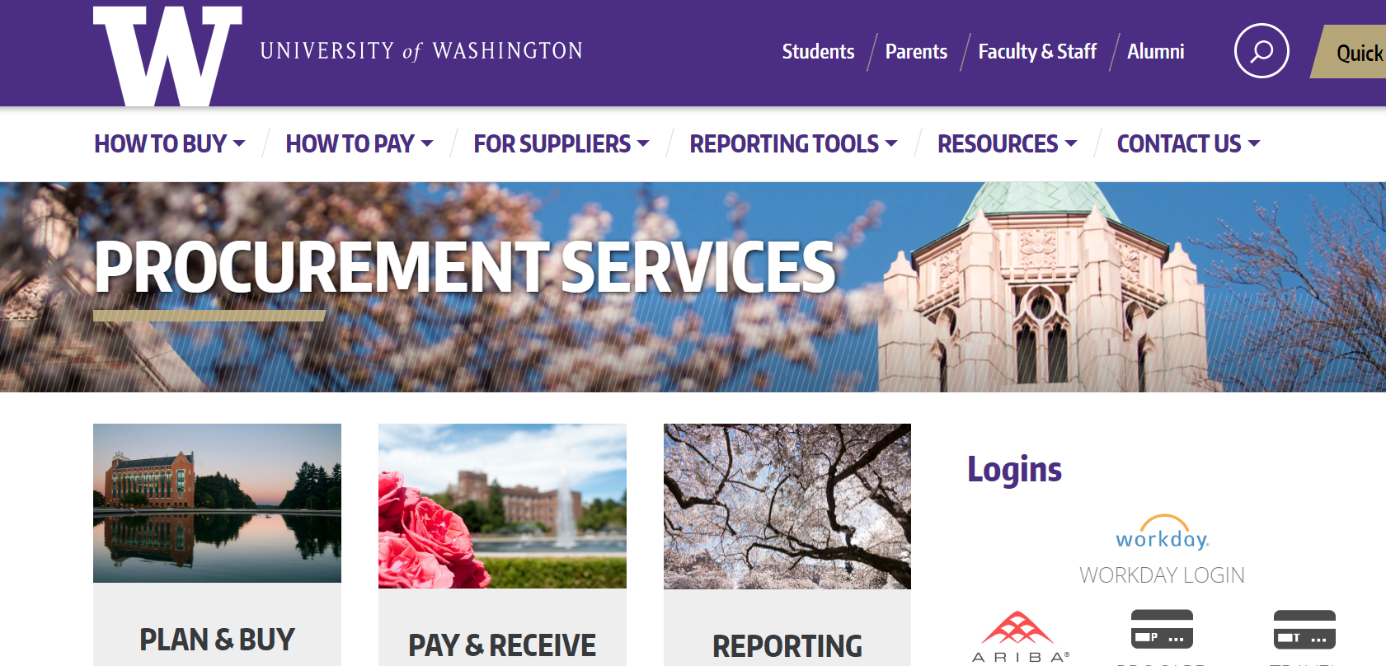
RESOURCES
UW Connect Finance Portal:
How to Create a Non-Catalog Requisition (UWA)
How to Create Requisitions for Catalog Suppliers (UWA
Procurement Services Website:
How to Buy
Workday Requisitions

Slide 4
WHAT TO KNOW BEFORE YOU BEGIN

Slide 5
REQUISITION PROCESS
Requisition requested through Workday
Requisition Approved
Purchase order sent to supplier
Supplier ships items/performs services
Supplier submits invoices
Invoices paid/viewable through Workday

Slide 6
REQUISITION ACCESS
For requisition entry: the "Requisition Requester" security role in Workday. This role allows a user to create requisitions and will also be the role that allows for receiving, if receiving is required for incoming invoices.
For approvals: Any individuals that need to approve requisitions will need to be set up as funding approvers in Workday.
  Examples: Cost Center Manager and Grant Manager.

Slide 7
REQUISITION TYPES
Requisition Type | Description
Goods and Services | Primary requisition type to order general goods and services. Commonly used for catalog orders and non-catalog orders for goods.
Blanket Request | An agreement between a supplier and an organization that outlines pricing and terms that can be used over time for orders to be placed against. Will involve multiple billings and start and end services dates.
Capital Asset Request | This Requisition Type is used to purchase Capital Assets (items with a useful life > 1 year and a total cost >= $5,000 including ancillary costs) and all weapons and accessories, regardless of cost. Per UW Policy these must be tracked in Workday. Visit the Equipment Inventory Office web page for more information on this requisition type and to learn about the “Trackable Spend Categories” which must be used with this requisition type to identify capital equipment.
Construction - Capital Projects | Request to purchase materials needed for a specific capital construction project
Multi-Component Capital Asset Request | This is the Requisition Type used when purchasing multiple components/parts that need to be combined to create one functioning piece of equipment. When the components are combined, they must have a total cost >= $5,000 including ancillary costs and a useful life > 1 year. Visit the Equipment Inventory Office web page for more information on this requisition type and to learn about the “Trackable Spend Categories” which must be used with this requisition type to identify capital equipment.

Slide 8
CATALOG REQUISITIONS

Slide 9
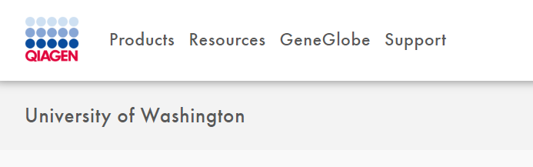
CATALOGS
17 catalogs for Goods and Services available for UWA to purchase through Workday
Catalogs are based on UW contracts which have established pricing, terms and discounts designed to offer best overall value to UW.
Catalogs are accessed through Workday and GHX

Slide 10
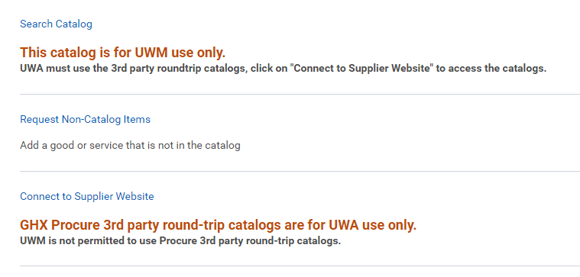
Select the Supplier Website option

Slide 11



CATALOG SUPPLIERS
Tip: Some catalogs have an “Order Status” option to track your order

Slide 12
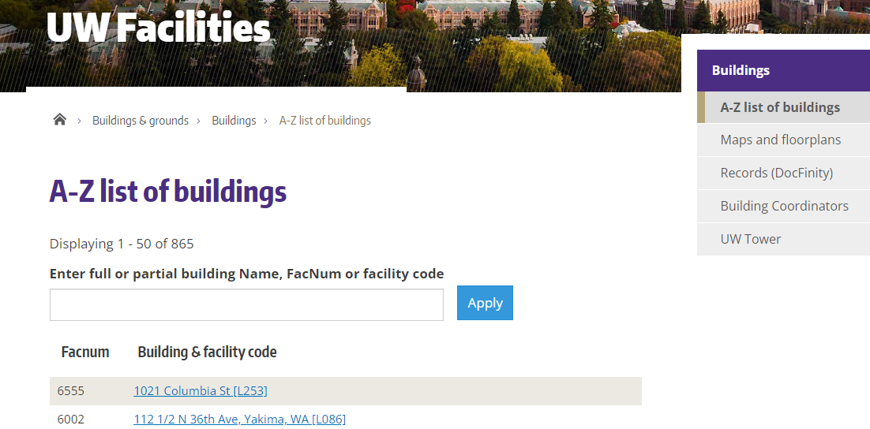
DELIVER TO-SHIP TO
Tip: Learn from your team. What address have they been using in Workday and worked well for delivery?
A full list of UWA addresses is available through this UW Facilities report
In Workday, select the Deliver-To first. Let the Ship–To address populate based on the Deliver-To selection.
Do not manually change the ship-to address in catalog orders. This could result in the order failing to send.

Slide 13
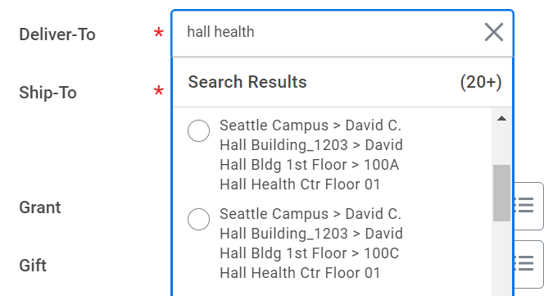
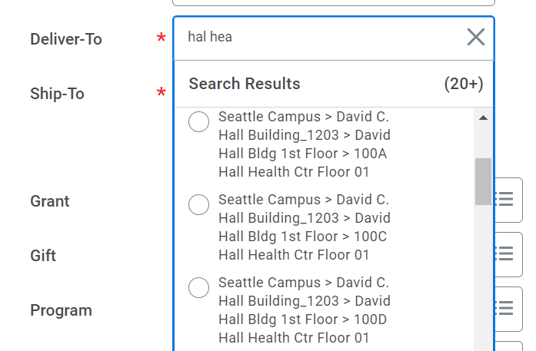
DELIVER TO - SHIP TO
Deliver-To’s can be searched three ways:
1. Search the building name. You can enter full building names in multiple ways such as using the full name of the location.
Example for Hall Health: “Hall Health”
2. Workday uses 3-letter matching which can aid in your search. You can search by three letter abbreviated names. This saves time and sometimes returns more accurate results.
Example for Hall Health: Enter “Hal Hea” in the search.

Slide 14
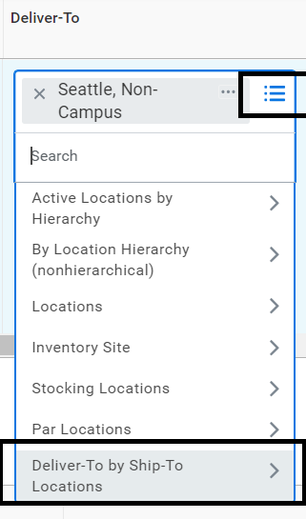
DELIVER TO – SHIP TO
3. You can use the “Deliver-To by Ship-To Locations” option for searching found by clicking the three lines.

Slide 15
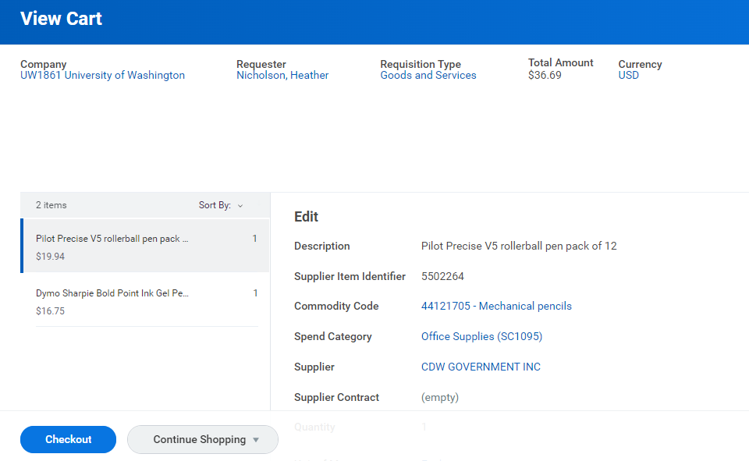
Shopping Cart

Slide 16
APPROVALS FOR CATALOG REQUISITIONS
Who​ | When​
Funding Approver​ | All catalog requisitions​
IT Procurement Specialist​ | Only when the Spend Category requires​
Environmental Health and Safety Specialist​ | Only when the material type requires​
Business Asset Tracking Specialist​ | Only when the Spend Category requires​

Slide 17
NON-CATALOG REQUISITIONS

Slide 18
NON-CATALOG REQUISITIONS IN WORKDAY
Requisitions that do not use the catalogs in GHX
Initiator enters a requisition with all line-time details.
Supplier must be established in Workday to submit the requisition.
Entry must be accurate, and quotes are encouraged
Before entry obtain:
  Current, correct item pricing
  Part number(s)
  Full item description
  Quote number (if available)
  Contact Name
  Email address and or fax number for supplier

Slide 19
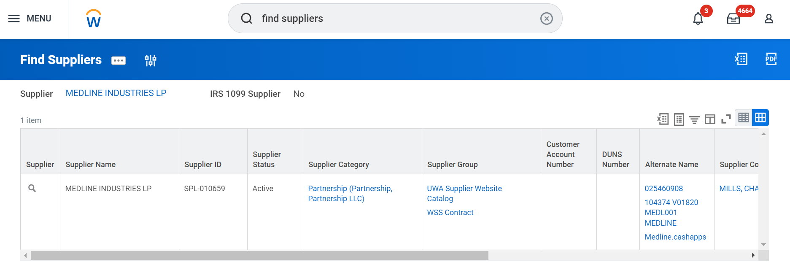
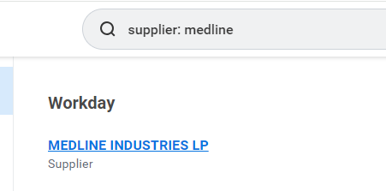
FIND SUPPLIERS REPORT IN WORKDAY
“Find Suppliers Report” in Workday
Enter in search bar supplier: “supplier name”
Verify is the supplier has any divisions in the Order-From Connections tab

Slide 20
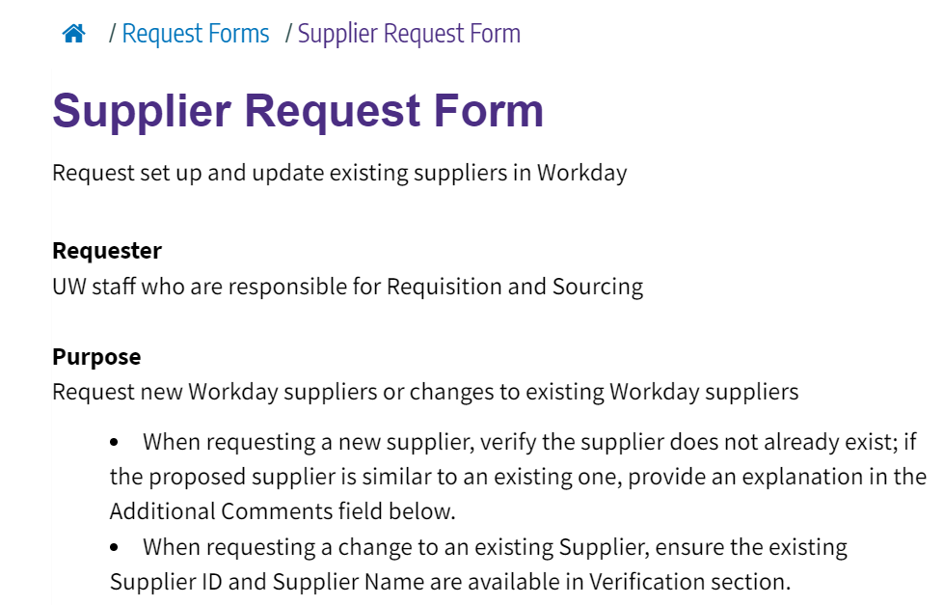
NEW SUPPLIERS
Use the Supplier Request Form in the UW Connect Finance Portal

Slide 21
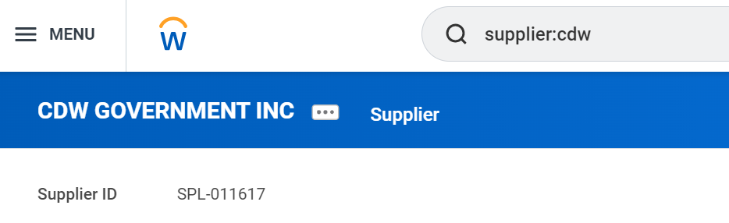
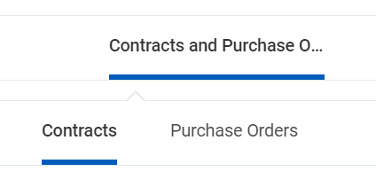
CONTRACTS IN WORKDAY
Contracts with ENT are available to UWA
Finding Contracts UWA Job Aid

Slide 22
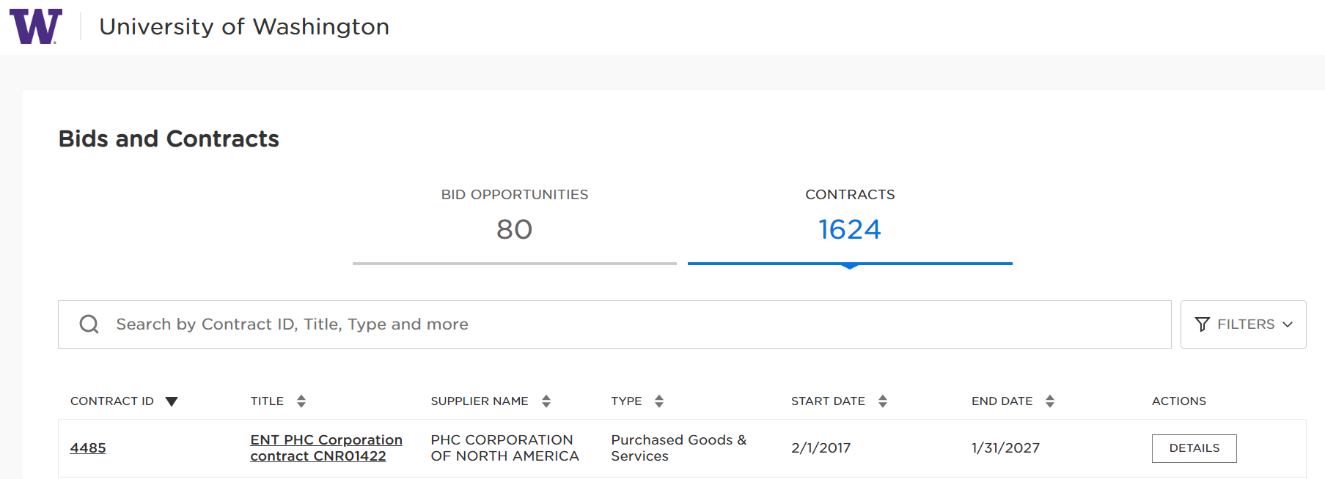
CONTRACTS OUTSIDE WORKDAY
UW Public Contract Search Portal
Naming convention ENT (enterprise) or UWA (academy)

Slide 23
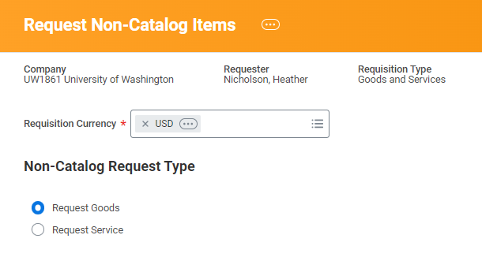
LINE ITEMS
Goods Line Item: Quantity
Services Line Item: Dollar amount

Slide 24
GOODS LINE ITEMS
Do:
Supplier Item Identifier (supplier item number or part number).
Spend Category: taxability is driven by the spend category selected. Pick a spend category with the correct taxability. Refer to the Spend Category report for more information.
Select the correct Supplier (This is required despite missing a red asterisk).
Do Not:
No line items for shipping
Do not use “lot” as a Unit of Measure (if a line needs multiple billings for a blanket order, use Service line item)
No zero dollar or negative dollar (discount) line items (PO won’t release)
Line-Item Memo: No sensitive internal information on the line-item memo field, it is visible to suppliers.

Slide 25
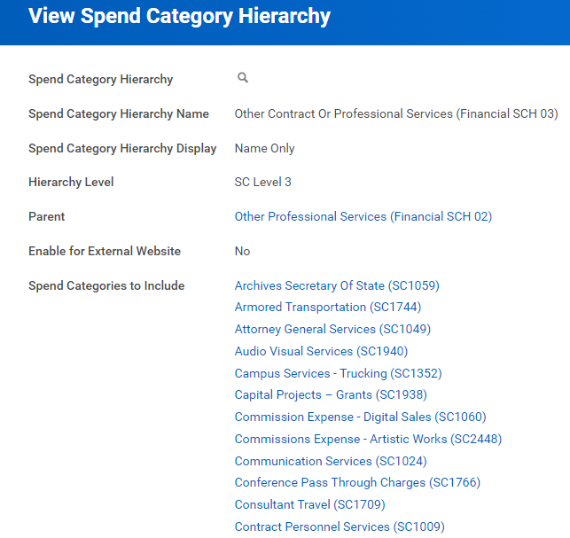
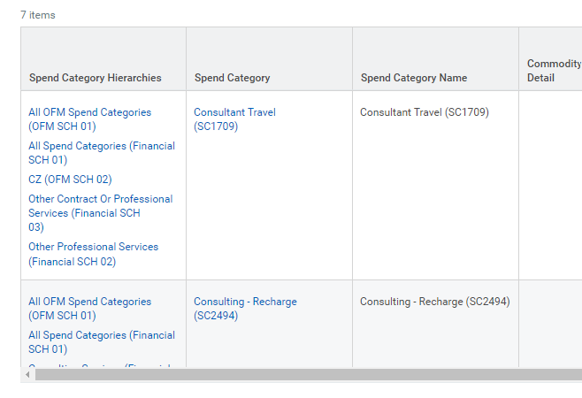
SPEND CATEGORY HIERARCHY EXAMPLE: OTHER SERVICES
“Find Spend Categories” report in Workday
48 options for Other Contract or Professional Services.

Slide 26
SERVICE LINE ITEMS
Do:
Best line-item type for blanket orders.
Spend Category: taxability is driven by the spend category selected. Pick a spend category with the correct taxability. Refer to the Spend Category report for more information.
Service Dates (start and end): this should reflect the period of services on the quote.
Select the correct supplier. (This is required despite missing a red asterisk).
Do Not:
No zero dollar or negative dollar (discount) line items (PO won’t release)
Line-item Memo Guidance: no sensitive internal information on the line-item memo field, it is visible to suppliers
No line-items for shipping

Slide 27
REQUESTS OVER THE DIRECT BUY LIMIT
The Direct Buy Limit is 10K. Anything over this dollar amount will be reviewed by the Purchasing department before the order is sent.
Enter basis for the supplier selection in the “Internal Comments” field
  Sole source justification
  Contract number
  Competitive solicitation information
Other useful information for the “Internal Comments:”
  M&E statement
  Prior PO number

Slide 28
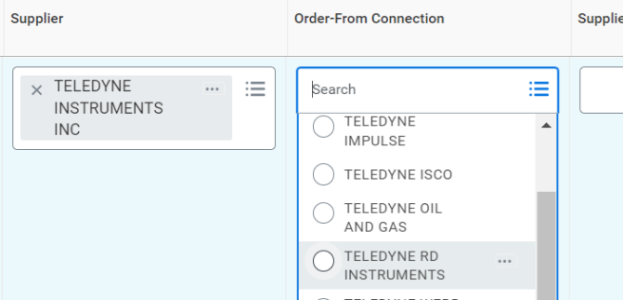
ORDER-FROM CONNECTION
Check “Order-From Connection” field to see if there are multiple to choose from. If there are, select
the appropriate division.
IMPORTANT: Those with references to UWMC or HMC are internal configurations for use by UW Medicine only. They should not be selected manually.

Slide 29
MEMO TO SUPPLIER FIELD
Include:
Deliver-To instructions on room and floor number
Alert that M&E tax exemption is attached
Announcement of replacement order (i.e.: this order
replaces PO-000###”)
Anything else the supplier should know
Note: If no information is added, you will get a red alert message to add content

Slide 30


Errors
You may see Alert messages in the top right-hand corner.
Red Error messages mean something will need to be fixed before submitting.
Orange and yellow Alert messages indicate warnings
but will not impede the routing of your request.

Slide 31
ATTACHMENTS
Attachments for suppliers should be flagged “external”
Quotes
M&E certificate (with PO shown on it)
Resale certificate
Scope of work
Attachment for internal review (not for supplier):
A page from the grant award
Sole source document justification

Slide 32
APPROVALS FOR NON-CATALOG REQUISITIONS
Who​ | When​
Shared Environment Requisition Specialist​ | All non-catalog requisitions​
Funding Approver​ | All non-catalog requisitions​
IT Procurement Specialist​ | Only when the Spend Category requires​
Environmental Health and Safety Specialist​ | Only when the material type requires​
Buyer​ | Only when the requisition is greater than $10,000​
Business Asset Tracking Specialist​ | Only when the Spend Category requires​
Requisition Event Filter Nanolearning

Slide 33
NON-CATALOG REMINDERS
Do not sign any goods and services contracts with a supplier. Contact the Purchasing team for assistance.
Check with Purchasing for available contracts that the purchase can be bought with if you don’t see one during your initial search. See the Subject Matter Expert webpage to find the right individual.

Slide 34
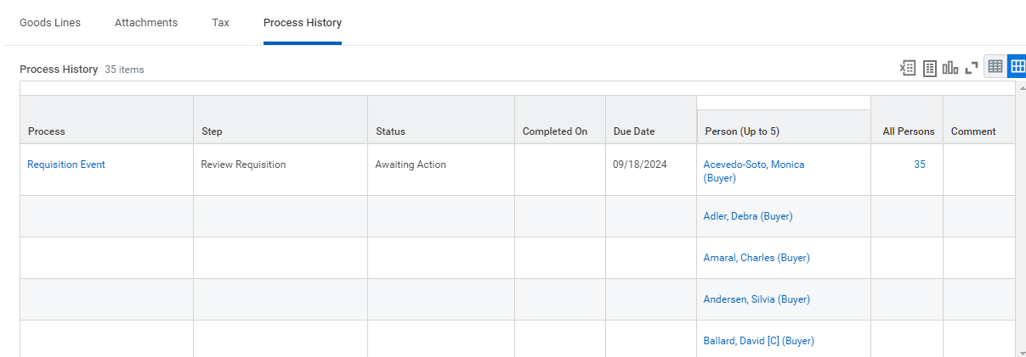
TRACKING
Find Requisitions Report in Workday
Add Requisitions App to your menu
“Process History” will show the approval process up to the current step. But be mindful that not all individuals who show up as “Buyers” in Process History can help with the order. Check the SME page for a contact.

Slide 35
OTHER REQUISITION CONSIDERATIONS

Slide 36
EXCEPTION ITEMS
Some purchases require special considerations, including prior approvals or other requirements. An Exception Items list has been created to assist with your purchasing decisions.
Exceptions include things like fume hoods, biological safety cabinets, live animals, radioactive materials and more. Full list on the Exceptions web page.
Requests for these commodities may require completing a questionnaire in Workday and approval from other teams.

Slide 37
CAPITAL ASSET TRACKING
Trackable spend categories were created specifically to identify equipment purchases that will result in the creation of an asset record.
Business Asset Tracking will review requisitions and receipts based on spend category used.
Visit the EIO website.

Slide 38
REQUIREMENTS ON M&E TAX EXEMPTIONS
The Exemption is intended for Research & Development. The research must qualify for the exemption:
  Five qualifying categories: 1. Advanced Computing 2. Advanced Materials 3. Biotechnology 4. Electronic Device Technology 5. Environmental Technology
Purchase must meet these requirements:
  1. Useful life > = 1 year
  2. used more than 50% annually on qualifying research
  3. Have an acquisition cost >= $200 (exception to $200: Workday Fabrication Project exists (PJ worktag needs to be added in additional worktags section)
  NO CONSUMABLES or WARRANTIES allowed

Slide 39
MORE M&E TAX EXEMPTION REQUIREMENTS
3. The only proper purchasing method:
  Requisition in Workday as PRE-approval is required.
  No ProCard purchases
  No employee reimbursements
  No after the fact Supplier Invoice requests (SQs) for already received items where invoice needs to be paid (Exception: M&E approval was in the legacy system, Ariba, but the Supplier was not paid prior to WD cutover. Must provide legacy PO details.)
4. Include a valid M&E Research statement :
Provide a brief description of the type of research being done, and the hoped-for development outcome. M&E Statement Examples
5. Attach a valid M&E Tax Exemption certificate
Single-use
Include supplier name and put current date in lower right-hand corner of page 1.
Must be marked External = Yes (as this must go to the supplier)

Slide 40
MACHINERY AND EQUIPMENT TAX
If the equipment does qualify, you will find the Machinery & Equipment tax exempt certificate on EIO Home page.
Suppliers often request to have the purchase order number showing on this certificate when they receive it.

Slide 41
FINANCIAL TREATMENT WORKTAGS
Financial Treatment worktags allow you to indicate a special taxability on a transaction.
Tax Exempt (FT001): Common for resale. Use this worktag to flag a line item as tax exempt when the spend category is flagged taxable. Add a note to the memo field why this is tax exempt.
  Make sure to attach a copy of the resale certificate.
Machinery and Equipment Tax Exempt (FT003): Use this worktag to flag an item as tax exempt. Provide M&E statement for this exception in the line memo field. Review Equipment and Inventory guidelines for using this code.
  Make sure to attach a copy of the M&E certificate and include the PO number on it.

Slide 42
OTHER COMMODITIES
Charters and Transportation
Customs Clearance
Conference and Event Planning
Gases
And visit the How to Buy web page

Slide 43

Demonstration

