Slide 1
Supplier Invoice Requests

Slide 2
Agenda
What are Supplier Invoice Requests
Supplier Invoice Request Process
Special Fields to Consider
Resources

Slide 3
What Are Supplier Invoice Requests?

Slide 4
What is a Supplier Invoice Request?
A Supplier Invoice Request (SIR) is an online tool in Workday used to make a payment to a supplier when:
PO was not required
The cost is under the Direct Buy Limit (10K)
The order has already been received
Important:
When the ultimate aggregate cost to the unit for a service or the purchase of a product will exceed the direct buy limit, regardless of the period of time, please contact Procurement Services for guidance before paying through SIR.
Workday Security Role Needed- None

Slide 5
Supplier Invoice Request Process

Slide 6
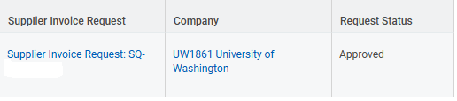
Supplier Invoice Request Process Flow
SQ#
SI#
Initiator: enters the SIR
Unit Approver: approves the SIR
Accounts Payable: approves
the SIR
SIR converts to an SI and Accounts Payable approves the SI
Request Status: Draft
Request Status: In Progress
Request Status: Approved

Slide 7
What to Do Before Entering an SIR
Obtain invoice copy from the supplier
If the invoice is incorrect, get corrected invoice from supplier before proceeding
Check Workday for supplier
If the supplier is there, note the remit-to connection to make sure it is the correct address to send payments
If supplier isn’t found, use the supplier registration process

Slide 8
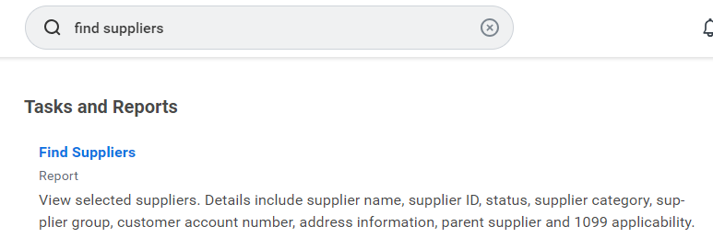
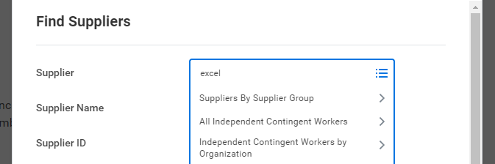
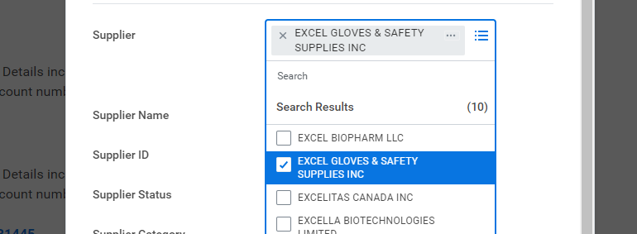
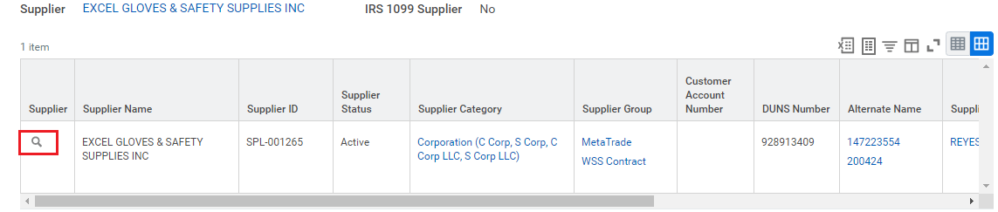
Finding the Supplier: Find Suppliers Report in Workday

Slide 9
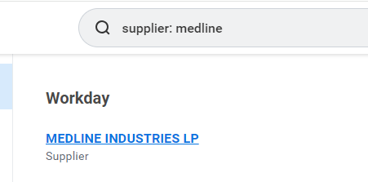
Finding the Supplier: Name in Search Box
Alternatively, enter in search bar: supplier: “supplier’s name”

Slide 10
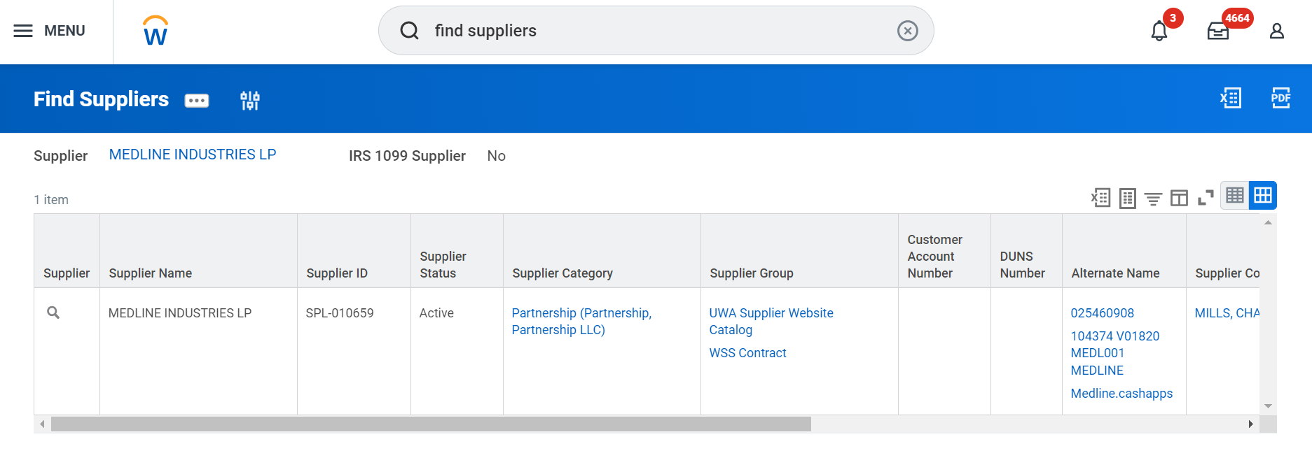
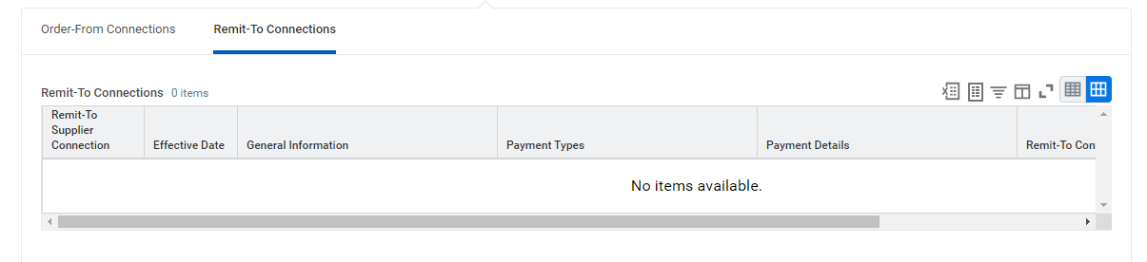
Finding the Supplier: What to Look For
Verify if the supplier:
Is active. Supplier cannot be used if inactive
Has any divisions in the Order-From Connections tab
Remit-To Connections:
If there is no information, do not proceed as the supplier account cannot receive payments.
Send a Connect Ticket to PCS Help about the missing Remit-To Connection.

Slide 11
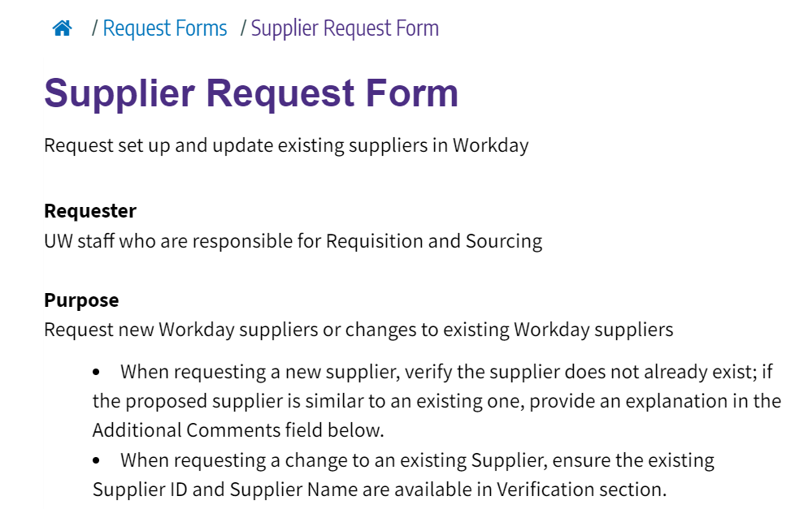
New Supplier
Use the Supplier Request form in UW Connect to request having registration request sent to the supplier
Request will be sent to the supplier.
Unit will look for supplier in Workday to see when available
Note: Supplier Registration Process Being Updated in 2026

Slide 12
What Not to Do
Quotes, statements, proforma invoices and packing slips are not used to issue payments
Do not split the invoice between more than one SIR
Invoice cannot be more than 30 days into the future
Some commodities cannot be paid on SIR. Do not use SIR to pay for commodities on the Exceptions list.
If there is a valid PO, pay with the PO unless a business case is provided in the “comments” field of the SIR.

Slide 13
Best Practices
Review supplier information before entering. Supplier names can be similar; make sure you have selected the correct one.
Keep invoices separate
AP needs to know why an SIR is used if an open PO is available by adding a comment before submitting
If you receive an error that there is a duplicate invoice, reach out to customer service through pcshelp@uw.edu before moving on. They can check to see what the duplicate is.

Slide 14
One-time Payment
Avoid setting up a supplier for single purchase/payment or limited business.
Please consider contracted suppliers and suppliers already in Workday.
Consider using a ProCard with doing business with suppliers that your unit will have limited business with.
ProCard is ideal for one-time payments, especially for commodities like subscriptions, catering, conference registrations and other allowable purchases listed on the ProCard Allowable/Unallowable list on the ProCard home page.

Slide 15
Special Fields to Consider

Slide 16

Supplier’s Invoice Number
No special characters or asterisk in the invoice number when entering in Workday

Slide 17
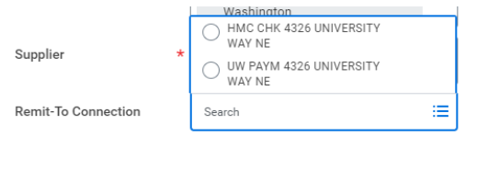
Remit-To Address
When selecting an address to send payment to, use the addresses labeled with “UW” and matches the invoice.

Slide 18

Tax, Handling and Freight
Freight
Add any freight charges in the “Freight” field
If there is a handling charge as well, combine the handling amount with the freight amount and enter the total in the “Freight” field.
Tax
Add the “Tax” amount. If the purchase is taxable, the chosen spend category should be taxable as well.
If tax was not charged, leave tax blank. Use tax will be assessed after submission.

Slide 19
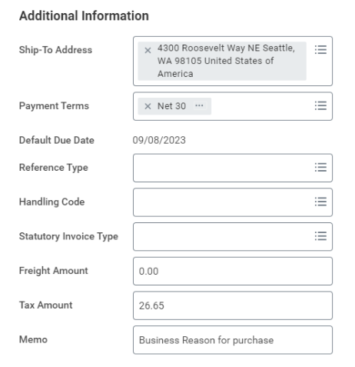
Memo
Add a business reason for the purchase in the “Memo” field.

Slide 20
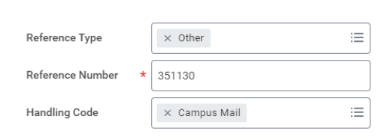

Handling Code
Campus Mail: If you need a check sent through campus mail
Use “Reference Type” field and select “Other.”
Add a campus box number and unit contact name (put box number first). Then use the “campus mail” Handling Code.
Check Pickup: is picked up from Mailing Services.
Attachments: having attachment added to payment before mailed.
Select “Hold-Attch” in the Handling code
Then email the attachment to mailproc@uw.edu
Foreign Payment: If a check payment is being mailed that needs extra postage

Slide 21
Attachments

Slide 22
Attachments Best Practices
DO:
Attach supplier invoice/membership voucher/subscription voucher/registration documents, etc.
Attach the invoice to the Summary page of your Supplier Invoice Request.
Any supporting documents for proof of delivery, i.e., packing slips.
DO NOT:
Attach it to the line-item, as this will make it hard to find the invoice in the future.
Include scans of any information that includes bank account numbers, credit card numbers, or social security numbers.
For information regarding the University policies on documents, please visit the Records Management website.

Slide 23
Resources

Slide 24
Other Resources
Supplier Invoice Request Job Aid
Supplier Invoice Request web page
Find Supplier Invoice R1149: All Supplier Invoices
View the invoice or adjustment number, company, status, supplier, invoice date, memo, discount date, due date, invoice amount, amount due and adjustment for entered supplier invoices.
Procurement Center of Excellence Event Training Calendar
PCS Help: When it doubt, send a ticket to PCS Help through Connect or call 206-543-4500
Exception Item list

