Slide 1
SUPPLIERS IN WORKDAY
Presented by: Tina Padilla
Supplier Administration
Business Systems, Procurement Services
UW Finance, Planning & Budgeting

Slide 2

AGENDA
What is Supplier Lifecycle Management?
Considerations
By the Numbers
How Supplier Onboarding Works in Workday
Using Workday Supplier Records
Best Practices & Resources
Look for
extra tips included along the way!

Slide 3
SUPPLIER LIFECYCLE MANAGEMENT
SUPPLIER: A business entity, registered with the Internal Revenue Service (IRS) and the states they operate in, to sell goods and/or services
Onboarding
Steps which units, the supplier & central office staff must complete to have a new supplier in Workday so that UW can conduct business with them
Maintenance
Process to assist the UW-registered supplier community with keeping UW’s records up-to-date and accurate
Offboarding
Setting records to Inactive when business entities change, or UW is no longer doing business, and records have become stale and likely inaccurate
In Workday, suppliers are identified with the prefix “SPL” and a format of SPL-XXXXXX

Slide 4

CONSIDERATIONS
Before choosing a new supplier, try checking:
Workday catalogs
For an existing supplier, especially diverse suppliers and suppliers with UW contracts
If the supplier accepts ProCard for allowable purchases
With a subject matter expert in Procurement
Onboarding requires many teams working together
Unit/Dept
Staff & SEs
Central Office
Staff
Supplier

Slide 5
WHO SHOULD BE REGISTERED?
Suppliers with UW business engagements; active participants in the procure-to-pay process for ongoing work and/or repeated use
Payment types that are intended to be processed through other processes, such as Honoraria or Travel reimbursements
Suppliers who offer their goods or services through an existing or contracted supplier, to avoid redundancy and lost spend with contracted or diverse businesses
Suppliers with limited business or engagements best suited to ProCard/CTA, in some cases even if agreements are signed

Slide 6
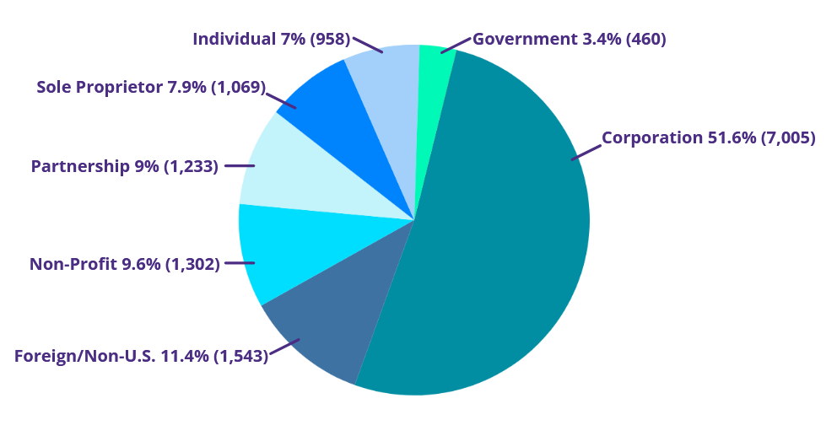
BY THE NUMBERS
Active Suppliers: 13,571
Avg New Per Day: 9

Slide 7
SUPPLIER ONBOARDING IS CHANGING!
What IS Changing:
Suppliers will create accounts and onboard in a different part of Workday
  Note: Invitation is sent from Workday and only that email can login and complete the form (i.e., cannot be forwarded or a different email used to login and create the onboarding account)
  Go-live is scheduled for mid-February 2026
Minor changes will be coming to the Supplier Request Form
  Changes will be visible approximately March 2026
What is NOT Changing:
UW’s supplier request process remains the same
Processing time remains the same
Supplier records in Workday and how they are used remains the same

Slide 8
HOW DO THEY COMPARE?
Workday
Registration
Portal
WSS
Supplier Onboarding
Single Use Link - No Supplier Account
No Multi-Factor Auth (MFA)
Forms: TWO - U.S. & Foreign
Customizations: Available & In Use
No Supplier Feedback for Accuracy
Separate Login for RFX/Contracts
Not WCAG 2.1 AA Accessible
Workday Central Login Supplier Account
Multi-Factor Auth (MFA) App Required
Forms: ONE
Customizations: None
Feedback for Accuracy (Address/Zip)
One Login: Onboarding + RFX/Contracts
WCAG 2.1 AA Accessible

Slide 9
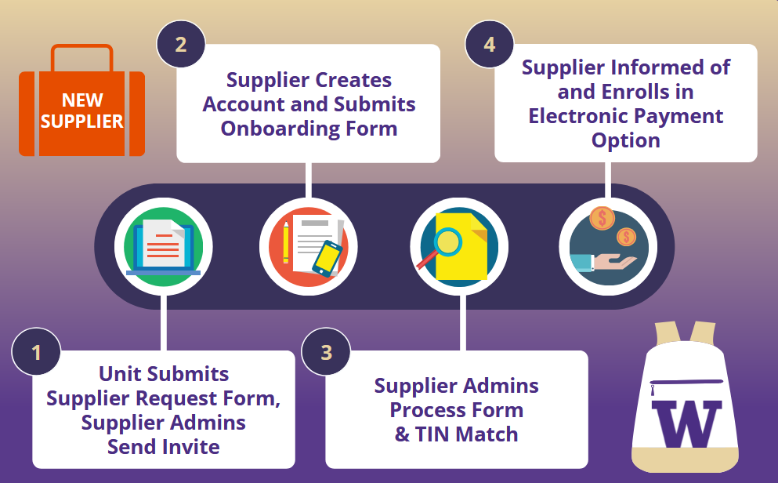
HOW SUPPLIER ONBOARDING WORKS

Slide 10
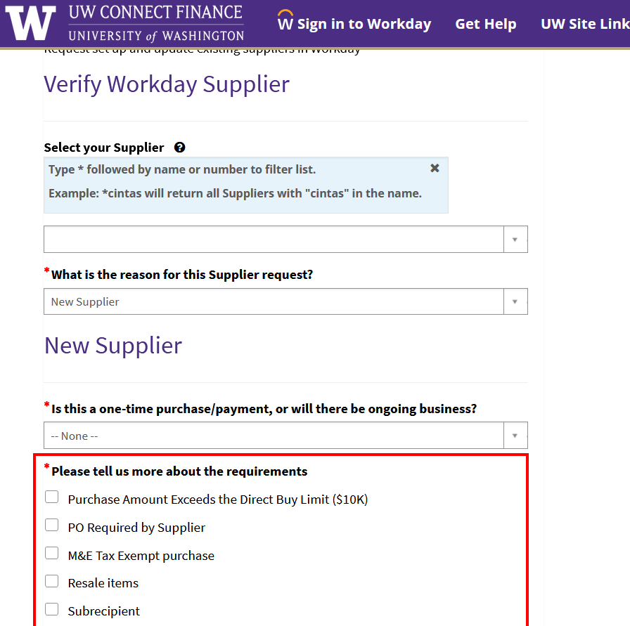
STEP 1: SUPPLIER REQUEST FORM
1. Verify the New Supplier requirements!
These are the common reasons for onboarding a supplier.
* If at least one doesn’t apply, there might be an easier way to pay them!
2. Know whether the supplier is eligible to be a UW supplier
* Current and former employees are generally excluded from being UW suppliers (including companies they own)
Notes:
Current and Former Employees are generally excluded from being UW suppliers (including companies they own)

Slide 11
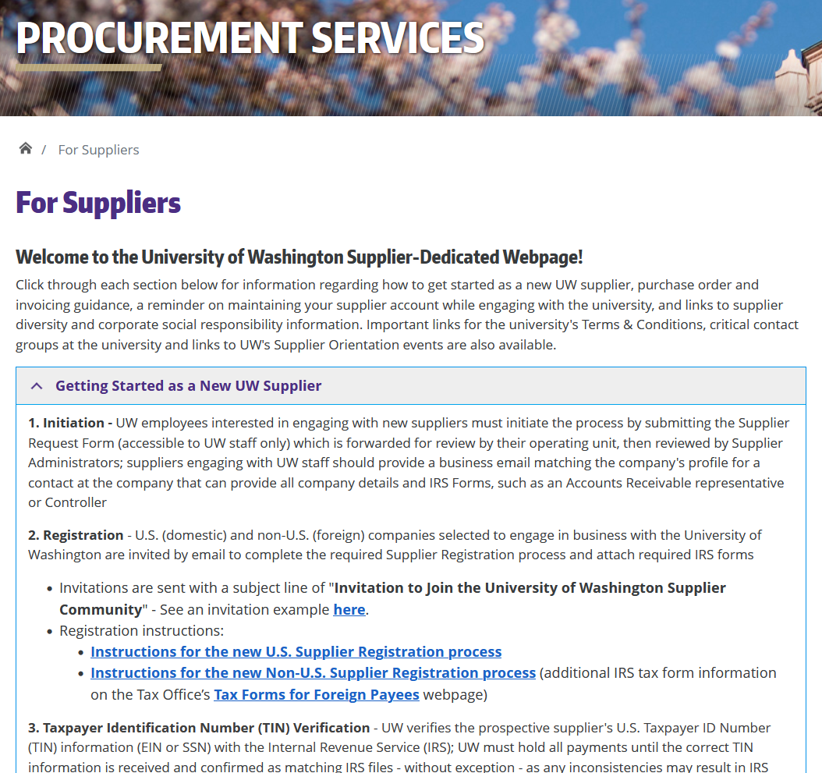
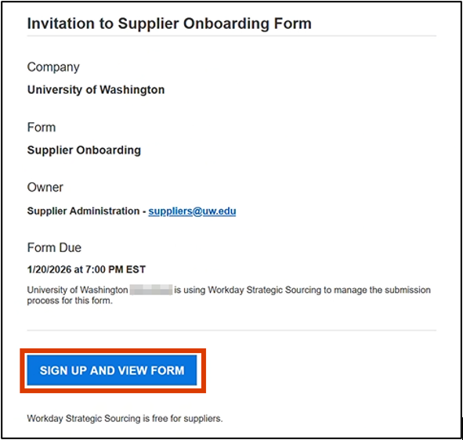
STEP 1: SUPPLIER IS SENT INVITATION
Supplier invited to complete onboarding as ticket is Resolved
Link in the invitation goes to Workday Strategic Sourcing to set up secure account
Supplier completes Supplier Onboarding Form
UW’s supplier-dedicated website: https://finance.uw.edu/ps/suppliers

Slide 12
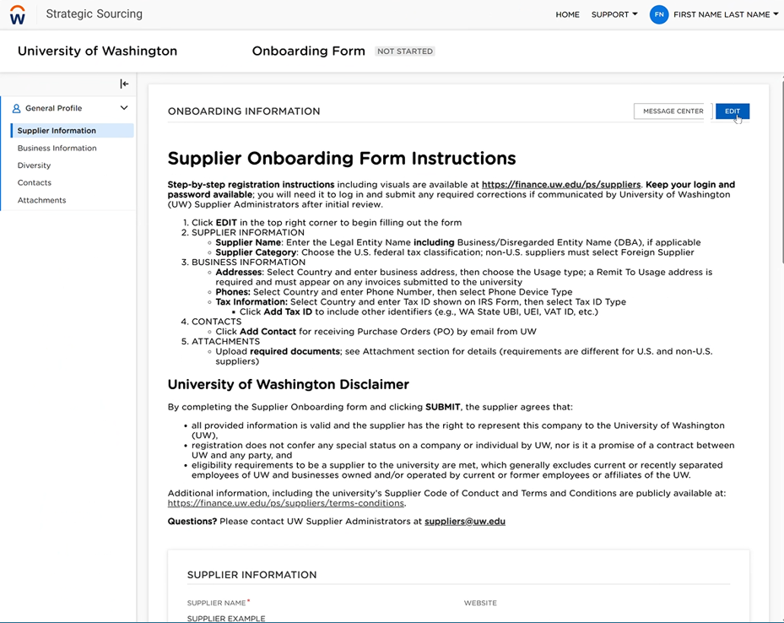
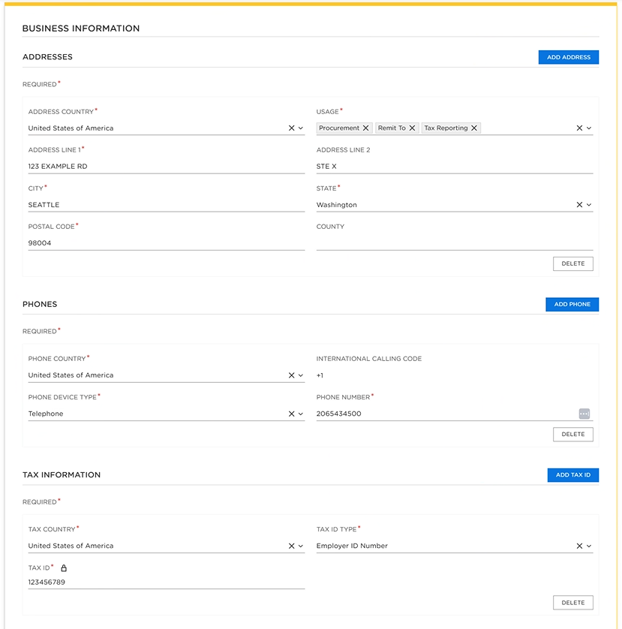
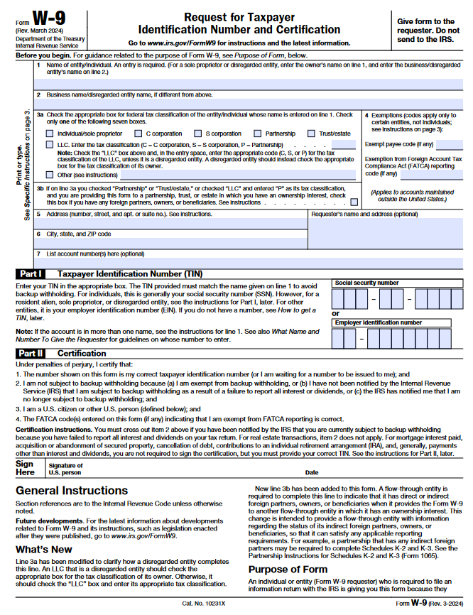
STEP 2: SUPPLIER SUBMITS FORM
Four sections:
Name & Tax ID
Address
Emails
Attachments
  U.S. - IRS W-9
  Non-U.S. - IRS W-8 + Bank Verification Letter

Slide 13
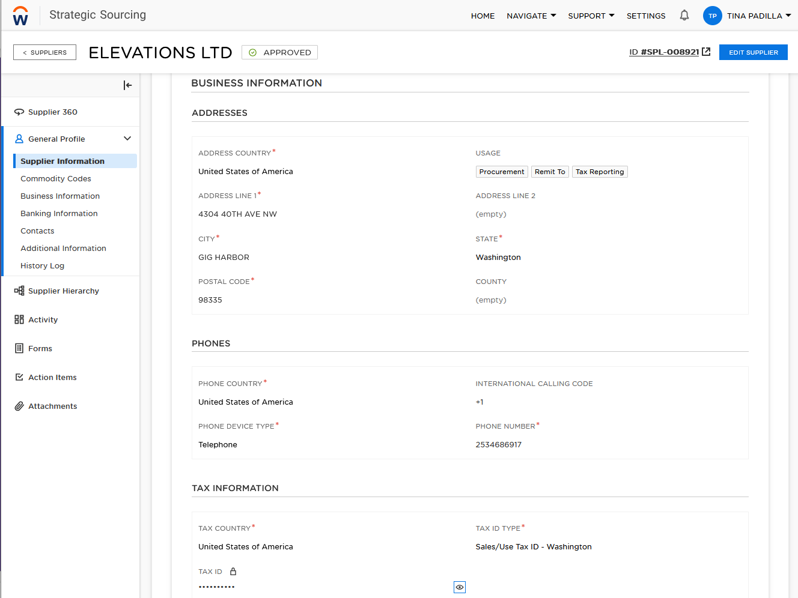
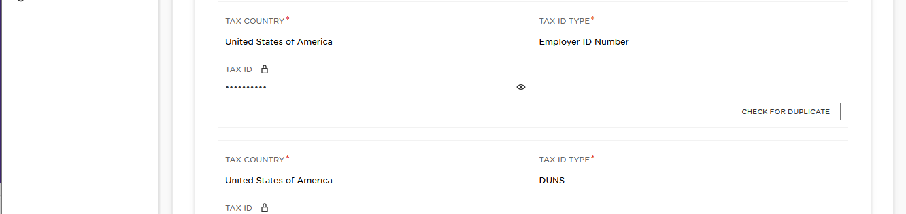
STEP 3. SUPPLIER ADMIN PROCESSES
Onboarding Form is submitted and reviewed by Supplier Administrators
When approved, supplier’s information is processed into Workday for use
The supplier receives an automated email indicating the supplier record is ready, and next steps for electronic payment, when applicable

Slide 14

STEP 3. SUPPLIER ADMIN TIN-MATCH
TIN Matching: Supplier's Taxpayer ID Number (TIN) is verified with the IRS database
If a TIN mismatch happens, the supplier is contacted for corrections and updated copy
Form cannot be processed until the correct TIN information is received & confirmed to match IRS files, without exception; any inconsistencies may result in IRS penalties

Slide 15


STEP 4. ELECTRONIC PAYMENT
All suppliers have a Default Payment Type immediately
  Domestic suppliers are paid by Check while other options (when applicable) are in progress
  Foreign suppliers are submitting their foreign bank information during registration now to receive Wires
Payment options are described on the For Suppliers page
Domestic suppliers can request Paymode-X for ACH deposit payments or ePayables for bank card payments
Supplier Admins only configure
the records to begin enrollment
No banking information is kept
in Workday for U.S. domestic
suppliers
All electronic options involve a partner bank external to UW

Slide 16
WHEN DOES ONBOARDING NOT WORK?
Supplier onboarding has multiple contacts involved and the parts are not all connected; it works because the friendly people in each office make it work
When it doesn’t work, reasons might include:
  Expectations for the steps supplier must complete may not have been communicated or well-understood
  Suppliers are non-responsive & need prompting from someone at the unit who has engaged them for business
  Some suppliers are just not well-suited for procure-to-pay processes

Slide 17
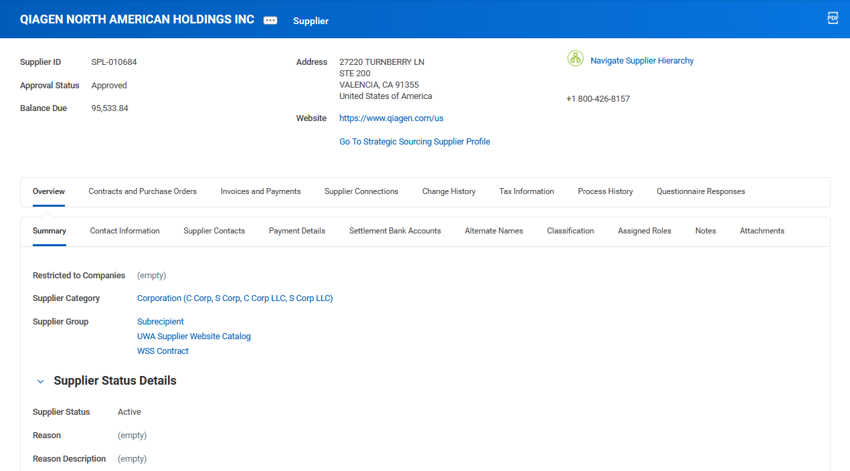
USING WORKDAY SUPPLIERS
IRS Entity Type
Critical Processes:
UWA Supplier Website Catalog
Subrecipient
Find Suppliers R1495 report can be filtered for Groups
Goods & Services Offered, like:
Audio/Visual Services
IT Services
Catering
Status, Reason & Reason Description:
Inactive Suppliers May Have Important Notes Here

Slide 18
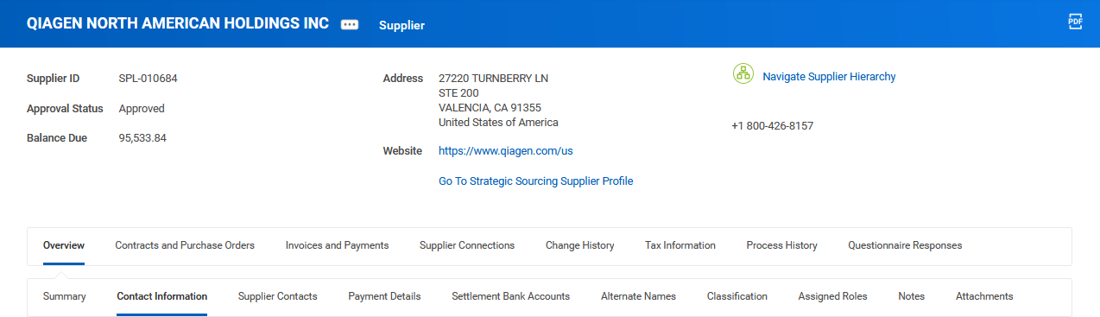
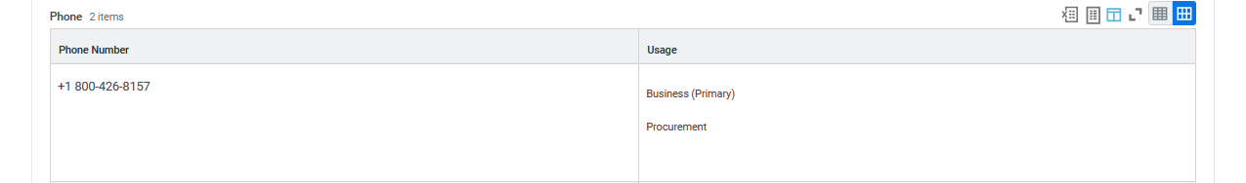
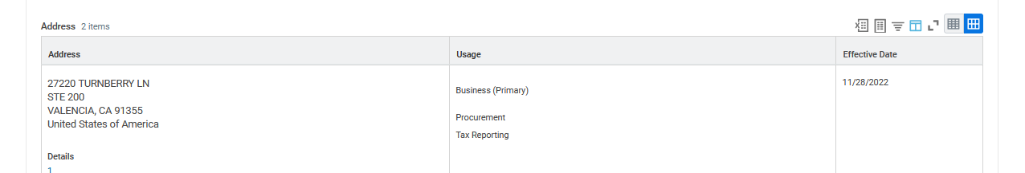
USING WORKDAY SUPPLIERS: OVERVIEW
How POs are Issued
(Many by Email)
Remit-To Connections
Order Connections
Phone, Address, Email and
How They are Used
Alternate Supplier Connection
Doing Business As Names,
and Connect REF
Supplier Addresses
Usage Defined for Each Address

Slide 19
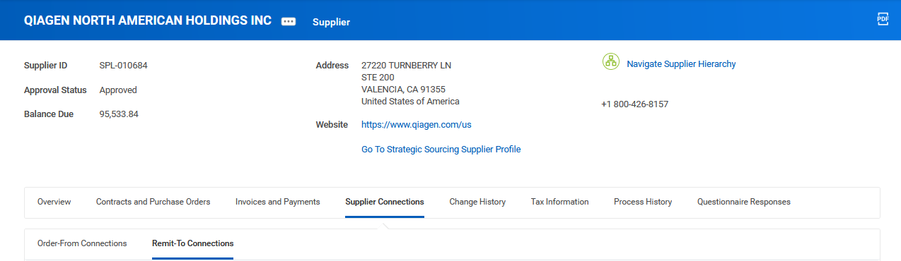
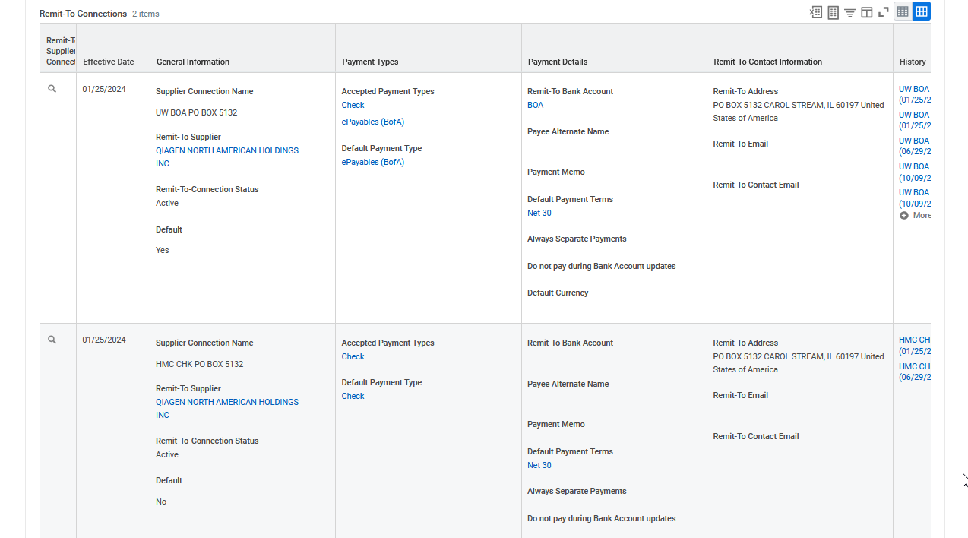
USING WORKDAY SUPPLIERS: REMIT-TO CONNECTIONS
Very Few Suppliers Have Order-From Connections
All Suppliers Have at Least One Remit-To Connection
Connection Name
Company + Payment + Address
Remit-To Connection Address
Payment Options
Still in Progress
Cannot be Used
How Supplier Will be Paid

Slide 20
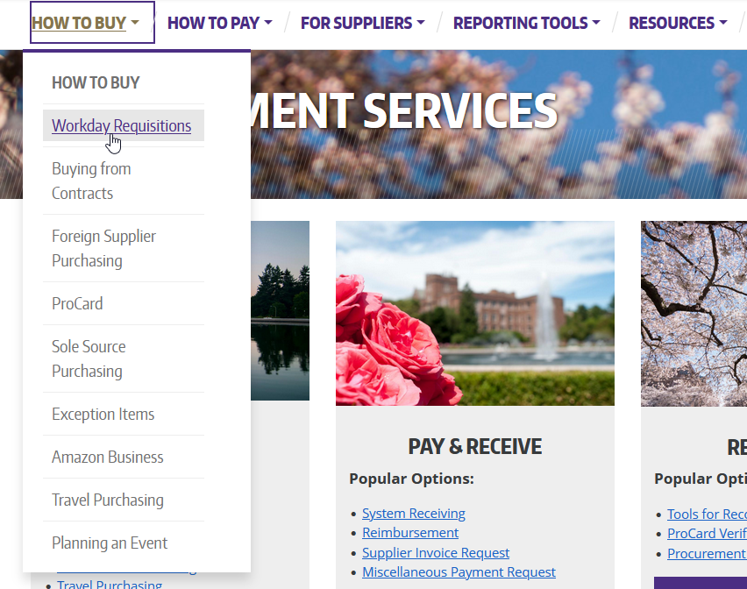
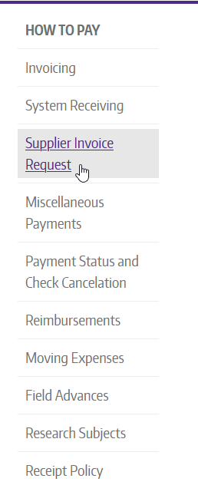
USING WORKDAY SUPPLIERS: RESOURCES
Refer to the website guidance and UWCF Job Aids for transactions

Slide 21
BEST PRACTICES: BEFORE REQUEST
Before Requesting a New Supplier, Check:
Workday catalogs
For an existing supplier, especially diverse suppliers and suppliers with UW contracts
If the supplier accepts ProCard for appropriate purchases
With a subject matter expert in Procurement
Unit/Dept
Staff & SEs
Central Office
Staff
Supplier

Slide 22
BEST PRACTICES: AFTER REQUEST
After Requesting a New Supplier:
Look up suppliers in Workday using the search bar with “supplier: [name]” or SPL number
Use the Find Suppliers R1495 report
  Under Quick Reports on the Financial Desktop Procurement tab
  Search by email, full or partial, and often the email from the Supplier Request Form
  Search by REF ticket number in the Supplier field
If the supplier cannot be found in Workday within 2-3 business days of the ticket being Resolved, they likely did not submit the onboarding form as requested
Utilize the online resources created by Central Office to avoid confusion when communicating with suppliers

Slide 23
BEST PRACTICES
When Using Workday Suppliers:
If the supplier exists but is unfamiliar, it’s great to point them to the website for the "Maintaining Your Profile" instructions - we may not have heard from them in a while, and the record may need updating
Check for important things like Supplier Name or Alternate Payee Name
Verify the Supplier Address still matches; if it doesn’t, ask the supplier to contact us before submitting an SIR
Check if the supplier is one of the special cases, such as a those with Order Connections

Slide 24
RESOURCES
For UW Staff & Shared Environment Specialists:
Supplier Request Form Nano-Learning Video (<7 min)
Supplier Request Form
UWCF Request Form Routing Instructions
Knowledge Navigator – UW Workday Terms
For Suppliers:
UW Supplier-Dedicated Webpage: https://finance.uw.edu/ps/suppliers

