Slide 1
SUPPLIERS IN WORKDAY
Presented by: Tina Padilla
Supplier Administration
Business Systems, Procurement Services
UW Finance, Planning & Budgeting

Slide 2

AGENDA
What is Supplier Lifecycle Management?
Considerations
By the Numbers
How Supplier Onboarding Works in Workday
Using Workday Supplier Records
Best Practices & Resources
Look for
extra tips included along the way!

Slide 3
SUPPLIER LIFECYCLE MANAGEMENT
SUPPLIER: A business entity, typically registered with the Internal Revenue Service (IRS) and the states they operate in, to sell goods and/or services
Onboarding
Steps which units, the supplier & central office staff must complete to have a new supplier in Workday so that UW can conduct business with them
Maintenance
Process to assist the UW-registered supplier community with keeping UW’s records up-to-date and accurate
Offboarding
Setting records to Inactive when business entities change, or UW is no longer doing business, and records have become stale and likely inaccurate
In Workday, suppliers are identified with the prefix “SPL” and a format of SPL-XXXXXX

Slide 4
WHO SHOULD BE REGISTERED?
Suppliers with UW business engagements; active participants in the procure-to-pay process for ongoing work and/or repeated use
Payment types that are intended to be processed through Miscellaneous Payments, such as Honoraria or Awards
Suppliers who offer their goods or services through an existing or contracted supplier, to avoid redundancy and lost contracted or diverse business
Suppliers with limited business or engagements best suited to ProCard/CTA, in some cases even if agreements are signed

Slide 5

CONSIDERATIONS
Before choosing a new supplier, try checking:
Workday catalogs
For an existing supplier, especially diverse suppliers and suppliers with UW contracts
If the supplier accepts ProCard for appropriate purchases
With a subject matter expert in Procurement
Onboarding requires many teams working together
Unit/Dept
Staff & SEs
Central Office
Staff
Supplier

Slide 6

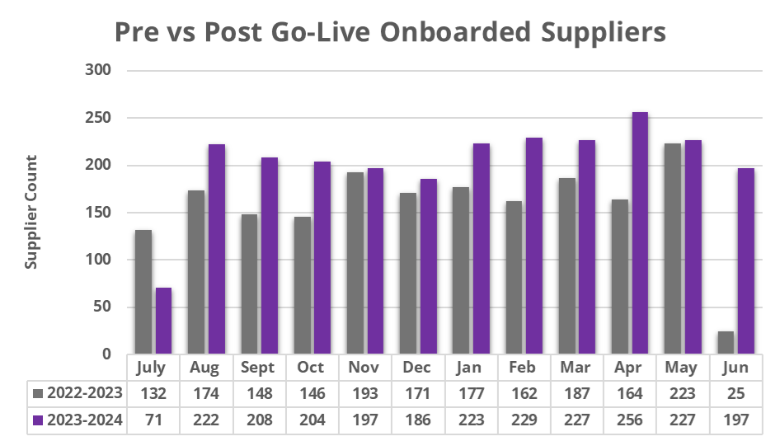
BY THE NUMBERS
New registrations have increased a lot in Workday
+ 29%

Slide 7
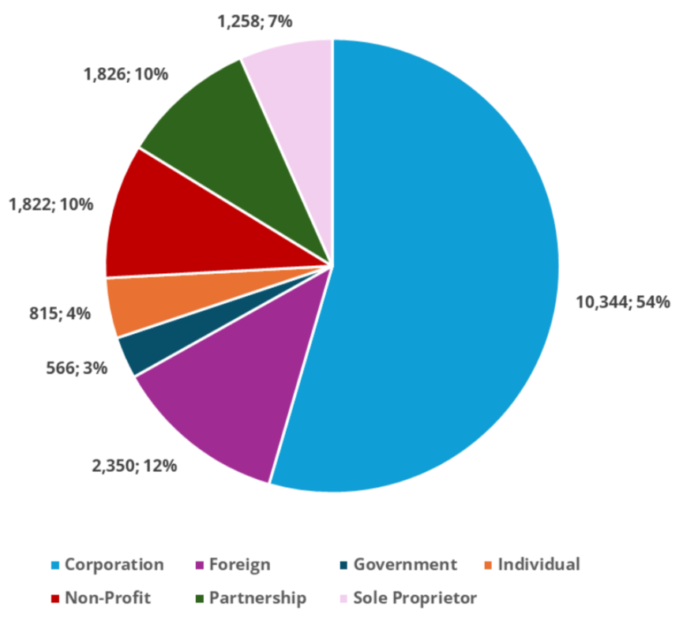

BY THE NUMBERS – SUPPLIER DATA
Total Suppliers:
Converted Suppliers:
16,160
New Since Go-Live: 2,821
Total Active: 18,981
Connect Tickets:
New Supplier
4,355
Modify Supplier
2,012

Slide 8
HOW IS THIS DIFFERENT NOW?
Onboarding timelines were reduced from
8 days to
1-2 days
Legacy
Process
Workday
Process
Open Registration Link
Substitute IRS W-9
TIN Matching Once Per Week
Had to Wait Overnight to Use
Invited Upon Request
Not a Substitute IRS W-9
TIN Matching Immediately
Can Use Immediately

Slide 9
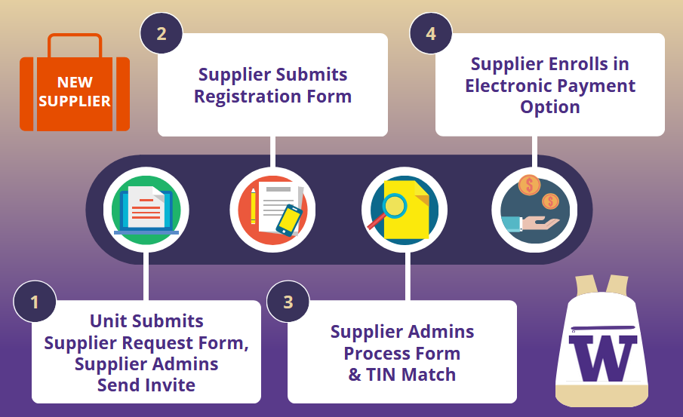
HOW ONBOARDING WORKS NOW

Slide 10
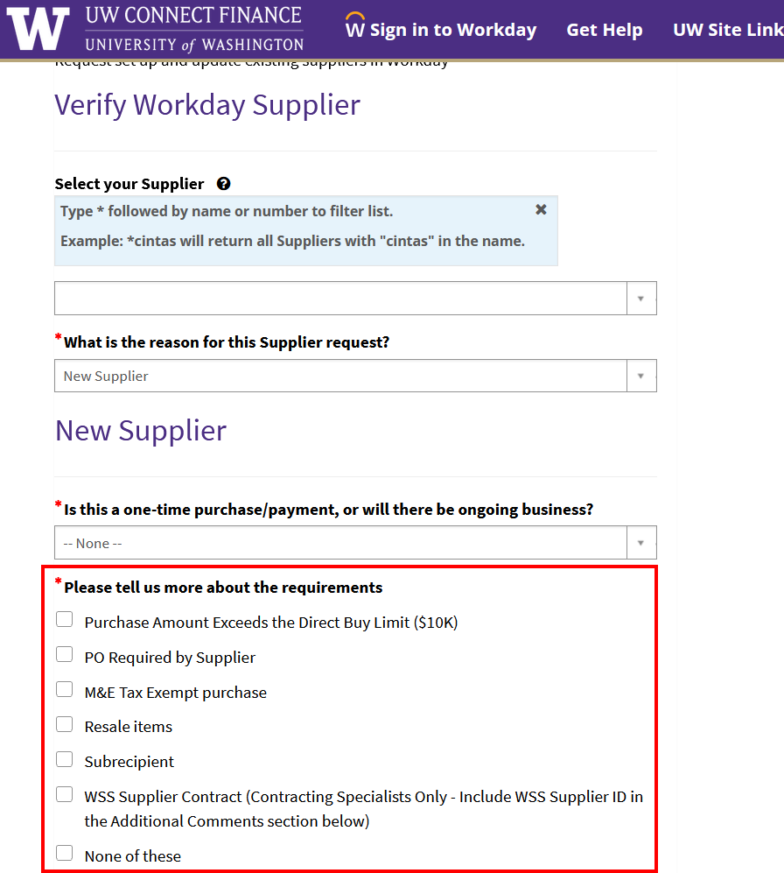
STEP 1: SUPPLIER REQUEST FORM
1. Be sure to check the New Supplier requirements!
These are the common reasons for onboarding a supplier.
If at least one doesn’t apply, there might be an easier way to pay them!
2. Know whether the supplier is eligible to be a UW supplier - Current and former employees are generally excluded from being UW suppliers (including companies they own)
Notes:
Current and Former Employees are generally excluded from being UW suppliers (including companies they own)

Slide 11
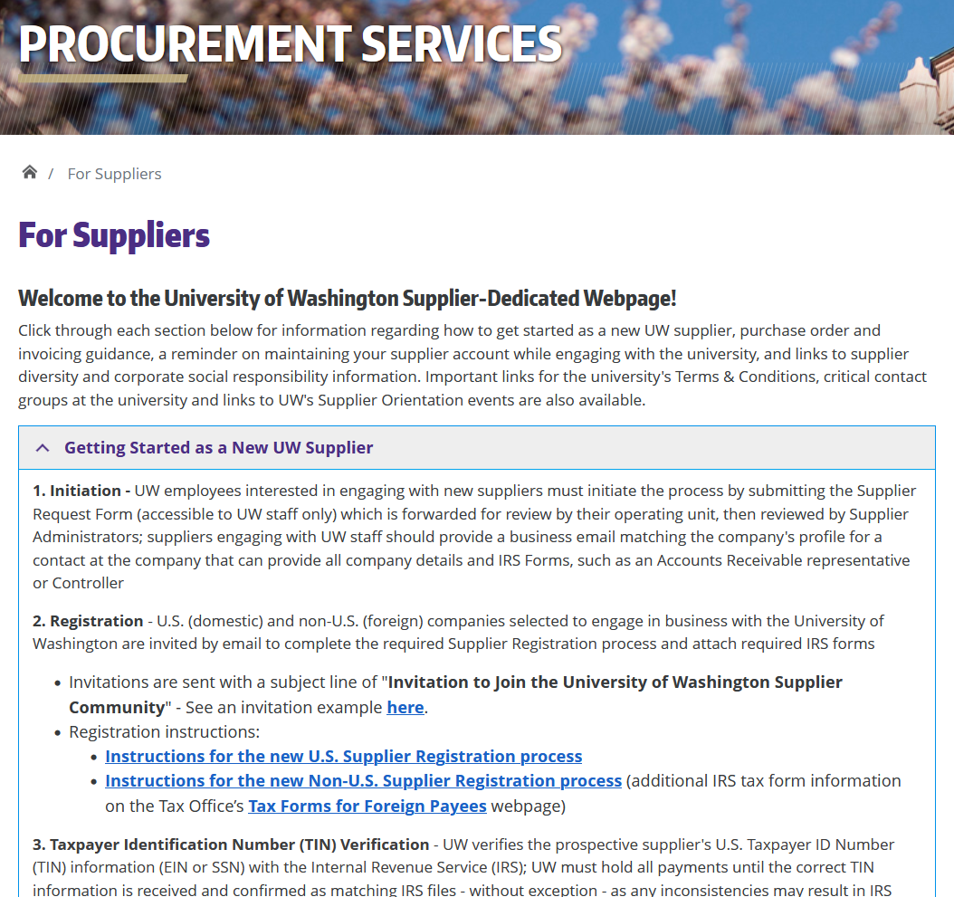
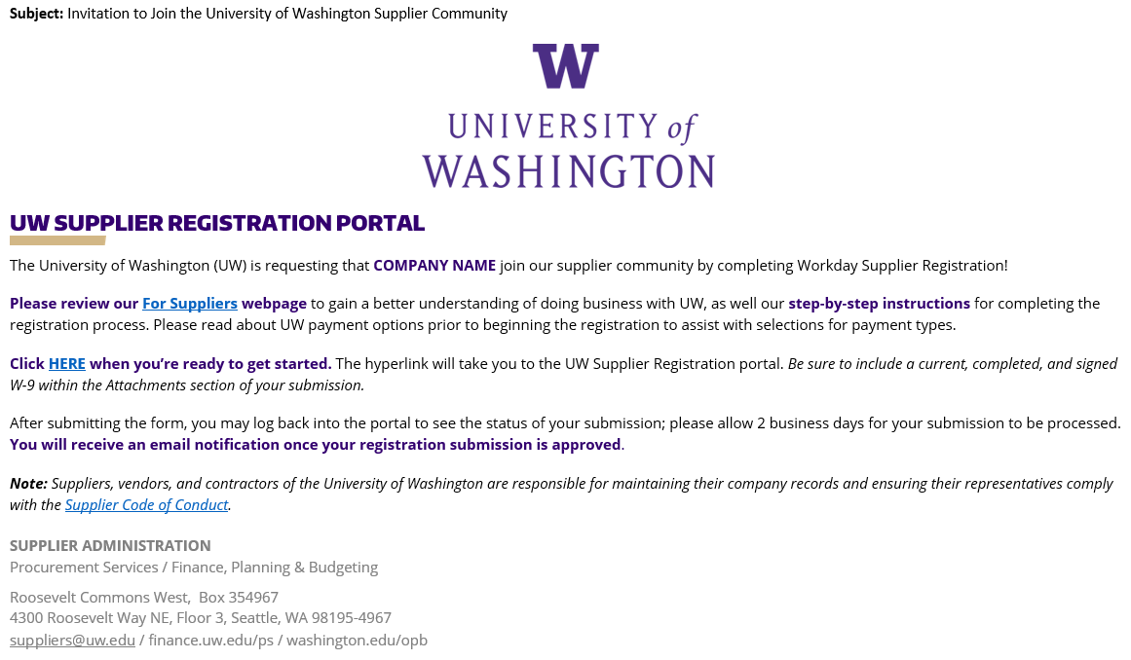
STEP 1: SUPPLIER IS SENT INVITATION
Supplier is invited to register in real time, as ticket/case is Resolved
Link in the invitation goes to a Workday site called the Supplier Registration Portal
UW’s supplier-dedicated website: https://finance.uw.edu/ps/suppliers

Slide 12
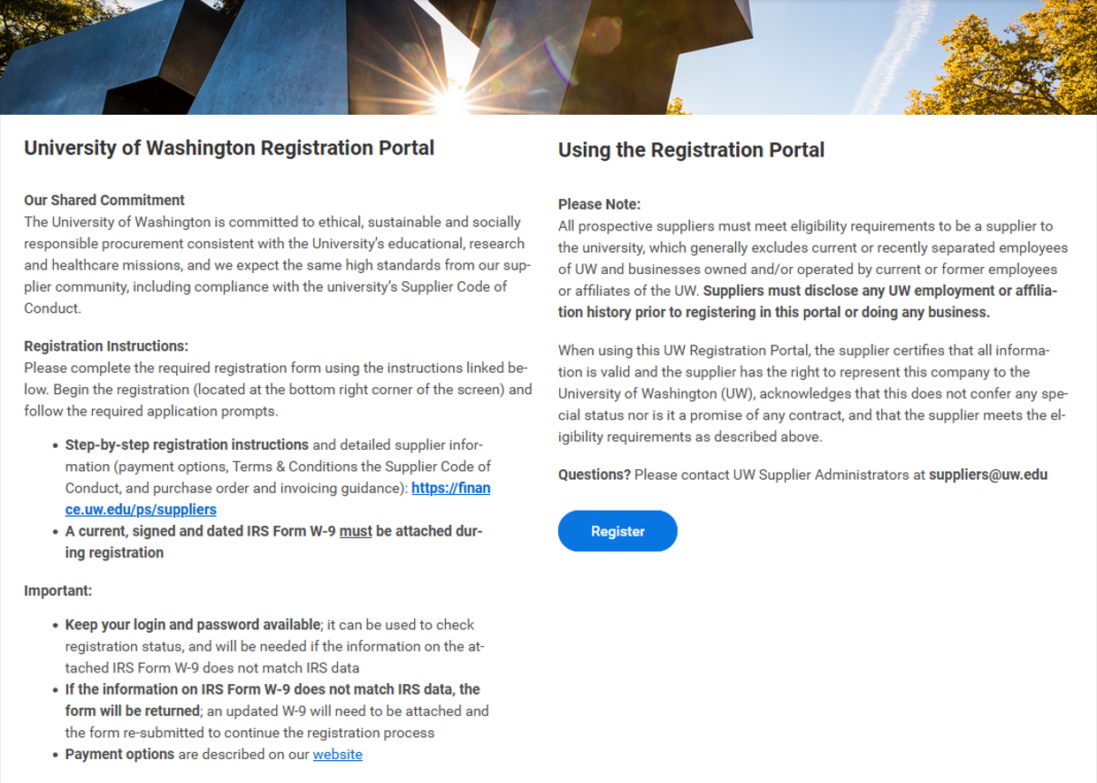
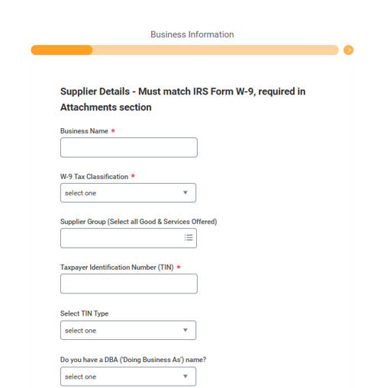
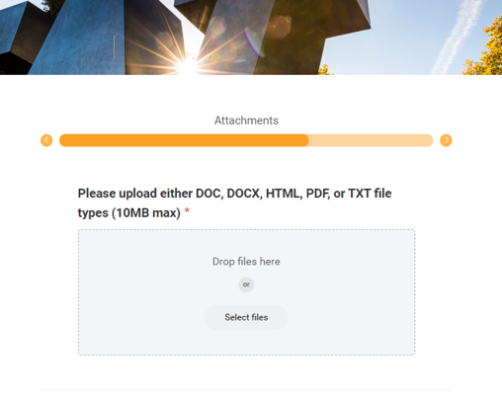
STEP 2: SUPPLIER REGISTERS
Domestic/U.S.:
Three sections to enter details like Supplier Name and TIN, attach IRS W-9
Foreign/non-U.S.:
Four sections (same as above plus banking for foreign wire payments), attach IRS W-8 & Bank Verification Letter

Slide 13
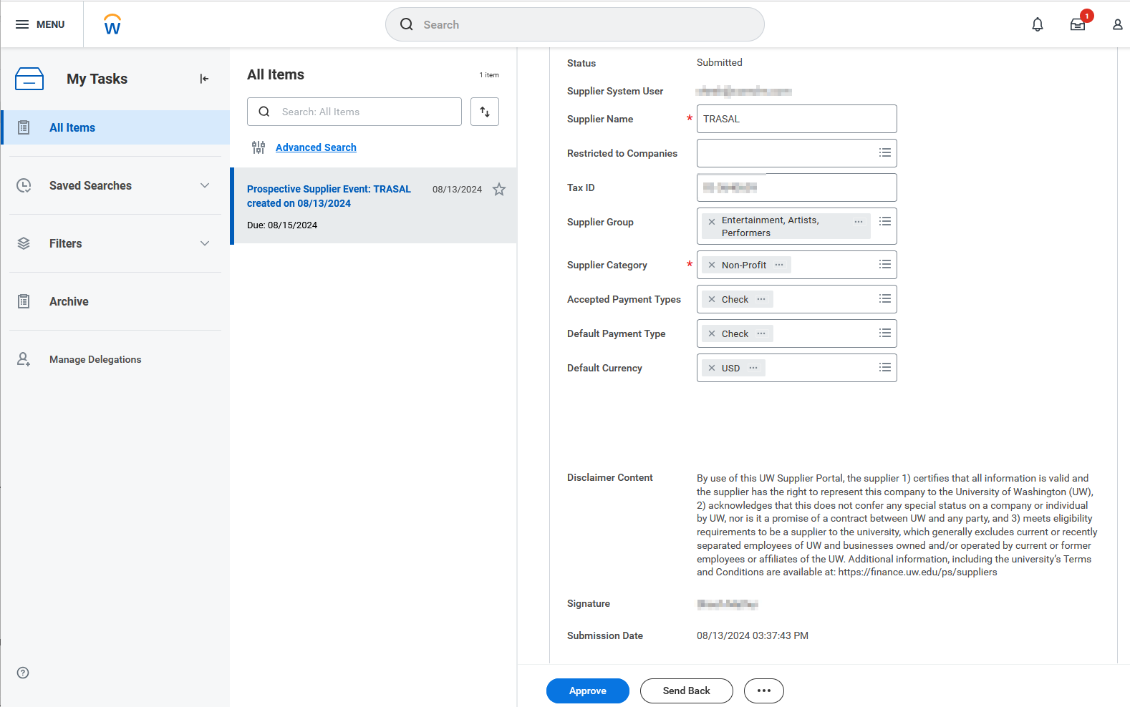
STEP 3. SUPPLIER ADMIN PROCESSES
Supplier Registration Form is submitted and reviewed by Central Office Supplier Administrators
When approved, supplier’s information is processed into Workday for immediate use
The supplier receives an automated email indicating the supplier record is ready, and next steps for electronic payment, when applicable

Slide 14
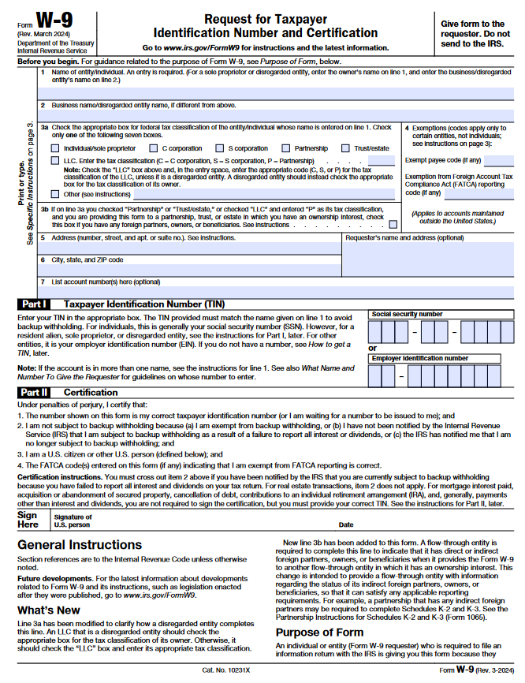

STEP 3. SUPPLIER ADMIN TIN-MATCH
TIN Matching: Supplier's Taxpayer ID Number (TIN), EIN or SSN, is verified with the IRS database
If a TIN mismatch happens, the form is returned to the supplier for corrections
Form cannot be processed until the correct TIN information is received & confirmed to match IRS files, without exception; any inconsistencies may result in IRS penalties

Slide 15


STEP 4. ELECTRONIC PAYMENT (OPTION)
All suppliers have a Default Payment Type immediately
  Domestic suppliers are paid by check while other options (when applicable) are in progress
  Foreign suppliers are submitting their foreign bank information during registration now to receive wires
Payment options are described on the For Suppliers page
Domestic suppliers can request Paymode-X for ACH deposit payments or ePayables for bank card payments
No banking information is kept in
Workday for domestic suppliers
Foreign suppliers are typically paid
by a bank transfer wire (but not
always!)
All electronic options involve a partner bank external to UW

Slide 16
HOW DID THE TRANSITION GO?
Supplier data was worked on for three years prior to go-live
Supplier lifecycle management processes are stable
Supplier processes have been improved since go-live:
  Updated Supplier Request Form
  Enhanced Connect Ticket Messaging
  Optimized Supplier Registration Forms
  More Focused Automated Emails to Suppliers
Legacy: Supplier Search Report was frozen, and Supplier Registration was decommissioned and retired

Slide 17
WHEN DOES ONBOARDING NOT WORK?
Supplier onboarding has multiple contacts involved and the parts are not all connected; it works because the friendly people in each office make it work
When it doesn’t work, reasons might include:
  Expectations for the steps supplier must complete may not have been communicated or well-understood
  Suppliers are non-responsive & need prompting from someone at the unit who has engaged them for business
  Some suppliers are just not well-suited for procure-to-pay processes

Slide 18
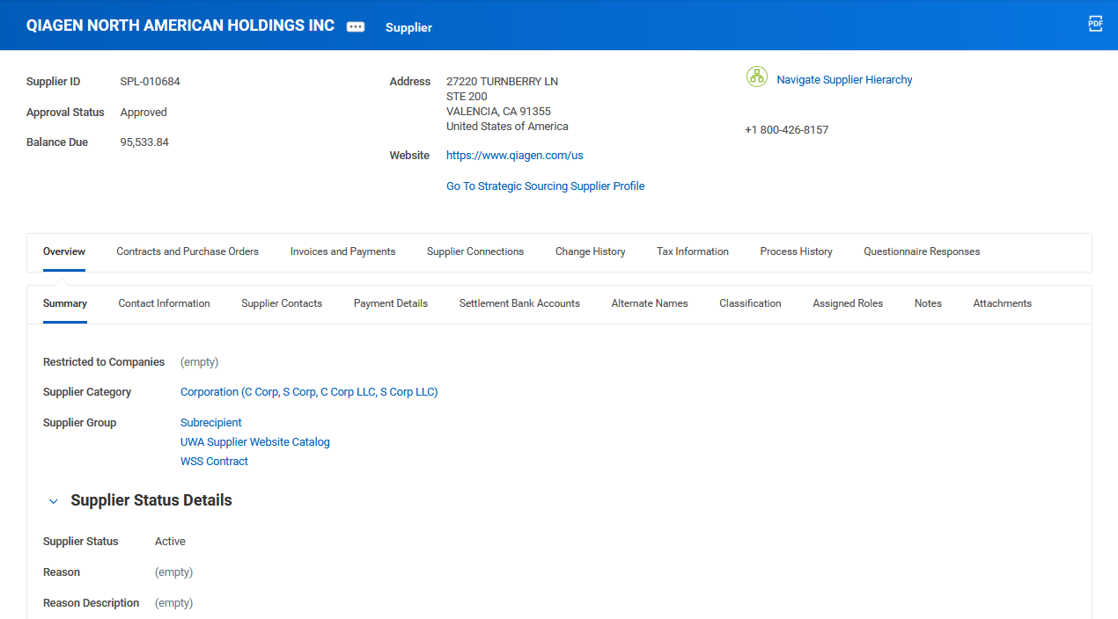
USING WORKDAY SUPPLIERS
IRS Entity Type
Critical Processes:
UWA Supplier Website Catalog
WSS Contract
Subrecipient
Both of the
Find Suppliers reports can be filtered for Groups
Goods & Services Offered, like:
Audio/Visual Services
IT Services
Catering
Status, Reason & Reason Description:
Inactive Suppliers May Have Important Notes Here

Slide 19
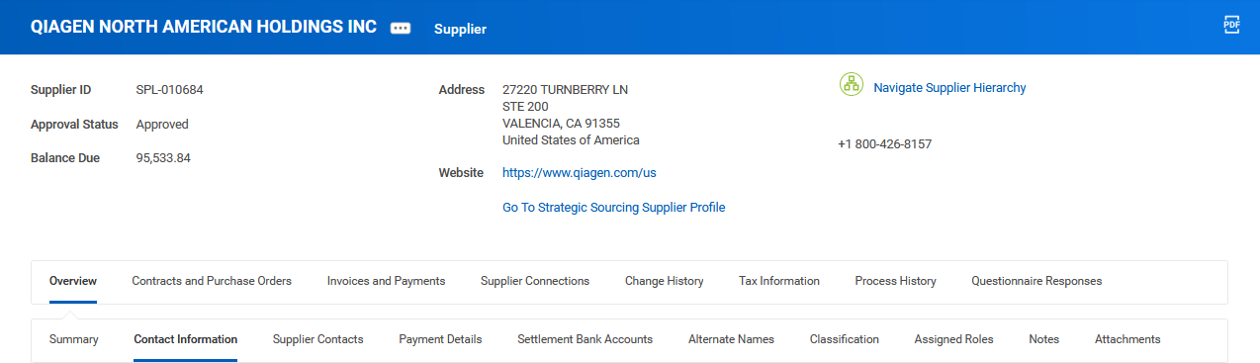
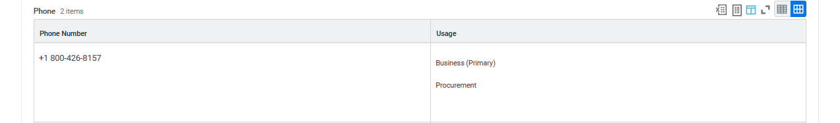
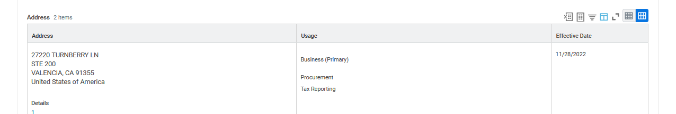
USING WORKDAY SUPPLIERS - OVERVIEW
How POs are Issued
(Many by Email)
Remit-To Connections
Order Connections
Phone, Address, Email and
How They are Used
Alternate Supplier Connection
Doing Business As,
Trade Names & Divisions
Supplier Addresses
Have the Usage Defined for Each Address

Slide 20
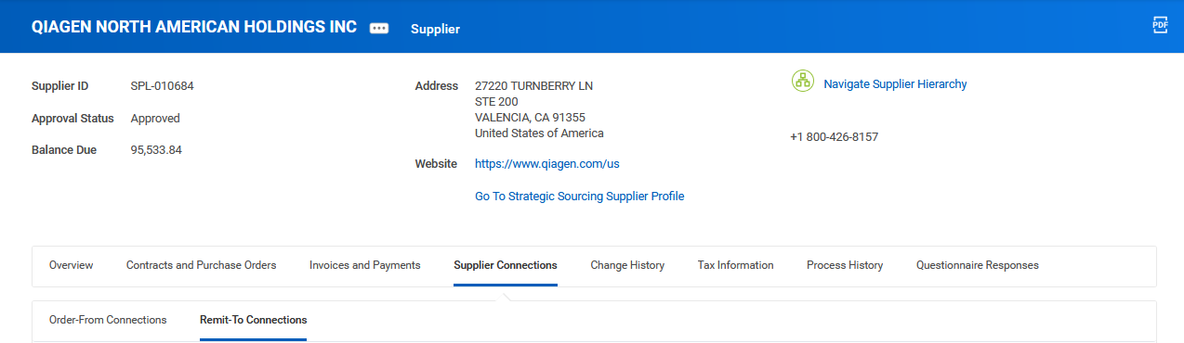
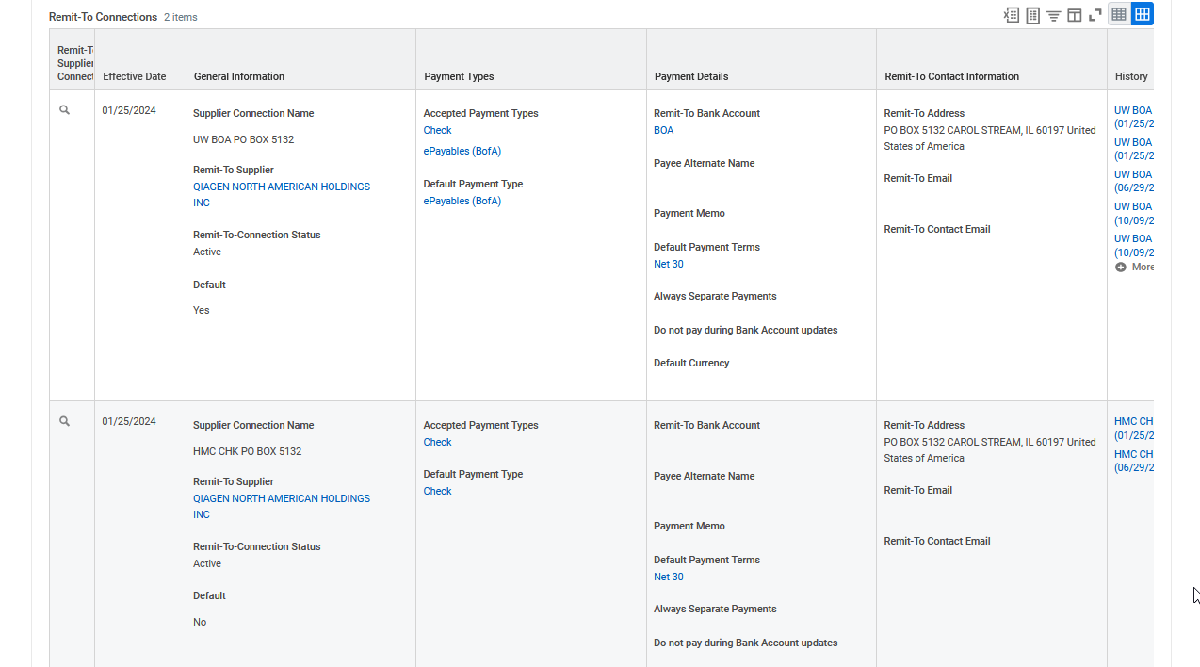
USING WORKDAY SUPPLIERS - ADDRESSES
Very Few Suppliers Have Order-From Connections
All Suppliers Have at Least One Remit-To Connection
Connection Name
Company + Payment + Address
Remit-To Connection Address
Payment Options
Still in Progress and
Cannot be Used
How Supplier Will be Paid

Slide 21
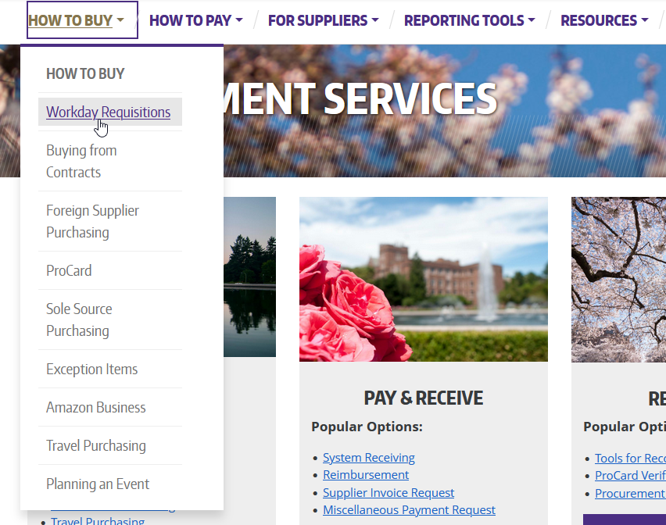
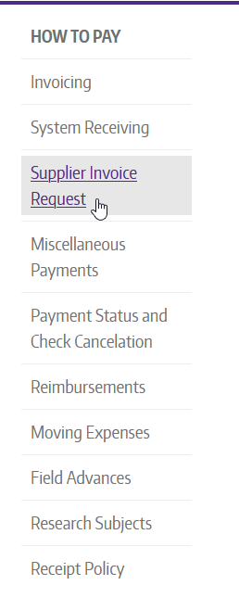
USING WORKDAY SUPPLIERS RESOURCES
Refer to the website guidance and UWCF Job Aids for transactions

Slide 22
BEST PRACTICES
Before Onboarding a New Supplier, Check:
Workday catalogs
For an existing supplier, especially diverse suppliers and suppliers with UW contracts
If the supplier accepts ProCard for appropriate purchases
With a subject matter expert in Procurement
Onboarding requires many teams working together
Unit/Dept
Staff & SEs
Central Office
Staff
Supplier

Slide 23
BEST PRACTICES FOR ONBOARDING
After Requesting a New Supplier
Look up suppliers in Workday using the search bar with “supplier: [name]”
Use the Find Suppliers or Find Suppliers R1495 reports
  Find Suppliers R1495 was created because you can search by email, full or partial (often the email from the Supplier Request Form)
If the supplier cannot be found in Workday within 2-3 business days of the ticket being Resolved, they likely did not submit the registration form as requested
Procurement Customer Service (PCS) is the resource for unit and SE questions, including about suppliers
Utilize the online resources created by Central Office to avoid confusion when communicating with suppliers

Slide 24
BEST PRACTICES IN WORKDAY
When Using Workday Suppliers:
Keep in mind Workday Suppliers are enterprise data
If the supplier exists but is unfamiliar, it’s great to point them to the website for the "Maintaining Your Profile" instructions - we may not have heard from them in a while
Check for important things like Supplier Name or Alternate Payee Name
Verify the Supplier Address still matches; if it doesn’t, ask the supplier to contact us before submitting an SIR
Check if the supplier is one of the special cases, such as a those with Order Connections or Parent/Child set-ups

Slide 25
RESOURCES
For UW Staff & Shared Environment Specialists:
Supplier Request Form Nano-Learning Video (<7 min)
Supplier Request Form
UWCF Request Form Routing Instructions
Knowledge Navigator – UW Workday Terms
For Suppliers:
UW Supplier-Dedicated Webpage: https://finance.uw.edu/ps/suppliers

