Slide 1


Travel Information Meeting
March 2026

Slide 2

Agenda
Enterprise/National Car Rental Presentation
Buying from Contracts/Signing Policy Review
Policy Reminders & Updates
Workday Updates
Questions

Slide 3

Enterprise/National Car Rental Presentation
Presented by Enterprise

Slide 4

Buying from Contracts/Signing Policy Review
Departments are to not sign contracts or agreements (may subject employee to personal liability)
Submit document for signature via Procurement Contract Manager Support Request form
Buying from Contracts

Slide 5

Policy & Procedure Reminders
Reimbursing expenses on behalf of others
  FAQ: How do I request travel reimbursement if I paid for someone else?
  Name of other travelers, relation to the UW business
Package Deals
  Not a recommended method to book travel – may be taxable due to limited itemization
  If purchased, please email travel@uw.edu with employee name, employee ID #, expense report #, payment description and package deal line item amount. Please attach proof to the expense report.
Per Diem
  Individual meal allowance (ex: If department allows only breakfast, they may be reimbursed up to breakfast per diem and not the total daily per diem)

Slide 6

Policy & Procedure Reminders cont.
Travel Agencies
  3 UW-contracted agencies: Key Travel, Tangerine Travel and Collegiate Travel Planners
  Cost-savings (UW and state contracted and agreements + agencies' additional internal discounts) & duty of care (unused tickets, on-call support)
  Encouragement to use CTA over personal funds = time saved by not having to submit reimbursement
Domestic & International Travel Assistance:
  Domestic: Obtaining department contact, having insurance on file,
    Field Work: Contact UW Environmental Health & Safety
    Financial Assistance: Emergency Aid
  International: Global Travel Health & Safety – Emergency Resources

Slide 7

Policy & Procedure Reminders cont. (2)
Airfare Upgrades
  Complementary upgrade due to airline status, please note on reimbursement for context
  All medical reasons for upgrades must obtain a prior approval from the DSO office (ADA Compliance/Travel Medical Accommodations)
  14-hour rule
    Flight times and layovers (less than 24 hours)
  Class of Service fields
    Seat fees are considered Premium Economy, please select "Premium Economy Class" OR input a separate Seat Fee expense item
    Example: Alaska Airlines – Main Preferred Seat

Slide 8

Policy & Procedure Update
As of October 1, 2025, Live Presentations expenses, including conferences, seminars, workshops, lectures, etc., within Washington are considered taxable sales.
  Live presentations may also include registration, membership, and abstract fees.
  In-Person live presentations should be taxed using the sales tax rate of the location of the presentation.
  Virtually attended live presentations should be taxed based on the attendee's location. If no information is provided about the attendee's location, the billing address will be used.
  Contact Tax Office (taxofc@uw.edu) for assistance

Slide 9

Policy & Procedure Update (Demo)
Expense Reports: See Expense Report Job Aid (Page 26) on "How to Apply Use Tax"
  If using the Business Travel Business Purpose, please select the expense item, "Registration/Conf. Fees - Washington State".
  If using the Non-Travel Business Purpose, please continue to use the expense item, "Training and Conference Fees".
Miscellaneous Payments: Please select the spend category, "Training and Conference Fees (SC1046)".
  Training and Conference Fees expense item and spend category (SC1046) are identified as taxable sales. Users must comment on the reimbursement request that the expense is not taxable and the reason (i.e. Out of State, Foreign).
  For assistance, contact Procurement Customer Service (pcshelp@uw.edu)
Conference Expenses Page

Slide 10

Workday Updates
In Progress - 60 Day Policy (Date is TBD)
On the roadmap - Request for Non-Employees (Students, Visitors, Candidates) to be reimbursed through the "Expense Report for Non-Worker" module
In Progress - Spend Authorization Enhancement
  Pre-trip approval

Slide 11
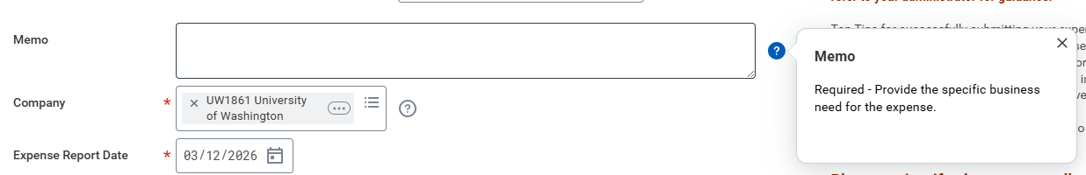
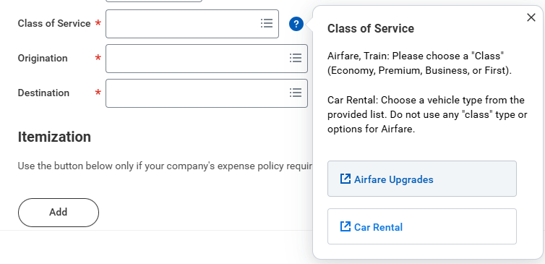
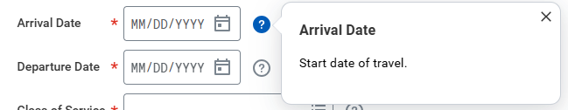
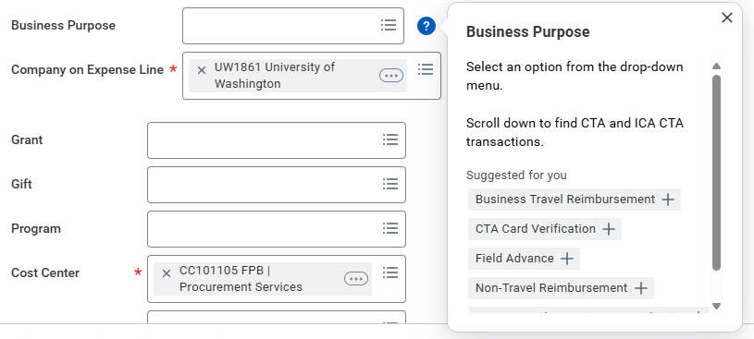
Workday Updates (Demo)
In Progress - QuickTips (Expense Reports & Spend Authorizations)

Slide 12
Questions?

