Slide 1


Travel Information Meeting July 2024

Slide 2


Agenda
Alaska Airlines Presentation
DSO/ADA Update & Q&A with DSO team
Car Service Policy updates
Mobile Payment Services updates (Venmo, Paypal, etc.)
Reimbursements to Employees with foreign bank accounts
New Reduced/legacy per diem expense items
NEF Form update
WD Updates
Questions
Notes:
Expenses aren't described as the description is dependent on whatever the person puts it as

Slide 3

Alaska Airlines Presentation
Dan Nevill & Gina Olan

Slide 4

DSO/ADA Update
Required documentation has been simplified to only a comment on reimbursement requests. An email from the DSO confirming accommodation has been removed
It is the department's responsibility to keep the letter of approval on file
Annual renewal is now only required for those who do not have permanent conditions
Travelers are required to obtain prior approval before the travel takes place
If the travel has taken place with no prior approval, the traveler must work with their department on receiving a post-travel approval:
Dean/VP/Vice Provost (First/Business Class)
Administrator (Main Cabin/Economy Upgrade)

Slide 5
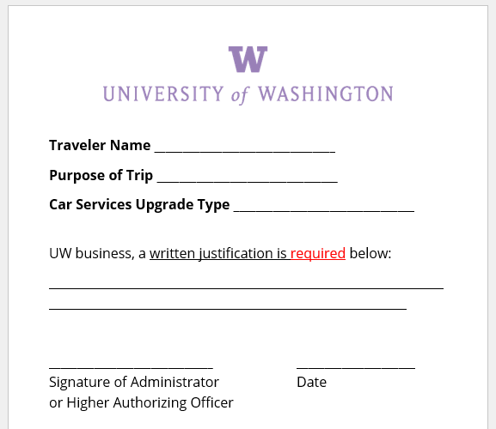
Car Service Policy updates
For travel taken on and after 09.01.2024
Admin Approval for Car Service upgrades and fees
New admin approval form
Business Justification & Approval
All Car Service expenses will require receipts
Car services will no longer be included under the $75 misc. expense receipt exception
If unsure whether a receipt is acceptable, please contact us!
Notes:
Admin approval similar to airfare admin approval for coach upgrades
Uber and Lyft receipts are always available in the app.
Full uber and lyft receipts will be required
Flexibility for what is offered in developing countries. Ie. handwritten receipts
Admin approval is approve the business justification provided.

Slide 6
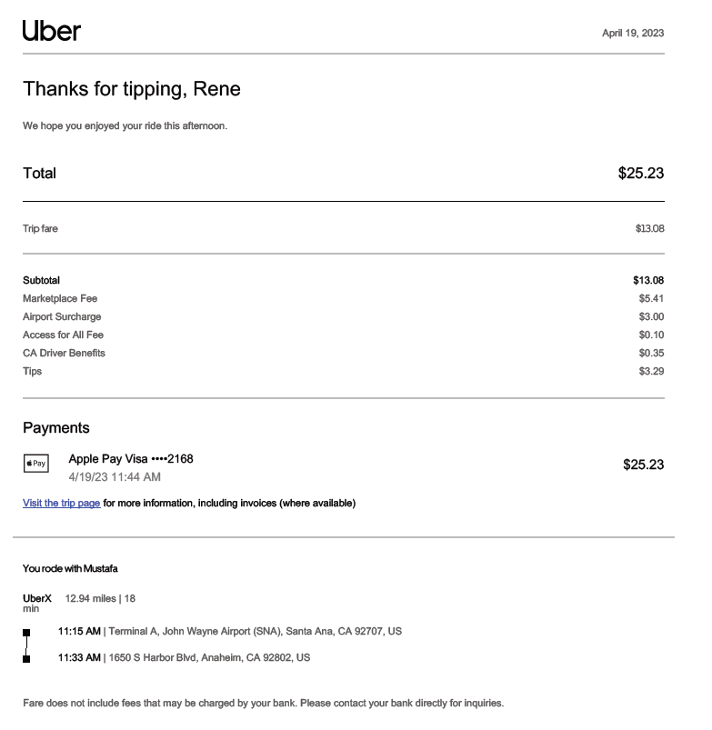
Uber

Slide 7
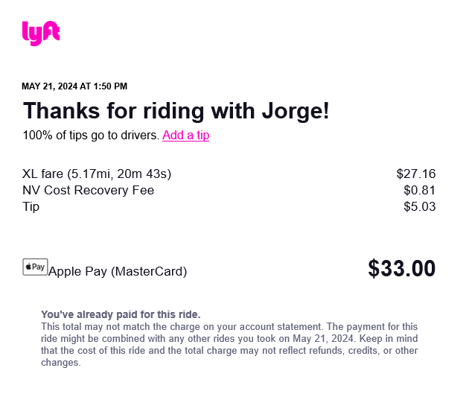
Lyft

Slide 8

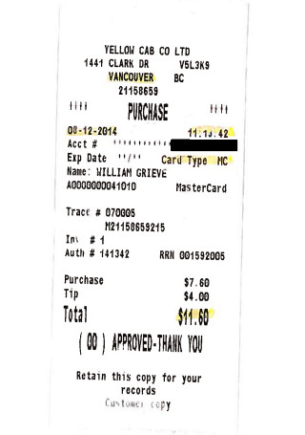
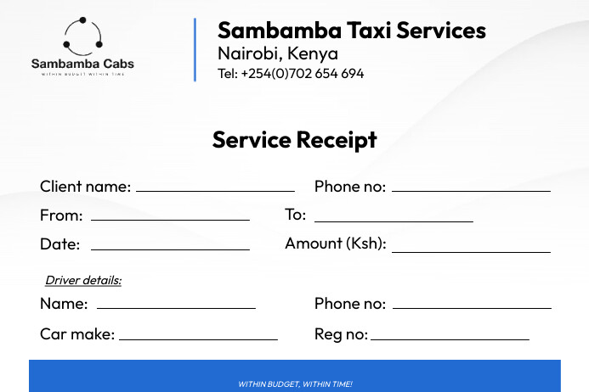
Taxi

Slide 9

Mobile Payment Services Update (Venmo, Paypal, etc.)
After collaborating with Internal Audit, Venmo, PayPal and other mobile payment services will not require additional documentation such as bank or credit card statements
Policy regarding Exchanging of Funds using these types of payments will continue to be upheld

Slide 10

Reimbursements to Employees with foreign bank accounts
Applies to employees receiving foreign payroll wires
Notify Travel Services at travel@uw.edu
Provide ER#
Provide $ amount being wired
Attach a filled-out wire form.
Notes:
Accounts payable granted exception to allow these as manual wire requests due to no in system solution

Slide 11

NEF Form update
Attempt to fix the unchecking personal time box bug in browsers
Updated “UW Box #” field to “Phone Number”
Suggestions? Email us!
Still accepting the previous one but recommend the new one

Slide 12
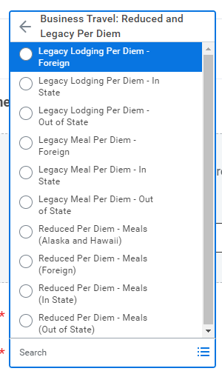
Workday Updates
Per Diem - Legacy/Reduced Expense Item has been replaced by the Reduced and Legacy Per Diem Expense Item Group (see photo)
Reduced Per Diem – Meals only, similar to Ariba's Override Field, reimbursing less than per diem rate or a custom lower than per diem rate
Legacy Per Diem – Meals & Lodging, travel prior to 2023
Includes inputting Travel Status Start/End Dates and Times

Slide 13


Workday Updates
In Progress - Request for Non-Employees (Students, Visitors, Candidates) to be reimbursed through the "Expense Report for Non-Worker" module
In Progress – Per Diem Integration – Working with UW-IT on a back-end system to upload per diem more efficiently
In Progress - Company Errors for UWM Spend Authorization and Expense Report Reconciliation
Pre-Encumbrance vs Travel Advance

Slide 14

Submitted Questions
Flight Receipts – What is pertinent information on an itemized airfare receipt?
Origin and Destination
Flight Dates
Flight Class (Fare Class)
Breakdown of Costs (Total Amount, Add-Ons, Taxes, Fees)

Slide 15
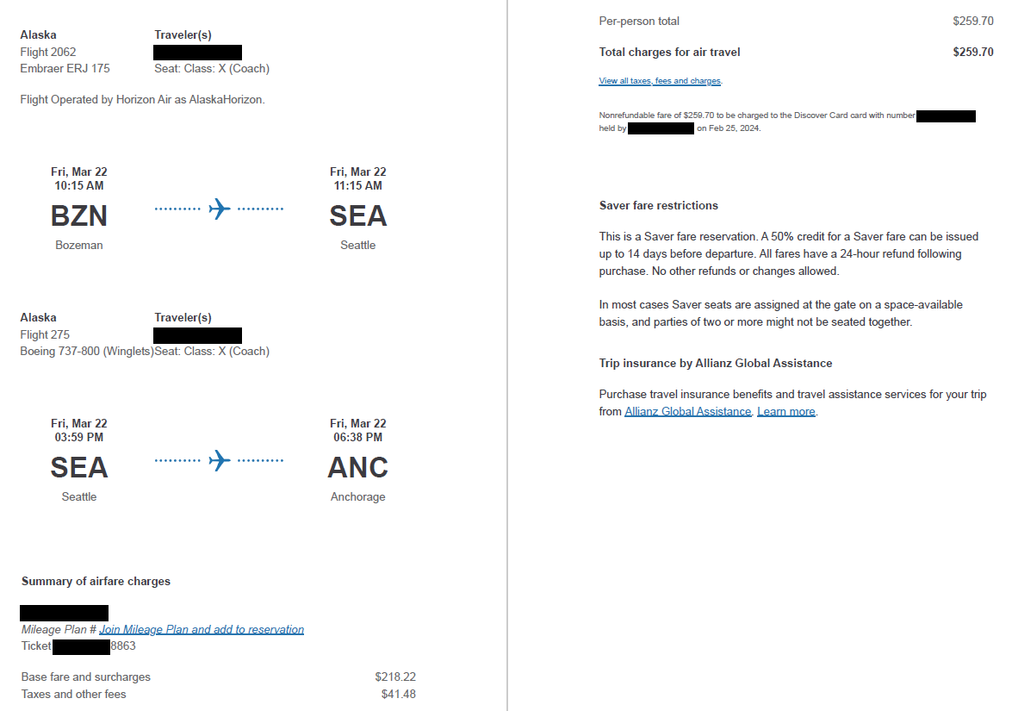
Submitted Questions Part 2

Slide 16
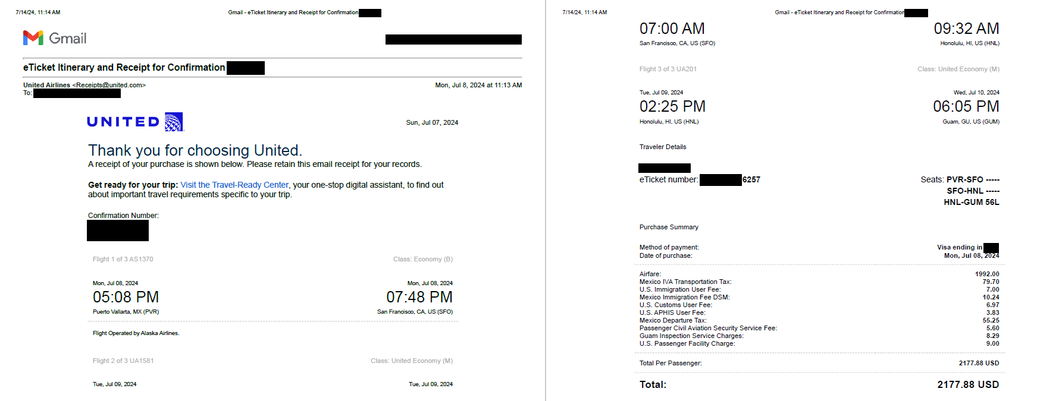
Submitted Questions Part 3

Slide 17
Submitted Questions Part 4
Additional Driver - What if the 2nd driver is a driving for medical reasons? What if someone else drives because the UW traveler cannot drive?
2nd Driver for medical reasons must be reviewed by the DSO as a travel medical accommodation
If the traveler is not able to drive and another person must drive, the additional driver must be on UW business. Ex: A person from the Collaborator's Team or Sending another from the Department

Slide 18
Submitted Questions Part 5
Rural Travel: Is there approved documentation to use on how to handle reimbursements for rural places? These include cash societies or receiptless locations for research such as the Amazon or other remote locations.
Will depend on the type of expense, this is on a case-by-case basis and it is recommended to email Travel Services
For travel to remote locations, it is recommended to request a Field Advance. Field Advances are for conducting UW business in places where credit card or check are not accepted.

Slide 19
Submitted Questions Part 6
Alternatives to Flying: Is this quantitative (miles or hours between destinations)? For example, in the case of driving from Pasadena to Berkeley, do we need to include a flight comparison to show how much airfare would have cost?
The department must determine (1) what is the most economical method (pre-trip approval process) and (2) if driving vs flying is a personal preference for the traveler
If it is personal preference, a flight comparison must be obtained and the lesser cost between the mileage vs flight will be reimbursed
If it is not personal preference, no further action is to be taken

Slide 20
Questions?

