Slide 1


Travel Information Meeting February 2025

Slide 2


Agenda
GTS Travel Insurance Update
UW Travel Discounts
14-hour rule
Travel Status & Ground Transportation, 11-hour rule
Return Checks & Check Cancellations AP Procedure
Travel Advances Policy + SOM/UWM
Questions
Notes:
Expenses aren't described as the description is dependent on whatever the person puts it as

Slide 3
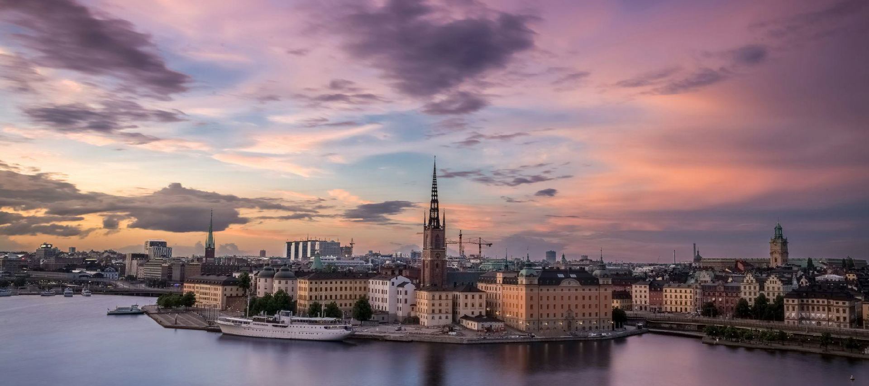
Global Insurance and Travel Changes, 2025
UW Global Travel Health and Safety
Office of Global Affairs - Maddie Macmath

Slide 4



Insurance Provider
Emergency Assistance Provider
Insurance company who creates scope of coverage and pays for services
Cigna
Provides on the ground assistance
to impacted travelers
International SOS
What is Global Insurance?

Slide 5
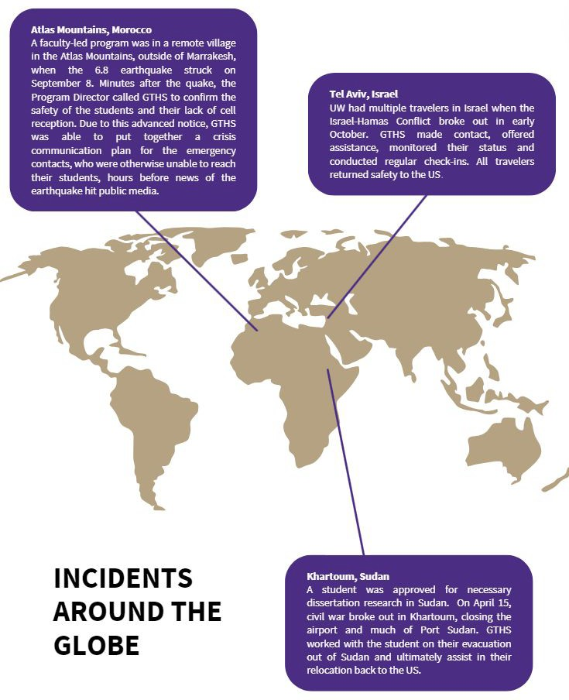
Why?
Travel Registration
Awareness
Increased Support
Your Health and Safety

Slide 6
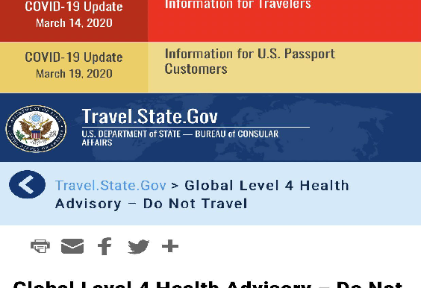
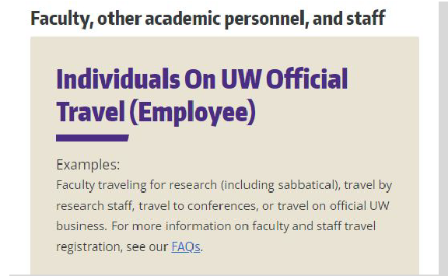
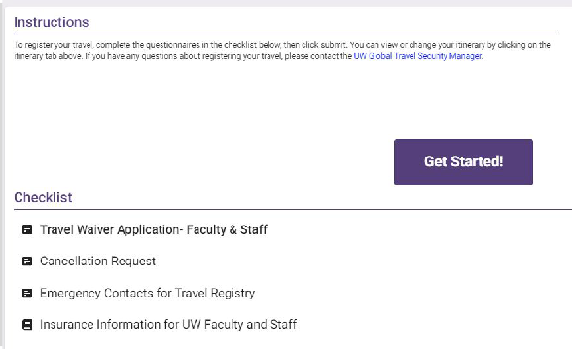
Travel Registration & Accessing Insurance
Travel registration helps us assist you in the event of an emergency. All UW oﬃcial travel should be registered.
1. Click “Travel Registration” and “Employee”
www.washington.edu/globa laffairs/global-travelers
3. For countries with Department of State Level 4 advisory areas, you will be required to sign a travel waiver document.
2. Create a new itinerary and input emergency contacts.

Slide 7
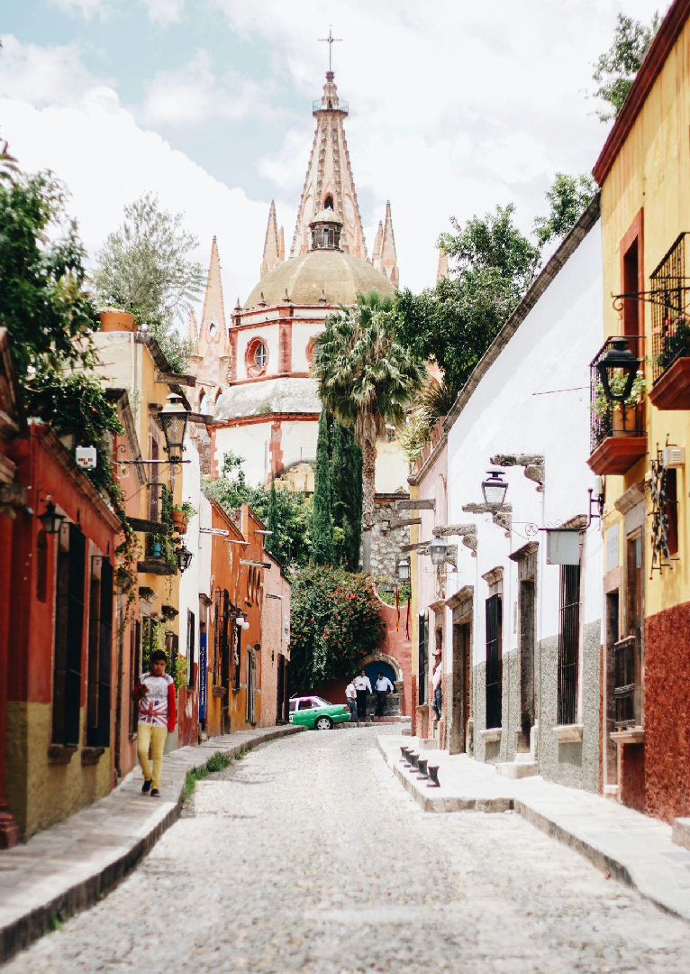
What’s covered under insurance:
NOTE: As of January 1, 2025, dependents are covered when traveling with a staﬀ/faculty member on UW oﬃcial business
$500K medical maximum per traveler, per year. This includes coverage for pre-existing conditions.
$250K medical evacuation/repatriation
$0 deductible, no coinsurance
Evacuation for political crises, natural disasters Coverage for mental health treatment
Preventative care, trip delay/cancellation, high-risk activities are NOT covered.
Note that there are no individual enrollments.
➢
➢
➢
➢
➢
➢
➢
➢

Slide 8
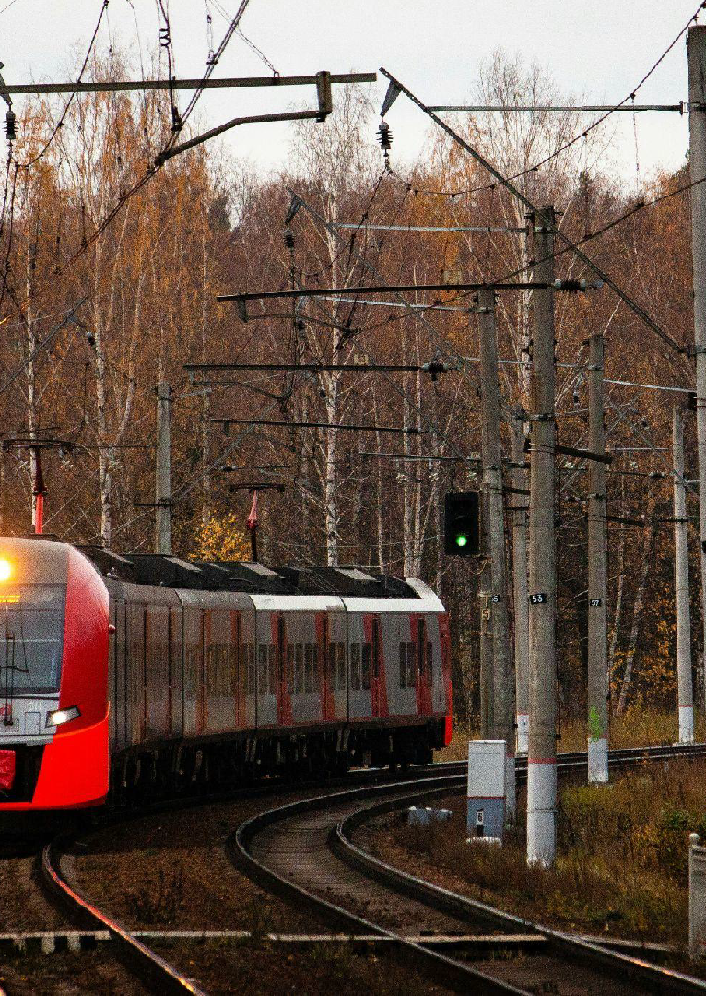
Executive Orders Impacting Global Travel
NOTE: there is still limited information on the total eﬀect of the EOs and future actions that will impact global travel.
Reach out to travelemergency@uw.edu with questions
The Department of State has removed the third-gender marker (gender X) option and will no longer issue or renew passports with a third-gender marker.
Active passports with a third-gender marker will remain valid
The current administration has ordered a 60 day-review to compile a report of recommendations around potential travel restrictions
Important note: Travelers with US visas really need to have their travel documentation in order prior to departing.
➢
➢
➢
➢
➢

Slide 9
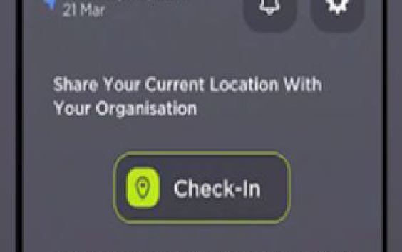
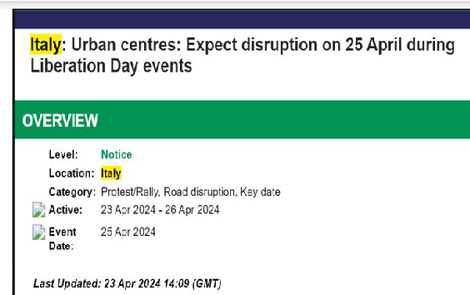
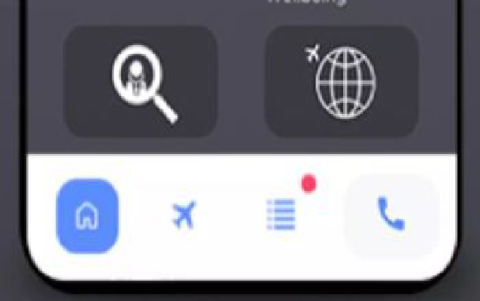
INTERNATIONAL SOS
Use the GREEN check-in button
Pay Attention to ALERTS
When in doubt: CALL ISOS!
ISOS is your emergency assistance provider.
We recommend that you download and set up the app when traveling abroad. Calling ISOS during an emergency or for help setting up medical care is the easiest way to get support.

Slide 10
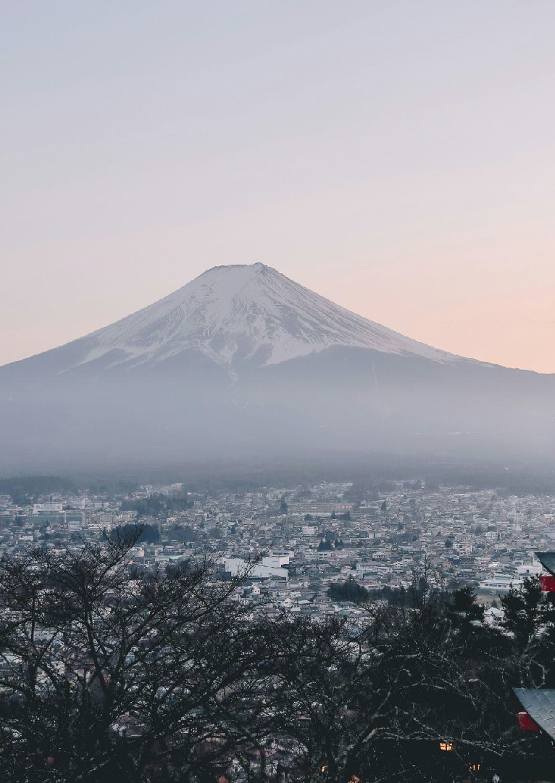
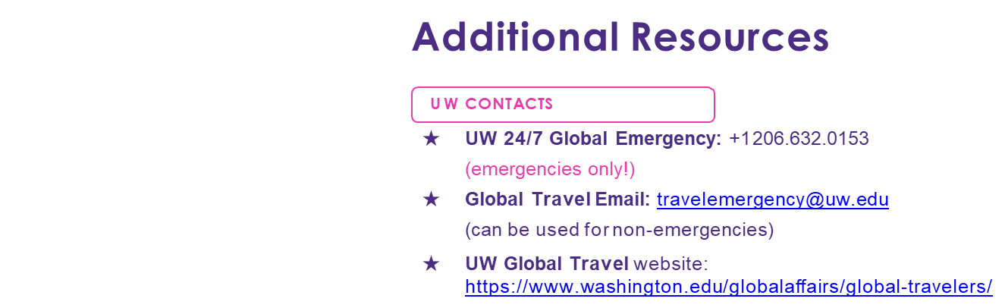
Additional Resources
INTERNATIONAL SOS
★ ISOS Assistance Center: +1 215.942.8226
★ Cigna Member ID: 09895A001

Slide 11

UW Travel Discounts
Airfare (Alaska/Delta/Turkish Airlines)
Lodging (Over 70+ Vendors)
Personal vs Business
Car Rental (Enterprise/National)
Travel Agencies
Other Ground Transportation (Parking, Charters/Shuttle, Ferry)

Slide 12
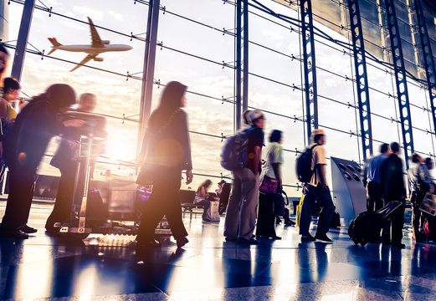
14 Hour Rule
Allows for upgrades to business class or foreign layover en route or at destination
Not to exceed 24 hours
Time counted towards the 14 hours =
Flight time from origin airport to destination airport + layovers
Applies per leg
Only needs prior approval

Slide 13

Travel Status & Ground Transportation, 11 Hour Rule
Travel Status eligibility does not apply to Ground Transportation expenses
Travel Status = Per Diem (Lodging/Meals)
Reminder 11-Hour Rule – Do not factor meals into hour amount
Ground Transportation = Route

Slide 14

Return Checks & Check Cancellations AP Procedure
Checks printed with no address are sent to Gateway Building (UDSB)
AP cancels and shreds all reimbursement checks
Requester actions:
Adjust address in payee profile (for MPs)
Have payee update their address in WD
Resubmit payment

Slide 15

Spend Auth/Travel Advances Policy, SOM/UWM
UW1861 worktags only
SOM/UWM are not able to reconcile spend authorizations or travel advances
Error stating their intercompany (SOM, UWMSS, HMC etc) cannot be used and UW1861 is only allowed.

Slide 16
Questions?

