Slide 1


UW Global Support
Maddie Macmath
Manager for Global Travel Health and Safety

Slide 2

Core Functions - Global Travel Health and Safety
Travel Registration
Create awareness of global footprint; monitoring of global events
Emergency Response
Insurance
24/7 Global Emergency Line (work with UWPD); rotation of Duty Officers
Ensure travelers have adequate coverage
-Blanket Policy as of 2024
-International SOS

Slide 3

Pt. I: New! APS 75.1 Official Intl. Travel
What It Is: Policy that requires online registration for official international travel undertaken by UW faculty, staff and other academic personnel. The APS primarily does three things:
Defines ‘official’ international travel
Outlines the Roles and Responsibilities of university units in administering the policy
Provides requirements for registering official international travel and the submission of travel waivers for travel to high-risk destinations.

Slide 4
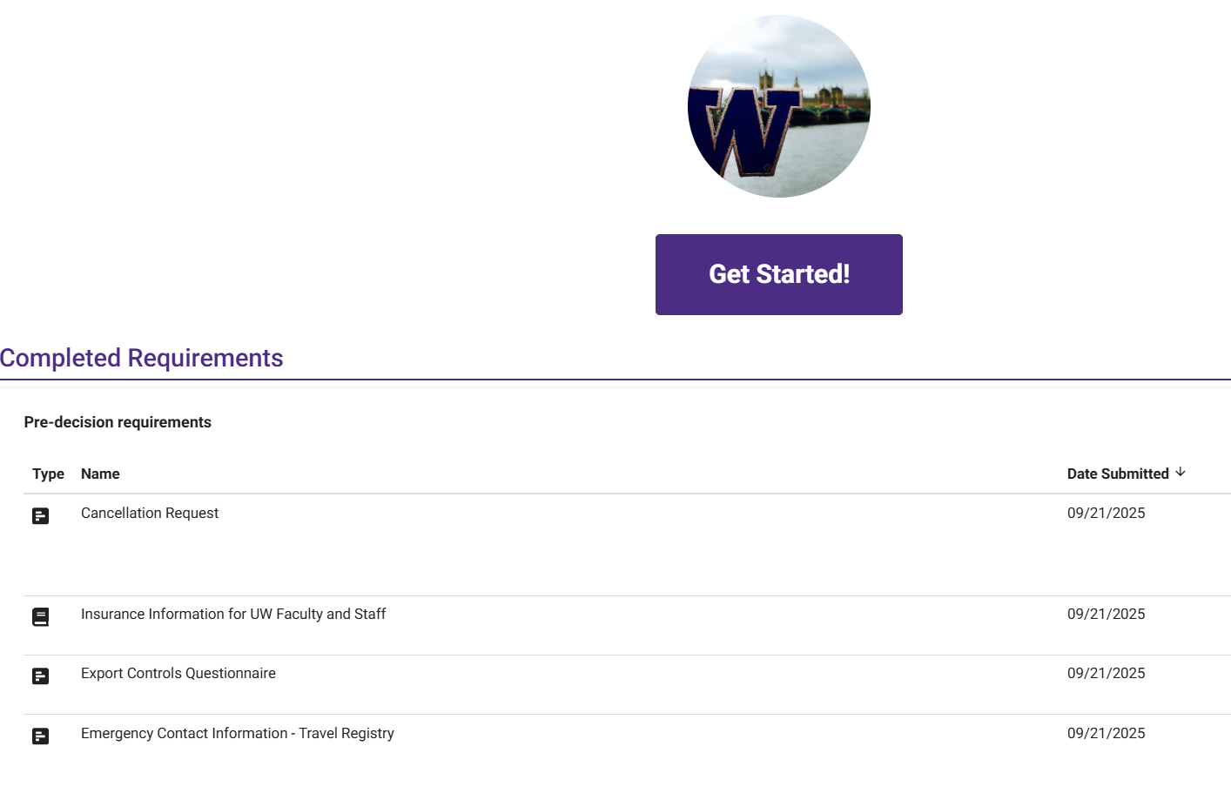
What Does This Look Like for the Traveler?
Registration takes just a few minutes
Review information on accessing insurance
Provide emergency contacts
High-risk travel petition (limited cases)
Working on proxy registration option!

Slide 5

Pt. II: Updated Temporary International Remote Work Policy
Reaffirms the principle that UW employees are generally prohibited from working remotely from an international location on an ongoing basis (more than 30 days)
Outlines that limited exceptions to this rule require advance approval
Updates the request form and approvals process.
Applies to both current UW employees temporarily remotely working abroad, and to UW employees hired into overseas locations.

Slide 6

Why?
The policy protects both UW and individual employees from the legal and tax risks associated with long-term work abroad without a registered legal presence in that jurisdiction
It will help UW be in compliance with international tax and employment laws, and mitigate risk to the UW globally
Taking a risk-based approach to assessing requests, allowing
units to make informed decisions

Slide 7

How Does It Work?
Departments can request* approval for an employee to temporarily work from an international location, for periods longer than 30 days. The form is linked from the policy.
Forms should be submitted to UW Global at least 4 weeks prior to the start date of the work abroad.
Form is signed off on by department head.
Requests are reviewed by UW Global and other relevant units, including UW HR, Tax Office, Export Controls, and UW-IT.
*Should be essential to work responsibilities or due to a personal emergency
Notes:
https://hr.uw.edu/hybridwork/telework-policies-and-agreements/international-remote-work-for-staff-and-student-employees

Slide 8

We’re Here to Help!
Global Travel Health and Safety: travelemergency@uw.edu
Global Operations Support: globaloperations@uw.edu
Office of Research: researchsecurity@uw.edu
https://www.washington.edu/globalaffairs/global-travelers/

Slide 9

Questions?
https://www.washington.edu/globalaffairs/global-travelers/travelregistry/facstaff/
Pre-submitted questions:
  What is the role of a unit to check if the someone registered travel?
  Will proof of registration be a requirement for all international reimbursements?

