Slide 1
University of Washington
Private Business Use Training
October 30, 2025

Slide 2
Agenda
  Private Business Use (“PBU”) Overview
    Overview of Guidelines
    How is it measured?
    Consequences – exceeding IRS limit
  Overview of the University’s PBU Process
  InVision Replacement - FM Systems Overview
  Q&A
Notes:
Shannon to start
*and securities law requirements, but we won’t discuss those today

Slide 3
Private Business Use:
Overview

Slide 4
Basic Rule (Governmental)
Bonds issued as governmental bonds will become “private activity bonds” and therefore lose their tax status if:
  More than 10% of bond proceeds are used for a “private business use” and
  More than 10% of the debt service on the bonds is directly or indirectly payable from or secured by property used in a private business.
  Or, more than 5% of the bond proceeds are loaned to a private entity
Note: Special rule for bond issues above $150 million: The amount of private business use is effectively capped at $15 million per issue.
Notes:
Alison

Slide 5
Private Business Users
Federal government
Foreign governments
  Corporations, partnerships or any other entity engaged in business
  Natural persons engaged in a trade or business
  Governmental Bonds: 501(c)(3) organizations
  Special rules for partnerships with private users
  Note: Students are not private users. They are natural persons, not engaged in a trade or business.
Notes:
Alison

Slide 6
Types of Private Use
    Ownership
    Leases
    Management Contracts
    Output Contracts
    Sponsored Research Agreements
    Other actual or beneficial use
      Special Legal Entitlements
      Priority Rights
      Naming Rights
Notes:
Alison

Slide 7
Short Term Use Exceptions
50 Day Short Term Use Exception
Use by a nongovernmental person is not PBU if
      Term not greater than 50 days
      Negotiated arm’s length arrangement with fair market value compensation
      The property was not financed for the principal purpose of providing that property for use by that nongovernmental person
      Renewal options: for this purpose, it means a provision providing either party a legally enforceable right to renew the contract
        Does not include “evergreen” provisions if either party can cancel
100 Day Short Term Use Exception
Only applies if facilities aren’t available for use by the public (i.e. prisons)
Notes:
Alison

Slide 8
Management Contracts 101
What is a management contract?
    A management, service, or incentive payment contract between a governmental person and a service provider under which the service provider provides services involving all, a portion of, or any function of, a facility.
      Examples: Contract for management of dining services, incentive payment contract for physician services at a hospital.
    Can result in private business use unless:
      The Regulations specifically say it is not treated as a management contract.
      The contract is a “qualified management contract” under Revenue Procedure 2017-13.
      The contract under the “facts and circumstances” does not result in a net profits arrangement or otherwise constitute private business use.
    Net profit compensation is a problem
Notes:
Alison

Slide 9
Research Agreements
What is a research agreement? An agreement by a nonqualified person to sponsor research performed by a qualified person.
      Might also be called Collaboration Agreement, Material Transfer Agreement.
Why would this be private use? Basically, the IRS does not want private entities using the University to do their product testing for them or to be the primary beneficiaries of University research.
Sponsored “applied research” is generally private business use. For example, product testing supporting the trade or business of a specific nongovernmental person is applied research.
Sponsored basic research may or may not be private business use. “Basic research” means any original investigation for the advancement of scientific knowledge not having a specific commercial objective.
Notes:
Commercial objective vs. knowledge objective

Slide 10
Qualified Research Agreements
Safe Harbors in Revenue Procedure 2007-47:
Corporate Sponsorship:
      Single sponsor (not including federal government)
      Can grant an exclusive license to the sponsor, but only on the same terms that would be offered to a non‑sponsoring party
      Must pay fair market value determined after the IP/technology has been created
Notes:
Note: An exclusive license to a sponsor will be a red flag to the IRS. Any contracts granting exclusive license rights or royalties should be reviewed for private business use.

Slide 11
Qualified Research Agreements
  Additional Safe Harbors
    Industry Sponsorship
      Single or multiple sponsors (can include the federal government).
      The qualified user determines the research to be performed and the manner in which it is to be performed (for example, selection of the personnel to perform the research).
      Title to any patent or other product incidentally resulting from the basic research lies exclusively with the qualified user.
      The sponsor or sponsors are entitled to no more than a nonexclusive, royalty-free (NERF) license to use the product of any of that research.
    Federal Sponsorship
      Subcategory under “Industry Sponsorship”—includes Federal agencies like National Institute of Health and National Science Foundation.
      The existence of march in rights under the Bayh-Dole Act will not cause the contract to be outside the safe harbor.

Slide 12
Basic Measurements
The amount of private business use of property is determined according to the average percentage of private business use of that property during the measurement period.
Measurement Period:
      Starts: later of the issue date of the bonds or the date the property is placed in service
      Ends: earlier of the last date of the reasonably expected economic life of the property or the latest maturity date of the bonds
Track the private business use on an annual basis and then average the annual use over the measurement period.
“Qualified Equity” can off-set private business use in each year
Notes:
Note: An exclusive license to a sponsor will be a red flag to the IRS. Any contracts granting exclusive license rights or royalties should be reviewed for private business use.

Slide 13
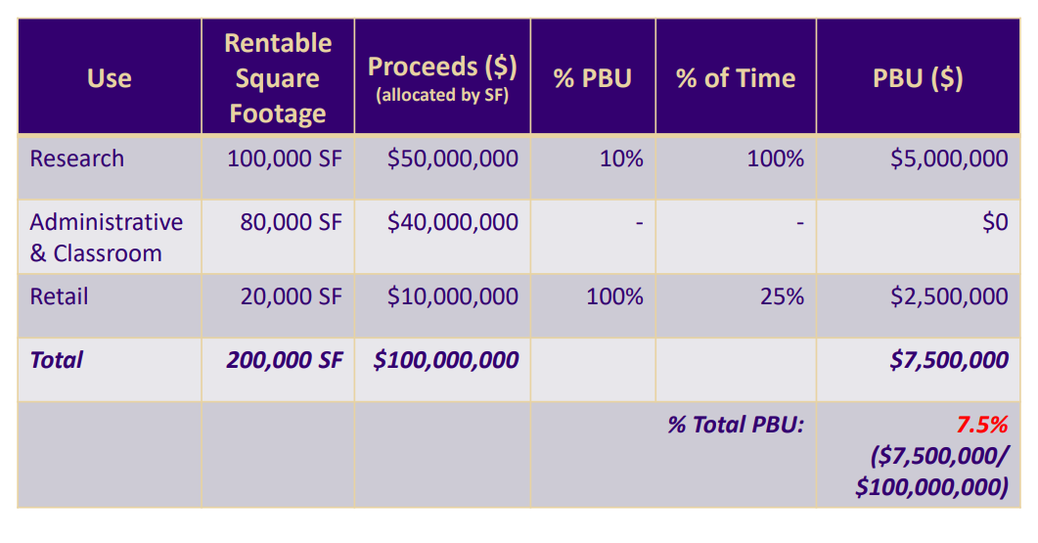
PBU Calculation Example
Example: UW finances a building with $100,000,000 in tax-exempt bonds. The bonds have a 20-year measurement period and the building has 200,000 total RSF with the following uses:
      Research (100,000 RSF): Building has $4,000,000 in annual research expenditures and $400,000 per year is private use (10% of the research space)
      Administrative & Classroom (80,000 RSF): Used for classroom instruction and administrative purposes (no private business use)
      Retail Lease (20,000): Portion of facility is leased to a private retail tenant for 5 years (25% of the measurement period)

Slide 14
Remedial Action, VCAP, Audits
  Remedial Actions
      In some cases, you can take a remedial action to ‘fix’ a change in use that would otherwise cause bonds to be private activity bonds
      Redeem nonqualified bonds
      Alternative use of disposition proceeds or facilities
      90-day window
  Voluntary Compliance Agreement Program (VCAP)
  IRS Examinations/Audits
Notes:
Alison, if we have time

Slide 15
Post Issuance Tax Compliance:
UW Resources and Process

Slide 16
Private Business Use - Resources
PBU Resources Available at: http://f2.washington.edu/treasury/pbu
    Guide to Identifying and Measuring Private Business Use in
      Tax-Exempt Facilities
PBU calculation examples
Sample PBU calculation workbook
Tax-Exempt bond-financed campus map
Annual PBU Survey link
Instructions for updating Space Manager for PBU survey
Notes:
Shannon

Slide 17

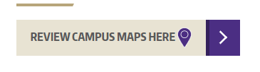
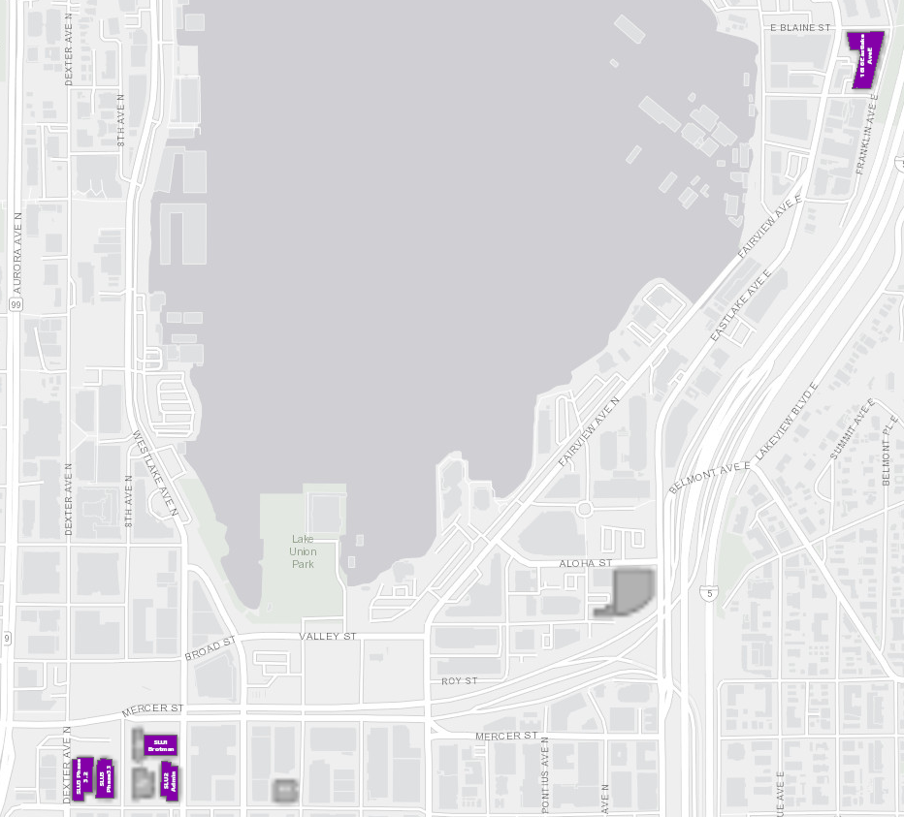
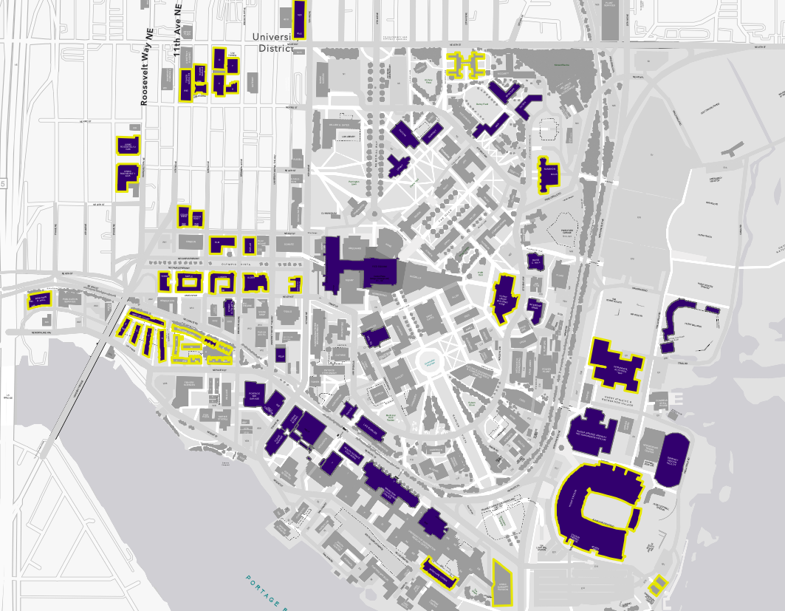
Tax-Exempt Financed Facilities
Notes:
Shannon
Measuring PBU starts with identifying which buildings will be financed with bond proceeds.
Expectations: as part of the planning for each bond issue we identify
Building to be financed
Sources of funds (qualified equity – next slide)
Potential private uses
All set forth in tax certificate at closing
Actual – sometimes the buildings financed or the amount of equity or private use changes.
“Final Allocation” - within 5 years of issue date and 18 months of PIS date

Slide 18
PBU Tracking Annual Process
Surveys are sent each summer for all bond-financed facilities
ORIS separately sends research expenditure data
School of Medicine sends HHMI investigator data
Treasury pulls current space data
Treasury reviews surveys and compiles a summary
Treasury collects any new or updated contracts
Pacifica reviews the summary, research data and contracts
Pacifica sends updated spreadsheets and summary info to DMA
Treasury compiles annual PBU book
Treasury sends SLU spreadsheets to Grow America for 990 filings
Notes:
Shannon

Slide 19
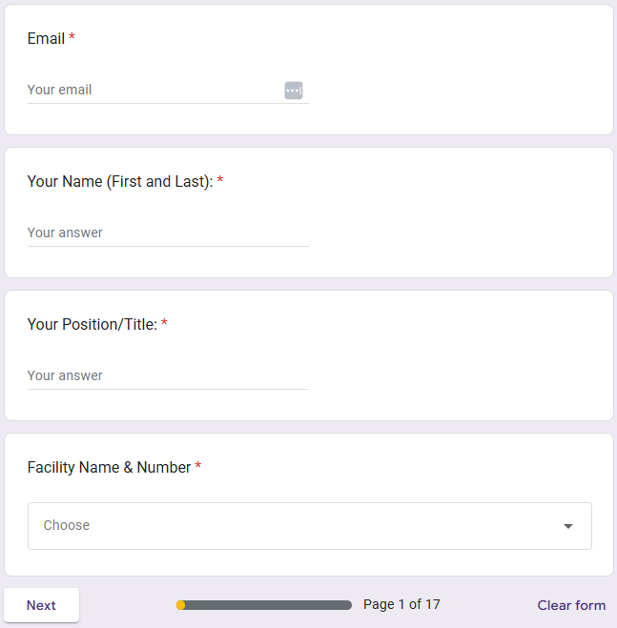
Annual Building Survey (1/4)
Notes:
Caroline
Mention using UW email not personal gmail
FY25 Annual UW Survey Regarding Use of Bond-Financed Projects

Slide 20
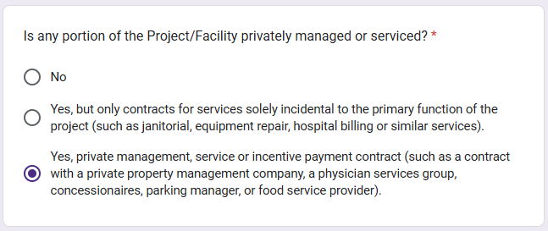
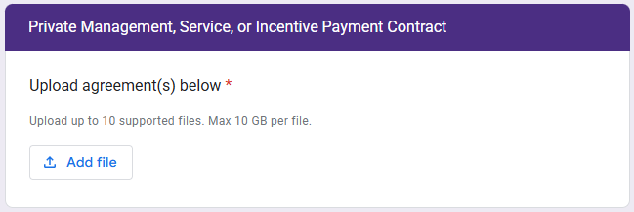
Annual Building Survey (2/4)
Notes:
Caroline
Mention using UW email not personal gmail
FY25 Annual UW Survey Regarding Use of Bond-Financed Projects

Slide 21
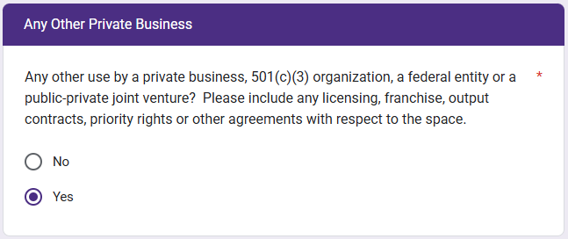
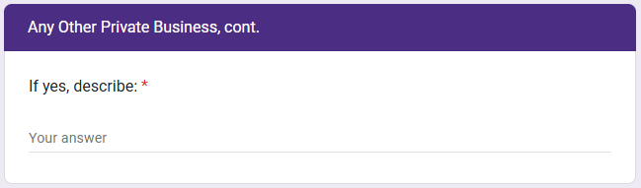
Annual Building Survey (3/4)
Notes:
Caroline
Mention using UW email not personal gmail
You can edit your responses once submitted
FY25 Annual UW Survey Regarding Use of Bond-Financed Projects

Slide 22
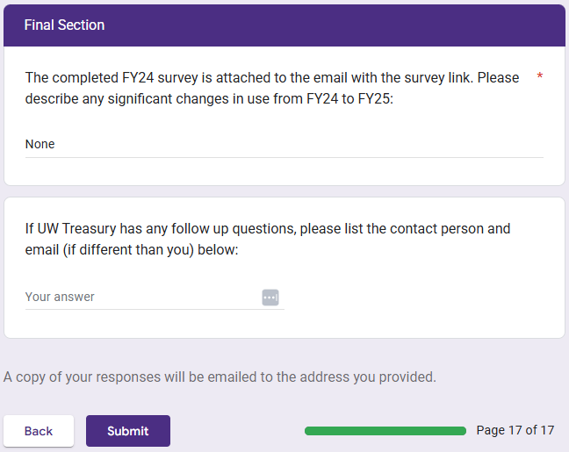
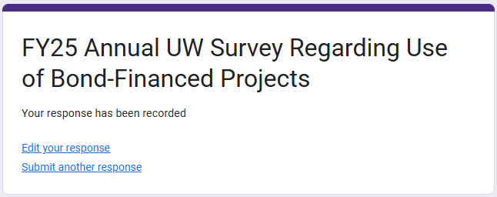
Annual Building Survey (4/4)
Notes:
Caroline
Mention using UW email not personal gmail
You can edit your responses once submitted
FY25 Annual UW Survey Regarding Use of Bond-Financed Projects

Slide 23
Research Contracts - IP Flag
Instead of reviewing annually, sponsored research contracts are reviewed by OSP when entered into and flagged for potential private use using the following questions:
Does sponsor have a license or right to use (or receive royalties from) any resulting technology? Yes/No
-If yes, is the price to be paid for the license or use at least fair market value? Yes/No
-Is the price to be determined when the license or technology is available for use? Yes/No
Does the University (or University personnel) determine the research to be performed and the manner performed? Yes/No
Does title to any patent or product resulting incidentally from the basic research lie exclusively with the University? Yes/No
Is the sponsor entitled only to a non-exclusive, royalty-free license to use the product of the research? Yes/No
If federally sponsored, are there any “march-in” rights over licensing (other than those mandated by the Bayh-Dole Act)? Yes/No
Notes:
Alison

Slide 24
Research PBU Summary
(HHMI + IP Flag)/(HHMI + Total Research) = % PBU Research
Research Space * % PBU Research = % PBU Building
If Equity > % PBU Building, then PBU Bonds = 0
If Equity<% PBU Building, then PBU Bonds = % PBU Building – Equity
Notes:
Alison
Note: SLU buildings are special cases and have their own spreadsheets. MolE is also tracked separately. Sometimes other buildings show up on the list but it may turn out they should not be included here for one reason or another. If you think your building should be listed here and it isn’t pleased reach out to Treasury.
ARCF is an example of where numbers go wrong sometimes. We have the full space listed as research, but only a tiny amount of research expenditures that are all private use.
HHMI: special case. Contracts for HHMI investigators have IP and control clauses that create private use issues. Nancy Hovis has been helping us track HHMI usage of bond-financed buildings.
You can see that this combines the information gathered from various sources:
Facility surveys, FM Systems (formerly Invision/GEOSims) (Jay Dalstrom), HHMI info and UWM research check from Carson, IP Flag from Carol, Equity amounts (Treasury)

Slide 25
PBU Summary by Bond Issue
All PBU data gathered, including the research data, is then compiled in a summary for each bond issue. This is the 2009 Bonds summary from 2023:
Notes:
Alison
Once we’ve gathered all of the private use data for a facility, we allocate those uses to bond proceeds.
First, equity is taken out. This shows the “net” PBU allocable to bond proceeds.
Then, private use percentage is applied to the bond proceeds allocable to that project.
Provides a snapshot of whether there are any private use issues. Also provides a quick way to test potential changes in use.

Slide 26
PBU Summary all Bond Issues
“Master Summary” tracks all bond issues over time.
Note: the 10% PBU restriction is measured over the life of the bonds. Exceeding 10% in one year is not a violation.
Notes:
Alison
Finally, the annual PBU for each bond issue is summarized in the master, which provides a quick glance at the current PBU status of all of the bond issues. (Excluding the SLU projects, which are all done separately)

Slide 27
Accomplishments & Goals
Accomplishments
Multi-year development of annual private use tracking and documentation process has been successfully implemented
IP Flag implemented
Annual PBU Book
Increased awareness by facilities managers of private use issues
UWM supplemental surveys for small works projects and affiliation agreements
Digital surveys
Goals
Continue to streamline and automate the process
  Verification of final facilities costs and qualified equity as needed
Maximize efficiency and minimize duplicative efforts
Complete process more quickly each year
Improve process documentation to reduce impacts of staffing changes
Process checklists
Units to complete space data updates in FM Systems annually
For rooms with research activity, units to add/update grant worktags
Notes:
Shannon

Slide 28
InVision Replacement - FM Systems

Slide 29
Discussion

Slide 30
Next Steps
      Surveys will be distributed within the next 1-2 days
      Update space data (FM Systems)
      Responses due back November 21, 2025
      Questions? Contact:
        Shannon Thompson sbthomp@uw.edu
        Nick Herrera nickherr@uw.edu
        Caroline Sabella criley24@uw.edu
Notes:
Shannon

Slide 31

Q&A
Thanks for joining us!

