Slide 1
UCO: SE Accounting Forum

Slide 2
agenda
Encumbrance Roll forward Update
Financial Reporting Book – budgeting approach update
Open Discussion: Worktag Balance Cleanup / combination issues
SE Accounting Forum Materials:
https://finance.uw.edu/fr/netid-se-acctg-forum

Slide 3
Encumbrance Rollforward Data Issues / Fix Status
Duplicate rollforward, inconsistent duplicates
Isolated to Encumbrance Ledger
Custom reports leverage different data sources than trial balance
Errors in detail do not necessarily cause an error in report balances

Slide 4
Encumbrance Rollforward Example
On R1234, this amt $132,794.02 is correctly reflected
(this amount did not change after the roll-forward journals fix was tested in SBX)
PO-0100148941
1 service line split into 3 grants
Line 1 $235,237.50 applied to GR048703 and had $132,794.02 amount remaining to roll forward to FY26 at the end of FY25
On the PO Balances tab, the obligation amount remaining is also $132,794.02
Trial Balance is where the PO duplications show up for Encumbrance ledger 31020 Reserve for Spend Encumbrance ledger account. The correct rollover amt (the total PO) should be $492,970.17, but this amount is doubled on the journal and the double journal entries are listed in the file.

Slide 5
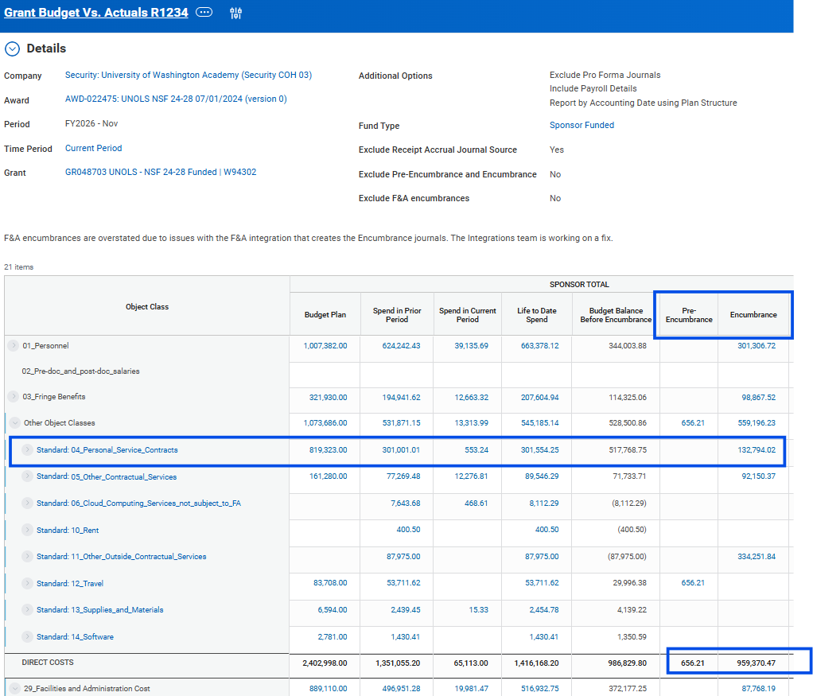
R1234 Balance

Slide 6
Trial Balance / PO
Workday navigation

Slide 7
Financial Reporting Book Budget Approach
Enterprise vs. SE budget

Slide 8
Open Discussion:
Worktag balance / combination issues

