Slide 1
UCO:
SE Accounting Forum

Slide 2
agenda
Intro/Welcome
  Since we’ve been gone
  Backlog
  UCO functions
Fund Transfer Guidance – revisions / outstanding decisions
Budget Cycle Preparation – FY27
  Financial Reporting Book
  Purpose/Goal
  Plan/Guidance

Slide 3
UCO Backlog
71 Projects/Issues to support or resolve
  Institutional priorities
    IBB
    FY27 budget cycle*
  Break Fixes
    Fringe
    ISD
    Encumbrance roll-forward
  Governance
    CV management
    Fund transfer coding*
    Function worktag

Slide 4
Organization Chart
UCO
Central Accounts Receivable (CAR)
Capital Accounting Operations (CAO)
Financial Reporting (FR)
Accounting, Compliance & Governance (ACG)

Slide 5
Finance Projects
Education & Compliance
UCO Functions: Accounting Compliance & Governance
Financial Accounting
FDM & Core Data Operations
Primary team responsible for carrying out data governance, operational data management, core data stewardship.
Provides project support for data requirements and compliance ex:
  IBB
  Fringe
  F&A
Maintain and continue to grow Core Data stewardship program across the institution.
Responsible for answering accounting questions for SEs, Deans Offices, campus departments, etc. on behalf of UCO
Takes on primary accounting duties and oversight for partner central offices: GCA, SFS, etc.
Retains key external reporting duties (Single Audit/SEFA, Federal Interest Remission, Section 117 and NSF Foreign Financial Disclosure Reporting.
Primary team responsible for developing and implementing UCO’s ICOFR strategic plan.
Researches & guides updates to implementation of GASB, UG, GAAP and SAAM guidance.
Establishes and maintains institutional accounting policy manual/handbook.
Responsible for university-wide deficit monitoring and enhanced monitoring efforts. Develop additional monitoring attributes in conjunction with Internal Audit team.
Maintain institutional overhead assessment and exemption review process.
Develops and maintains a consistent communication channel in our decentralized environment to promulgate any WDAY accounting functionality updates or. requirements.
Works with FDM team & IADS to develop reporting tools to regularly review, monitor, and work with units to correct activity.
Develops a university-wide training plan; providing a foundational course that in the future will be a prerequisite to WDAY accounting roles access.
Primary team working to execute projects related to WDAY implementation, fixes, redesign.
Act as a first stop for review of requested changes to WDAY accounting elements for feasibility & appropriateness.
Coordinate testing for Workday fixes
Regularly review and research WDAY planned releases to ensure UW is adopting and implementing beneficial functionality timely.
Serve on WDAY Design Partner Groups as well as Functional Reviews to ensure items escalated to WDAY for review are truly WDAY (and not UW) issues.

Slide 6
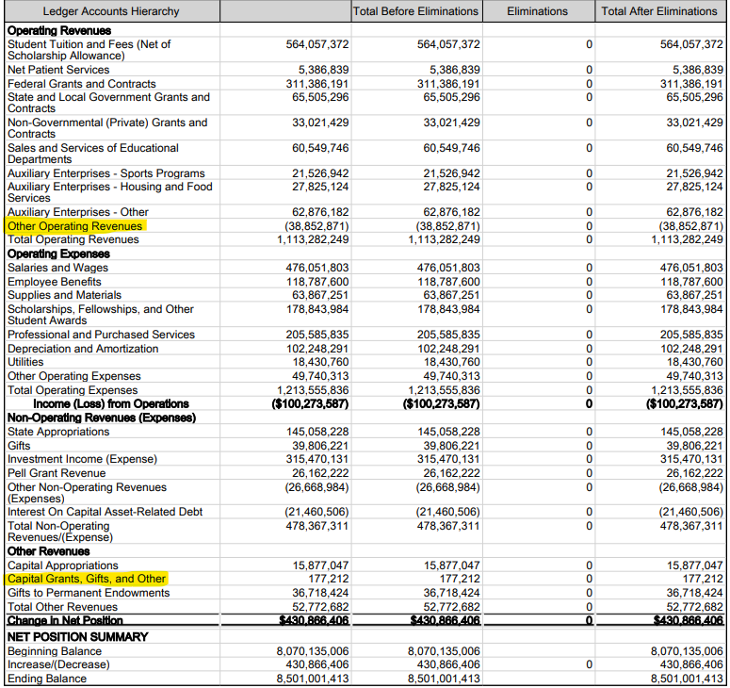
Fund Transfer Guidance
47000/47010 Core Fund Distribution In/Out
47100/47110 Funding Transfer In/Out
84050 Other Changes to Net Position

Slide 7
Fund Transfer Guidance
Current Period
  Ideal to use original coding, transfer natural class of expense or revenue
  Funding Transfer In/Out must net to zero
  Core Funding Transfer In/Out must be used in accordance with guidance
Prior Period
  Prior year activity transferred using 84050 or Funding Transfer In/Out is problematic (especially crossing funds)
  Immaterial transfers of net position (guidance TBD)

Slide 8
Budget cycle preparation
Financial reporting book
  Asset Cost vs Depreciation
  Capitalization threshold transition (5K up to 10K)
Revenue timing
  Core fund distributions
Other enterprise budgeting (minimal SE impact)
  Leave liability
  Scholarship allowance
  Etc….

Slide 9
Financial reporting book
Refresh on book codes
Review asset book transactions
Concepts: cost vs. depreciation
  Balance Sheet vs. Income Statement
  Transition budgeting focus

Slide 10
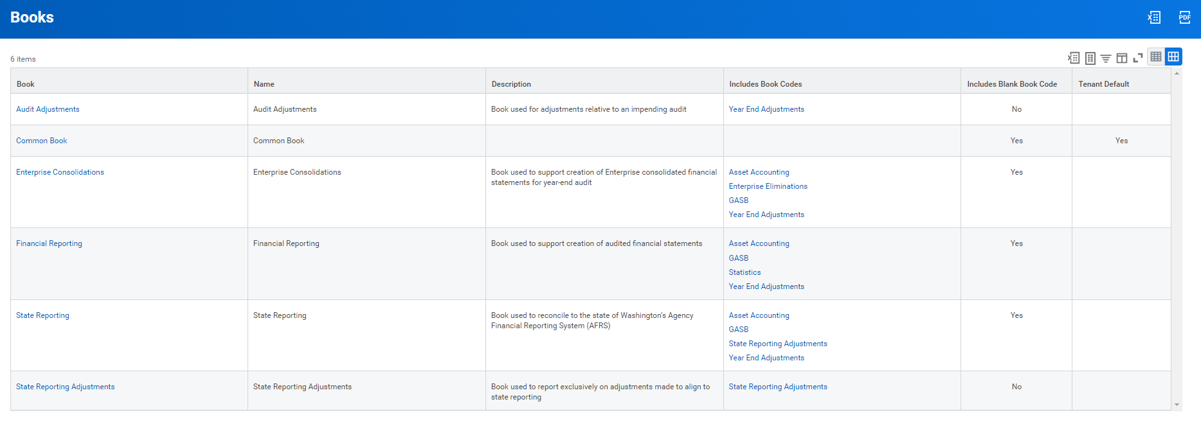
Books and Book Codes
Book is a “collection” of book codes
Common = Blank
but
Blank is more than common
Notes:
A book is a collection
A book code can be in many books (common is best example)
Common Book used on most reports
Financial Reporting is second most likely view
All else – typically for central use
Most important aspect of financial reporting book is the inclusion of the asset accounting book

Slide 11
 | Common | Asset | Combined
Expense | $ 48,000 | $ (48,000) | $ -
Capital Asset | $ - | $ 48,000 | $ 48,000
 | $ - | $ - | $ -
 | $ - | $ - | $ -
Net Position | $ (48,000) |  | $ (48,000)
Common Book vs. Financial Reporting Book
Equipment purchase $48,000
Common Book (COST)
  $48,000 Expense [reduces net position = typically restricted expendable or unrestricted]
Financial Reporting Book (Asset Book Code)
  ($48,000) Expense [reverses effect on net position = in 400 series fund]
  $48,000 Capital Asset [creates capital asset = 400 series fund]
Original Fund
400 fund series
 | Blank Book Code | Asset Book Code | Financial Reporting Book
Expense | $ 48,000 | $ (48,000) | $ -
Capital Asset | $ - | $ 48,000 | $ 48,000
Accounts Payable | $ (48,000) | $ | $ (48,000)
 | $ - | $ - | $ -
Net Position - Fund Original | $ 48,000 |  | $ 48,000
Net Position - Fund 400 |  | $ (48,000) | $ (48,000)
Original Fund
400 fund series
Notes:
We’ll explain later the nature of the 400 series funds
Even though this has a net zero effect on expense in the financial reporting book on expense – it is NOT net neutral on fund $48,000 debit in original, ($48,000) credit in 400 series.
This will come back to when we look at r1300 using the common book vs. financial reporting book

Slide 12
Net Position – Book view
 | Cost Center CC999999 - Common Book
Revenue |  | Month 1 | Month 2 | Month 3 | Total
 | Sales and Services | $ 10,000 | $ 10,000 | $ 10,000 | $ 30,000
 | Other Revenue | $ 1,000 | $ - | $ 1,000 | $ 2,000
 | Total Revenue | $ 11,000 | $ 10,000 | $ 11,000 | $ 32,000
Expense
 | Salaries and Wages | $ 7,000 | $ 7,000 | $ 7,000 | $ 21,000
 | Benefits | $ 3,000 | $ 3,000 | $ 3,000 | $ 9,000
 | Supplies and Materials | $ 50,000 * | $ 1,000 |  | $ 51,000
 | Depreciation
 | Total Expense | $ 60,000 | $ 11,000 | $ 10,000 | $ 81,000
Net income (loss) |  | $ (49,000) | $ (1,000) | $ 1,000 | $ (49,000)
Net Position
 | Beginning Balance | $ 50,000 | $ 1,000 | $ -
 | Increase (Decrease) | $ (49,000) | $ (1,000) | $ 1,000
 | Ending Balance | $ 1,000 | $ - | $ 1,000
Equipment:
Cost: | $48,000
Life: | 24 months
Month Depr: | $2,000
Depreciation Schedule
 | Mo 1 | Mo 2 | Mo 3
Capital | $ 48,000
Depr | $ 2,000 | $ 2,000 | $ 2,000
Accum Depr | $ 2,000 | $ 4,000 | $ 6,000
Net | $ 46,000 | $ 44,000 | $ 42,000
*Supplies and Materials include $48,000 Equipment
Notes:
Let’s go back to the R1300 view (look at multiple months side by side)
Comment on the matching principle – does the $48,000 equipment directly relate to the revenue earned in the period?
Explain the concept of the depreciation schedule – align the cost of the asset with the revenue it will earn, spreads out the cost

Slide 13
Net Position – Book view
 | Cost Center CC999999 - Financial Reporting Book
Revenue |  | Month 1 | Month 2 | Month 3 | Total
 | Sales and Services | $ 10,000 | $ 10,000 | $ 10,000 | $ 30,000
 | Other Revenue | $ 1,000 | $ - | $ 1,000 | $ 2,000
 | Total Revenue | $ 11,000 | $ 10,000 | $ 11,000 | $ 32,000
Expense
 | Salaries and Wages | $ 7,000 | $ 7,000 | $ 7,000 | $ 21,000
 | Benefits | $ 3,000 | $ 3,000 | $ 3,000 | $ 9,000
 | Supplies and Materials | $ 2,000 | $ 1,000 |  | $ 3,000
 | Depreciation | $ 2,000 | $ 2,000 | $ 2,000 | $ 6,000
 | Total Expense | $ 14,000 | $ 13,000 | $ 12,000 | $ 39,000
Net income (loss) |  | $ (3,000) | $ (3,000) | $ (1,000) | $ (7,000)
Net Position
 | Beginning Balance | $ 50,000 | $ 47,000 | $ 44,000
 | Increase (Decrease) | $ (3,000) | $ (3,000) | $ (1,000)
 | Ending Balance | $ 47,000 | $ 44,000 | $ 43,000
Equipment:
Cost: | $48,000
Life: | 24 months
Month Depr: | $2,000
Depreciation Schedule
 | Mo 1 | Mo 2 | Mo 3
Capital | $ 48,000
Depr | $ 2,000 | $ 2,000 | $ 2,000
Accum Depr | $ 2,000 | $ 4,000 | $ 6,000
Net | $ 46,000 | $ 44,000 | $ 42,000
Notes:
Comment on the matching principle – does the $48,000 equipment directly relate to the revenue earned in the period?

Slide 14
Net Position – Book view
 | Cost Center CC999999 - Common Book
Revenue |  | Month 1 | Month 2 | Month 3 | Total
 | Sales and Services | $ 10,000 | $ 10,000 | $ 10,000 | $ 30,000
 | Other Revenue | $ 1,000 | $ - | $ 1,000 | $ 2,000
 | Total Revenue | $ 11,000 | $ 10,000 | $ 11,000 | $ 32,000
Expense
 | Salaries and Wages | $ 7,000 | $ 7,000 | $ 7,000 | $ 21,000
 | Benefits | $ 3,000 | $ 3,000 | $ 3,000 | $ 9,000
 | Supplies and Materials | $ 50,000 * | $ 1,000 |  | $ 51,000
 | Depreciation
 | Total Expense | $ 60,000 | $ 11,000 | $ 10,000 | $ 81,000
Net income (loss) |  | $ (49,000) | $ (1,000) | $ 1,000 | $ (49,000)
Net Position
 | Beginning Balance | $ 50,000 | $ 1,000 | $ -
 | Increase (Decrease) | $ (49,000) | $ (1,000) | $ 1,000
 | Ending Balance | $ 1,000 | $ - | $ 1,000
 | Cost Center CC999999 - Financial Reporting Book
Revenue |  | Month 1 | Month 2 | Month 3 | Total
 | Sales and Services | $ 10,000 | $ 10,000 | $ 10,000 | $ 30,000
 | Other Revenue | $ 1,000 | $ - | $ 1,000 | $ 2,000
 | Total Revenue | $ 11,000 | $ 10,000 | $ 11,000 | $ 32,000
Expense
 | Salaries and Wages | $ 7,000 | $ 7,000 | $ 7,000 | $ 21,000
 | Benefits | $ 3,000 | $ 3,000 | $ 3,000 | $ 9,000
 | Supplies and Materials | $ 2,000 | $ 1,000 |  | $ 3,000
 | Depreciation | $ 2,000 | $ 2,000 | $ 2,000 | $ 6,000
 | Total Expense | $ 14,000 | $ 13,000 | $ 12,000 | $ 39,000
Net income (loss) |  | $ (3,000) | $ (3,000) | $ (1,000) | $ (7,000)
Net Position
 | Beginning Balance | $ 50,000 | $ 47,000 | $ 44,000
 | Increase (Decrease) | $ (3,000) | $ (3,000) | $ (1,000)
 | Ending Balance | $ 47,000 | $ 44,000 | $ 43,000
Equipment:
Cost: | $48,000
Life: | 24 months
Month Depr: | $2,000
Depreciation Schedule
 | Mo 1 | Mo 2 | Mo 3
Capital | $ 48,000
Depr | $ 2,000 | $ 2,000 | $ 2,000
Accum Depr | $ 2,000 | $ 4,000 | $ 6,000
Net | $ 46,000 | $ 44,000 | $ 42,000
Later we’ll discuss the nature/classification of this net position
(fund 400 series)
Notes:
In the common book all of the cost of the asset is expensed and therefore brings down your net position the entire cost, in the asset book the expense is removed (reclassed to asset account on bal sheet) the net position does not decrease… HOWEVER the $46,000??
The nature of the $43,000 net position.. Let’s come back to this after we explore the fund and net position classifications and resource relationships
This equipment may have been purchased with various funds (hypothetically for instance with FD100 general funds) – but we have purchased an asset

Slide 15
Books and Book Codes: Takeaways
Reflect different reporting perspectives
Book views will change the net position results
  Common book primarily reflects all costs as decrease in net position
  Financial Reporting book (and others) better align the recognition of expense with the earning of revenue (matching principle)
These views differ in how they align with budget
  budget currently is more aligned with the common book
Notes:
Transactions start in Workday generally through the following ways

Slide 16
Budgeting – Financial Reporting Book
Goals
  Aligns enterprise budget with enterprise financial statement
  Consistent budget vs. actual basis UWA and UWM
  Quarterly financial reporting (actuals) comparability to budget
  Distinction between income statement budget and capital budget
Guidance
  To be delivered in December, FY27 budget cycle guides
  Optimal approach: data to be delivered by FPB to support budget building

